Slide 1
OTAN Website resources and demonstration
California Adult Education Program, December 11, 2019
Anthony Burik, OTAN Project Specialist
aburik@otan.us or Twitter @otananthony
OTAN website: otan.us

Slide 2
Agenda and resources
Introductions and a little about OTAN
OTAN website and membership
Learn about training opportunities
Explore teaching tools and resources
Stay connected to OTAN after today
Experience Adult Education Students Succeed stories
Let’s start with a survey: bit.ly/OTAN19demo

Slide 3
START SLIDE

Slide 4
CALIFORNIA STATE LEADERSHIP PROJECTS

Slide 5
Top of the otan website (otan.us)

Slide 6
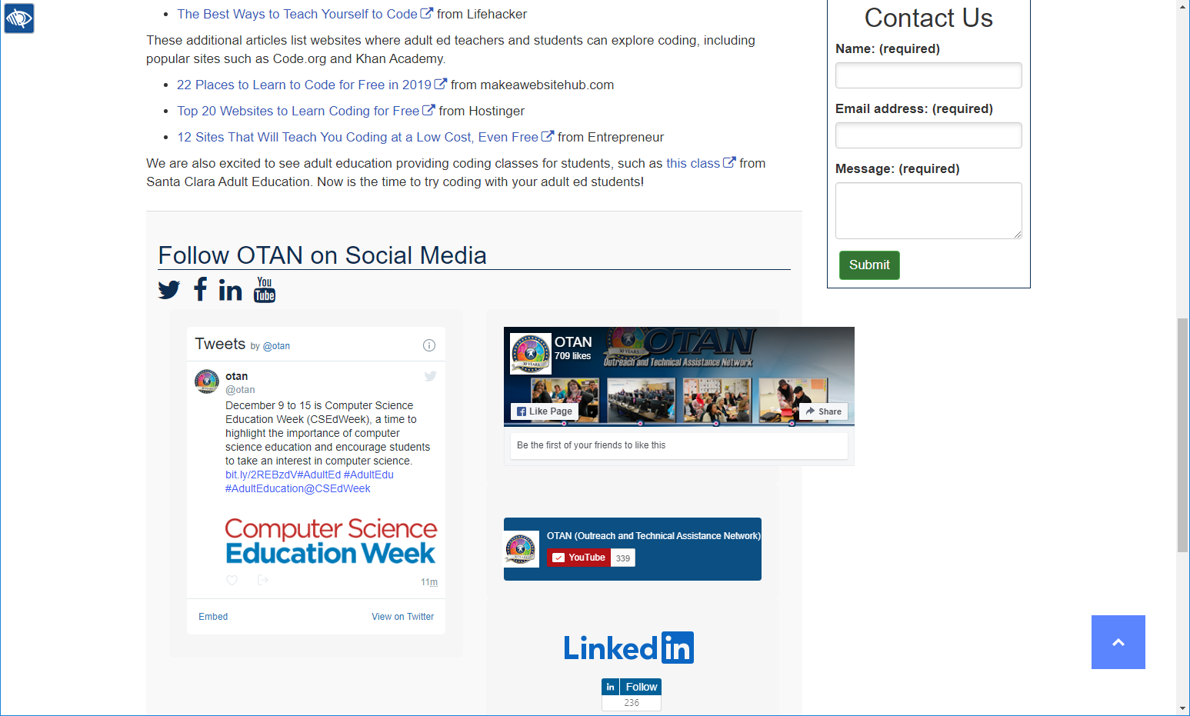
Bottom of the otan website (otan.us)

Slide 7
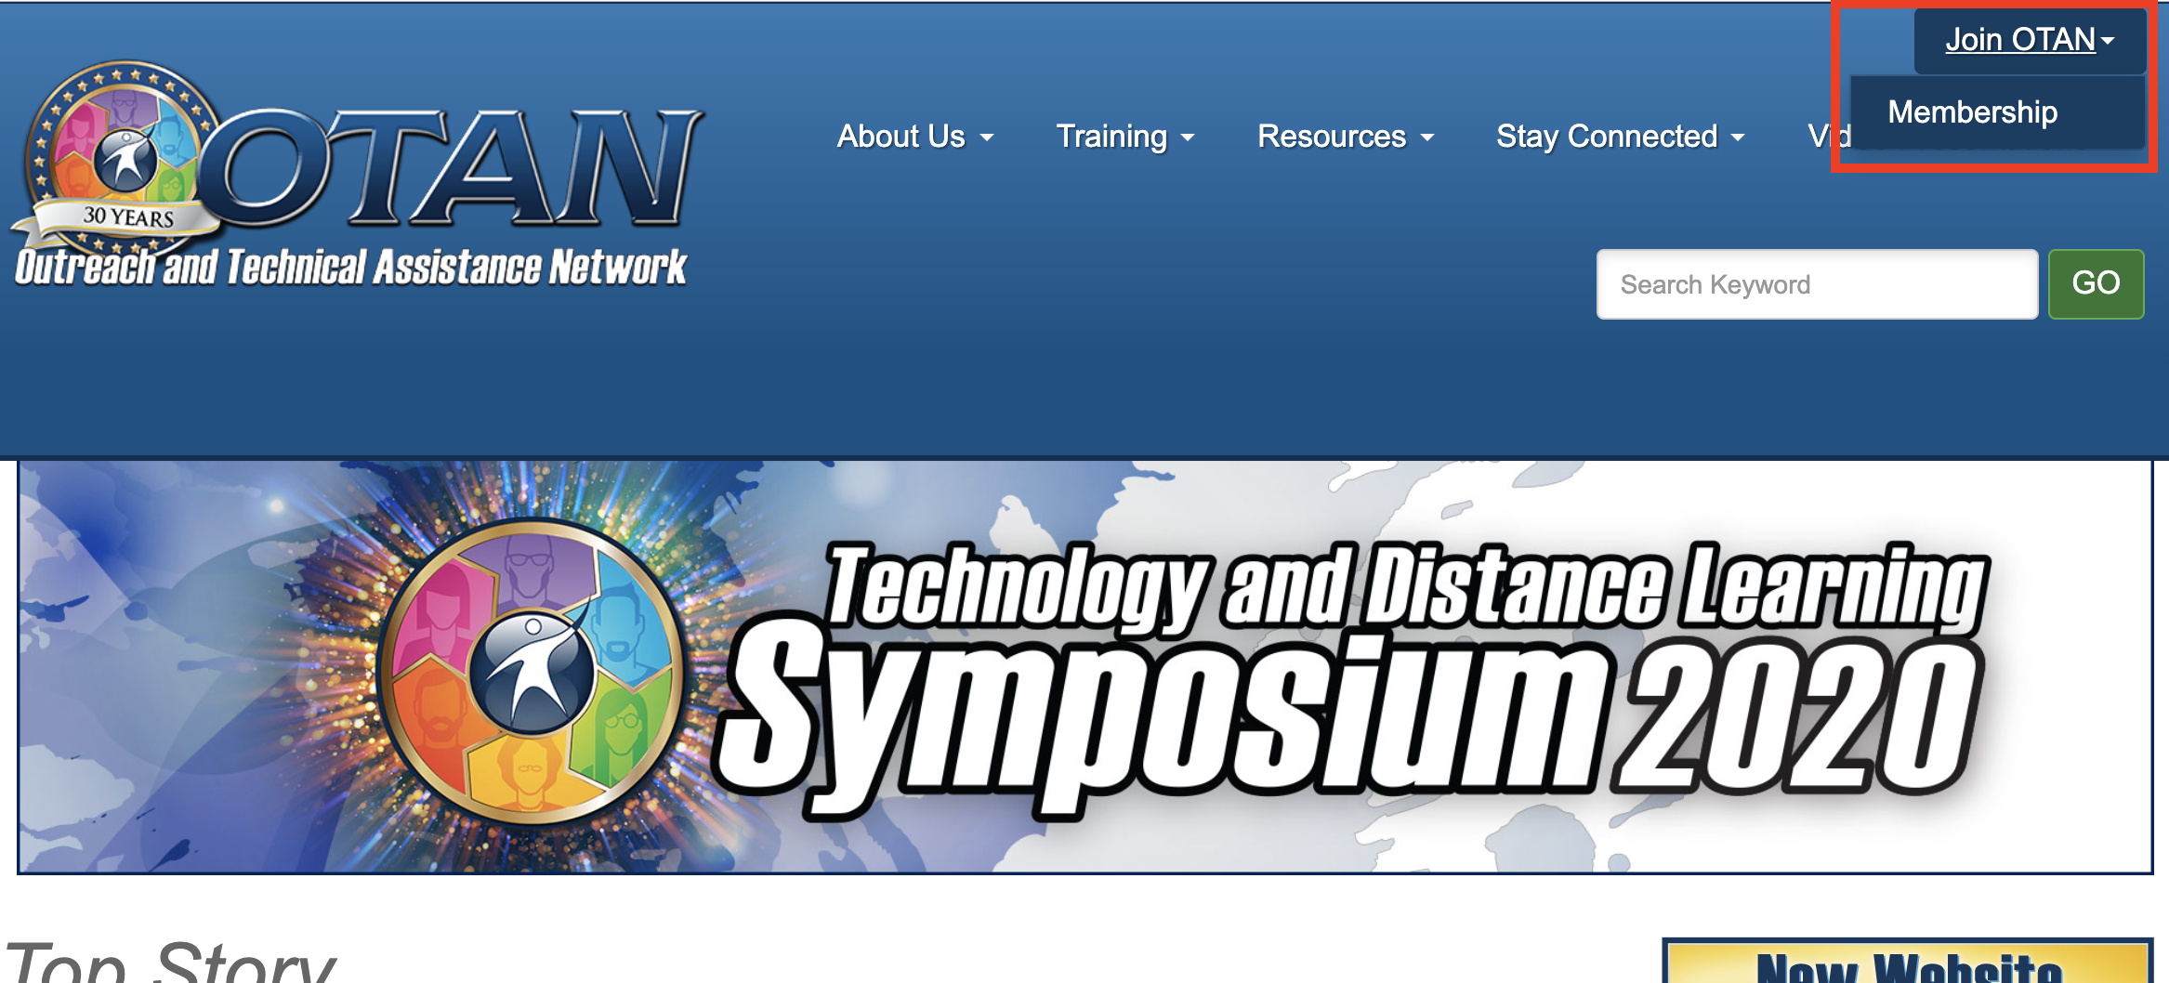
Otan membership – please join!

Slide 8
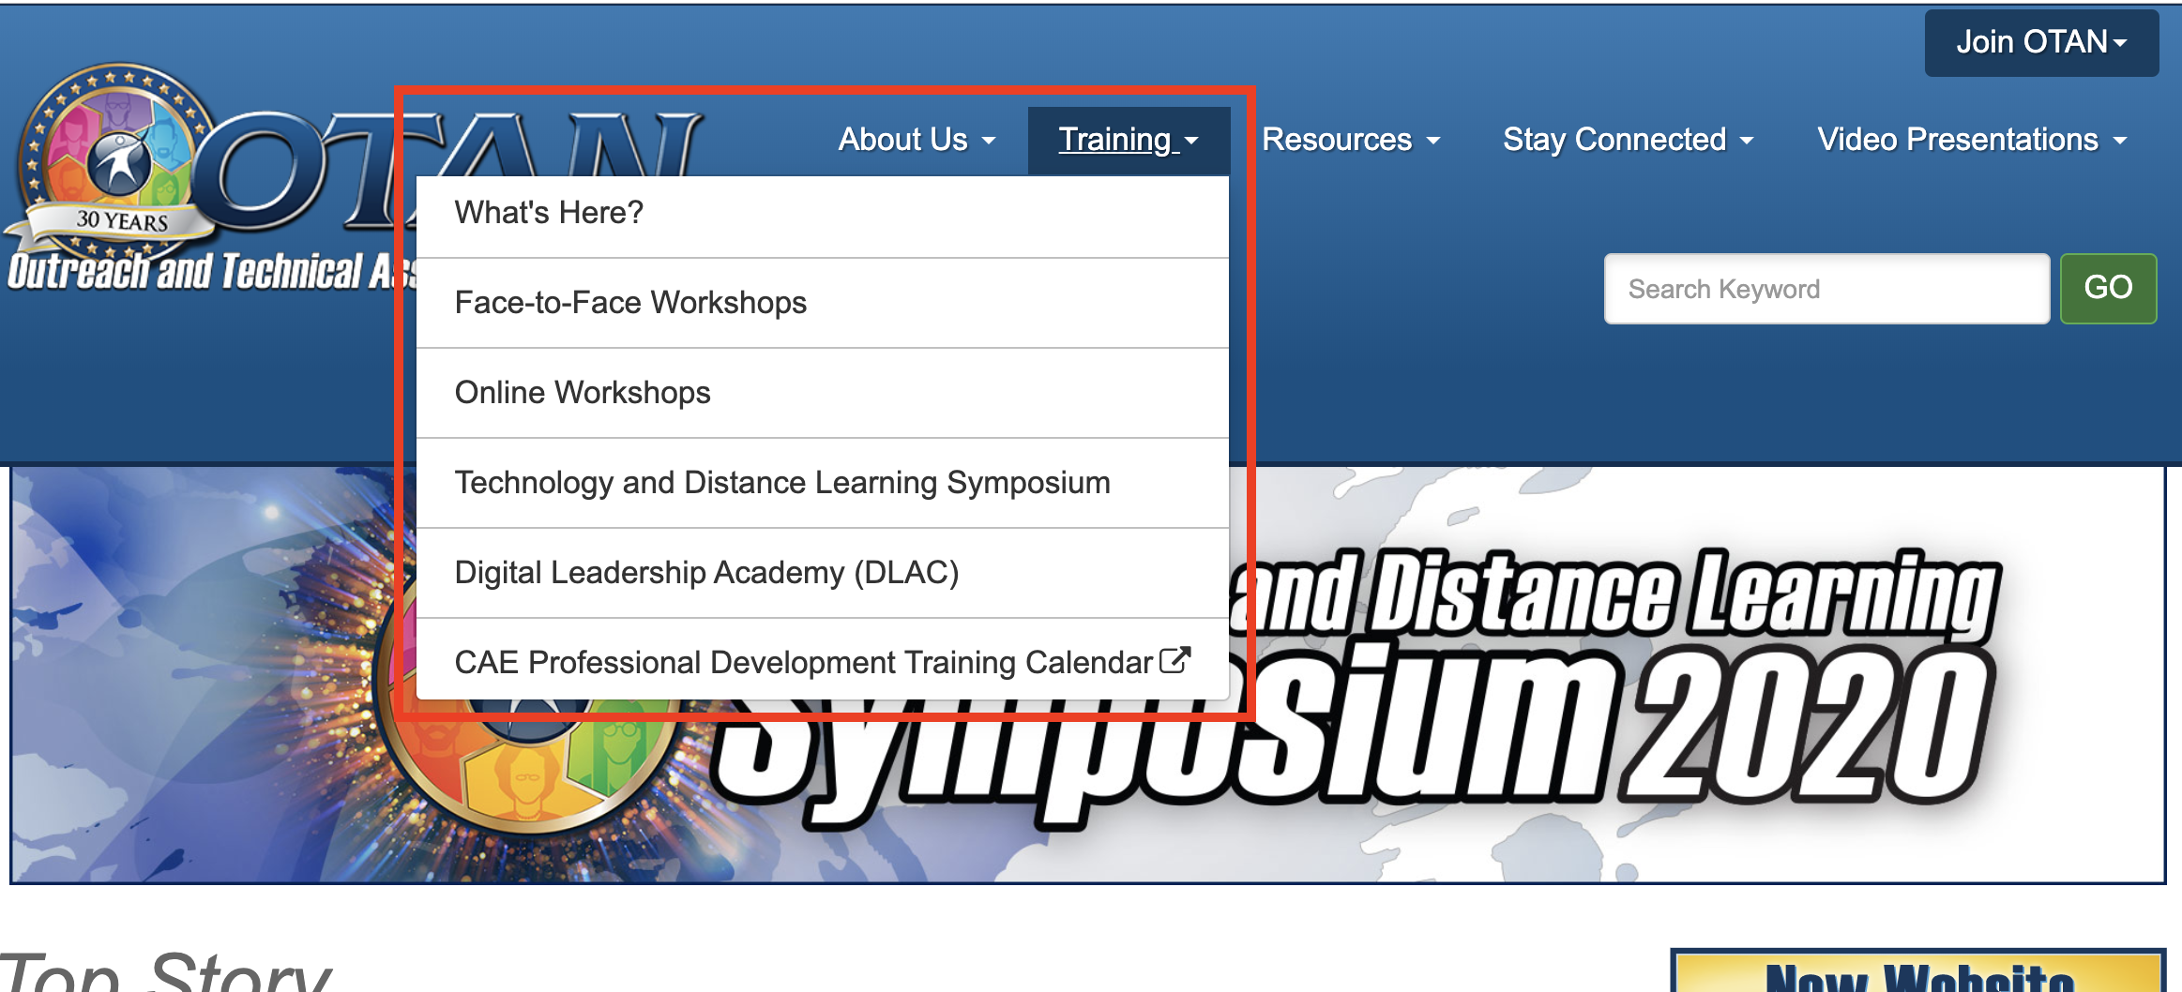
Training opportunities

Slide 9
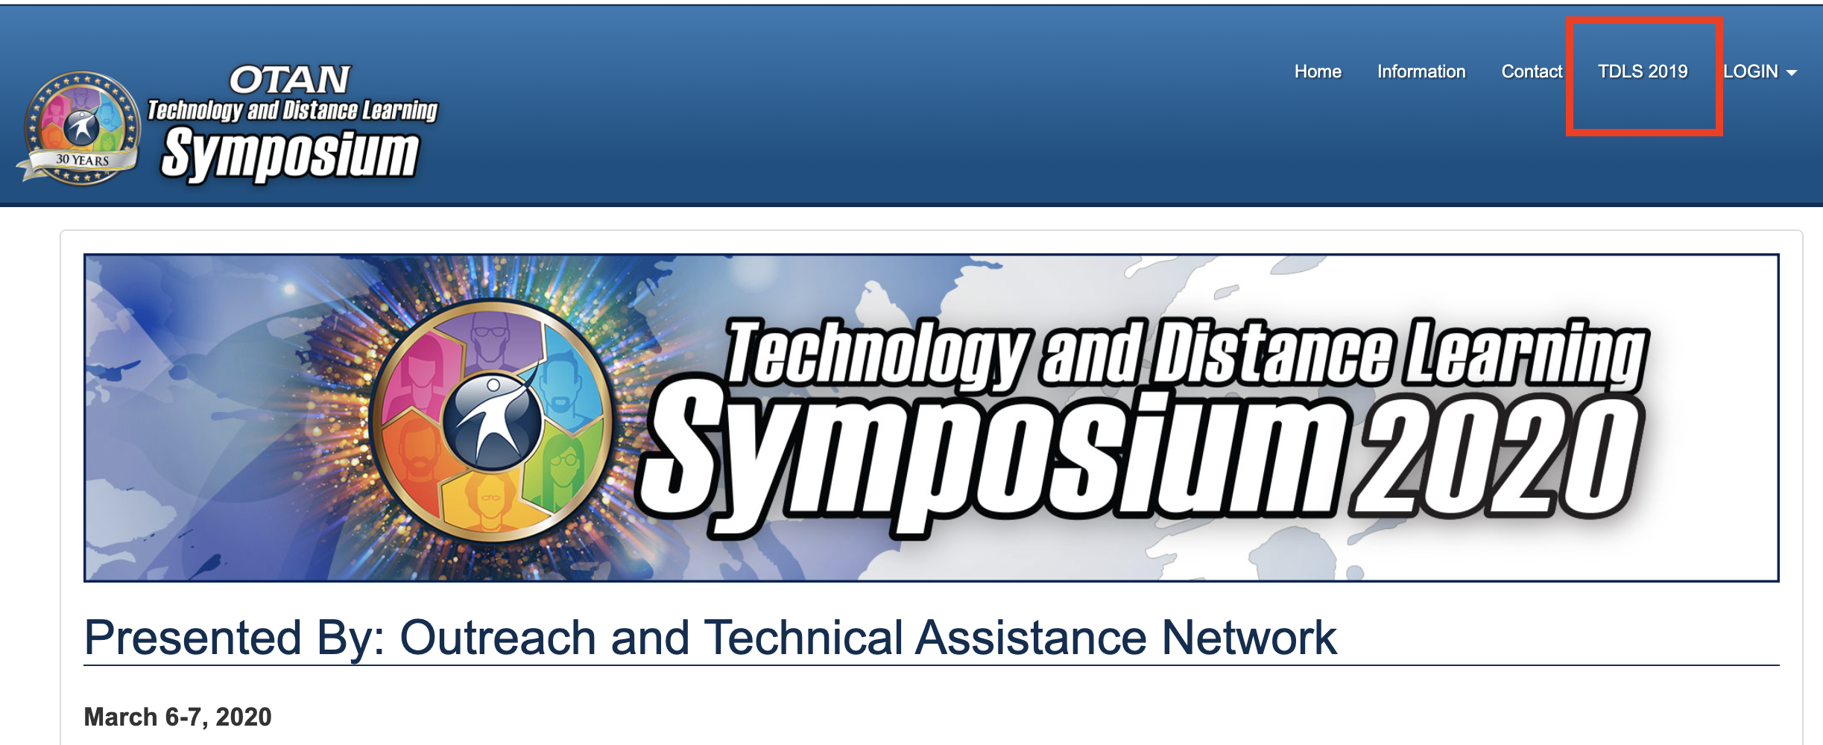
Tech & distance learning symposium

Slide 10
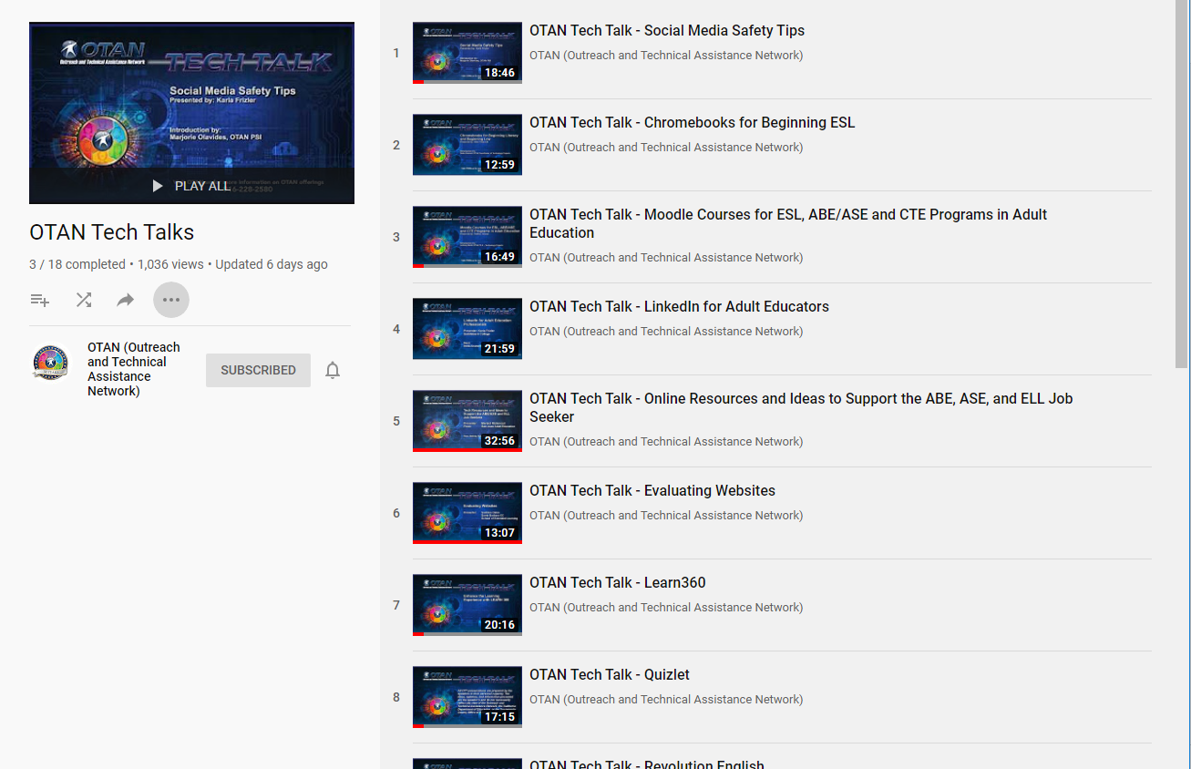
Listen to OTAN Tech talks

Slide 11
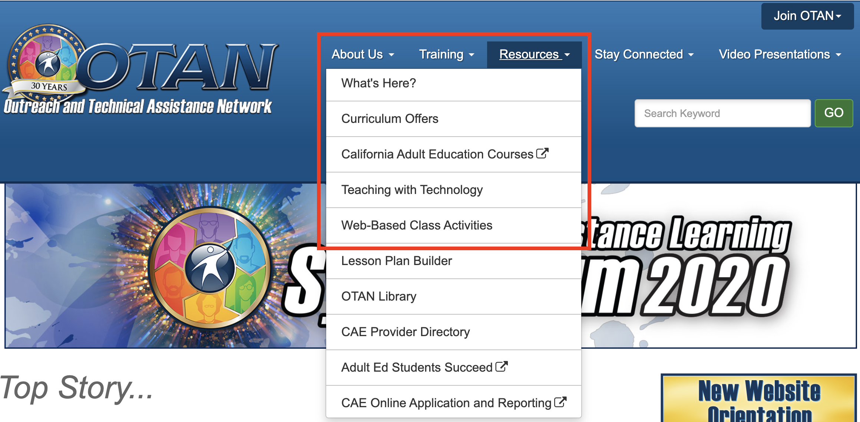
Teaching tools and resources

Slide 12
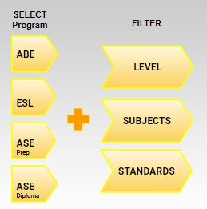
Teaching with technology

Slide 13
Web based class activities

Slide 14
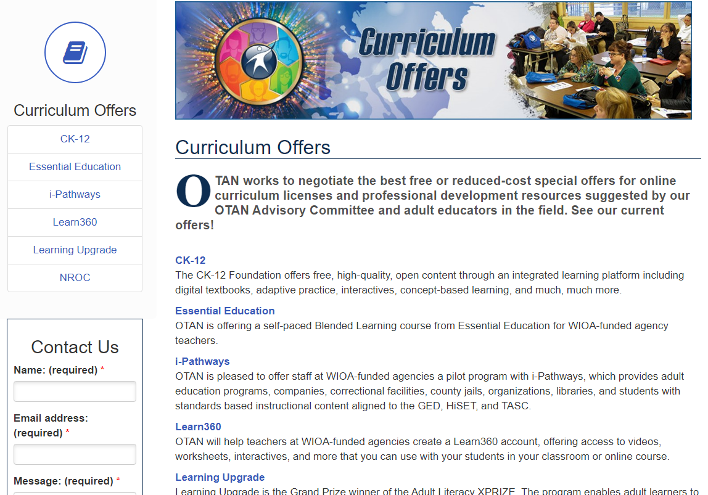
Curriculum offers

Slide 15
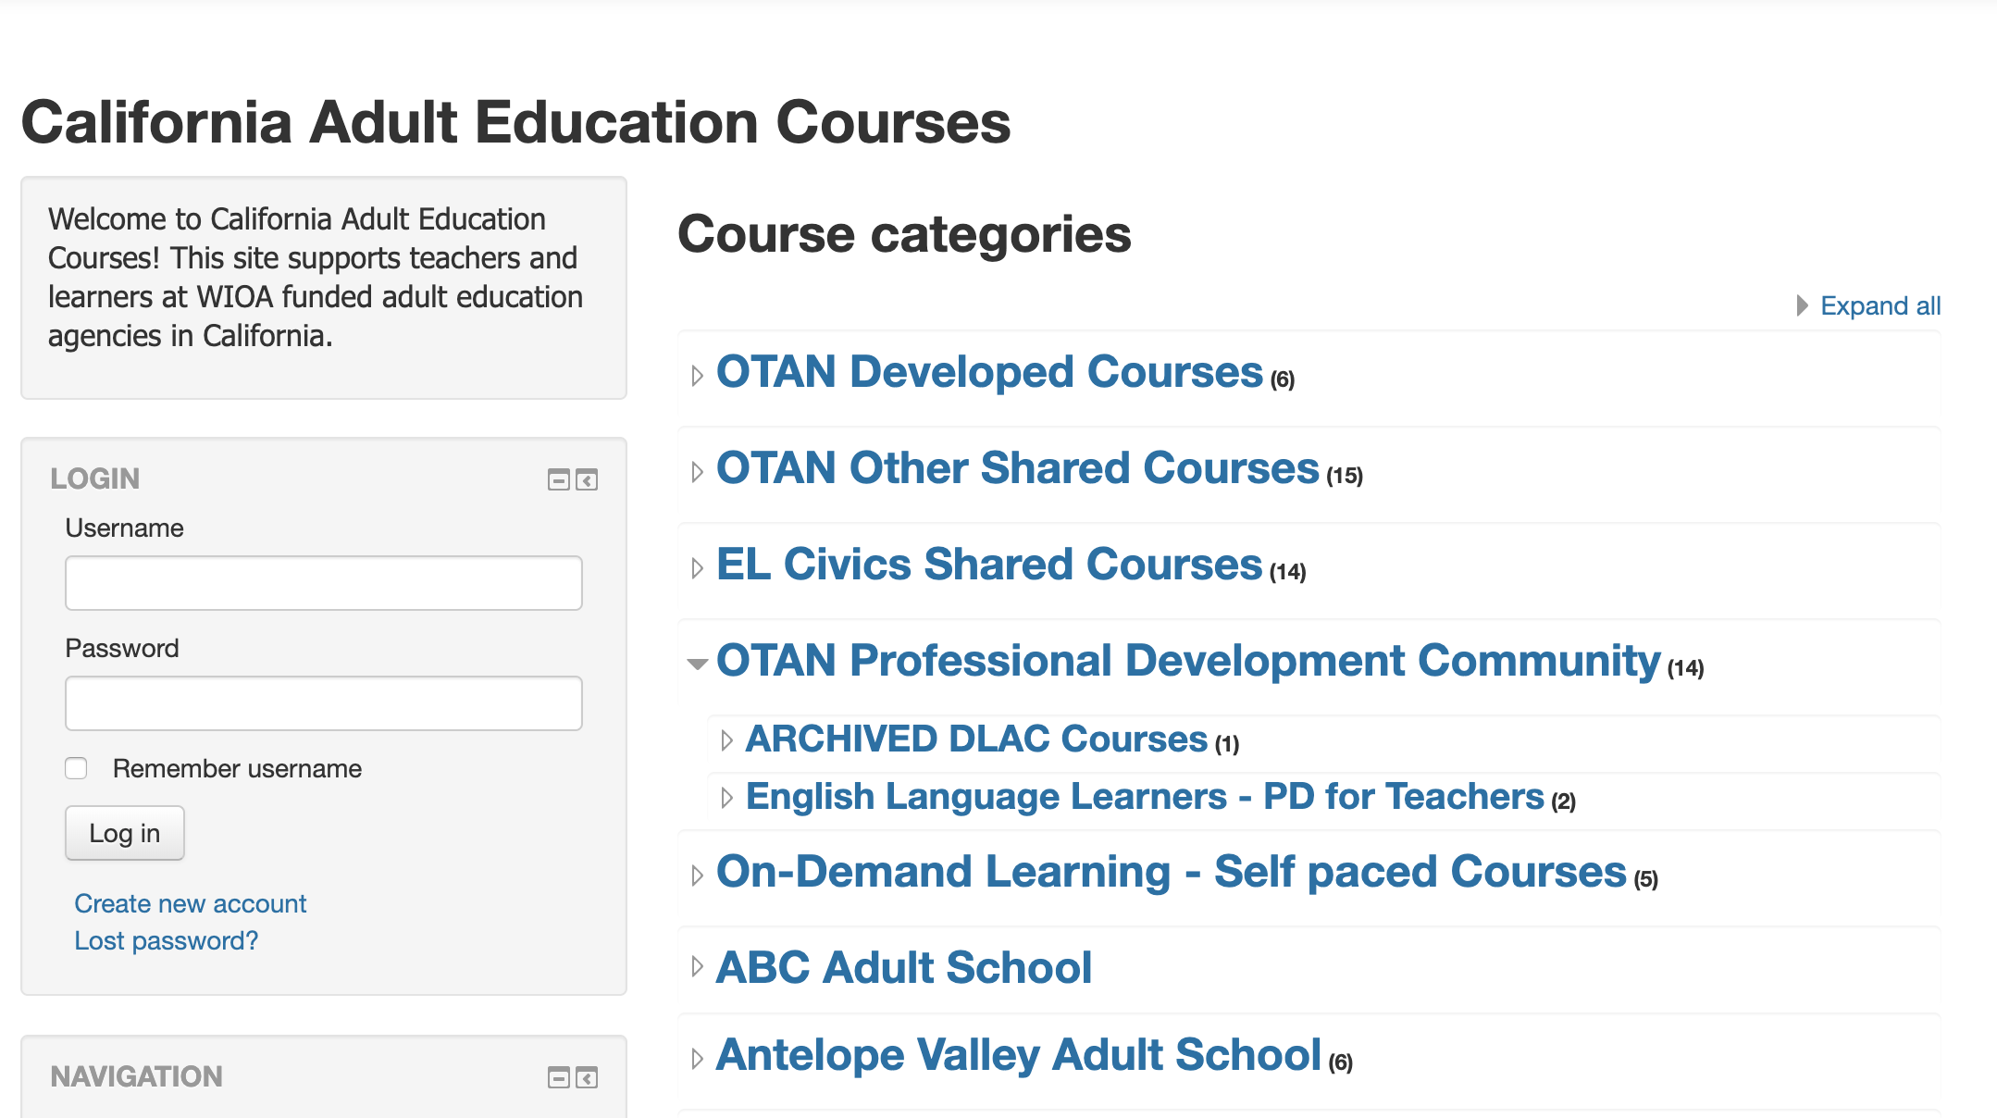
Moodle for distance/blended learning

Slide 16
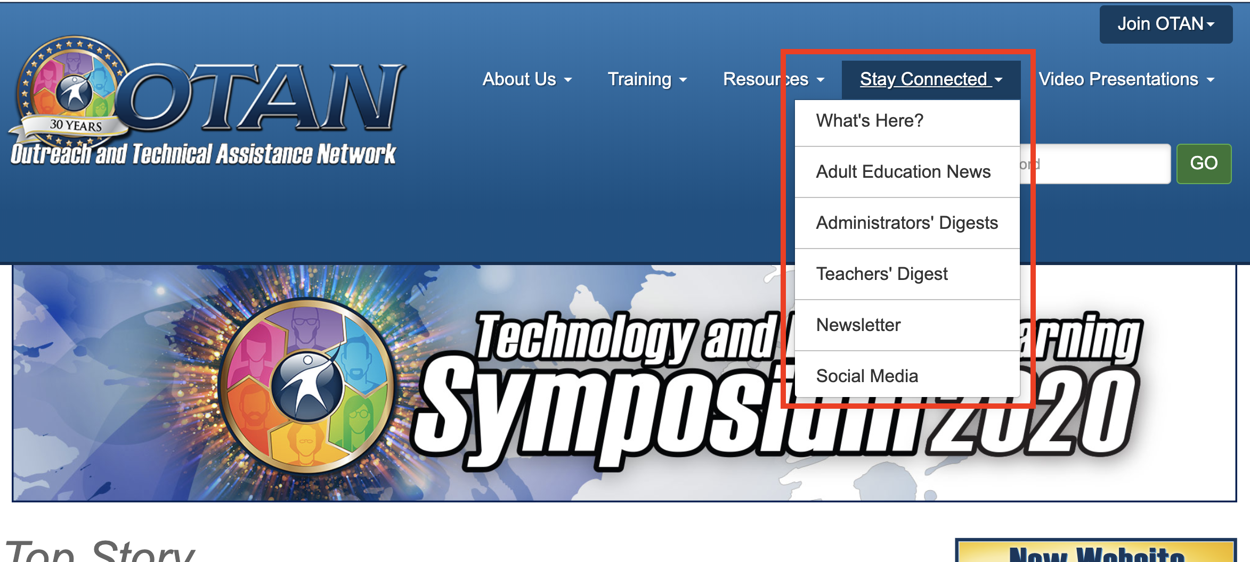
Stay connected to otan

Slide 17
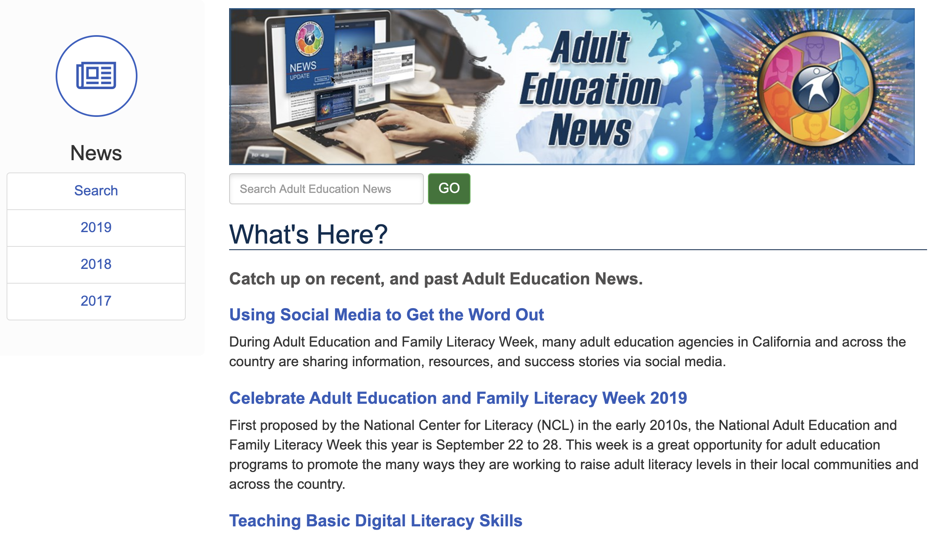
Adult education news items

Slide 18
Social media

Slide 19
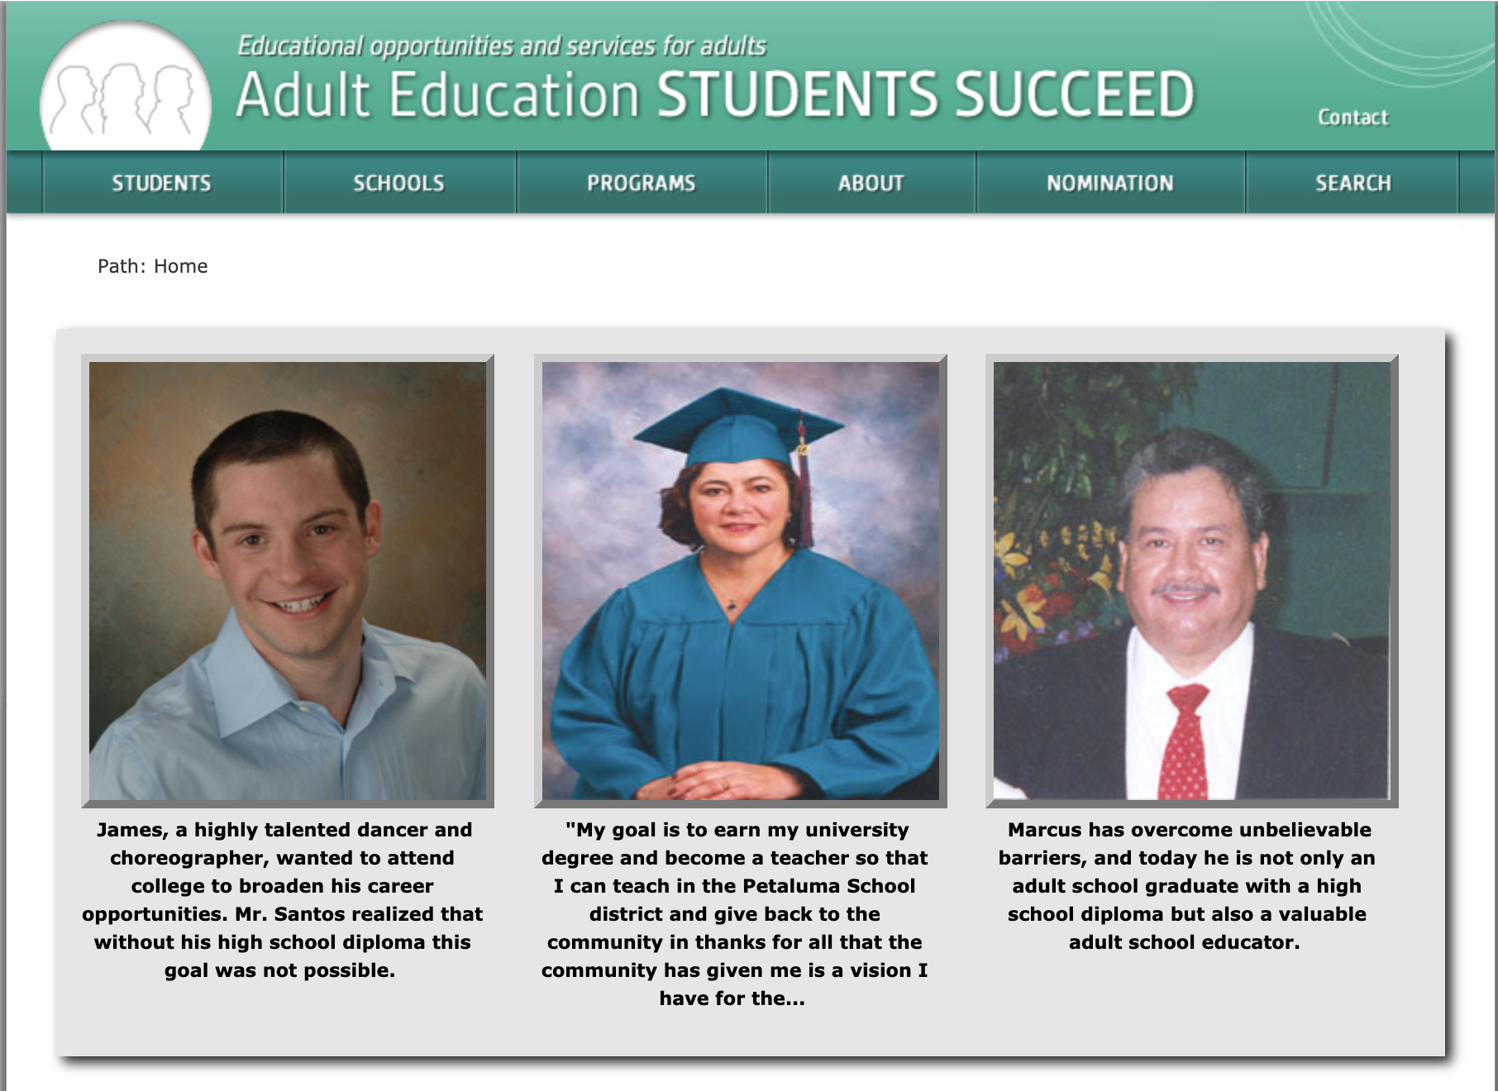
Adult education students succeed

Slide 20
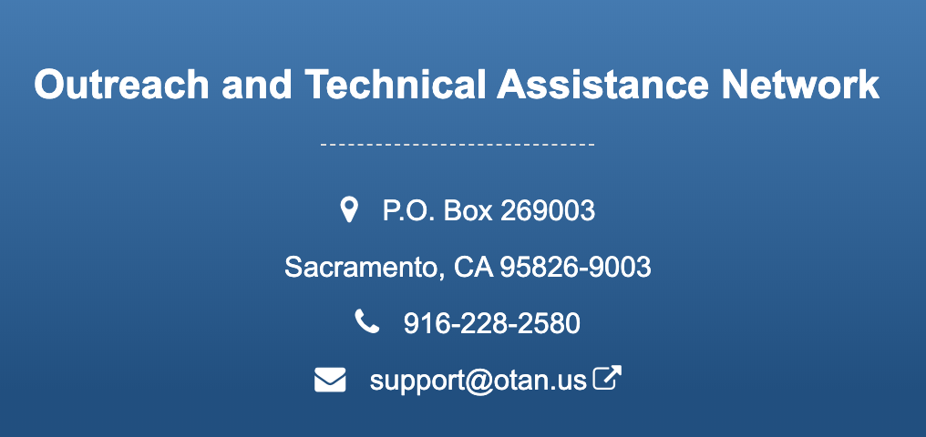
For more information…

Slide 21
3-2-1 reflection tool
Reflect on…
3 things you learned today
2 things you will share
1 thing you will try

Slide 22
END SLIDE

