Slide 1
CAEP 19-20 Student Data Reporting & More
November 2019

Slide 2
Summary of Changes
Workforce Reentry is being interpreted as Workforce Preparation.
CAEP will not track service hours in 19-20.
Agencies will record student barriers at intake.
The Passage of Exam Measurable Skills Gain for WIOA I will align with the CAEP Occupational Skills Gain and Workforce Preparation Outcome.
NOVA Program Area Reporting clarification for 18-19.

Slide 3
19-20 Reporting Changes (local)
For district/agency reporting of Program Areas
CAEP will continue to have the Seven Program Areas: ABE/ASE, ESL, Short-term CTE, Workforce Prep, Pre-Apprenticeship, AWD, and K12 Student Success
Workforce Reentry is being interpreted as Workforce Preparation.

Slide 4
19-20 Reporting Changes (state)
For State Level Reporting of Program Areas
Five Main Program Areas: ABE/ASE, ESL, CTE, AWD, and K12 Student Success
CTE – will include subcategories for
  Short Term CTE
  Workforce Preparation
  Pre-apprenticeship
Workforce Reentry is being interpreted as Workforce Preparation.

Slide 5
19-20 Reporting Changes (enrollment)
Enrollment / Instructional Hour Definitions
“Adults Served” is a required reporting category in AB104 and will be a summary count of anyone with at least 1 instructional contact hour or who received a service.
“Adults Served” will be disaggregated to identify ‘service only’ students, students receiving 1-11 instructional contact hours, and ‘participants’ who received 12 or more instructional contact hours over a single program year.

Slide 6
Enrollment/Instructional Hour Definitions
“Adults Served” will be disaggregated into three categories:
  Service only students
  Students receiving 1-11 instructional contact hours
  Participants who received 12 or more instructional contact hours over a single program year.

Slide 7
19-20 Reporting Changes
Enrollment / Instructional Hours
What is the definition of an instructional hour?
An instructional hour must meet OCTAE guidelines and be associated with an instructional program. Thereby, service hours must not be commingled with instructional hours.

Slide 8
Contact Hours
Definition. Hours of instruction or instructional activity that the participant receives from the program. Instructional activity includes any program-sponsored activity designed to promote learning in the program curriculum, such as classroom instruction, assessment, tutoring, or participation in a learning lab. Time spent on assessment can be counted only if the assessment is designed to inform placement decisions, assess progress, or inform instruction. Time used simply to administer tests, such as the GED tests, cannot be counted as instructional activity.
https://www.nrsweb.org/sites/default/files/NRS_TA_Guide.pdf
(p. 57 of NRS online technical assistance guide)

Slide 9
19-20 Reporting Changes (services)
Services/Service Hours
CAEP will not track service hours.
In other integrated reporting frameworks for services it is more common to report service contacts and type of service delivered than hours.
Tracking service contact types and how those align with student outcomes is an area that the CAEP State Office will continue to explore.

Slide 10
19-20 Reporting Changes
Tracking hours of instruction for integrated courses (ESL/CTE, ASE/CTE, ABE, CTE, etc.)
  For K12/COE:
  If a class is identified as integrated, the hours will be divided equally between the programs designated for that record.
  If not integrated, or if the hours are split unevenly – the agency can create two classes, one for each instructional program represented.
  For Colleges: Additional exploration is required to review how colleges are coding such courses.

Slide 11
Enrollment Instructional Hours
How do we track hours of instruction for integrated courses (ESL/CTE, ASE/CTE, ABE, CTE, etc.)?
  For K12/COE:
  If a class is identified as integrated, the hours will be divided equally between the programs designated for that record.
  If not integrated, or if the hours are split unevenly – the agency can create two classes, one for each instructional program represented.
  For Colleges: Additional exploration is required to review how colleges are coding such courses.

Slide 12
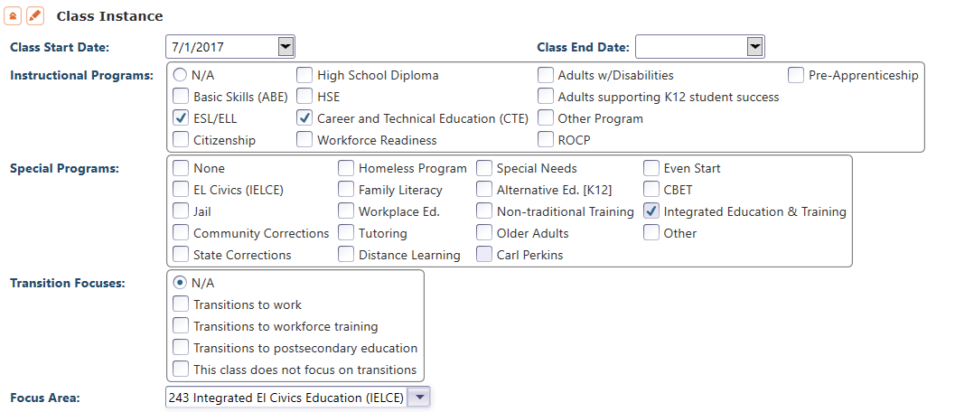
Enrollment Instructional Hours
You can mark multiple instructional programs in the TE Class Instance record for classes that address more than one CAEP instructional program.

Slide 13
19-20 Reporting Changes (CTE skills gain)
WIOA I / CAEP Alignment – Occupational Skills Gain
The Passage of an Exam Measurable Skills Gain for WIOA I will align with the CAEP Occupational Skills Gain and Workforce Preparation Outcome
  When a student achieves an Occupational Skills Gain, that now entails that the student passes an exam such as work skills demonstration, written test, standardized pre/post-test, etc.
  Workforce Preparation Outcome should include some documentation of work skills progression or attainment.

Slide 14
WIOA I Passing Knowledge-Based Exam
The Skills Progression MSG has now been replaced by Passage of an Exam.
Learner passes an exam during the year that is required for a job, or that demonstrates progress in attaining technical or occupational skills.
Exam can be a hands on occupational skills demonstration, written test, standardized pre/post-test, or other method of assessment that clearly demonstrates skill progression or attainment.

Slide 15
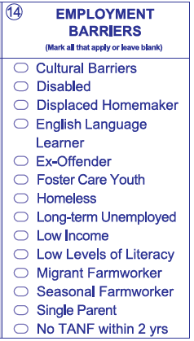
Student Barriers to Employment
Agencies will record barriers to employment for all CAEP students at intake.
CAEP student barriers and their definitions will align with federal WIOA II barriers to employment.
As part of the federal alignment, ABE/ASE and ESL learners will automatically tie into specific barriers
For Workforce Preparation/Workforce Re-Entry – learners are no longer tied to any specific barriers, and no longer tied to 55 + years of age.

Slide 16
Student Barriers to Employment
For WIOA II –
  OCTAE has identified ABE/ASE enrollees by definition as having the Low Levels of Literacy barrier
  All ESL/ELL learners are defined as Low English Literacy/English Language Learner.
  Cultural Barriers also relates to WIOA Title II, but is not directly aligned to a particular program.

Slide 17
Student Barriers to Employment
For Workforce Preparation/Workforce Re-Entry:
Learners are no longer tied to any specific barriers
No longer automatically assigned if 55 + years of age.

Slide 18
WIOA Alignment to AB 104
The WIOA Performance Indicators, along with the 5 types of MSG, comprise the framework for the six AB 104 outcomes:
Indicators:
Employment
Wages
MSGs:
Literacy gain
Secondary
Post-Secondary
Training Milestone
Skills Progression
AB 104 Outcomes:
Improved literacy skills
Completion of high school diplomas or their recognized equivalents
Completion of postsecondary
Placement into jobs
Improved wages
Post Secondary Transition

Slide 19
CAEP Outcomes
Literacy Gains
HSE/HS Diploma
Post-Secondary
Enter Employment
Increase Wages
Transition
Pre/Post Level Completion
Carnegie Units /HS Credits
CDCP Certificate
Occupational Skills Gain
Workforce Preparation
High School Diploma
Passed GED
Passed HiSET
Passed TASC
College Degree – AA, AS, BA, BS
Graduate Studies
Training Credential
Occupational Licensure/Certificate
Apprenticeship
Get a Job
Retain a Job
Enter Military
Increase Wages
Get a Better Job
Transition to ASE
Transition to Post-Secondary/CTE
Transition to Post-Secondary/College

Slide 20
Literacy Gains
AEBG Outcome | Recording Method
Pre/Post-Test Gains | Enter pre/post-test results
Carnegie Units | No “bubble” but via self reported level
CDCP Certificate | Mastered course competencies Skills Progression
Occupational Skills Gain | Met Work based Project Training Milestone
Workforce Preparation | Acquired Workforce Readiness

Slide 21
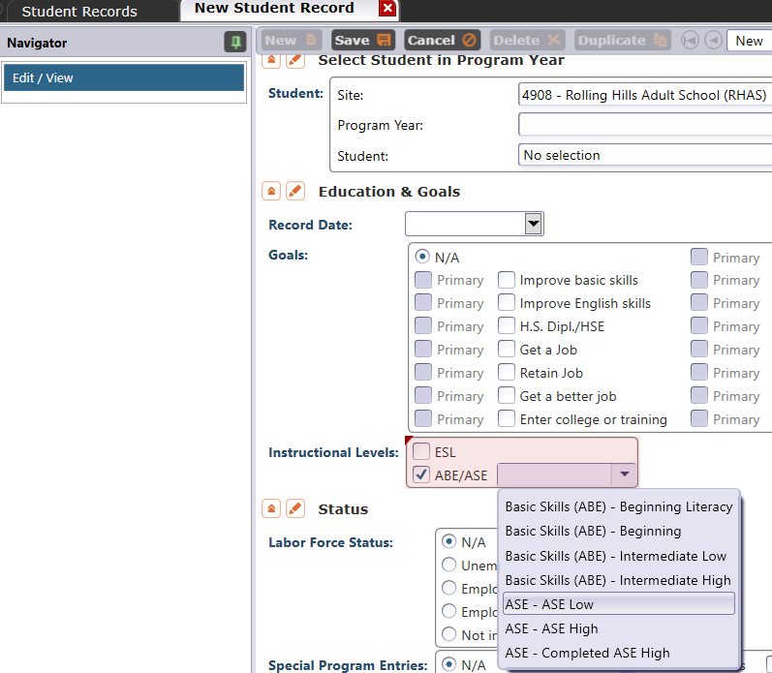
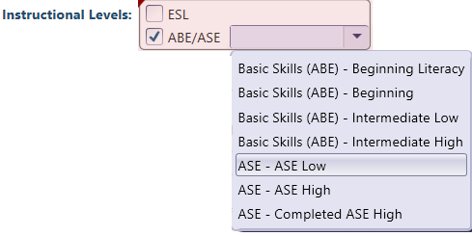
Literacy Gains – HS Credits
In TE, go to Records – Students – Records and refer to Instructional Levels:
Select ASE Low upon enrollment
Select ASE High later in the year once student progresses to the 11th or 12th grade level

Slide 22
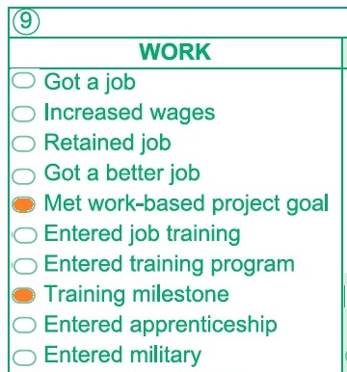
MSG’s for CTE
The Passage of Exam Measurable Skills Gain for WIOA I will align with the CAEP Occupational Skills Gain
  When a student achieves an Occupational Skills Gain, that now entails that the student passes an exam such as work skills demonstration, written test, or standardized pre/post-test

Slide 23
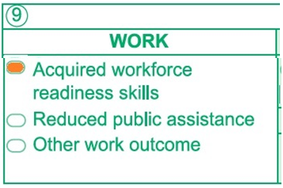
MSG’s for CTE
The Passage of Exam Measurable Skills Gain for WIOA I will align with the CAEP Workforce Preparation Outcome
  Workforce Preparation Outcome should include some documentation of work skills progression or attainment.

Slide 24
Literacy Gains – CTE Related Outcomes
Occupational Skills Gain:
Usually suggests accomplishment of a portion of a longer term program
  For example: a student enrolls in a long term welding program in CTE, which is five semesters/five modules long. The student passes a skills check/written test that indicates the student is ready to finish Module I and enroll in Module II.
Workforce Prep Outcome:
Usually suggests completion of a shorter term program
  For example: a student enrolls and completes a 15 hour instructional module on job search strategies. The student earns documentation such as an informal certificate at the end of the instructional module.

Slide 25
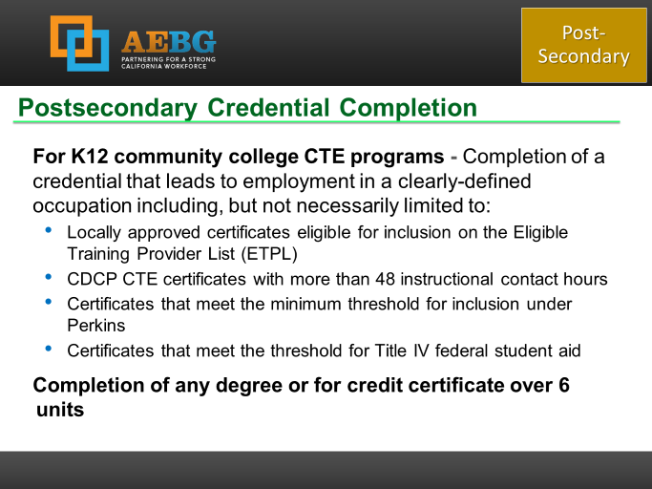
Occupational Outcomes: Post-Secondary vs. Literacy Gains
Post-Secondary:
Attained Credential
Occupational licensure
Occupational certificate
Literacy Gains:
Occupational Skills Gain
Workforce Prep Milestone
Post-Secondary =
Completion of a longer term program
“Literacy Gains” =
Partial completion of a longer term program
Completion of a shorter term program

Slide 26
Transition
AEBG Title | Update Record
Transition to ASE | No “bubble” but via instructional program
Transition to Post-Secondary/CTE | Entered job training Entered training pgm Entered apprenticeship
Transition to Post-Secondary/College | Enrolled in secondary Transition to credit

Slide 27
Transition
From:
To:
K12 Adult Education
(ABE, ASE, ESL)
K12 Adult Ed CTE
CC CTE
Non Credit CC
(ABE, ASE, ESL)
For Credit CC
Transition to CTE
Transition to for credit

Slide 28
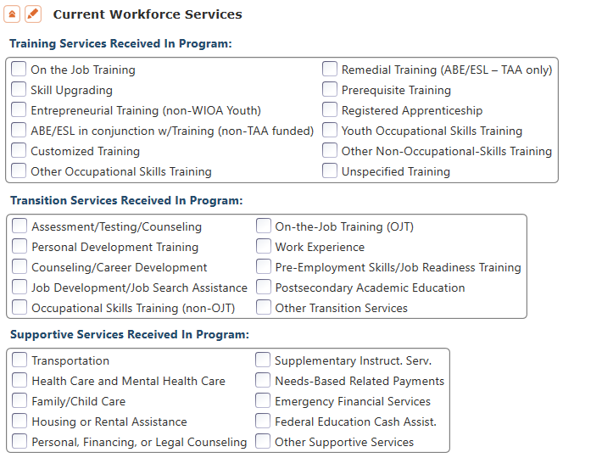
CAEP Short Term Services
Record short term services such as counseling or mentorship that may be received outside of the classroom.
Supportive Services
Training Services
Transition Services

Slide 29
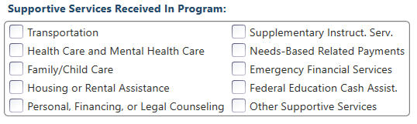
Supportive Services
Services that better enable an individual to participate in adult education activities, or related activities such as WIOA Title I -- such as transportation, child care, dependent care, housing, and personal needs

Slide 30
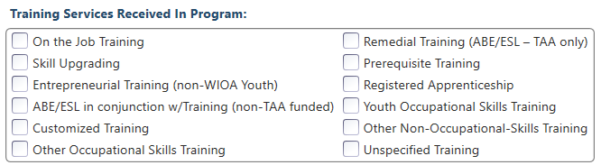
Training Services
Services that help individuals:
Select programs that relate to economic priorities in local planning region
Enroll/meet minimum qualifications for longer term employment and/or employment training programs
Services administered to individuals who have been determined to:
Be unlikely to obtain/retain employment
Be in need of additional services in order to attain economic self-sufficiency/permanent employment
Have skills sufficient to enroll in appropriate training program that provides skills necessary for self-sufficiency

Slide 31
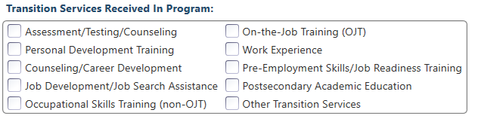
Transition Services
Services that help individuals:
Facilitate successful transition from school to postsecondary life, such as attaining employment, enrolling in college, or accessing designated pre-employment transition services.
Provide opportunities to receive training and other services necessary to achieve competitive employment or postsecondary enrollment

Slide 32
CAEP Short Term Services
Supportive Services
Transition Services
Training Services
Transportation
Child Care
Personal Counseling
Financial Assistance
Assessment (other than required pre/post)
Academic/Career Counseling
Job Development
Student Orientation
Community Support Training (OSHA, CPR, etc.)
Prerequisite Training

Slide 33
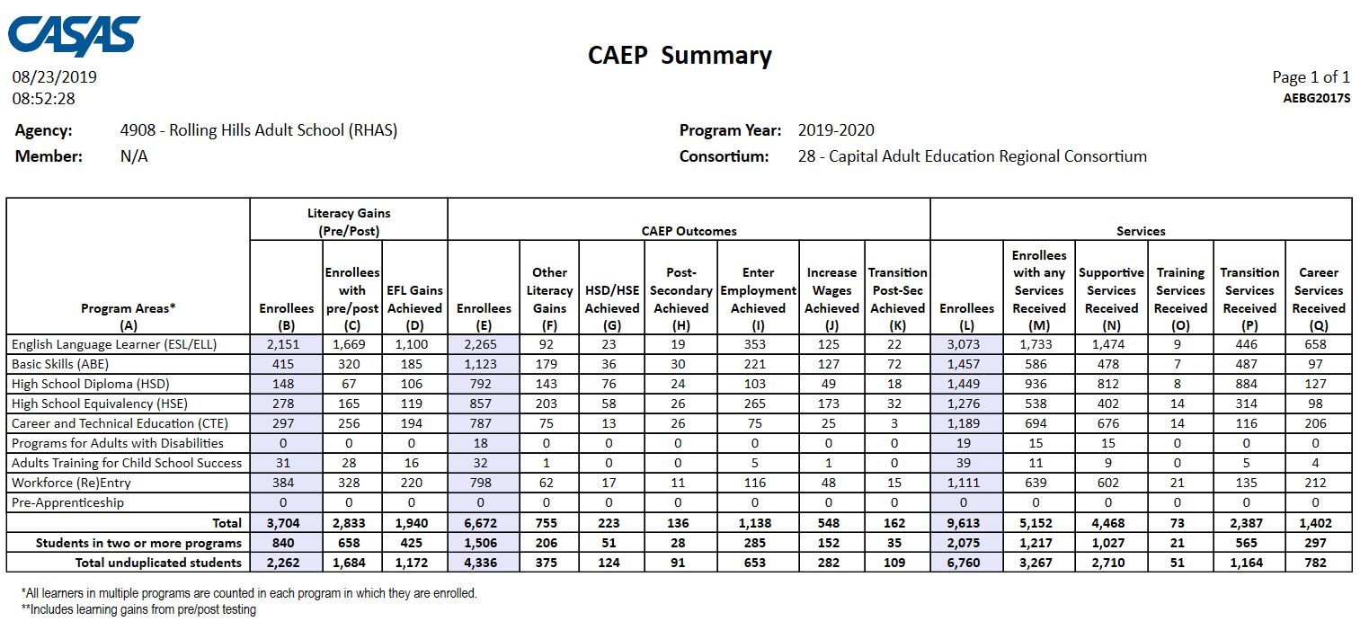
Displays outcomes in three separate sections:
Literacy Gains (Pre/Post) using NRS Table 4 guidelines
Other AB 104 outcomes using WIOA II reporting requirements but not pre/post
Services Received that do not impose WIOA II reporting requirements

Slide 34
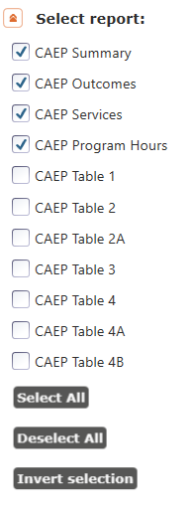
CAEP Tables Setup Options
New options for charting and number
of CAEP programs
New setup for Report Selection
Outcomes Summary
Services Summary
CAEP Program Hours

Slide 35
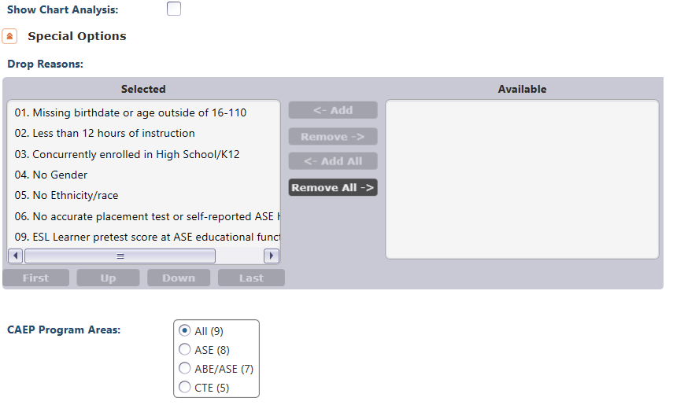
CAEP Tables Setup Options

Slide 36

Literacy Gains
Employment
Secondary
Wages
Post-Secondary
Transition

Slide 37
In TE go to Records--Students--Records

Slide 38
CAEP Statewide Enrollment
Recorded students that make it to 1 hour of instruction
(Program Enrollment)
          Statewide percentage = 77%.
Recorded students that make it to 12 hours or more of instruction
          Statewide percentage = 63%.
Students with 1 hour of instruction that make it to 12 hours of instruction (and eligible to earn CAEP outcomes)
(Program Persistence)
          Statewide percentage = 82%.

Slide 39
Data Submission Calendar
AEBG Program Year Reporting
 | Date Range | Reporting Deadline
First Quarter | July 1 – Sept 30 | October 31, 2019
Second Quarter | July 1 – Dec 31 | January 31, 2020
Third Quarter | July 1 – Mar 31 | April 30, 2020
Fourth Quarter-EOY | July 1 – June 30 | August 1, 2020

Slide 40
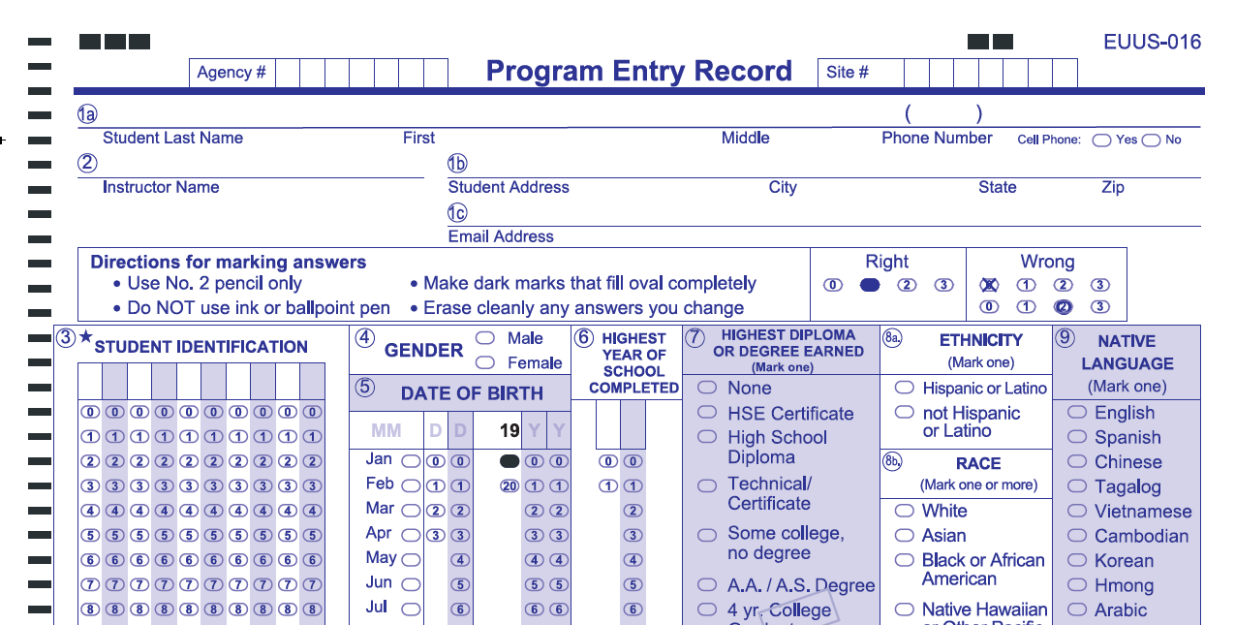
New EUUS-019 form implemented July 1, 2019
Includes three selections in gender field
Updates DOB and record date fields
Documents learner enrollment, and continues WIOA compliance that began July 1, 2016
Notes:
Note starred fields

Slide 41
CASAS Assessments
Authorized for NRS for 2019-20
ABE and ASE only:
CASAS GOALS Reading and Math
ESL only:
Life and Work Listening
Life and Work Reading
Secondary Level Assessment (SLA):
  Language Arts 513-14
POWER, AA-AAAAA not authorized for NRS, but are authorized for CA reporting

Slide 42

CAEP TAP
The AEBG Technical Assistance Program (TAP) provides professional development resources for all CAEP agencies statewide.
https://caladulted.org/
tap@aebg.org

Slide 43
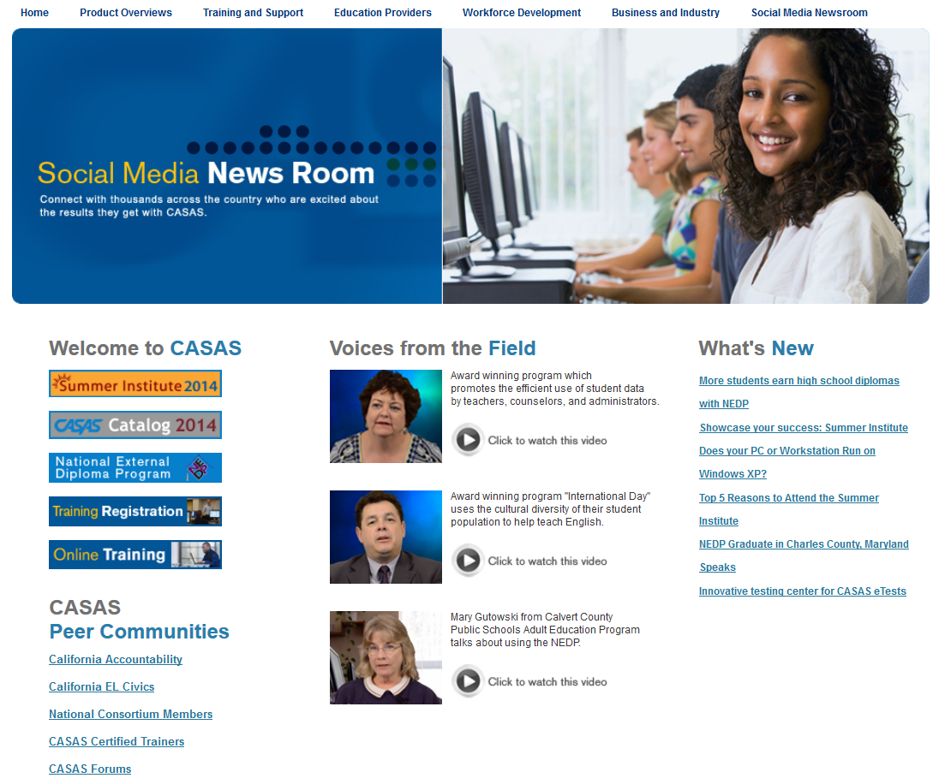
CASAS Web Site
What’s New
Online Registration
California Accountability
AEBG Web page
CASAS Forums
Download Centers
www.casas.org

Slide 44
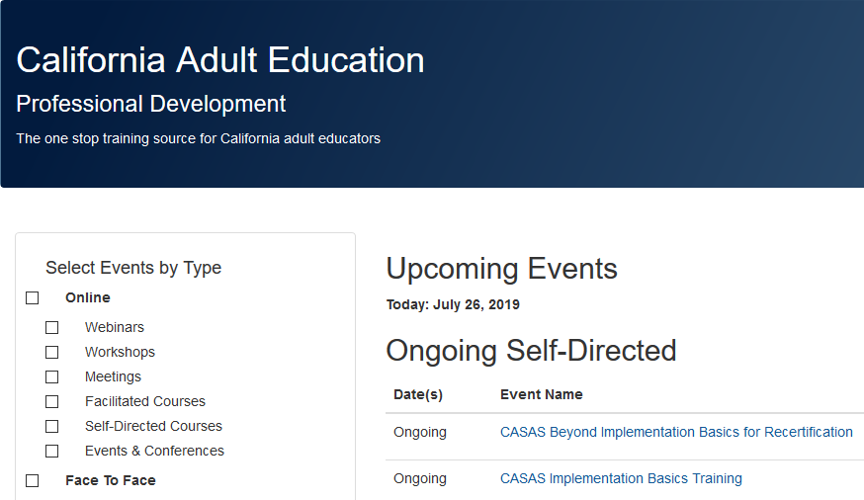
Online Training Registration
Register for all face to face and Web-based trainings on the CAEP TAP Website:
https://www.caadultedtraining.org/

