Slide 1


Stakeholder Mapping Step 1*: Identification
Customers (e.g. direct customers, indirect customers, and advocates)
Employees (e.g. current employees, potential employees, retirees, representatives, and dependents)
Industry (e.g. competitors, industry associations, industry opinion leaders, and media)
Community (e.g. chambers of commerce, resident associations, schools, community organizations, and special interest groups)
Government (e.g. public authorities, and local policymakers; regulators; and opinion leaders)
Civil society organizations (e.g. NGOs, faith-based organizations, and labor unions)
* List taken from “Business for Social Responsibility Stakeholder Mapping,” 2011.

Slide 2
Stakeholder Mapping Step 1: Identification
Learn from past and ongoing engagement
Be forward thinking
Be diverse
Be social
Be aware
Notes:
❑ ?Learn from past and ongoing engagement: Look at your organization’s existing engagement activities. What are the objectives of these activities? What stakeholders communicate regularly with your company? What groups do they cover well? Where can you reach beyond this existing comfort zone to engage with lesser-known stakeholders?
❑ ?Be forward thinking: Consider potential stakeholders from new markets, new technologies, new customers, and new impending regulations. Depending on your objectives, the relevant stakeholders you need to engage with may not play the usual sustainability roles but may instead serve other functions relevant to your business.
❑ ?Be diverse: Make sure to include a rich diversity of stakeholder expertise, geography, and tactics from across the spectrum. This is an opportunity to reach out and mix the old with the new, including individuals from each of the following stakeholder categories: influencers, collaborators, advocators, and implementation partners.
❑ ?Be social: Social media provides an unparalleled opportunity to identify and reach lesser-known stakeholder groups. Canvas blogs, forums, networking, reviews, and news sites to discover stakeholders relevant to your business and to learn about their interest in your activities.
❑ ?Be aware: People have a tendency to focus on formal authorities in the mapping process, but the loudest voices or heaviest campaigners are not necessarily your key stakeholders. Step back and add silent members to your list because they may have a hidden wealth of expertise.

Slide 3
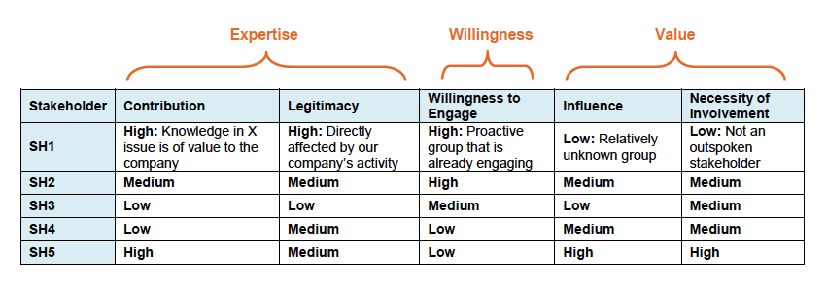
Stakeholder Mapping Step 2*: Analysis
* Grid taken from “Business for Social Responsibility Stakeholder Mapping,” 2011.
Notes:
❑ ?Learn from past and ongoing engagement: Look at your organization’s existing engagement activities. What are the objectives of these activities? What stakeholders communicate regularly with your company? What groups do they cover well? Where can you reach beyond this existing comfort zone to engage with lesser-known stakeholders?
❑ ?Be forward thinking: Consider potential stakeholders from new markets, new technologies, new customers, and new impending regulations. Depending on your objectives, the relevant stakeholders you need to engage with may not play the usual sustainability roles but may instead serve other functions relevant to your business.
❑ ?Be diverse: Make sure to include a rich diversity of stakeholder expertise, geography, and tactics from across the spectrum. This is an opportunity to reach out and mix the old with the new, including individuals from each of the following stakeholder categories: influencers, collaborators, advocators, and implementation partners.
❑ ?Be social: Social media provides an unparalleled opportunity to identify and reach lesser-known stakeholder groups. Canvas blogs, forums, networking, reviews, and news sites to discover stakeholders relevant to your business and to learn about their interest in your activities.
❑ ?Be aware: People have a tendency to focus on formal authorities in the mapping process, but the loudest voices or heaviest campaigners are not necessarily your key stakeholders. Step back and add silent members to your list because they may have a hidden wealth of expertise.

Slide 4
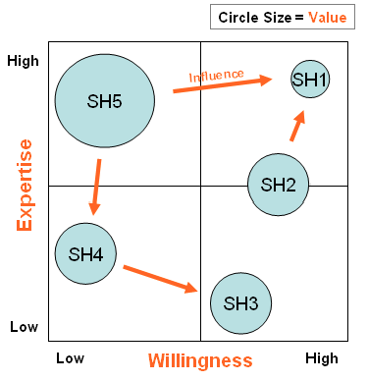
Stakeholder Mapping Step 3*: Mapping
* Grid taken from “Business for Social Responsibility Stakeholder Mapping,” 2011.

