Slide 1

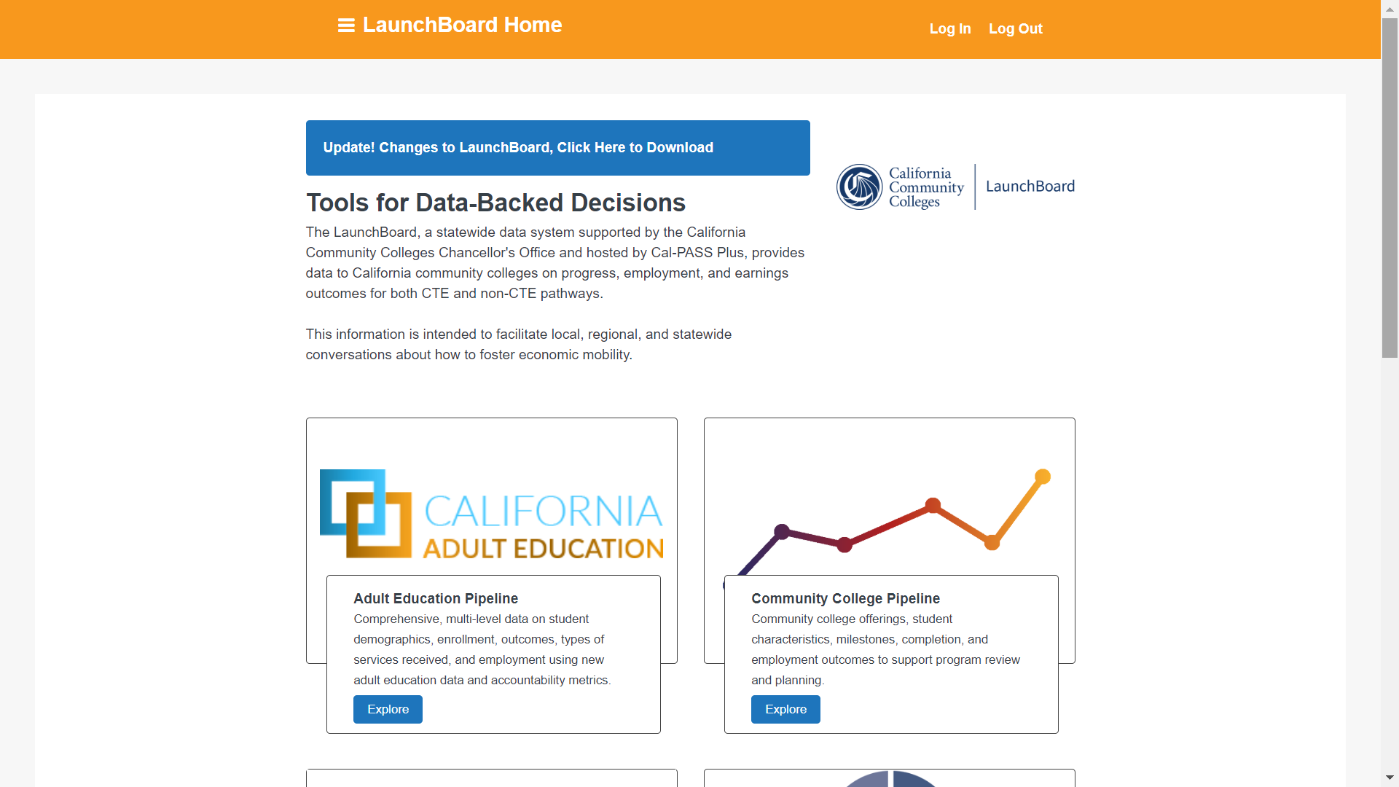
Data Tools for Planning and Program Improvement
Randy Tillery, WestEd
rtiller@wested.org

Slide 2
Topics
The LaunchBoard – how to think about and use the data
Adult Education Career Pathways research project
AB705 and the alignment between the college CB21 framework and the Educational Functioning Levels

Slide 3
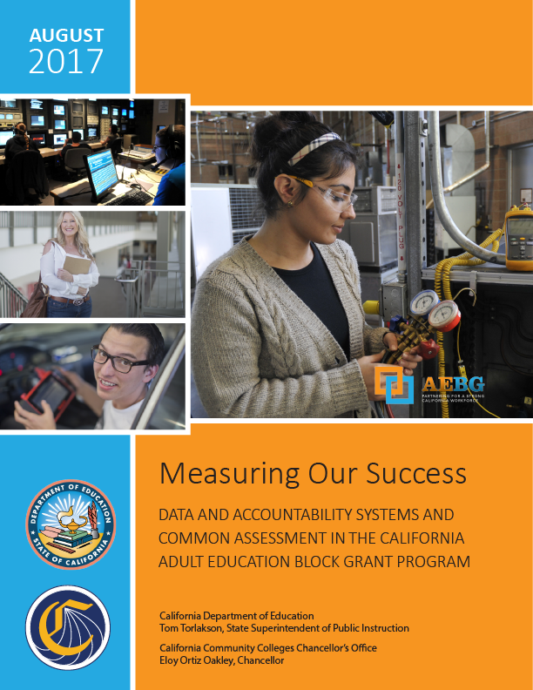
Measuring Our Success
Aligns definition of students, programs, and core measures for adult education for K12 adult ed and CC noncredit
Result of an 8 week field team process with 35 practitioners in 40 hours of meetings
Data collection and alignment of measures for student assessment, progress and success
How AE aligns with key WIOA metrics and definitions as well as perkins, Title IV, etc
Process for aligning assessment between community colleges and adult schools

Slide 4
Adult Education Program Student Outcomes
Progress
EFL Attainment
Workforce Prep
Occupation Skills
Transition
ABE/ESL to ASE
Transition to Postsecondary
Completion
Diploma or HSE
Postsecondary Credentials
Employment
Employment
Wage Gains
Living Wage

Slide 5
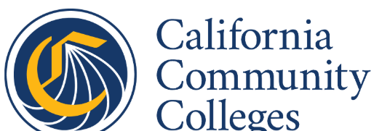
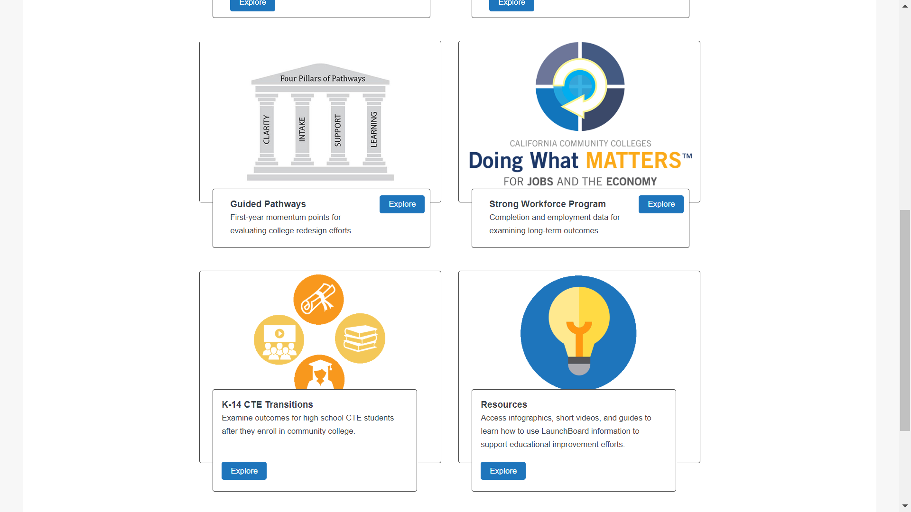
LaunchBoard
Student Success Metrics
Community College Pipeline
Adult Education Pipeline
K14 CTE Transitions
Resources
Guided Pathways

Slide 6
What is the LaunchBoard?
A group of data visualization tools that provide data on enrollment, progress, success, and earnings
Intersegmental – includes both community college data and data on K14 and AE to CC student journeys
It is public
Uses and connects existing publicly collected datasets and creates access for practitioners to better understand their students
Primary intended purpose was to support conversations and planning for program improvement
Two types of tools – student journeys; ed reform

Slide 7
LaunchBoard Data Sets
Primary Student Data
CCCCO MIS
Enrollment Data
K12 Adult Ed
(TOPSpro)
K12 Secondary (CalPASS)
Supplemental Data Matching
EDD Wage
File
High School
Equivalency
CASAS Testing
Data
DAS
Records
Other Data Sources
CTE Outcome
Survey
Labor Market Info (EMSI)

Slide 8
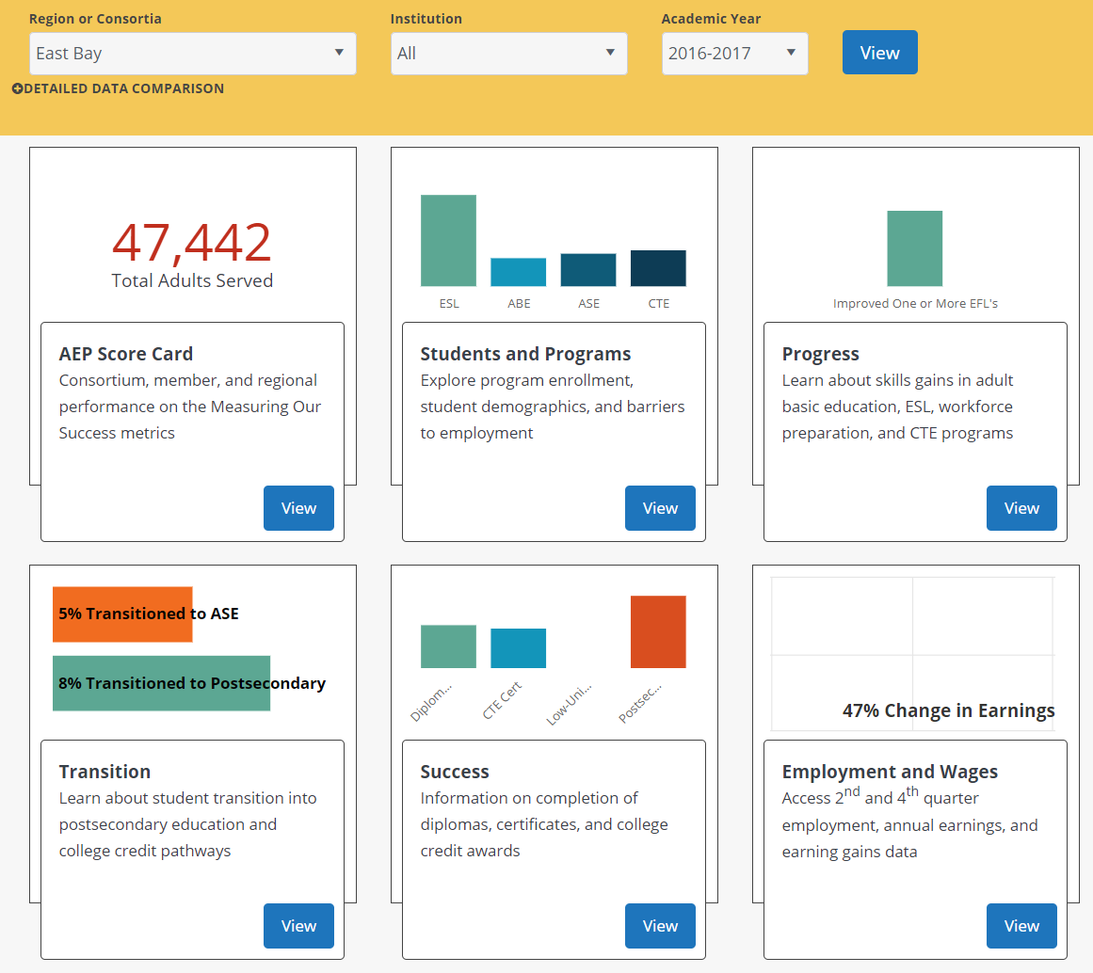
Adult Education Pipeline

Slide 9
What about the Data
A data point is a question – it should make you ask why and question your assumptions
No single data point is sufficient to tell the story of your students
You should gather more information – talk to your customers
It should result in action (interesting vs actionable data)

Slide 10
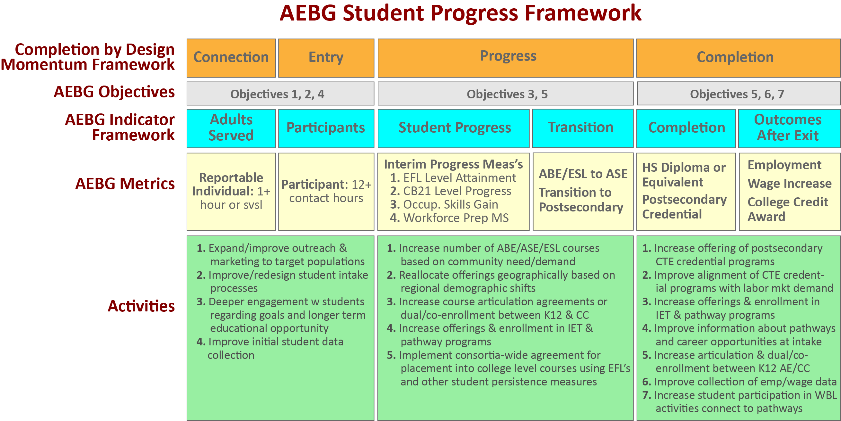

Slide 11
Changes in Build 3 – Feb 21st
Begin leveraging longitudinal data to look at cohorts
Revised metric definitions to better align with vision goals, student success metrics, etc
New Metrics
Adults served with 1-11 instructional contact hours
Service only students
Participants in Workforce Preparation
First Time Participants (by program area)
Returning or Continuing Participants
Participants taking courses in more than one program area
Participants taking courses at more than one adult school
Subsequently took transfer level math or English
Persistence

Slide 12
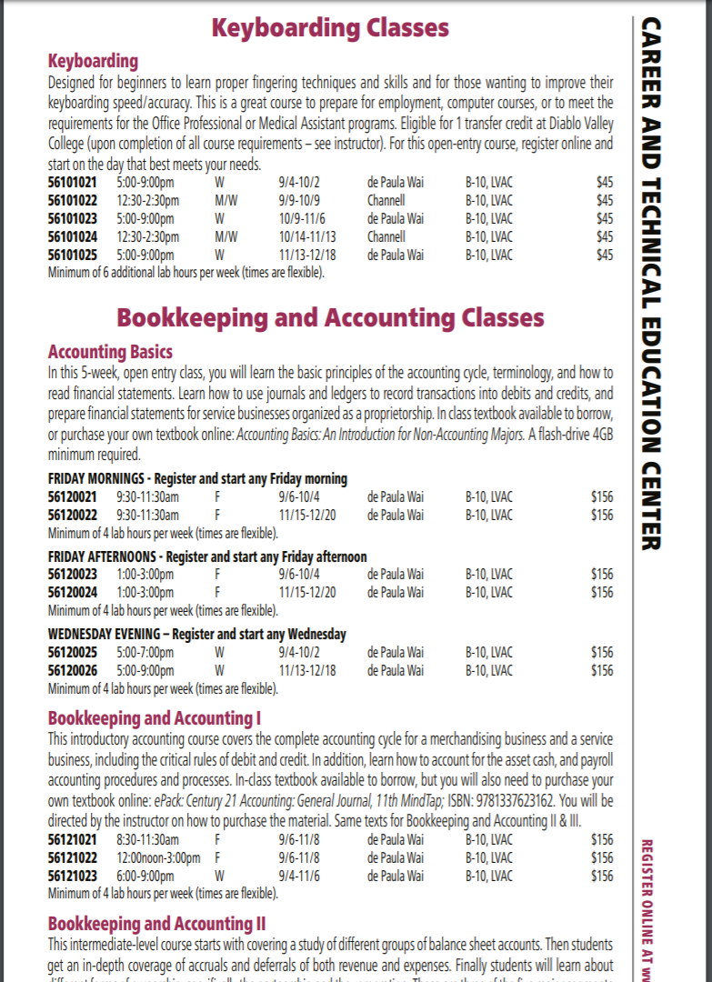
Adult Education
Career Pathways

Slide 13
Inventory and Map every K12 adult and noncredit CTE and workforce preparation pathway/course in the State
Comparison to aligned college pathways and programs and local regional labor markets
Result will be a statewide report and data set that can be filtered to the local/regional level
Should support pathway development and planning for Perkins V CLNA
Include scraping of data from catalogues, interviews with practitioners, and regional meetings to vet and get feedback on the data
Timeline for completion Spring 2020

Slide 14

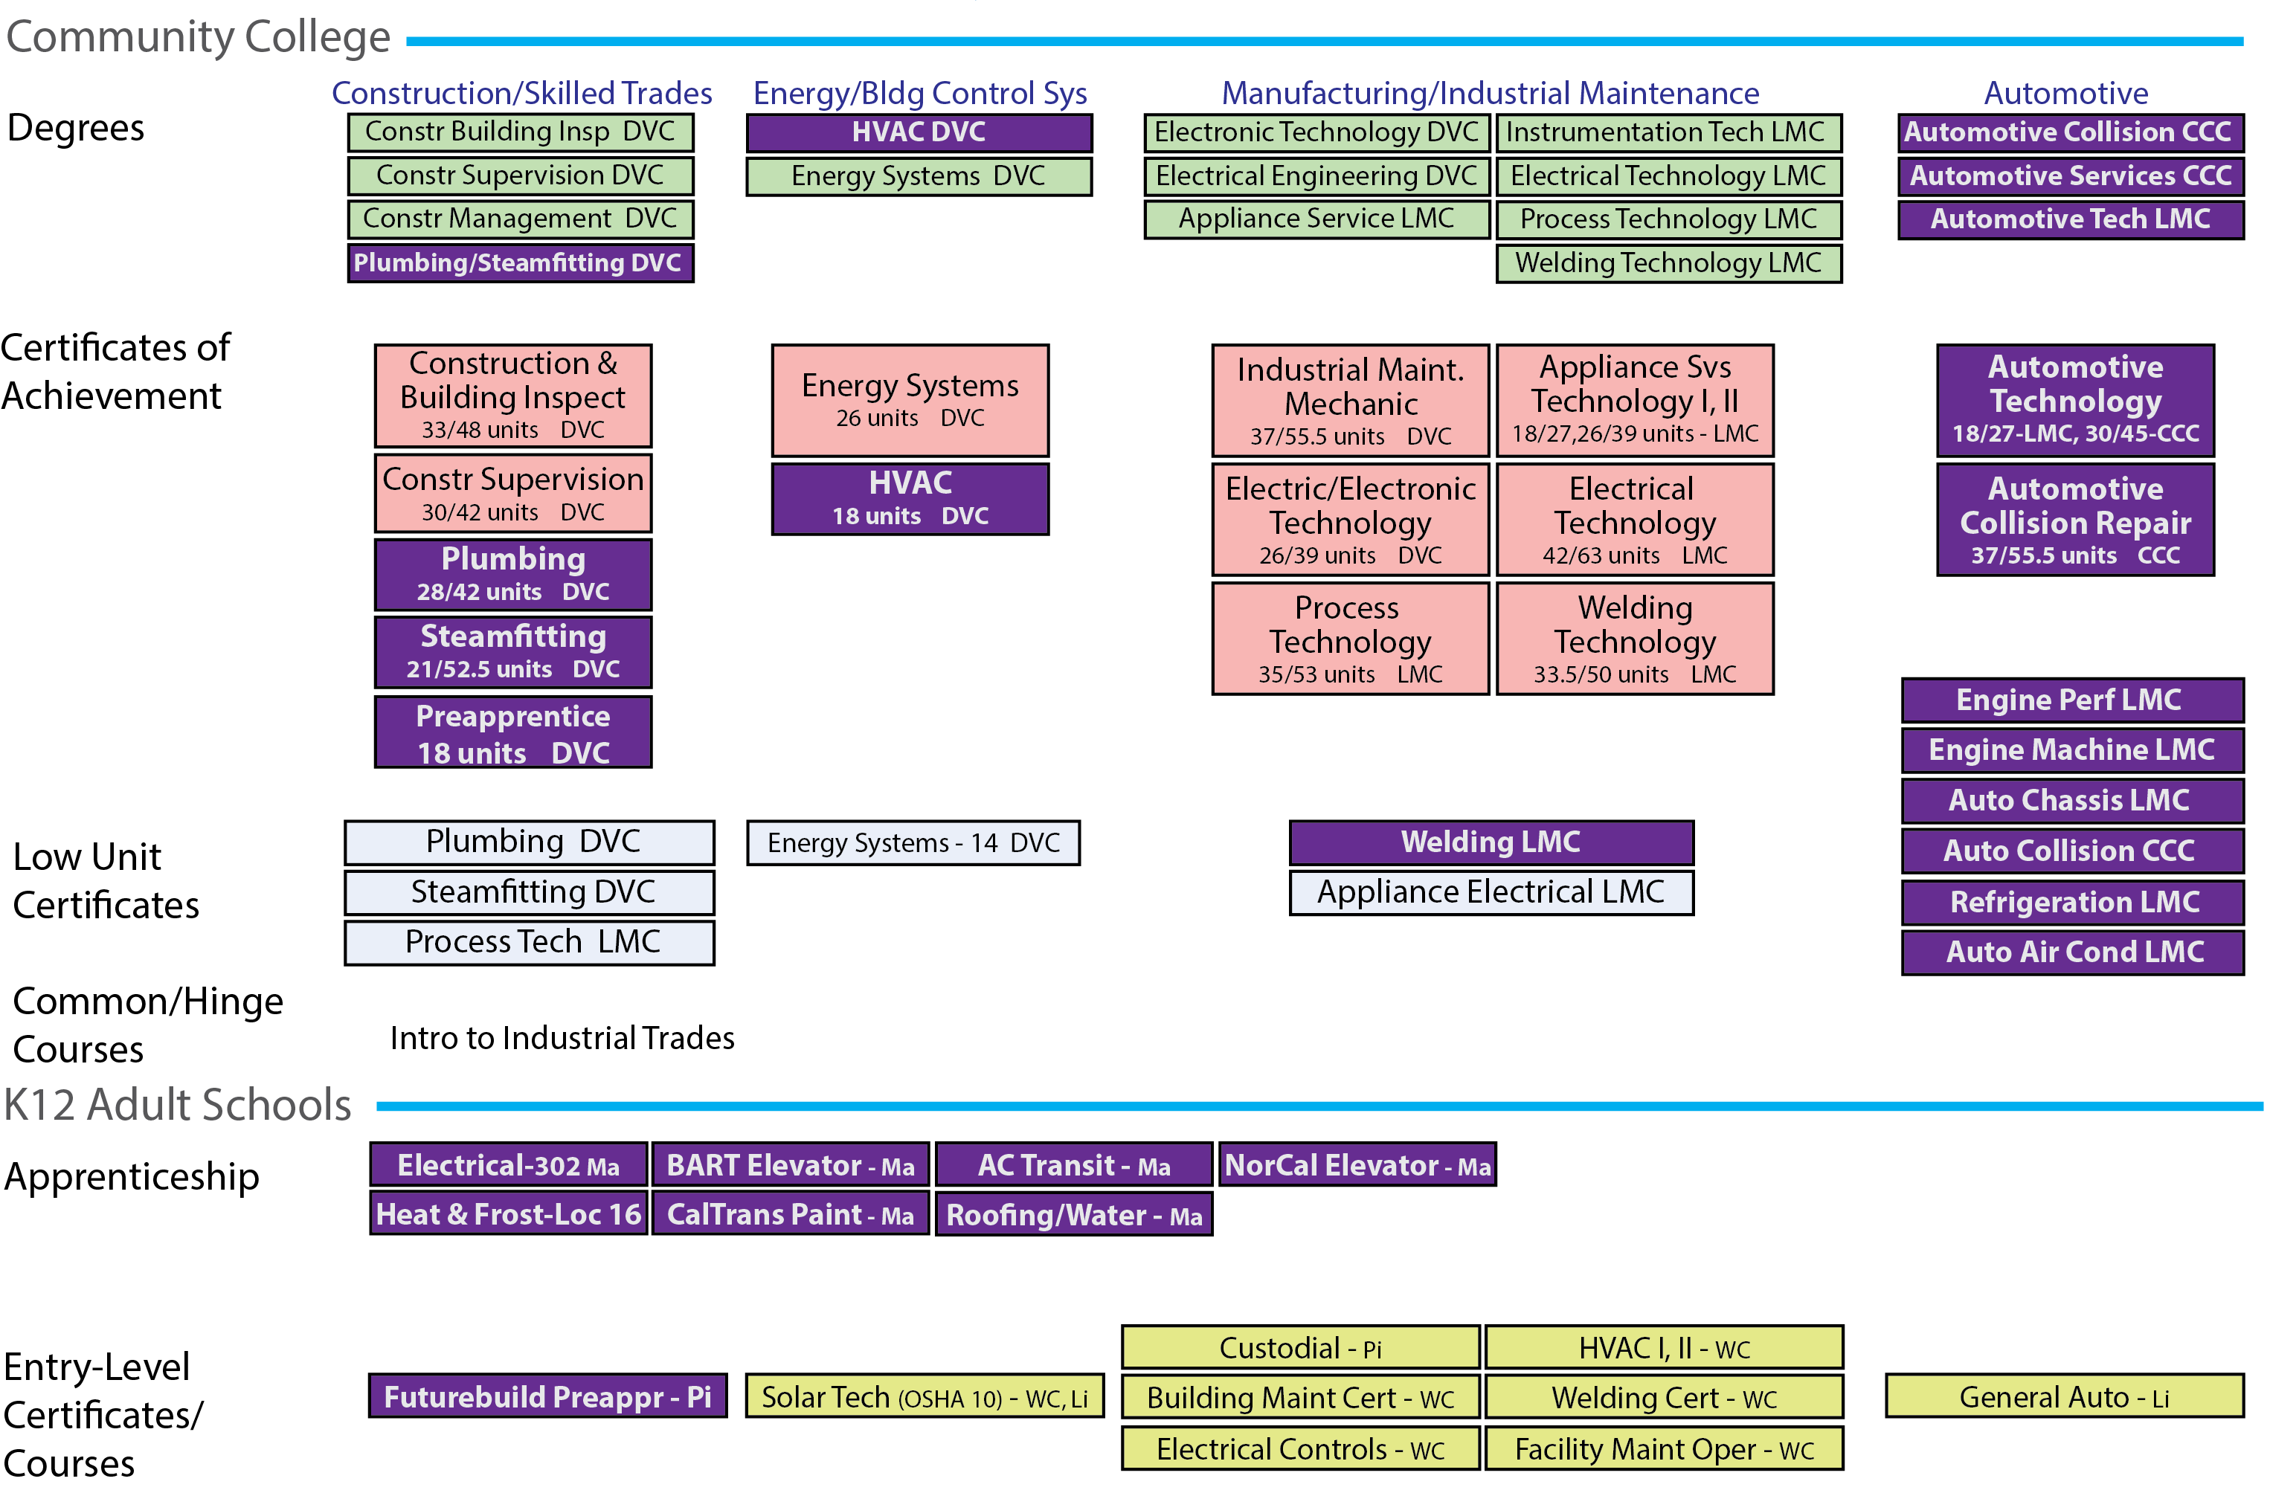

Slide 15
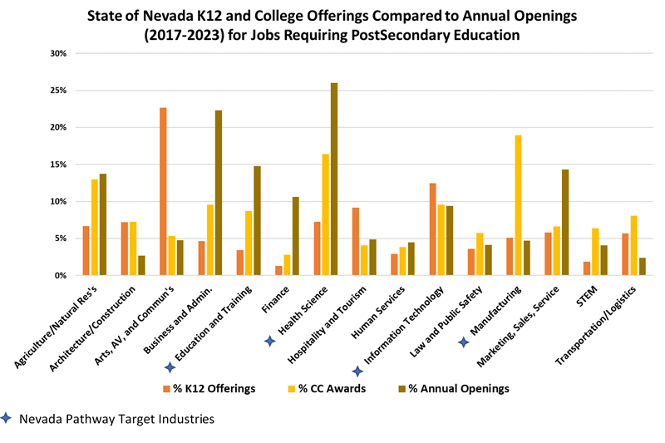

Slide 16
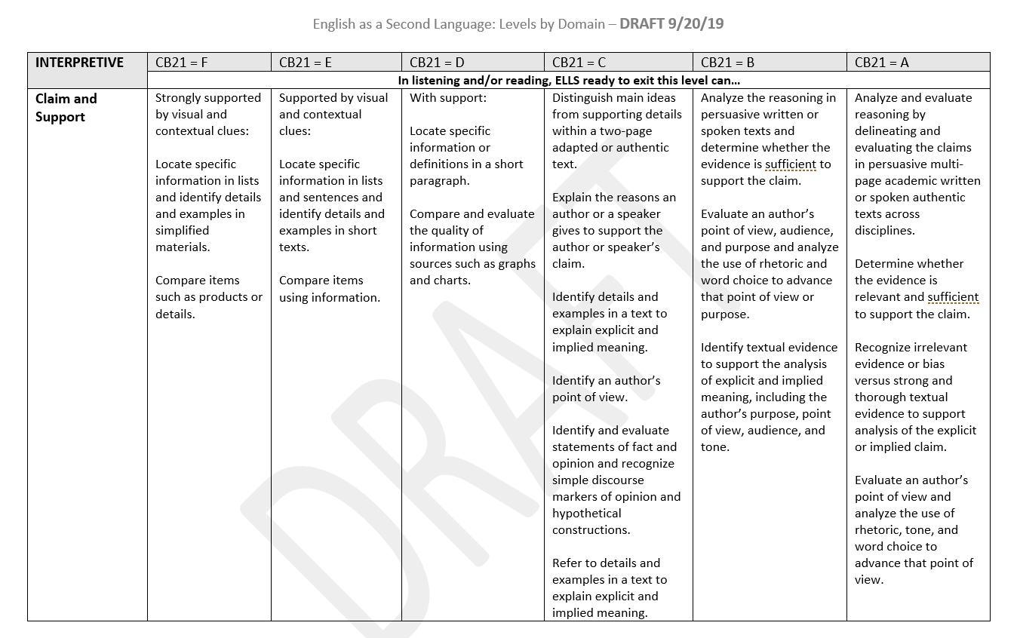
AB705 – CB21 Revision Project

Slide 17
CB21 – Course Level Below College Level
Applies to Math, English or ESL
Rubric for coding developmental education courses leading to college level math or English
While ESL is not considered developmental ed it is still considered leading to TLE
As many as 8 levels in old (2010) versions
Missing competencies

Slide 18
Process
Largely kept original language from Federal EFL’s, modified or added to the EFL’s from established vetted resources
Up to 9 months of meetings (ESL) hundreds of hours of discussion
Added additional detail from common assessment initiative rubrics, old CB21 rubrics, Global Standard of English (ESL)

Slide 19
After 2017 field teams WestEd conducted crosswalk mapping sessions between CB21 and the old and new EFLs to inform student transition planning
Passage of AB705 changed how students could place students into college level coursework
Fall 2018 CO and ASCCC decided to redesign CB21 with a recommendation to WestEd to align to the Federal EFL’s
WestEd convened Faculty teams in 2018/19 for the CB21 revision work
Math and English were approved Spring 2019, ESL will be approved in November
Plans for roll out and field convening in Spring 2020

