Slide 1
CAEP Update
September 2019

Slide 2
Updates
Program Changes for 19-20
Colleges using MIS Reporting for 19-20
Co-enrollment / CalWIRE
SB554 – Roth
Consortium Oversight
Census Recruitment
CAEP Onboarding Tool
And more

Slide 3
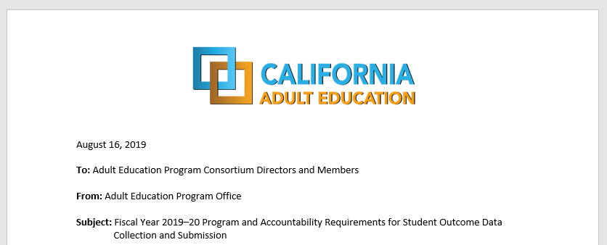
BOY Letter for PY 2019-20
Sent out mid August… this letter includes the data submission requirements for all CAEP agencies.

Slide 4
Program Changes
Workforce Reentry is being interpreted as Workforce Preparation.
CAEP will not track service hours in 19-20.
Agencies will record student barriers at intake.
The Passage of Exam Measurable Skills Gain for WIOA I will align with the CAEP Occupational Skills Gain and Workforce Preparation Outcome.
NOVA Program Area Reporting clarification for 18-19.

Slide 5
19-20 Reporting Changes (enrollment)
Enrollment / Instructional Hour Definitions
“Adults Served” is a required reporting category in AB104 and will be a summary count of anyone with at least 1 instructional contact hour or who received a service.
“Adults Served” will be disaggregated in counts by CASAS and the LaunchBoard to identify ‘service only’ students, students receiving 1-11 instructional contact hours, and ‘participants’ who received 12 or more instructional contact hours over a single program year.

Slide 6
Contact Hours
Definition. Hours of instruction or instructional activity that the participant receives from the program. Instructional activity includes any program-sponsored activity designed to promote learning in the program curriculum, such as classroom instruction, assessment, tutoring, or participation in a learning lab. Time spent on assessment can be counted only if the assessment is designed to inform placement decisions, assess progress, or inform instruction. Time used simply to administer tests, such as the GED tests, cannot be counted as instructional activity.
https://www.nrsweb.org/sites/default/files/NRS_TA_Guide.pdf
(p. 57 of NRS online technical assistance guide)

Slide 7
19-20 Reporting Changes (student barriers)
Student Barriers to Employment
Agencies will record student barriers at intake.
CAEP student barriers and their definitions will align with federal WIOA II barriers to employment.
For WIOA II – OCTAE has identified ABE/ASE enrollees by definition as having the Low Literacy Skills barrier, and all ESL/ELL learners as Low English Literacy.

Slide 8
19-20 Reporting Changes (CTE skills gain)
WIOA I / CAEP Alignment – Occupational Skills Gain
The Passage of an Exam Measurable Skills Gain for WIOA I will align with the CAEP Occupational Skills Gain and Workforce Preparation Outcome
When a student achieves an Occupational Skills Gain, that now entails that the student passes an exam such as work skills demonstration, written test, standardized pre/post-test, etc.
Workforce Preparation Outcome should include some documentation of work skills progression or attainment.

Slide 9
NOVA Program Area Reporting Timeline
December 1, 2019 – each consortia member will be asked to certify their amounts into for NOVA for the following:
Program Year 18-19 – hours of instruction by program area.
Program Year 18-19 – expenses by program area by fund source.

Slide 10
NOVA Program Area Reporting Updates
Program Area Clarification
Definition of an Instructional / Contact Hours
Integrated Course Hours Reporting
Service Hours
Reduction of the fund sources for reporting expenses
Alignment with WIOA on defining fees/program income and in-kind contributions

Slide 11
MIS Reporting for CAEP 19-20
For 19-20, California Community College Districts (CCDs) are required to use the Chancellor’s Office Management Information System (COMIS or MIS) to enter their noncredit adult learner demographics, barriers, services received and program outcome information.
Enrollment, demographics, barriers, and most student outcomes for noncredit adult education students rely on data entered into the MIS system almost exclusively to populate the LaunchBoard Adult Education Pipeline and exclusively to populate the metrics in the new Student Success Metrics dashboard for Adult Ed/ESL student journey.

Slide 12
MIS Reporting for CAEP 19-20 (cont. 1)
MIS is a term-based system. CAEP will pull data from the state level MIS that is provided each semester by the community colleges
There are no separate reporting deadlines for data collected and entered into MIS.
Colleges should capture all data relevant to their students and ensure it is entered completely into their local MIS system.
Colleges will submit their adult education data through their colleges’ regular data uploads to the Chancellor’s Office. There is no separate submission of MIS data to the Chancellor’s Office for adult education students.

Slide 13
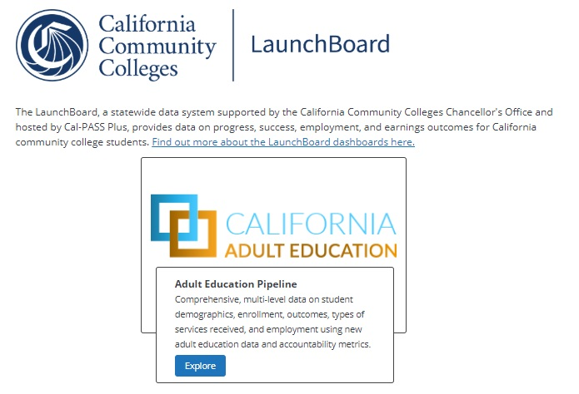
MIS CAEP Program Metric Definitions for 18-19

Slide 14
Adult Education Launchboard
Data Elements & Outcomes:
Adult Served
Enrollment (1 hr. to 12 hrs.) by program area (being added this year)
Enrollment (12 hrs. or more) by program area
Adults Served Services Only
Demographics
Barriers to Employment
Measurable Skills Gain – by Educational Functional Level
Students who complete a CTE a workforce preparation course or training milestone or occupational skills gain
Student Transition to Post-Secondary and/or Adult Secondary Education
Students who earn a high school diploma or high school equivalency
Students who earn a post secondary CTE certificate
Students who complete a post secondary credential
Number of students employed and change in earnings
Number of students who attained the living wage and median annual earnings

Slide 15
Adult Education Launchboard – WIOA II grantees
Data Elements & Outcomes:
Adult Served
Enrollment (1 hr. to 12 hrs.) by program area (being added this year)
Enrollment (12 hrs. or more) by program area
Adults Served Services Only
Demographics
Barriers to Employment
Measurable Skills Gain – by Educational Functional Level
Students who complete a CTE a workforce preparation course or training milestone or occupational skills gain
Student Transition to Post-Secondary and/or Adult Secondary Education
Students who earn a high school diploma or high school equivalency
Students who earn a post secondary CTE certificate
Students who complete a post secondary credential
Number of students employed and change in earnings
Number of students who attained the living wage and median annual earnings

Slide 16
Adult Education Launchboard – CCD’s non- WIOA II grantees (using course progression for EFLs or SA07)
Adult Served
Enrollment (1 hr. to 12 hrs.) by program area (being added this year)
Enrollment (12 hrs. or more) by program area
Adults Served Services Only
Demographics
Barriers to Employment
Measurable Skills Gain – by Educational Functional Level
Students who complete a CTE a workforce preparation course or training milestone or occupational skills gain
Student Transition to Post-Secondary and/or Adult Secondary Education
Students who earn a high school diploma or high school equivalency
Students who earn a post secondary CTE certificate
Students who complete a post secondary credential
Number of students employed and change in earnings
Number of students who attained the living wage and median annual earnings

Slide 17
Regional Training Dates
August 7 – Mt Diablo (9am to 12noon)
August 13 – North Orange (9am to 12noon)
September 11 – Fresno (9am to 12noon)
September 25 – Burbank (9am to 12noon)
October 1 – San Mateo (12:30pm to 3:30pm)
October 10 – Sacramento (9am to 12noon)
October 28 –Vista Adult (11am to 2pm)
November 21 – San Bernardino (9am to 12noon)

Slide 18
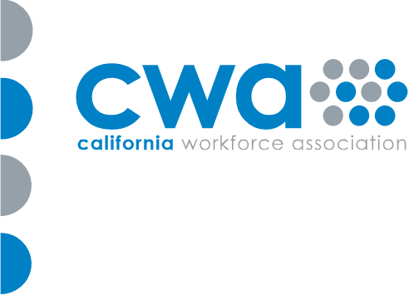
English Language Learner Co-Enrollment Pilot Training Data Collection as a Partnership
CalWIRE Efforts

Slide 19
SB554 - Roth
Pending signature
Dual enrollment for K12 adult school and community college students
Limited to ASE students
Streamlines the process
Help students get around income verification or residency documentation
Another transitional pathway to credit coursework

Slide 20
Consortium Oversight
The buck stops at the consortium level
Legislation holds the consortium & members responsible to hold public meetings to make decisions on plans, budgets, expenses, allocations, goals, and performance/effectiveness.
They left very little resources for state level compliance.
The AB104 legislative language is limited to age, program areas, governance, structure/membership, funding formula, required plans/reports, funding disbursement, data collection, sharing of specific fund sources, and administrative costs.
All existing education code and regulations are still in effect.

Slide 21
Plan for Census 2020
 | Description | Activity | Timeline
Phase 1 | Field Staff Recruitment | Create awareness of Census 2020 job openings for Address Lister positions | May - Jun 28, 2019
Phase 2 | Pathways: Digital Literacy Customer Service Communications | Develop curriculum and prepare students for Census 2020 Enumerator positions | July – Sept, 2019
Phase 3 | EL Civics Objectives COAAP 54.1 | Educate ESL students on the Census 2020 purpose and process | Oct - Dec 2019
Phase 4 | Community Awareness Day Campaign “Get Counted” | Work with community partners (United Way, Latino Chamber of Commerce, churches) to encourage community responses to census | Dec. 2019
Notes:
Neil

Slide 22
CAEP Onboarding Tool

Slide 24
First In, First Out

Slide 25
Governance

Slide 26
CAEP TAP
The AEBG Technical Assistance Program (TAP) provides professional development resources for all CAEP agencies statewide.
https://caladulted.org/
tap@aebg.org

