Slide 1

The CAEP Annual Planning & Fiscal Reporting Webinar
August 2019

Slide 2
Agenda
3-year plans
Annual plans
NOVA Processing
Fiscal Reporting in NOVA
What’s FIFO?
Closing out CAEP funds
Data & Accountability final report & practice with promise
Questions

Slide 3
Planning
3 year plans were due June 7, 2019.
These are regional plans to guide your consortium.
They are not “approved” by the State – but submission is required.
3 year plans drive the annual plans – due August 15th.
Annual plans drive the member work plans due September 30th.

Slide 4
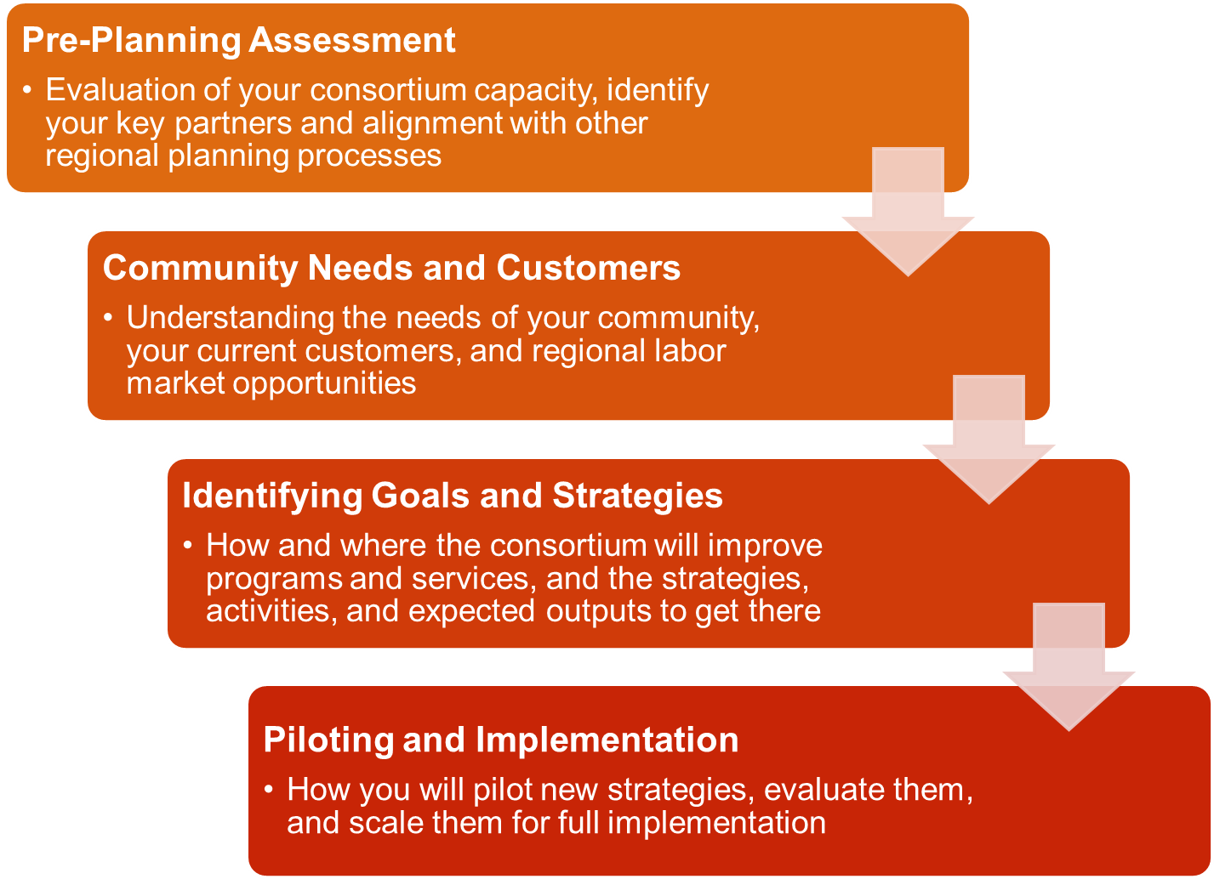

Slide 5
19-20 Annual Plan
Same as last year (see 18-19 annual plans in NOVA).
Same text boxes to complete in NOVA.
Aligns with the 3 year planning process.
Consortium must type in NOVA the responses to the annual planning prompts.
All members must certify the annual plan.

Slide 6
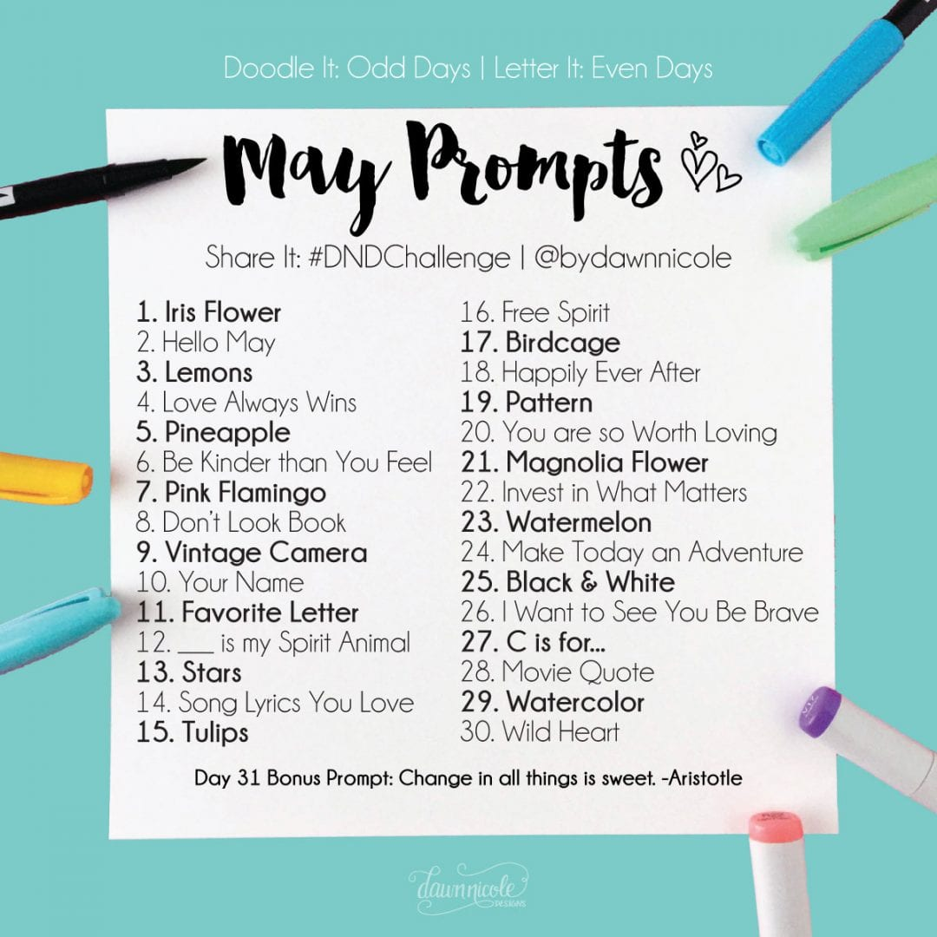
Review of Annual Plan Prompts

Slide 7
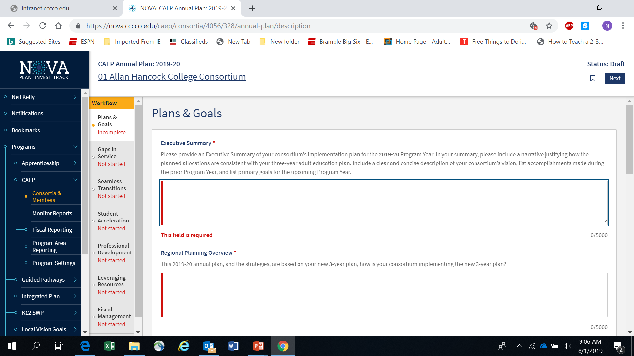

Slide 8
NOVA Annual Plan Tips
Use information from your new 3 year plan.
Annual Plan strategies will become your member work plan objectives.
Make sure your strategies are broad enough for members to use in their work plans.
Work plans are supported by the member’s budget.
Notes:
S

Slide 9
NOVA Annual Plan Tips (cont.)
Consortium certification of annual plan and member work plans & budgets will satisfy State’s need for consortium & district approval to spend CAEP funding for the year.
Use the Fiscal Management section to explain your consortium’s carry over policies and how funds will be liquidated.
Notes:
S

Slide 10
NOVA Annual Plan Tips (cont. 1)
Annual plans must be approved in NOVA by all the consortium members.
Make sure you are in contact with your members about the 8/15/19 due date.
If you miss the 8/15 due date, it will delay your members from creating their work plans and budgets.
Notes:
S

Slide 11

Fiscal Reporting in NOVA
Notes:
S

Slide 12
Fiscal Reporting
Member budgets are based on work plans and the consortium annual plan.
Prior year carry-over will be included in member budgets & expense reporting.
All members must be up to date on their work plans, budgets & expense reporting in order to move into the next year and/or next quarter.

Slide 13
What’s FIFO?
FIFO = First In, First Out.
CAEP funds are 3 year funds.
State tracks CAEP funds via NOVA.
Member district must also track CAEP funds expenses via their accounting office.
NOVA = 3 year expense reporting.
Local accounting = 1 year expense reporting.

Slide 14
What’s FIFO? (cont.)
Sometimes the NOVA expenses will not match the local district accounting expenses.
Once a Q4 report is certify by the consortium in NOVA – we cannot reopen that year for any changes.
If expenses are missed – catch up in the next year. It’s 3 year funding.

Slide 15
Closing Out CAEP funds
CAEP funds are 3 year funds.
The 17-18 CAEP funds were disbursed effective July 1, 2017.
The State targeted 100% spend down of these 17-18 funds by June 30, 2019.
With corrective action, members can have an additional six months until 12/31/19.
NOVA will close out 17-18 CAEP funds effective March 1, 2020.

Slide 16
Closing Out CAEP funds (cont.)
This means each member must have spend all 17-18 CAEP funds and certify to that in NOVA effective March 1, 2020.
Consortium should have by-laws in place to review prior year funds (and prior prior year funds) to see if a member is spending down their funds in a timely manner.
Consortium can use the allocation amendment process in NOVA to shift funds to other members (with cause or member agreement).

Slide 17
Data & Accountability Close Out
Last step in the close out process.
Final report due August 26, 2019 in the old MIS WebEx system.
Data & Accountability Practices with Promise are due via the caladulted website on 8/26/19.
http://aebgpracticeswithpromise.com/showcase_data_accountability.asp

Slide 18
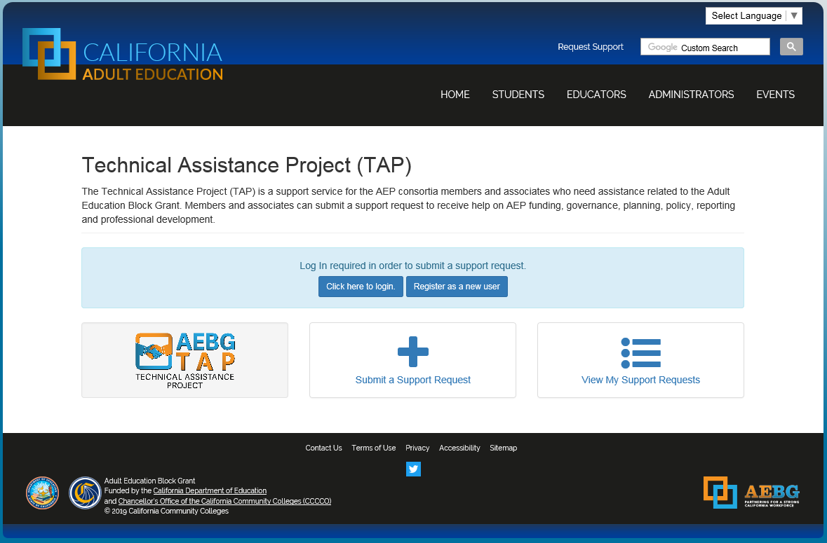
Request Support from CAEP TAP

Slide 19
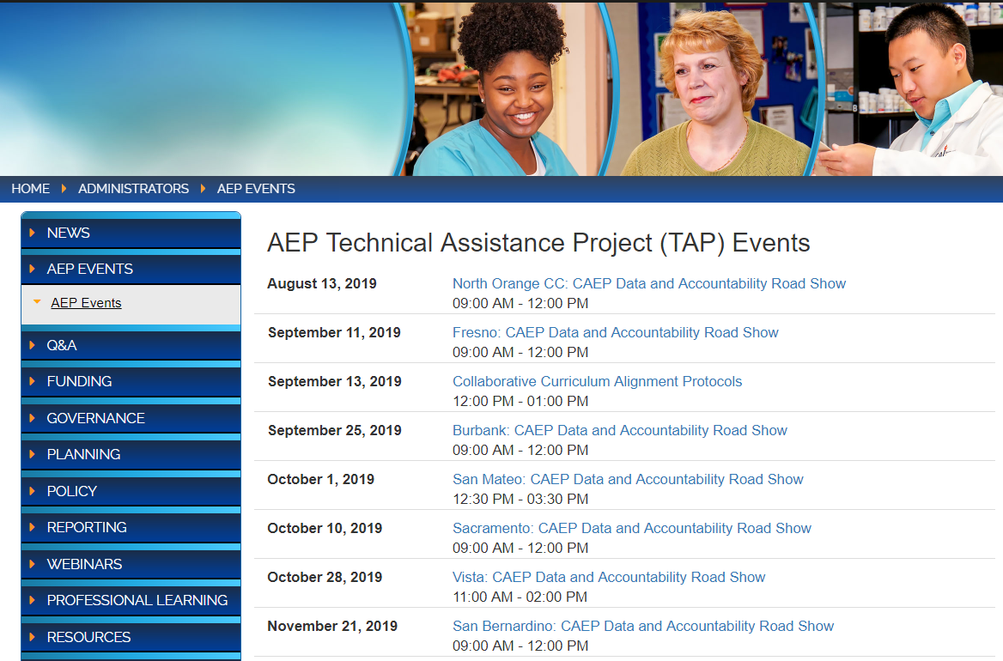
Upcoming Webinars and In-person Trainings

