Slide 1
CAEP 19-20 Student Data Reporting & More
Fall 2019

Slide 2
Agenda (part 1)
Overview: Program Changes for 19-20
  Student Data Reporting Changes
  Program Area Reporting in NOVA
Immigrant Integration Update
Colleges using MIS Reporting for 19-20

Slide 3
Agenda (part 2)
K12/COEs using TE Reporting for 19-20
  Program Changes Reviewed
  Review of Federal Metrics
  Outcomes – Key Considerations
  Transition & Short Term Services
  Review of CAEP Reports
  Updates to Resources and Materials
Questions/Answers

Slide 4
Summary of Changes
Workforce Reentry is being interpreted as Workforce Preparation.
CAEP will not track service hours in 19-20.
Agencies will record student barriers at intake.
The Passage of Exam Measurable Skills Gain for WIOA I will align with the CAEP Occupational Skills Gain and Workforce Preparation Outcome.
NOVA Program Area Reporting clarification for 18-19.

Slide 5

Student Data Reporting Changes for 19-20

Slide 6
19-20 Reporting Changes (local)
For district/agency reporting of Program Areas
CAEP will continue to have the Seven Program Areas: ABE/ASE, ESL, Short-term CTE, Workforce Prep, Pre-Apprenticeship, AWD, and K12 Student Success
Workforce Reentry is being interpreted as Workforce Preparation.

Slide 7
19-20 Reporting Changes (state)
For State Level Reporting of Program Areas
LaunchBoard (State Level)
Legislative Reports
Five Main Program Areas: ABE/ASE, ESL, CTE, AWD, and K12 Student Success
CTE – will include subcategories for Short Term CTE, Workforce Preparation, and Pre-apprenticeship
Workforce Reentry is being interpreted as Workforce Preparation.

Slide 8
19-20 Reporting Changes (enrollment)
Enrollment / Instructional Hour Definitions
“Adults Served” is a required reporting category in AB104 and will be a summary count of anyone with at least 1 instructional contact hour or who received a service.
“Adults Served” will be disaggregated in counts by CASAS and the LaunchBoard to identify ‘service only’ students, students receiving 1-11 instructional contact hours, and ‘participants’ who received 12 or more instructional contact hours over a single program year.

Slide 9
Enrollment/Instructional Hour Definitions
“Adults Served” are a required reporting category in AB104 and should be a summary count of learners:
  Having at least 1 instructional contact hour
  or
  Who received a short term service.

Slide 10
Enrollment/Instructional Hour Definitions
“Adults Served” will be disaggregated into three categories:
  Service only students
  Students receiving 1-11 instructional contact hours
  Participants who received 12 or more instructional contact hours over a single program year.

Slide 11
Contact Hours
Definition. Hours of instruction or instructional activity that the participant receives from the program. Instructional activity includes any program-sponsored activity designed to promote learning in the program curriculum, such as classroom instruction, assessment, tutoring, or participation in a learning lab. Time spent on assessment can be counted only if the assessment is designed to inform placement decisions, assess progress, or inform instruction. Time used simply to administer tests, such as the GED tests, cannot be counted as instructional activity.
https://www.nrsweb.org/sites/default/files/NRS_TA_Guide.pdf
(p. 57 of NRS online technical assistance guide)

Slide 12
19-20 Reporting Changes (services)
Services/Service Hours
CAEP will not track service hours.
In other integrated reporting frameworks for services it is more common to report service contacts and type of service delivered than hours.
Tracking service contact types and how those align with student outcomes is an area that the CAEP State Office will continue to explore.

Slide 13
19-20 Reporting Changes (student barriers)
Student Barriers to Employment
Agencies will record student barriers at intake.
CAEP student barriers and their definitions will align with federal WIOA II barriers to employment.
For WIOA II – OCTAE has identified ABE/ASE enrollees by definition as having the Low Literacy Skills barrier, and all ESL/ELL learners as Low English Literacy.

Slide 14
19-20 Reporting Changes (CTE skills gain)
WIOA I / CAEP Alignment – Occupational Skills Gain
The Passage of an Exam Measurable Skills Gain for WIOA I will align with the CAEP Occupational Skills Gain and Workforce Preparation Outcome
  When a student achieves an Occupational Skills Gain, that now entails that the student passes an exam such as work skills demonstration, written test, standardized pre/post-test, etc.
  Workforce Preparation Outcome should include some documentation of work skills progression or attainment.

Slide 15
WIOA I Passing Knowledge-Based Exam
The Skills Progression MSG has now been replaced by Passage of an Exam.
Learner passes an exam during the year that is required for a job, or that demonstrates progress in attaining technical or occupational skills.
Exam can be a hands on occupational skills demonstration, written test, standardized pre/post-test, or other method of assessment that clearly demonstrates skill progression or attainment.

Slide 16
WIOA I Training Milestone
Participant is in an education or training program and accomplishes one or more of the following:
  Masters specific job skills or steps required for that job
  Receives pay increase
  Attains performance increase on the job
  Completes one apprenticeship program
  Completes other locally defined work outcome

Slide 17

NOVA Program Area Reporting Changes for 18-19 reporting

Slide 18
Reporting Requirements
All CAEP members (K12 districts, county offices of education, joint powers authority, and community college districts) must submit in NOVA the total hours of instruction for program year 18-19 provided to students in the seven CAEP program areas (adult education/noncredit).
All CAEP members (K12 districts, county offices of education, joint powers authority, and community college districts) must submit in NOVA the total operational cost for program year 18-19 by fund source in the seven CAEP program areas (adult education/noncredit).

Slide 19
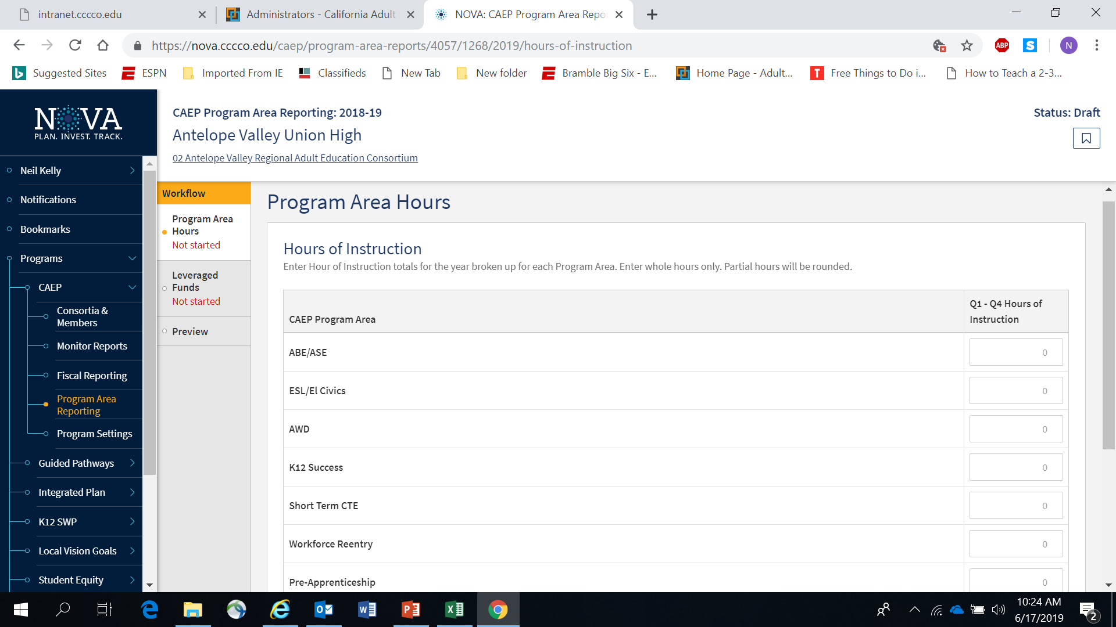
Screen capture of the Nova website indicating the Program Area Hours page.

Slide 20
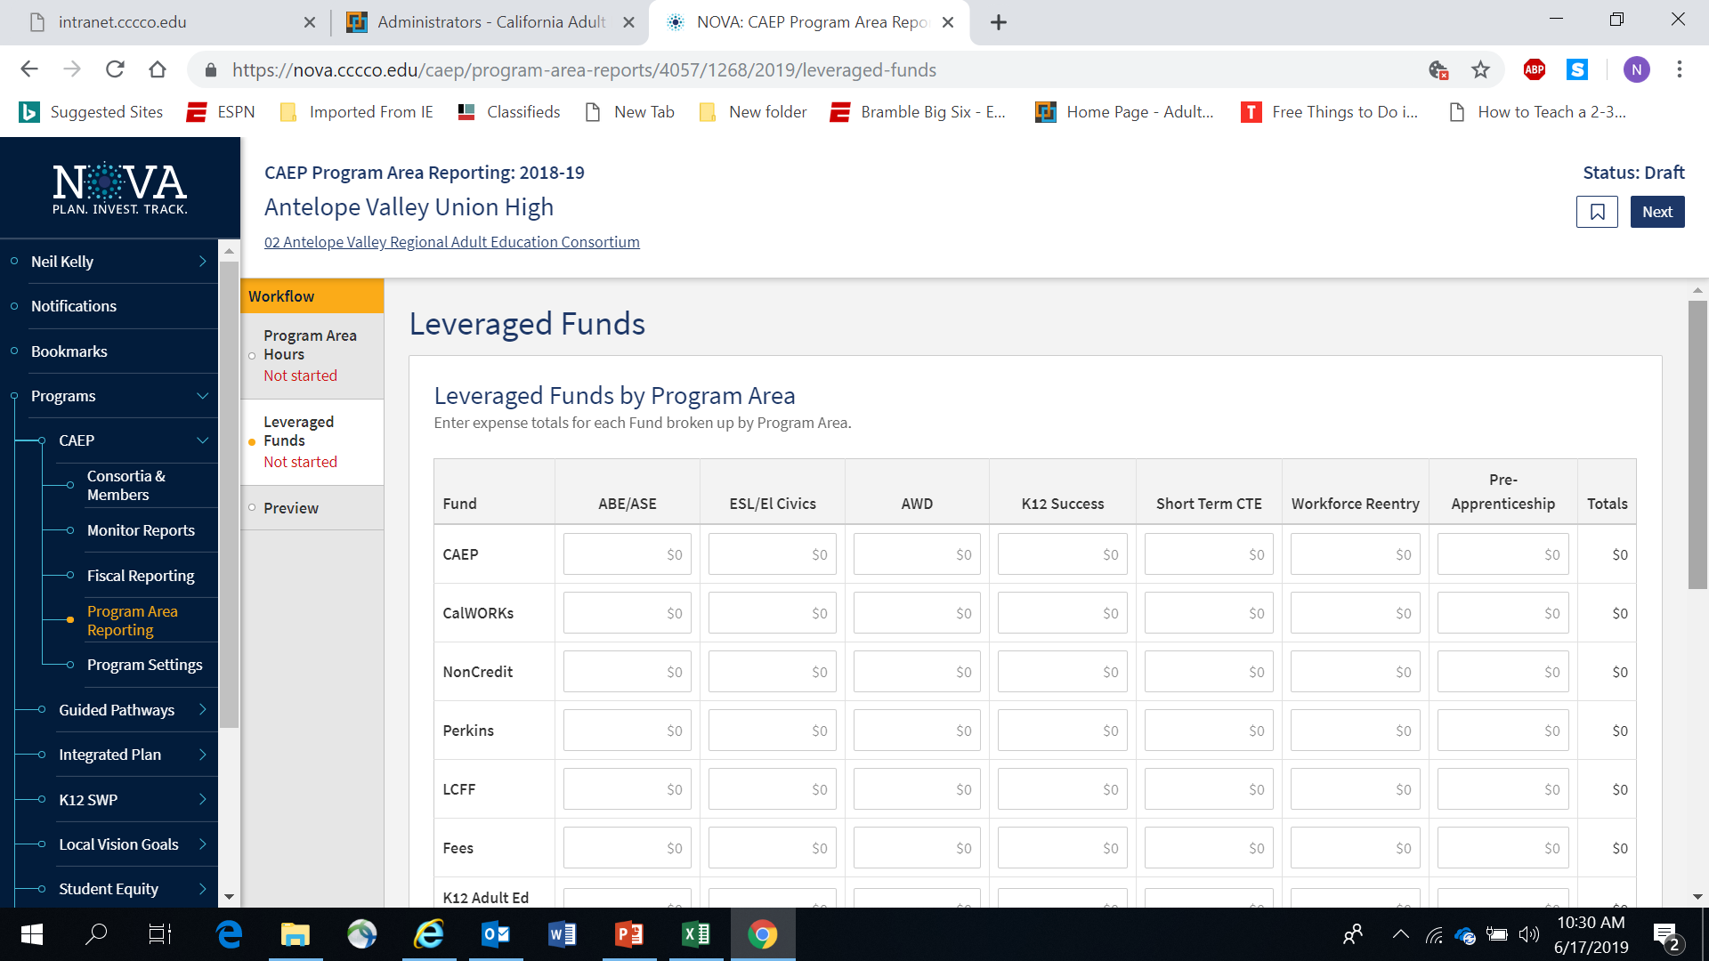
Screen capture of the Nova website indicating the Leveraged Funds page.

Slide 21
NOVA Program Area Reporting Timeline
September 1, 2019 – each consortia member will be asked to submit an estimated amount into for NOVA for the following:
  Program Year 18-19 – hours of instruction by program area.
  Program Year 18-19 – expenses by program area by fund source.

Slide 22
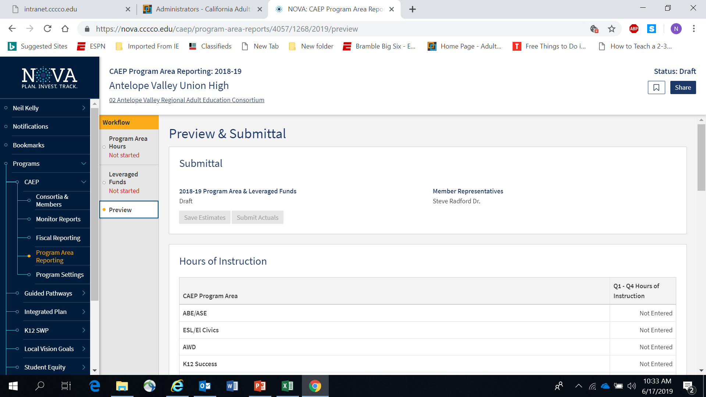
Screen capture of the Nova website indicating the Preview and Submittal page.

Slide 23
NOVA Program Area Reporting Timeline
December 1, 2019 – each consortia member will be asked to certify their amounts into for NOVA for the following:
  Program Year 18-19 – hours of instruction by program area.
  Program Year 18-19 – expenses by program area by fund source.

Slide 24
Screen capture of the Nova website indicating the Preview and Submittal page.

Slide 25
NOVA Program Area Reporting Updates
Program Area Clarification
Definition of an Instructional / Contact Hours
Integrated Course Hours Reporting
Service Hours
Reduction of the fund sources for reporting expenses
Alignment with WIOA on defining fees/program income and in-kind contributions

Slide 26
Reporting Changes for 18-19 Program Area Reporting in NOVA
Reporting of Program Areas
CAEP is still reported by the seven Program Areas.
But we want to avoid the duplication of hours between CTE and Workforce Reentry (now called Workforce Prep).
Workforce Reentry is not being used to collect barriers to employment (or characteristic demographics).

Slide 27
19-20 Reporting Changes
Tracking hours of instruction for integrated courses (ESL/CTE, ASE/CTE, ABE, CTE, etc.)
  For K12/COE:
  If a class is identified as integrated, the hours will be divided equally between the programs designated for that record.
  If not integrated, or if the hours are split unevenly – the agency can create two classes, one for each instructional program represented.
  For Colleges: Additional exploration is required to review how colleges are coding such courses.

Slide 28
19-20 Reporting Changes
Enrollment / Instructional Hours
What is the definition of an instructional hour?
An instructional hour must meet OCTAE guidelines and be associated with an instructional program. Thereby, service hours must not be commingled with instructional hours.

Slide 29
Contact Hours
Definition. Hours of instruction or instructional activity that the participant receives from the program. Instructional activity includes any program-sponsored activity designed to promote learning in the program curriculum, such as classroom instruction, assessment, tutoring, or participation in a learning lab. Time spent on assessment can be counted only if the assessment is designed to inform placement decisions, assess progress, or inform instruction. Time used simply to administer tests, such as the GED tests, cannot be counted as instructional activity.
https://www.nrsweb.org/sites/default/files/NRS_TA_Guide.pdf

Slide 30
19-20 Reporting Changes
Services/Service Hours
CAEP will not track service hours.
CAEP will only report instructional hours for NOVA program area reporting.

Slide 31
19-20 Reporting Changes
NOVA Program Area Reporting - expenditures
Use only the following fund sources for the program area expenditure reporting exercise: CAEP, WIOA II, Noncredit Apportionment, CalWORKs, Perkins, LCFF, & Jail Ed Funds, Fees, and In-Kind.
Eliminate or make optional several funds sources to report on for the program area report. (Contracted Services, Comm. College Supportive Services, Donations, WIOA I / ITAs, Other Federal Grants, Other State Grants, Strong Workforce).

Slide 32
19-20 Reporting Changes
Annual Program Area Reporting - expenditures
Align “in-kind” & donations with WIOA II reporting requirements.
Define “fee” using WIOA II definition (K12/COE only).

Slide 33
In-kind definition (federal regulations)
Under “Other Non-Federal and/or In-kind,” report contributions such as: Cash and designated foundation grants or other non-federal awards used for AEFLA programs Buildings, land, and donated property–classroom space must be valued at the fair rental rate of the space Volunteer services valued at rates paid for similar work in the local agency Donated books and supplies valued at the market rate Utilities and property maintenance valued at the market rate Cost sharing of equipment valued at the fair rental rate All resources must be verifiable from the local agency records. Additional details are provided in The Uniform Administrative Requirements, Cost Principles and Audit Requirements for Federal Awards. (2 CFR 300.306) * State General Funding: This encompasses any funds from the state budget used for Title II programs including funds from LCFF, AEBG, Charter School funds, Prop 98 money, state set aside funds for programs that fall within Title II.
https://www.ecfr.gov/cgi-bin/text-idx?SID=997b9bc1eeb1e71a99a78bd2d3b561b5&mc=true&node=se2.1.200_1306&rgn=div8

Slide 34
Program Income definition (federal regs)
Program Income/fees reporting is a WIOA Title II: AEFLA grant requirement. Program income is defined as 2 CFR 200.80 as “gross income earned by the non-Federal entity that is directly generated by a supported activity or earned as a result of the Federal award during the period of performance except as provided in §200.307 paragraph (f). (See §200.77 Period of performance.) Program income includes but is not limited to income from fees for services performed, the use or rental or real or personal property acquired under Federal awards, the sale of commodities or items fabricated under a Federal award, license fees and royalties on patents and copyrights, and principal and interest on loans made with Federal award funds. Interest earned on advances of Federal funds is not program income. Except as otherwise provided in Federal statutes, regulations, or the terms and conditions of the Federal award, program income does not include rebates, credits, discounts, and interest earned on any of them.” (2 CFR 200.80) Fees reported must be reasonable and necessary, equitably administered, and must not reach levels that adversely affect the participation of economically disadvantaged students. California Statutory Requirement (Management Bulletin: July 1, 2016) While federal regulations allow program fees to be collected, the California statute is more restrictive and governs the implementation of the AEFLA grant for local education agencies (LEAs) in California. Under California Education Code Section 52612, school districts may generally charge adult fees for adult classes, with the exception of a “charge of any kind” for classes in English, Citizenship and elementary subjects; and a “fee charge” for high school classes (including high school equivalency classes) taken by an adult without a high school diploma. This exception does not apply to non-LEAs. Note: Agencies must expend all program fees collected prior to encumbering or expending AEFLA grant funds. Funds from program income/fees must be disbursed to the program for which the fees were collected within the program year.
https://www.ecfr.gov/cgi-bin/text-idx?SID=997b9bc1eeb1e71a99a78bd2d3b561b5&mc=true&node=se2.1.200_1307&rgn=div8

Slide 35
NOVA Evaluation of Program Area Reporting
NOTE: The State CAEP Office realizes that these changes are being implemented at the end of the 18-19 program year.
If your members are still using the old guidance – they will not be penalized or have their data/fiscal submission rejected.
We hope that these changes will reduce the amount of work that each member will be required to do annually.

Slide 36

Immigrant Integration AB2098

Slide 37
AB 2098 – Immigrant Integration
Consortia may report additional measures for assessing the effectiveness of programs in meeting the needs of immigrant learners seeking integration in civic and community life.
An AB 2098 state workgroup, convened by the CAEP Office, provided a set of recommendations in June 2019. The CAEP Office will submit a report to the legislature on October 1, 2019, on additional measures to be collected as indicators of immigrant integration

Slide 38
AB 2098 – Immigrant Integration
Key Points About AB 2098:
We already serve this population
WIOA II grantees report EL Civics outcomes
EL Civics effectiveness is shown through these metrics
Most of the data is already there
This is not a mandate

Slide 39
AB 2098 – Immigrant Integration
The AB 2098 state workgroup identified key outcomes to be reported as indicators of immigrant integration.
These outcomes prioritize, but are not limited to - existing EL Civics COAAPs.
Many CAEP agencies already report EL Civics outcomes for WIOA Title II, and there are already systems in place to select and administer EL Civics COAAP’s – so there is not an increase in workload for most CAEP agencies.

Slide 40
Immigrant Integration Metrics
1 - Economic Security
2 – English Proficiency
3 – First Language Proficiency
4 – Credentials and Residency
5 – Health and Wellbeing
6 – Education and Career
7 – Children and Family
8 – Civic and Community Participation
9 – Digital Literacy
10 – Self Efficacy and System Navigation

Slide 41
Sample Alignment – AB 2098 and EL Civics
Integration Metric as per AB 2098 | EL CIVICS COAAPS (COAAP #)
Improved English proficiency | *This metric can already be measured using the CAEP literacy gains outcome*
Increased economic security | Health Insurance (EL Civics Objective 26) Obtain housing (4) Rental Agreements (5) Tenant Rights (6) Banking (1)
Increased credentials and residency | Immigrant Rights/Agencies (19) Voting/Political Process (39) Environmental Issues (43) Research/address community issues (8) Workers' Rights (35) Safety (37)
Increased health and well-being | Access health care (28) Access substance abuse treatment (31) Keep family and home safe (7) Understand medication usage (30)

Slide 42
What We Are Working On….
Implementing the workgroup recommendations.
Creating reports in TE that align to Immigrant Integration metrics and outcomes .
Creating downloadable reports to see how your current co-applications match up to the Immigrant Integration framework (see prior slide).

Slide 43
Immigration Integration Down the Road….
Create a community-level needs assessment and overall strategy and program development.
Emphasize that we serve students that identify as immigrants in all CAEP programs, not just ESL.
Use strategies such as education planning, counseling, partner involvement, etc.
Think about redesigning how we approach the adult student – welcome centers, serving the whole student and their needs, touch points, etc.

Slide 44

MIS Reporting for CAEP 19-20

Slide 45
MIS Reporting for CAEP 19-20
For 19-20, California Community College Districts (CCDs) are required to use the Chancellor’s Office Management Information System (COMIS or MIS) to enter their noncredit adult learner demographics, barriers, services received and program outcome information.
Enrollment, demographics, barriers, and most student outcomes for noncredit adult education students rely on data entered into the MIS system almost exclusively to populate the LaunchBoard Adult Education Pipeline and exclusively to populate the metrics in the new Student Success Metrics dashboard for Adult Ed/ESL student journey.

Slide 46
MIS Reporting for CAEP 19-20 (cont. 1)
MIS is a term-based system. CAEP will pull data from the state level MIS that is provided each semester by the community colleges
There are no separate reporting deadlines for data collected and entered into MIS.
Colleges should capture all data relevant to their students and ensure it is entered completely into their local MIS system.
Colleges will submit their adult education data through their colleges’ regular data uploads to the Chancellor’s Office. There is no separate submission of MIS data to the Chancellor’s Office for adult education students.

Slide 47
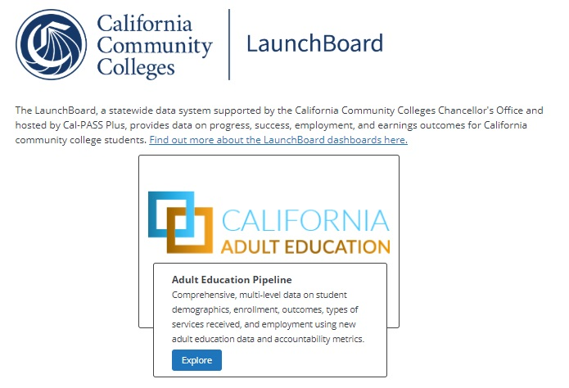
MIS CAEP Program Metric Definitions for 18-19

Slide 48
MIS Technical Details for CAEP 18-19
Community colleges must make sure their local MIS has the appropriate course and student information to identify valid enrollment in each CAEP program.
For the 2012-13 through 2018-19 years of data, the following MIS Data Elements are used or will be used in metrics displayed on the Adult Ed dashboard (AEP) for ESL, ABE, ASE, CTE, AWD and K12:
CB03 COURSE-TOP-CODE
CB04 COURSE-CREDIT-STATUS
CB09 COURSE-SAM-PRIORITY-CODE
CB21 COURSE-PRIOR-TO-COLLEGE-LEVEL
CB22 COURSE-NONCREDIT-CATEGORY
GI03 TERM-IDENTIFIER
SB00 STUDENT-IDENTIFIER
SB23 STUDENT-APPRENTICESHIP-STATUS
STD1 STUDENT-AGE-AT-TERM
SX05 ENROLLMENT-POSITIVE-ATTENDANCE-HOURS
Notes:
Added precision of years displayed

Slide 49
MIS Technical Details for CAEP 18-19
A student must FIRST meet the criteria below to be included as an Adult Education Participant.
Adult Education Participant:
An adult education student age 16+
WHERE SB00 has the following: MIN(STD1) ≥ 16
With a valid noncredit enrollment
AND [CB04 = N
AND SX05 ≥ 12]
In the selected year
AND GI03 is within the selected year

Slide 50
MIS Technical Details for CAEP 18-19 (cont. 1)
Adult Education Participants in ESL or ABE Programs:
English as a Second Language (ESL)
Who enrolled in noncredit ESL in the selected year
WHERE CB04 = N AND
[CB22 IN (A, B) OR
CB03 IN (4930.84, 4930.85, 4930.86, 4930.87, 4930.90, 4931.00)]
Adult Basic Education (ABE)
Who enrolled in ABE in the selected year
WHERE CB04 = N AND
[CB03 IN (1701.00, 1501.00, 1520.00) AND
CB21 IN (D, E, F, G, H)]

Slide 51
MIS Technical Details for CAEP 18-19 (cont. 2)
Adult Education Participants in ASE or AWD Programs:
ASE Students
Who enrolled in ASE in the selected year
WHERE CB04 = N AND
[CB03 IN (1701.00, 1501.00, 1520.00) AND
CB21 IN (A, B, C)]
For Adults with Disabilities (AWD):
Participants Who enrolled in programs specifically designed to meet the needs of adults with disabilities in the selected year
WHERE CB22 = E
(Note: “E” indicates Substantial Disabilities on any TOP code)

Slide 52
MIS Technical Details for CAEP 18-19 (cont. 4)
Adult Education Participants in CTE Programs (Workforce Prep, Short-Term CTE, or Pre-Apprenticeship)
Who met ONE of the following CTE Criteria in the selected year:
Either enrolled in a Workforce preparation course
WHERE CB22 = J
Or enrolled in Short-Term CTE in courses flagged as vocational by TOP code or as occupational by SAM code
OR [CB03 = “*” in TOP_VE_STATUS table
OR CB09 IN (A, B, C)]
Or is identified as a student in a Pre-apprenticeship program
OR WHERE SB23 = 2
Notes:
In a meeting with Kathy and Randy this week, we decided to eliminate the 9 unit threshold for short-term CTE

Slide 53
MIS Technical Details for CAEP 18-19 (cont. 3)
Adult Education Participants in Adult Training to Support Child School Success (K12 Success):
Participants Who Enrolled in Parenting courses for parents of children in elementary or secondary education in the selected year
WHERE CB22 = F
(Note: F is "Parenting" for the following TOP codes 130500-130590 and 130800)
Since AB104 Legislation limits K12 parenting to elementary and secondary students, only the following TOP codes will be included for this metric on the AE 3.0 dashboard:
1305.20 Children with Special Needs
1305.50 The School Age Child
1305.60 Parenting and Family Education
1305.70 Foster and Kinship Care
1308.00 Family Studies

Slide 54
MIS Technical Details for CAEP 19-20
NEW MIS Data Elements potentially for 2020-2021 to be used in metrics displayed on CAEP:
SA07 STUDENT-EDUCATIONAL-FUNCTION-LEVEL
New element for GED and HS diploma
New course flag for pre-apprenticeship
Note: SA07 is for reporting math and English EFLs and logic check between SA01 and SA07 needs to be removed; so, all EFLs can be reported
DISCLAIMER: discussions in currently progress with MIS. Nothing has been finalized yet.

Slide 55
MIS 19-20 Exceptions
Regardless of whether colleges report data through TOPSpro® Enterprise for WIOA TITLE II, colleges are also expected to capture and enter all student data elements into their MIS system.
Failure to enter all student data into MIS could result in underreporting of student data in the LaunchBoard, the Student Success Metrics, and in end of year reporting to the legislature.
The notable exceptions to this include the attainment of Educational Functioning Levels and Secondary Certificates (high school diploma), which use the data entered in both MIS and submitted through TOPSpro® Enterprise.

Slide 56
Final MIS clarification
The CAEP system captures virtually all the WIOA II student data through TE already sent over for CAEP.
CAEP just adds in specific program data for students enrolled in programs not reported in WIOA II data.
The TE data file for CAEP is not two separate data sets.

Slide 57
Final MIS clarification (cont.)
BUT…..
CCDs that receive WIOA II funding for services under the Adult Education and Family Literacy Act (AEFLA) are required to collect and report adult learner demographics, barriers, and program outcomes for their WIOA II funded programs and students using TOPSpro® Enterprise.
In addition, CCDs receiving WIOA II funding must enter all adult learner demographics, barriers, and program outcomes into their MIS system.
Finally, CCDs that are WIOA Title II grantees will continue to collect and report CASAS assessment results using TOPSpro® Enterprise.

Slide 58

Adult Education Launchboard and Student Success Dashboard

Slide 59
Adult Education Launchboard
Data Elements & Outcomes:
  Adult Served
  Enrollment (1 hr. to 12 hrs.) by program area (being added this year)
  Enrollment (12 hrs. or more) by program area
  Adults Served Services Only
  Demographics
  Barriers to Employment
  Measurable Skills Gain – by Educational Functional Level
  Students who complete a CTE a workforce preparation course or training milestone or occupational skills gain
  Student Transition to Post-Secondary and/or Adult Secondary Education
  Students who earn a high school diploma or high school equivalency
  Students who earn a post secondary CTE certificate
  Students who complete a post secondary credential
  Number of students employed and change in earnings
  Number of students who attained the living wage and median annual earnings

Slide 60
Adult Education Launchboard – WIOA II grantees
Data Elements & Outcomes:
  Adult Served
  Enrollment (1 hr. to 12 hrs.) by program area (being added this year)
  Enrollment (12 hrs. or more) by program area
  Adults Served Services Only
  Demographics
  Barriers to Employment
  Measurable Skills Gain – by Educational Functional Level
  Students who complete a CTE a workforce preparation course or training milestone or occupational skills gain
  Student Transition to Post-Secondary and/or Adult Secondary Education
  Students who earn a high school diploma or high school equivalency
  Students who earn a post secondary CTE certificate
  Students who complete a post secondary credential
  Number of students employed and change in earnings
  Number of students who attained the living wage and median annual earnings

Slide 61
Adult Education Launchboard – CCD’s non- WIOA II grantees (using SA07 – pre/post testing)
  Adult Served
  Enrollment (1 hr. to 12 hrs.) by program area (being added this year)
  Enrollment (12 hrs. or more) by program area
  Adults Served Services Only
  Demographics
  Barriers to Employment
  Measurable Skills Gain – by Educational Functional Level
  Students who complete a CTE a workforce preparation course or training milestone or occupational skills gain
  Student Transition to Post-Secondary and/or Adult Secondary Education
  Students who earn a high school diploma or high school equivalency
  Students who earn a post secondary CTE certificate
  Students who complete a post secondary credential
  Number of students employed and change in earnings
  Number of students who attained the living wage and median annual earnings

Slide 62
Adult Education Launchboard – CCD’s non- WIOA II grantees (using course progression for EFLs)
Adult Served
Enrollment (1 hr. to 12 hrs.) by program area (being added this year)
Enrollment (12 hrs. or more) by program area
Adults Served Services Only
Demographics
Barriers to Employment
Measurable Skills Gain – by Educational Functional Level
Students who complete a CTE a workforce preparation course or training milestone or occupational skills gain
Student Transition to Post-Secondary and/or Adult Secondary Education
Students who earn a high school diploma or high school equivalency
Students who earn a post secondary CTE certificate
Students who complete a post secondary credential
Number of students employed and change in earnings
Number of students who attained the living wage and median annual earnings

Slide 63
Student Success Dashboard for CCD’s
Data Elements & Outcomes:
  Adult Participants (12 hrs. or more) Enrolled by Program
  Enrollment (1 hr. to 12 hrs.) by program area
  Demographics
  Successful Enrollment (CCC Apply data)
  Measurable Skills Gain – by Educational Functional Level (if fixed)
  Student Transition to Post-Secondary and/or Adult Secondary Education
  Students who earn a high school diploma or high school equivalency
  Students who earn a post secondary CTE certificate
  Students who complete a CTE a workforce preparation course or training milestone
  Students who complete a post secondary credential
  Number of students who secured employment
  Median annual earnings and median change in earnings

Slide 64

TOPSPro Enterprise (TE) Reporting for 19-20

Slide 65
Enrollment Instructional Hours
How do we track hours of instruction for integrated courses (ESL/CTE, ASE/CTE, ABE, CTE, etc.)?
  For K12/COE:
  If a class is identified as integrated, the hours will be divided equally between the programs designated for that record.
  If not integrated, or if the hours are split unevenly – the agency can create two classes, one for each instructional program represented.
  For Colleges: Additional exploration is required to review how colleges are coding such courses.

Slide 66
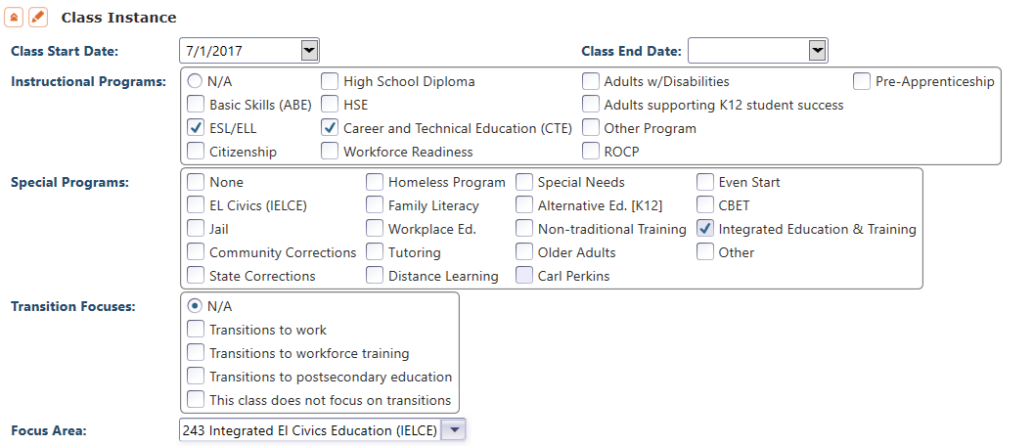
Enrollment Instructional Hours
You can mark multiple instructional programs in the TE Class Instance record for classes that address more than one CAEP instructional program.

Slide 67
Contact Hours
Definition. Hours of instruction or instructional activity that the participant receives from the program. Instructional activity includes any program-sponsored activity designed to promote learning in the program curriculum, such as classroom instruction, assessment, tutoring, or participation in a learning lab. Time spent on assessment can be counted only if the assessment is designed to inform placement decisions, assess progress, or inform instruction. Time used simply to administer tests, such as the GED tests, cannot be counted as instructional activity.
https://www.nrsweb.org/sites/default/files/NRS_TA_Guide.pdf
(p. 57 of NRS online technical assistance guide)

Slide 68
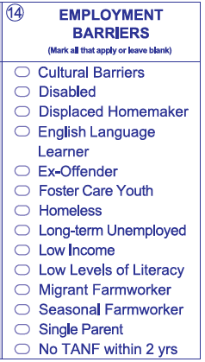
Student Barriers to Employment
Agencies will record barriers to employment for all CAEP students at intake.
CAEP student barriers and their definitions will align with federal WIOA II barriers to employment.
As part of the federal alignment, ABE/ASE and ESL learners will automatically tie into specific barriers
For Workforce Preparation/Workforce Re-Entry – learners are no longer tied to any specific barriers, and no longer tied to 55 + years of age.

Slide 69
Student Barriers to Employment
For WIOA II –
  OCTAE has identified ABE/ASE enrollees by definition as having the Low Levels of Literacy barrier
  All ESL/ELL learners are defined as Low English Literacy/English Language Learner.
  Cultural Barriers also relates to WIOA Title II, but is not directly aligned to a particular program.

Slide 70
Student Barriers to Employment
For Workforce Preparation/Workforce Re-Entry:
Learners are no longer tied to any specific barriers
No longer automatically assigned if 55 + years of age.

Slide 71
Quick Review of Federal Metrics and
Alignment to CAEP Outcomes

Slide 72
WIOA Performance Indicators
WIOA uses Performance Indicators to evaluate program and student/participant performance.
Employment after 2Q
Employment after 4Q
Median Earnings
Credential Attainment Rate
Measurable Skill Gains (MSG)
Effectiveness to Employers
One of these Performance Indicators is Measurable Skill Gains (MSG). WIOA defines five different MSGs to monitor progress and results.
Notes:
The Workforce Innovation and Opportunity Act (WIOA) includes six performance indicators, including five Measurable Skill Gains (MSGs), to monitor participant progress.
States must report performance for the required indicators and measures on all participants, who are defined as individuals who receive 12 hours or more of service.
The U.S. Departments of Labor and Education use the WIOA indicators to evaluate State performance and negotiate expected levels of performance.

Slide 73
WIOA Measurable Skills Gains (MSGs)
Notes:
Literacy Gains/Educational Functioning Level (EFL)
Secondary Diploma/Credential
Post-Secondary Credential
Training Milestone
Skills Progression/Passage of an Exam

Slide 74
WIOA Alignment to AB 104
The WIOA Performance Indicators, along with the 5 types of MSG, comprise the framework for the six AB 104 outcomes:
Indicators:
Employment
Wages
MSGs:
Literacy gain
Secondary
Post-Secondary
Training Milestone
Skills Progression
AB 104 Outcomes:
Improved literacy skills
Completion of high school diplomas or their recognized equivalents
Completion of postsecondary
Placement into jobs
Improved wages
Post Secondary Transition

Slide 75
CAEP Outcomes
Literacy Gains
HSE/HS Diploma
Post-Secondary
Enter Employment
Increase Wages
Transition
Pre/Post Level Completion
Carnegie Units /HS Credits
CDCP Certificate
Occupational Skills Gain
Workforce Preparation
High School Diploma
Passed GED
Passed HiSET
Passed TASC
College Degree – AA, AS, BA, BS
Graduate Studies
Training Credential
Occupational Licensure/Certificate
Apprenticeship
Get a Job
Retain a Job
Enter Military
Increase Wages
Get a Better Job
Transition to ASE
Transition to Post-Secondary/CTE
Transition to Post-Secondary/College

Slide 76
WIOA Performance Indicators and CAEP Outcomes
Employment after 2Q
Employment after 4Q
Median Earnings
Credential Attainment Rate
Measurable Skill Gains (MSG)
Effectiveness to Employers
Enter Employment
Increase Wages
HSE/HS Diploma
Transition
Post-Secondary
Literacy Gains
Notes:
The Workforce Innovation and Opportunity Act (WIOA) includes six performance indicators, including five Measurable Skill Gains (MSGs), to monitor participant progress.
States must report performance for the required indicators and measures on all participants, who are defined as individuals who receive 12 hours or more of service.
The U.S. Departments of Labor and Education use the WIOA indicators to evaluate State performance and negotiate expected levels of performance.

Slide 77
WIOA MSGs and CAEP Outcomes
HSE/HS Diploma
Post-Secondary
“Literacy Gains” for CTE
Transition
Literacy Gains
Notes:
Literacy Gains/Educational Functioning Level (EFL)
Secondary Diploma/Credential
Post-Secondary Credential
Training Milestone
Skills Progression/Passage of an Exam

Slide 78
CAEP Outcomes
Literacy Gains
HSE/HS Diploma
Post-Secondary
Enter Employment
Increase Wages
Transition
Pre/Post Level Completion
Carnegie Units /HS Credits
CDCP Certificate
Occupational Skills Gain
Workforce Preparation
High School Diploma
Passed GED
Passed HiSET
Passed TASC
College Degree – AA, AS, BA, BS
Graduate Studies
Training Credential
Occupational Licensure/Certificate
Apprenticeship
Get a Job
Retain a Job
Enter Military
Increase Wages
Get a Better Job
Transition to ASE
Transition to Post-Secondary/CTE
Transition to Post-Secondary/College

Slide 79
Literacy Gains
Literacy Gains
AEBG Outcome | Recording Method
Pre/Post-Test Gains | Enter pre/post-test results
Carnegie Units | No “bubble” but via self reported level
CDCP Certificate | Mastered course competencies Skills Progression
Occupational Skills Gain | Met Work based Project Training Milestone
Workforce Preparation | Acquired Workforce Readiness

Slide 80
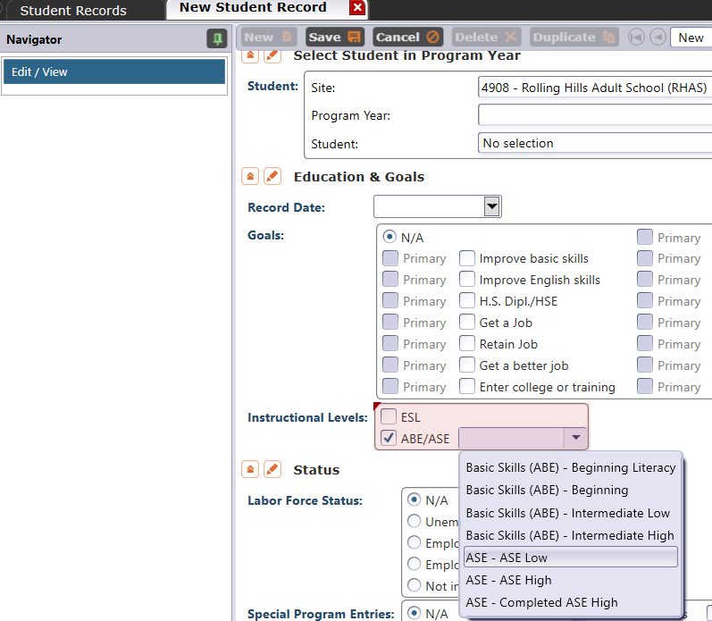
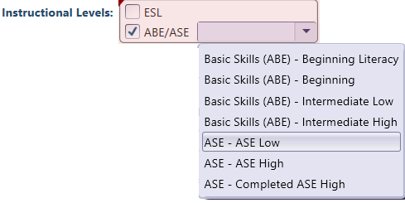
Literacy Gains – HS Credits
In TE, go to Records – Students – Records and refer to Instructional Levels:
Select ASE Low upon enrollment
Select ASE High later in the year once student progresses to the 11th or 12th grade level

Slide 81
Training Milestone
Participant is in an education or training program and accomplishes one or more of the following:
  Masters specific job skills or steps required for that job
  Receives pay increase
  Attains performance increase on the job
  Completes one apprenticeship program
  Completes other locally defined work outcome

Slide 82
Passing Knowledge-Based Exam
The Skills Progression MSG has now been replaced by Passage of an Exam.
Learner passes an exam during the year that is required for a job, or that demonstrates progress in attaining technical or occupational skills.
Exam can be a hands on occupational skills demonstration, written test, standardized pre/post-test, or other method of assessment that clearly demonstrates skill progression or attainment.

Slide 83
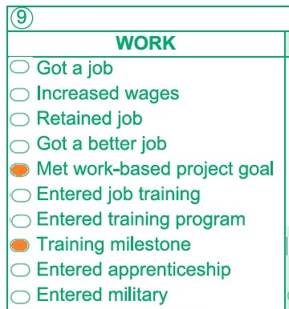
MSG’s for CTE
The Passage of Exam Measurable Skills Gain for WIOA I will align with the CAEP Occupational Skills Gain
  When a student achieves an Occupational Skills Gain, that now entails that the student passes an exam such as work skills demonstration, written test, or standardized pre/post-test

Slide 84
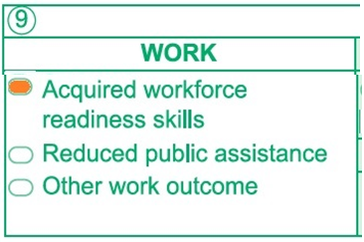
MSG’s for CTE
The Passage of Exam Measurable Skills Gain for WIOA I will align with the CAEP Workforce Preparation Outcome
  Workforce Preparation Outcome should include some documentation of work skills progression or attainment.

Slide 85
Literacy Gains – CTE Related Outcomes
Occupational Skills Gain:
Usually suggests accomplishment of a portion of a longer term program
  For example: a student enrolls in a long term welding program in CTE, which is five semesters/five modules long. The student passes a skills check/written test that indicates the student is ready to finish Module I and enroll in Module II.
Workforce Prep Outcome:
Usually suggests completion of a shorter term program
  For example: a student enrolls and completes a 15 hour instructional module on job search strategies. The student earns documentation such as an informal certificate at the end of the instructional module.

Slide 86
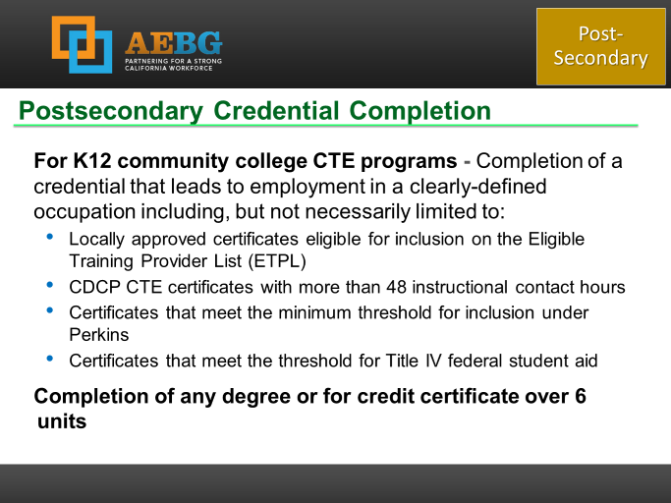
Occupational Outcomes: Post-Secondary vs. Literacy Gains
Post-Secondary:
Attained Credential
Occupational licensure
Occupational certificate
Literacy Gains:
Occupational Skills Gain
Workforce Prep Milestone
Post-Secondary =
Completion of a longer term program
“Literacy Gains” =
Partial completion of a longer term program
Completion of a shorter term program

Slide 87
Transition
Transition
AEBG Title | Update Record
Transition to ASE | No “bubble” but via instructional program
Transition to Post-Secondary/CTE | Entered job training Entered training pgm Entered apprenticeship
Transition to Post-Secondary/College | Enrolled in secondary Transition to credit

Slide 88
Transition
From:
To:
K12 Adult Education
(ABE, ASE, ESL)
K12 Adult Ed CTE
CC CTE
Non Credit CC
(ABE, ASE, ESL)
For Credit CC
Transition to CTE
Transition to for credit

Slide 89
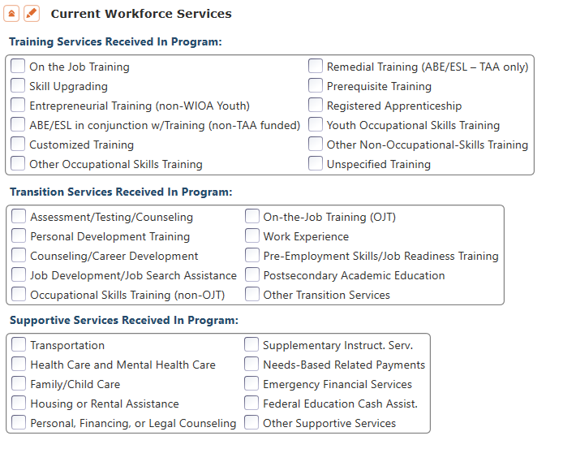
CAEP Short Term Services
Record short term services such as counseling or mentorship that may be received outside of the classroom.
Supportive Services
Training Services
Transition Services

Slide 90
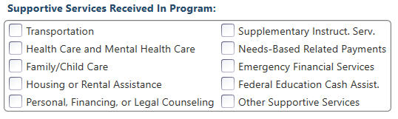
Supportive Services
Services that better enable an individual to participate in adult education activities, or related activities such as WIOA Title I -- such as transportation, child care, dependent care, housing, and personal needs

Slide 91
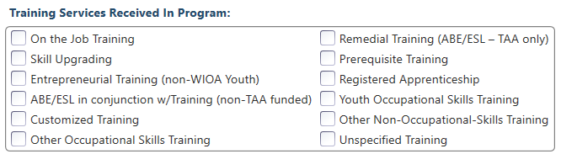
Training Services
Services that help individuals:
Select programs that relate to economic priorities in local planning region
Enroll/meet minimum qualifications for longer term employment and/or employment training programs
Services administered to individuals who have been determined to:
Be unlikely to obtain/retain employment
Be in need of additional services in order to attain economic self-sufficiency/permanent employment
Have skills sufficient to enroll in appropriate training program that provides skills necessary for self-sufficiency

Slide 92
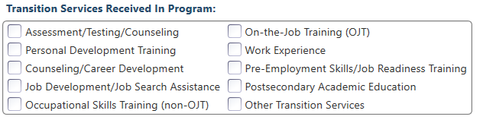
Transition Services
Services that help individuals:
Facilitate successful transition from school to postsecondary life, such as attaining employment, enrolling in college, or accessing designated pre-employment transition services.
Provide opportunities to receive training and other services necessary to achieve competitive employment or postsecondary enrollment

Slide 93
CAEP Short Term Services
Supportive Services
Transition Services
Training Services
Transportation
Child Care
Personal Counseling
Financial Assistance
Assessment (other than required pre/post)
Academic/Career Counseling
Job Development
Student Orientation
Community Support Training (OSHA, CPR, etc.)
Prerequisite Training

Slide 94
Review of CAEP Reports & Outcomes

Slide 95
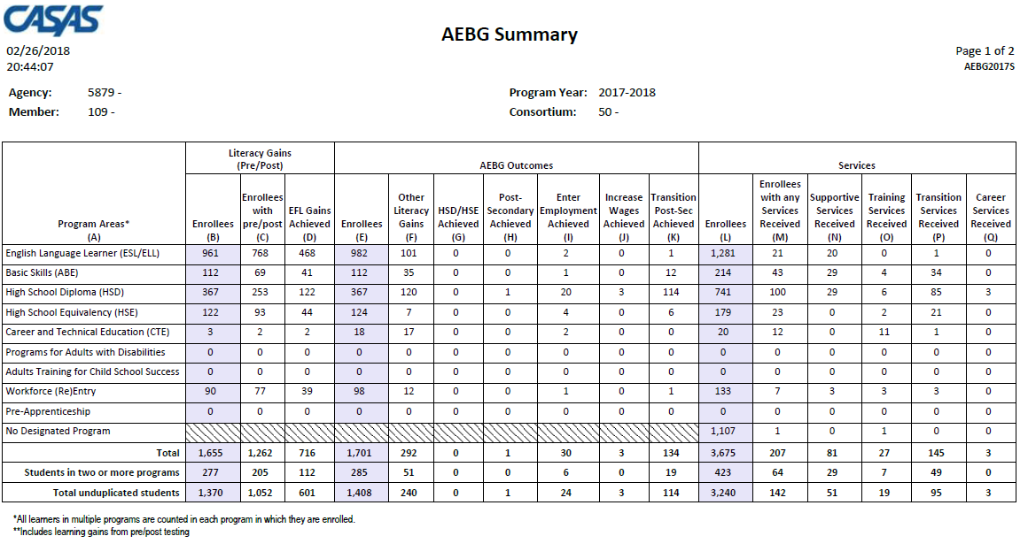
AEBG Summary
Displays outcomes in three separate sections:
Literacy Gains (Pre/Post) using NRS Table 4 guidelines
Other AB 104 outcomes using WIOA II reporting requirements but not pre/post
Services Received that do not impose WIOA II reporting requirements

Slide 96

Learner Results and WIOA Milestones
Literacy Gains
Employment
Secondary
Wages
Post-Secondary
Transition

Slide 97
In TE go to Records--Students--Records

Slide 98
CAEP Statewide Enrollment
Recorded students that make it to 1 hour of instruction
(Program Enrollment)
          Statewide percentage = 77%.
Recorded students that make it to 12 hours or more of instruction
          Statewide percentage = 63%.
Students with 1 hour of instruction that make it to 12 hours of instruction (and eligible to earn CAEP outcomes)
(Program Persistence)
          Statewide percentage = 82%.

Slide 99
Performance and Persistence Questions
Of those students with any AEP activity, how many enrolled in an instructional program? (Column L on AEP Summary)
Of those with program enrollment, how many students reached at least 12 hours of instruction? (Compare Columns E and L)
Of those who qualified for outcomes with 12+ hours, how many students achieved outcomes? (Columns E-K)
Of those who qualified with 12+ hours, how many students completed a pre/post-test pair? Of those, how many achieved a level gain? (Columns B-C)

Slide 100
Measure Agency and Consortium Level Performance and Persistence:
Measure persistence by determining percentage of students with any AEP activity that achieve official AEP program enrollment by enrollment in a class and with at least one hour of instruction
Measure persistence by determining percentage of students with AEP program enrollment that receive at least 12 hours of instruction?
Measure performance by calculating percentage of learners with 12 hours of instruction that achieved at least one official AEP outcome
Measure persistence by calculating percentage of learners with 12 hours of instruction with a pre- and post-test pair
Measure performance by computing percentage of learners with 12 hours of instruction that achieve a pre/post-test level gain

Slide 101
Updates to Resources and Materials

Slide 102

BOY Letter for PY 2019-20
Sent out mid August… this letter includes the data submission requirements for all CAEP agencies.

Slide 103
Data Submission Calendar
AEBG Program Year Reporting
 | Date Range | Reporting Deadline
First Quarter | July 1 – Sept 30 | October 31, 2019
Second Quarter | July 1 – Dec 31 | January 31, 2020
Third Quarter | July 1 – Mar 31 | April 30, 2020
Fourth Quarter-EOY | July 1 – June 30 | August 1, 2020

Slide 104
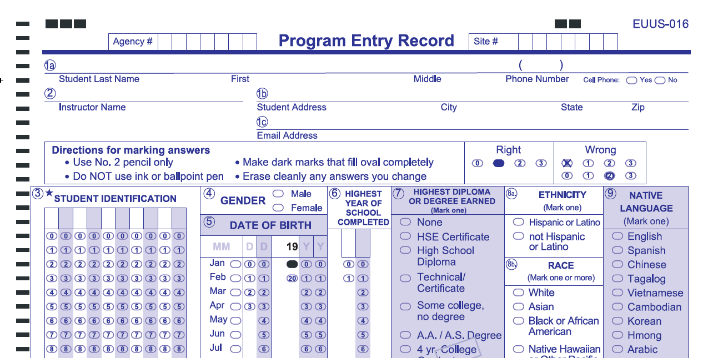
New EUUS-019 form implemented July 1, 2019
Includes three selections in gender field
Updates DOB and record date fields
Documents learner enrollment, and continues WIOA compliance that began July 1, 2016
Notes:
Note starred fields

Slide 105
CASAS Assessments
Authorized for NRS for 2019-20
ABE and ASE only:
CASAS GOALS Reading and Math
ESL only:
Life and Work Listening
Life and Work Reading
Secondary Level Assessment (SLA):
  Language Arts 513-14
POWER, AA-AAAAA not authorized for NRS, but are authorized for CA reporting

Slide 106


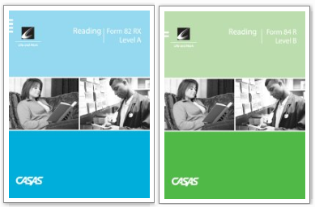

Use of Assessment Modalities
ABE/ASE: Use Reading or Math CASAS GOALS series
ESL: Use Life and Work Reading or Listening

Slide 107
Use of Assessment Modalities
ABE/ASE: Use Reading or Math GOALS series
Pre- and post-test pairs must always be from the same test modality.
If using CASAS GOALS, both the pretest and the post-test must use the same test series. Cannot match GOALS with any other CASAS test series.

Slide 108
CASAS GOALS
New GOALS series
    Reading approved in February 2018
    Math approved March 2019
    Currently aligning Reading for ELL
    Listening in development
Strongly aligned with College and Career Readiness (CCR) Standards for Adult Education
      Reading – assesses higher order thinking skills (Depth of Knowledge), complex informational text, and vocabulary, including academic language
      Math – math concepts assessed via common life and work applications
    Computer and paper administered
    All NRS levels will be covered in 4 test levels
Notes:
PRESENTER/TRAINER NOTES: Linda

Slide 109

CAEP TAP
The AEBG Technical Assistance Program (TAP) provides professional development resources for all CAEP agencies statewide.
https://caladulted.org/
tap@aebg.org

Slide 110
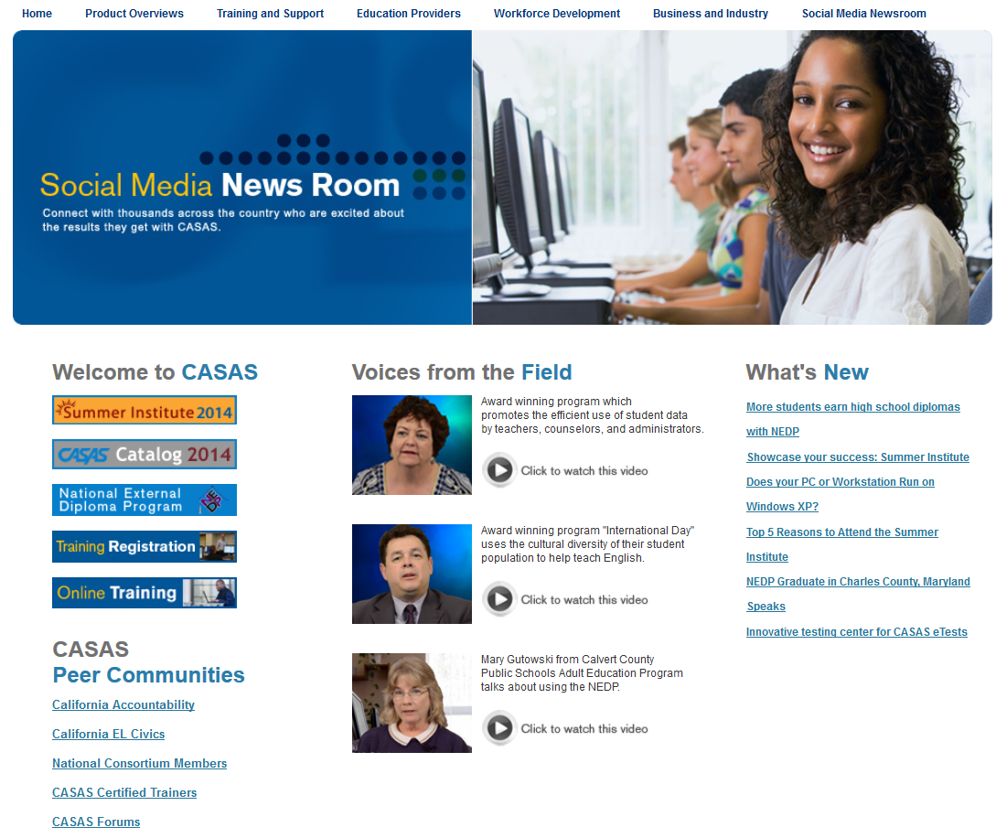
CASAS Web Site
What’s New
Online Registration
California Accountability
AEBG Web page
CASAS Forums
Download Centers
www.casas.org

Slide 111
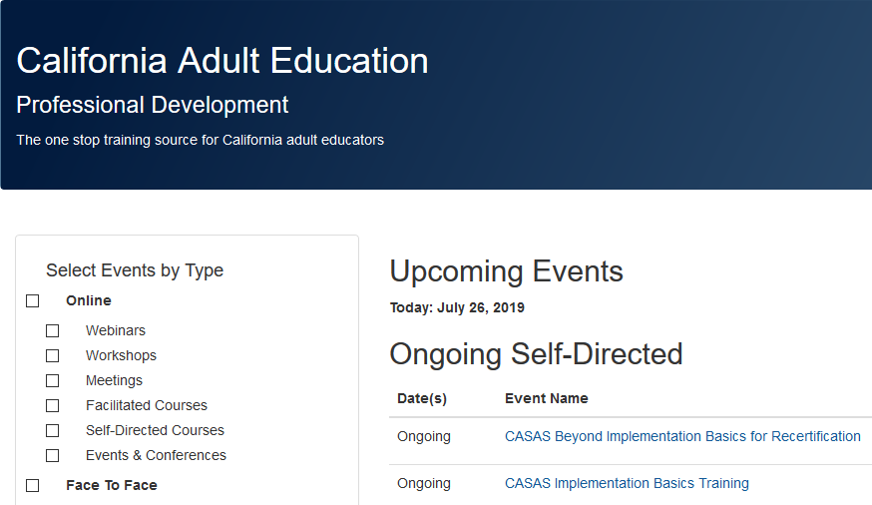
Online Training Registration
Register for all face to face and Web-based trainings on the CAEP TAP Website:
https://www.caadultedtraining.org/

Slide 112
Regional Training Dates
August 7 – Mt Diablo (9am to 12noon)
August 13 – North Orange (9am to 12noon)
September 11 – Fresno (9am to 12noon)
September 25 – Burbank (9am to 12noon)
October 1 – San Mateo (12:30pm to 3:30pm)
October 10 – Sacramento (9am to 12noon)
October 28 –Vista Adult (11am to 2pm)
November 21 – San Bernardino (9am to 12noon)

