Slide 1
CAEP 19-20 Program Changes
July 2019

Slide 2
Changes
Student Data Reporting for CAEP in TOPSPro Enterprise and MIS.
Beginning of the Year Letter will be released in August.
Program Area Reporting – by program area by hours, and by program area by expenditures in NOVA.
NOVA programming letter will be released in August.

Slide 3
Summary of Changes
Workforce Reentry is now called Workforce Preparation.
Still defined as “Programs for adults, including, but not limited to, older adults, that are primarily related to entry or reentry into the workforce”.
CAEP will not track service hours in 19-20.
Agencies will record student barriers at intake.
The Passage of Exam Measurable Skills Gain for WIOA I will align with the CAEP Occupational Skills Gain and Workforce Preparation Outcome.
NOVA Program Area Reporting clarification for 18-19.

Slide 4
Student Data Reporting Changes for 19-20

Slide 5
19-20 Reporting Changes
For district/agency reporting of Program Areas
CAEP will continue to have the Seven Program Areas: ABE/ASE, ESL, Short-term CTE, Workforce Prep, Pre-Apprenticeship, AWD, and K12 Student Success
Workforce Reentry will be redefined as Workforce Preparation.
“Programs for adults, including, but not limited to, older adults, that are primarily related to entry or reentry into the workforce”.

Slide 6
19-20 Reporting Changes
For State Level Reporting of Program Areas
LaunchBoard (State Level)
Legislative Reports
Five Main Program Areas: ABE/ASE, ESL, CTE, AWD, and K12 Student Success
CTE – will include subcategories for Short Term CTE, Workforce Preparation, and Pre-apprenticeship
Workforce Reentry will be redefined as Workforce Preparation.

Slide 7
19-20 Reporting Changes
Enrollment / Instructional Hour Definitions
“Adults Served” is a required reporting category in AB104 and will be a summary count of anyone with at least 1 instructional contact hour or who received a service.
“Adults Served” will be disaggregated in counts by CASAS and the LaunchBoard to identify ‘service only’ students, students receiving 1-11 instructional contact hours, and ‘participants’ who received 12 or more instructional contact hours over a single program year.

Slide 8
19-20 Reporting Changes
Services/Service Hours
CAEP will not track service hours.
In other integrated reporting frameworks for services it is more common to report service contacts and type of service delivered than hours.
Tracking service contact types and how those align with student outcomes is an area that the CAEP State Office will continue to explore.

Slide 9
19-20 Reporting Changes
Student Barriers to Employment
Agencies will record student barriers at intake.
CAEP student barriers and their definitions will align with federal WIOA II barriers to employment.
For WIOA II – OCTAE has identified ABE/ASE enrollees by definition as having the Low Literacy Skills barrier, and all ESL/ELL learners as Low English Literacy.

Slide 10
19-20 Reporting Changes
WIOA I / CAEP Alignment – Occupational Skills Gain
The Passage of Exam Measurable Skills Gain for WIOA I will align with the CAEP Occupational Skills Gain and Workforce Preparation Outcome
When a student achieves an Occupational Skills Gain, that now entails that the student passes an exam such as work skills demonstration, written test, standardized pre/post-test, etc.
Workforce Preparation Outcome should include some documentation of work skills progression or attainment.

Slide 11
WIOA I Passing Knowledge-Based Exam
The Skills Progression MSG has now been replaced by Passage of an Exam.
Learner passes an exam during the year that is required for a job, or that demonstrates progress in attaining technical or occupational skills.
Exam can be a hands on occupational skills demonstration, written test, standardized pre/post-test, or other method of assessment that clearly demonstrates skill progression or attainment.

Slide 12
WIOA I Training Milestone
Participant is in an education or training program and accomplishes one or more of the following:
Masters specific job skills or steps required for that job
Receives pay increase
Attains performance increase on the job
Completes one apprenticeship program
Completes other locally defined work outcome

Slide 13
NOVA Program Area Reporting Changes for 18-19 reporting

Slide 14
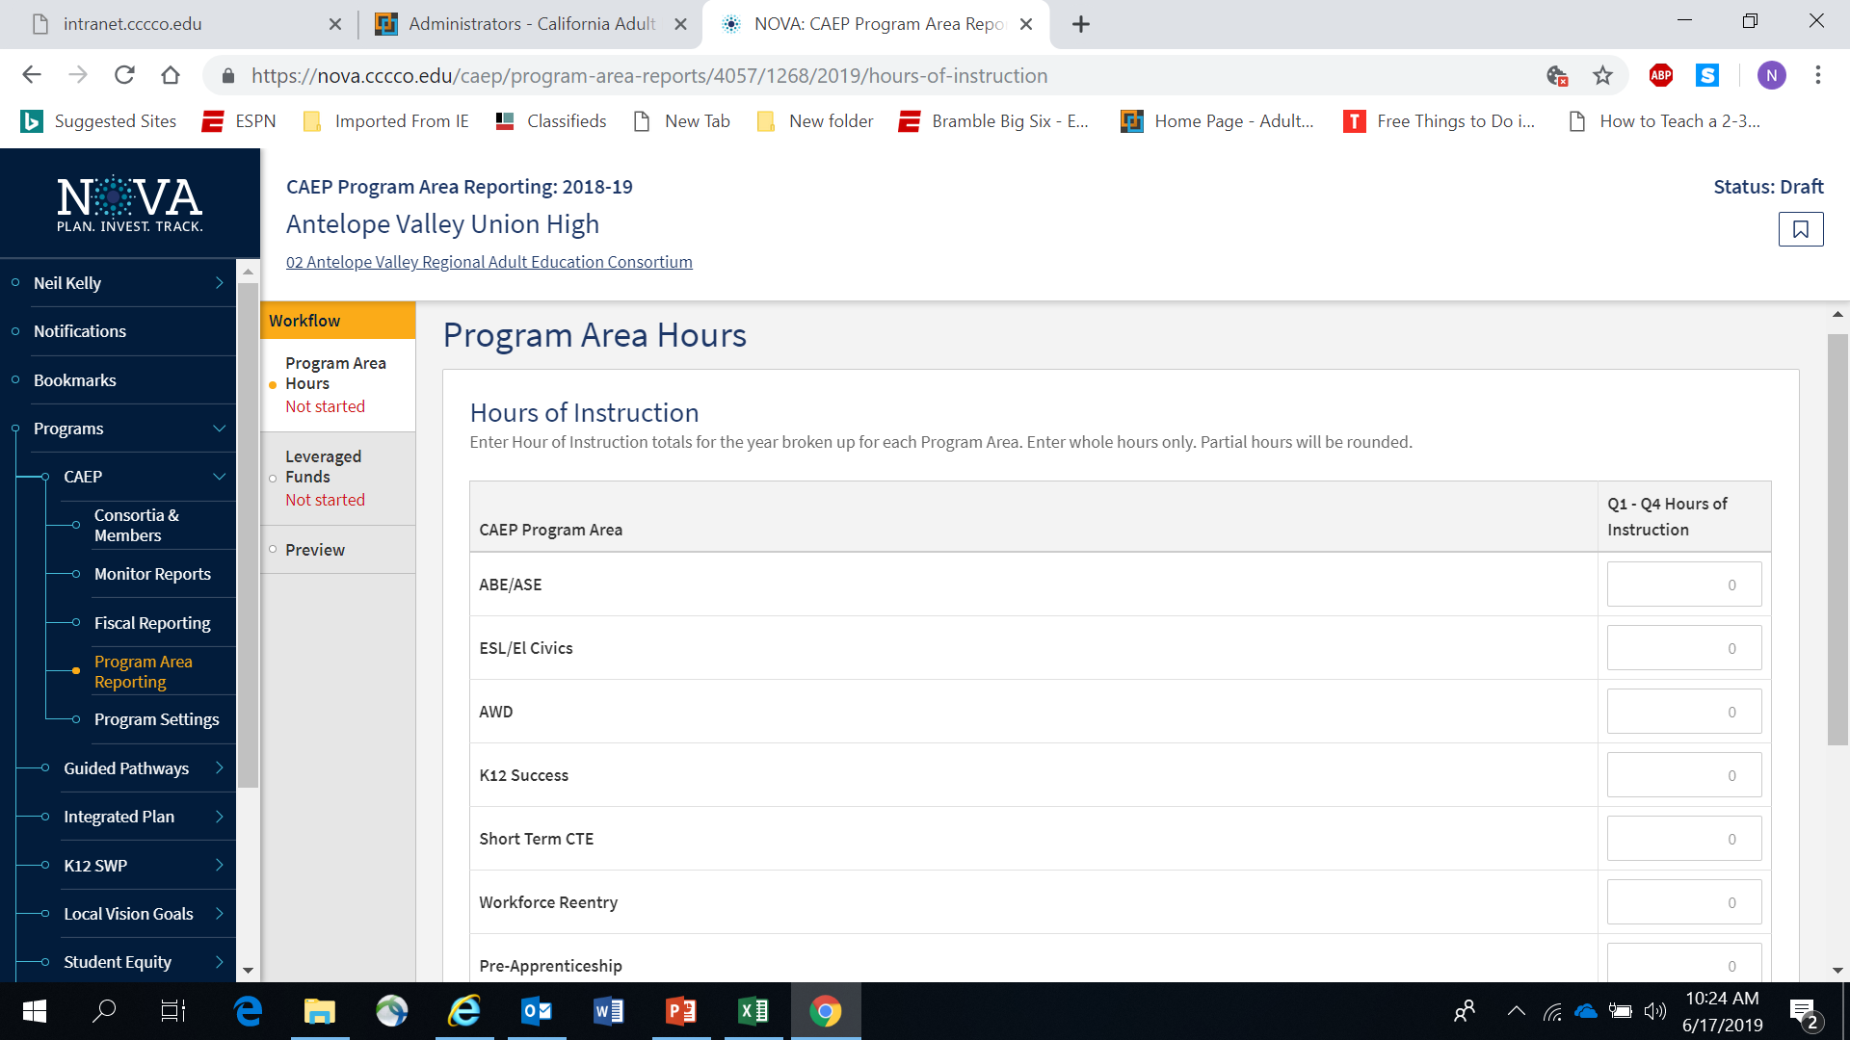

Slide 15
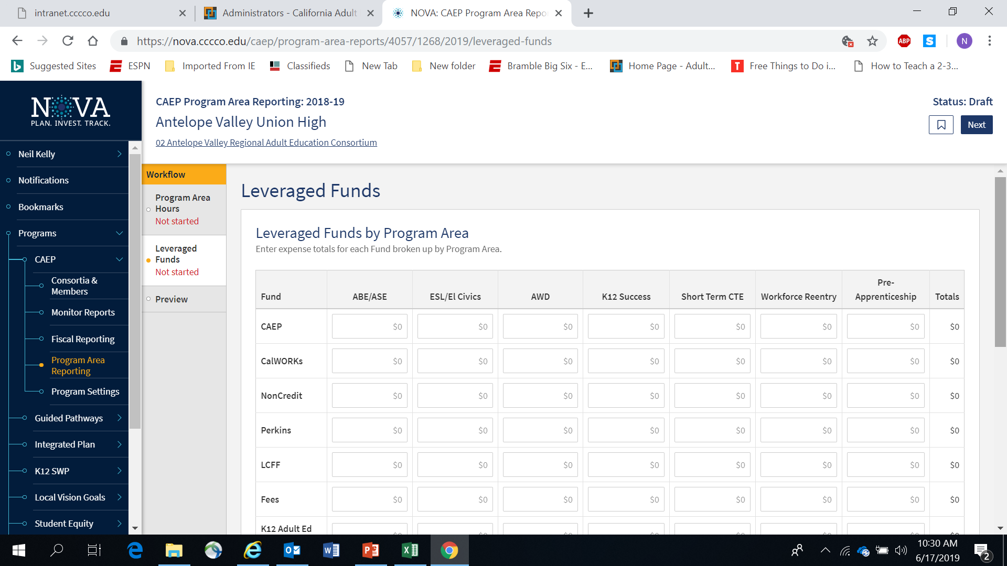

Slide 16
NOVA Evaluation of Program Area Reporting
CLASP interviewed many consortia and individual district administrators to obtain feedback in the NOVA program area hours and expense reporting.
These changes will be reflected in the 18-19 Program Area Reporting guidance for NOVA.
However, NOVA programmers were not able to make the changes for this upcoming reporting cycle.

Slide 17
NOVA Evaluation of Program Area Reporting
NOTE: The State CAEP Office realizes that these changes are being implemented at the end of the 18-19 program year.
If your members are still using the old guidance – they will not be penalized or have their data/fiscal submission rejected.
We hope that these changes will reduce the amount of work that each member will be required to do annually.

Slide 18
NOVA Program Area Reporting Timeline (cont.)
September 1, 2019 – each consortia member will be asked to submit an estimated amount into for NOVA for the following:
Program Year 18-19 – hours of instruction by program area.
Program Year 18-19 – expenses by program area by fund source.

Slide 19
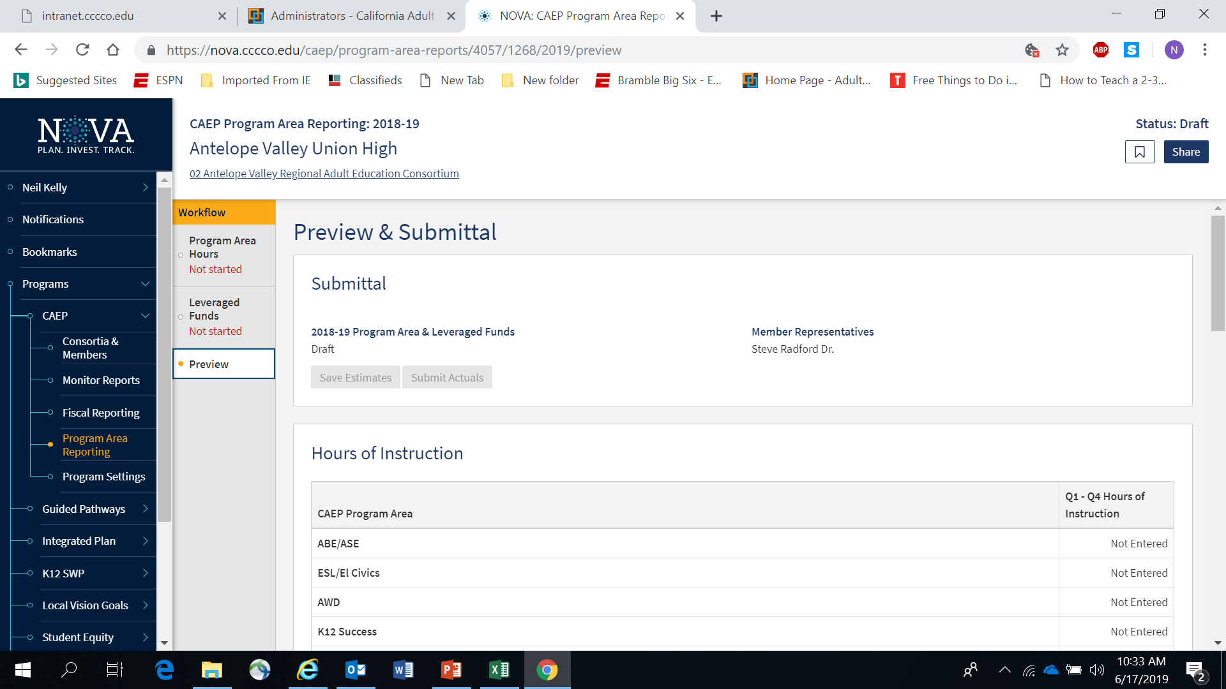

Slide 20
NOVA Program Area Reporting Timeline (cont.1)
December 1, 2019 – each consortia member will be asked to certify their amounts into for NOVA for the following:
Program Year 18-19 – hours of instruction by program area.
Program Year 18-19 – expenses by program area by fund source.

Slide 21
Reporting Changes for 18-19 Program Area Reporting in NOVA
Reporting of Program Areas
CAEP is still reporting by the Seven Program Areas.
But we want to avoid the duplication of hours between CTE and Workforce Reentry (now called Workforce Prep).
Workforce Reentry is not being used to collect barriers to employment (or characteristic demographics).
Workforce Reentry will be called Workforce Prep and is it’s own program. Definition remains the same.

Slide 24
19-20 Reporting Changes
Enrollment / Instructional Hours
How do we track hours of instruction for integrated courses (ESL/CTE, ASE/CTE, ABE, CTE, etc.)?
For K12/COE:
If a class is identified as integrated, the hours will be divided equally between the programs designated for that record.
If not integrated, or if the hours are split unevenly – the agency can create two classes, one for each instructional program represented.
For Colleges: Additional exploration is required to review how colleges are coding such courses.

Slide 25
19-20 Reporting Changes
Enrollment / Instructional Hours
What is the definition of an instructional hour?
An instructional hour must meet OCTAE guidelines and be associated with an instructional program. Thereby, service hours must not be commingled with instructional hours.

Slide 26
Contact Hours
Definition. Hours of instruction or instructional activity that the participant receives from the program. Instructional activity includes any program-sponsored activity designed to promote learning in the program curriculum, such as classroom instruction, assessment, tutoring, or participation in a learning lab. Time spent on assessment can be counted only if the assessment is designed to inform placement decisions, assess progress, or inform instruction. Time used simply to administer tests, such as the GED tests, cannot be counted as instructional activity.
https://www.nrsweb.org/sites/default/files/NRS_TA_Guide.pdf

Slide 27
19-20 Reporting Changes
Services/Service Hours
CAEP will not track service hours.
CAEP will only report instructional hours for NOVA program area reporting.

Slide 28
19-20 Reporting Changes
Annual Program Area Reporting - expenditures
Use only the following fund sources for the program area expenditure reporting exercise: CAEP, WIOA II, Noncredit Apportionment, CalWORKs, Perkins, LCFF, & Jail Ed Funds, Fees, and In-Kind.
Eliminate or make optional several funds sources to report on for the program area report. (Contracted Services, Comm. College Supportive Services, Donations, WIOA I / ITAs, Other Federal Grants, Other State Grants, Strong Workforce).

Slide 29
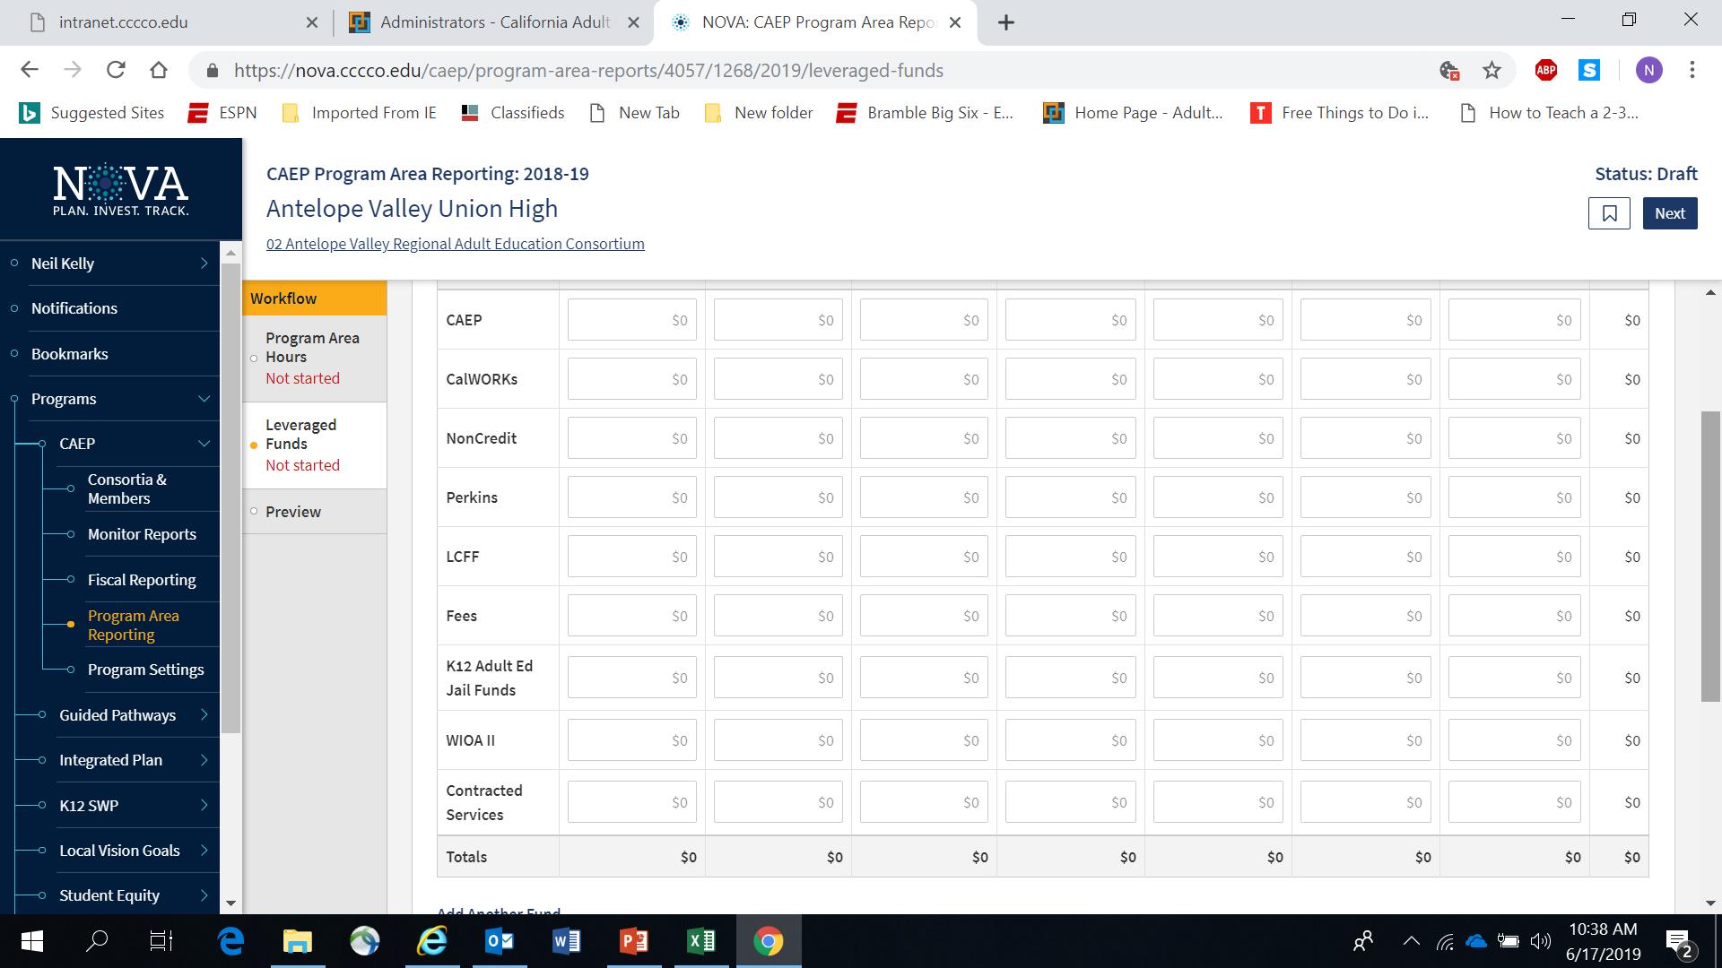

Slide 30
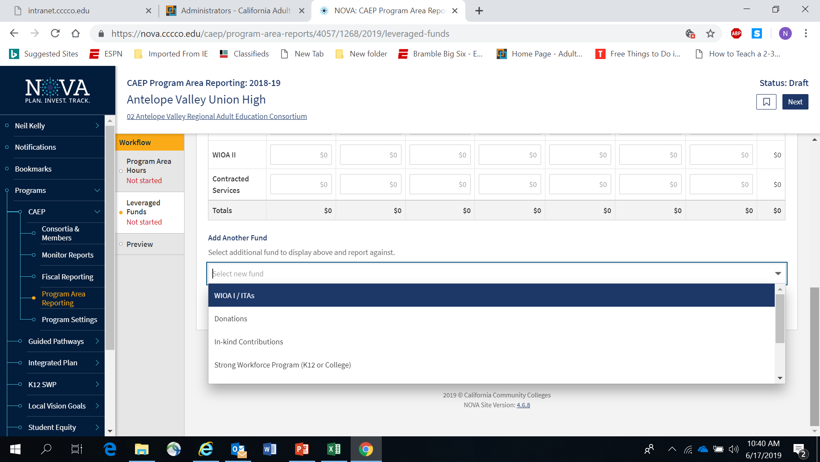

Slide 31
19-20 Reporting Changes
Annual Program Area Reporting - expenditures
Align “in-kind” & donations with WIOA II reporting requirements.
Define “fee” using WIOA II definition and/or limit it to tuition (K12/COE only).

Slide 32
Regional Training Dates
August 7 – Mt Diablo (9am to 12noon)
August 13 – North Orange (9am to 12noon)
September 11 – Fresno (9am to 12noon)
September 25 – Burbank (9am to 12noon)
October 1 – San Mateo (12:30pm to 3:30pm)
October 10 – Sacramento (9am to 12noon)
October 28 –Vista Adult (11am to 2pm)
November 21 – San Bernardino (9am to 12noon)

Slide 33
Summary of Changes
Workforce Reentry is now called Workforce Preparation.
Still defined as “Programs for adults, including, but not limited to, older adults, that are primarily related to entry or reentry into the workforce”.
CAEP will not track service hours in 19-20.
Agencies will record student barriers at intake.
The Passage of Exam Measurable Skills Gain for WIOA I will align with the CAEP Occupational Skills Gain and Workforce Preparation Outcome.
NOVA Program Area Reporting clarification for 18-19.

