Slide 1
Using Data
to Improve
Program Performance
July 10, 2019

Slide 2


Agenda
Review: NRS Performance & Persistence
Applying NRS Performance and Persistence to CAEP Data Reporting
Analyze Data:
  Performance & persistence rates are low
  Low performance when persistence is high
Identify Strategies for Improvement
    Agency Level
    Student Level
Identify Resources for Improvement

Slide 3
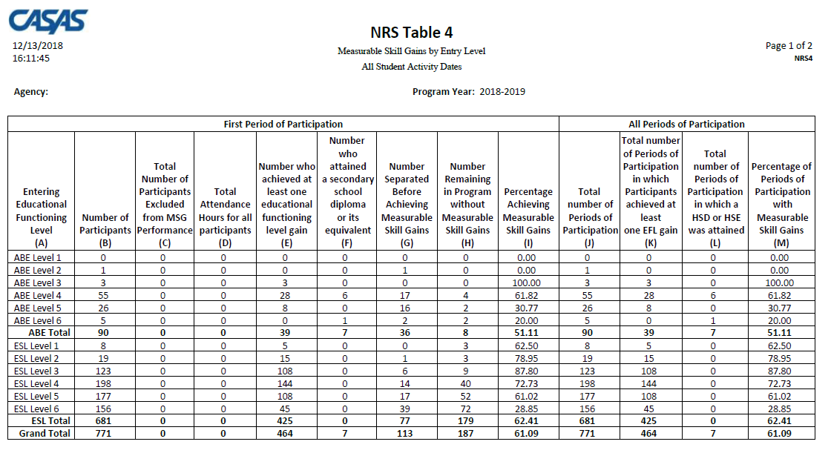
Federal Table 4
Table 4 = Gains by Educational Functioning Level Reports learners who entered program at one Instructional Level and finished the program year (June 30) at a higher level.

Slide 4
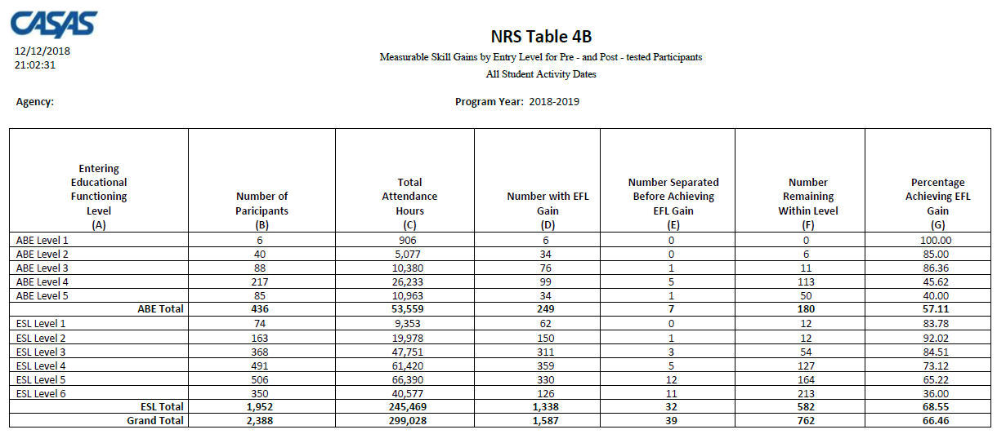
Federal Table 4B
Table 4B = Same level advancement information as Table 4 (but without PoPs)
Only includes learners who completed a valid pre- and post-test.

Slide 5
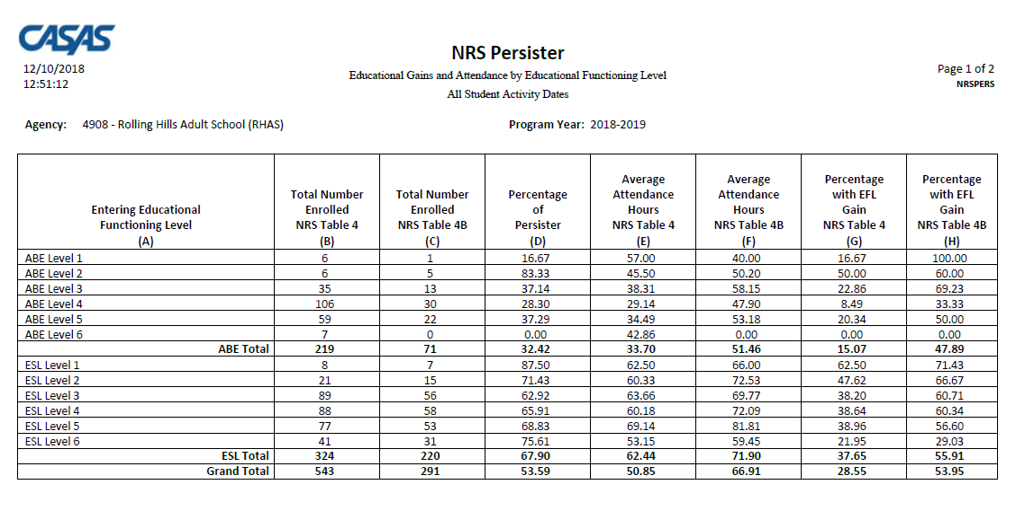
NRS Persister Report

Slide 6
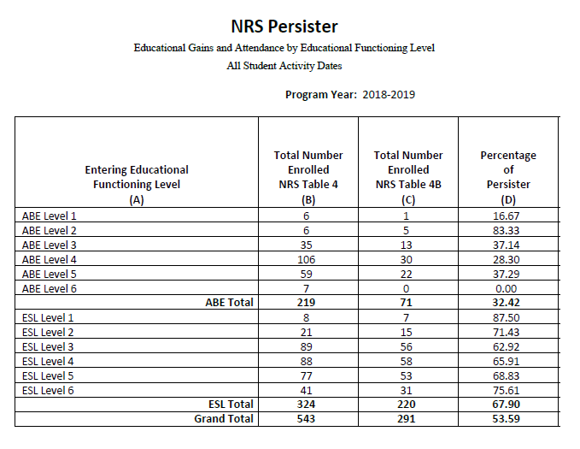
NRS Persister Report
The Persister looks at the percentage of Table 4 students who also qualify for Table 4B – (the percentage of qualified enrollees who have a pre/post-test pair).
Column C ÷ Column B = Column D (% of Persister)

Slide 7
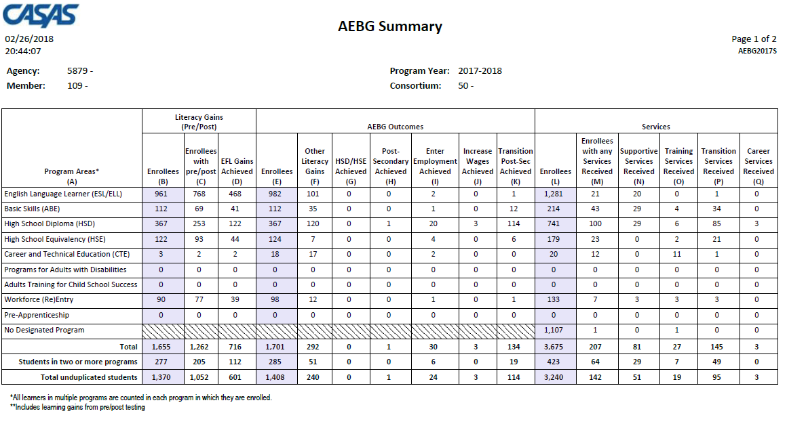
CAEP Summary
Displays outcomes in three separate sections:
Literacy Gains (Pre/Post) using NRS Table 4 guidelines
Other AB 104 outcomes using WIOA II reporting requirements but not pre/post
Services Received that do not impose WIOA II reporting requirements

Slide 8
Measuring Persistence in CAEP
Relate NRS persister results using Literacy Gains section of CAEP Summary
Compare students with program enrollment in Services section (Column L) with no enrollment
Compare CAEP Outcomes (middle) section of CAEP Summary with Services (right) sections of CAEP Summary – Columns E and L
Use CAEP Outcomes (Column E) to compare total Enrollees with the number of students achieving at least one outcome

Slide 9
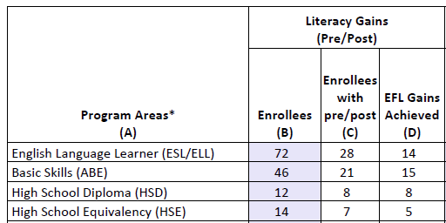
Measuring Persistence in CAEP
Refer to the Literacy Gains (Pre/Post) section of the TE CAEP Summary to determine your agency’s overall persistence rate, or your persistence by program.
Compare the number with a pre/post-test pair with total number of enrollees. (This mimics the NRS Persister.)

Slide 10
Measuring Persistence in CAEP
To determine the persistence rate, divide the total in Column C by the total in Column B.
Column C ÷ Column B = Persistence Rate
“Good persistence” = 70% or better

Slide 11
Measuring Performance in CAEP
Refer back to the Literacy Gains section of the CAEP Summary to determine overall performance, or performance by program.
Compare the number with EFL Gains with total number of enrollees. (This mimics NRS Table 4.)
Compare Enrollees with pre/post to Enrollees. (This mimics NRS Table 4B.

Slide 12
Lo Performance
Hi Persistence
Hi Performance
Hi Persistence
Lo Performance
Lo Persistence
Hi Performance
Lo Persistence
Persistence
Performance

Slide 13
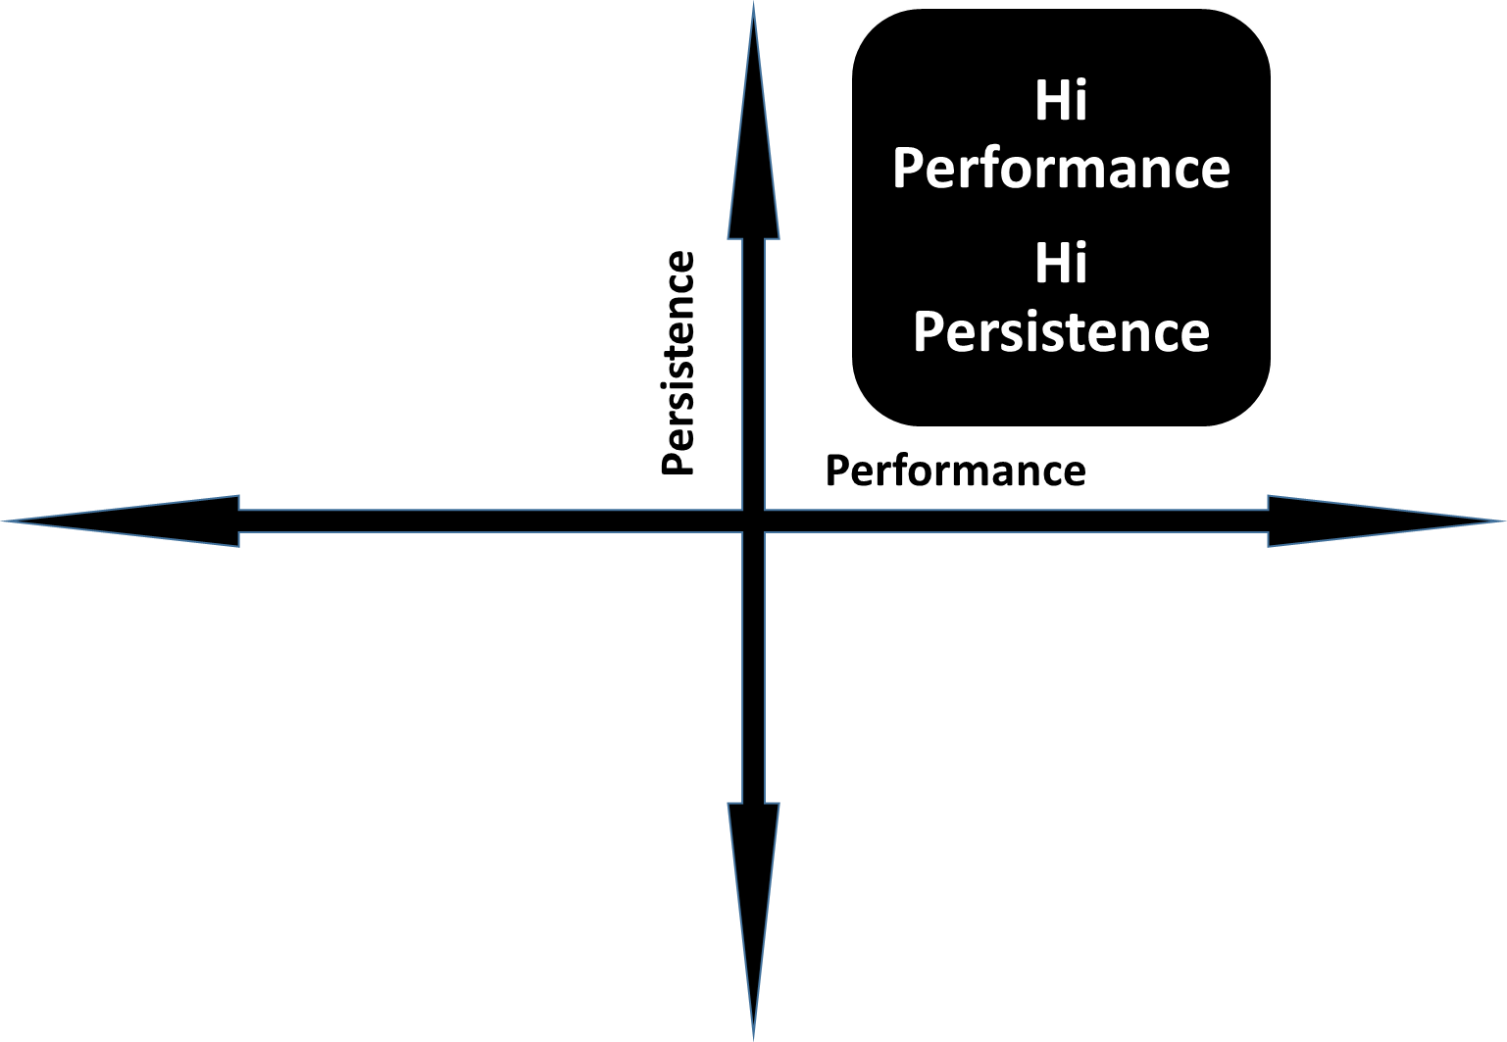
When Performance and Persistence are High
If performance and persistence are both high, CONGRATULATIONS!!!

Slide 14
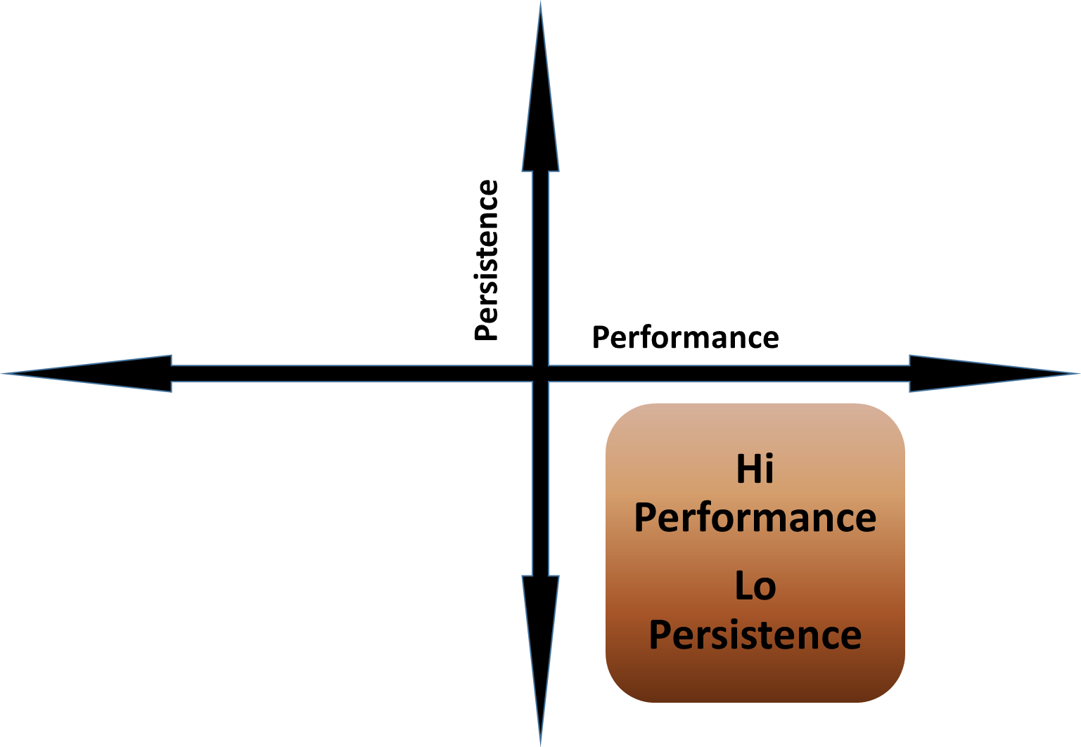
When Performance is High and Persistence is Low
VERY UNUSUAL
But if so, the agency should take steps to increase the frequency of pre/post-testing rates for students.

Slide 15
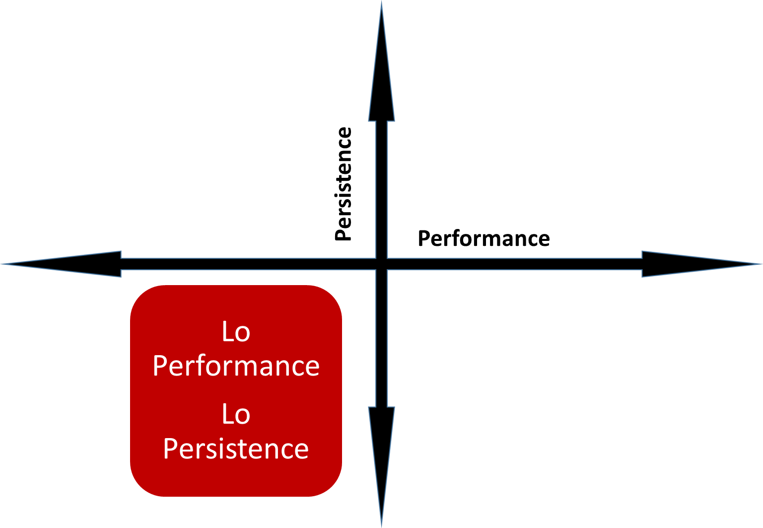
When Performance and Persistence are Both Low
The agency should address basic data clean up first – that is, missing student demographics or attendance hours.
Once basic clean up is complete, then start with the persistence side – specifically, student pre/post-testing rates.

Slide 16
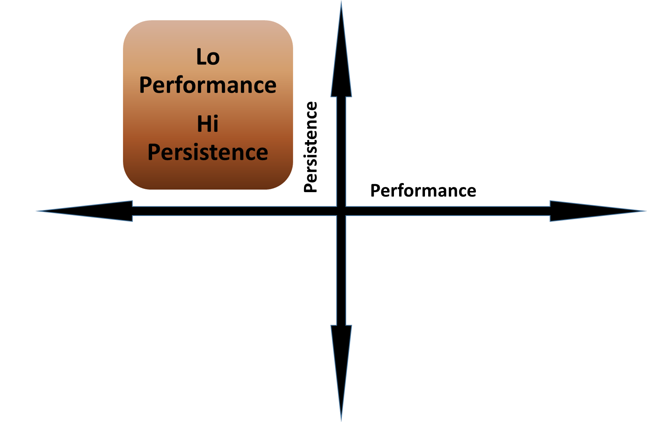
When Performance is Low and Persistence is High
The agency is doing well with completing testing requirements, but needs to address instruction in the classroom.

Slide 17

Improving Learner Persistence
What if my agency’s persistence rates are at or below the state averages?
There is a strong possibility the issue is with pre- and post-testing all of your agency’s students.

Slide 18

Student Level Strategies for Obtaining Better Persistence
Track students’ attendance.
  Follow up on students who miss three+ days of class.
  Provide a clear line of communication between teacher and students.
  Tell students upon entry that they need to tell the teacher if they are leaving the class.

Slide 19
Student Level Strategies for Obtaining Better Persistence
Track students’ attendance.
  Review overall flexibility of schedule for students
  For learners who do not enroll in class, or who drop out early, review overall school schedule for availability of classes
  Investigate alternatives such as distance learning

Slide 20
Student Level Strategies for Obtaining More Pre-/Post-test Pairs
Establish program that rewards students for obtaining pre-/post-test pairs
Reduce student “test anxiety”
Use TOPSpro Enterprise (TE) reports that display test results by date and form number (such as Students Gains, Learning Gains, or Student Test Summary.)
Use TE reports and other resources to align assessment with instruction

Slide 21
Agency Level Strategies for Obtaining Better Persistence
Maintain a clear line of communication among testing staff, teachers and administration.
  Discuss critical decisions with team:
    Which classes/programs to prioritize and when to schedule
    Which assessments to administer for each class and program
    Time between testing dates.
  Work as a group to determine:
    Who does what?
    When does it happen?
    Each staff person’s responsibilities in completing testing?

Slide 22

Agency Level Strategies for Obtaining More Pre-/Post-test Pairs
Maintain a calendar of the year’s testing dates.
  Plan specific dates as “testing dates.”
  Ensure those leaving programs early complete testing.
  Schedule specific “make up” days for students who are absent.
  Ensure all students are aware of testing dates and understand the importance of testing.

Slide 23
Agency Level Strategies for Obtaining More Pre-/Post-test Pairs
*Use State and Local Assessment Policies to inform staff of local agency testing responsibilities*
Establish procedure for appropriate instructional placement, and pre- and post-testing
Specify times for testing
Designate person(s) responsible for coordinating testing/maintaining computer lab/paper booklets
Specify policies to ensure “hard to reach” students are tested, such as students with disabilities, distance learning students, high school recovery

Slide 24
Agency Level Strategies for Obtaining More Pre-/Post-test Pairs
*Use data reports to determine level of effort and to target specific groups for intervention*
Identify specific groups of students who lack pre/post-test pairs – look for specific barriers to employment, programs, classes, Educational Functioning Levels (EFLs)
Verify test selection meets state and federal requirements – look at test modality, levels, appropriate pre/post-test matches
Use reports such as the Persister to target specific levels of ABE and ESL

Slide 25

Improving Learner Performance
What if my agency’s persistence rates meet or exceed state averages but performance is still low?
If your agency’s Percentage of Persister is average or better, but your performance remains low, then there is a possibility the issue is student performance on the pre- and post-tests.

Slide 26
Student Focused Strategies for Improving Learner Performance
Assign appropriate student goals and review them regularly
Align instructional materials/ lesson planning with local and statewide priorities
Compare placement level with learner’s assigned class, and verify whether it is consistent
Ensure learner expectations match what is actually presented in class

Slide 27
Student Focused Strategies for Improving Learner Performance
Recognize student accomplishments
Review “test taking skills” with students
Individualize instruction
“Review, review, review…”
Evaluate performance by student and identify best practices of top performers

Slide 28
Agency Focused Strategies for Improving Learner Performance
**Review agency-wide assessment performance and compare by class, level, and program**
Generate TE Instructional Reports and disseminate to teachers promptly
Monitor instructional hours to ensure there is enough time between test administrations
Solicit constant feedback from both teachers and students
Evaluate performance by class and identify best practices of top performers

Slide 29
Agency Focused Strategies for Improving Learner Performance
**Ensure assessment performance is in synch with local and statewide priorities**
Align instruction to agency-specific population
Compare test performance with learner barriers to employment and demographics
Identify potential external issues, such as the local economy, transportation, housing
Establish firm attendance/local assessment policy to ensure consistency – meeting minimum data standards does not guarantee success
Define and implement NRS Local Performance Goals

Slide 30

Resources for Agency and
Student Level Improvement
What if my agency’s persistence AND performance need to improve???
There are resources available at the state, local, and student levels to help improve learner performance and persistence.

Slide 31
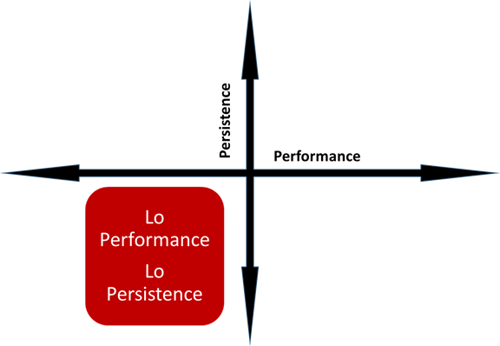
Resources for Improving Learner Performance in the Classroom
CAEP Web site
https://caladulted.org/TAP
Resources for Students, Educators, and Administrators
Student Success Stories
Student Supports
Practices with Promise
www.caladulted.org

Slide 32
Resources for Improving Learner Performance in the Classroom
CASAS Quick Search
EL Civics Web site
Alignment with CASAS Content Standards and CCR/CCSS
TE Instructional Reports (Under Reports – Test Results):
  Competency Reports
  Content Standards
  Individual Skills Profile
  Learning Gains/Test History
www.casas.org

Slide 33

CAEP Web Site
www.caladulted.org
The CAEP Web site includes resources for students, teachers, and administrators.

Slide 34
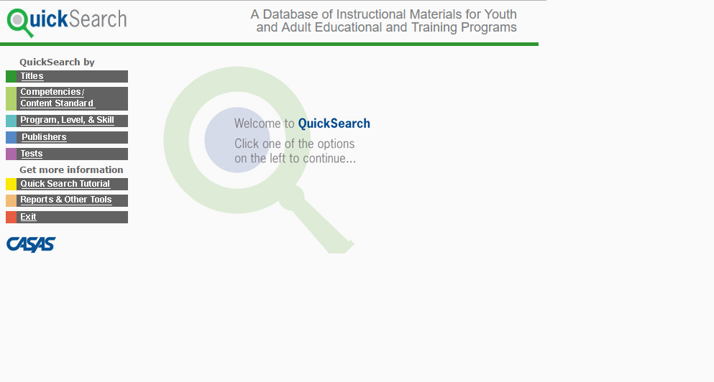
CASAS Quick Search
CASAS Quick Search enables selection of over 2,300 instructional materials from an online database.

Slide 35
EL Civics Web Site
The EL Civics section of the CASAS Web site includes 53 civic objectives that address community integration skills for all levels of ESL, as well as many resources for both ESL instruction and citizenship preparation.

Slide 36
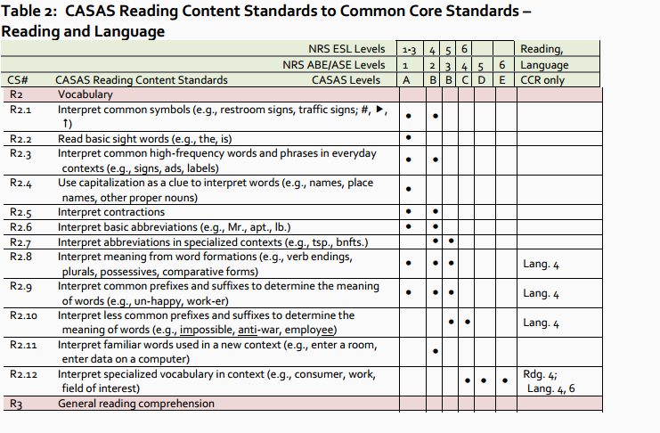
Alignment of CASAS Content
Standards to CCR/CCSS
CASAS has developed crosswalk documents that align CASAS content standards to CCR/CCSS.

Slide 37
Resources for Improving Agency
Level Performance
CASAS Data Portal
American Community Survey https://www.census.gov/programs-surveys/acs/
Promising Practices
TE Data Management Reports:
  Demographics Summary
  Enrollment/Update Summary
  Data Integrity Report
  NRS Reports
www.caladulted.org
www.casas.org

Slide 38
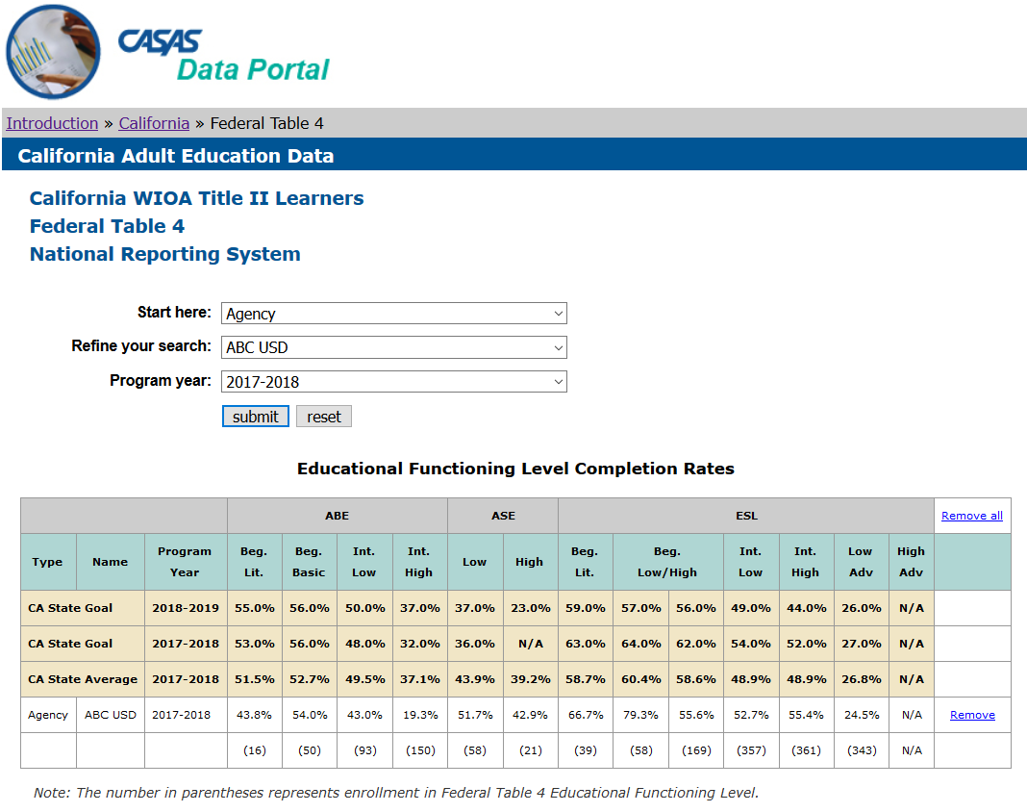
CASAS Data Portal
The CASAS Data Portal allows comparison of NRS performance and persistence results by agency, region, provider type, and statewide.
This feature only includes results for WIOA II funded agencies – but includes references helpful to all agencies, such as statewide goals and averages for both performance and persistence, dating back to PY 2004-05

Slide 39
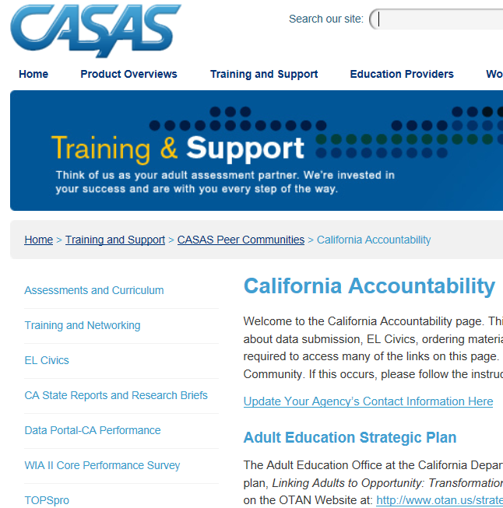
CASAS Data Portal
Go to www.casas.org/ CA Accountability

Slide 40
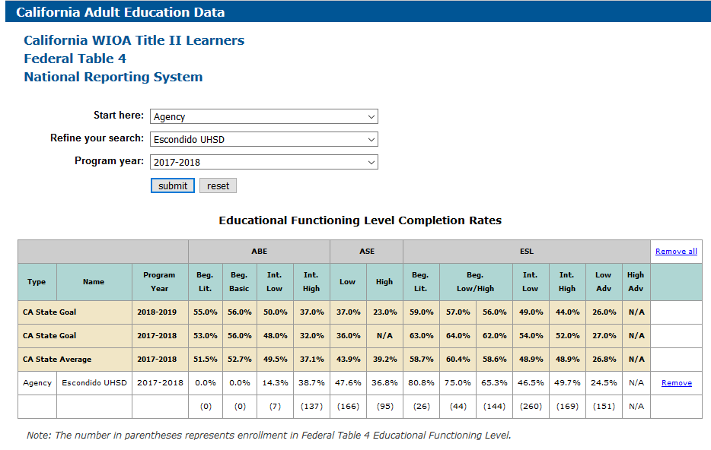
NRS Performance Example

Slide 41
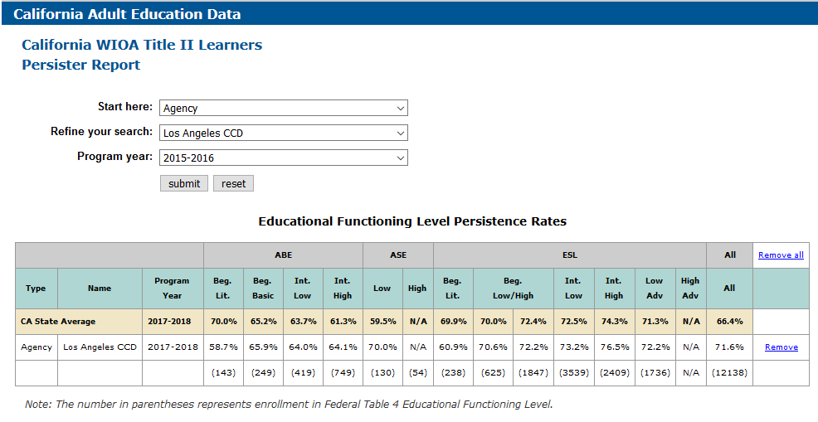
NRS Persistence Example

Slide 42
Performance and Persistence Exercise: NRS Perspective
Review your NRS Table 4, Table 4B, and Persister.
Identify your agency’s performance rates for ABE and ESL. Compare to statewide goals and averages.
Identify 2-3 areas of strength for your agency.
Identify 2-3 areas of improvement for your agency.
Compare the 2-3 areas of improvement with the corresponding persistence rates at each level.
What are some strategies your agency could employ to address areas of improvement.

Slide 43
Performance and Persistence Exercise: CAEP Perspective
Review your CAEP Summary.
Calculate your agency’s persistence rates for the 7 CAEP programs. Compare them to 70% average.
Identify a program of strength for your agency.
Identify a program for improvement for your agency.
Compare the program with low persistence to the the corresponding performance rate for that program.
What are some strategies your agency could employ to address areas of improvement.

Slide 44
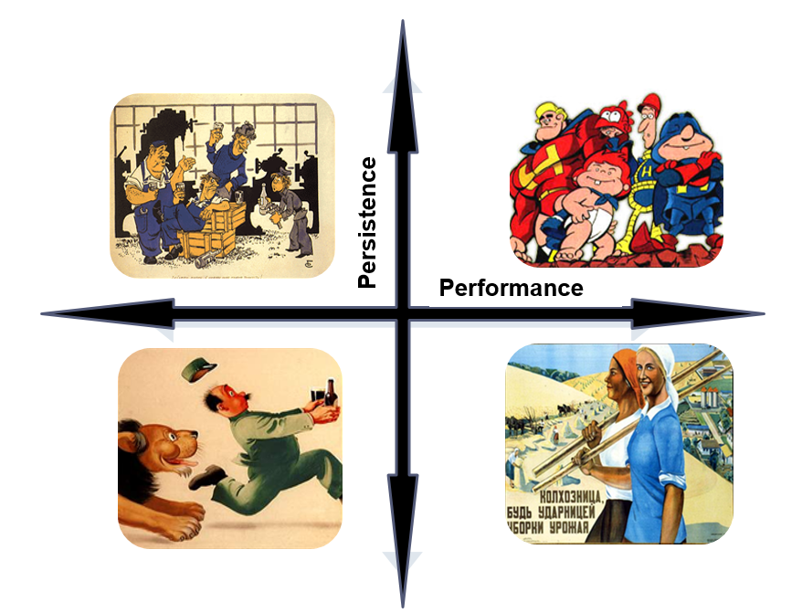






Slide 45


Slide 46
Persistence
Performance

Slide 47
Performance and Persistence Exercise: NRS Perspective
Review your NRS Table 4, Table 4B, and Persister.
Identify your agency’s performance rates for ABE and ESL. Compare to statewide goals and averages.
Identify 2-3 areas of strength for your agency.
Identify 2-3 areas of improvement for your agency.
Compare the 2-3 areas of improvement with the corresponding persistence rates at each level.
What are some strategies your agency could employ to address areas of improvement.

Slide 48
Performance and Persistence Exercise: CAEP Perspective
Review your CAEP Summary.
Calculate your agency’s persistence rates for the 7 CAEP programs. Compare them to 70% average.
Identify a program of strength for your agency.
Identify a program for improvement for your agency.
Compare the program with low persistence to the the corresponding performance rate for that program.
What are some strategies your agency could employ to address areas of improvement.

Slide 49
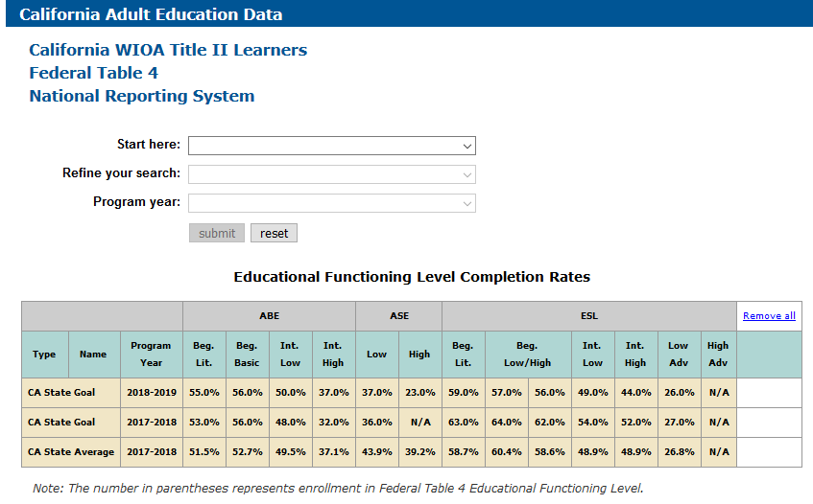
CA Statewide Performance

Slide 50
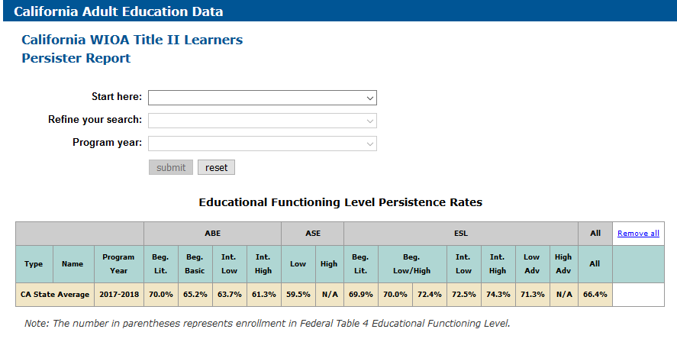
CA Statewide Persistence

Slide 51
CAEP Statewide Enrollment
Recorded students that make it to 1 hour of instruction (Program Enrollment)
          Statewide percentage = 77%.
Recorded students that make it to 12 hours or more of instruction
          Statewide percentage = 63%.
Students with 1 hour of instruction that make it to 12 hours of instruction (and eligible to earn CAEP outcomes)
(Program Persistence)
          Statewide percentage = 82%.

Slide 52
Measuring Program Enrollment in CAEP
How many adult education program students that participate – actually make it into an instructional program?
Use Column L: (Total Unduplicated - No Program) ÷ Total Unduplicated = Program Persistence Rate

Slide 53
Measuring Program Enrollment in CAEP
Compare numbers of Enrollees across Column L
Subtract number in “No Designated Program” from “Total Unduplicated Students”
Divide that result from number in Total unduplicated students.
Use Column L: (3240 – 1107) ÷ 3240 = 65.8%

Slide 54
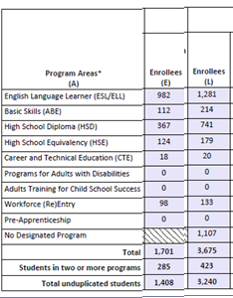
Measuring Program Persistence in CAEP
Of those who enroll in an CAEP program, how many stay long enough to accrue at least 12 hours of instruction?
Column E ÷ (Column L- No Program) = Program Persistence Rate

Slide 55
Measuring Program Persistence in CAEP
Compare number of Enrollees in Columns E and L.
For services students, subtract the number in No Designated Program.
Divide the total in Column E with that result from Column L.
1408 ÷ (3240-1107) = 66%

Slide 56
Measuring Outcomes Performance in CAEP
Of those students in an instructional program, how many are showing any progress as defined by AEBG/CAEP metrics?
Sum of Columns F, G, H, I, J, K ÷ Column E = Outcomes Attainment Rate

Slide 57
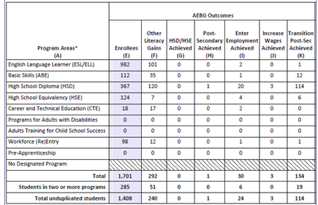
Measuring Outcomes Performance in CAEP
Add up total number of outcomes across the 6 CAEP outcomes areas
Divide this total by total Enrollees in Column E
(240 + 0 + 1 + 24 + 3 + 114) ÷ 1408 = 27%

