Slide 1
CFAD Revisited 19-20

Slide 2
Agenda
Funding Calendar
Governor’s May Revise – where it started
Allocation Reduction Steps
Decision Making
Recommendations
NOVA processing
What happens if you miss the deadline?
Questions???

Slide 3
Funding Calendar (consortia/member level)
January – Gov’s Budget Proposed
February – Preliminary Allocation Released
March-April – Meetings
May – CFAD Due
May – May Revision
June – Budget Passed
July – Governor’s Signs
August – CAEP funds are released installments

Slide 4
Funding Calendar Part II (state level)
June – Budget Passed
July – Governor’s Signs
July – Board of Governor’s Approves
July – CDE/Chancellor’s Office create Interagency Agreement
August – CAEP funds are released via installments
September – State Controllers send funds to County
Sept/Oct – County Offices send funds to districts

Slide 5
May Revise
As a result of the Governor’s May Revise, the California Adult Education Program (CAEP) 19-20 allocation will be reduced by $1,043,000. The State CAEP Office will adjust each regional consortium’s allocation in NOVA to reflect the cost-of-living adjustment from 3.46 percent to 3.26 percent.

Slide 6
Allocation Steps for the Reduction
The State CAEP Office reduced each consortium’s 19-20 allocation in NOVA. (See newsletter & direct email for sheet).
Each consortium must certify new allocation amounts for members.
All members must certify the allocation amendment.
Due Date for certification – June 30, 2019.

Slide 7
Decision Making
Per education code, members receive no less than the prior year – unless they are reduced for cause.
Any additional amounts over the prior year - follow your consortium by-laws.
Remember to follow your public meeting AB104 education code (EC 84905) and Brown Act.

Slide 8
Recommendation
The CDE and the Chancellor Office recommend that members having any unspent 17-18 CAEP funds as of the recent Q2 reporting in NOVA, take the reduction of funds for the consortium (provided the cut doesn’t go below the prior year allocation).
We understand this is still a local decision and members would have to decide who should take the reduction using the same decision making process used in the initial CFAD certification.

Slide 9
Recommendation (part 2)
To view Q2 in NOVA go to the CAEP section – then the fiscal reporting menu choice.
Once there, click on the FIFO report button at the top of the screen.
Once in the FIFO report, click Year 18-19, Reporting Level – Member Agency, and then select the member agency to see if there are any remaining 17-18 funds.(Look at the chart at the bottom of the page by allocation year).

Slide 10
NOVA Processing

Slide 11
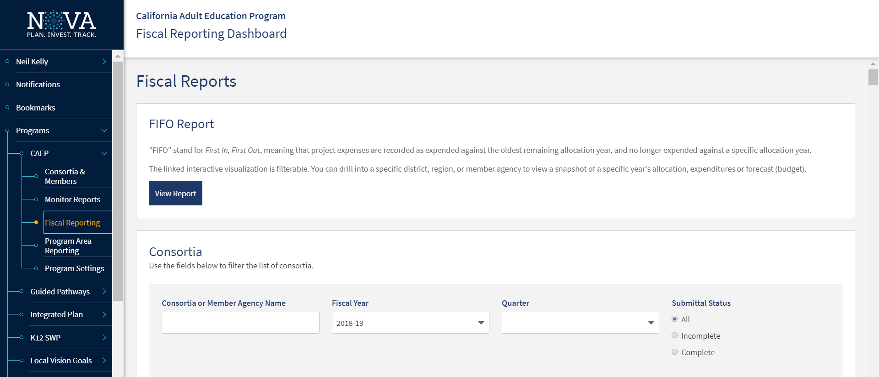

Slide 12
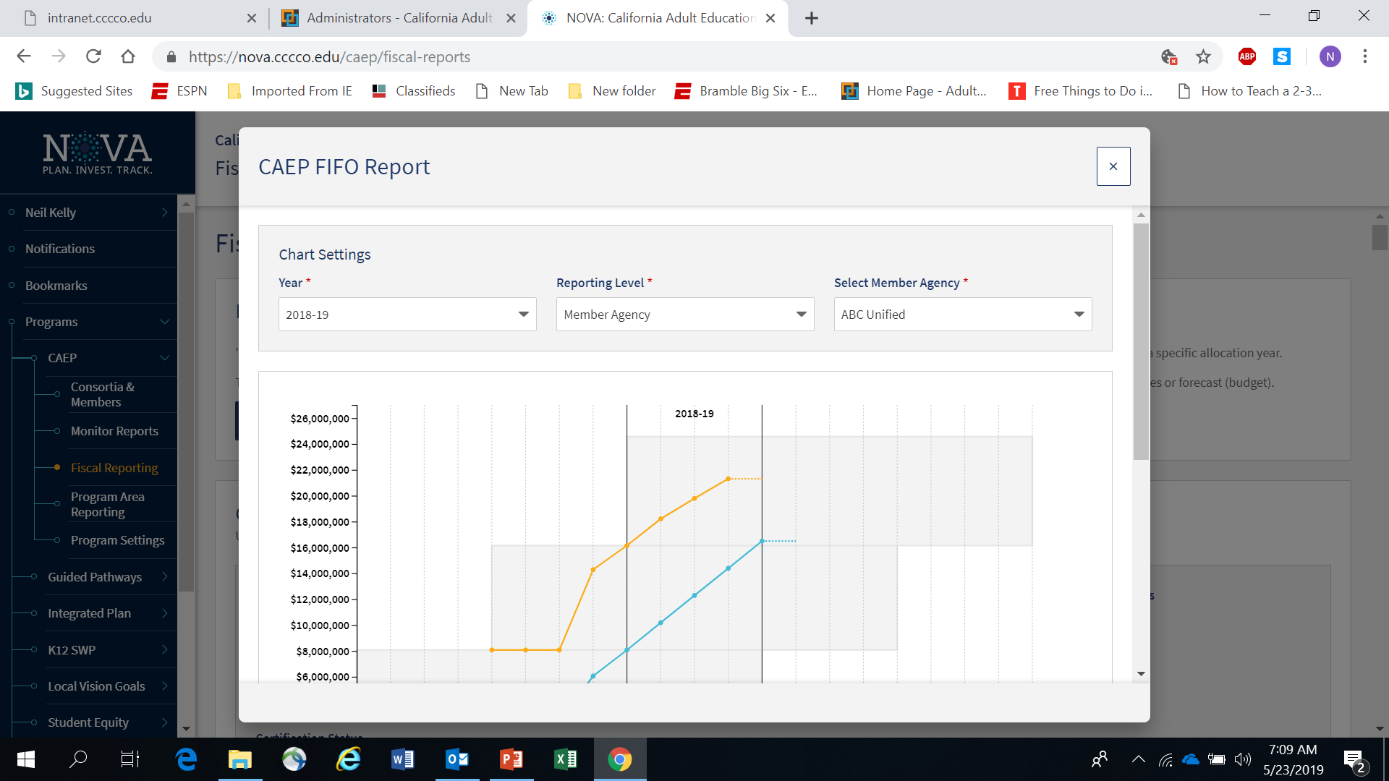

Slide 13
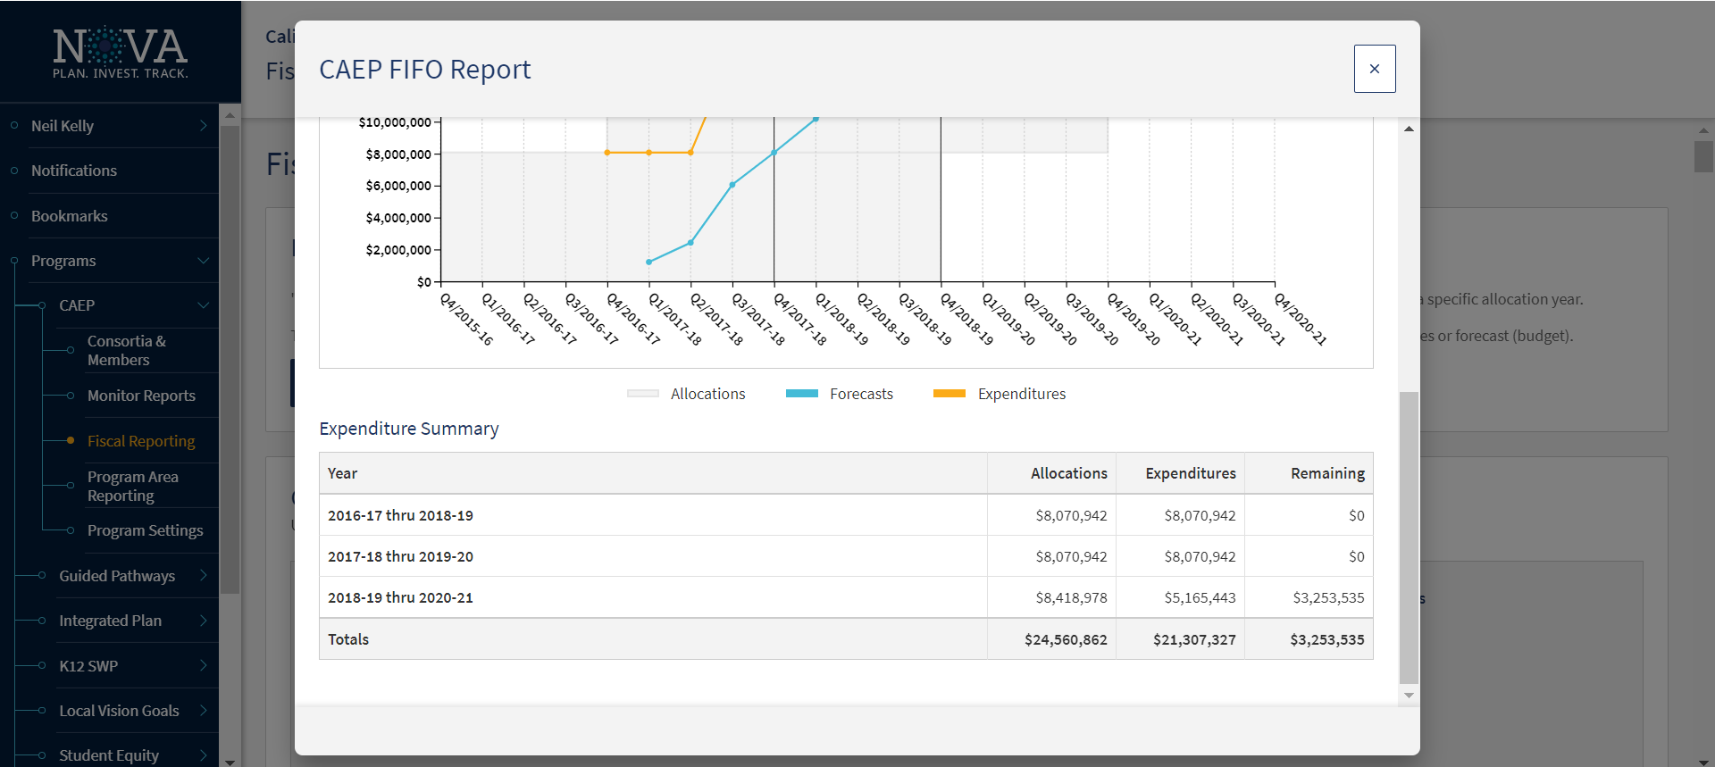

Slide 14
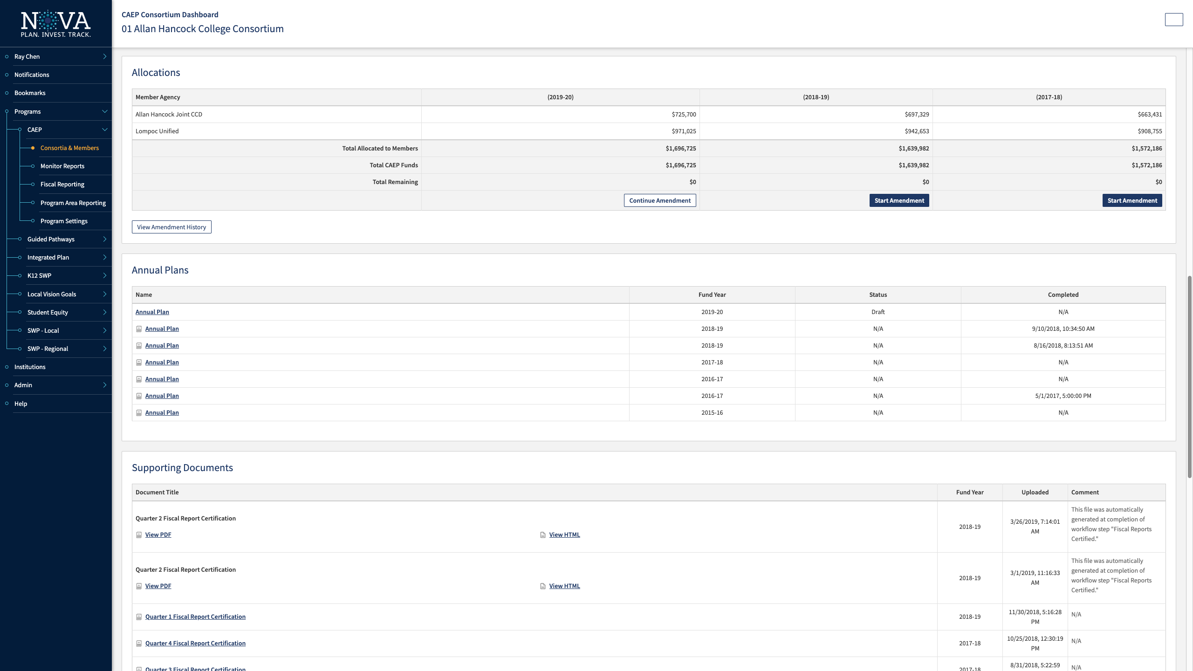

Slide 15
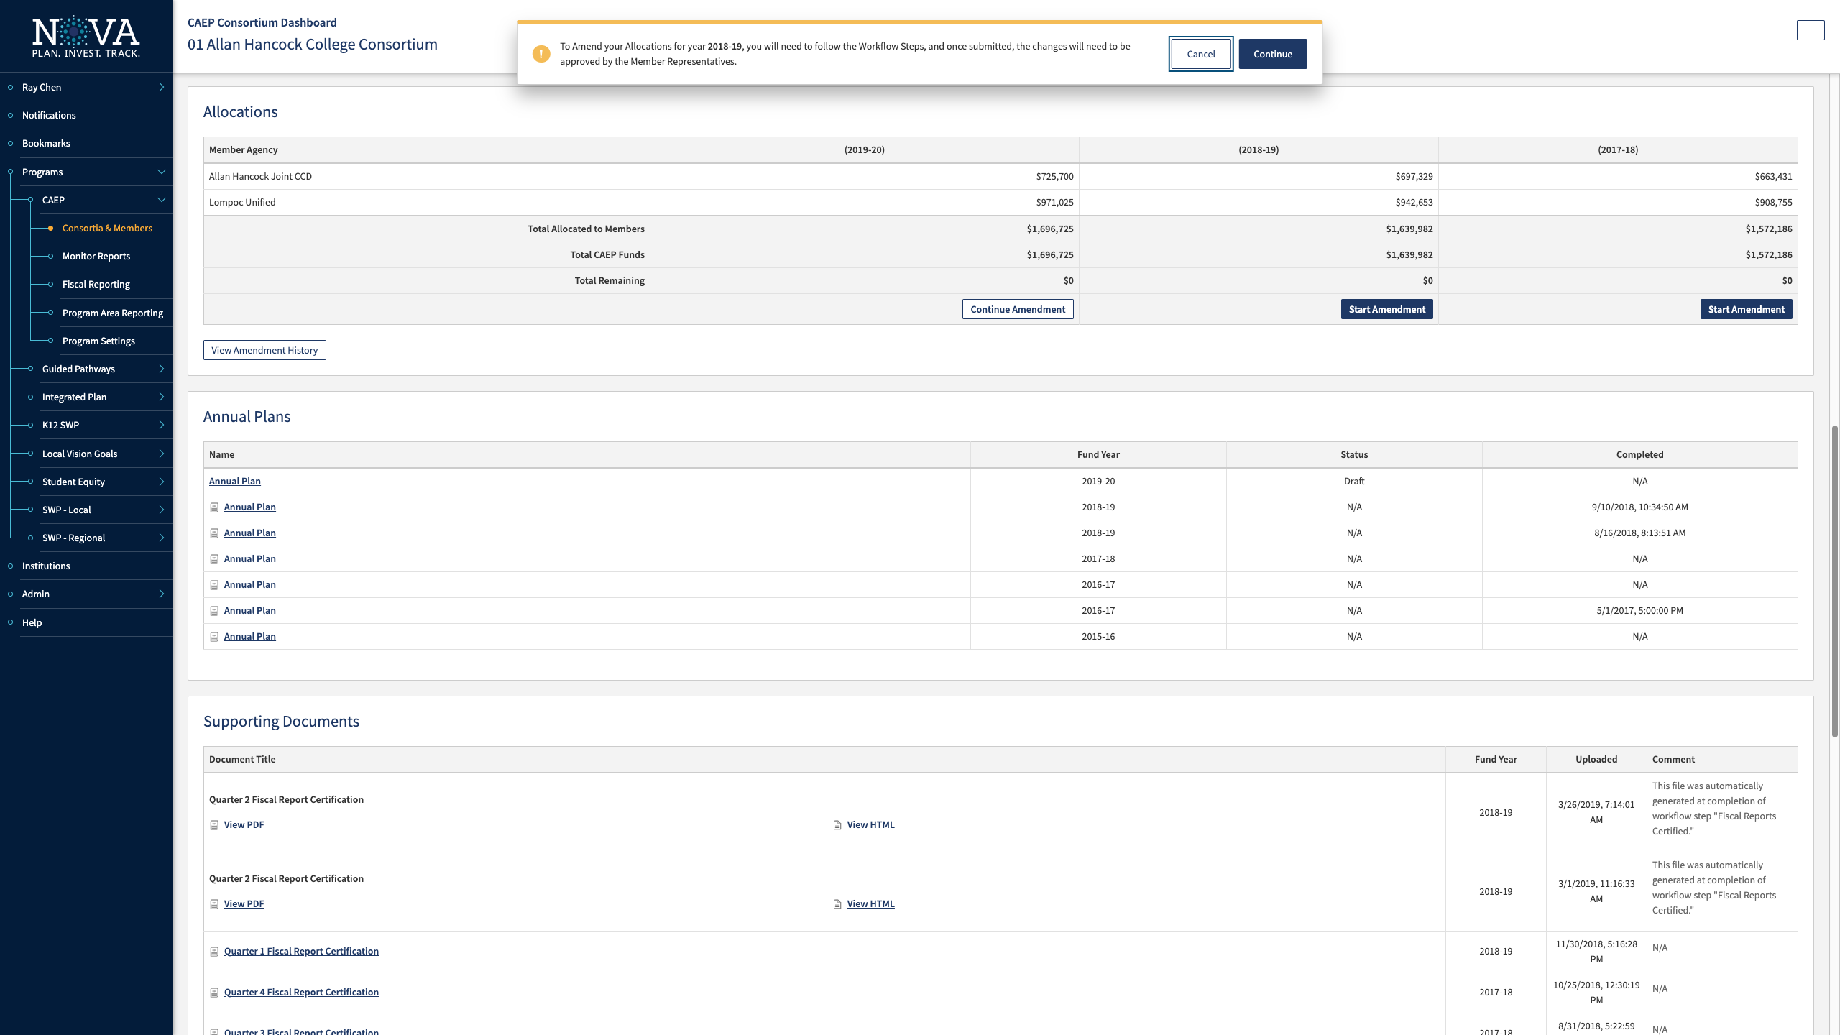

Slide 16
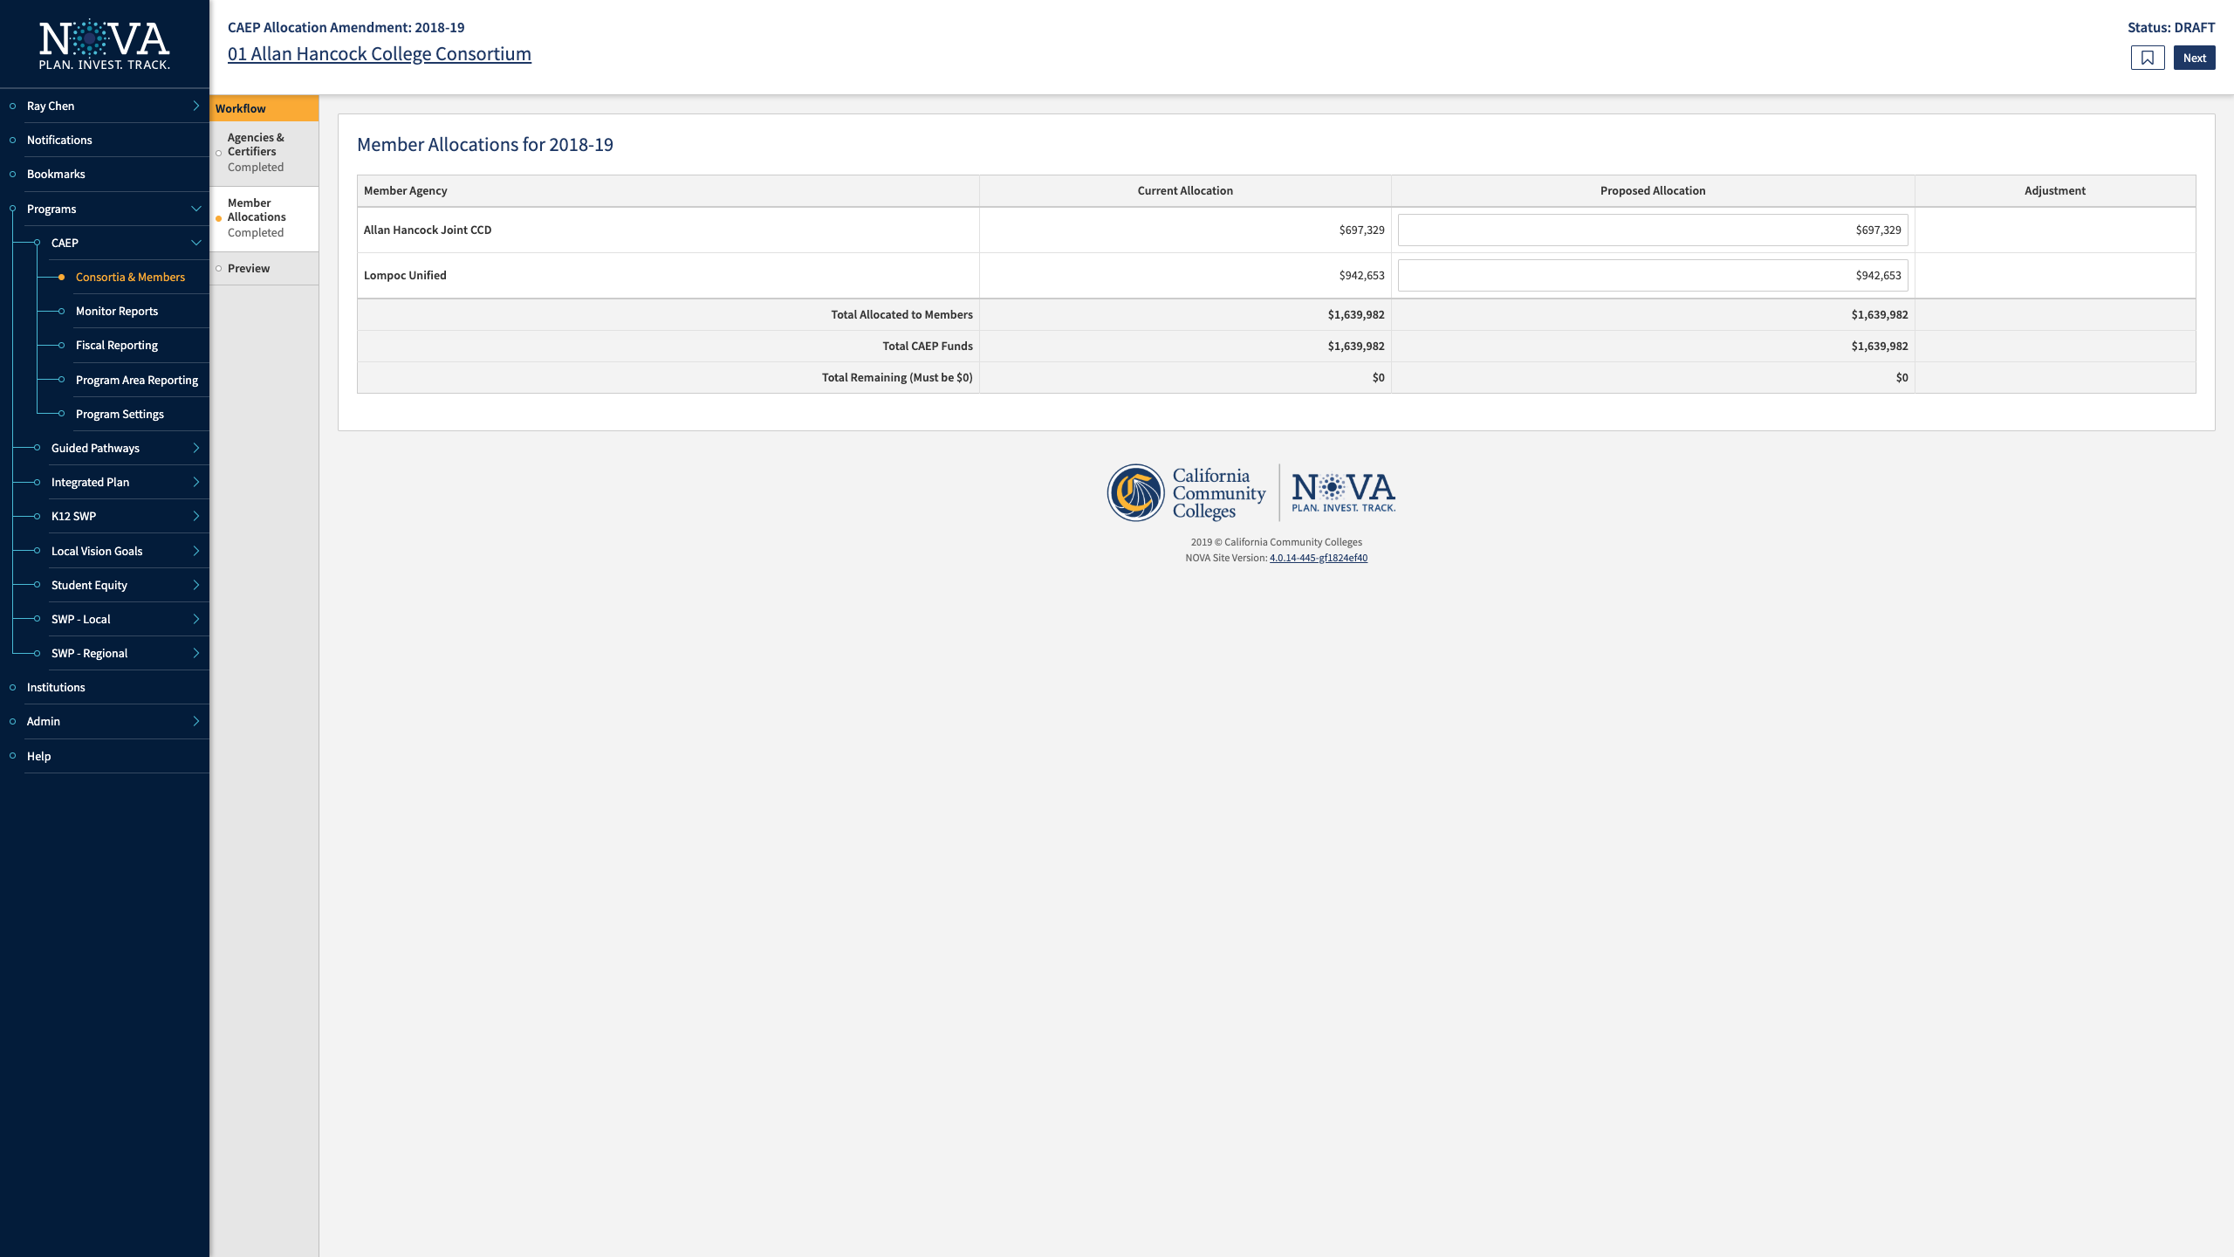

Slide 18
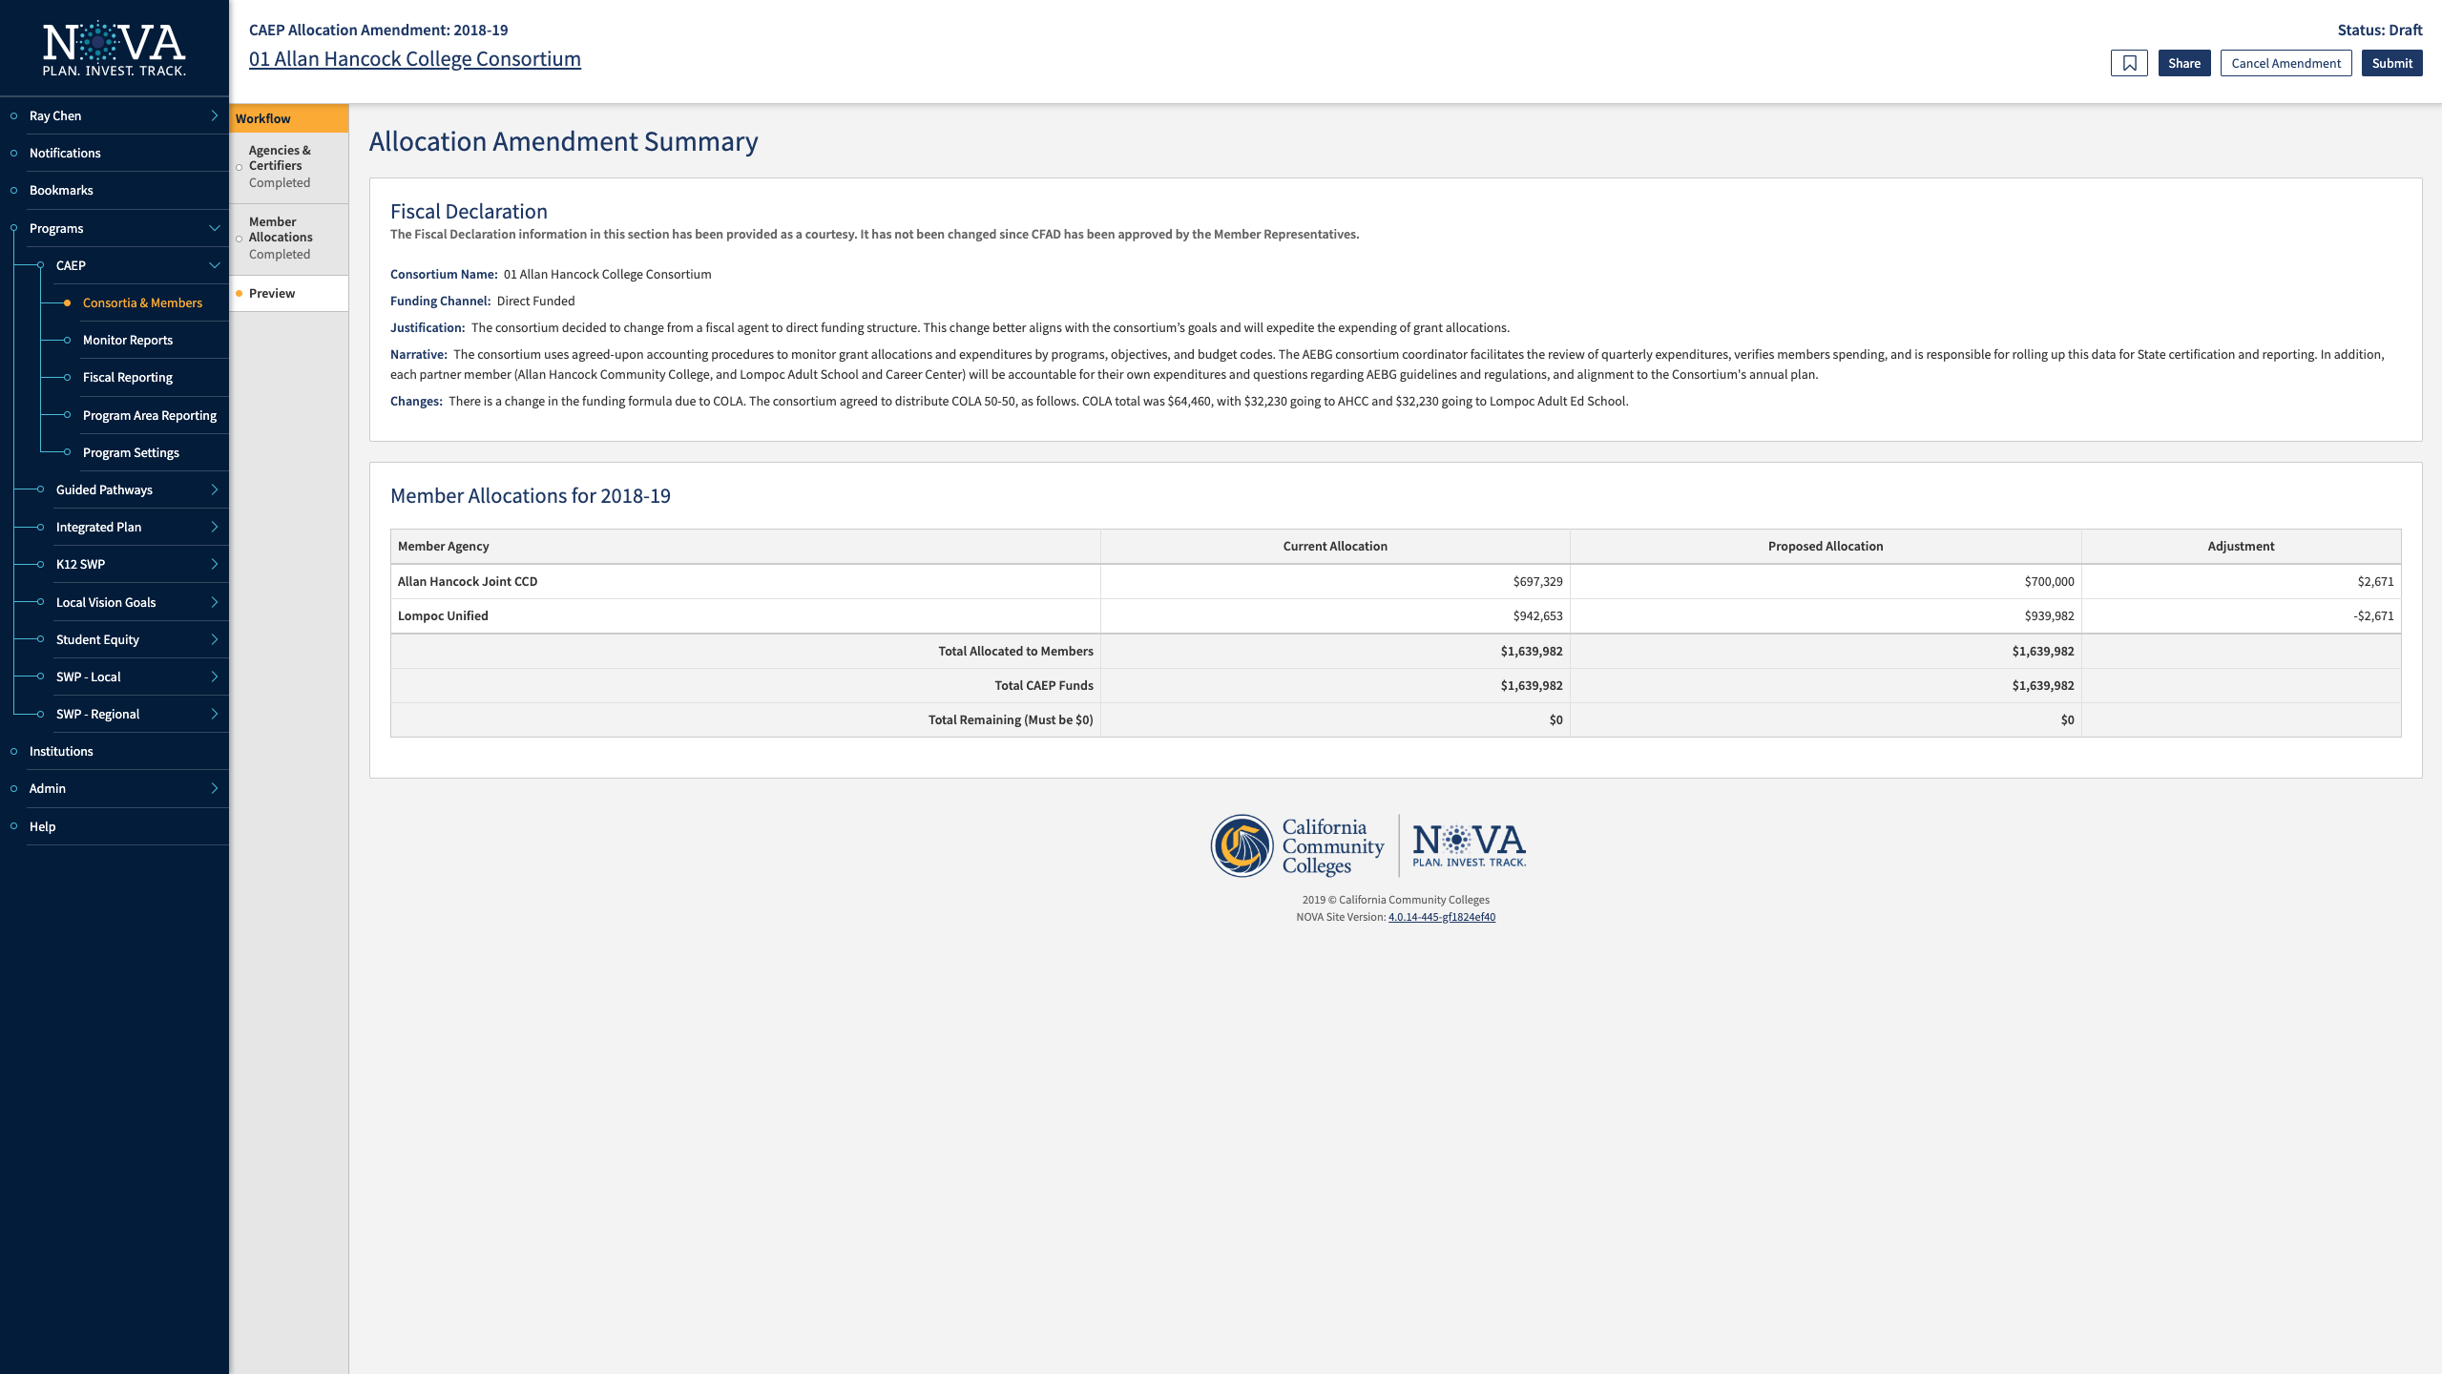

Slide 19
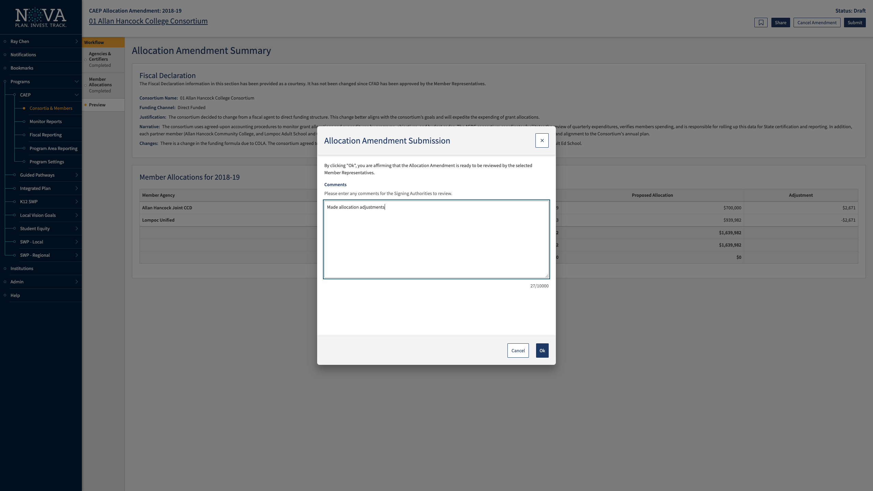

Slide 20
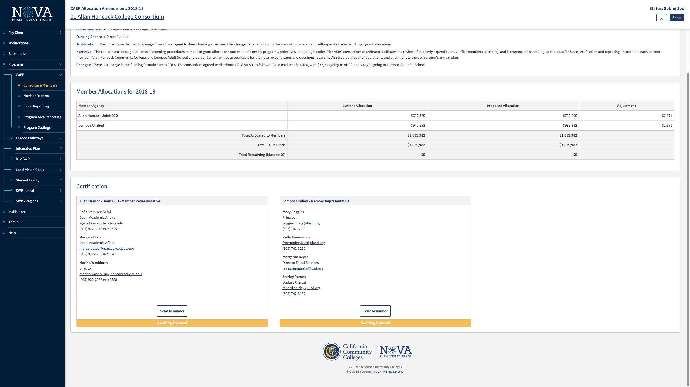

Slide 21
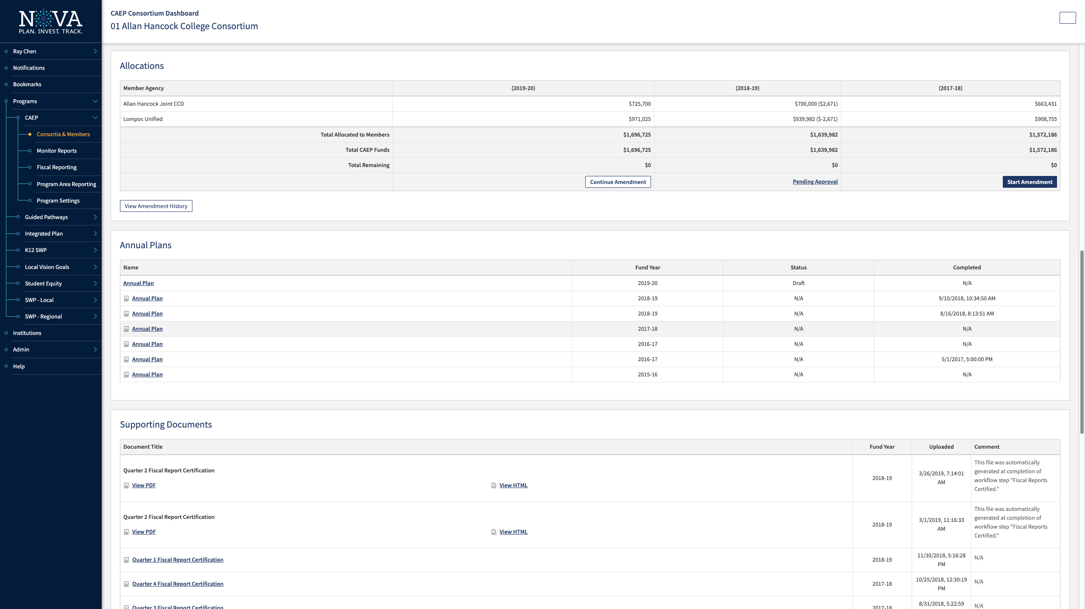

Slide 22
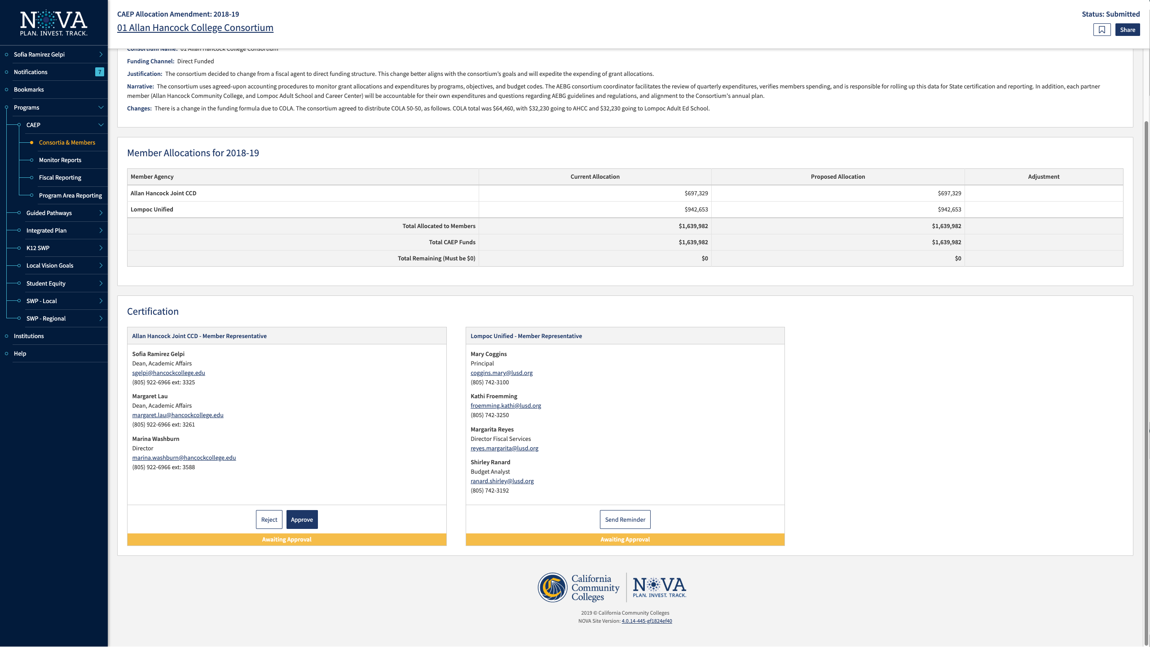

Slide 23
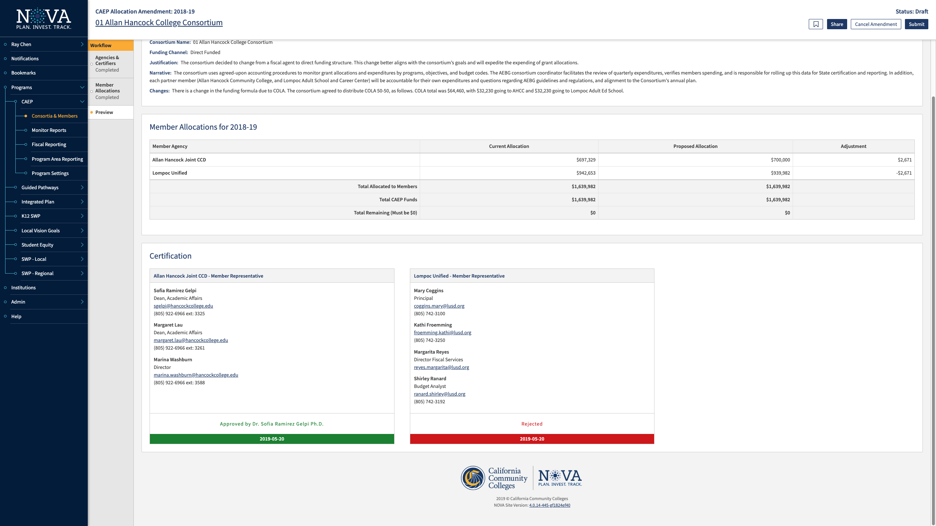

Slide 24
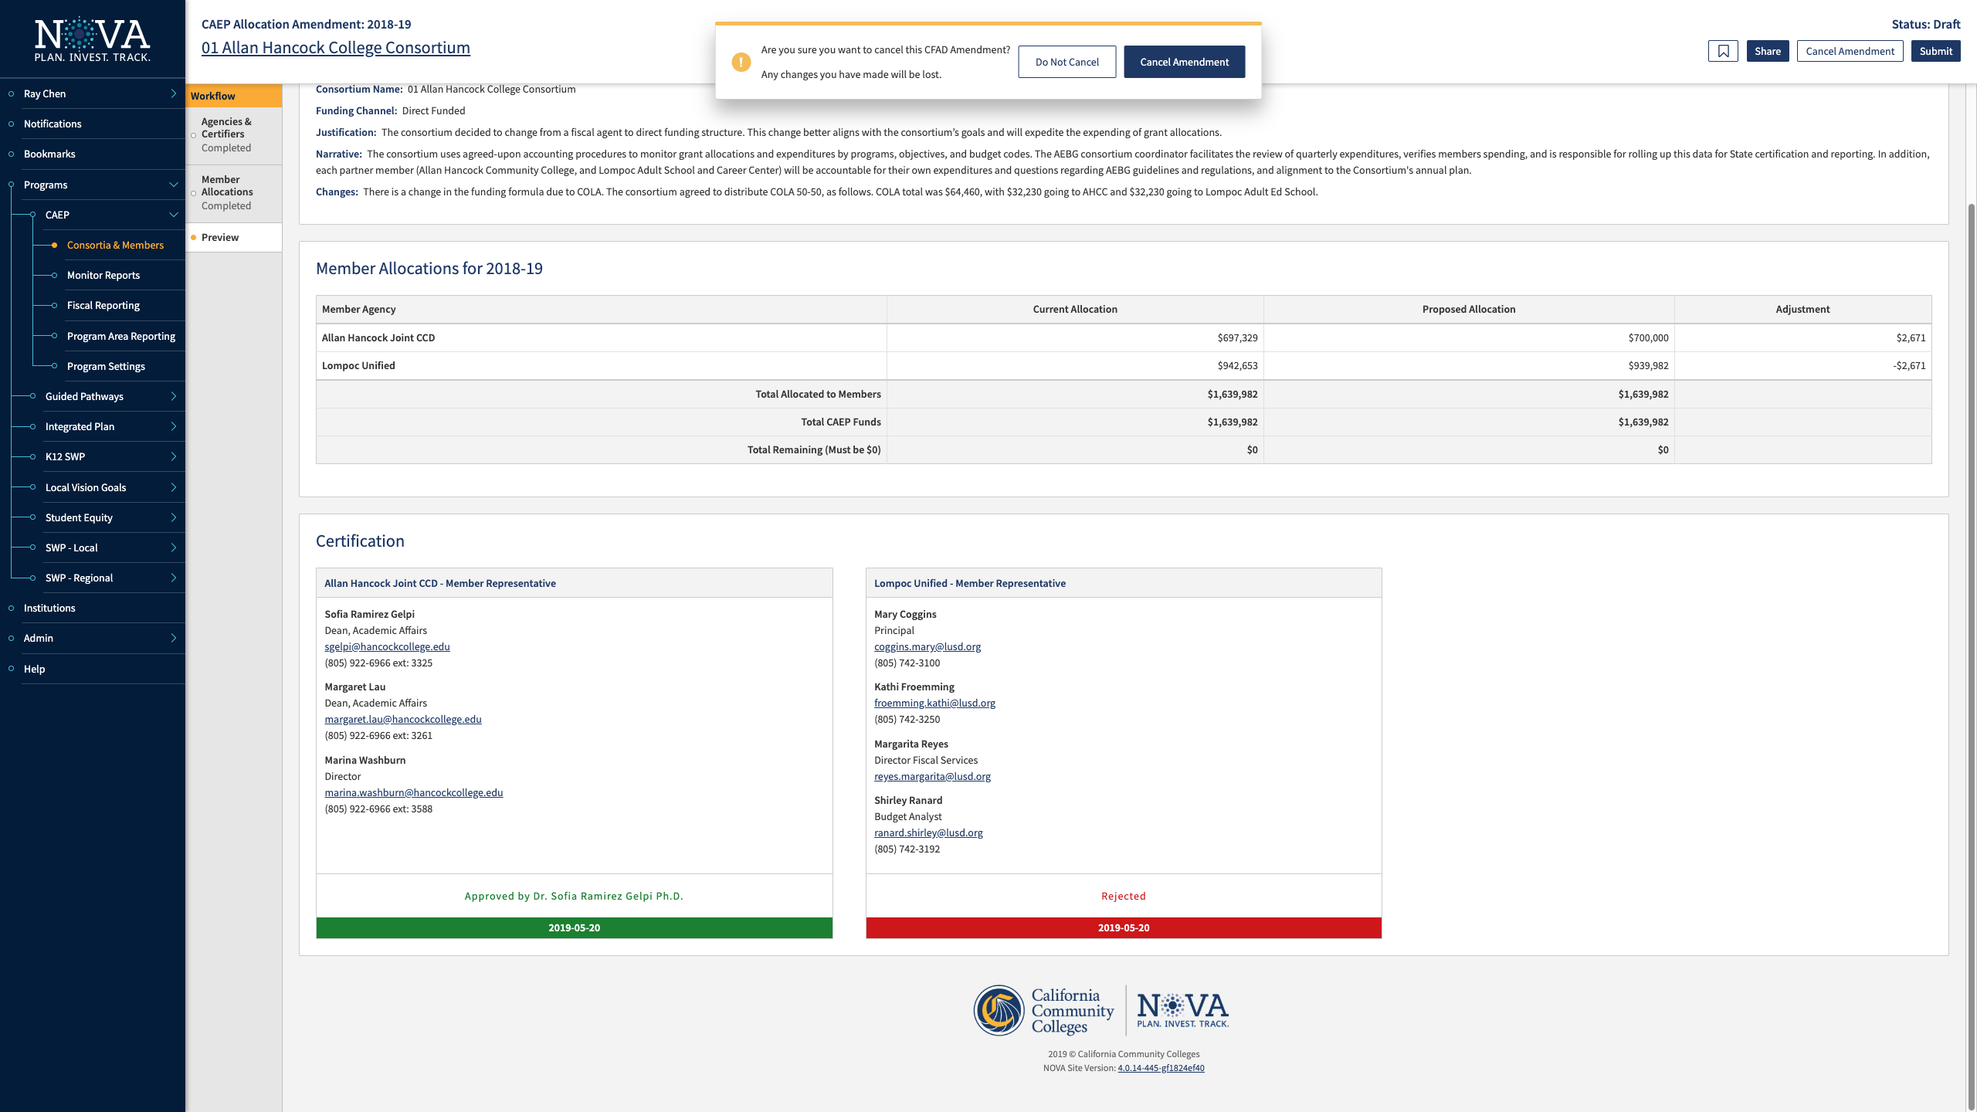

Slide 26
What happens if you miss the deadline?
CFAD amendment approval is due June 30, 2019.
What happens if my consortium & members don’t certify by then?
The State CAEP Office will use a proportional share to reduce the funding in NOVA.

Slide 27
Request Support from CAEP TAP

Slide 28
Upcoming Webinars and In-person Trainings

