Slide 1
AEP Data Dive Webinar
March 25, 2019

Slide 2
Agenda
Review of “Qualitative” program suggestions from Webinar on 2/20/19
Review of AEP Reports in TE
TE Drill Down & Supplemental Reports
Consortium level AEP Reports in TE
Agency Level Troubleshooting Examples
Consortium Level Troubleshooting Examples

Slide 3
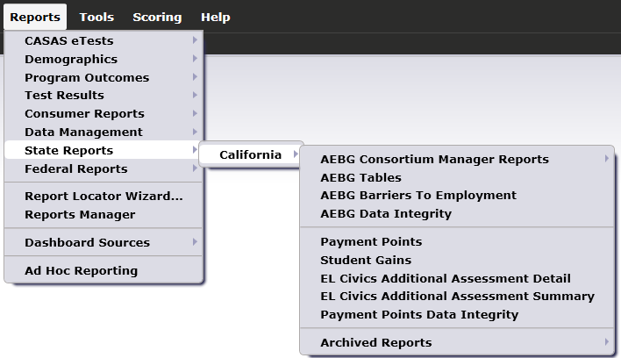
AEP Reports in TE are located by going to Reports – State Reports – California

Slide 4
Basic Questions from 2/20 Webinar:
Of those students with any AEP activity, how many enrolled in an instructional program? (Column L on AEP Summary)
Of those with program enrollment, how many students reached at least 12 hours of instruction? (Compare Columns E and L)
Of those who qualified for outcomes with 12+ hours, how many students achieved outcomes? (Columns E-K)
Of those who qualified with 12+ hours, how many students completed a pre/post-test pair? Of those, how many achieved a level gain? (Columns B-C)

Slide 5
Lo Performance
Hi Persistence
Hi Performance
Hi Persistence
Persistence
Performance
Lo Performance
Lo Persistence
Hi Performance
Lo Persistence

Slide 6
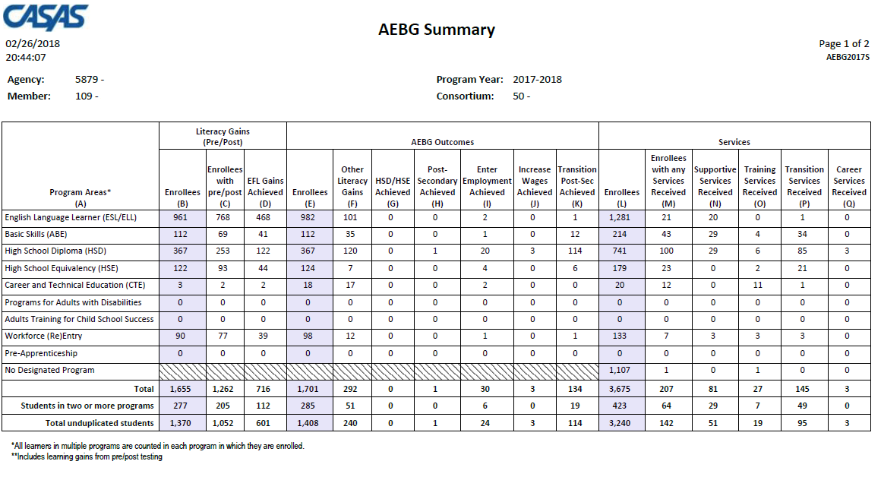
Displays outcomes in three separate sections:
Literacy Gains (Pre/Post) using NRS Table 4 guidelines
Other AB 104 outcomes using WIOA II reporting requirements but not pre/post
Services Received that do not impose WIOA II reporting requirements

Slide 7
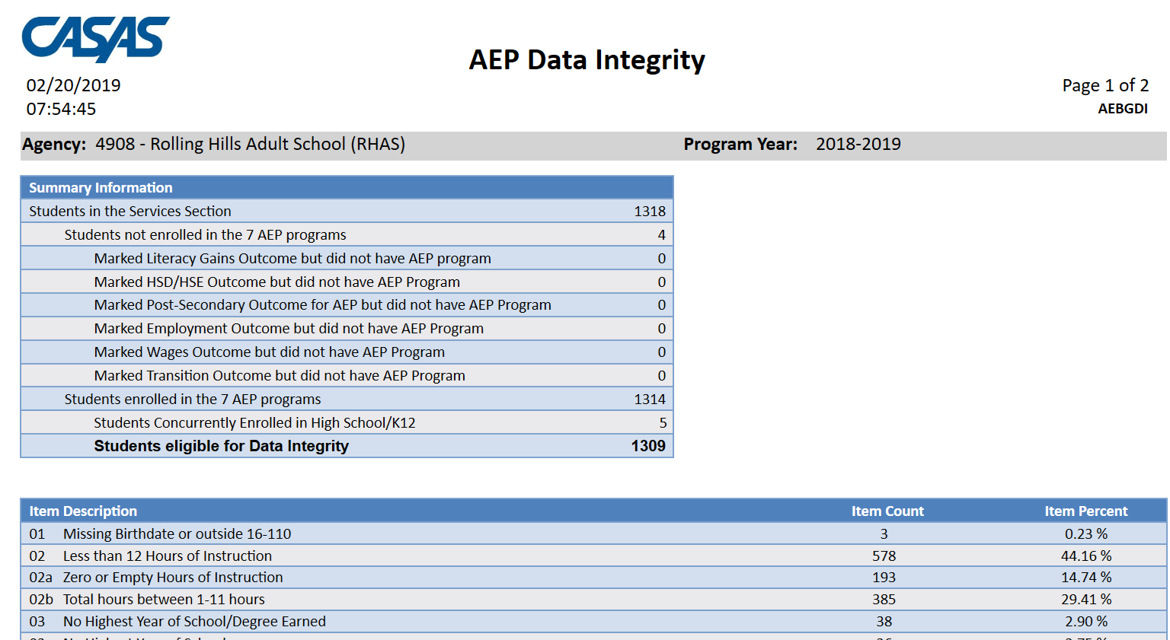
AEP Data Integrity displays 27 different data elements related to the AEP instructional programs and outcomes.
Item Description lists 27 data elements that may prevent or contribute to official AEP outcomes.
The DIR displays the item count and percentage for each listed item.
Item Percent = Item Count ÷ # of Students Enrolled in 7 AEP Programs

Slide 8
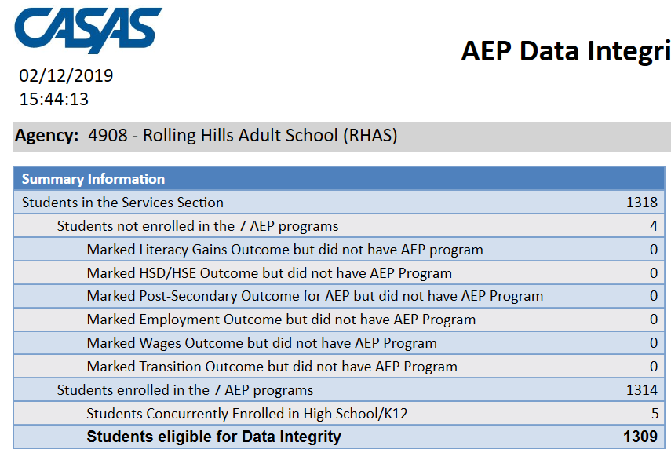
Summary Information reconciles all of the students included in AEP reporting.
Students in the Services Section includes everyone reported for AEP -- whether for official enrollment or for services only.
Students not enrolled in the 7 AEP programs subtracts those who received services but are not enrolled in one of the 7 AEP program areas.
The next 6 rows are subsets of those not enrolled in the 7 AEP programs – showing students not enrolled in program but who earned outcomes and may need enrollment.
Students in the Services Section
− Students not enrolled in the 7 AEP programs Students enrolled in the 7 AEP programs
Students enrolled in the 7 AEP programs is the total limited to students with official enrollment, and this number serves as the denominator for the 27 DIR items.

Slide 9
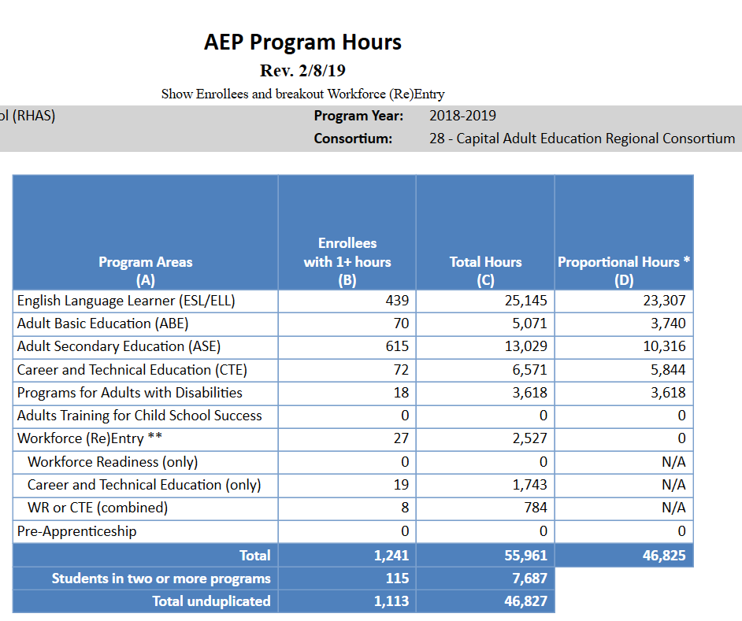

AEP Program Hours
AEP Program Hours displays instructional hours of AEP enrollees by program.
Use Table Option in the setup window to display the expanded format
ABE/ASE breakdown
Three ways of identifying Workforce Reentry
Total Hours vs. Proportional Hours

Slide 10
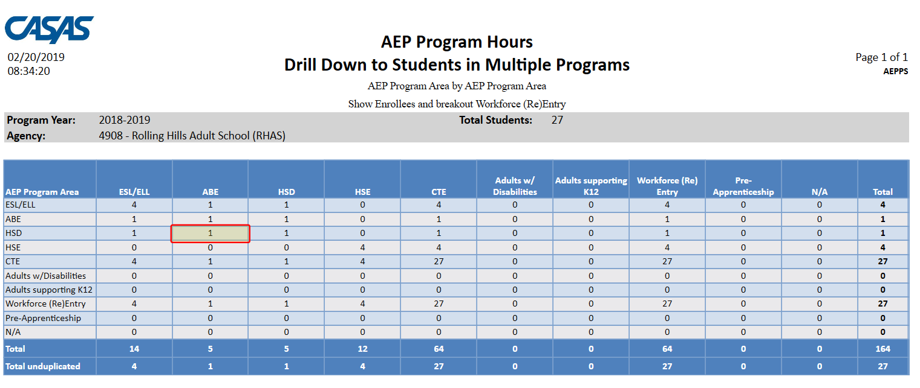
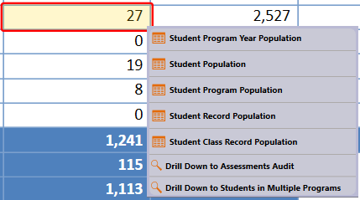
AEP Program Hours
Students in Multiple Programs generates item counts of students in more than one program

Slide 11
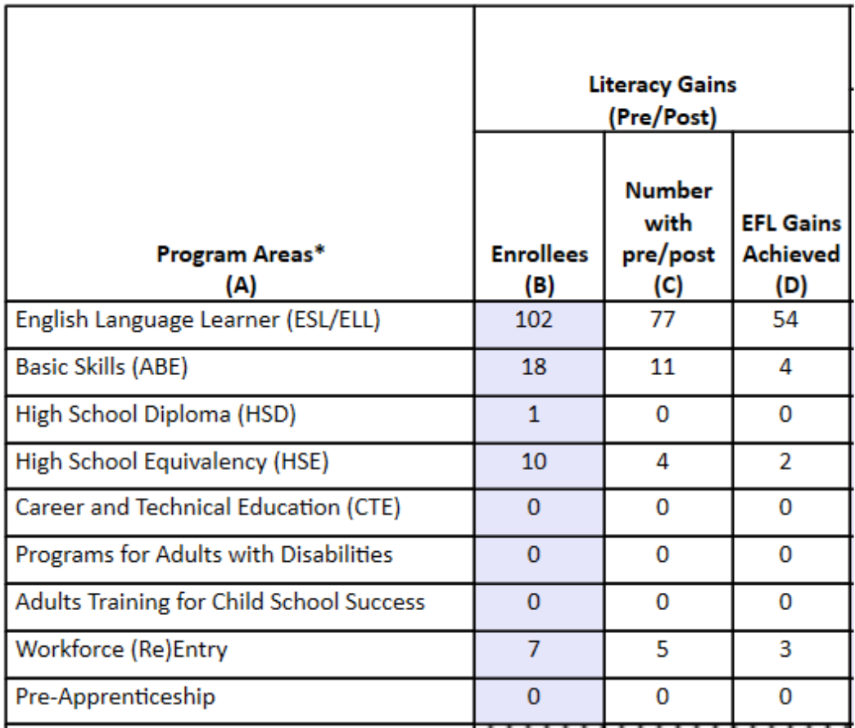
Click any cell to generate a list of students included in that cell.

Slide 12
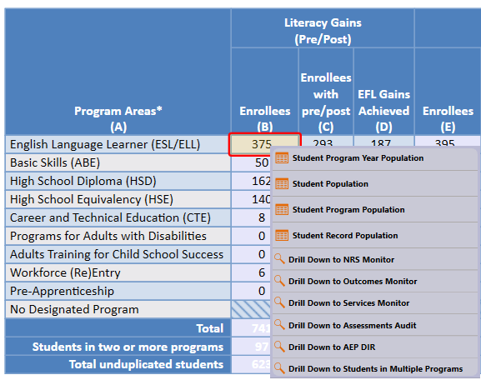
Right click any cell and select from 6 listers and 6 reports:

Slide 13
4 AEP drill down listers:
Student Program Year provides a simple list of students and matches the item count in the data cell
Student Population displays the TE demographics lister
Student Program Population lists student program enrollments
Student Record Population displays the lister that enables editing of specific AEP outcomes

Slide 14
6 AEP drill down reports:
NRS Monitor includes all students represented in the data cell with all AEP related details
Outcomes Monitor displays detailed outcomes from the 6 areas of AB 104 for each student
Services Monitor details specific services achieved by student
Assessments Audit lists pre/post-tests for each student
AEP DIR displays the entire DIR for the specific group of students selected
Students in Multiple Programs generates item counts of students in more than one program

Slide 15
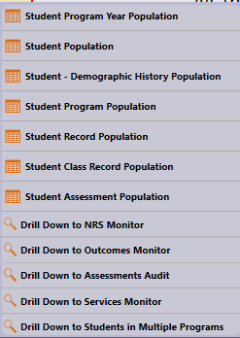
The AEP DIR has 2 additional right click options:
Student Class Record drills down to class level information to enable review of instructional hours
Student Assessment drills down to student level test results

Slide 16
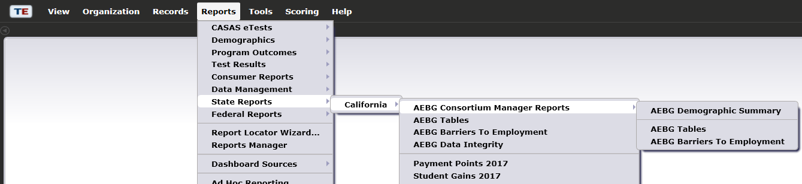
AEP Consortium Manager Reports allow a consortium level login to compare and contrast outcomes across agencies within one consortium.
Menu currently includes three reports options with this feature

Slide 17
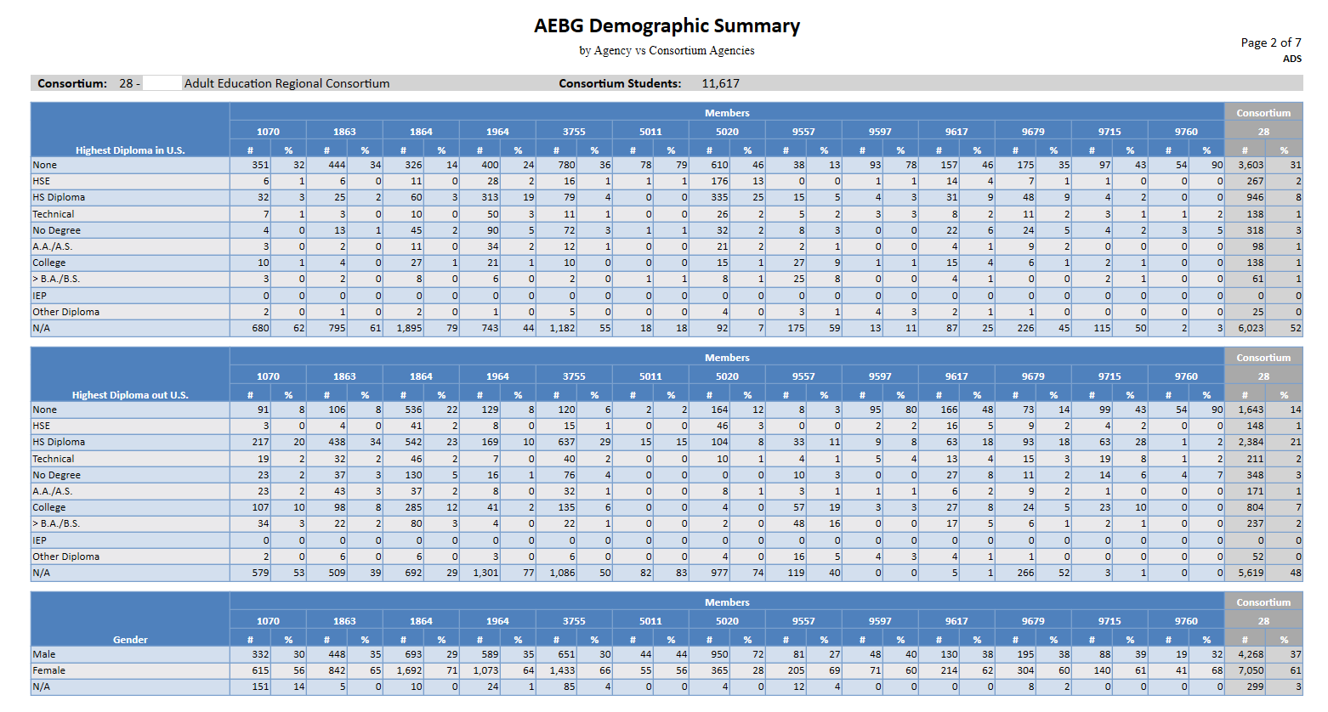

Slide 18

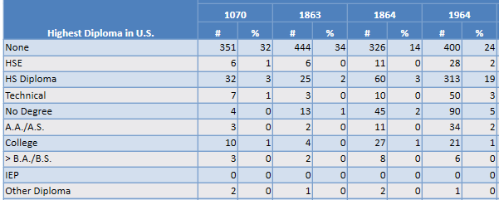
Lists item count and percentage by Agency ID
Aggregates results for the entire consortium on the right hand column

Slide 19

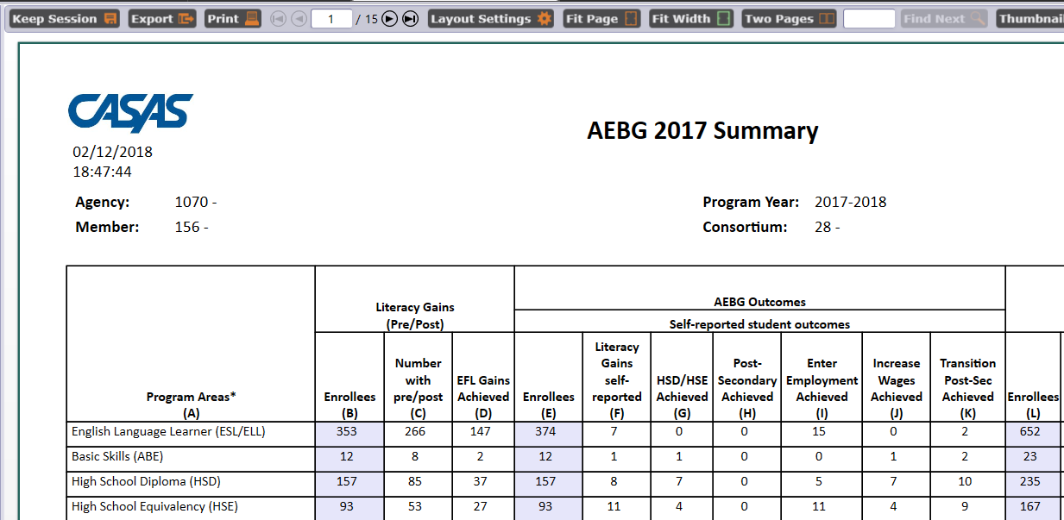
For the AEP Summary, the Consortium Manager reports provide separate pages for each agency in the consortium.

Slide 20
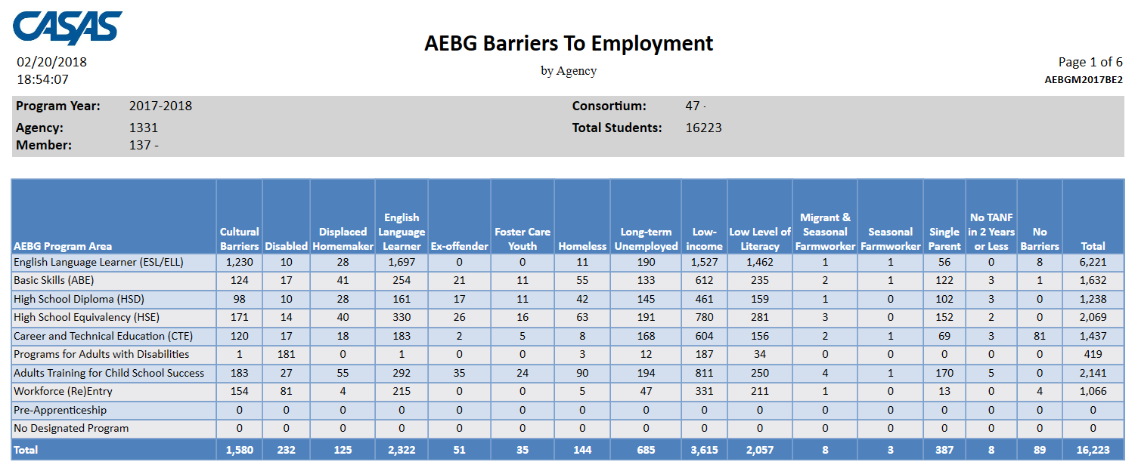
The Consortium Manager reports also provide separate pages when generating AEP Barriers to Employment.

Slide 21
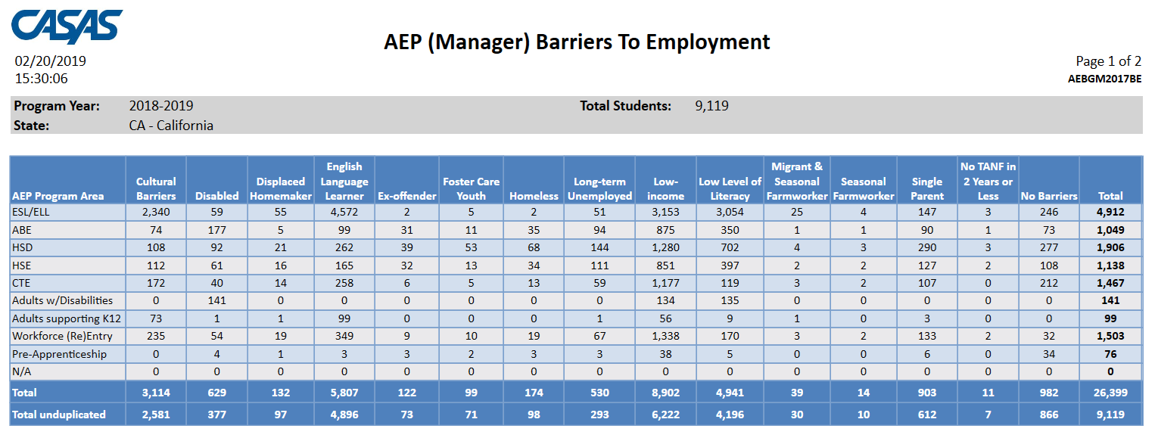
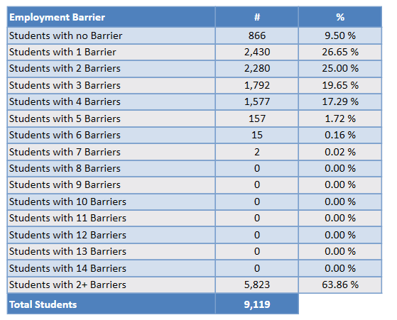
The AEP Barriers to Employment also lists frequency totals for number of barriers recorded overall.

Slide 22

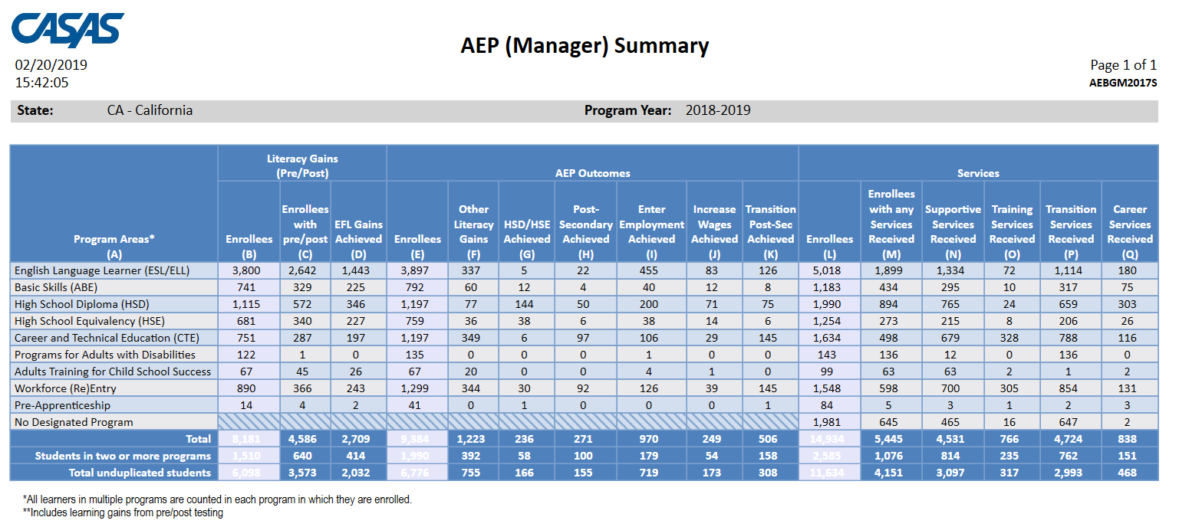
Click Aggregate Multiple Agencies to run a combined summary of all agencies in the consortium.

Slide 23
Examples of Agency Level Data Evaluation
Agencies: Use TE drill down features
Example 1: Basic DIR drill down illustration
Example 2: AEP Summary self-reported outcomes trouble shooting
Example 3: Using AEP specific numbers from the DIR
Example 4: AEP Program enrollment calculation
Example 5: AEP Program persistence calculation
Example 6: Combined AEP outcomes calculation
Example 7: Pre/post-test evaluation when persistence is low
Example 8: Pre/post-testing when persistence is good but pre/post performance is low

Slide 24
Example 1: the number of students missing an important data element is high, especially when compared to the number of reported students in the DIR overall. enrollees.

Slide 25
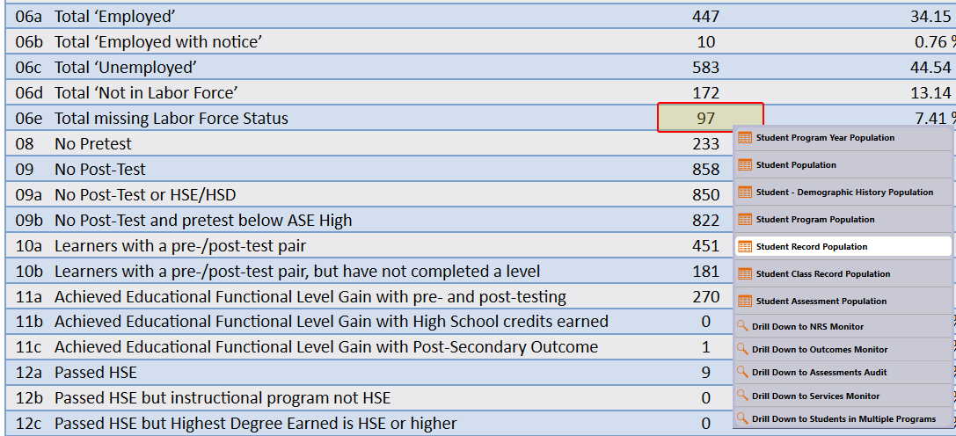
Solution: Right click the number of students missing Labor Force Status and drill down to “Student Record Population.”

Slide 26
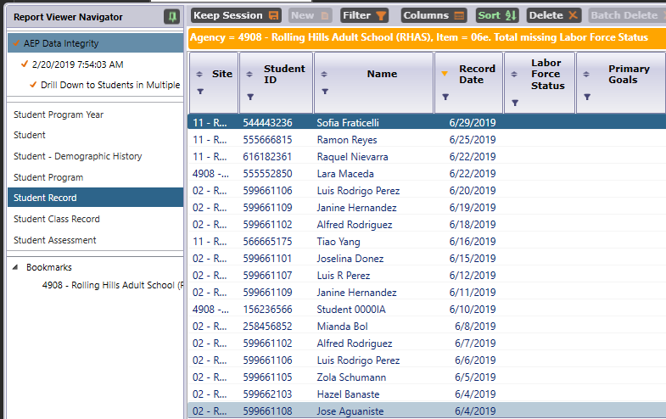
Solution: This takes you to the Records – Students – Records lister in TE – that is the lister that includes the records with Labor Force Status.

Slide 27
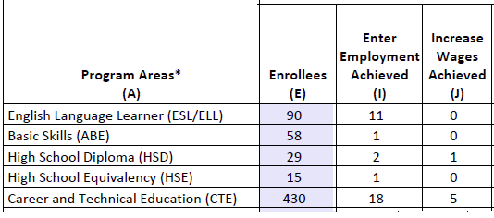
Example 2: the number of AEP outcomes is lower than expected, and low when compared to the number of enrollees.

Slide 28
Example 2: Right click the figures displayed in Columns E, I, and J, and generate the AEP DIR for the three different groups of students.
Compare the three reports to identify students with missing demographics and less than 12 hours of instruction.
Review DIR items specific to the outcome in question – in this example look at items 25a/25b for Employment and items 26a/26b for Wages.
High totals in 25b and 26b suggest “data clean up” is necessary to improve these outcomes.
Low totals in 25b/26b in relation to totals in 25a/26a suggest that the data is “clean” – but you may just need to input more positive outcomes.

Slide 29
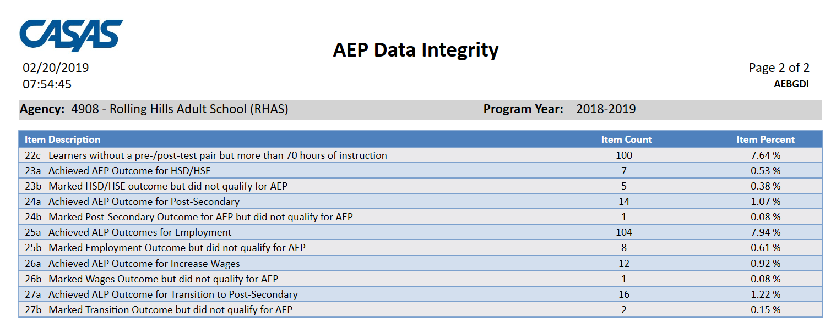
Example 3: the number of AEP outcomes is lower than expected, and low when compared to the number of enrollees.
Use the AEP DIR items 23-27 to evaluate the likely source of the problem.

Slide 30
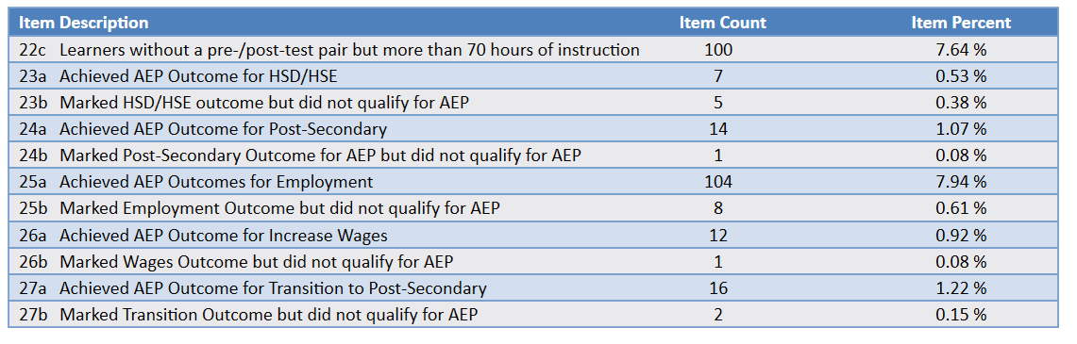
In 23a-23b for HSD/HSE, there are almost as many who marked the outcome & did not qualify as there are those who achieved the outcome.
In 25a-25b for Employment, almost all who marked an employment outcome qualified for the AEP outcome.

Slide 31
Basic Questions from 2/20 Webinar:
Of those students with any AEP activity, how many enrolled in an instructional program? (Column L)
Of those with program enrollment, how many students reached at least 12 hours of instruction? (Compare Columns E and L)
Of those who qualified for outcomes with 12+ hours, how many students achieved outcomes?
Of those who qualified with 12+ hours, how many students completed a pre/post-test pair? Of those, how many achieved a level gain?

Slide 32

Example 4: AEP Program Enrollment
Compare numbers of Enrollees across Column L
Subtract number in “No Designated Program” from “Total Unduplicated Students”
Divide that result from number in Total unduplicated students.
(8043 – 700) ÷ 8043 = 91.2%

Slide 33
Example 3: Compare item counts in 23a-27a to item counts in 23b-27b
If the large majority who marked AEP outcomes achieved the outcome (that is the b item count is much lower than the a item count) then the likely issue is the need to review and mark more outcomes for students.
If the number who marked the outcome but did not qualify is close to or exceeds the number who achieved that outcome (high item count in b) then the likely issue is the need to review drop reasons.

Slide 34
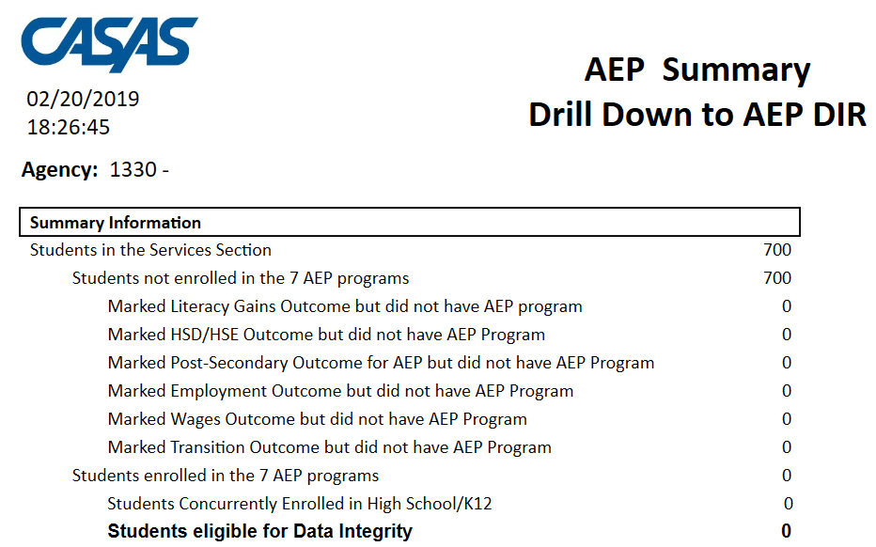
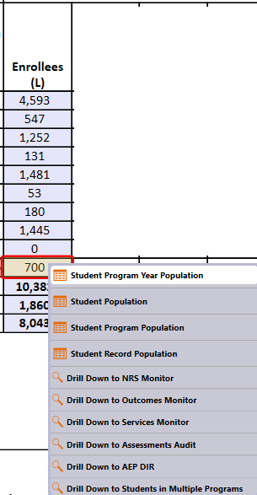
Verify “No designated program” item count by right clicking and drilling down to AEP DIR.
Identify “No designated program” students by right clicking to the In Program Years lister.

Slide 35

Example 5: AEP Program Persistence
Compare number of Enrollees in Columns E and L.
For services students in Column L, subtract the number in No Designated Program.
Divide the total in Column E with that result from Column L.
5119 ÷ (8043 - 700) = 69.7%

Slide 36
Example 5: AEP Program Persistence
Compare number of Enrollees in Columns E and L.
Look for specific areas where these numbers are different. In this example, 1) HSD/HSE, 2) CTE.
Right-click areas of concern:
  Select NRS Monitor to review instructional hours for each student
  Select AEP DIR and then investigate the students in DIR item #2 less than 12 hours
  Select Students In Program Years lister for both Columns E and L and compare the two lists.
5119 ÷ (8043 - 700) = 69.7%

Slide 37
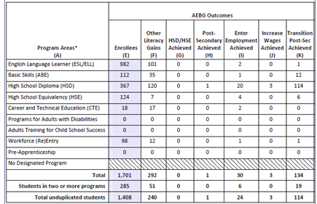
Example 6: AEP Program Outcomes
Add up total number of outcomes across the 6 AEP outcomes areas (Columns F-K)
Divide this total by total Enrollees in Column E
(240 + 0 + 1 + 24 + 3 + 114) ÷ 1408 = 27%

Slide 38
Example 6: AEP Program Outcomes
Review the total number of outcomes in each of the 6 AEP outcomes areas (Columns F-K)
Look for areas that may need to improve (Column F looks good; others may need improvement)
Right click the cells that are areas of concern:
  Select Outcomes Monitor to review more specific outcomes earned
  Select AEP DIR and compare items 23-27 like in Example #2
(240 + 0 + 1 + 24 + 3 + 114) ÷ 1408 = 27%

Slide 39
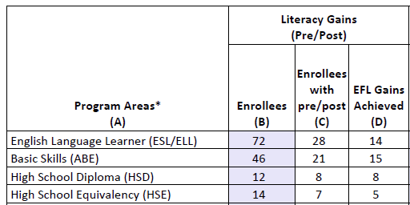
Example 7 & 8: the number of pre/post-test learning gains is low as compared to the number of enrollees.

Slide 40
Solution:
Compare the number of enrollees (Column B) with the number of enrollees with pre/post (Column C).
If these numbers in Columns B and C are far apart (like in the example above) then you need to ensure all students complete a pre/post-test pair.
If Columns B and C numbers are similar (rule of thumb: Column C should be equal to or greater than 70% of Column B) then you have done well completing testing for your students, but you should review students test scores and learning gains, and evaluate performance in the classroom to improve individual test results.

Slide 41
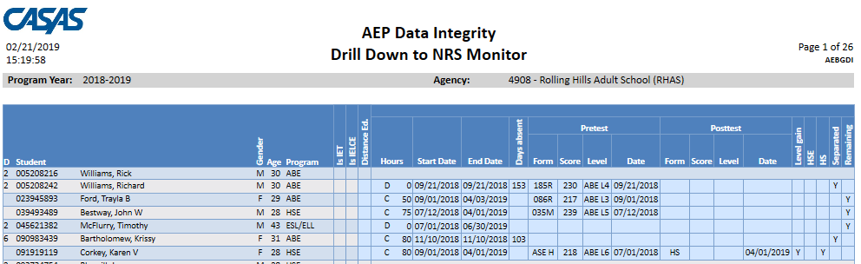
Solution: Generate NRS Monitor
If these numbers in Columns B and C are far apart (like in the example above) then you need to ensure all students complete a pre/post-test pair.
  Right click to generate NRS Monitor to identify students who have qualified enrollment but no pre/post-test pair.
If Columns B and C are similar (rule of thumb: Column C should be equal to or greater than 70% of Column B) then review students test scores and evaluate performance in the classroom to improve test results.
  Right click to generate NRS Monitor to identify students test performance and highlight students with zero or minimal gains.

Slide 42
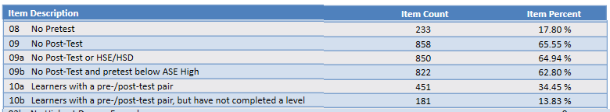
Solution: Drill down to AEP DIR and review DIR items 8, 9, and 10
If these numbers in Columns B and C are far apart (like in the example above) then you need to ensure all students complete a pre/post-test pair.
  Right click to generate AEP DIR and investigate items 8 and 9 to identify students who have qualified enrollment but no pre/post-test pair.
If Columns B and C are similar (rule of thumb: Column C should be equal to or greater than 70% of Column B) then review students test scores and evaluate performance in the classroom to improve test results.
  Right click to generate AEP DIR and investigate items 10a-10b to identify students with pairs/and who have not achieved a level gain.

Slide 43
Examples of Consortium Level Data Evaluation
Consortia: Convert TE consortium reports to Excel
Example 1: Filter by agency and program
Example 2: Isolate for a specific AEP outcome area
Example 3: AEP Program enrollment calculation
Example 4: AEP Program persistence calculation
Example 5: Combined AEP outcomes calculation
Example 6: Use Excel to compute consortium wide performance and persistence percentages
Example 7: Create charts and graphs

Slide 44
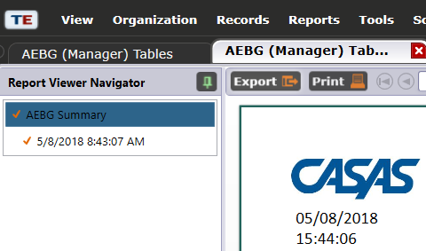
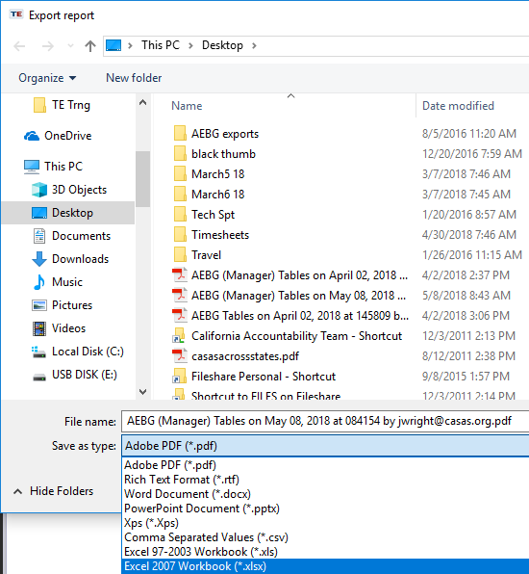

Creating Excel Spreadsheets in TE
Convert any TE report into an Excel spreadsheet by clicking Export, then Save As Excel.

Slide 45
The resulting Excel worksheet includes all data elements from the AEP Summary.

Slide 46
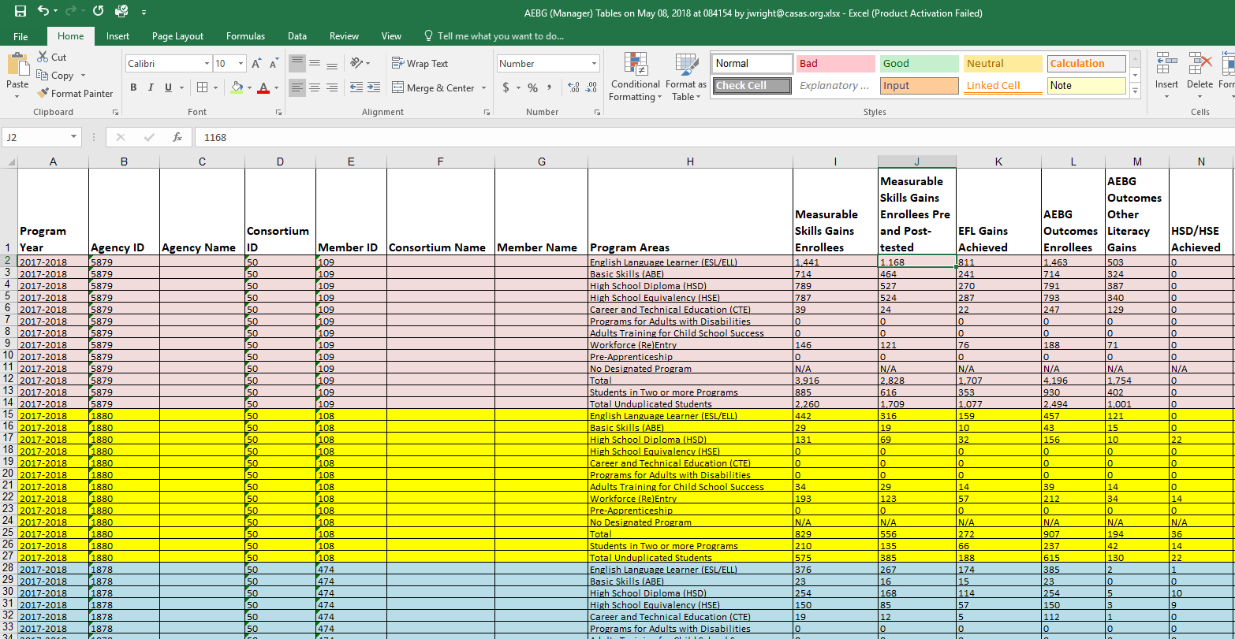
Use features in Excel to highlight key data points from the AEP report in TE.

Slide 47
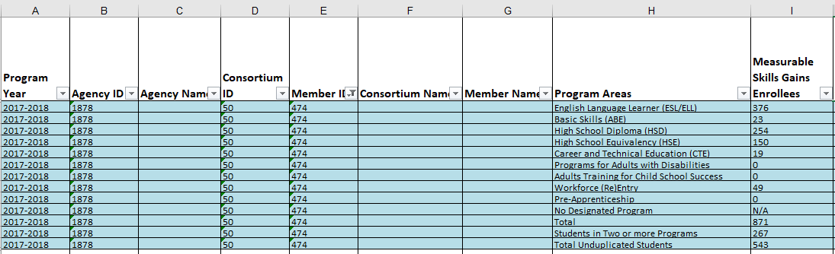
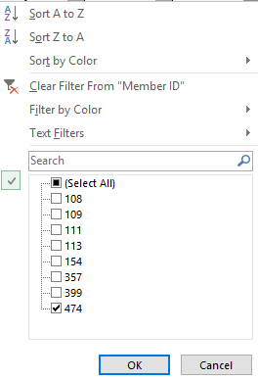
Example 1: Filter the spreadsheet by individual agency.

Slide 48
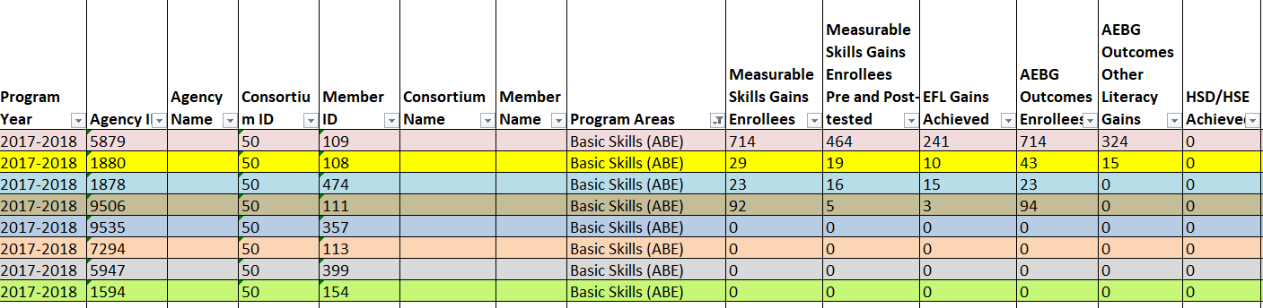
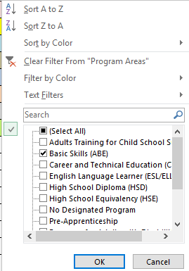
Example 1: Filter by instructional program area across all agencies.

Slide 49
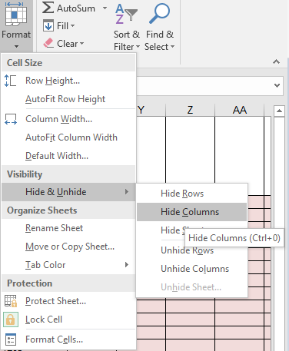
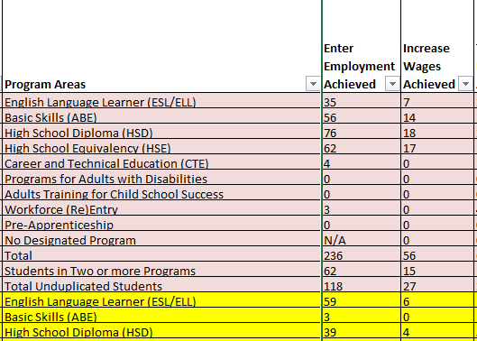
Example 2: Format cells to isolate key data points.

Slide 50
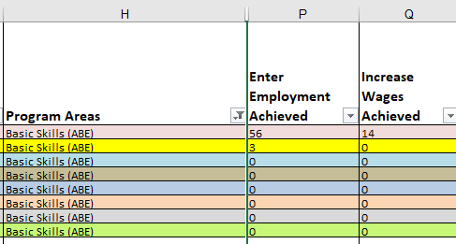
Example 2: In this example, the document uses filtering and formatting to isolate specific data results.

Slide 51
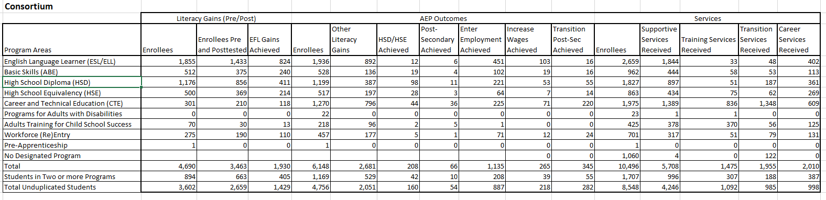
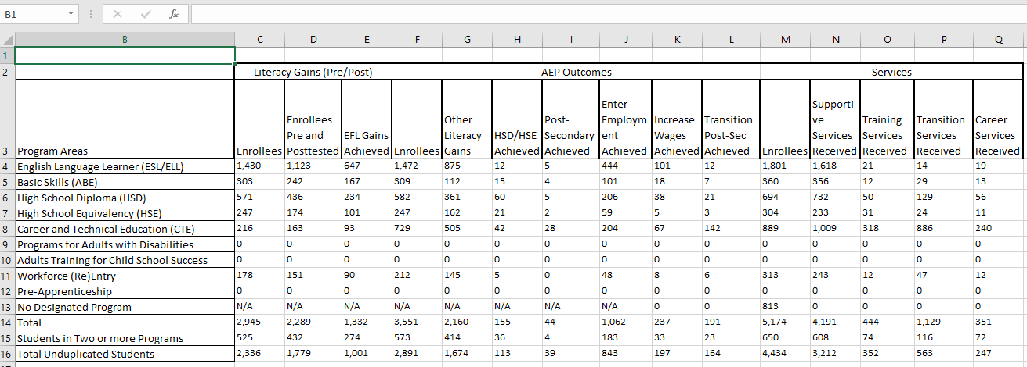
Making Simple Calculations in Excel
Using the consortium level AEP Summary, you can convert the consortium wide or individual agency level AEP Summary reports into Excel.

Slide 52
Basic Questions from 2/20 Webinar:
Of those students with any AEP activity, how many enrolled in an instructional program? (Column L)
Of those with program enrollment, how many students reached at least 12 hours of instruction? (Compare Columns E and L)
Of those who qualified for outcomes with 12+ hours, how many students achieved outcomes?
Of those who qualified with 12+ hours, how many students completed a pre/post-test pair? Of those, how many achieved a level gain?

Slide 53
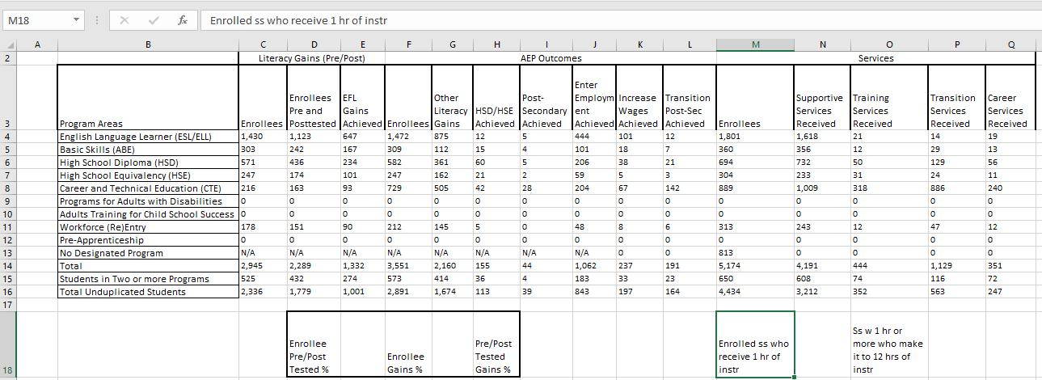
Example 3: AEP Program Enrollment
Compare numbers of Enrollees across Column M (Excel columns may be different than what’s in TE)
Subtract number in “No Designated Program” from “Total Unduplicated Students”
Divide that result from number in Total unduplicated students.

Slide 54
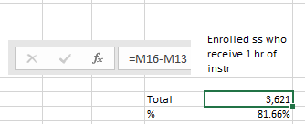
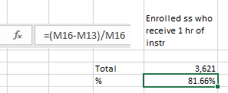
Example 3: AEP Program Enrollment
Compare numbers of Enrollees across Column M
Subtract number in “No Designated Program” from “Total Unduplicated Students”
Divide that result from number in Total unduplicated students.
4434 ÷ (4434-813) = 81.6%

Slide 55
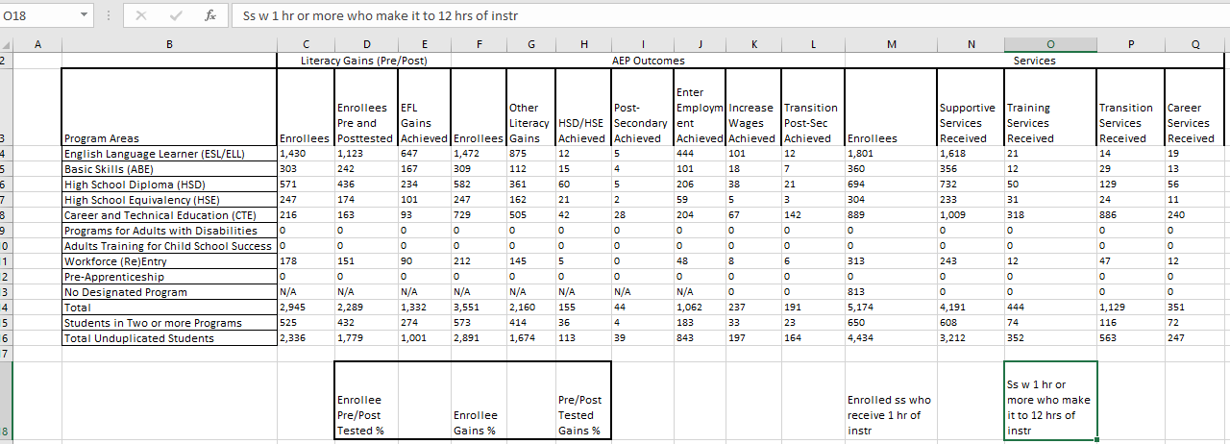
Example 4: AEP Program Persistence
Compare number of Enrollees in Columns F and M (E and L on the TE AEP Summary).
For services students in Column L, subtract the number in No Designated Program.
Divide the total in Column E with that result from Column L.

Slide 56
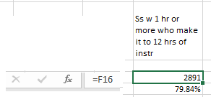
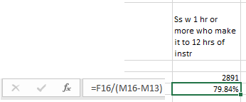
Example 4: AEP Program Persistence
Compare number of Enrollees in Columns F and M (E and L on the TE AEP Summary).
For services students in Column M, subtract the number in No Designated Program.
Divide the total in Column F with that result from Column M.
2891 ÷ (4434-813) = 79.8%

Slide 57
Example 5: AEP Program Outcomes
Add up total number of outcomes across the 6 AEP outcomes areas (Columns G-L in Excel)
Divide this total by total Enrollees in Column F

Slide 58

Example 5: AEP Program Outcomes
Add up total number of outcomes across the 6 AEP outcomes areas (Columns G-L in Excel)
Divide this total by total Enrollees in Column F
(1,674 + 113 + 39 + 843 + 197 + 164) ÷ 2891 = 104.8%!!!

Slide 59
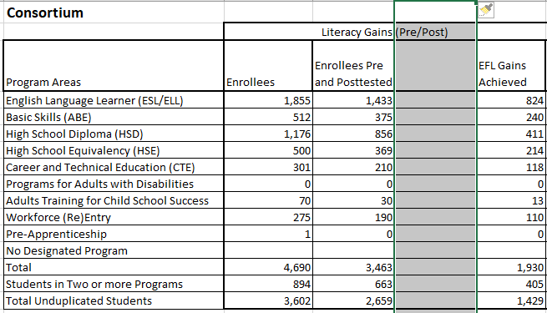
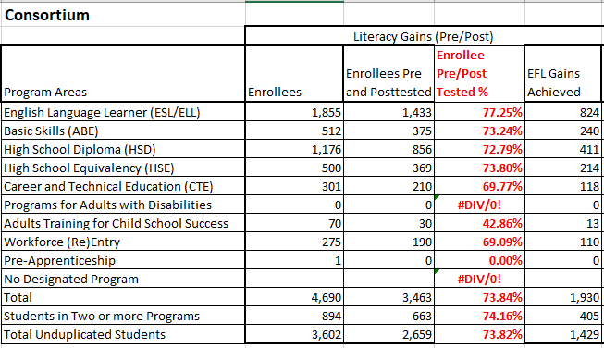
Example 6: Making Simple Calculations in Excel
Example 6: This example calculates the pre/post persistence rates for each AEP program.

Slide 60
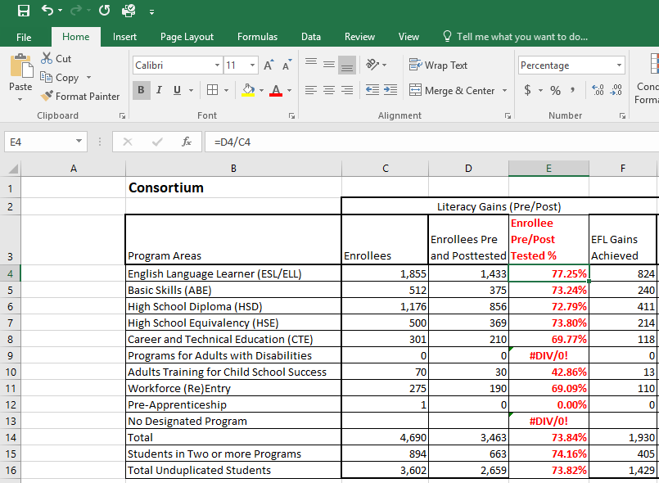
Making Simple Calculations in Excel
Divide the number of students who pre/post-tested in Column D by the total number of enrollees in Column C
Once you type in the first formula, you can drag that cell down to view the same calculation for all rows in the spreadsheet

Slide 61

Making Simple Calculations in Excel
Add another column next to EFL Gains to make the same calculation for pre/post-test performance rates by program.

Slide 62
Making Simple Calculations in Excel
Divide the number of students who achieved a pre/post-test EFL gain (Column F in this example) by the total number of enrollees in Column C

Slide 63
Making Simple Calculations in Excel
Use this same technique to calculate percentages for other AEP outcomes – this example compares Transitions outcomes totals to totals of Enrollees in Column F.

Slide 64

Example 7: Creating Charts and Graphs in Excel
Highlight the cells for which you wish to create the chart
In Excel, go to the Insert menu to select the specific chart or graph

Slide 65
Creating Charts and Graphs in Excel
Once you create the chart, you can use additional features to further customize it.
In this example, we added a title, changed the color of the bars, and added item counts to each

Slide 66

This example uses TE and Excel to evaluate results from AEP Barriers to Employment.

Slide 67

This example uses TE and Excel to evaluate results from the Demographics Summary.

