Slide 1
AEP Data Dive Webinar
March 27, 2019

Slide 2
Agenda
Review Part I from 3/25/19
Review of “Qualitative” program suggestions from Webinar on 2/20/19
Review of AEP Reports in TE
Consortium level AEP Reports in TE
Consortium Level Troubleshooting Examples

Slide 3
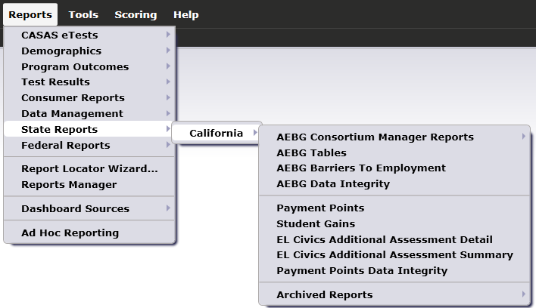
AEP Reports in TE are located by going to Reports – State Reports – California

Slide 4
Basic Questions from 2/20 Webinar:
Of those students with any AEP activity, how many enrolled in an instructional program? (Column L on AEP Summary)
Of those with program enrollment, how many students reached at least 12 hours of instruction? (Compare Columns E and L)
Of those who qualified for outcomes with 12+ hours, how many students achieved outcomes? (Columns E-K)
Of those who qualified with 12+ hours, how many students completed a pre/post-test pair? Of those, how many achieved a level gain? (Columns B-C)

Slide 5
Lo Performance
Hi Persistence
Hi Performance
Hi Persistence
Persistence
Performance
Lo Performance
Lo Persistence
Hi Performance
Lo Persistence

Slide 6
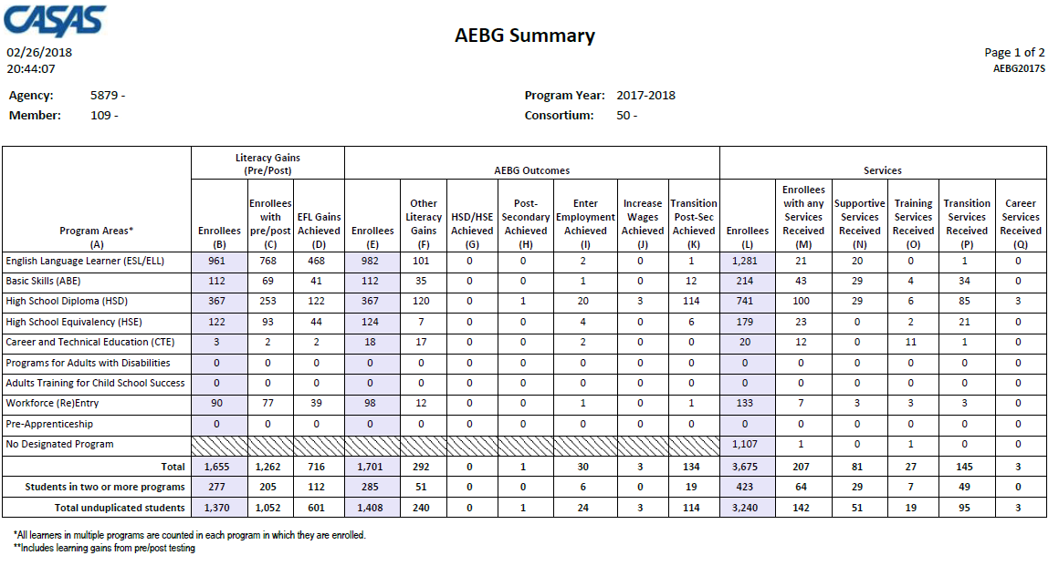
Displays outcomes in three separate sections:
Literacy Gains (Pre/Post) using NRS Table 4 guidelines
Other AB 104 outcomes using WIOA II reporting requirements but not pre/post
Services Received that do not impose WIOA II reporting requirements

Slide 7
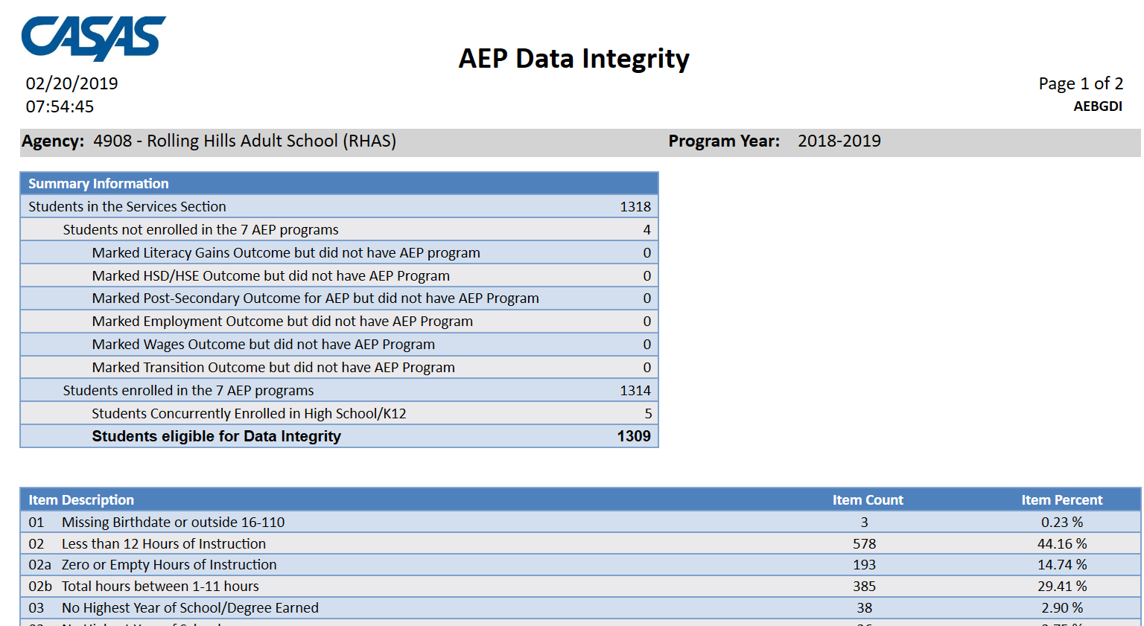
AEP Data Integrity displays 27 different data elements related to the AEP instructional programs and outcomes.
Item Description lists 27 data elements that may prevent or contribute to official AEP outcomes.
The DIR displays the item count and percentage for each listed item.
Item Percent = Item Count ÷ # of Students Enrolled in 7 AEP Programs

Slide 8
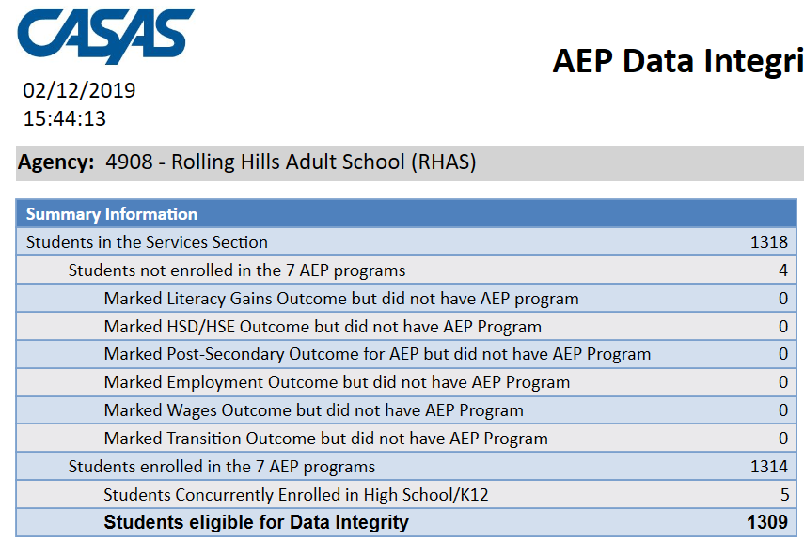
Summary Information reconciles all of the students included in AEP reporting.
Students in the Services Section includes everyone reported for AEP -- whether for official enrollment or for services only.
Students not enrolled in the 7 AEP programs subtracts those who received services but are not enrolled in one of the 7 AEP program areas.
The next 6 rows are subsets of those not enrolled in the 7 AEP programs – showing students not enrolled in program but who earned outcomes and may need enrollment.
Students in the Services Section
− Students not enrolled in the 7 AEP programs Students enrolled in the 7 AEP programs
Students enrolled in the 7 AEP programs is the total limited to students with official enrollment, and this number serves as the denominator for the 27 DIR items.

Slide 9
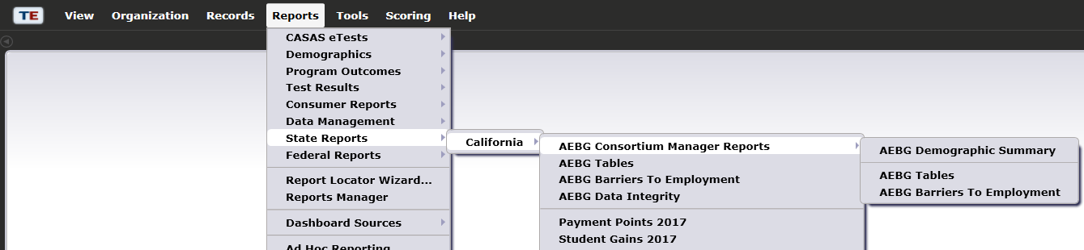
AEP Consortium Manager Reports allow a consortium level login to compare and contrast outcomes across agencies within one consortium.
Menu currently includes three reports options with this feature

Slide 10
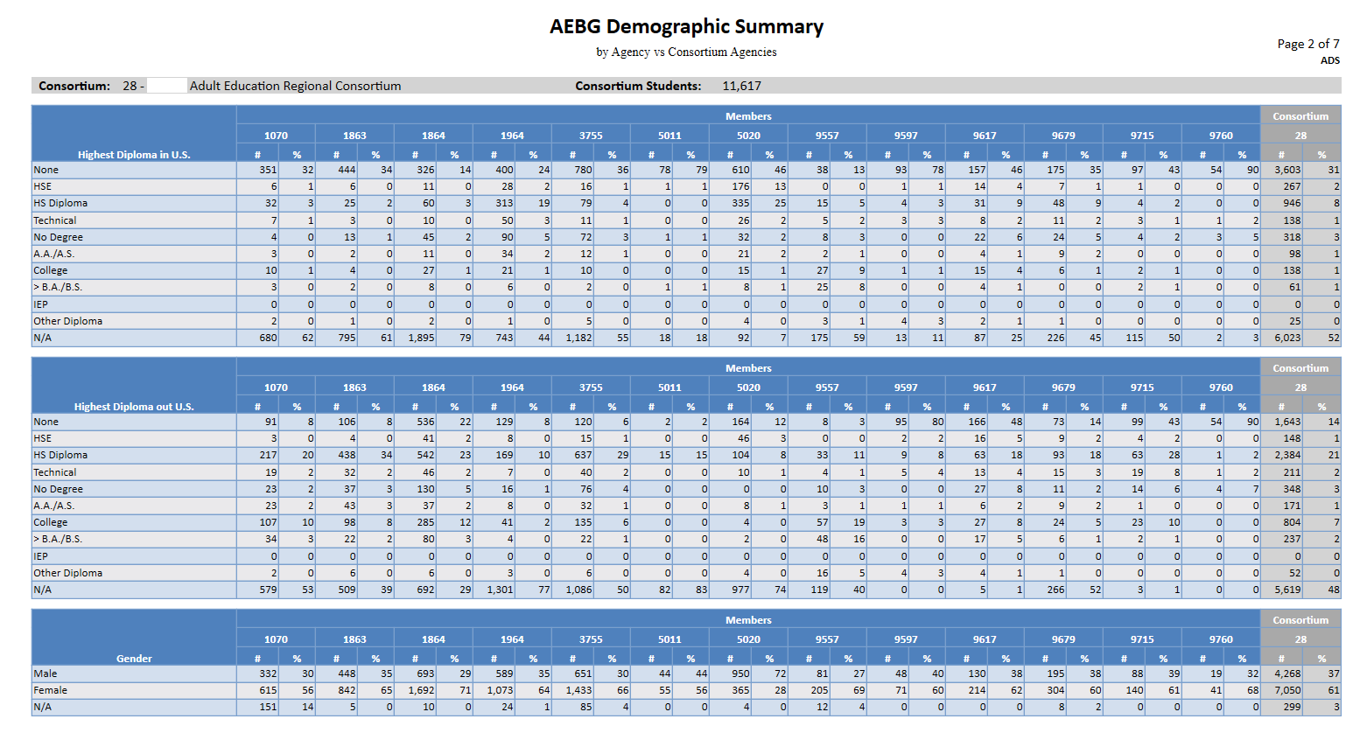

Slide 11

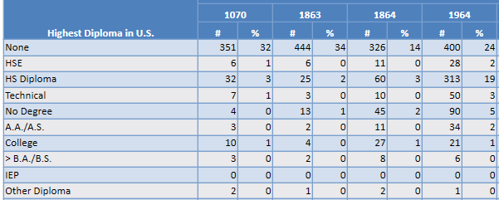
Lists item count and percentage by Agency ID
Aggregates results for the entire consortium on the right hand column

Slide 12

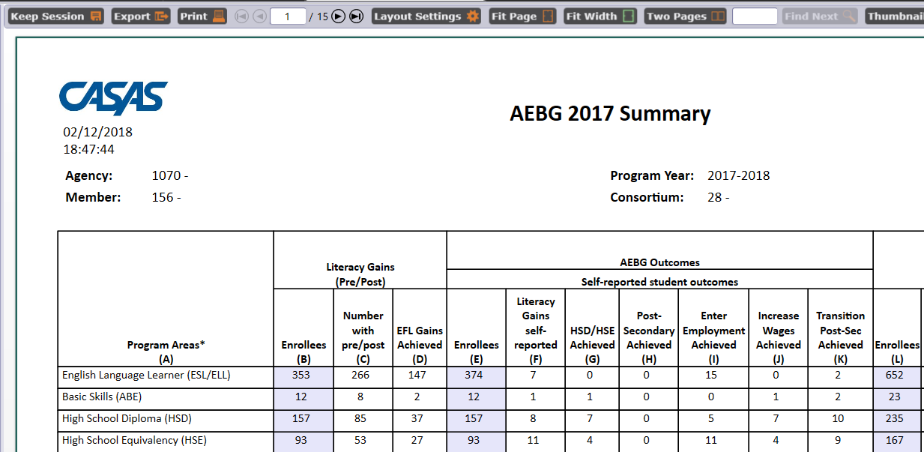
For the AEP Summary, the Consortium Manager reports provide separate pages for each agency in the consortium.

Slide 13
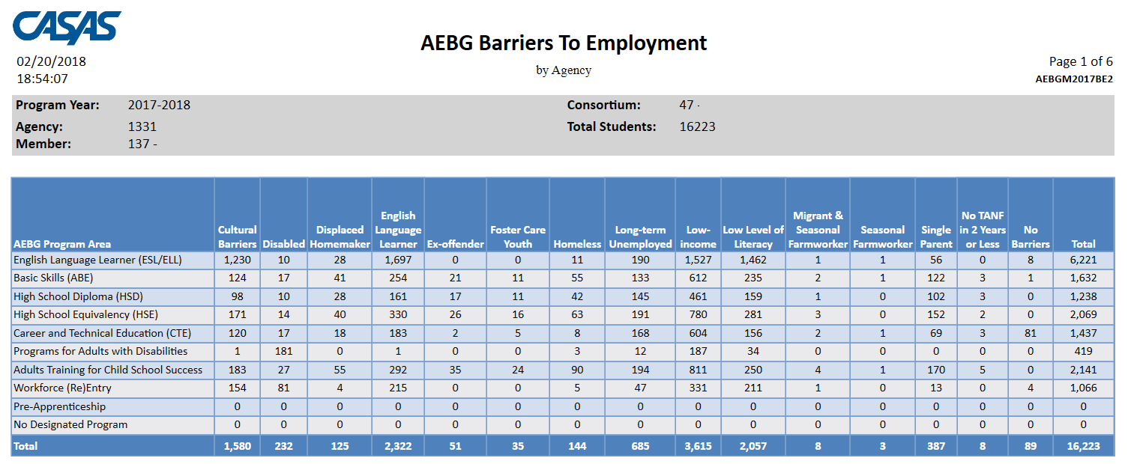
The Consortium Manager reports also provide separate pages when generating AEP Barriers to Employment.

Slide 14
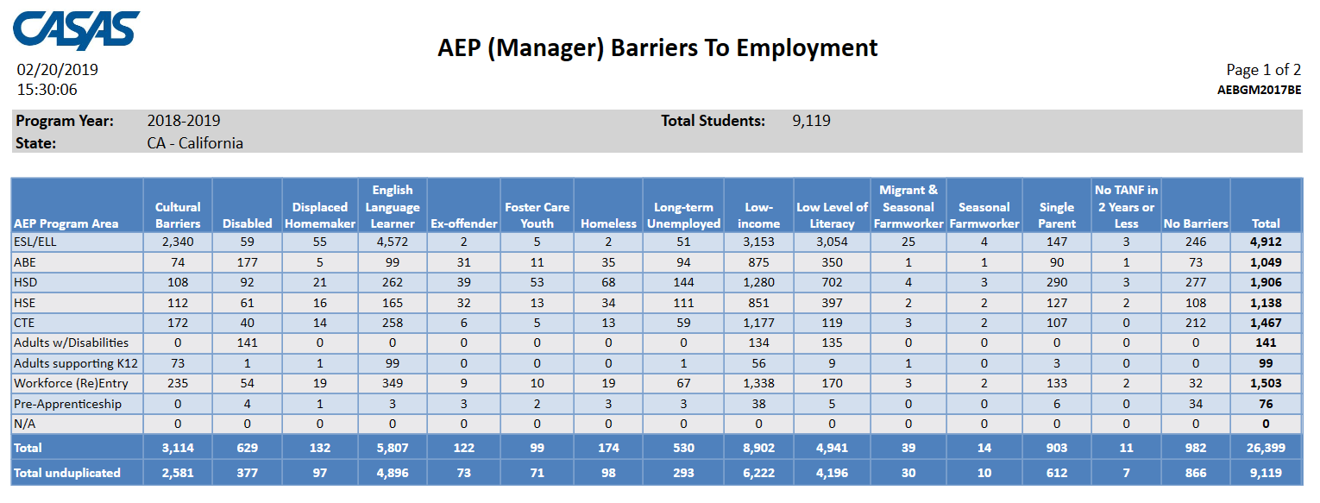
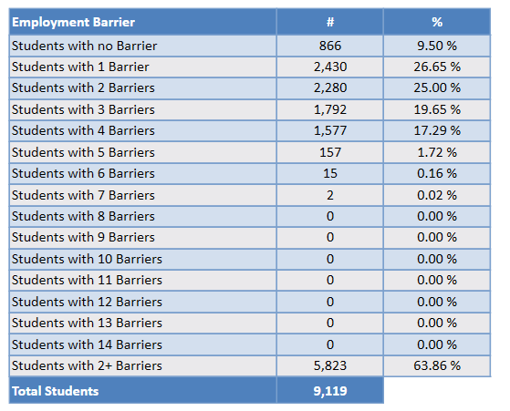
The AEP Barriers to Employment also lists frequency totals for number of barriers recorded overall.

Slide 15

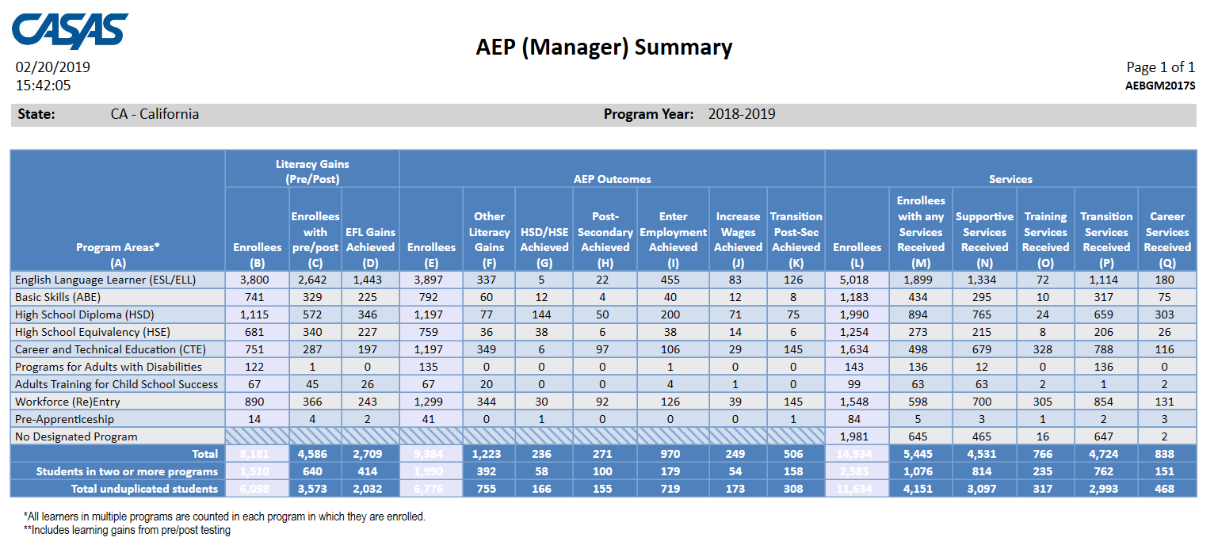
Click Aggregate Multiple Agencies to run a combined summary of all agencies in the consortium.

Slide 16
Examples of Agency Level Data Evaluation
Agencies: Use TE drill down features
Example 1: Basic DIR drill down illustration
Example 2: AEP Summary self-reported outcomes trouble shooting
Example 3: Using AEP specific numbers from the DIR
Example 4: AEP Program enrollment calculation
Example 5: AEP Program persistence calculation
Example 6: Combined AEP outcomes calculation
Example 7: Pre/post-test evaluation when persistence is low
Example 8: Pre/post-testing when persistence is good but pre/post performance is low

Slide 17
Basic Questions from 2/20 Webinar:
Of those students with any AEP activity, how many enrolled in an instructional program? (Column L)
Of those with program enrollment, how many students reached at least 12 hours of instruction? (Compare Columns E and L)
Of those who qualified for outcomes with 12+ hours, how many students achieved outcomes?
Of those who qualified with 12+ hours, how many students completed a pre/post-test pair? Of those, how many achieved a level gain?

Slide 18
Lo Performance
Hi Persistence
Hi Performance
Hi Persistence
Persistence
Performance
Lo Performance
Lo Persistence
Hi Performance
Lo Persistence

Slide 19
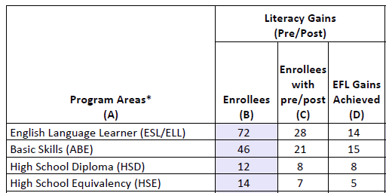
Solution:
Compare the number of enrollees (Column B) with the number of enrollees with pre/post (Column C).
If these numbers in Columns B and C are far apart (like in the example above) then you need to ensure all students complete a pre/post-test pair.
If Columns B and C numbers are similar (rule of thumb: Column C should be equal to or greater than 70% of Column B) then you have done well completing testing for your students, but you should review students test scores and learning gains, and evaluate performance in the classroom to improve individual test results.

Slide 20
If these numbers in Columns B and C are far apart (like in the example above) then you need to ensure all students complete a pre/post-test pair.
  Right click to generate NRS Monitor to identify students who have qualified enrollment but no pre/post-test pair.
If Columns B and C are similar (rule of thumb: Column C should be equal to or greater than 70% of Column B) then review students test scores and evaluate performance in the classroom to improve test results.
  Right click to generate NRS Monitor to identify students test performance and highlight students with zero or minimal gains.

Slide 21
Examples of Consortium Level Data Evaluation
Consortia: Convert TE consortium reports to Excel
Example 1: Filter by agency and program
Example 2: Isolate for a specific AEP outcome area
Example 3: AEP Program enrollment calculation
Example 4: AEP Program persistence calculation
Example 5: Combined AEP outcomes calculation
Example 6: Use Excel to compute consortium wide performance and persistence percentages
Example 7: Create charts and graphs

Slide 22
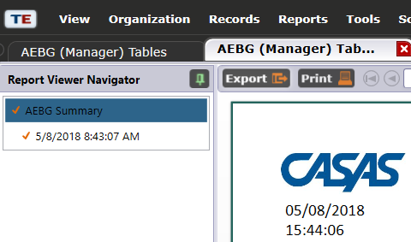
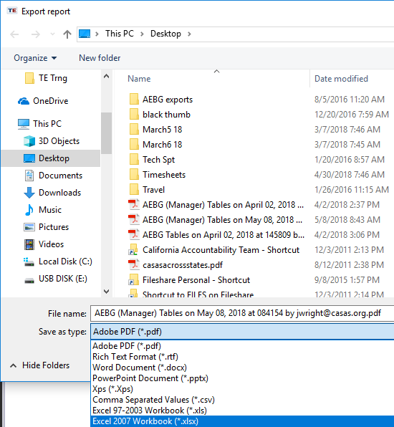

Creating Excel Spreadsheets in TE
Convert any TE report into an Excel spreadsheet by clicking Export, then Save As Excel.

Slide 23
The resulting Excel worksheet includes all data elements from the AEP Summary.

Slide 24
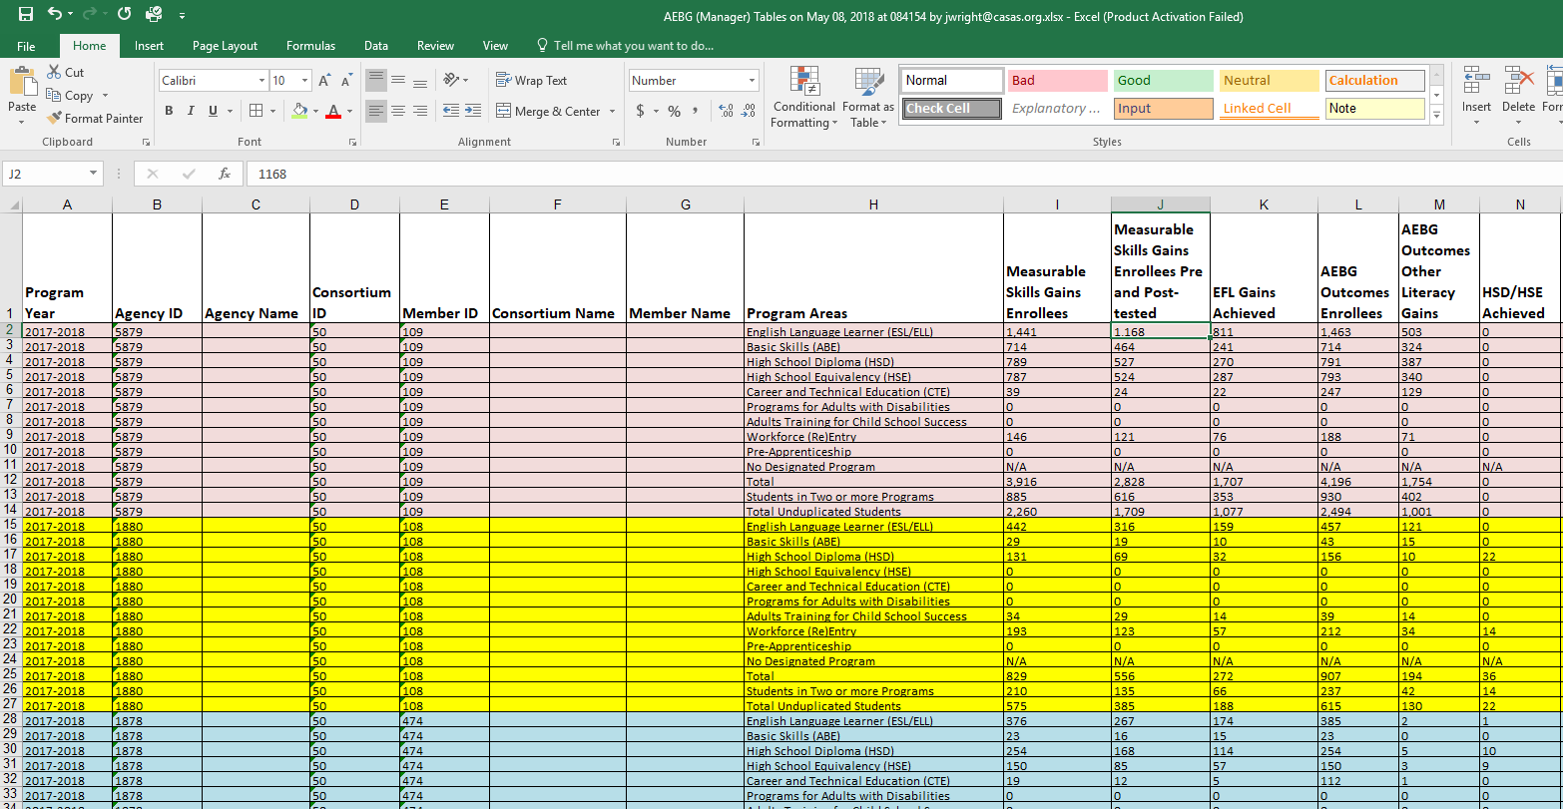
Use features in Excel to highlight key data points from the AEP report in TE.

Slide 25
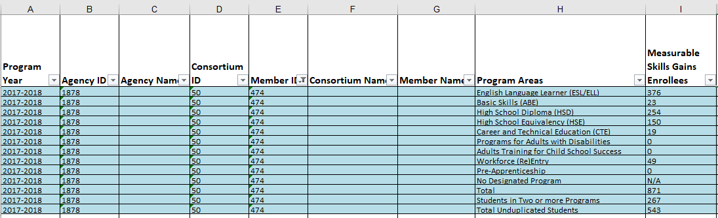
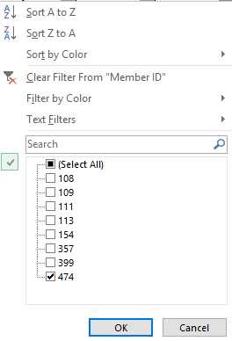
Example 1: Filter the spreadsheet by individual agency.

Slide 26
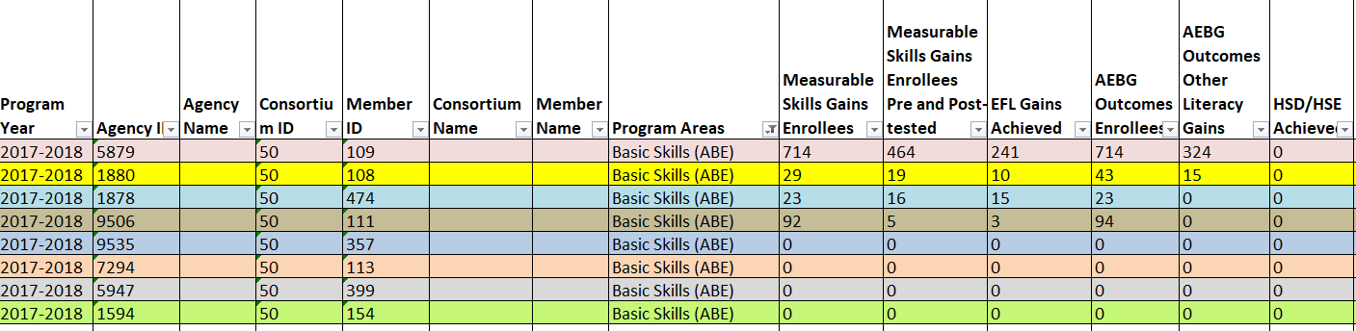
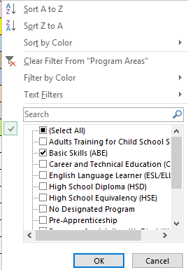
Example 1: Filter by instructional program area across all agencies.

Slide 27
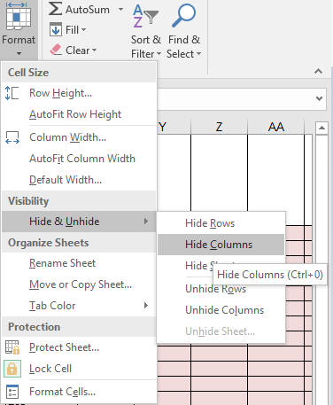
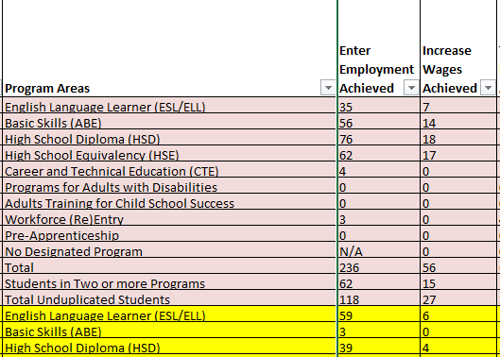
Example 2: Format cells to isolate key data points.

Slide 28
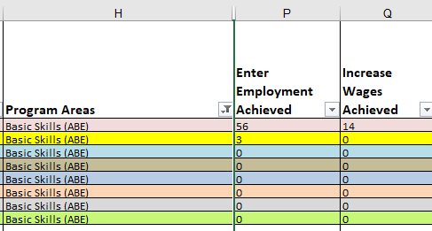
Example 2: In this example, the document uses filtering and formatting to isolate specific data results.

Slide 29
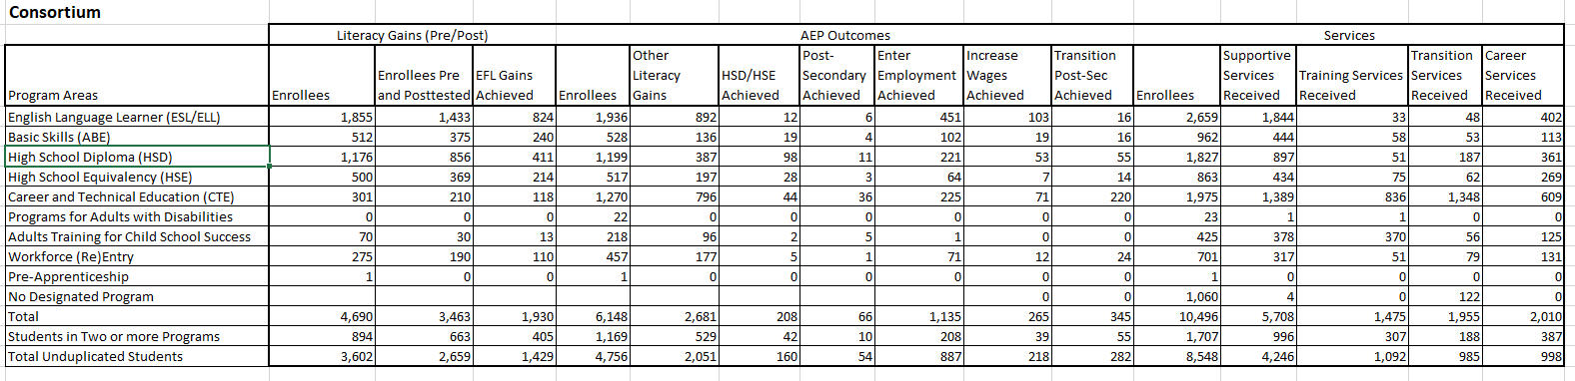
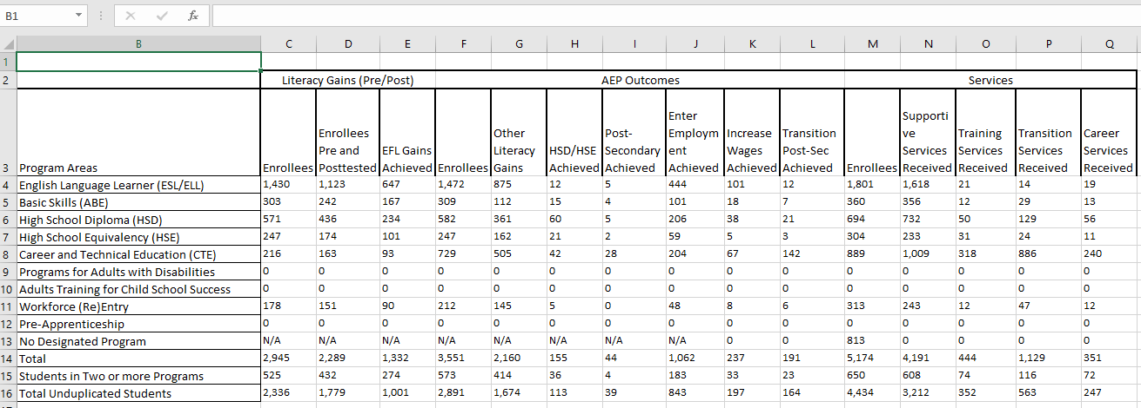
Making Simple Calculations in Excel
Using the consortium level AEP Summary, you can convert the consortium wide or individual agency level AEP Summary reports into Excel.

Slide 30
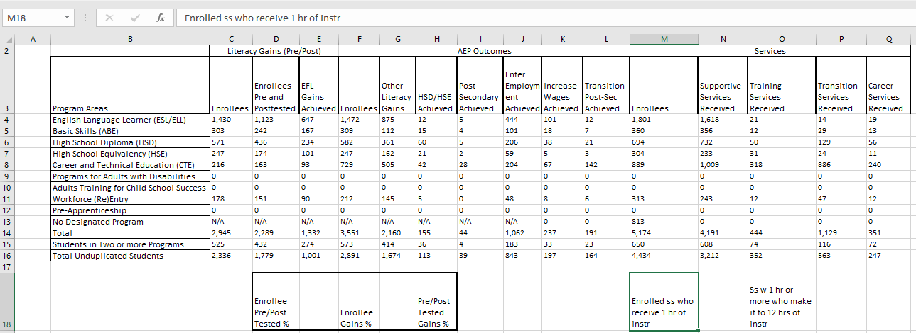
Example 3: AEP Program Enrollment
Compare numbers of Enrollees across Column M (Excel columns may be different than what’s in TE)
Subtract number in “No Designated Program” from “Total Unduplicated Students”
Divide that result from number in Total unduplicated students.

Slide 31
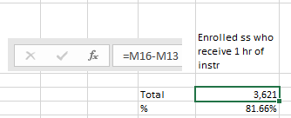
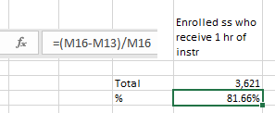
Example 3: AEP Program Enrollment
Compare numbers of Enrollees across Column M
Subtract number in “No Designated Program” from “Total Unduplicated Students”
Divide that result from number in Total unduplicated students.
4434 ÷ (4434-813) = 81.6%

Slide 32
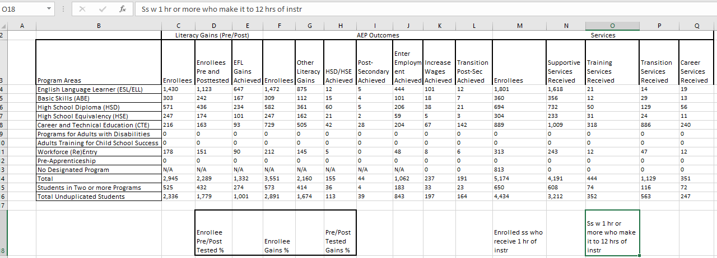
Example 4: AEP Program Persistence
Compare number of Enrollees in Columns F and M (E and L on the TE AEP Summary).
For services students in Column L, subtract the number in No Designated Program.
Divide the total in Column E with that result from Column L.

Slide 33
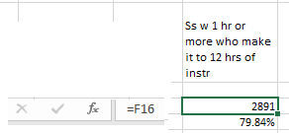
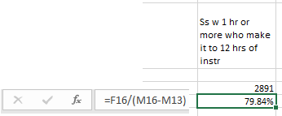
Example 4: AEP Program Persistence
Compare number of Enrollees in Columns F and M (E and L on the TE AEP Summary).
For services students in Column M, subtract the number in No Designated Program.
Divide the total in Column F with that result from Column M.
2891 ÷ (4434-813) = 79.8%

Slide 34
Example 5: AEP Program Outcomes
Add up total number of outcomes across the 6 AEP outcomes areas (Columns G-L in Excel)
Divide this total by total Enrollees in Column F

Slide 35

Example 5: AEP Program Outcomes
Add up total number of outcomes across the 6 AEP outcomes areas (Columns G-L in Excel)
Divide this total by total Enrollees in Column F
(1,674 + 113 + 39 + 843 + 197 + 164) ÷ 2891 = 104.8%!!!

Slide 36
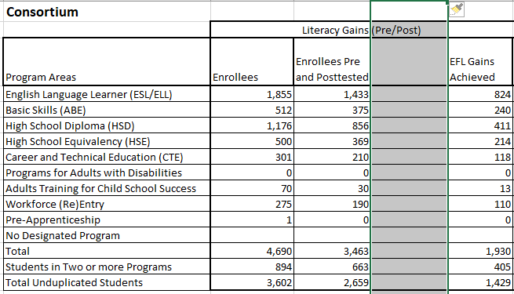
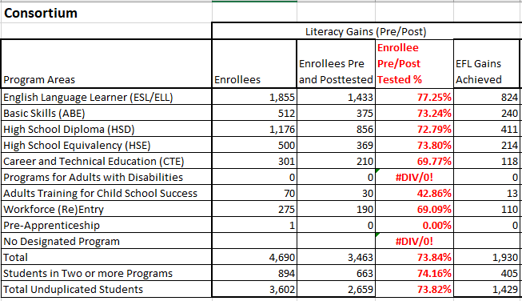
Example 6: Making Simple Calculations in Excel
Example 6: This example calculates the pre/post persistence rates for each AEP program.

Slide 37
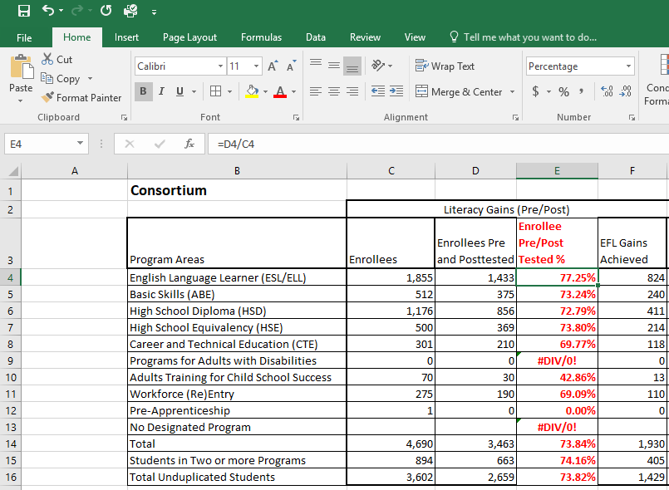
Making Simple Calculations in Excel
Divide the number of students who pre/post-tested in Column D by the total number of enrollees in Column C
Once you type in the first formula, you can drag that cell down to view the same calculation for all rows in the spreadsheet

Slide 38
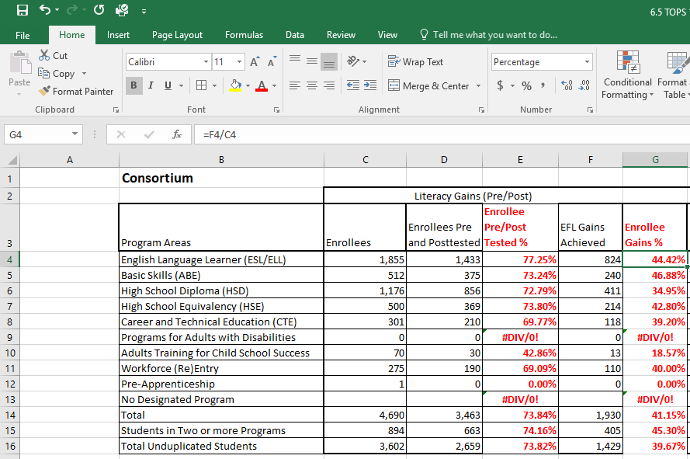
Making Simple Calculations in Excel
Add another column next to EFL Gains to make the same calculation for pre/post-test performance rates by program.

Slide 39
Making Simple Calculations in Excel
Divide the number of students who achieved a pre/post-test EFL gain (Column F in this example) by the total number of enrollees in Column C

Slide 40
Making Simple Calculations in Excel
Use this same technique to calculate percentages for other AEP outcomes – this example compares Transitions outcomes totals to totals of Enrollees in Column F.

Slide 41
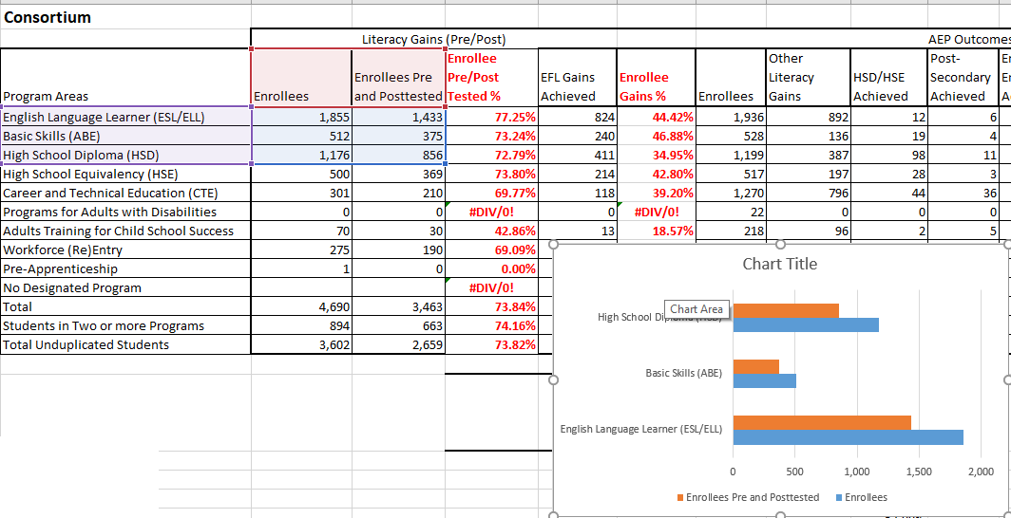
Example 7: Creating Charts and Graphs in Excel
Highlight the cells for which you wish to create the chart
In Excel, go to the Insert menu to select the specific chart or graph

Slide 42
Creating Charts and Graphs in Excel
Once you create the chart, you can use additional features to further customize it.
In this example, we added a title, changed the color of the bars, and added item counts to each

Slide 43
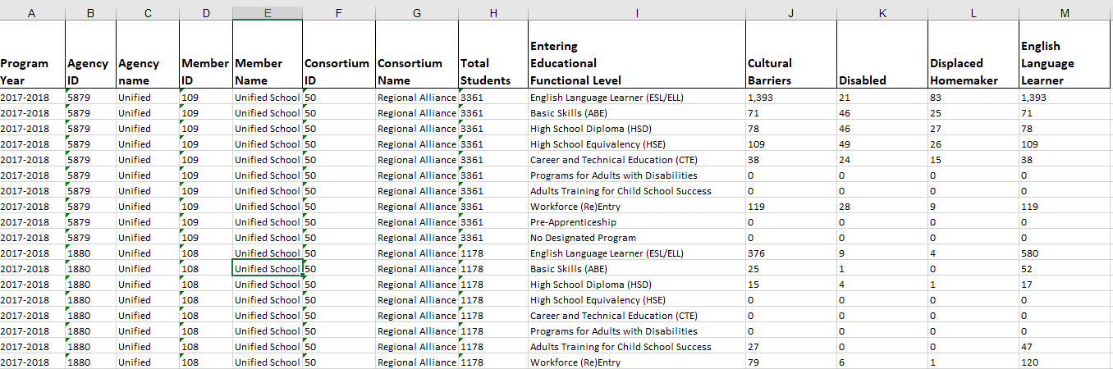

This example uses TE and Excel to evaluate results from AEP Barriers to Employment.

Slide 44
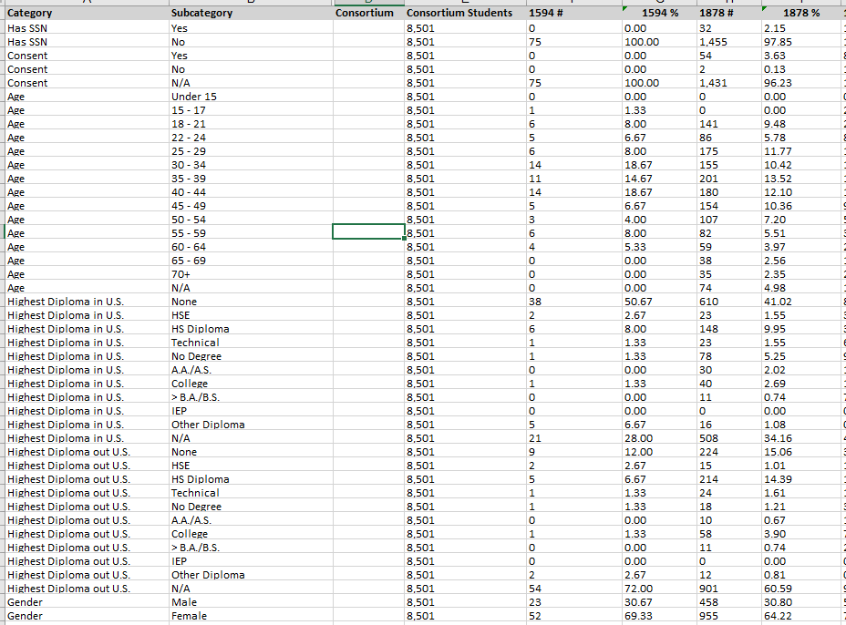
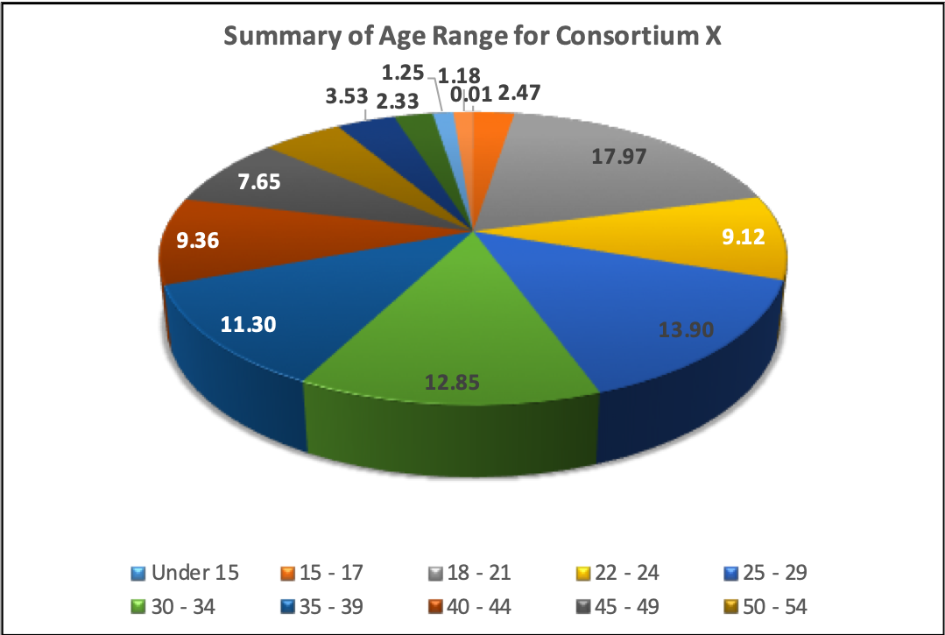
This example uses TE and Excel to evaluate results from the Demographics Summary.

