Slide 1
AEP Data Dive Webinar
March 25, 2019

Slide 2
Agenda
Review of “Qualitative” program suggestions from Webinar on 2/20/19
Review of AEP Reports in TE
TE Drill Down & Supplemental Reports
Consortium level AEP Reports in TE
Agency Level Troubleshooting Examples
Consortium Level Troubleshooting Examples

Slide 3
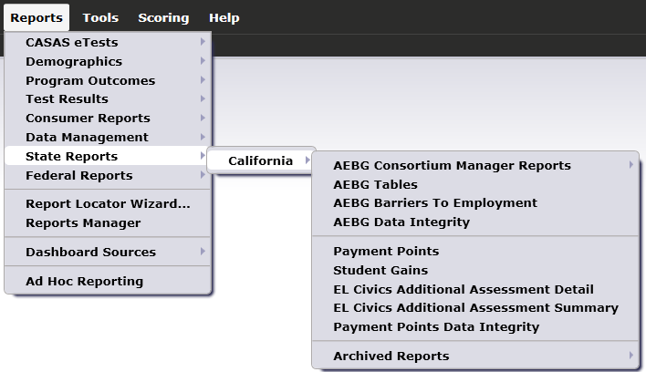
AEP Reports in TE are located by going to Reports – State Reports – California

Slide 4
Basic Questions from 2/20 Webinar:
Of those students with any AEP activity, how many enrolled in an instructional program? (Column L on AEP Summary)
Of those with program enrollment, how many students reached at least 12 hours of instruction? (Compare Columns E and L)
Of those who qualified for outcomes with 12+ hours, how many students achieved outcomes? (Columns E-K)
Of those who qualified with 12+ hours, how many students completed a pre/post-test pair? Of those, how many achieved a level gain? (Columns B-C)

Slide 5
Lo Performance
Hi Persistence
Hi Performance
Hi Persistence
Persistence
Performance
Lo Performance
Lo Persistence
Hi Performance
Lo Persistence

Slide 6
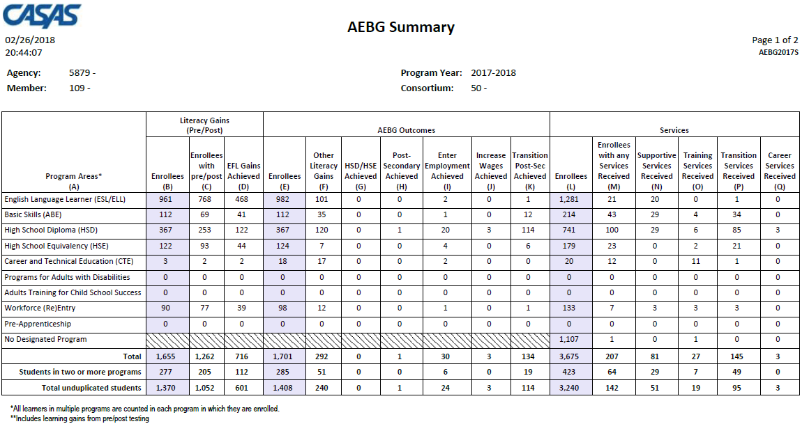
Displays outcomes in three separate sections:
Literacy Gains (Pre/Post) using NRS Table 4 guidelines
Other AB 104 outcomes using WIOA II reporting requirements but not pre/post
Services Received that do not impose WIOA II reporting requirements

Slide 7
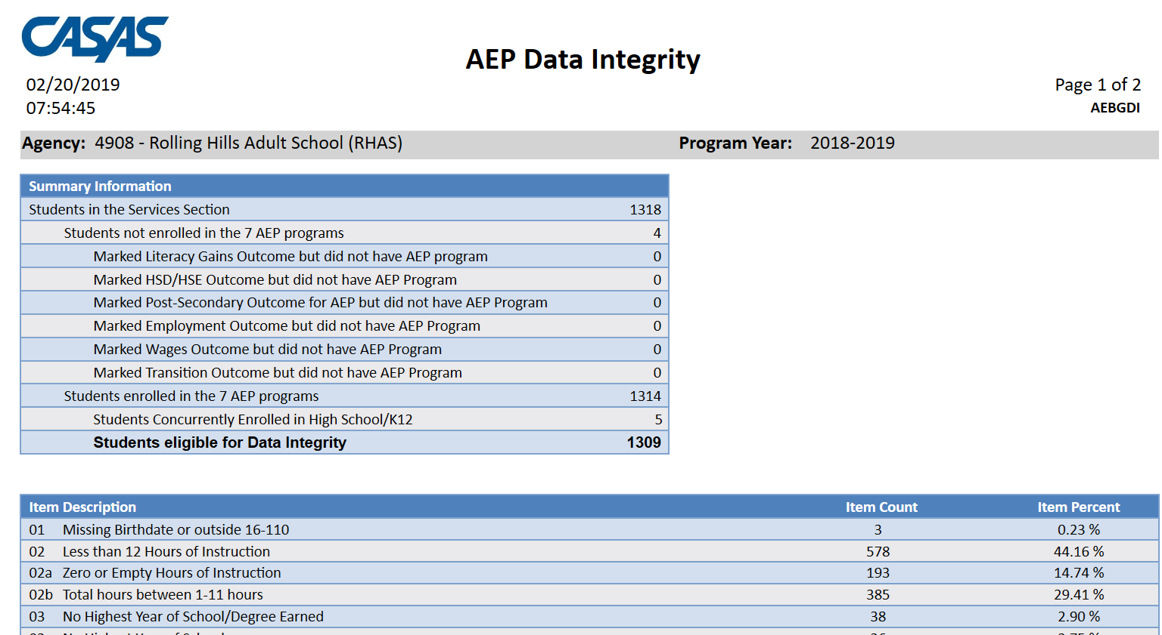
AEP Data Integrity displays 27 different data elements related to the AEP instructional programs and outcomes.
Item Description lists 27 data elements that may prevent or contribute to official AEP outcomes.
The DIR displays the item count and percentage for each listed item.
Item Percent = Item Count ÷ # of Students Enrolled in 7 AEP Programs

Slide 8
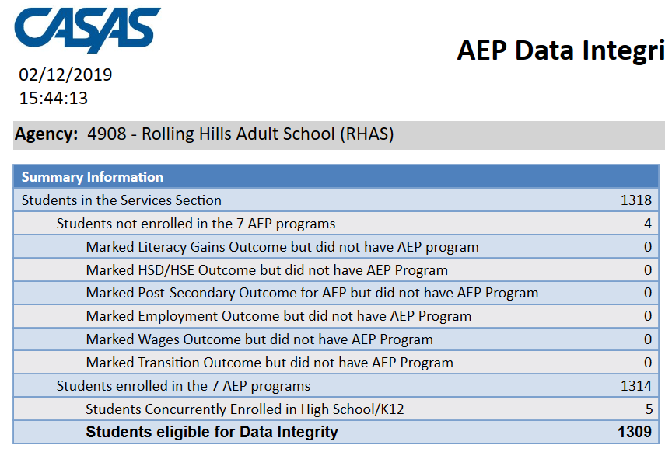
Summary Information reconciles all of the students included in AEP reporting.
Students in the Services Section includes everyone reported for AEP -- whether for official enrollment or for services only.
Students not enrolled in the 7 AEP programs subtracts those who received services but are not enrolled in one of the 7 AEP program areas.
The next 6 rows are subsets of those not enrolled in the 7 AEP programs – showing students not enrolled in program but who earned outcomes and may need enrollment.
Students in the Services Section
− Students not enrolled in the 7 AEP programs Students enrolled in the 7 AEP programs
Students enrolled in the 7 AEP programs is the total limited to students with official enrollment, and this number serves as the denominator for the 27 DIR items.

Slide 9
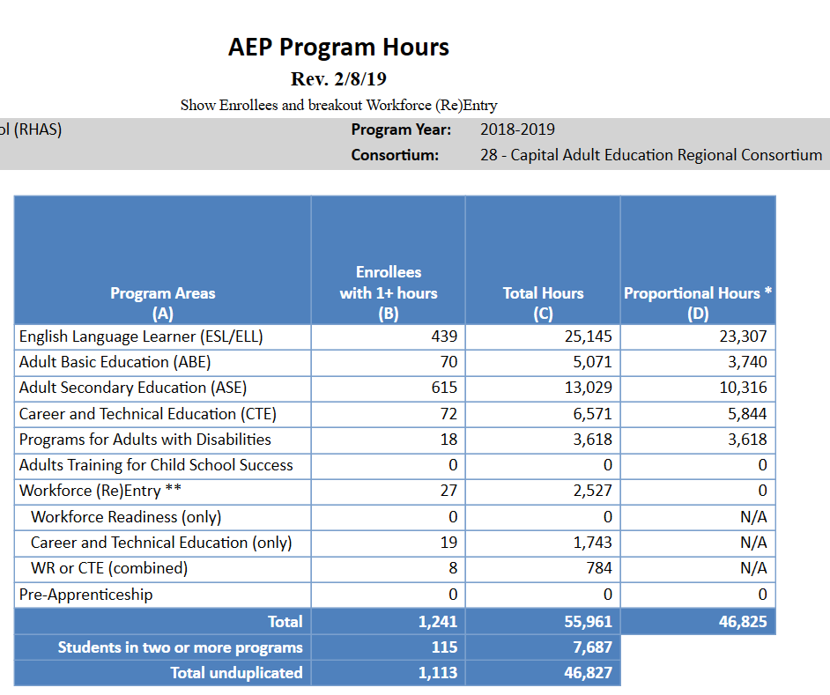

AEP Program Hours
AEP Program Hours displays instructional hours of AEP enrollees by program.
Use Table Option in the setup window to display the expanded format
ABE/ASE breakdown
Three ways of identifying Workforce Reentry
Total Hours vs. Proportional Hours

Slide 10
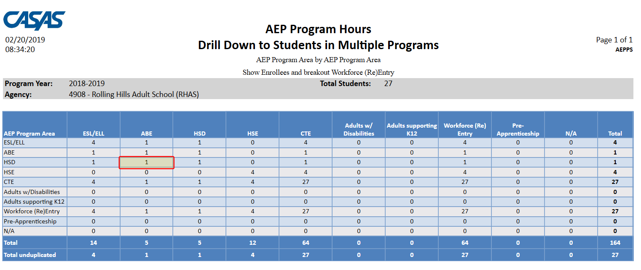
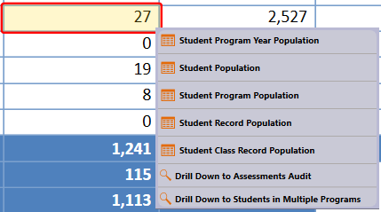
AEP Program Hours
Students in Multiple Programs generates item counts of students in more than one program

Slide 11
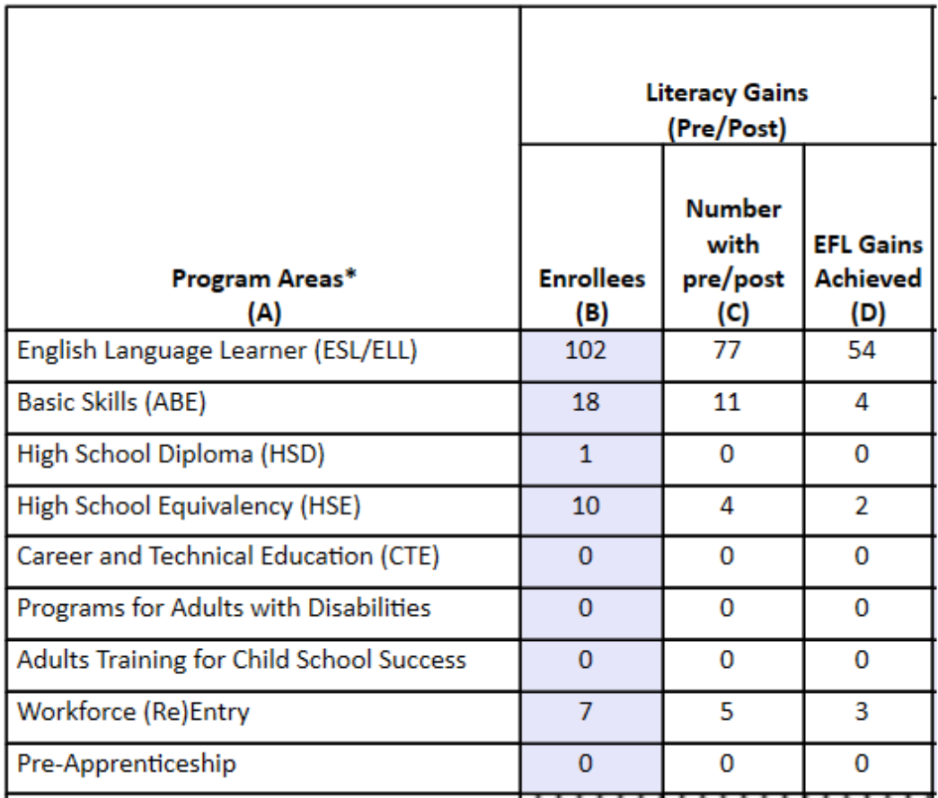
Click any cell to generate a list of students included in that cell.

Slide 12
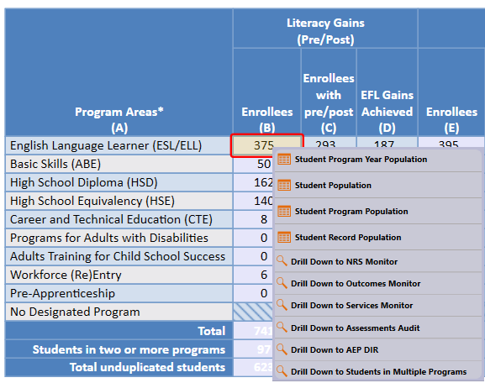
Right click any cell and select from 6 listers and 6 reports:

Slide 13
4 AEP drill down listers:
Student Program Year provides a simple list of students and matches the item count in the data cell
Student Population displays the TE demographics lister
Student Program Population lists student program enrollments
Student Record Population displays the lister that enables editing of specific AEP outcomes

Slide 14
6 AEP drill down reports:
NRS Monitor includes all students represented in the data cell with all AEP related details
Outcomes Monitor displays detailed outcomes from the 6 areas of AB 104 for each student
Services Monitor details specific services achieved by student
Assessments Audit lists pre/post-tests for each student
AEP DIR displays the entire DIR for the specific group of students selected
Students in Multiple Programs generates item counts of students in more than one program

Slide 15
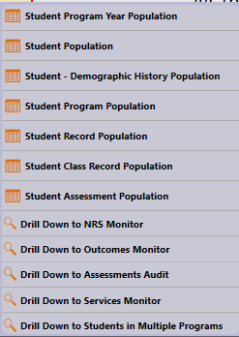
The AEP DIR has 2 additional right click options:
Student Class Record drills down to class level information to enable review of instructional hours
Student Assessment drills down to student level test results

Slide 16
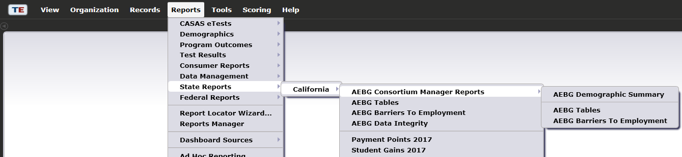
AEP Consortium Manager Reports allow a consortium level login to compare and contrast outcomes across agencies within one consortium.
Menu currently includes three reports options with this feature

Slide 17
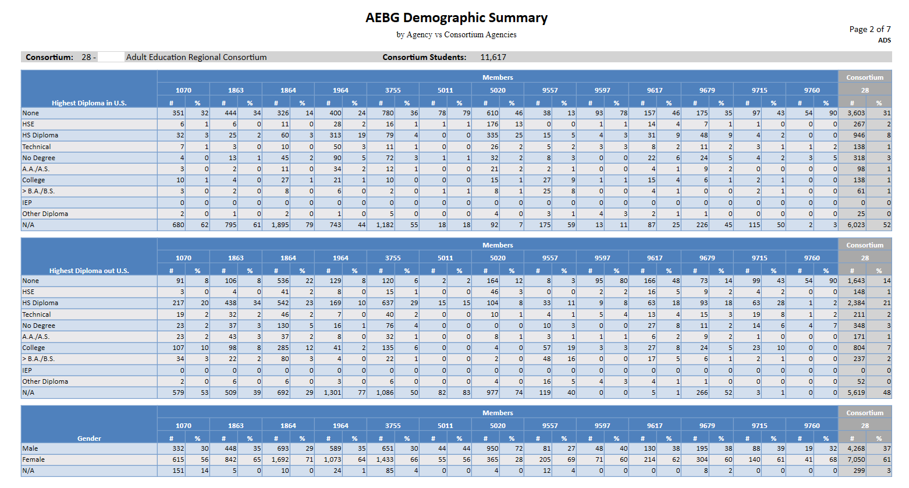

Slide 18

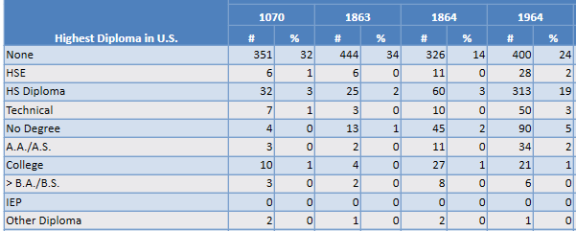
Lists item count and percentage by Agency ID
Aggregates results for the entire consortium on the right hand column

Slide 19

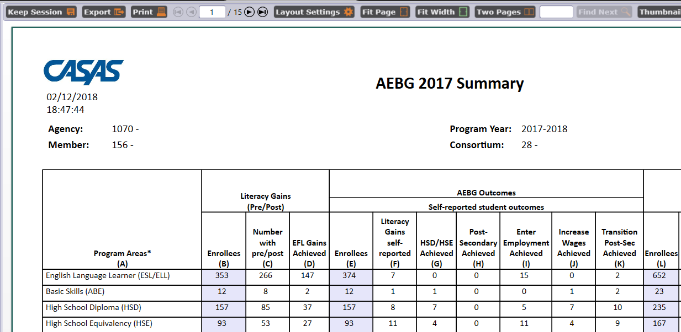
For the AEP Summary, the Consortium Manager reports provide separate pages for each agency in the consortium.

Slide 20
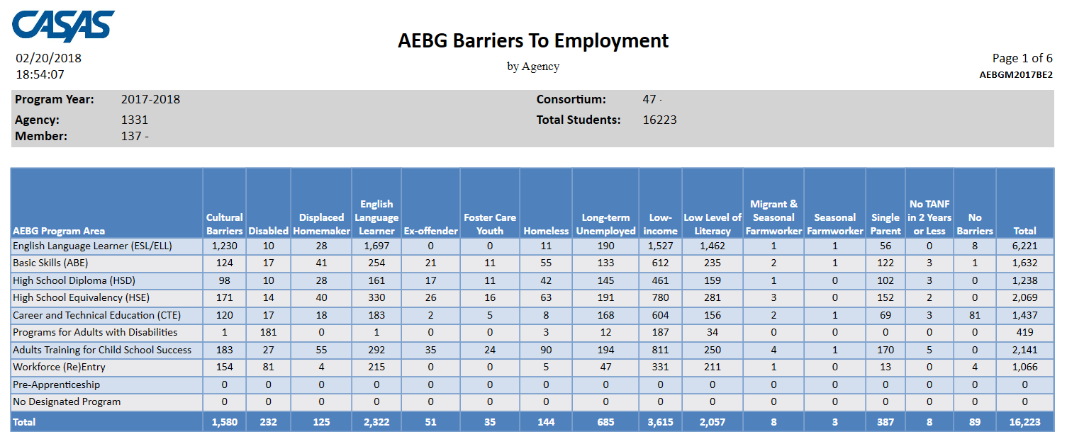
The Consortium Manager reports also provide separate pages when generating AEP Barriers to Employment.

Slide 21
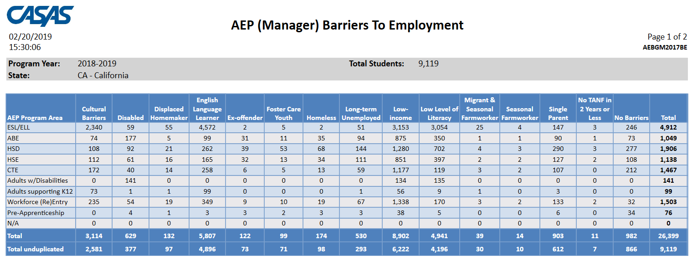
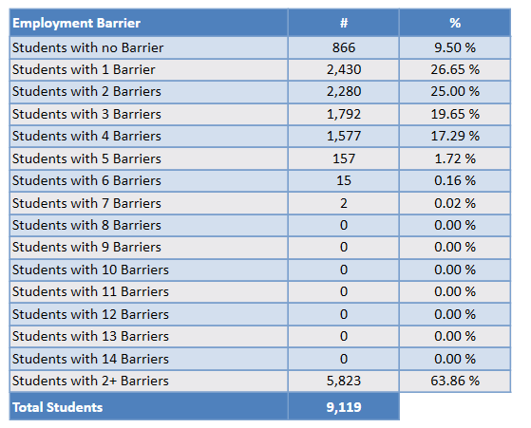
The AEP Barriers to Employment also lists frequency totals for number of barriers recorded overall.

Slide 22

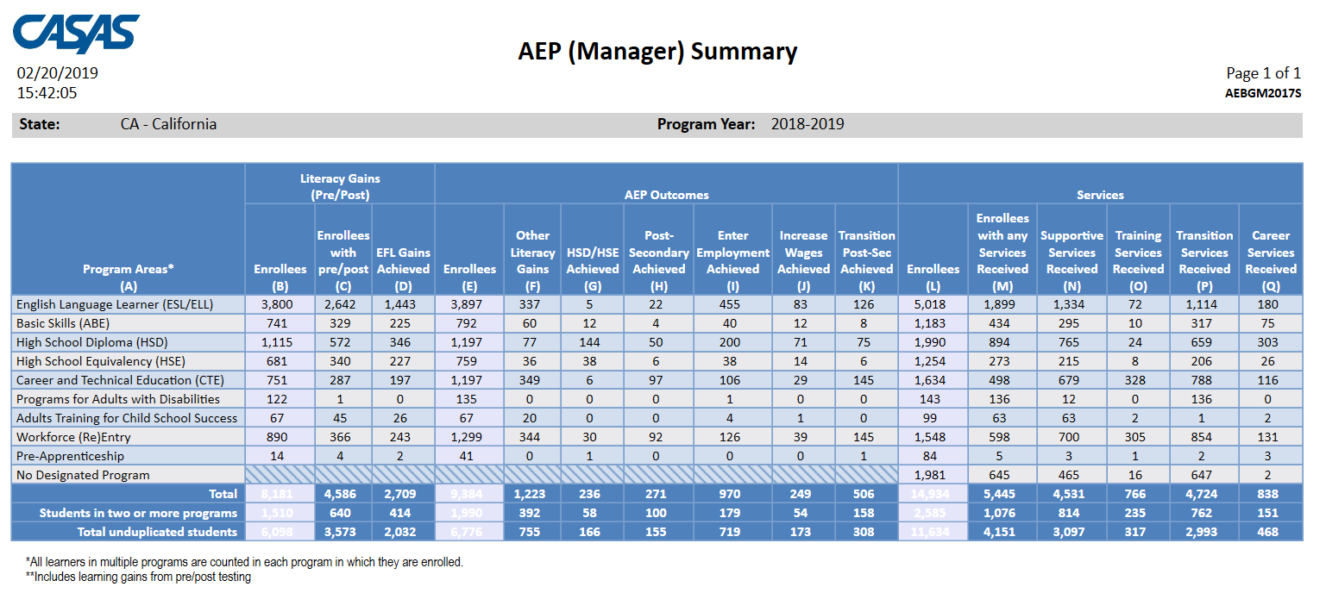
Click Aggregate Multiple Agencies to run a combined summary of all agencies in the consortium.

Slide 23
Examples of Agency Level Data Evaluation
Agencies: Use TE drill down features
Example 1: Basic DIR drill down illustration
Example 2: AEP Summary self-reported outcomes trouble shooting
Example 3: Using AEP specific numbers from the DIR
Example 4: AEP Program enrollment calculation
Example 5: AEP Program persistence calculation
Example 6: Combined AEP outcomes calculation
Example 7: Pre/post-test evaluation when persistence is low
Example 8: Pre/post-testing when persistence is good but pre/post performance is low

