Slide 1

CAEP Webinar: Low Hanging Fruit – how to improve student performance of those already in the system
Part I

Slide 2
Agenda
Statewide Data Numbers
Adult Student Journey
CAEP Reports in TE
Review of TE Drill Down & Supplemental Reports
Consortium level CAEP Reports in TE
Agency Level Troubleshooting Examples
Consortium Level Troubleshooting Examples

Slide 3
Statewide Data Numbers
17-18 – Unduplicated student count is close to 800K. Up 10% from the prior year.
17-18 – Duplicated student count is close to 1M.
Currently we have 378 districts reporting student enrollment. That’s a 23% increase in districts reporting from the prior year.

Slide 4
Statewide Data Numbers
Overall CAEP cost per participant for 17-18 was a little over $1,000 per student. Nationwide the average cost per student for four-year colleges is $14,000, and for 2 year colleges it’s $9,000.

Slide 5
Statewide Enrollment
Enrolled students that make it to 1 hour of instruction
Statewide percentage = 77%.
Enrolled students that make it to 12 hours or more of instruction
Statewide percentage = 63%.
What is happening to these students that come to the school site, enroll, but never make it to our 1-12 hours of instruction?

Slide 6
Possible Reasons
Student is accessing services and doesn’t need classroom instruction.
Data systems are not picking up the student for the instructional hours.
Student may be working one or more jobs that makes it difficult to attend.
Is your placement/appraisal process working effectively? Is it complex?
Fees for classes are too much. Or if free, other fees are too much.
Childcare is not available or too expensive.
Difficult to balance family and school.
Transportation issues.

Slide 7
Statewide Instructional Hours
Students with 1 hour of instruction make it to 12 hours of instruction (and the CAEP outcome pool).
Statewide percentage = 82%.
Seems like once the student gets into the classroom, the chances of them getting to 12 hours or more is likely.
Jay will review persister reports, and other ways to track student retention.

Slide 8
Adult Education Journey
The adult education journey is a non-traditional journey that is different from the traditional high school to college journey.
Adult education students come from a variety of different life pathways or journeys.
These students’ journeys have different destinations and milestones, they have different goals such as college, work and family/life enrichment.

Slide 9
Program Areas
Some students never finish elementary school and have literacy/reading comprehension issues. These students may have issues such as incarceration, mental health issues, or drug/alcohol dependency.
Some students have severe learning disabilities, but do not have their K12 district support mechanism, despite the need for life and learning skills.
Other students are high school dropouts coming back to school for a diploma or their HS Equivalency.

Slide 10
Program Areas (cont.1)
We have parents that need strategies to create a successful environment for K12 students.
We have students that need short-term vocational or pre-apprenticeship skills in order to get a job or a better job.
We also have those middle aged or older students that need to keep their skill set sharpened to stay employable (or need to get back into the workforce).

Slide 11
Program Areas (cont.)
Finally, our largest group of students are those that enroll in ESL classes, vocational ESL and/or utilize immigrant services for integration into our communities.

Slide 12
CAEP Update
16-17 Close Out in NOVA – March 1st
NOVA Quarter 2 expense report – March 1st
Consortium certification due – March 31st
19-20 Preliminary Allocation Released – this week!!!
K12/COE - TOPSPro 3rd Quarter due
CFAD due May 2, 2019
Three Year Plan Due June 7, 2019

Slide 13
Using Data
to Improve
Program Performance
Spring 2019

Slide 14


Agenda
Review: CAEP Reports in TE
Review: NRS Performance & Persistence
Applying NRS Performance and Persistence to CAEP Data Reporting
Analyze Data:
  performance & persistence rates are low
  low performance when persistence is high
Identify Strategies for Improvement
    Agency Level
    Student Level
Identify Resources for Agency and Students

Slide 15
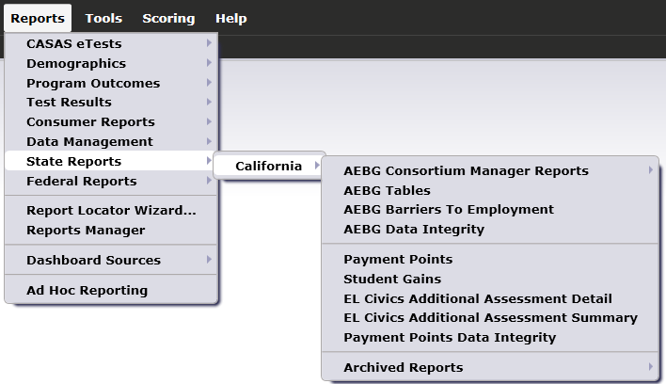
CAEP Reports in TE are located by going to Reports – State Reports – California

Slide 16
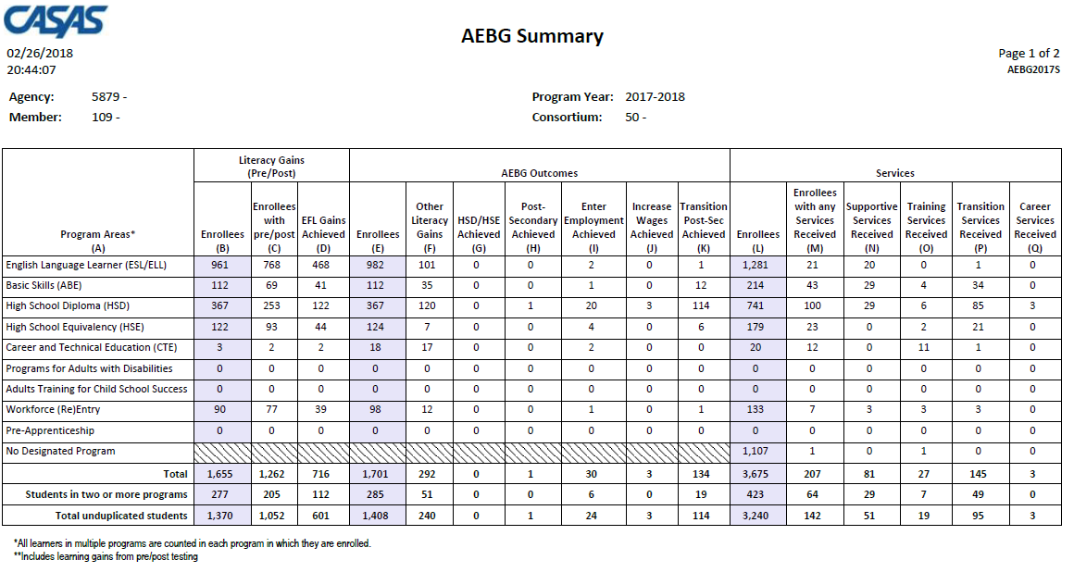
CAEP Summary
Displays outcomes in three separate sections:
Literacy Gains (Pre/Post) using NRS Table 4 guidelines
Other AB 104 outcomes using WIOA II reporting requirements but not pre/post
Services Received that do not impose WIOA II reporting requirements

Slide 17
CAEP Data Integrity
CAEP Data Integrity displays 27 different data elements related to the CAEP instructional programs and outcomes.
Item Description lists 27 data elements that may prevent or contribute to official CAEP outcomes.
The DIR displays the item count and percentage for each listed item.
Item Percent = Item Count ÷ # of Students Enrolled in 7 CAEP Programs

Slide 18
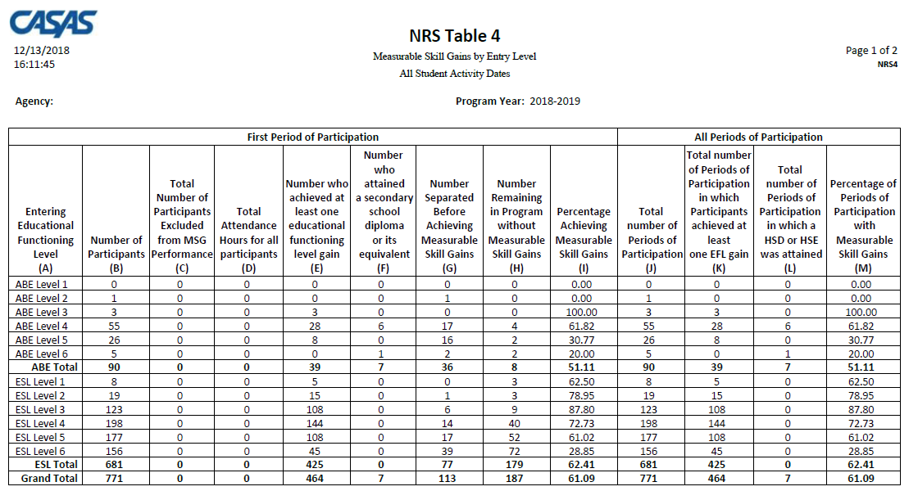
Federal Table 4
Table 4 = Gains by Educational Functioning Level Reports learners who entered program at one Instructional Level and finished the program year (June 30) at a higher level.

Slide 19
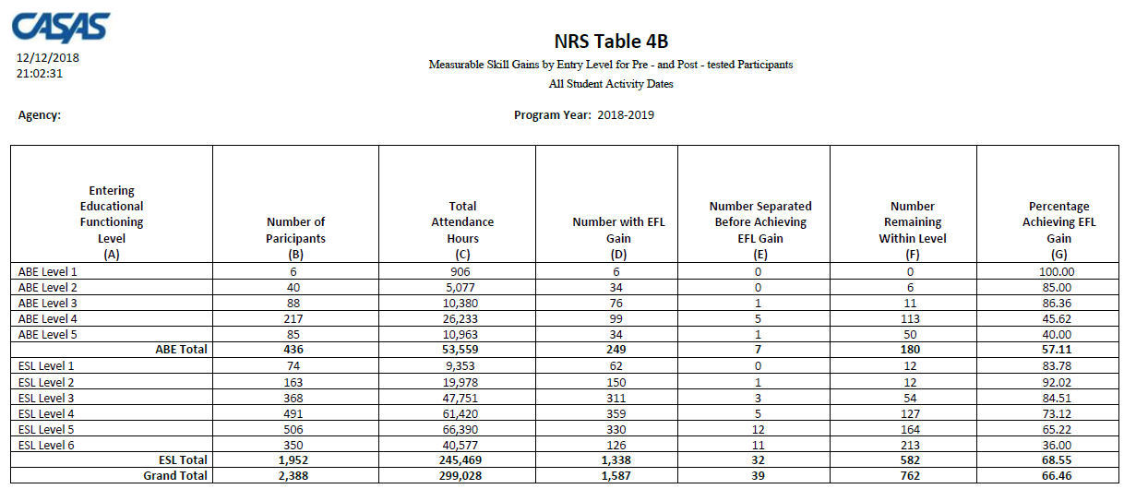
Federal Table 4B
Table 4B = Same level advancement information as Table 4 (but without PoPs)
Only includes learners who completed a valid pre- and post-test.

Slide 20
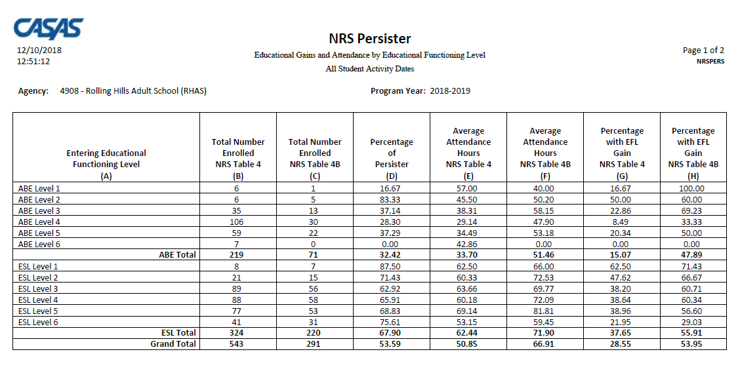
NRS Persister Report

Slide 21
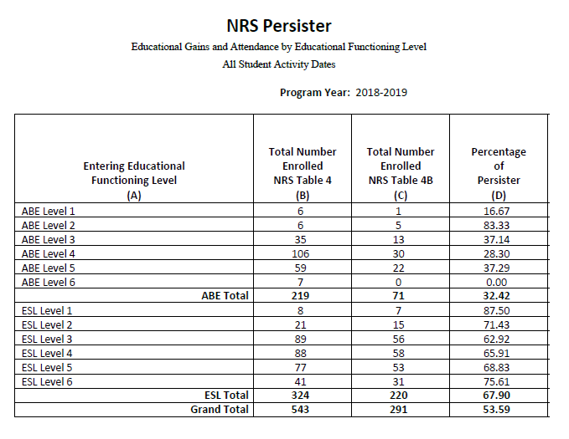
NRS Persister Report
The Persister looks at the percentage of Table 4 students who also qualify for Table 4B – (the percentage of qualified enrollees who have a pre/post-test pair).
Column C ÷ Column B = Column D (% of Persister)

Slide 22
Measuring Persistence in CAEP
Correspond NRS persister results using Literacy Gains section of CAEP Summary
Compare students with program enrollment in Services section (Column L) with no enrollment
Compare CAEP Outcomes (middle) section of CAEP Summary with Services (right) sections of CAEP Summary – Columns E and L
Use CAEP Outcomes to compare total Enrollees with total number of students achieving outcomes

Slide 23
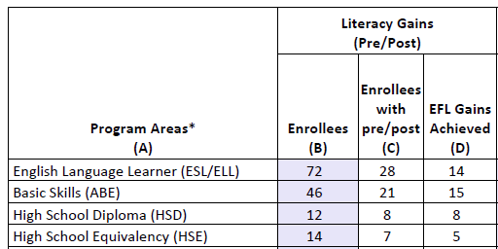
Measuring Persistence in CAEP
Refer to the Literacy Gains (Pre/Post) section of the TE CAEP Summary to determine your agency’s overall persistence rate, or your persistence by program.
This employs the same concept as the NRS Persister – that is, it compares the number with a pre/post-test pair with total number of enrollees.

Slide 24
Measuring Persistence in CAEP
To determine the persistence rate, divide the total in Column C by the total in Column B.
Column C ÷ Column B = Persistence Rate
“Good persistence” = 70% or better

Slide 25
Measuring Program Enrollment in CAEP
How many adult education program students that participate – actually make it into an instructional program?
Use Column L: (Total Unduplicated - No Program) ÷ Total Unduplicated = Program Persistence Rate

Slide 26
Measuring Program Enrollment in CAEP
Compare numbers of Enrollees across Column L
Subtract number in “No Designated Program” from “Total Unduplicated Students”
Divide that result from number in Total unduplicated students.
Use Column L: (3240 – 1107) ÷ 3240 = 65.8%

Slide 27
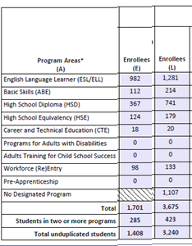
Measuring Program Persistence in CAEP
Of those who enroll in an CAEP program, how many stay long enough to accrue at least 12 hours of instruction?
Column E ÷ (Column L- No Program) = Program Persistence Rate

Slide 28
Measuring Program Persistence in CAEP
Compare number of Enrollees in Columns E and L.
For services students, subtract the number in No Designated Program.
Divide the total in Column E with that result from Column L.
1408 ÷ (3240-1107) = 66%

Slide 29
Measuring Outcomes Performance in CAEP
Of those students in an instructional program, how many are showing any progress as defined by AEBG/CAEP metrics?
Sum of Columns F, G, H, I, J, K ÷ Column E = Outcomes Attainment Rate

Slide 30
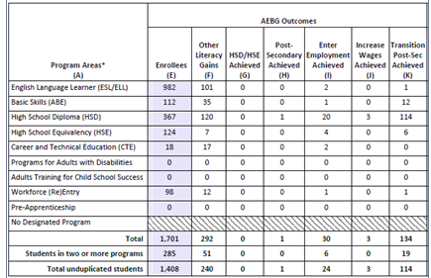
Measuring Outcomes Performance in CAEP
Add up total number of outcomes across the 6 CAEP outcomes areas
Divide this total by total Enrollees in Column E
(240 + 0 + 1 + 24 + 3 + 114) ÷ 1408 = 27%

Slide 31
Lo Performance
Hi Persistence
Hi Performance
Hi Persistence
Lo Performance
Lo Persistence
Hi Performance
Lo Persistence
Persistence
Performance

Slide 32
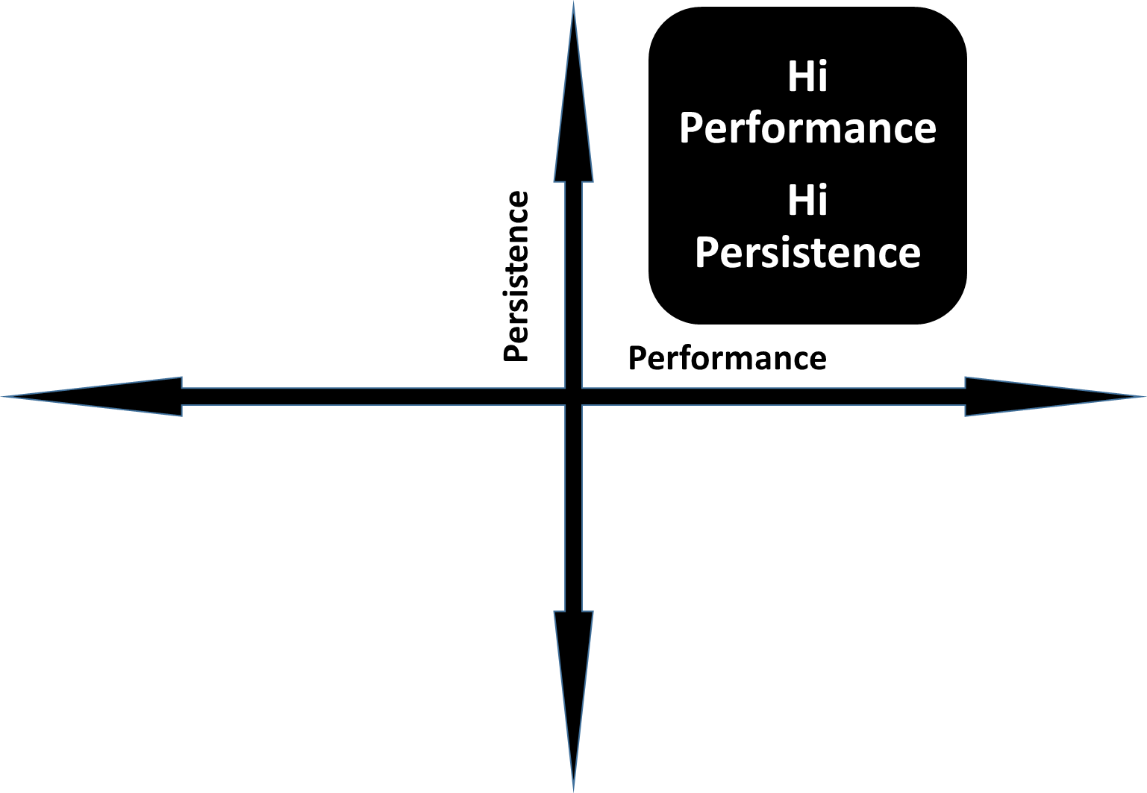
When Performance and Persistence are High
If performance and persistence are both high, CONGRATULATIONS!!!

Slide 33
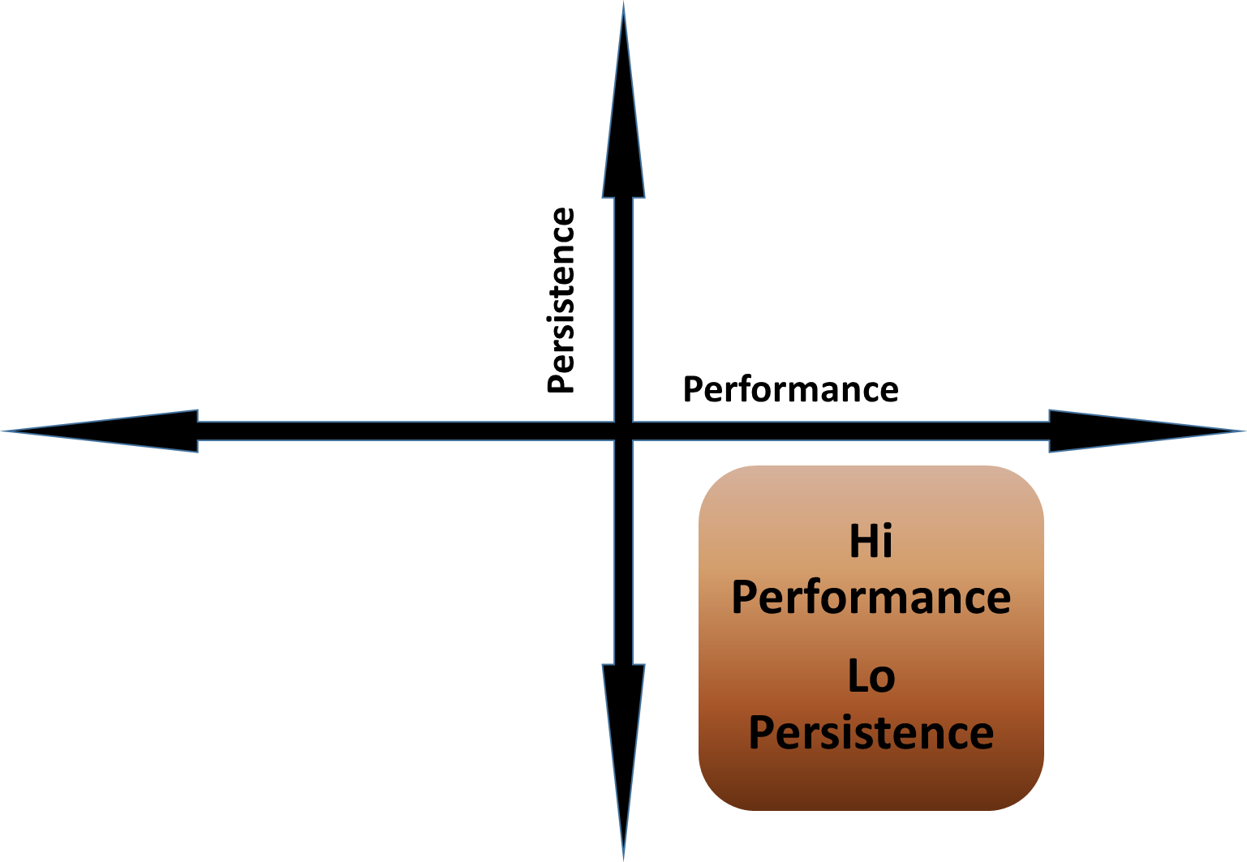
When Performance is High and Persistence is Low
VERY UNUSUAL
But if so, the agency should take steps to increase the frequency of pre/post-testing rates for students.

Slide 34
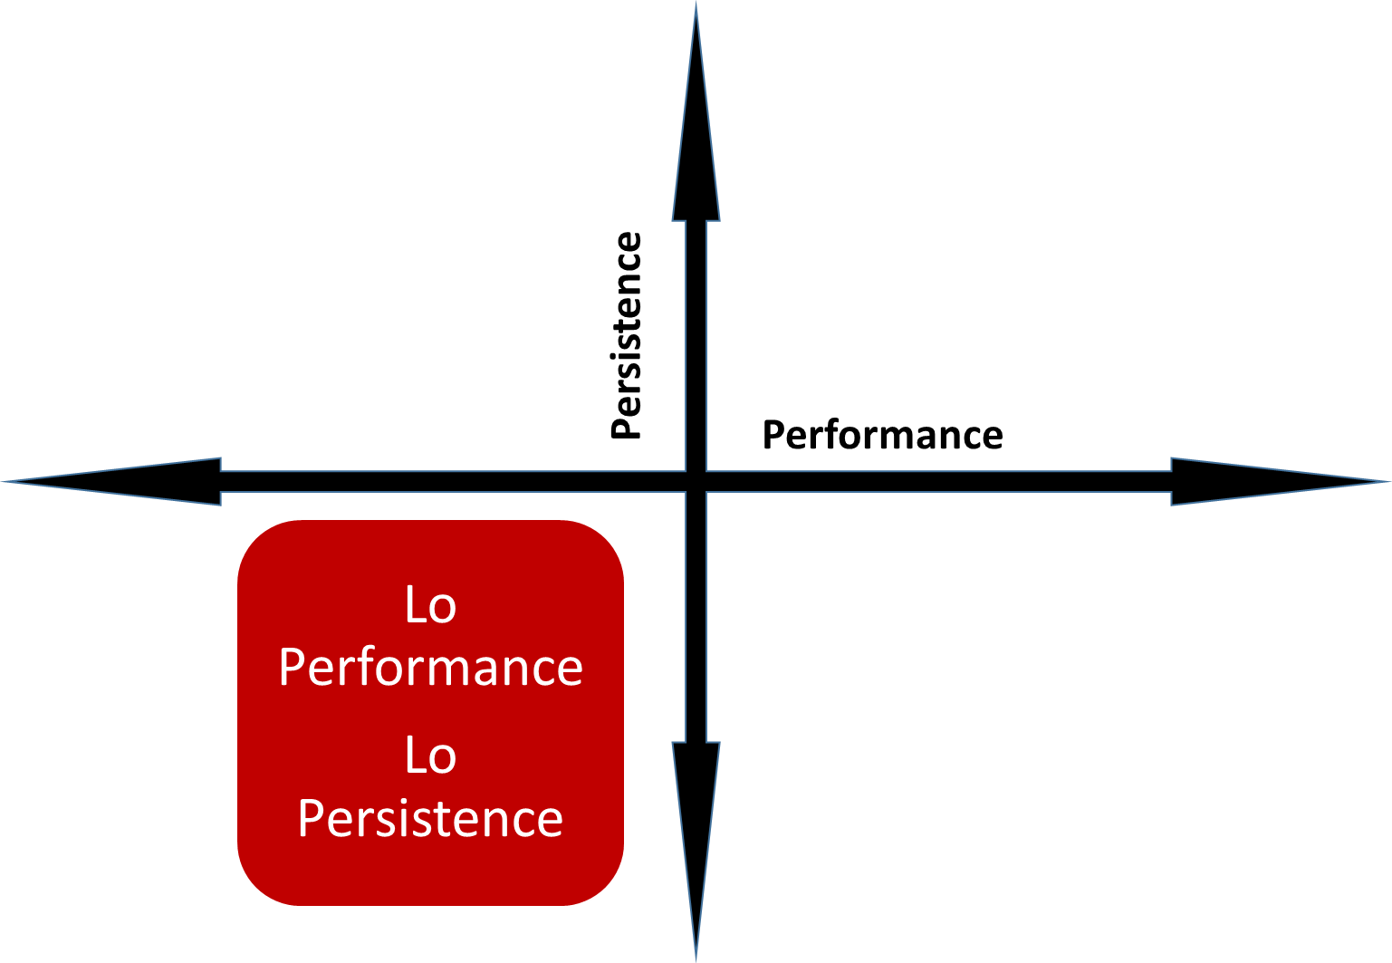
When Performance and Persistence are Both Low
The agency should address basic data clean up first – that is, missing student demographics or attendance hours.
Once basic clean up is complete, then start with the persistence side – specifically, student pre/post-testing rates.

Slide 35
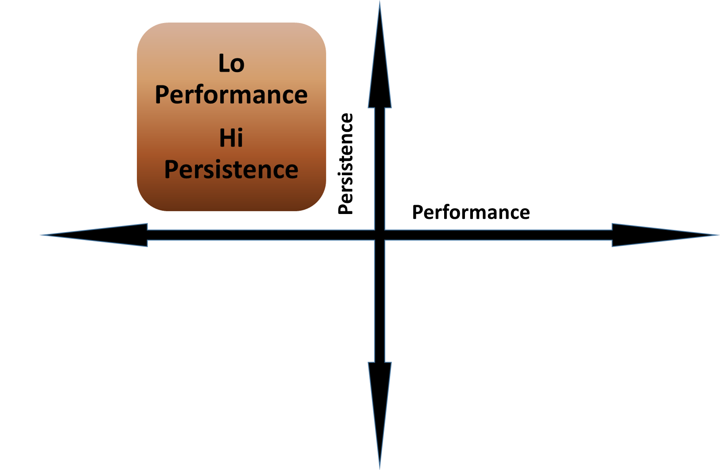
When Performance is Low and Persistence is High
The agency is doing well with completing testing requirements, but needs to address instruction in the classroom.

Slide 36

Improving Learner Persistence
What if my agency’s persistence rates are at or below the state averages?
There is a strong possibility the issue is with pre- and post-testing all of your agency’s students.

Slide 37
Improving Learner Persistence
There is a strong possibility the issue is with pre- and post-testing all of your agency’s students.
There are steps to address these issues at both the student and agency levels.

Slide 38

Student Level Strategies for Obtaining Better Persistence
Track students’ attendance.
  Follow up on students who miss three+ days of class.
  Provide a clear line of communication between teacher and students.
  Tell students upon entry that they need to tell the teacher if they are leaving the class.

Slide 39
Student Level Strategies for Obtaining Better Persistence
Track students’ attendance.
  Review overall flexibility of schedule for students
  For learners who do not enroll in class, or who drop out early, review overall school schedule for availability of classes
  Investigate alternatives such as distance learning

Slide 40
Student Level Strategies for Obtaining More Pre-/Post-test Pairs
Establish program that rewards students for obtaining pre-/post-test pairs
Reduce student “test anxiety”
Use TOPSpro Enterprise (TE) reports that display test results by date and form number (such as Students Gains, Learning Gains, or Student Test Summary.)
Use TE reports and other resources to align assessment with instruction

Slide 41
Agency Level Strategies for Obtaining Better Persistence
Maintain a clear line of communication among testing staff, teachers and administration.
  Discuss critical decisions with team:
    Which classes/programs to prioritize and when to schedule
    Which assessments to administer for each class and program
    Time between testing dates.
  Work as a group to determine:
    Who does what?
    When does it happen?
    Each staff person’s responsibilities in completing testing?

Slide 42

Agency Level Strategies for Obtaining More Pre-/Post-test Pairs
Maintain a calendar of the year’s testing dates.
  Plan specific dates as “testing dates.”
  Ensure those leaving programs early complete testing.
  Schedule specific “make up” days for students who are absent.
  Ensure all students are aware of testing dates and understand the importance of testing.

Slide 43
Agency Level Strategies for Obtaining More Pre-/Post-test Pairs
*Use State and Local Assessment Policies to inform staff of local agency testing responsibilities*
Establish procedure for appropriate instructional placement, and pre- and post-testing
Specify times for testing
Designate person(s) responsible for coordinating testing/maintaining computer lab/paper booklets
Specify policies to ensure “hard to reach” students are tested, such as students with disabilities, distance learning students, high school recovery

Slide 44
Agency Level Strategies for Obtaining More Pre-/Post-test Pairs
*Use data reports to determine level of effort and to target specific groups for intervention*
Identify specific groups of students who lack pre/post-test pairs – look for specific barriers to employment, programs, classes, Educational Functioning Levels (EFLs)
Verify test selection meets state and federal requirements – look at test modality, levels, appropriate pre/post-test matches
Use reports such as the Persister to target specific levels of ABE and ESL

Slide 45

Improving Learner Performance
What if my agency’s persistence rates meet or exceed state averages but performance is still low?
If your agency’s Percentage of Persister is average or better, but your performance remains low, then there is a possibility the issue is student performance on the pre- and post-tests.

Slide 46
Improving Learner Performance
If your agency’s Percentage of Persister is average or better, but your performance remains low, then there is a possibility the issue is student performance on the pre- and post-tests.
There are steps to address these issues at both the student and agency levels.

Slide 47
Student Focused Strategies for Improving Learner Performance
Assign appropriate student goals and review them regularly
Align instructional materials/ lesson planning with local and statewide priorities
Compare placement level with learner’s assigned class, and verify whether it is consistent
Ensure learner expectations match what is actually presented in class

Slide 48
Student Focused Strategies for Improving Learner Performance
Recognize student accomplishments
Review “test taking skills” with students
Individualize instruction
“Review, review, review…”
Evaluate performance by student and identify best practices of top performers

Slide 49
Agency Focused Strategies for Improving Learner Performance
**Review agency-wide assessment performance and compare by class, level, and program**
Generate TE Instructional Reports and disseminate to teachers promptly
Monitor instructional hours to ensure there is enough time between test administrations
Solicit constant feedback from both teachers and students
Evaluate performance by class and identify best practices of top performers

Slide 50
Agency Focused Strategies for Improving Learner Performance
**Ensure assessment performance is in synch with local and statewide priorities**
Align instruction to agency-specific population
Compare test performance with learner barriers to employment and demographics
Identify potential external issues, such as the local economy, transportation, housing
Establish firm attendance/local assessment policy to ensure consistency – meeting minimum data standards does not guarantee success
Define and implement NRS Local Performance Goals

Slide 51
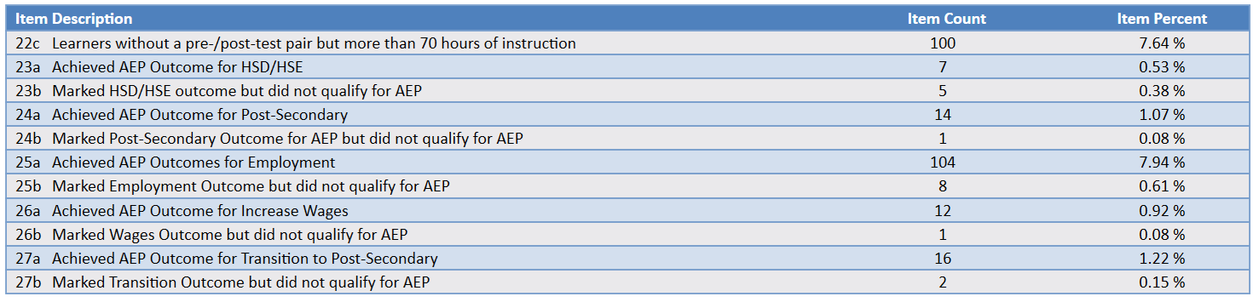
Agency Focused Strategies for Improving CAEP Learner Performance
**Compare qualified CAEP outcomes results to outcomes that do not qualify**
Run CAEP Data Integrity and review items 23-27
Compare 23a – 27a with 23b – 27b
23a – 27a lists qualified CAEP outcomes
23b – 27b lists outcomes that were marked but that did not qualify due to some drop reason

Slide 52
Resources for Agency and
Student Level Improvement
What if my agency’s persistence AND performance need to improve???
There are resources available at the state, local, and student levels to help improve learner performance and persistence.

Slide 53
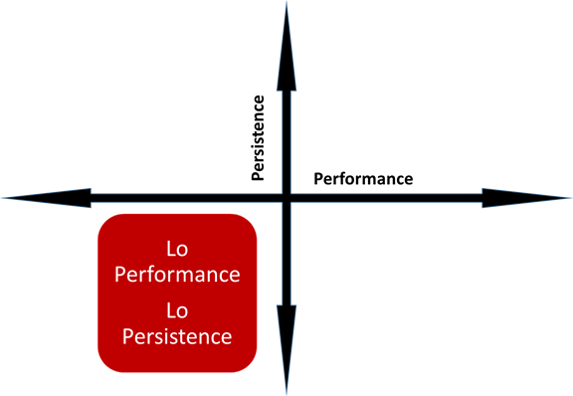
Resources for Improving Learner Performance in the Classroom
CAEP Web site
https://caladulted.org/TAP
Resources for Students, Educators, and Administrators
Student Success Stories
Student Supports
Practices with Promise
www.caladulted.org

Slide 54
Resources for Improving Learner Performance in the Classroom
CASAS Quick Search
EL Civics Web site
Alignment with CASAS Content Standards and CCR/CCSS
TE Instructional Reports (Under Reports – Test Results):
  Competency Reports
  Content Standards
  Individual Skills Profile
  Learning Gains/Test History
www.casas.org

Slide 55

CAEP Web Site
www.caladulted.org
The CAEP Web site includes resources for students, teachers, and administrators.

Slide 56
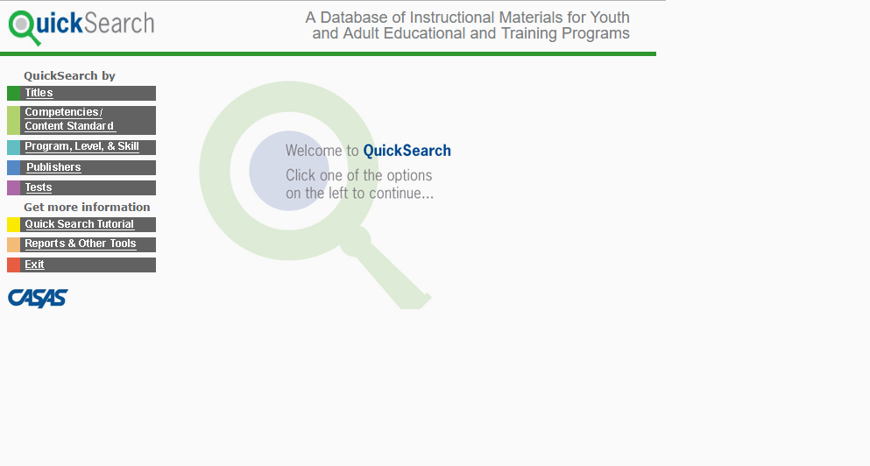
CASAS Quick Search
CASAS Quick Search enables selection of over 2,300 instructional materials from an online database.

Slide 57
EL Civics Web Site
The EL Civics section of the CASAS Web site includes 53 civic objectives that address community integration skills for all levels of ESL, as well as many resources for both ESL instruction and citizenship preparation.

Slide 58
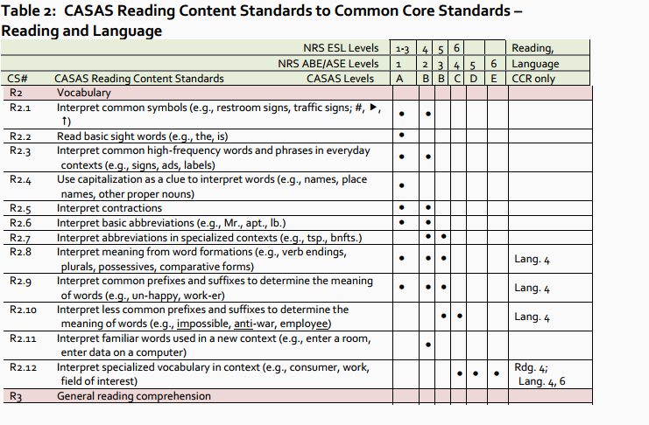
Alignment of CASAS Content
Standards to CCR/CCSS
CASAS has developed crosswalk documents that align CASAS content standards to CCR/CCSS.

Slide 59
Resources for Improving Agency
Level Performance
CASAS Data Portal
American Community Survey https://www.census.gov/programs-surveys/acs/
Promising Practices
TE Data Management Reports:
  Demographics Summary
  Enrollment/Update Summary
  Data Integrity Report
  NRS Reports
www.caladulted.org
www.casas.org

Slide 60
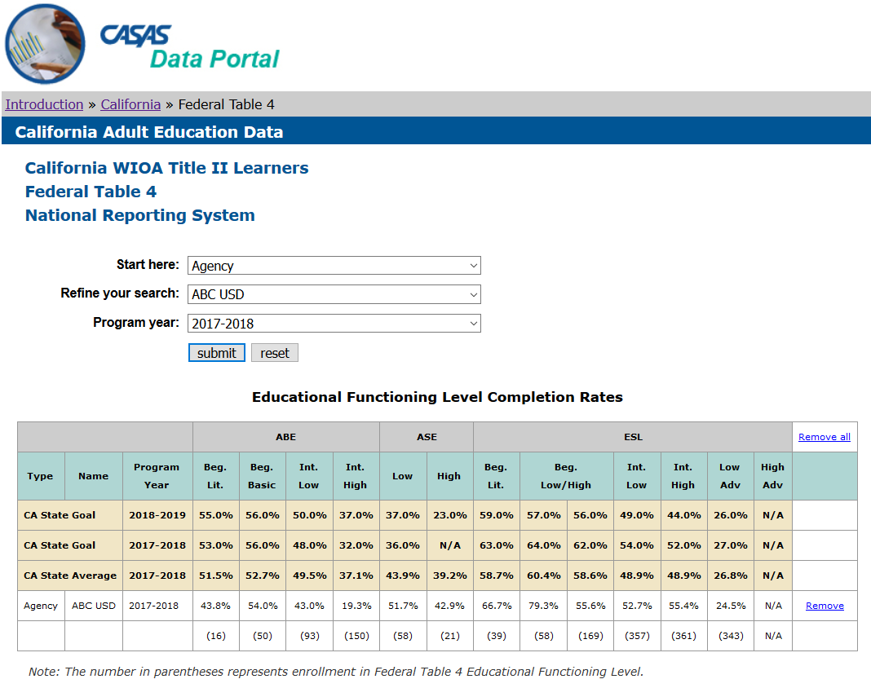
CASAS Data Portal
The CASAS Data Portal allows comparison of NRS performance and persistence results by agency, region, provider type, and statewide.
This feature only includes results for WIOA II funded agencies – but includes references helpful to all agencies, such as statewide goals and averages for both performance and persistence, dating back to PY 2004-05

Slide 61
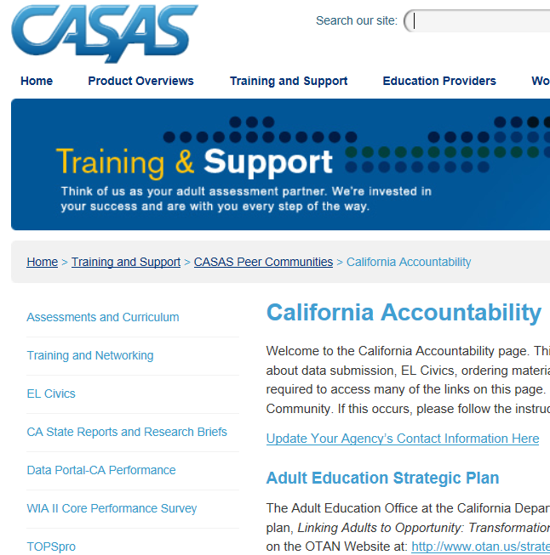
CASAS Data Portal
Go to www.casas.org/ CA Accountability

Slide 62


