Slide 1
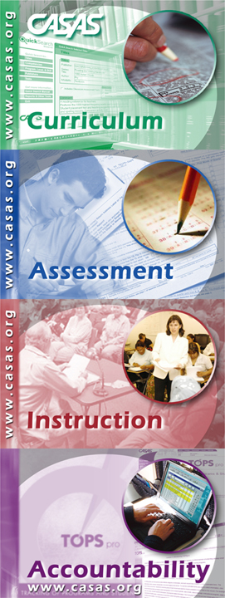

Assessment to Instruction
2018-19

Slide 2
Agenda
Overview of CASAS Assessment
Competencies, Task Areas and Content Standards
CASAS Testing – Key Considerations
Using Test Results to Inform Instruction
CASAS Resources
TOC
Notes:
TH – Table of Contents
Let’s go over the different sections of the handbook.
Explain why there are 2 sections on testing: the first section on testing – CASAS testing – gives the “big picture” of testing and accountability, what the scores mean and how they are used. The second section – Appraisals, Pretests and Post-Tests – cover the forms of the tests, the process for administering each test, and gives agencies the opportunity to present their processes and procedures for testing.

Slide 3
About CASAS Assessments
Measure basic skills in functional life and work contexts
Reading tests can be used in both ABE and ESL programs
Group administration is practical for large and small programs (can also be individually administered)
Includes computer-delivered options which provide immediate results and are very reasonably priced
Approved for NRS reporting

Slide 4
New CASAS GOALS Reading and Math Test Series
Greater Opportunties for Adult Learning Success
February 2018: reading tests received seven year approval from OCTAE/NRS
Math forms still in field testing
Strongly aligned to CCRS (College and Career Readiness Standards for Adult Education)
Reading GOALS assesses higher order thinking skills (Depth of Knowledge), complex informational text, and vocabulary, including academic language
For more information: http://www.casas.org/docs/default-source/product-brochures/reading-goals-for-abe-faqs.pdf

Slide 5
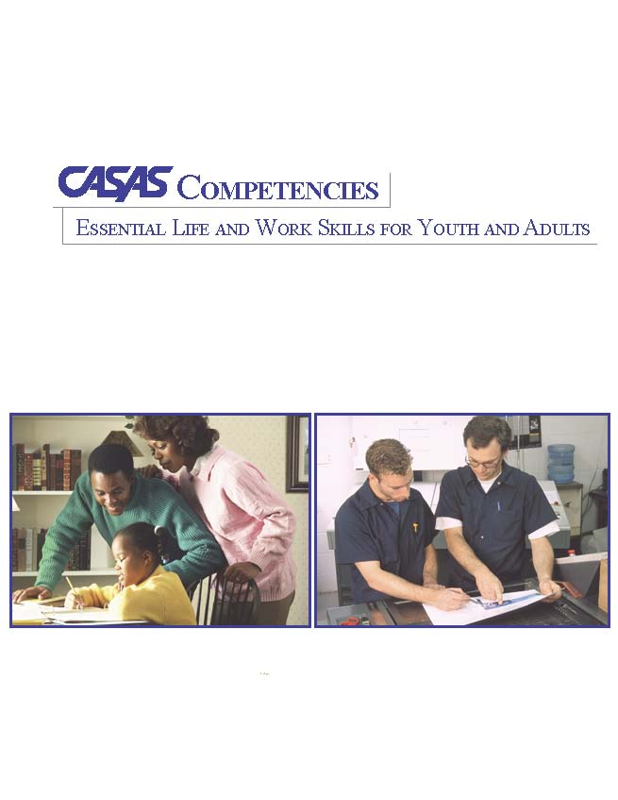
What are Competencies?
Measurable learning objectives written in a functional life skills context
Competency Content Areas
0. Basic Communication
1. Consumer Economics
2. Community Resources
3. Health
4. Employment
5. Government and Law
6. Computation
7. Learning to Learn
8. Independent Living Skills
CASAS Web site: www.casas.org/ About CASAS / CASAS Competencies
5
Notes:
A competency is.

Slide 6

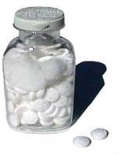
The Competency Coding System
Content Area
  3. Health
Competency Area
  3.4 Understand basic health & safety procedures
Competency Statements
  3.4.1. Interpret product label directions and safety warnings
  3.4.2. Identify safety measures that can prevent accidents and injuries
Every test item in the CASAS system is associated with a specific competency.
Notes:
The Competency Coding System
Every competency is identified with a three digit number. The first digit always refers to the content area.
The second digit refers to a competency area. 3.4 represents the content area of health and the more specific competency area of “understanding basic health and safety procedures”. The three digit competency statement describes a measurable action. Every test item in the CASAS system is associated with a specific competency.

Slide 7
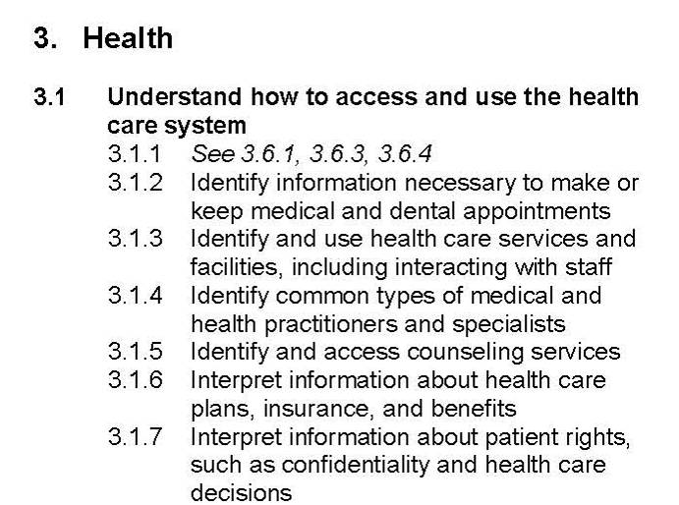
Competency Area
Content Area
Competency Area
Competency Statement
Page 6
Notes:
Under each of the nine Content Areas are Competency Areas. And finally, more specific Competency Statements give the clear objective for students to achieve.
Each Content Area is identified by a number, 0-8. This is followed by Competency Area and Competency Statement numbers, which creates the 3-digit Competency Coding System.

Slide 8
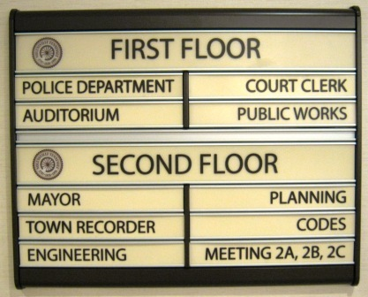
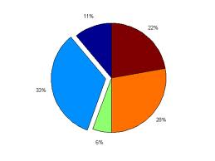
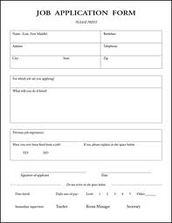

Task Areas
Test items can be presented according to a variety of task types
These task areas help to identify additional skills that need to be addressed during instruction
For example: a student may comprehend the language on a test item but not understand the item display, such as a bar chart, graph, or pie chart.

Slide 9
Test Items: Task Areas
Reading Task Areas
  Forms
  Charts, maps, consumer billings, matrices, graphs, or tables
  Stories, articles, paragraphs, sentences, directions, or pictures
  Signs, price tags, ads, or product labels
  Measurement scales and diagrams
Listening Task Areas (new)
  Picture prompt
  Comprehension question
  Predict next line of dialogue
  Identify true statement based on prompt
Pages 6 & 7

Slide 10
What are Content Standards?
Basic Skills Content Standards identify the underlying basic skills associated with CASAS Competencies. Foundation skills needed to
Use the Content Standards to fill in any gaps in the student’s education. For example, forms; but students don’t understand surname/last name
Page 8

Slide 11
Content Standards Categories
Reading
R1 Beginning literacy/phonics
Listening
L1 Phonology
Math
M1 Number Sense
R2 Vocabulary
R3 General reading comprehension
R4 Text in format
R5 Reference materials
R6 Reading strategies
R7 Reading and thinking skills
R8 Academic-oriented skills
R9 Literary Analysis (ABE/ASE only)
L2 Vocabulary
L3 Grammar
L4 General Discourse
L5 Informational Discourse
L6 Strategies and Critical Thinking
M2 Algebra
M3 Geometry
M4 Measurement
M5 Statistics, Data Analysis and Probability
Writing
W1 Beginning Literacy
W2 Spelling and Mechanics
W3 Grammar and Sentence Structure
W4 Vocabulary/Word Choice
W5 Organization
W6 Content
W7 Writing for Varied Purposes
W8 Academic-oriented Skills
Speaking
S1 Phonology/ Pronunciation
S2 Vocabulary
S3 Grammar
S4 General Discourse
S5 Informational Discourse
S6 Strategies and Critical Thinking
Notes:
11
Here are the categories for Reading Content Standards from the most basic to advanced for ASE level students.
They also have a coding system similar to the CASAS Competencies.

Slide 12
Basic Skills Content Standards and CASAS Competencies
Why are Basic Skills Content Standards important to use along with CASAS Competencies?
  Basic Skills Content Standards identify the underlying basic skills that should be taught in conjunction with CASAS Competencies.
  Basic Skills Content Standards support instructional planning.
  Learning Content Standards helps students master a specific competency to attain their goals.
Notes:
Remember that a Competency is a measurable learning objective, what a learner can do.
The Competencies are the “shells” in which the Content Standards are taught
The more CS that are necessary for that competency a student can do the better understanding of the Competency they will have.

Slide 13
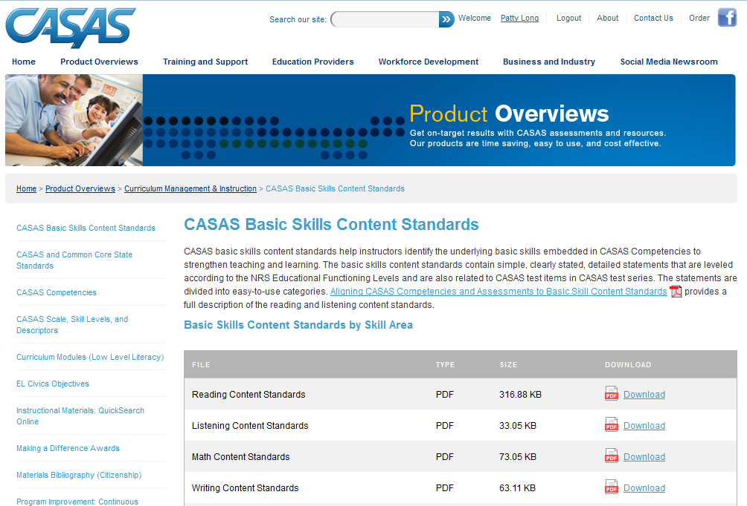

Slide 14

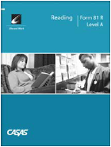

Assessment Process
1. Place
2. Diagnose
3. Instruct
4. Monitor
Screening and Appraisal
Determine program, level placement
Identify pretest level
Pretest
Diagnose learning needs based on pretest score
Instruction
Use Quick Search to identify appropriate instructional materials
Post-test
Select based on pretest score
Monitor progress
Page 17
Notes:
There are four main ways to track a learner’s performance with assessments. First, place students into your program by using a screening instrument or an appraisal. For ESL this can include an oral interview to check listening/speaking level, a form to screen for literacy and/or a short simple reading test. You can use your own screening instruments or the CASAS appraisal which includes literacy screening, oral interview and a listening and reading test for ESL. Next pre-test your students at their appropriate class level to diagnose their learning needs.
Third, provide instruction, and finally, post-test your students to measure their progress.

Slide 15
What’s the difference between the Appraisal and the Pretest?
180 185 190 195 200 205 210 215 220 225 230 235 240 250
Appraisals (Placement tests)
Appraisal test items are widely distributed along the CASAS scale. The items range from very easy items to difficult items.
Level B
Pre- and Post-Tests (Progress Tests)
Progress test items are clustered at a specific level.
Page 26
Notes:
This chart shows the difference between an appraisal and a pre post test.

Slide 16
What’s what
Appraisals determine which form is appropriate to administer as the learner’s pretest, and help agencies with program, level, and classroom placement
The Pretest is the “anchor” test for the fiscal year.
Post-tests are any/all tests that are given after the Pretest during that year.

Slide 17

Using Test Results
Identify students’ instructional needs
Relate information from test scores and accountability reporting to the student level
Choose competencies and Content Standards to target instruction
Use Quick Search software to locate instructional materials
Page 35
Notes:
Testing reports
1. allow teachers to share areas of strengths and weaknesses with individual students and their class
2. help teachers plan instruction
The Instructional Materials Quick Search correlates competencies with commercially published educational materials appropriate for youth and adults in competency-based programs.

Slide 18
CASAS Skill Level Descriptors
The Skill Level Descriptors describe in positive terms what a person is able to do or learn within a range of scale scores.
The scale score is determined by the raw score. Your TOPSpro reports will show you the scale score.
Use the Skill Level Descriptors to interpret the score.
Page 21
Notes:
TH page:
Have participants turn to the Skill Level Descriptors for ESL in their Handbooks.

Slide 19
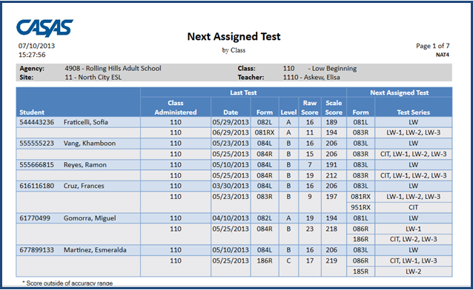
Next Assigned Test Report
Page 31
Notes:
Your TOPSpro staff can print a report specifically for your class to help you determine the appropriate post-test to administer for each student.

Slide 20
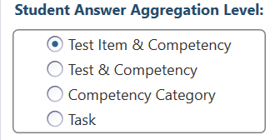
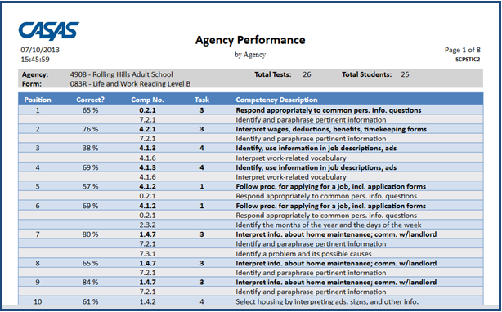
TOPSpro Report: Class Performance by Competency
The Task Number tells you the format in which the question was asked.
Test Question Number
The Competency Description gives more detail of the Competency Number
Percentage of Students who answered this question correctly
The Competency Number on which this question was based
Page 36
Notes:
So, let’s look at some more things on this report.
What date was this report printed?
What test dates are included in this report?
Which class is this report for?
What test form is covered in this report? (If students in your class took different test forms, there will be a page printed for each form.)
How many tests are represented in this report? (23)
How many students took Form 83R? (24)
Why don’t these numbers match? (One student has been in class long enough to take an 83 R, 84R, and an 83 R again.)

Slide 21
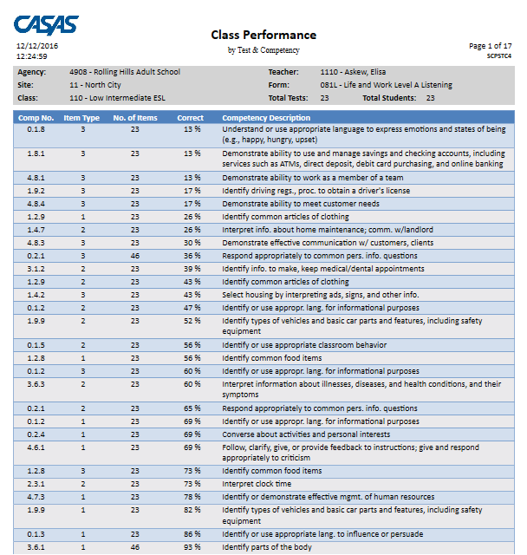
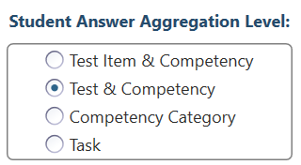

Slide 22

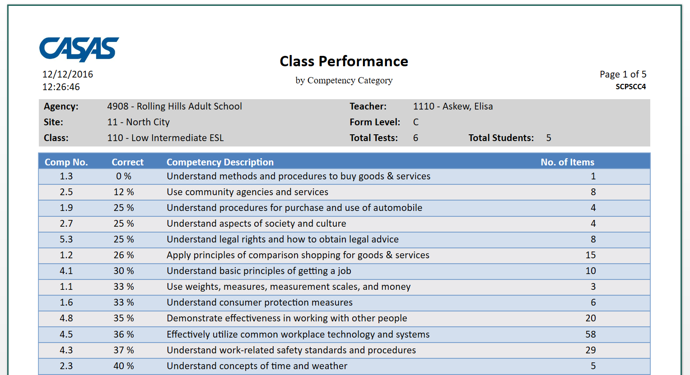

Slide 23
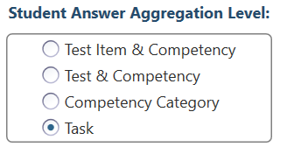
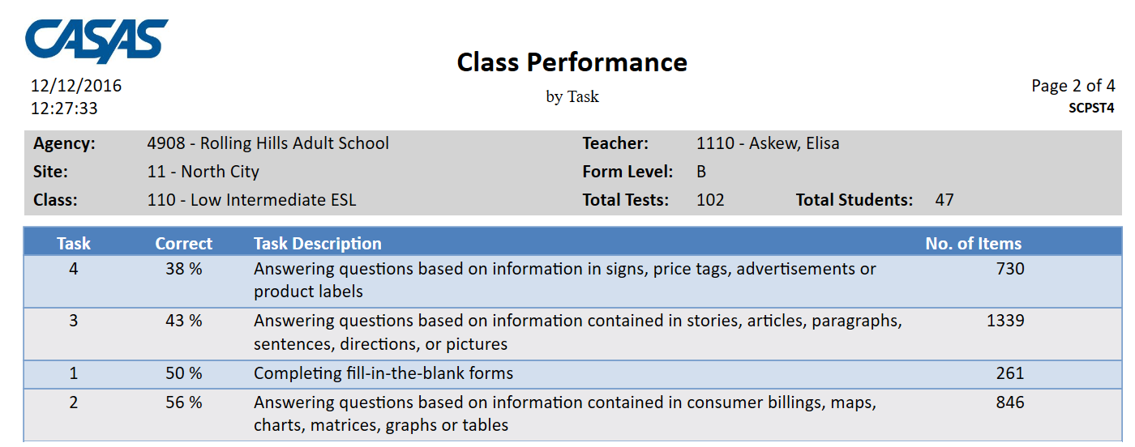

Slide 24
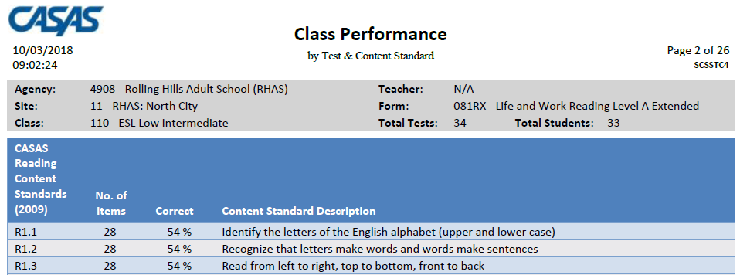
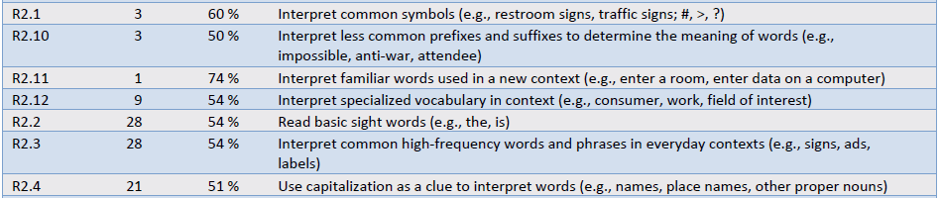
Content Standard Summary

Slide 25
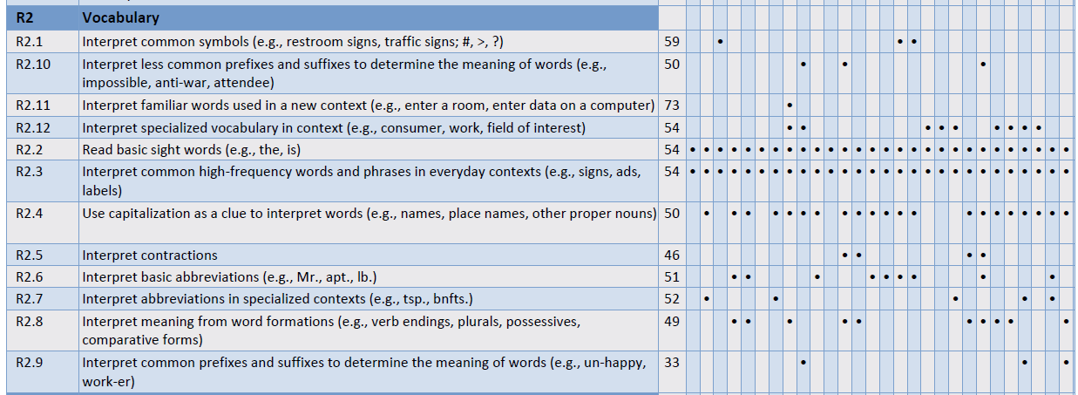

Content Standard Summary
Run the content standard reports by test item or by test form

Slide 26
CASAS Sample Test Items
An instructional tool to:
  Familiarize students and teachers with CASAS format
  Practice test taking skills using sample test items
  Practice marking the answer sheet
    Can use TOPSpro Test Record
Sample test items for Levels A, B, and C
  Life and Work Reading
  Life Skills Listening
5 to 6 test items per level for each skill area
Not a predictor of performance
Download from the CASAS Web site at www.casas.org.
Page 32
Notes:
26

Slide 27
Finding Instructional Materials
Scope and Sequence in your textbook
  Correlated to CASAS competencies
QuickSearch Online
Bibliography of Citizenship Materials
EL Civics Objectives
Page 40

Slide 28
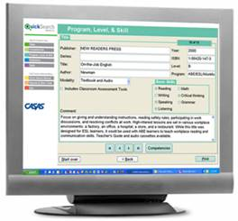
QuickSearch
Quick, easy access to database of more than 2,000 instructional materials
Includes print, audio, video, and software materials
Correlated to CASAS Competencies (and to Content Standards in 2008)
Search by
  Title
  Competency
  Program, Level, and Skill
  Publisher
  CASAS Test
Notes:
Instructional Materials Quick Search help program coordinators and instructors select materials to match their curriculum.
Review points and benefits of Instructional Materials Quick Search Updated annually to include new materials from publishers and software companies.

Slide 29
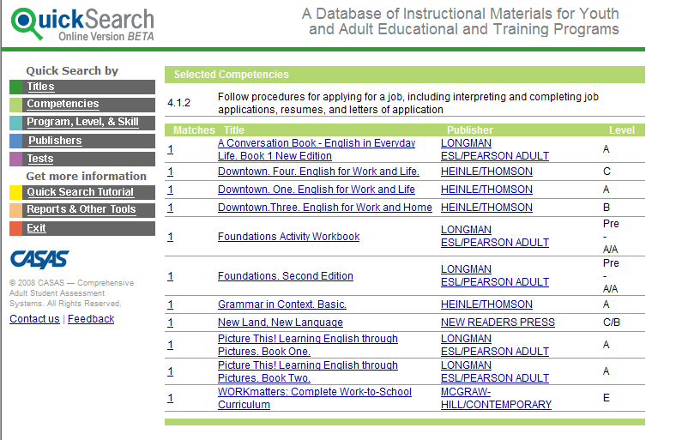
QuickSearch by Competencies
Competency selected for this report: 4.1.2
Page 41
Notes:
This QS screen lists the results of a search by competency
Competency 4.1.7 and Level B are specified
Mention that multiple competency searches are possible. The books that address all or most of the competencies appear ; the books that address only one of the selected competencies appear last

Slide 30
Thanks for your participation!

