Slide 1

CAEP Webinar
Closing Out 16-17 Adult Education Funds in NOVA

Slide 2
Agenda
CAEP Funding
Current Status of Spending
Targets
Cycle / Timeline
What to do if you still have 16-17 funds unspent?
Closing Out in NOVA
Step by Step Process
Technical Assistance

Slide 3
CAEP Funding
19-20 Governor’s Budget - $18M COLA proposed
Total CAEP Base Funding - $539,607,000 (proposed)
Look for May Revise for any additional changes.

Slide 4
CAEP Spending
Using the FIFO in NOVA
15-16 – 100% spent
16-17 – 100% spent
17-18 - 92% spent
Note – this is statewide, your consortia may vary. Need to check.

Slide 5
CAEP Target Guidelines
Base funding starts July 1 with the governor’s signing of the budget.
Allocated funds have a target of two years to spend.
For example: 17-18 funds were approved on July 1, 2017. Target to spent these funds is by June 30, 2019. 2 years.
If you can’t meet the target of 2 years to spend the funds, you can complete a corrective action plan in NOVA to allow an additional six months. Final date to cease activities would be extended to 12/31/19.

Slide 6
CAEP Target Guidelines (cont.)
Monitoring your funds at certain intervals – 1 yr., 18 months, 2 yr. – allows consortium to move funds around if members cannot spend their allocation.
Hitting your 2 year target is important in order to keep the first in / first out flow of funding.
Starting this year in NOVA – each March 1st members will certify a close out report for funds issued 30 months prior.
16-17 funds ended 12/31/18 and will be closed out 3/1/19.
17-18 funds will end 12/31/19 and will be closed out 3/1/20.
18-19 funds will end 12/31/19 and will be closed out 3/1/21.

Slide 7
Cycle / Timeline
Funds issued on July 1st
Target spending within 2 years – June 30th.
With corrective action plan in NOVA – receive an additional 6 months.
Activities must cease within 2 years 6 months – December 31st.
Close out for funds in NOVA – March 1st – member report.
Certification in NOVA – March 31st – consortium level.

Slide 8
What to do if you still have 16-17 funds unspent?
Activities must cease within 2 years 6 months – December 31st.
But you have 60 days to finalize expenses.
Close out for funds in NOVA – March 1st – member report.
But you could work with your consortium director or certifier to finalize expenses during March (prior to certification)
Certification in NOVA – March 31st – consortium level.

Slide 9
What to do if you still have 16-17 funds unspent?
If all that fails and you still have unspent 16-17 funds by March – then the state will invoice your district to return/pay back funds.
However, the funds are not reallocated – the state will send the funds to the general funds.
Work with your members to hit the 2 year target.
Monitor NOVA more closely.
Set up member reallocation processes via member amendment process.

Slide 10
Closing Out in NOVA

Slide 11
Step by Step Process

Slide 12
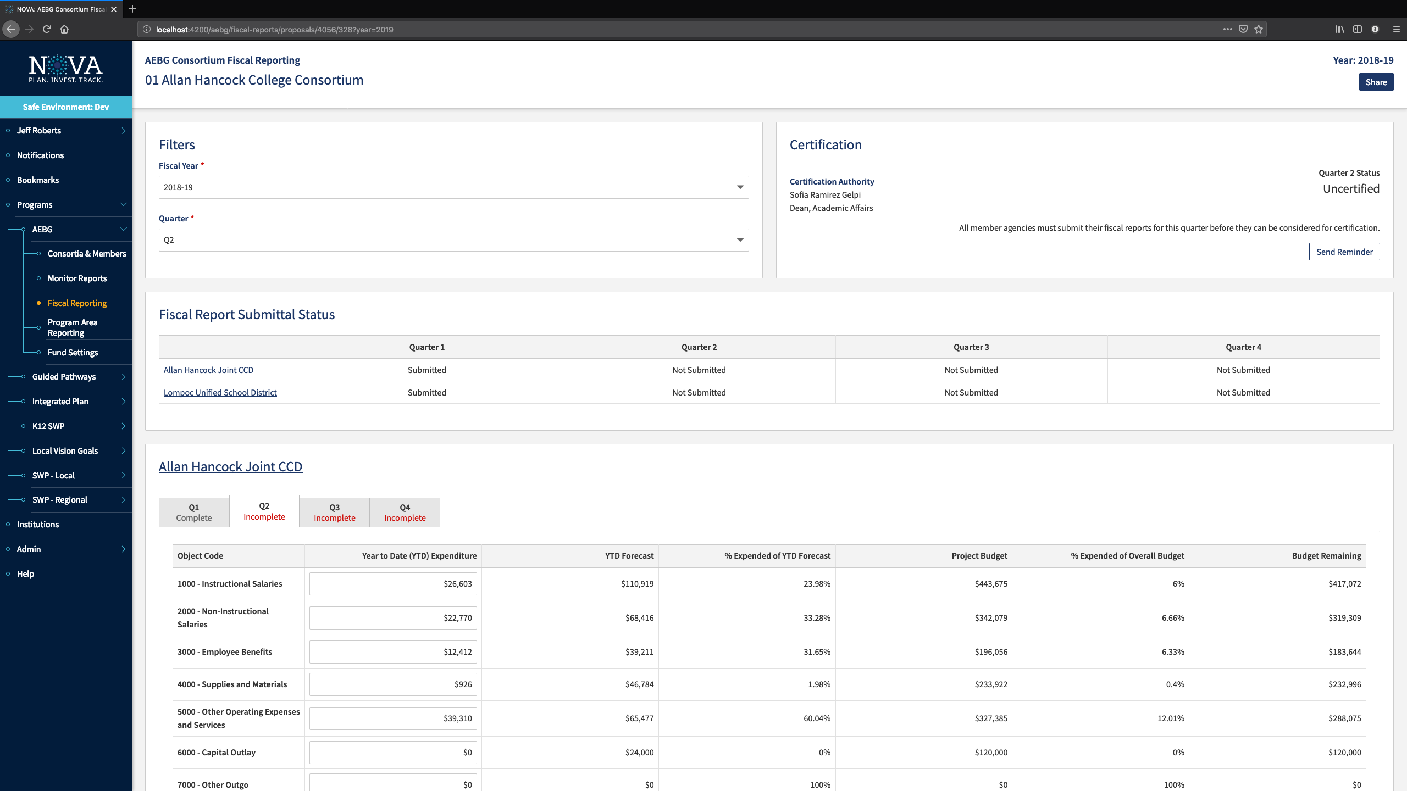

Slide 13
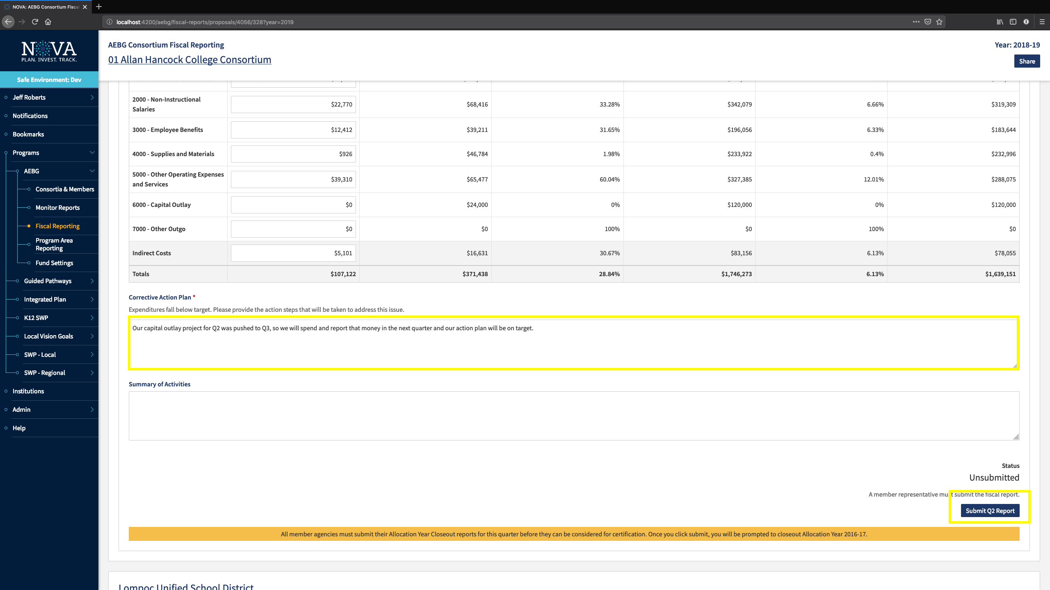

Slide 14
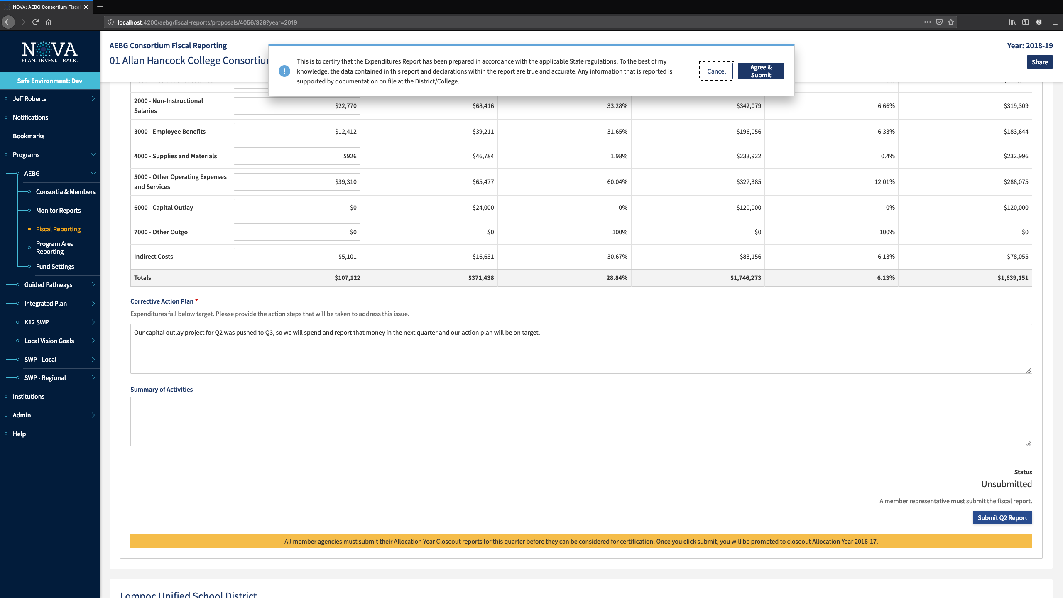

Slide 15
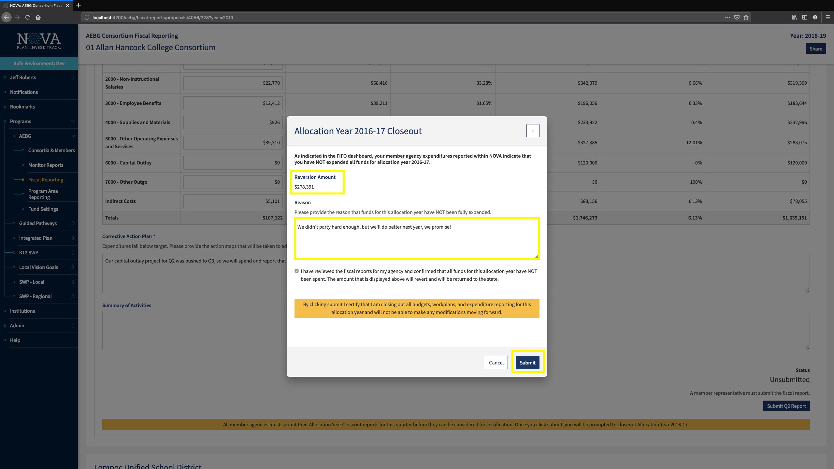

Slide 16
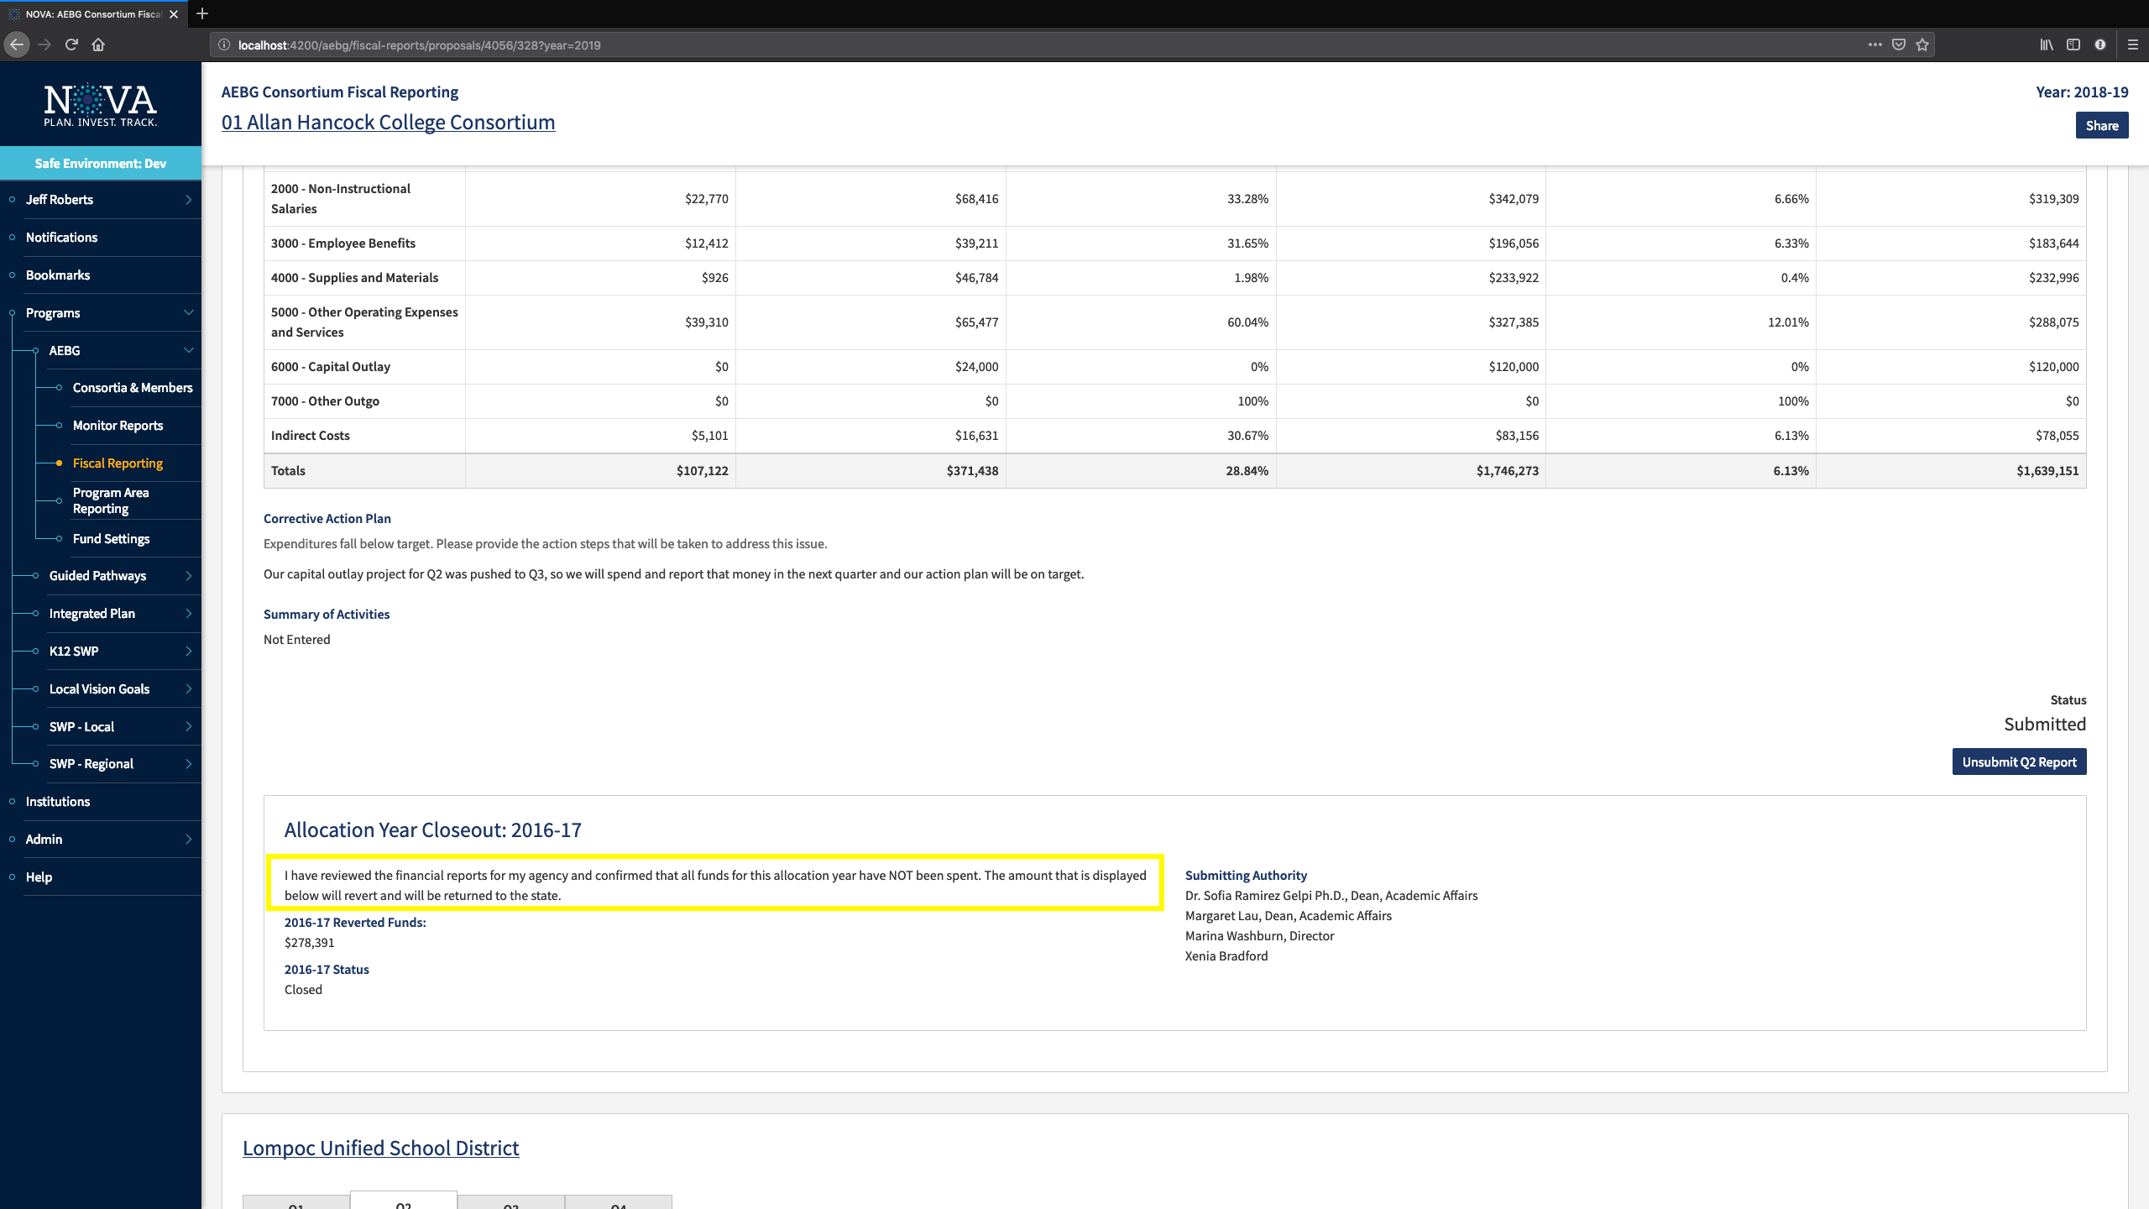

Slide 17
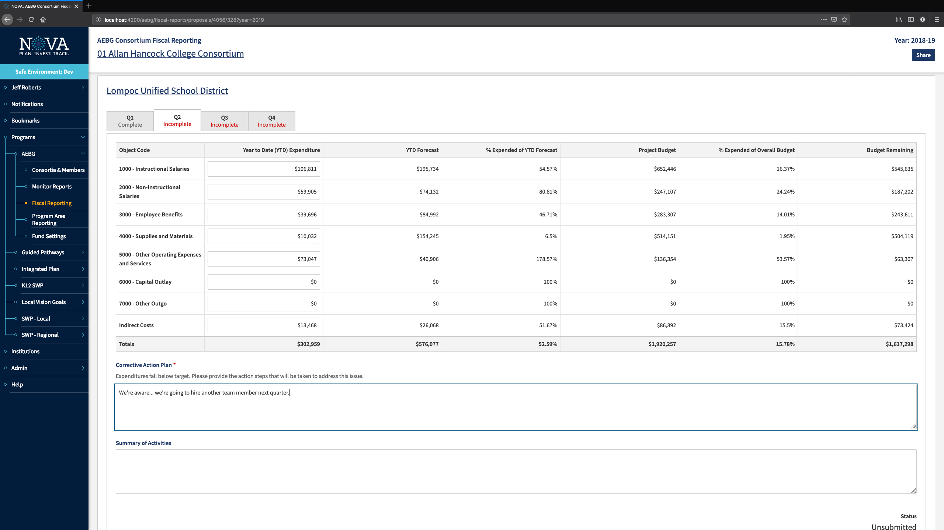

Slide 18
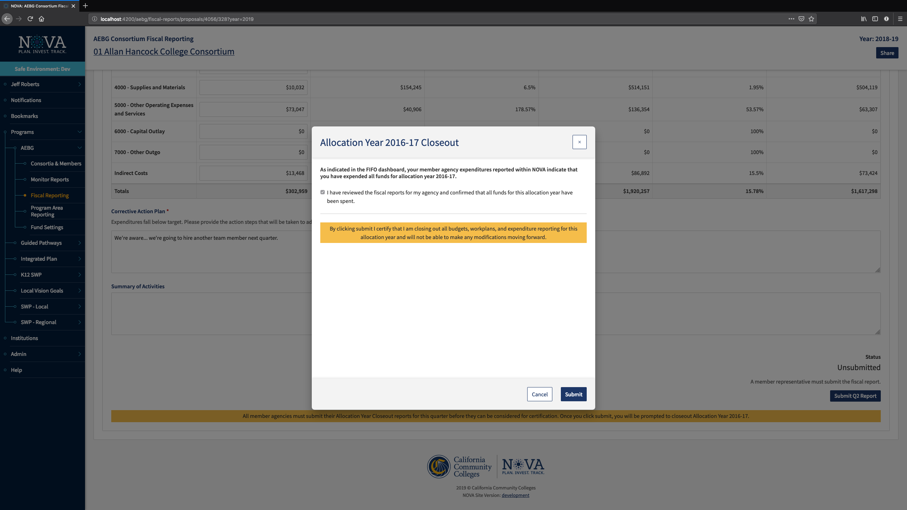

Slide 19
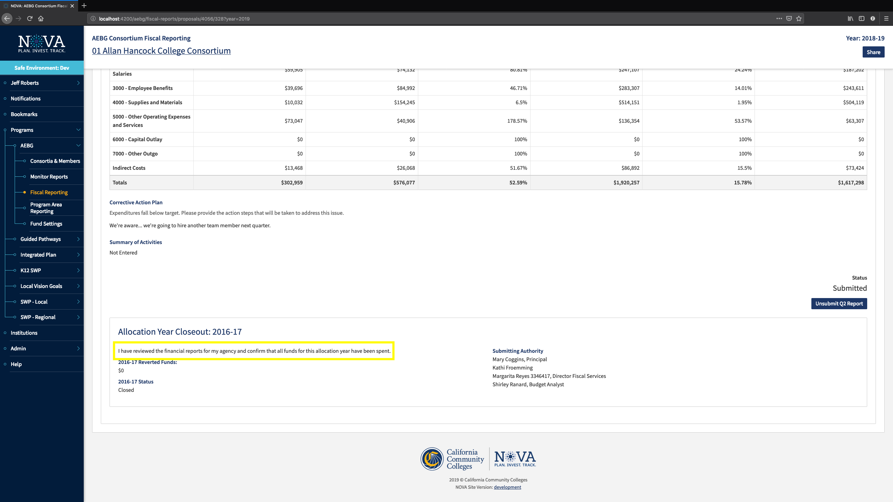

Slide 20
Budget Forecasts in NOVA

Slide 21
Step by Step Process

Slide 22
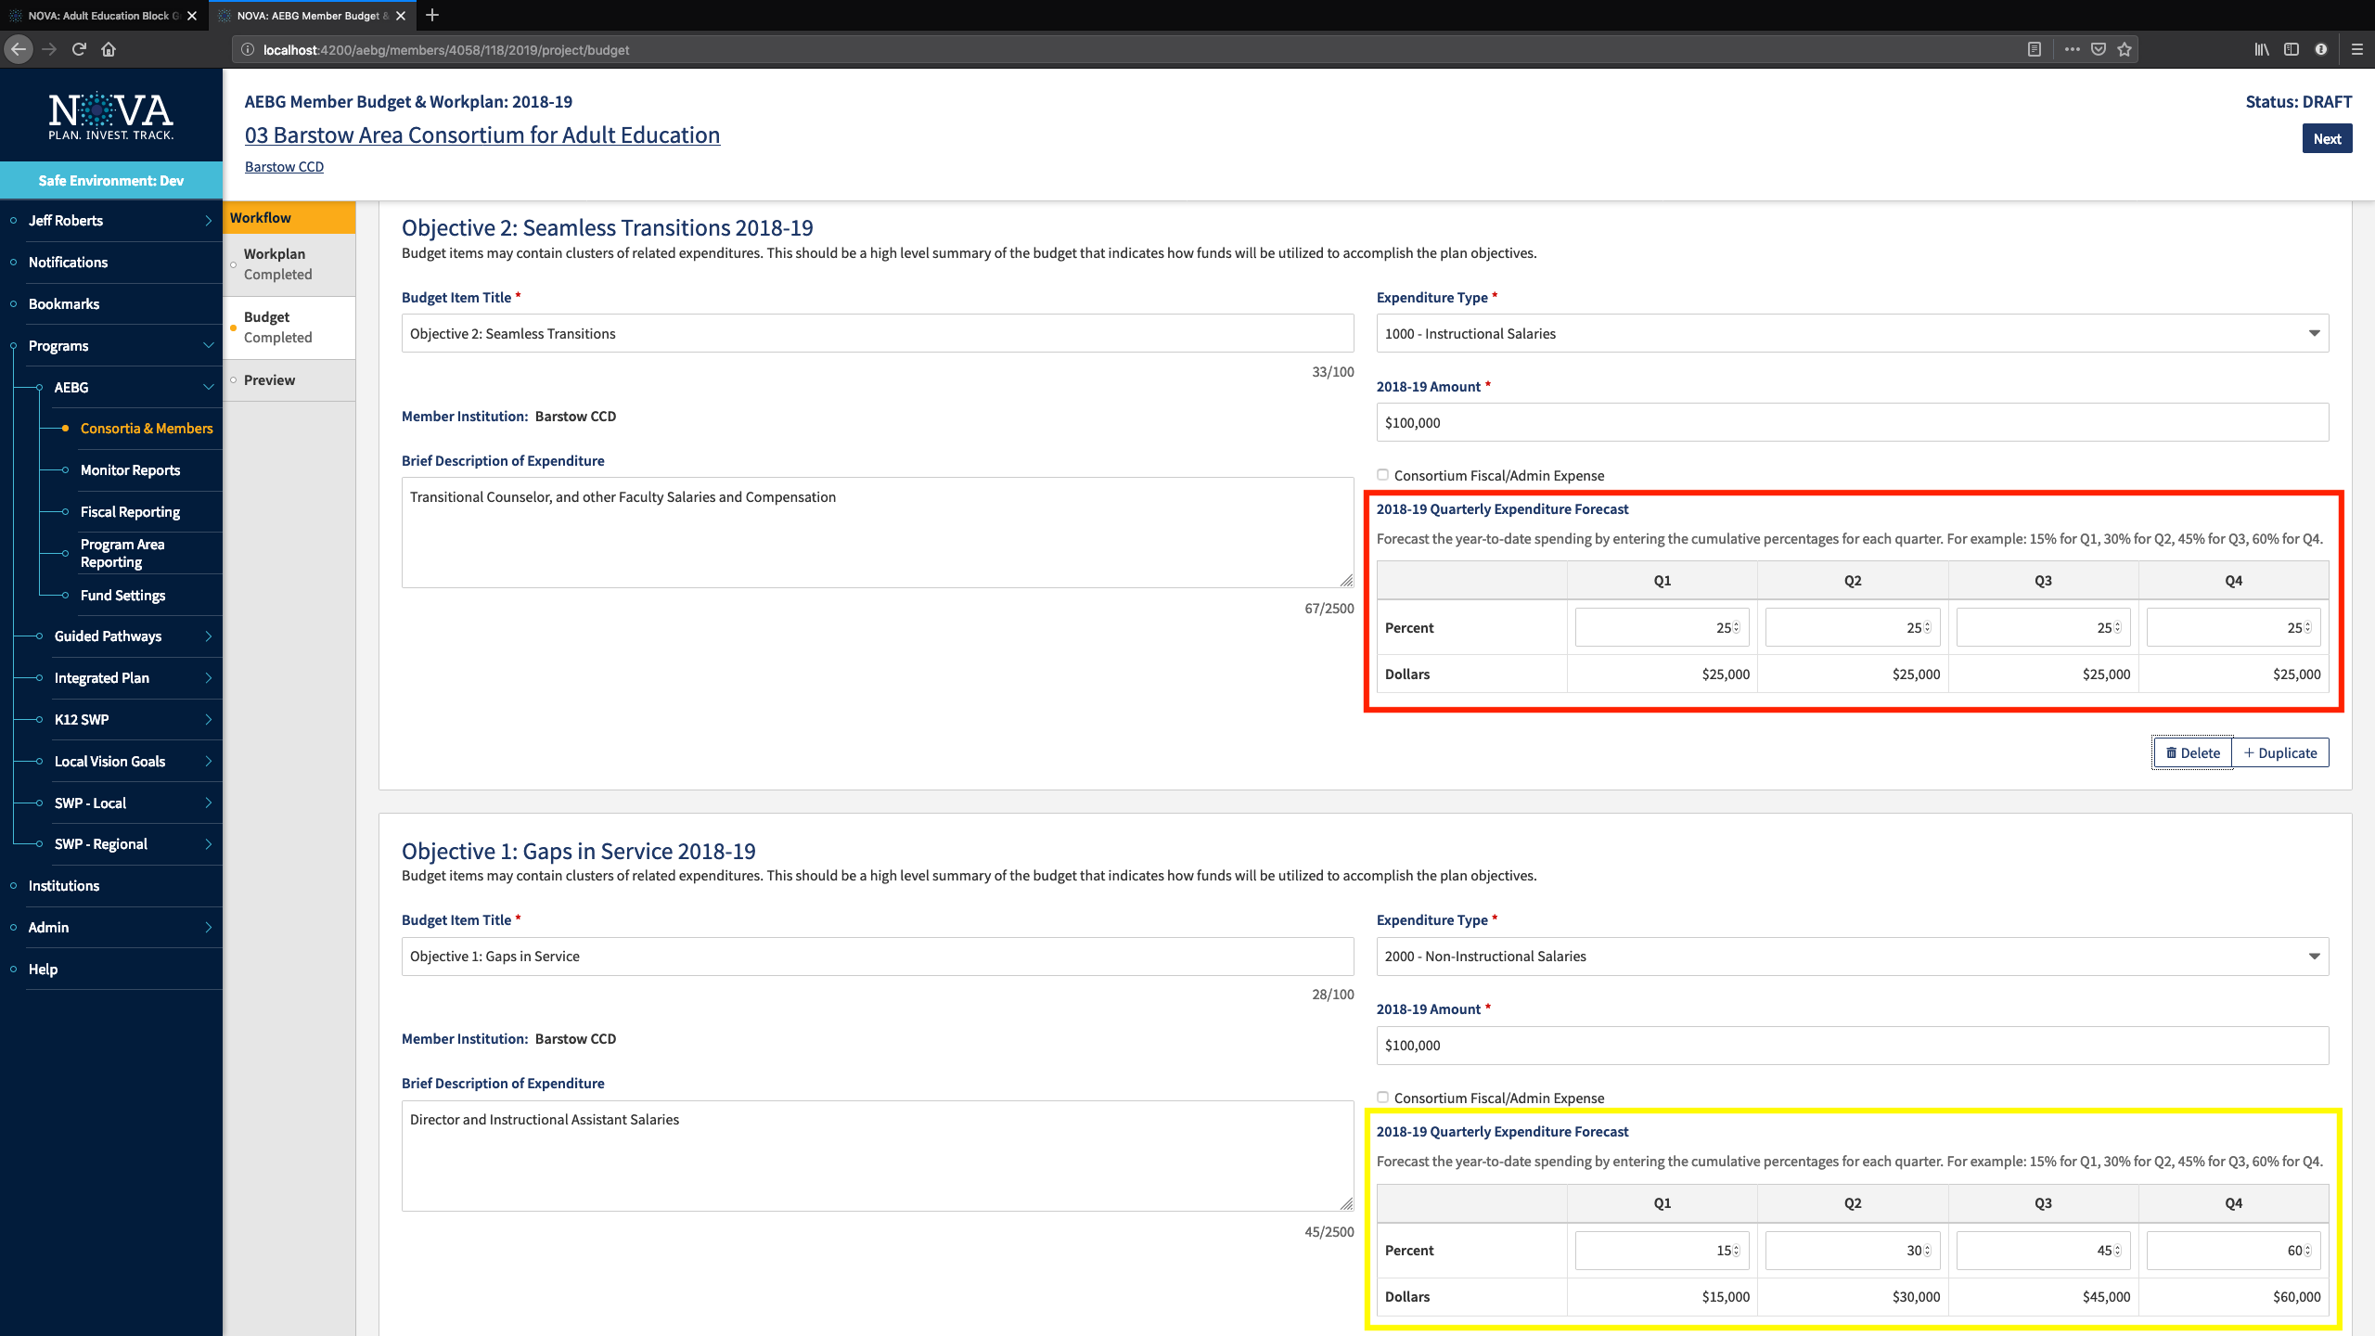

Slide 23
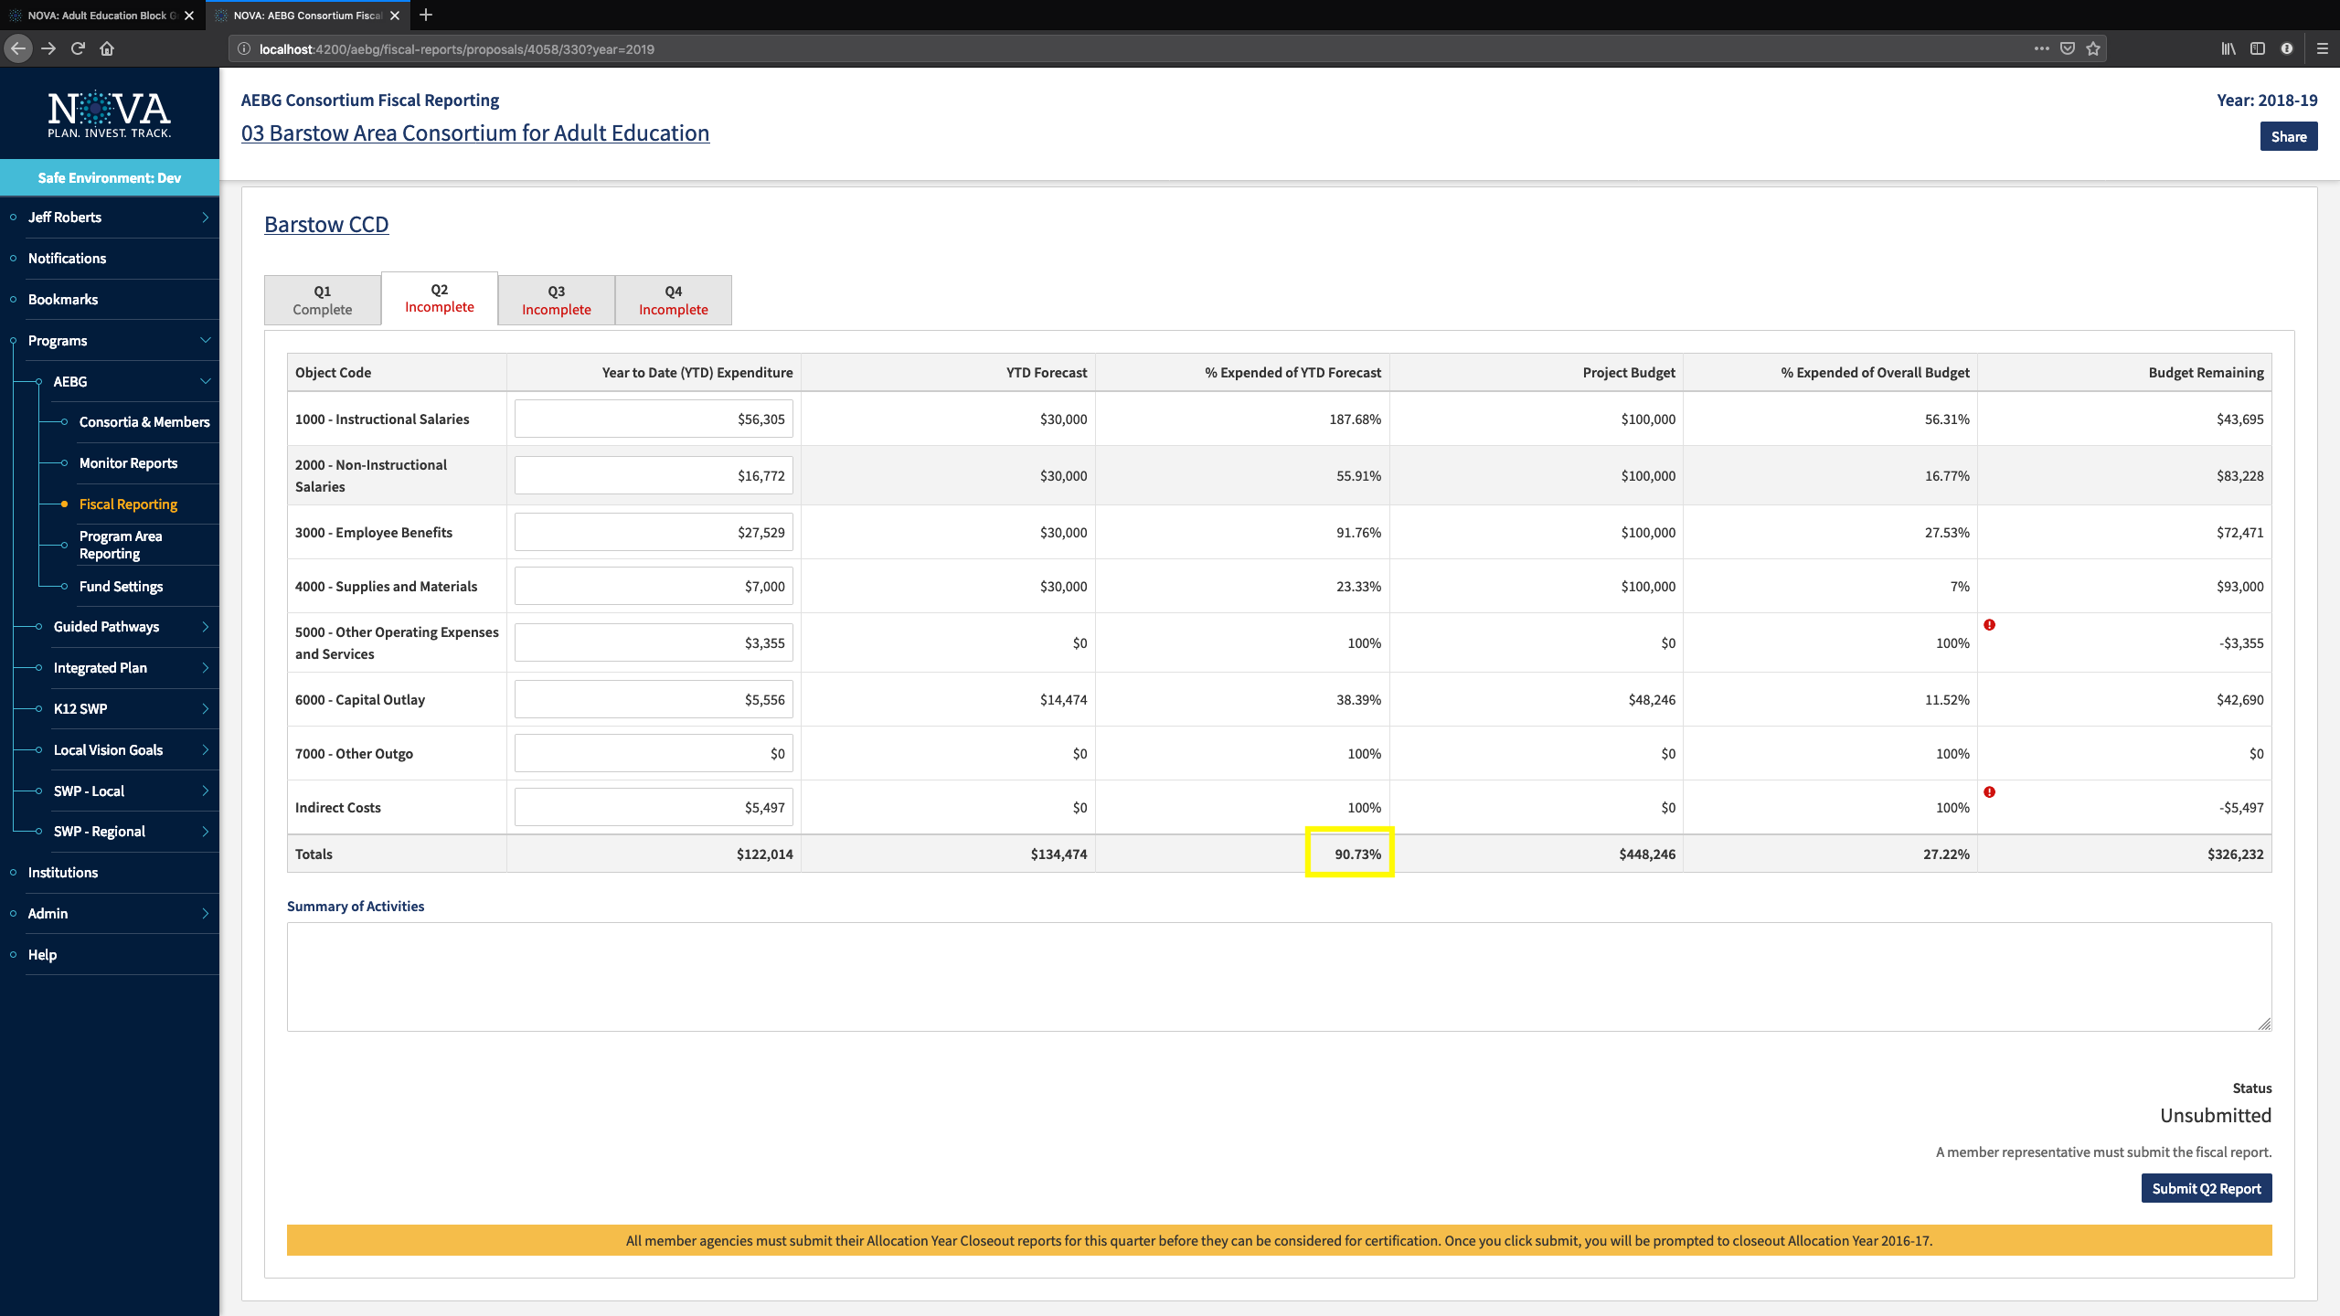

Slide 24
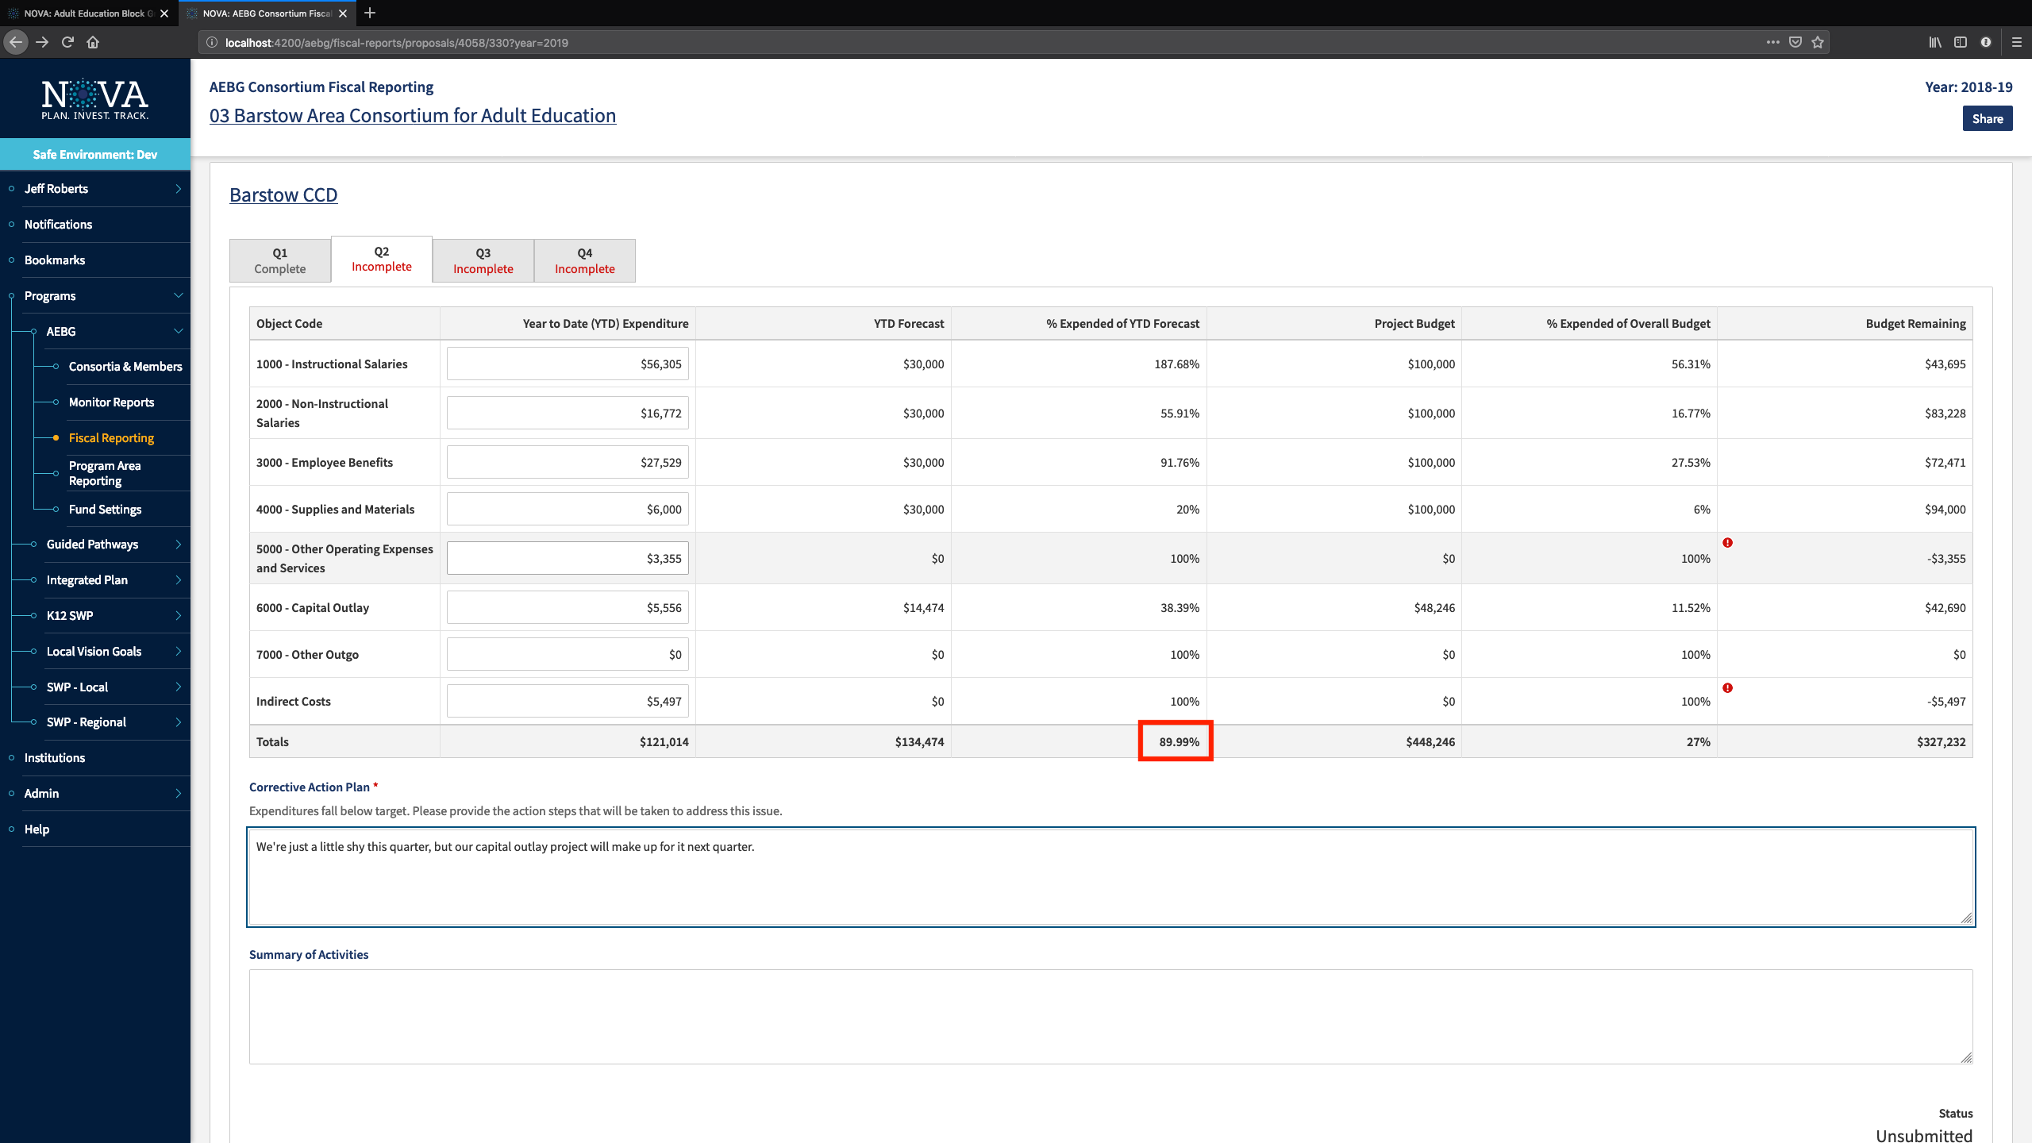

Slide 25
Technical Assistance

