Slide 1
Planning Tools & Self-Assessment November 28, 2018

Slide 2
Agenda
Overview / Purpose
Brief Review of Planning Guidance & Toolkit + Health Check
Overview of Self-Assessment Tool
Upcoming Webinars & Workshops

Slide 3
Three-Year Plan Guidelines
Guidelines & Templates are available on caladulted.org
Four main sections plus an Executive Summary
Three required tables:
              Regional Service Providers
              Progress Indicators
              Sources of Funding
    Plus a Logic Model
    Narrative is limited to 35pp (single-spaced) or 21k words
    Final plans must be submitted in MS Word and PDF formats by no later than June 7, 2019

Slide 4
Three-Year Plan Approach
Pre-Planning Assessment
Evaluation of your consortium capacity, identify your key partners and alignment with other regional planning processes
Community Needs and Customers
Understanding the needs of your community, your current customers, and regional labor market opportunities
Identifying Goals and Strategies
How and where the consortium will improve programs and services, and the strategies, activities, and expected outputs to get there
Piloting and Implementation
How you will pilot new strategies, evaluate them, and scale them for full implementation

Slide 5
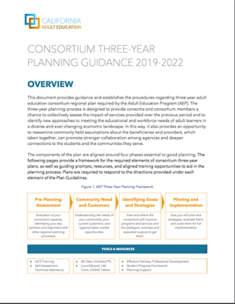
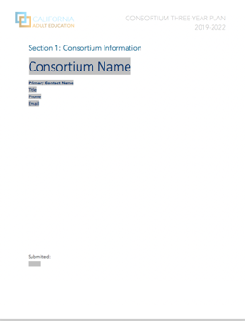
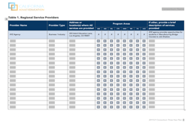
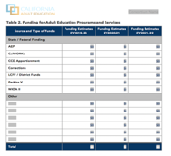
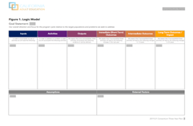
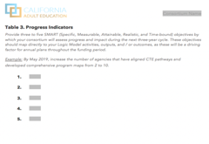
Planning Guidance and Templates
Three-Year Plan Guidance
Plan Template
Template Tables

Slide 6
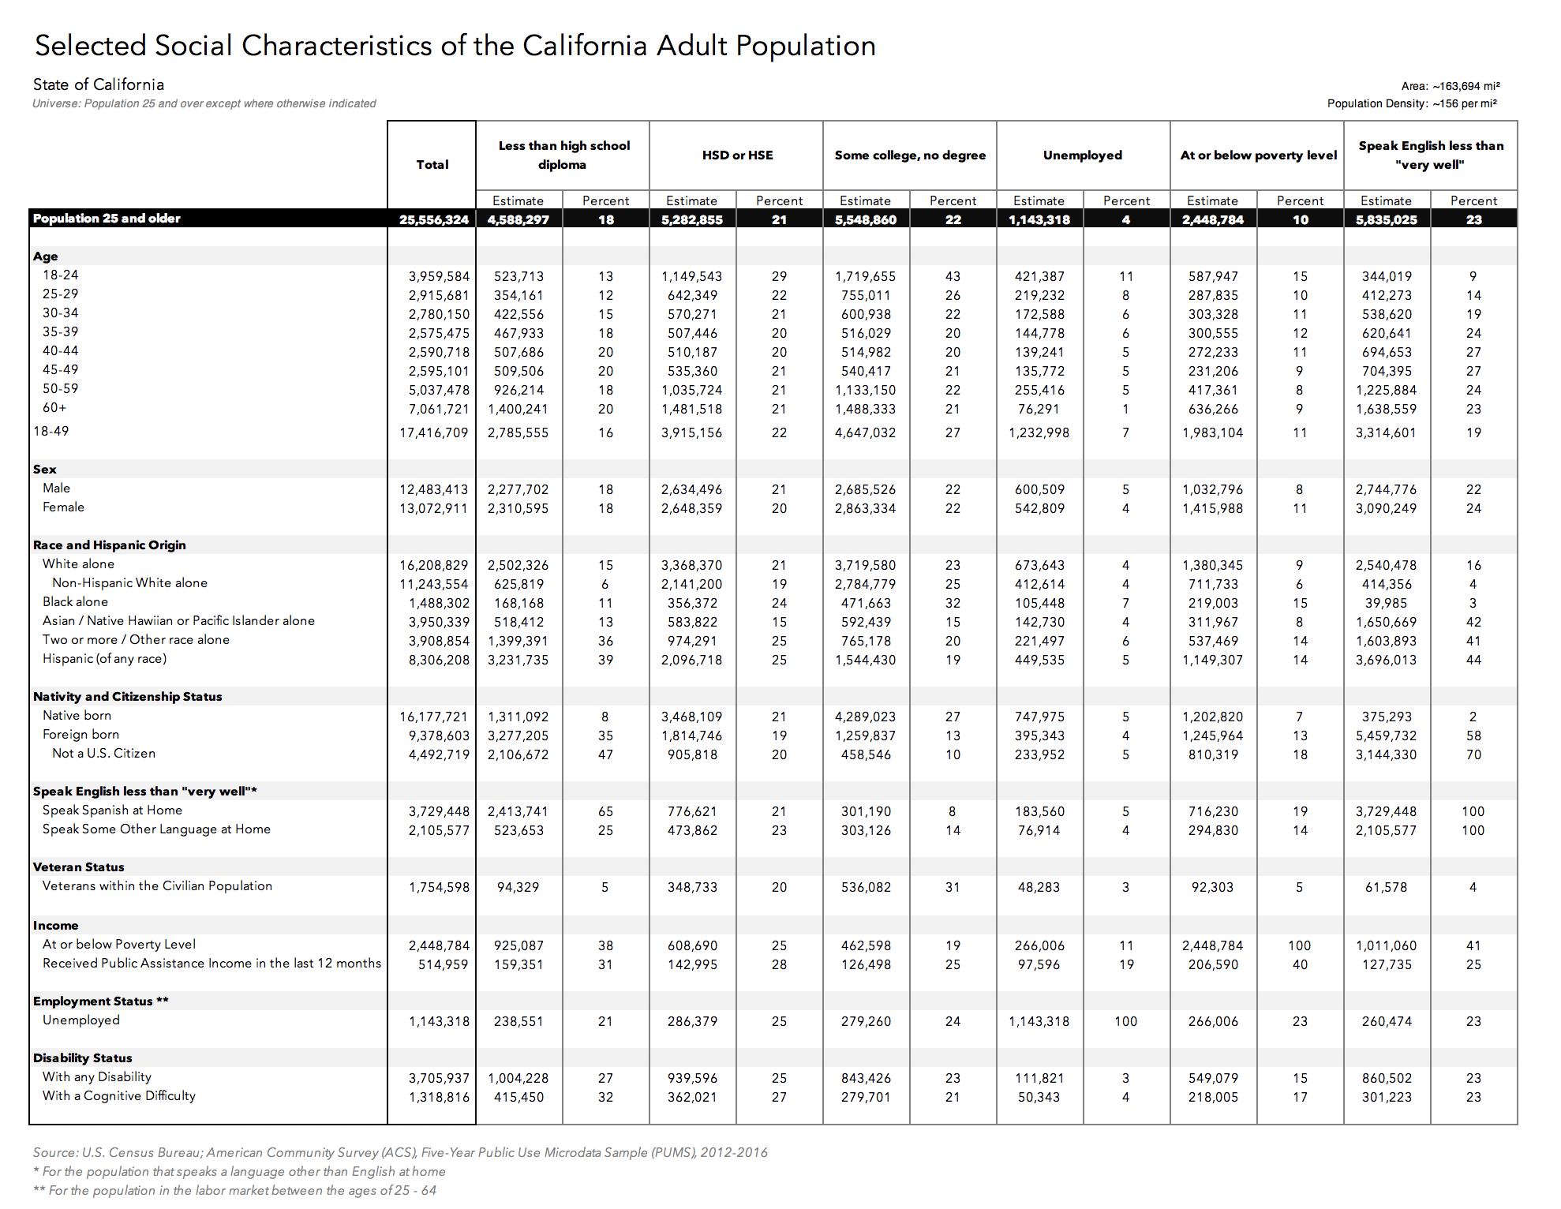
Community Needs Data

Slide 7
Health Check

Slide 8
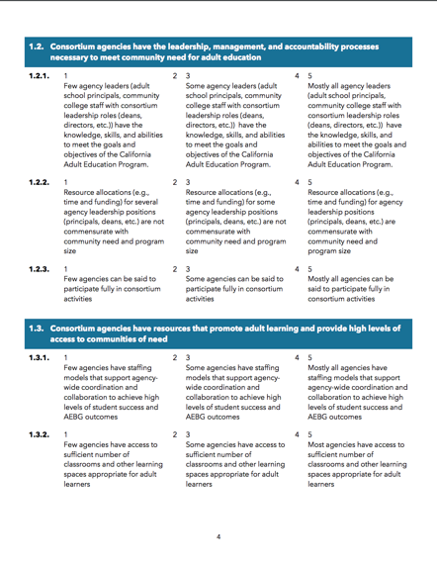
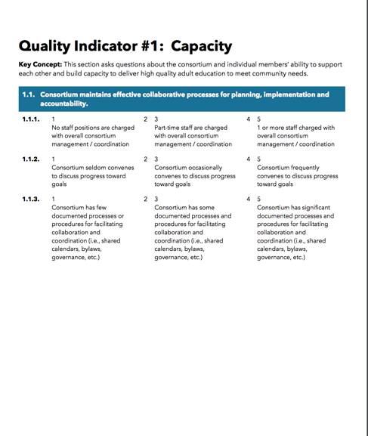
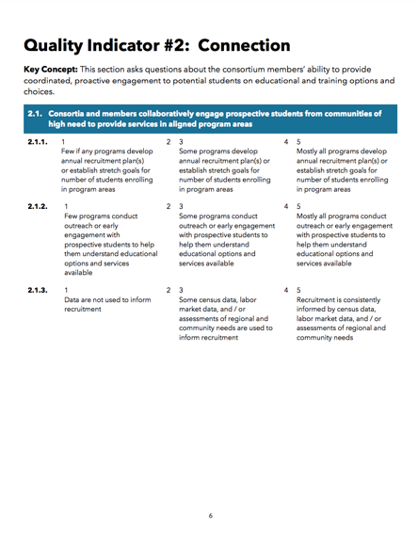
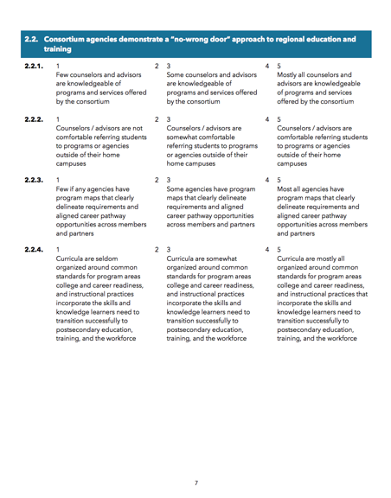
Self-Assessment Tool

Slide 9
Overview
The Self-Assessment Tool helps consortia / members analyze the quality of their programs currently and serves as a roadmap for program improvement in relation to the following areas:
Capacity
Connection
Entry
Progress
Completion/Transition
It is designed to help consortia / members with
Engaging key stakeholders in conversations about program quality and continuous improvement and encouraging them to consider ways they might support AE programs and services
Generating action plans to identify professional development and technical assistance support
Creating opportunities for more open and meaningful partnerships among agencies

Slide 10
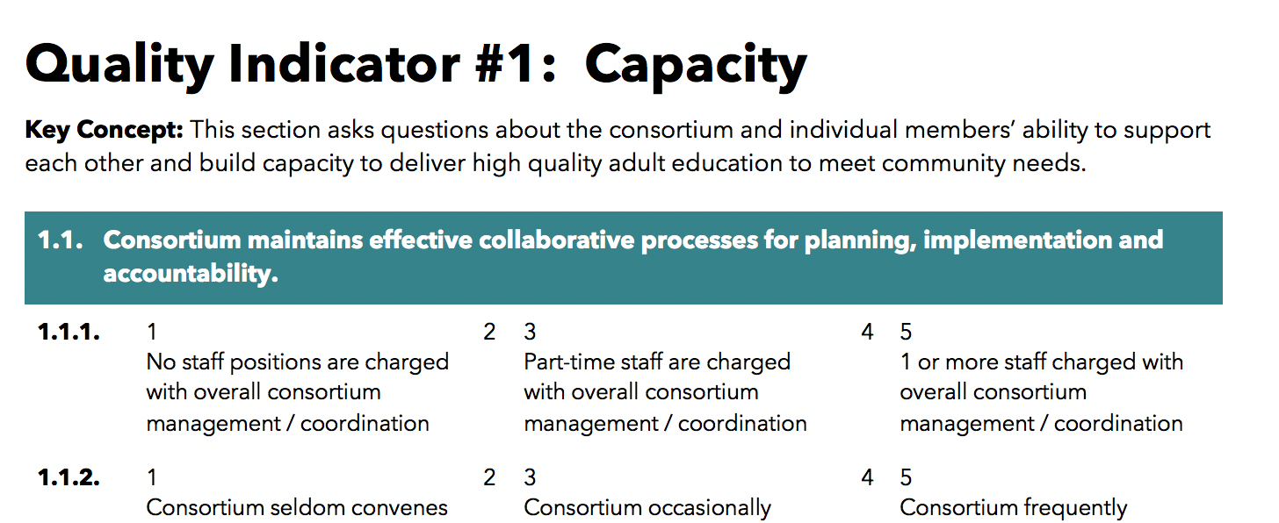
Anatomy of the Self-Assessment

Slide 11
Steps to Using the Self-Assessment Tool
Determine areas for assessment and form self-assessment team(s)
Conduct self-assessment & share results with key stakeholders and planning teams
Identify areas for improvement and develop action plan
Evaluate success of the action plans and intended results

Slide 12
Upcoming Webinars & Workshops
This Month
Regional Data Unlocked Workshops – Anaheim,11/29
      Logic Modeling Webinar – 11/30
      Coming Soon
      Mid-January 2019 – mini webinar series to review 3 year planning tools & best practices. TBA.
      Planning consultation – contact TAP.

Slide 13
Coming Soon
Onboarding Tool Kit
  A guide and web-based tool for new consortium staff and members.
  All you need to get started with the CA Adult Education Program
  Web tutorials, to-do lists, essential resource lists and much more
Data Resource Tool Kit
  A one-stop shop for all you need for student data, fiscal and economic data.

Slide 14
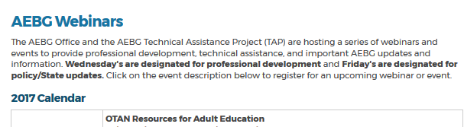
AEBG TAP
The AEBG Technical Assistance Program (TAP) provides professional development resources for all AEBG agencies statewide.

