Slide 1
Three-Year Plan
Preview
September 20, 2018

Slide 2
Agenda
Overview / Purpose
Review of Guidance
Resources / Tools
Feedback
Next Steps

Slide 3
Purpose
Based on AB104 legislation and education code 84906.
Still using requirements that were part of the last 3 year planning effort – so no surprises.
The State is providing better data tools and more technical assistance.

Slide 4
Changes
18-19 trailer bill language provided an extra year of planning for adult education regional consortia.
Three Year Plans will be approved and submitted by June of 2019.
Plans will be uploaded and certified by members in NOVA.

Slide 5
Review of Guidance

Slide 6
Three-Year Plan Approach
Pre-Planning Assessment
Evaluation of your consortium capacity, identify your key partners and alignment with other regional planning processes
Community Needs and Customers
Understanding the needs of your community, your current customers, and regional labor market opportunities
Identifying Goals and Strategies
How and where the consortium will improve programs and services, and the strategies, activities, and expected outputs to get there
Piloting and Implementation
How you will pilot new strategies, evaluate them, and scale them for full implementation

Slide 7
Pre-Planning Assessment
Goals
Identify / evaluate consortium / member capacity, including current levels and types of education and workforce programs and services for adults in the region, as well as funding available to members for adult education services*
Identify key partners, including their current levels and types of services and funding*
Identify alignment of adult education services provided by the consortia with other regional plans and planning processes (e.g., WIOA Titles I and II, Carl Perkins, Strong Workforce, etc.)
Guiding Questions
Who provides education and workforce services to adults in our region? What kinds of programs (i.e., levels and types) do they provide?
What is the capacity of the region to provide these services?
What kinds of resources are currently being utilized to provide services? What funding is available and is it being leveraged effectively?
To what extent is your consortium aligned with other regional planning processes? (e.g., WIOA I & II, Carl Perkins, SWP, etc.)

Slide 8
Community Needs and Customers
Goals
Describe the regional need for adult education and workforce services as it pertains to (1) your current customers, (2) the regional community, and (3) the regional labor market
Define shared and unique customers, as well as service priorities and communities of need
Evaluate the alignment between needs and levels and types of services available within the region to meet adult education and workforce needs.
Guiding Questions
Who are your current customers? What are their needs, goals, and priorities?
What characteristics define your region’s communities? What characteristics define the populations engaged in the programs you offer?
What industries is your region home to? What kind of skills are they looking for in their employees? What kinds of credentials do they value?

Slide 9
Identifying Goals and Strategies
Goals
Identify activities and measurable goals to address community needs & improve student outcomes
Describe strategies to improve integration of services among including, but not limited to alignment of intake / placement for adults seeking education and workforce services, program mapping, and alignment of curriculum and standards
Describe strategies to improve transitions into postsecondary education and the workforce
Describe approaches to prototype new strategies and evaluate their effectiveness
Guiding Questions
How will you coordinate programs to eliminate duplication, maximize program potential, and ensure access to all adults needing services in the region?
How will you ensure that adults transition seamlessly across programs, service providers, and into the workforce?
How we you concretely identify or quantify your outputs - e.g. which specific occupations or industries will you focus on, how many new training programs do you intend to build, where and how will you increase engagement and outreach to new customers, etc.?
How will data be used to evaluate progress and measure effectiveness?

Slide 10
Piloting and Implementation
Goals
Explain how you will prototype and pilot new strategies to address the region’s most urgent problems
Describe how you intend to evaluate the effectiveness of these pilots using formative data collected throughout to inform continuous improvement processes, as well as summative data to assess the overarching impact of these strategies
Guiding Questions
What problems most need solving?
What does it mean for a strategy to work? What criteria will you use to assess success or failure? What measures?
Are your strategies robust enough for objective measurement?
Are there time and sufficient resources to measure impact and evaluate success?

Slide 11
Resources & Planning Tools
Trainings, Workshops, and Webinars
Career Pathway Training
Tools and Resources
Regional demographic data
Guidance & Templates
Three-year planning guidance
Human Centered Design
Adult Education Data Unlocked Training
Logic Modeling, Community Asset Mapping, and more
Three-Year Plan Template
Logic Model Template
Partner, levels and types of services tables
LMI Reports, Supply and Demand Tools from the Centers of Excellence
LaunchBoard data tables for consortium outcomes
Webinars highlighting the current pilots that are showing results around the state
CASAS Quarterly and Annual Reports
Planning support through TAP
Consortium / Member Effectiveness Self-Assessment Tool

Slide 12
Feedback from the Field
Examples of feedback…….
Adding additional resources
Editing to provide clarity
More specific examples requested
Word count suggestions
Program area specific
Section on governance & by-laws
Direction on use of NOVA to satisfy fiscal requirements
Additional information on logic models

Slide 13
Next Steps
Guidance and tables will be edited based on field suggestions.
The State Adult Education Program Office will review and approve the final version.
Final guidance will be released next month.
Training, workshops, technical assistance, webinars, and consultation will be offered for the next 8 months.
NOVA will open 3 year plan submission portal and ability for members to certify in early Spring 2019 with deadline in June 2019.
Three Year Plans will be summarized and submitted to the legislature. All plans will be made available for public and stakeholder viewing.

Slide 14
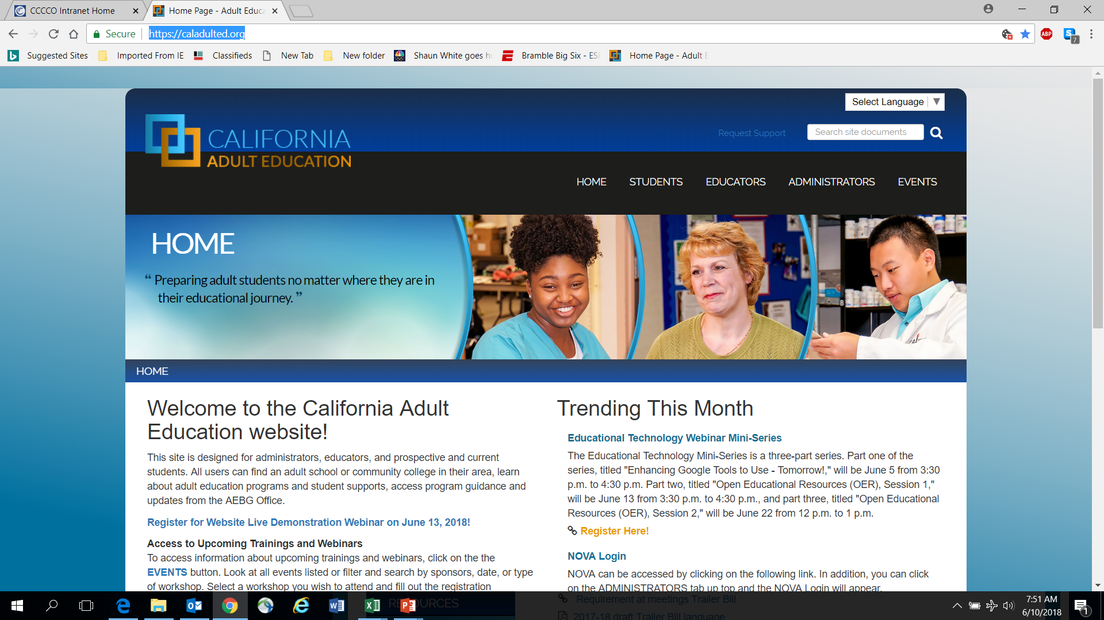
AEBG Web Site
https://caladulted.org/

Slide 15
AEBG TAP
The AEBG Technical Assistance Program (TAP) provides professional development resources for all AEBG agencies statewide.

