Slide 1
AEBG NOVA Webinar
2017-18 & 2018-19
August 24, 2018

Slide 2
Agenda
AEP/AEBG Update
Technical Update / NOVA
4Q Expense reporting
Additional Reporting
Targets & Close Out
Annual Plan
18-19 Updated Changes in NOVA

Slide 4
AEBG/AEP
Name Change
3 Year Planning Process
Indirect change
Collecting Data by Program Area
Hours of Instructions by AEP Program Area
Expenditures Program Area (includes fees)
Using the SSID for students that don’t have one
Immigrant Integration
Field Team Recommendations

Slide 5
Current NOVA Efforts

Slide 6
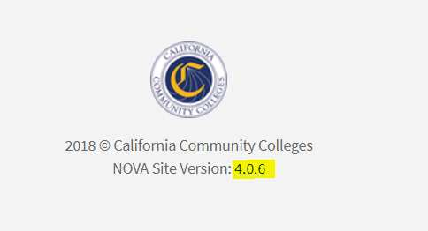
Notes:
As we release NOVA system updates, the version number will be updated. You can click on this link to view the Release Notes, which will provide information related to system enhancements and bug fixes.

Slide 7
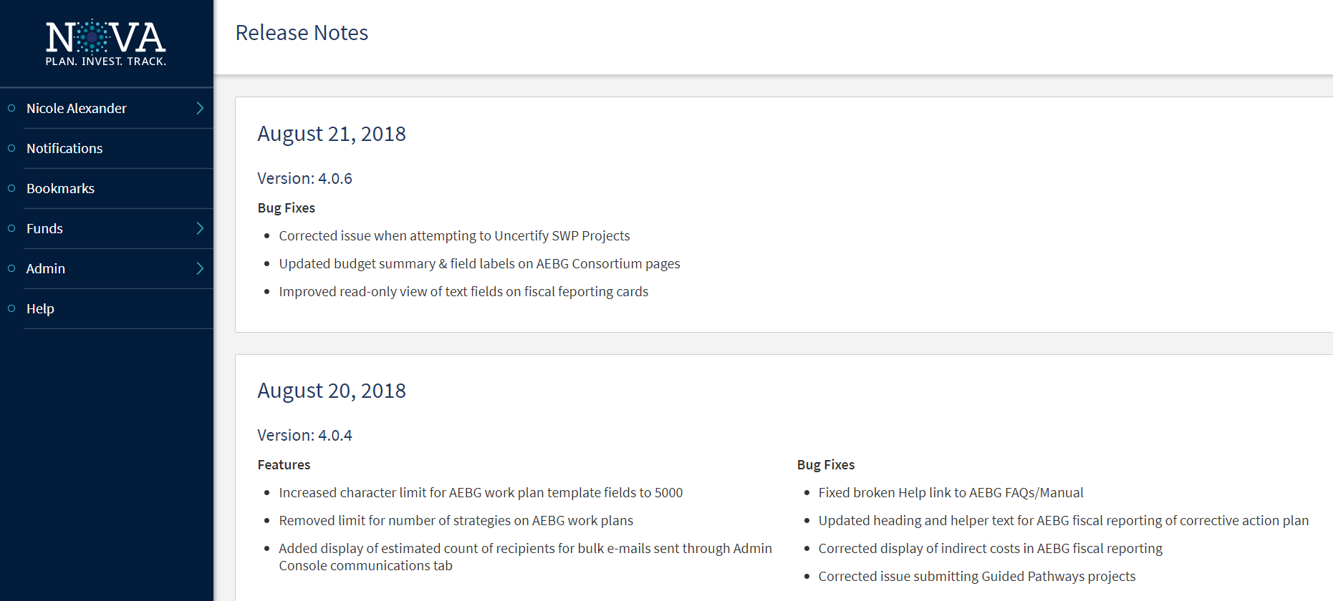
NOVA Release Notes
Notes:
-This screenshot shows the Release Notes page.
Bug Fixes include:
-Password reset functionality
-Q4 report refresh error message
-Budget revision issue
Updates:
-Annual plan strategy button limits and character limits

Slide 8
Reconciliation
Consortia confirmed that they have documentation reconciling the two systems (in case of an audit).

Slide 9
18-19 COLA/Additional Funding
Department of Finance has made a slight adjustment to the AEBG COLA.
AEBG Office is working with consortia leads on adjusting totals.

Slide 10
Budget Revisions 17/18
In the process of fixing an issue with NOVA not allowing budgets to be un-certified without having to un-submit and un-certify all of the expenditure reports for that fiscal year.
Should be fixed soon.
Please bear with us!!!

Slide 11
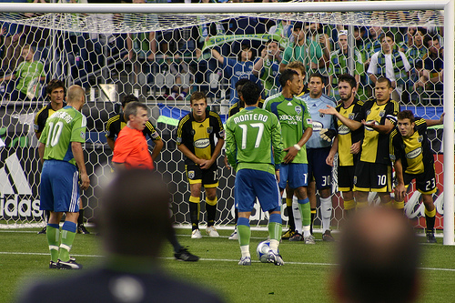
Indirect

Slide 12
Indirect for 17/18 Expense Reporting
Members must report their indirect (as defined in your accounting manual) on the indirect line in NOVA.
Operational costs are not indirect costs.
Indirect costs CANNOT be reported in object code 7000.
Indirect rate for 17-18 is the CDE approved rate for K12/COEs and the negotiated rate for Community Colleges.
If your 17-18 indirect rate in NOVA is red – please ignore for now. This was programmed for the 18-19 school year.

Slide 13
Indirect for 18/19 Budget & Expenses
For 18-19 - K12/COE – use the CDE approved indirect rate or 5% whichever is less. CCDs use the agreed upon indirect rate or 5% whichever is less.
See legislative trailer bill language via the link in the 18-19 CFAD Approval letter.

Slide 14
Indirect 18/19 (cont. 1)
Don’t confuse the indirect for members with the consortia level administrative 5% cap.

Slide 15
Expense Reporting

Slide 16
Expense Due Dates - 2017-2018
September 1st - Member 4Q expense report due
September 30th - Consortium Certification
Must be positive numbers – no negatives…..
Expenditure report cannot be submitted if expenditures exceed the allocated amount for a given object code (no negative balances).

Slide 17
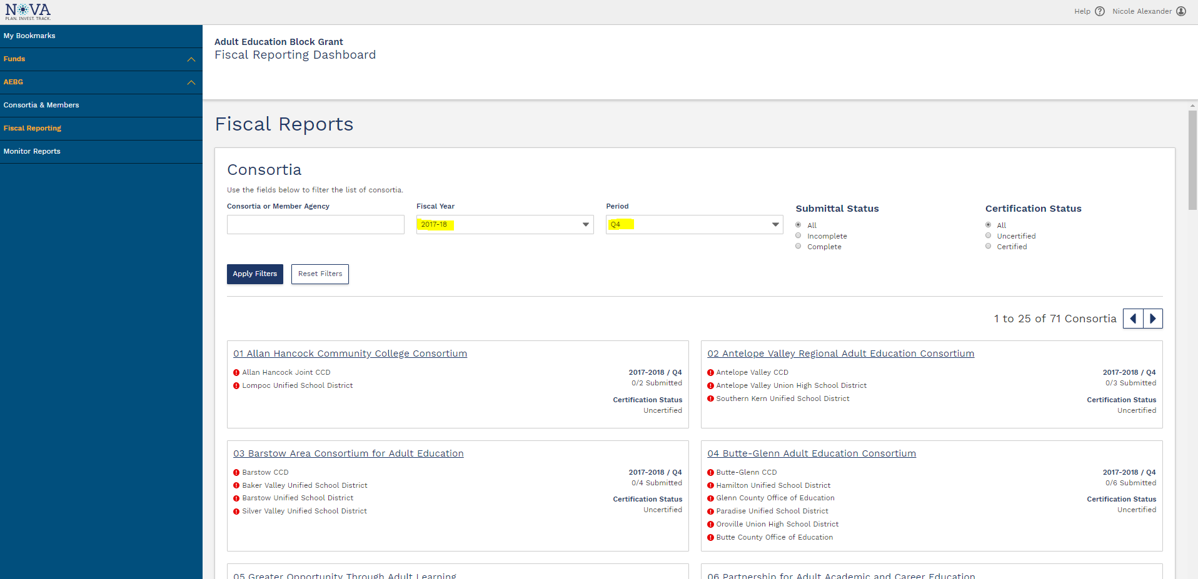
Expenditure Reporting
17
Notes:
-In these next few slides, I am going to go over how to complete the expenditure report in NOVA.
-To access the expenditure reports, once you log into NOVA, select AEBG under funds, and then click on Fiscal Reporting located on the left blue navigation pane.
-This will bring you to the Fiscal Reporting dashboard. From here you can scroll through the list to find your consortium, or use the filter located at the top of the screen.
-You can also search for previously submitted reports by using the Fiscal Year and Period filters at the top of the screen.
-Before you click into your consortium to complete your report, be sure that Quarter 4 is selected under the Period filter.

Slide 18
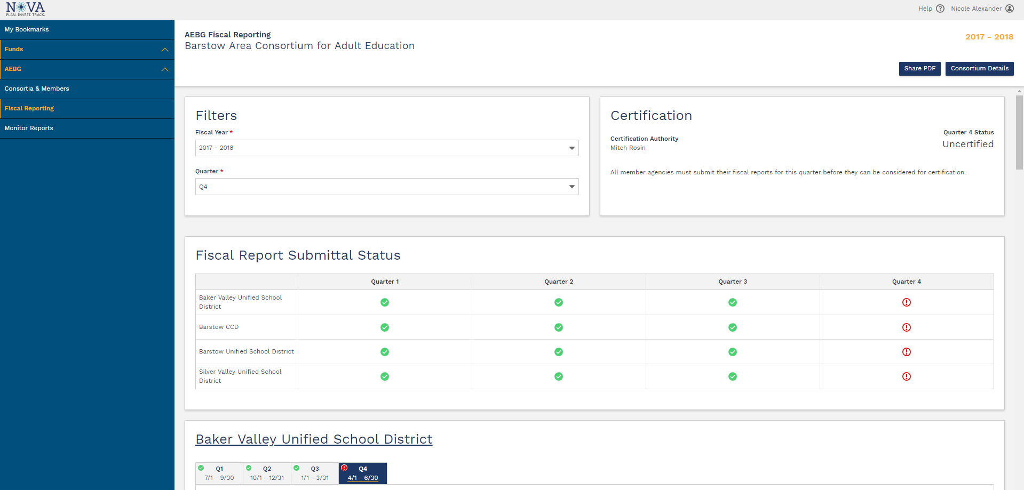
Expenditure Reporting
18
Notes:
-Once you click on your consortium, it will direct you to this page where you will find all of your member agencies quarterly reporting templates.
-You will notice that at the top of this page a summary is displayed, which shows the submittal status of prior quarters and the certification status of the current reporting period.

Slide 19
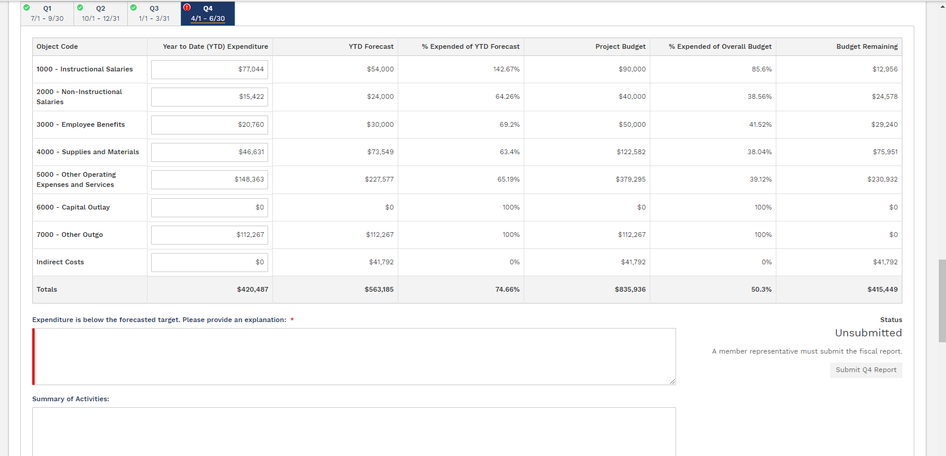
Expenditure Reporting
19
Notes:
-As you scroll through this screen you will find all of the member agency expenditure reporting templates.
-Only the Member Representative will have the ability to submit information for their agency.
-For the quarter 4 report, enter your expenditure information under the Q4 tab, under the column labeled, “Year to Date Expenditure”.
-I am going to quickly review the other columns shown here.
-The Year to Date Forecast column is a new concept that we are introducing for AEBG for fiscal year 18-19. This is intended to serve as a planning tool. For fiscal year 18-19 this tool will be a part of the budget submission process. We will have more information to share in the coming weeks, and will host a webinar to provide more detailed information. For now, the Forecast column has been pre-populated with the spending targets for that quarter, which for quarter 4 is 60%.
-The remaining columns show the percentage of expenditures in relation to the forecast and to the overall budget, as well as the remaining budget amount.
-If your expenditures fall below the spending targets, you will be required to enter an explanation before the report can be submitted.
-Upon submission of the report you will need to check the box that states that “I have complied with the Academic Expenditure Clause”. There will be a link that will pull up a PDF once you click on it. This box is to certify that this report has been prepared in accordance with the applicable State regulations, that information in this report is accurate and true to the best of your knowledge, and that any information is supported by documentation on file at the District/College.
-There is also a field for you to provide a brief summary of activities in this quarter.

Slide 20
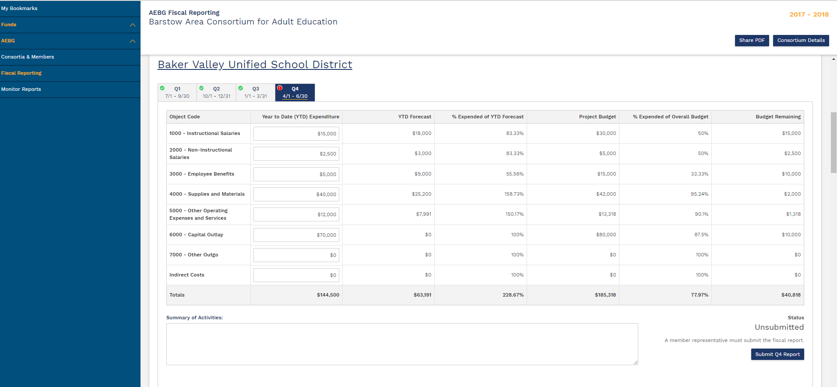
Expenditure Reporting
20
Notes:
-When the expenditure report is ready to be submitted, the Member Representative should click on the Submit Quarter 4 Report button, which is located on the bottom right side of the screen in their reporting card.
-The Member Representative is the only user role that can submit the expenditure reports. The Member Contact has the ability to enter and edit information, but only the Member Rep can submit.
Also, just a quick note that budgets must be in Certified status before the expenditure report can be submitted.
(The Member Representative must submit the budget before the Consortium Primary Contact can certify.)

Slide 21
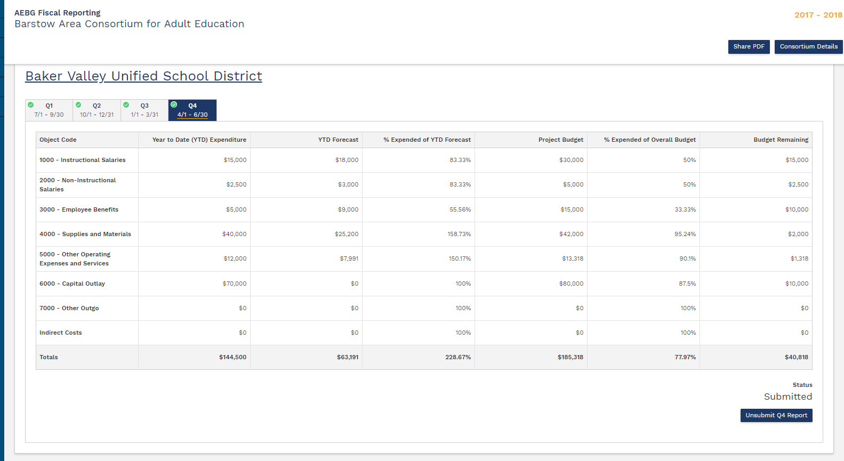
Expenditure Reporting
21
Notes:
-Once the member representative submits their report, the status will change to “Submitted”, as you can see on the lower right side of the screen.
-Once the report is submitted, the submit button then changes to display Unsubmit Quarter 4 Report. Member Representatives can un-submit and revise their report up until the time that the consortium primary contact certifies the expenditure reports.
-If an adjustment needs to be made to a report after it has been certified, the consortium primary contact will need to uncertify the reports first before the report can be unsubmitted. We will go over this in the slides to follow.

Slide 22
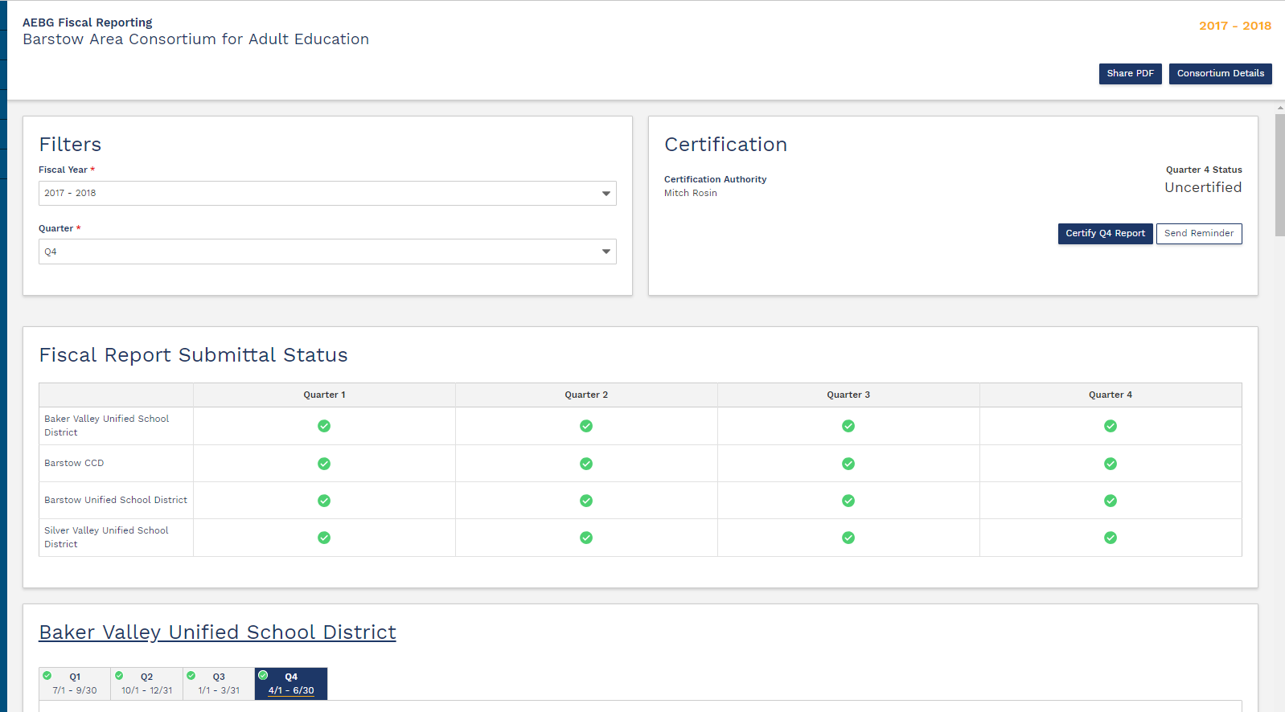
Expenditure Reporting
22
Notes:
-Once all of the member reports are submitted, the Consortium Primary Contact will be able to Certify by clicking on the Certify Quarter 4 Report button located at the top right side of the screen, as shown in this screenshot.
-The NOVA system will not allow the reports to be certified until all of the expenditure reports have been submitted by all member agencies.
-The primary contact only needs to certify once for the entire consortium.

Slide 23
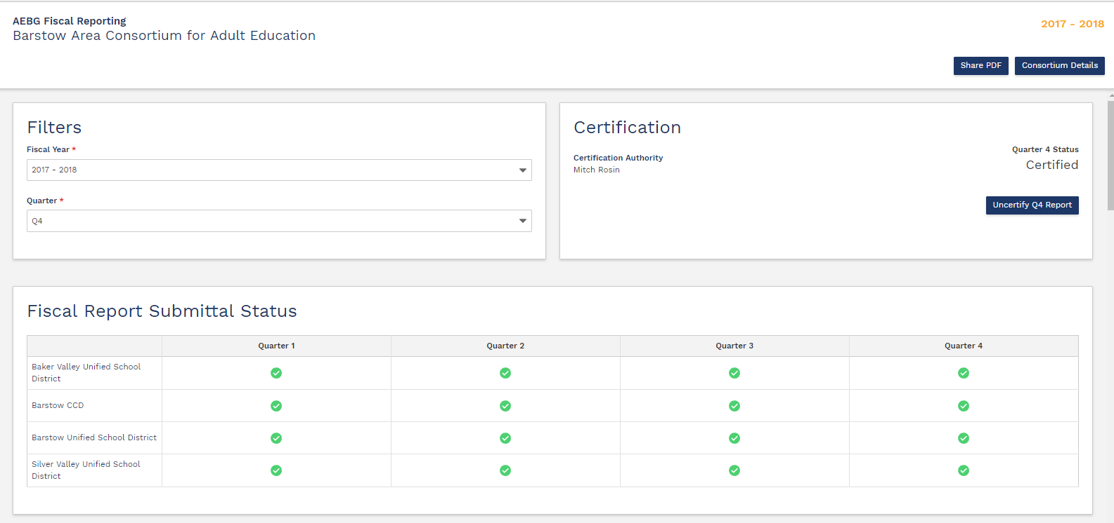
Expenditure Reporting
23
Notes:
-This screenshot shows the expenditure reports certified at the consortium level. You will notice that the Certify button has changed to display Uncertify Quarter 4 Report.
-If a report needs to be adjusted after it has been submitted and certified, the consortium primary contact will need to click on the uncertify button to be able to unsubmit and revise a report.
-This completes the expenditure reporting for today’s presentation – just checking if there are any questions.

Slide 24
Extra Reporting???

Slide 25
Additional Reporting for 2017-2018???
Due to other state mandates, and programming costs – there will only be a Q4 report for 17-18.
There will not be an extra “final report”.
The Q4 will be the final report for 17-18.
But we still have legislative mandated reporting required by member, by program area.

Slide 26
Can we celebrate now??

Slide 27
New Required Reporting - 2017-2018
Rolling out in early Spring (we hope)….
Members will be required to submit via NOVA - the total 17/18 expenses by program area. This includes all adult education fund sources including fees.
Members will also be required to report hours of instruction by program area in NOVA.

Slide 28
Crude Visual by Program Area

Slide 29
NOVA Targets

Slide 30
NOVA Targets
To continue to spend down 16-17 carry over funds to 12-31-18 – you will need a corrective action plan. Same will apply to 17-18 carry over for June 30, 2019.
This is completed via the narrative field for corrective action plan in the Q4 expenditure report.
Header title: “Corrective Action Plan: Expenditures fall below target. Please provide the action steps that will be taken to address this issue.”

Slide 31
NOVA Close Out
Keep in mind – AEBG/AEP funds still have a shelf life, they do expire, and we will be closing out every year.
For example: 16-17 funding.
Target spending June 30, 2018 – fully expended
With a corrective action plan – can extend to 12/31/18.
All activities related to 16/17 funds must cease by 12/31/18 (which is the end of the 2nd quarter of the SFY).

Slide 32
NOVA Close Out (cont.)
Q2 expense reports are due 3/1/19 with consortium approval due by 3/31/19.
NOVA will close out 16-17 funds in April of 2019. Each member will certify their close out.
Remaining 16-17 funds will be invoiced by the state and paid back by the member to the general fund.
The invoice process will take place in late April/May 2019.
State Accounting Offices will close the books on AEBG/AEP 16-17 funding in June 2019.

Slide 33
Annual Plan

Slide 34
Annual Plans
Consortia must submit by August 15, 2018.
Based on current 3 year plan (which is being extended to June 30, 2019).
Submitted by the consortium lead (primary) with approval of all members.
Annual plan will drive the member work plans and budget which are due in NOVA by September 30, 2018. Consortium leads certify member work plans and budget by October 30, 2018.

Slide 35
Annual Plans (cont.1)
The strategies in the member work plan must tie directly to the member’s budget for 18-19.
This budget includes carry over and new funds.
Although the State AEBG Office does not require a member tactical or activity plan to show who is doing what and when, the consortium may require that members follow up with such a plan and share at a public meeting.

Slide 36
Annual Plans Tools
For more information, please access the following resources:
Annual Plan Tips Guide
NOVA Technical Assistance Tools
NOVA AEBG Functionality YouTube Page
NOVA AEBG User Manual
NOVA Webinar Questions and Answers
NOVA You Tube Annual Plan Video
Other NOVA videos

Slide 37
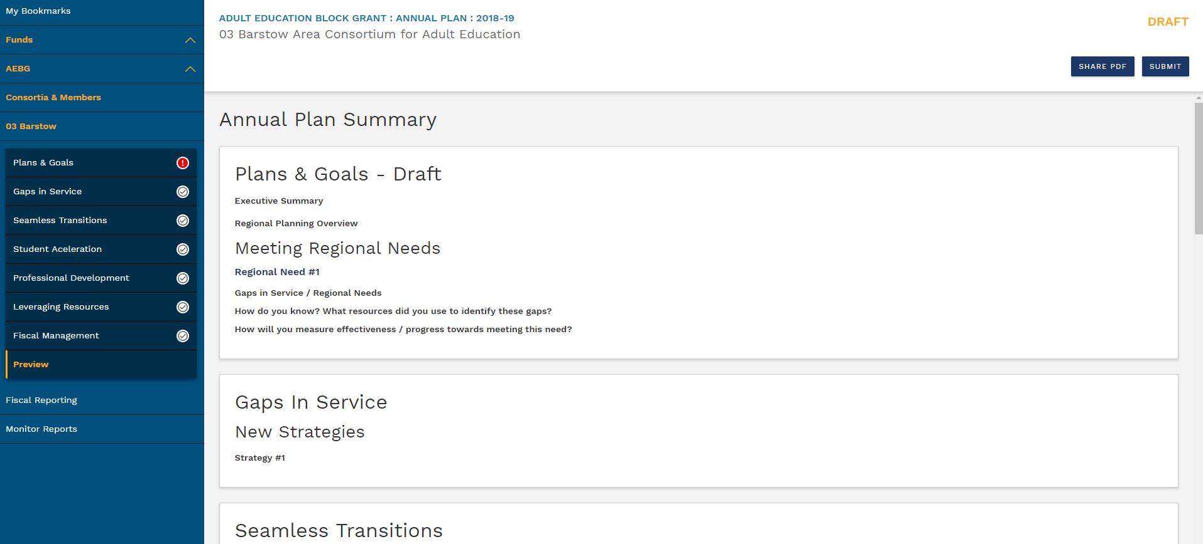
Annual Plan – Preview & Submit
38
Notes:
-Once the consortium primary contact has completed all of the sections of the annual plan, they should navigate to the Preview section to perform a final review and click on the submit button, which is located on the top right side of the screen.
-Once the annual plan is submitted, the member representatives will receive an email notifying them that the annual plan is ready for their review and approval. There will be a link in the email that will direct the member representative to the preview section of the annual plan.

Slide 38
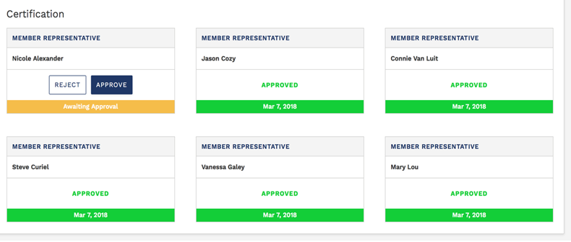
Annual Plan – Member Review & Approval
Notes:
-Once the member representative navigates to the preview section of the annual plan, they will see their name listed and options to either approve or reject the annual plan – as shown here.
-If a member representative chooses to reject the annual plan, a pop-up window will appear for them to provide any comments regarding their rejection, which will be sent to the consortium primary contact and the other member representatives.

Slide 39
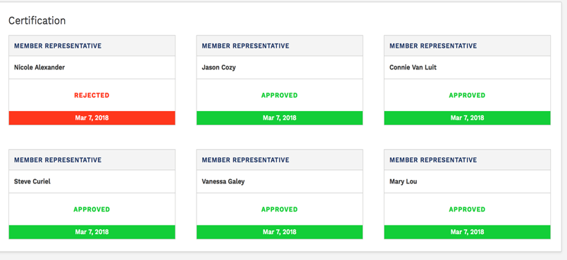
Annual Plan – Member Review & Approval
Notes:
-This screenshot shows a member representative that has rejected the annual plan.
-If the annual plan is rejected by a member representative, then it is reverted to draft status for the consortium primary contact to make the necessary edits and to re-submit and go through the review and approval process with all members again.

Slide 40
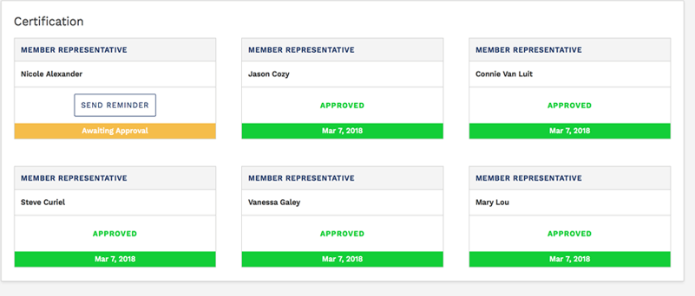
Annual Plan – Member Review & Approval
Notes:
-This screenshot shows a member representative that has not reviewed the annual plan. There is an option for the consortium primary contact to send a reminder directly from the system.
-Once all member representatives have approved the annual plan, the status will change to Member Approved and will be considered as officially submitted.

Slide 41
Update on 18-19 Changes in NOVA

Slide 42
Short Term 18-19 Changes in NOVA
16-17 Close out Process and annual close out process in NOVA for AEBG/AEP funds.
17-18 Hours & Expenses by Program Area
3 years plans will be uploaded and certified in NOVA.
19-20 Annual Plan connecting to the new 3 year plan

Slide 43
NOVA Changes later in 18-19
Text box add-ons for certifying expense reports.
Member certification required for all allocation amendments.
Adding the option to have multiple certifiers

Slide 44
Future Changes in NOVA
FY 18-19 consortium level reporting for administrative budget & expenditures.
Develop Community Services reporting in NOVA for all member agencies.

Slide 45
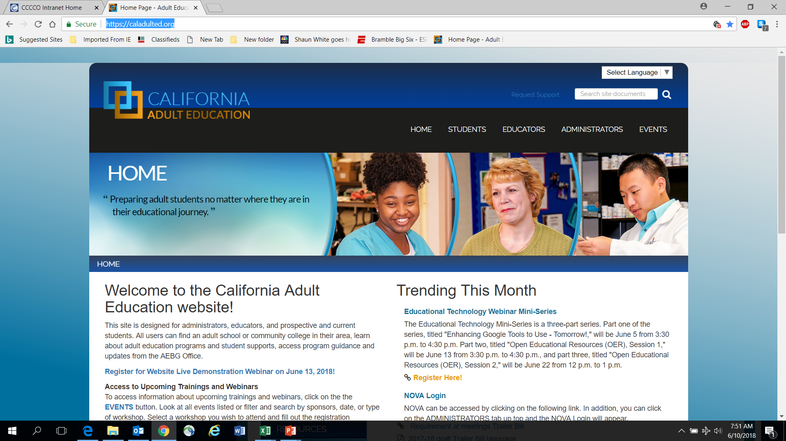
AEBG Web Site
https://caladulted.org/

Slide 46
AEBG TAP
The AEBG Technical Assistance Program (TAP) provides professional development resources for all AEBG agencies statewide.

