Slide 1
AEBG Accountability Training
2017-18

Slide 2
Agenda
Legislative Requirements
AEBG Field Team Process
New Reporting Requirements 17/18
AEBG Adult Education Programs
Alignment with WIOA
Reporting in TE / Data Collection
Reporting Elements - Outcomes
AEBG Data Matching / Use of LaunchBoard
Future changes and analysis
Pre-Post Testing
Resources

Slide 3
Legislative Requirements
August 1st report
      Data for measuring effectiveness of consortia
Plans for aligning assessment of students
Report deadlines to legislature
      Oct 31st: Preliminary Report
      March 1st: Final Report
Alignment w/WIOA, Perkins, other systems

Slide 4
AB104 Required Data Elements
Adults served by the consortium.
Adults served by the consortium have demonstrated the following:
Improved literacy skills
Completion of high school diplomas or recognized equivalents
Completion of post-secondary certificates, degrees, or training
Placement into jobs
Improved Wages

Slide 5
AEBG Metrics

Slide 6
Data and Accountability
Field Teams

Slide 8
Field Teams
3 Teams: Data & Accountability, CTE, Basic Skills
35 Field Participants
K12 adult school, community college noncredit and credit programs, WIOA system, labor, CDE, CCCCO, AEBG TAP
40 hours in 8 meetings over 8 weeks
White papers, notes, agendas published on AEBG site

Slide 9
References and Resources
AB86/AB104
Legislation
2012 LAO
Report
Workforce
Innovation &
Opportunity Act
Office of Career,
Technical, &
Adult Education
National
Reporting
System
Title IV Federal
Student Aid
Council on
Occupational
Education
Center for Law
& Social Policy

Slide 10
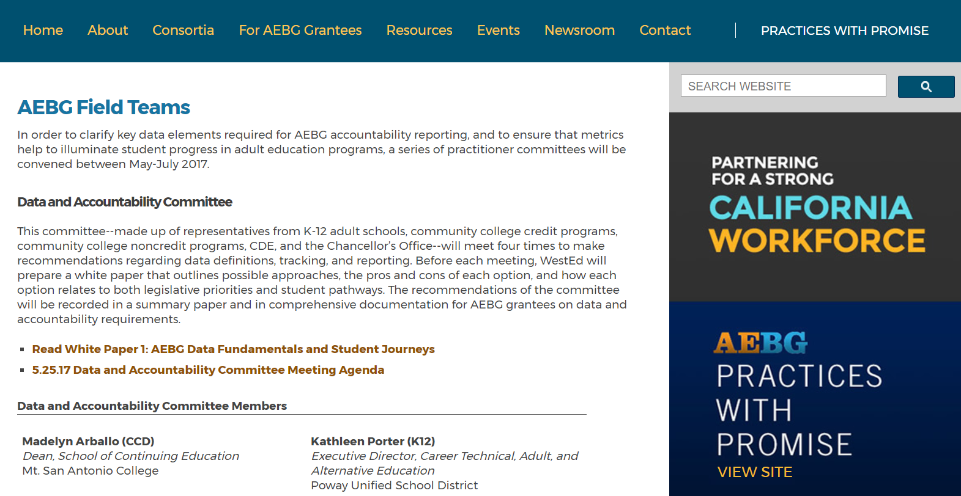
AEBG Data and Accountability Field Team Site
http://aebg.cccco.edu/About/Adult-Ed-Block-Grant-Framework/AEBG-Field-Teams

Slide 11
New 17/18 Reporting Requirements
and Systems

Slide 12
2017/2018 Reporting Requirements
Population: All adult education students enrolled in ABE, ASE, ESL, or CTE programs enrolled at a:
K12 adult education school
Community college noncredit program
Third party provider supported by a consortium for the purposes of providing training or supportive services
This includes all students regardless of funding source including AEBG, Noncredit, Perkins, WIOA II, CalWORKS, Adults on Correctional Facilities, Strong Workforce (noncredit programs), LCFF, etc.

Slide 13
2017/2018 Reporting Systems
All AEBG consortia members and providers will use TOPSPro Enterprise
Quarterly reporting of enrollment and outcomes
K12 adult school, community college noncredit, 3rd party providers supported by consortia
AEBG Office will use LaunchBoard to match AE student data with MIS, EDD wage file, HS equivalency testing data

Slide 14
Annual Plan General Assurances
Member Effectiveness:
Participation in planning processes (annual, 3 year).
Spending funds within the AEBG program areas.
Members must participate in public meetings & decision making.
Reporting student data in TE.
Sharing info on other resources being used to serve adults.
Sharing financial expenditure and progress reports with the regional consortium.
Providing services that address the needs identified in the adult education plan

Slide 15
Member Reduction in Funding
The amount of funds to be distributed to a member of that consortium shall be equal to or greater than the amount distributed in the prior fiscal year, unless the consortium makes at least one of the following findings related to the member for which the distribution would be reduced:
(A) The member no longer wishes to provide services consistent with the adult education plan.
(B) The member cannot provide services that address the needs identified in the adult education plan.
(C) The member has been consistently ineffective in providing services that address the needs identified in the adult education plan and reasonable interventions have not resulted in improvements.

Slide 16
AEBG Programs for 17/18

Slide 17
Adult Education Programs
Adult Basic Education
Foundational academic skills, such as reading, writing, and basic mathematics, as well as learning skills and study skills. Includes courses below Low Adult Secondary Education/9th grade level
Adult Secondary Education
Foundational academic skills and learning/study skills. Includes courses at Low Adult Secondary Education/9th grade level & above, and/or leading to a diploma, GED, or high school equivalency certificate
English as 2nd Language
Instruction in the English Language to adult non-native English speakers with varied academic, vocational, citizenship, and personal goals
Short Term CTE
Education and training that prepares adult learners to enter the workforce or improve their occupation or earnings in a a year or less

Slide 18
Adults w Disabilities
Mark instructional program = Adults with Disabilities if the participant is enrolled in a specialized program designed specifically for adults with intellectual/ developmental disabilities.
For participants with disabilities who are enrolling in other adult education programs, mark “Disabled” under Barriers to Employment in combination with the appropriate instructional program.
.

Slide 19
Adults w Disabilities
In CCCCO MIS: Flag courses in specialized AWD programs using CB22 code E for “courses for persons with substantial disabilities.” Use DSPS enrollment flags to identify AWD participants enrolled in other noncredit community college programs.

Slide 20
Entering or re-entering workforce
AEBG defines this program area as populations with systemic barriers to economic success who enroll in CTE programs. AEBG will extract data using population flags that are enrolled in short term CTE and aligned with the WIOA “barriers to employment”
Mark “Workforce Readiness” on TE Entry/Update Record to designate students in this program

Slide 21
Entering or re-entering workforce
In addition, this program area will include participants who are 55 years or older, based on their date of birth.
To ensure that this program area can be populated, all adult education providers should pay special attention to capturing barriers to employment status and date of birth at intake or at the time of the participants’ first course enrollment.

Slide 22
Preapprenticeship (DOL Quality Elements)
  Adult education providers should only enroll students in the pre-apprenticeship instructional program if participants are enrolled in programs that meet DOL Quality Elements criteria, including ensuring that that courses are offered in coordination with one or more apprenticeship programs approved by the Division of Apprenticeship Standards through an MOU or formal agreement.

Slide 23
Preapprenticeship (DOL Quality Elements)
  Approved training and curriculum based on industry standards and approved by a documented registered apprenticeship partner
  Recruitment, educational, and pre-vocational strategies that prepare under-represented, disadvantaged, or low-income individuals to meet the entry requirements of one or more registered apprenticeship programs
  Access to appropriate support services
  Meaningful hands-on training that does not displace existing paid employees
Formal direct entry or articulation agreements with its registered apprenticeship partners

Slide 24
Adults Training to Support Child School Success
  AEBG defines this program as providing education and training to adults, typically parents and-or community members, to help school-aged children succeed in school.
  Mark “Adults supporting K12 student success”

Slide 25
WIOA II & NRS Overview

Slide 26
The National Reporting System (NRS) is the accountability system that provides a means of regular evaluation for federally funded WIOA Title II adult education programs.
In June 2014, Congress passed the Workforce Innovation and Opportunity Act (WIOA), and President Obama signed it into law in July 2014.
June 2016 the U.S. DOL and U.S. DOE released final WIOA guidelines, and the NRS released the new update Federal Tables
WIOA started implementation starting July 1, 2016, and is approved through 2020.

Slide 27
To learn more information about the National Reporting System:
  NRS Website:
  http://www.nrsweb.org
  Official Federal Website for WIOA:
  https://www.doleta.gov/wioa/

Slide 28

WIOA Title I: Adult, Dislocated Worker, and Youth
WIOA Title II: Adult Education and Literacy (AEFLA)
WIOA Title III: Wagner-Peyser/One-stops
WIOA Title IV: Vocational Rehabilitation

Slide 29
Measurable Skills Gain (MSG)
The WIOA Performance Indicators, along with the 5 types of MSG, comprise the framework for the six AB 104 outcomes:
Indicators:
Employment
Wages
MSGs:
Literacy gain
Secondary
Post-Secondary
Training Milestone
Skills Progression
AB 104 Outcomes:
Improved literacy skills
Completion of high school diplomas or their recognized equivalents
Completion of postsecondary
Placement into jobs
Improved wages
Post Secondary Transition

Slide 30
Data Collection Guidelines

Slide 31
AEBG Program Year Reporting
 | Date Range | Reporting Deadline
First Quarter | July 1 – Sept 30 | October 31, 2017
Second Quarter | July 1 – Dec 31 | January 31, 2018
Third Quarter | July 1 – Mar 31 | April 30, 2018
Fourth Quarter-EOY | July 1 – June 30 | August 1, 2018

Slide 32
Quarterly TOPSpro Enterprise data reporting
  Submit TOPSpro Enterprise export to CASAS via Internet
  Data Integrity Report
End of Year Data Submission
  Submit TOPSpro Enterprise export to CASAS via Internet
  AEBG Summary
  Data Integrity Report
Data Sharing Requirements with CCCCO/EDD -- TBD
Notes:
Probe for familiarity with Core Perf, Inst Questionnaire, WIA Survey

Slide 33
Document enrollment for all learners in AEBG programs upon entry into class
Provide Update information for all AEBG learners who attend 12 or more hours of instruction
Test all AEBG learners in WIOA Title II programs (ABE, ESL, ASE)

Slide 34
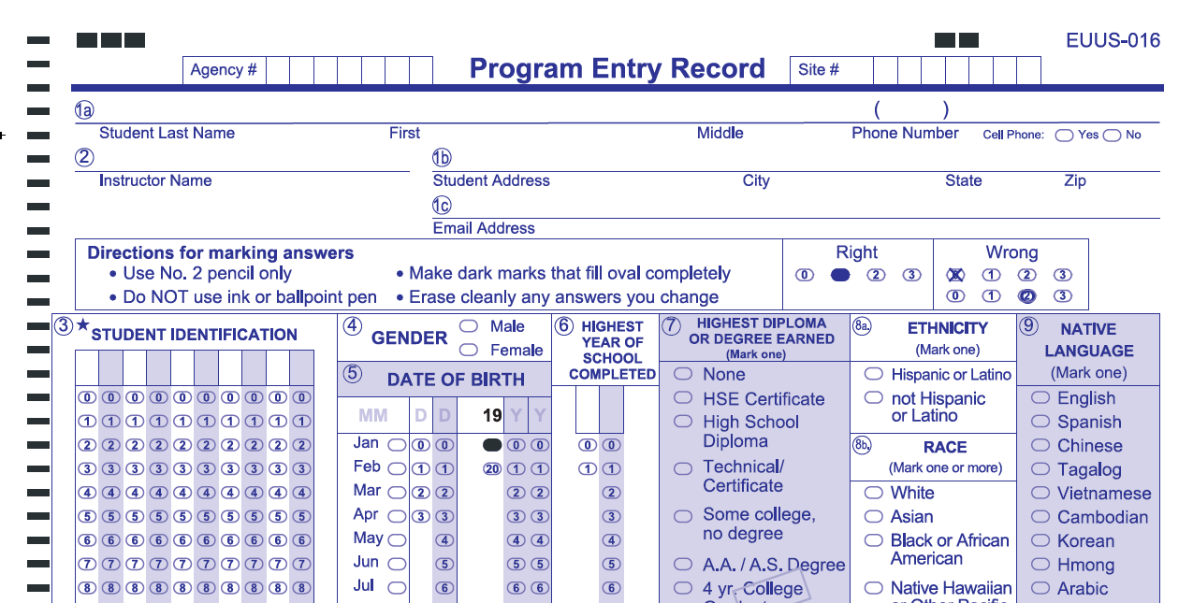
Entry Record
Includes fields to collect demographics, such as learner gender and date of birth
Documents program-related information, such as instructional program or date of entry into a class
Notes:
Note starred fields

Slide 35
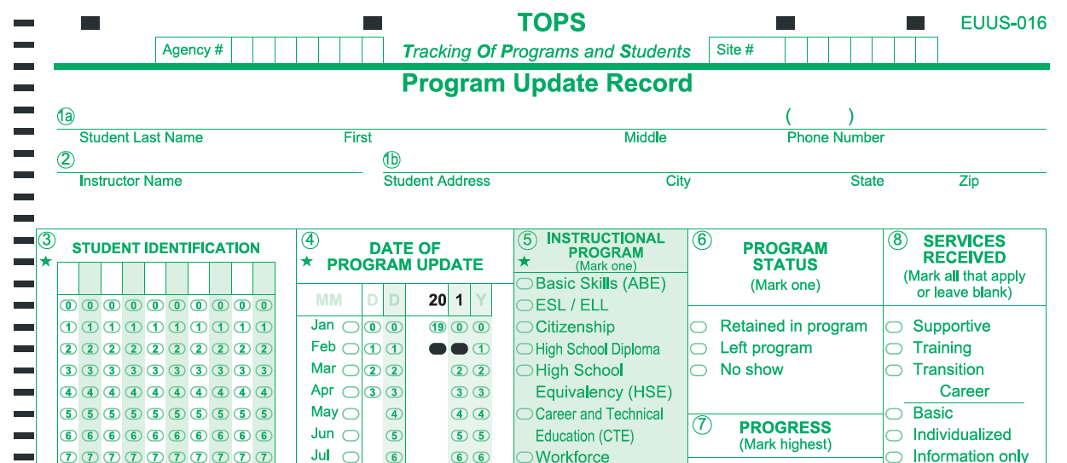
Update Record
Tracks learner progress and indicates results of instruction the learner received at your school or program.

Slide 36
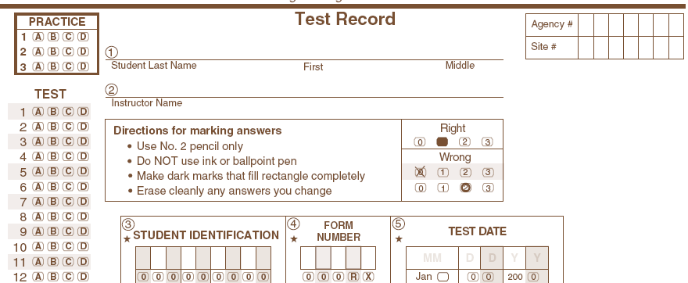
Test Record
Records answers to a single CASAS test and includes information about the test, such as test date and form number

Slide 37
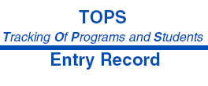
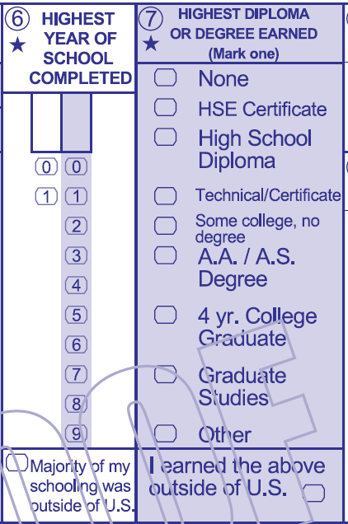
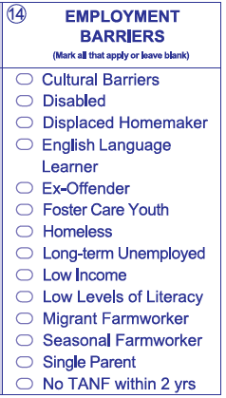
Entry Records
For Each AEBG Learner:
Collect Date of Birth, Gender, Race, and Ethnicity
Assist the learner in selecting highest year of school, highest degree, barriers to employment, and labor force status

Slide 38
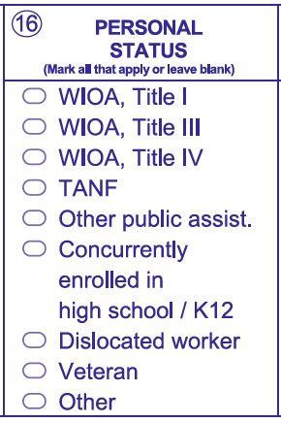
Entry Records
For Each AEBG Learner:
Select instructional program authorized for AEBG
Record as many barriers to employment (field 14 as apply to the learner
Indicate if learner is cross-enrolled
in another WIOA partner
program (Title I, III, IV)

Slide 39
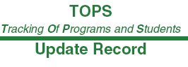
Update Records
Must be completed after a substantial block of instruction or at the end of the instructional period (semester, quarter, term)
Must be completed when a learner exits a program
Mark the appropriate learner status, progress, outcomes achieved, and reason for exiting

Slide 40
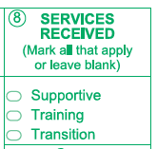
Short Term Services
Record short term services to students such as counseling or mentorship that may be received outside of the classroom.
Supportive Services
Training Services
Transition Services
Enter in TE in Records – Students –
In Program Years -OR- use Update Record field #8

Slide 41
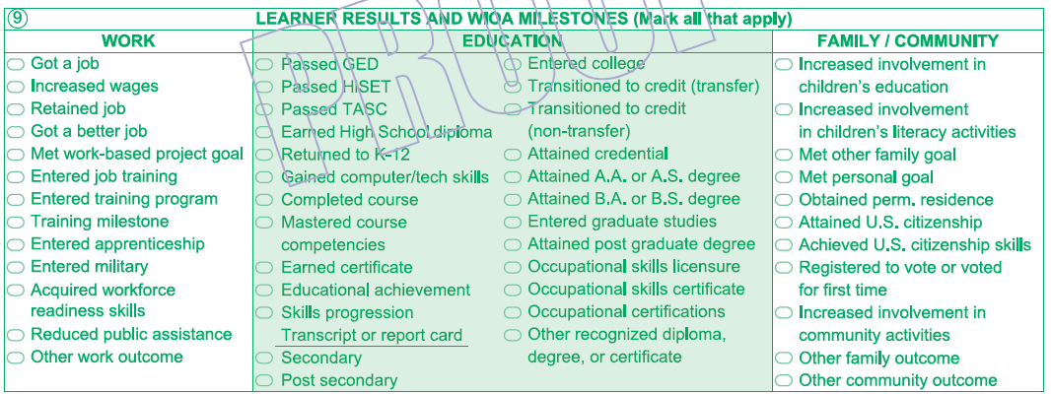
Update Records
New Update Record now includes many new workforce and training related outcomes related to all four titles of WIOA.

Slide 42
Pre- and Post-Testing
The AEBG Office requires AEBG agencies to test all students enrolled in ABE, ESL, and ASE instructional programs.
Can use any federally approved assessment tool.
Pretests are recommended as soon as the student enrolls in the program
Post-tests are recommended at the end of each quarter, semester, or term to document continuous learner improvement – after approximately 70-100 hours of instruction.

Slide 43
Pre- and Post-Testing
AEBG only allows NRS approved assessments to meet pre and post-testing requirements for AEBG reporting
For information about which test publishers are approved, please refer to the Federal Register:
https://www.federalregister.gov/documents/2016/12/13/2016-29899/tests-determined-to-be-suitable-for-use-in-the-national-reporting-system-for-adult-education

Slide 44



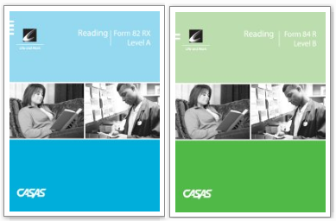

ABE/ASE: Use Reading or Math
ESL: Use Reading or Listening
Pre- and post-test pairs must always be from the same test modality.

Slide 45
Pre/Post-Testing
Q: How do we handle testing for students (especially in ASE) who score high on NRS approved assessment, and/or already have their high school diploma?
A: If a student completes HSE or high school diploma, then that student does not need to post-test.
Recommended practice for pretesting: administer an appraisal for that student. If using a CASAS appraisal, for example, if the student scores below 236, then that student qualifies for NRS levels and should be pre/post-tested. If the student scores 236+, then they have scored too high to make level gains for NRS reporting, so pre/post-testing is not required.

Slide 46
Reporting Elements
Outcomes

Slide 47
Population Definitions
Number of adults served by the consortium – Aligned to WIOA reportable individual definition. 1 or more contact hour of instruction or participation in self directed or information only activities
Adults who attain milestones or outcomes – Aligned to WIOA definition of a participant under AEFLA WIOA Title II. 12 or more contact hours of instruction in ABE, ASE, ESL or CTE.
AEBG will analyze outcomes for reportable individuals using the supplemental data report but not include that data in the primary report to the legislature for 17/18

Slide 48
AEBG Outcomes
Literacy Gains
HSE/HS Diploma
Post-Secondary
Enter Employment
Increase Wages
Transition Post-Sec

Slide 49
AEBG Outcomes
Improved Literacy Skills
High School Diploma/HSE
Post-Secondary
Job Placement
Improved Wages
Transition to Post-Secondary

Slide 50
AEBG Outcomes
AEBG will use a combination of self-reported outcomes in TE and data match for state level reporting.
Data Match
TE only

Slide 51
Learning Gains
Improved Literacy Skills
  For ABE/ESL/ASE programs, measured by pre/post learning gains
  ABE/ESL/ASE: Career Development and College Preparation (CDCP) certificate
  HS Diploma can report gains through achieving high school credits/Carnegie Units
  Occupational Skills gain
  Workforce Readiness Milestone

Slide 52
Learning Gains
Improved Literacy Skills – NRS Assessments
        Achieved when a learner makes enough progress from pretest to post-test to move up one Educational Functioning Level (EFL) on the federal/NRS chart.
        Must use pre/post-test assessment instruments approved by the National Reporting System (NRS).

Slide 53
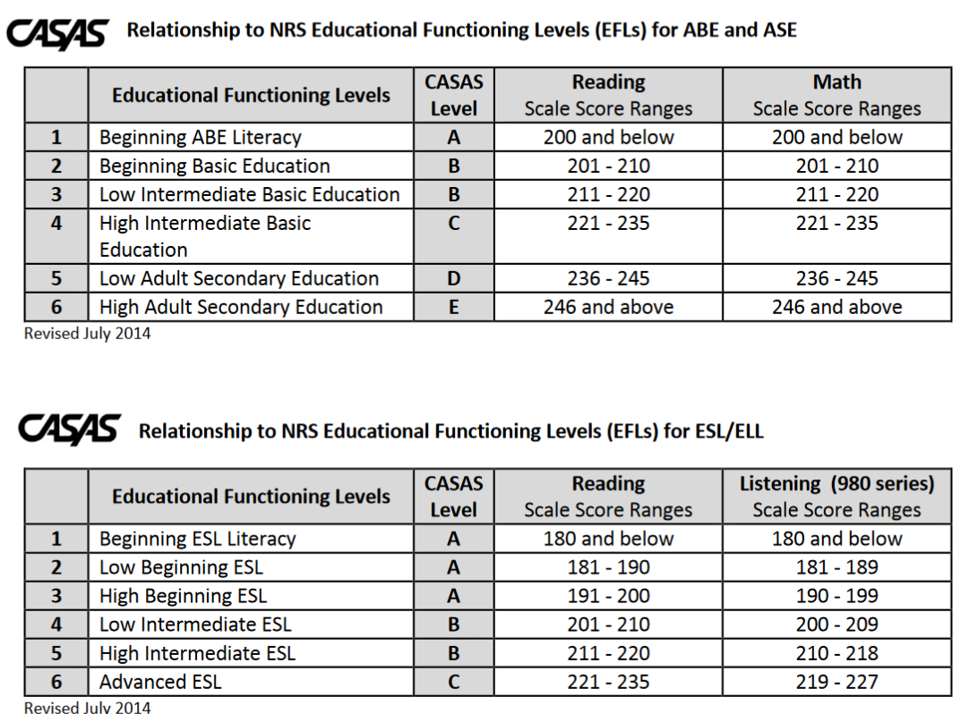
Learning Gains
Improved Literacy Skills – NRS Assessments
For NRS relationship with other test publishers, go to www.nrsweb.org

Slide 54

Adults With Improved Literacy & Basic Skills
Attainment of a functional level tied to completion of a course or a Career Development and College Preparation (CDCP) certificate using a crosswalk of the National Reporting System EFLs and the community college CB21 course rubric for levels below transfer
Mark “Mastered Course Competencies on Update field #9 (Education):

Slide 55
Learning Gains
Improved Literacy Skills – HS Diploma
      Progress towards Diploma (New) – Participants who improved from ASE low to ASE high on the NRS-approved assessment– or, who completed enough high school credits to advance from ASE Low (9th/10th grade) to ASE High (11th/12th grade) levels.
      Instructional Program = HS Diploma
      Instructional Level = ASE Low or ASE High – either through pretest or self-report (Entry Record field 18)
      If ASE Low – learner achieves outcome by marking self-report ASE High, or earn HS diploma
      If ASE High – learner achieves outcome by marking earn HS diploma

Slide 56

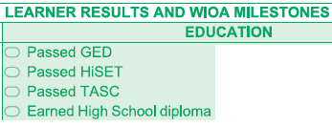
High School Diploma/HSE
Field 9 Education –
  Earned high school diploma
Passed GED
Passed HiSET
Passed TASC

Slide 57
Learning Gains
Improved Literacy Skills – Adults with Disabilities
  For learners with developmental/intellectual disabilities, agencies can use the AA-AAAAA Adult Life Skills series or the POWER performance based assessment to measure pre/post gains for intellectual disabilities.
  For students with learning and physical disabilities, agencies can use any approved assessment and provide approved testing accommodations.

Slide 58
Learning Gains
Other CTE-Related Skills Gains
Occupational Skills Gain – Participants who achieve milestones in CTE programs, but who do not complete their credential or certificate because they obtain employment or realize a shorter-term goal related to occupational advancement.
Workforce Preparation Milestone – Participants who complete workforce preparation courses or certificates. This is an exploratory metric for AEBG in PY 2017-18.

Slide 59
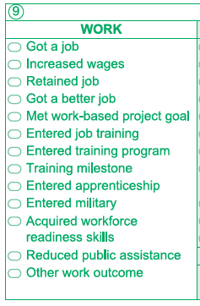
Learning Gains
Occupational Skills Gain
  Participants who achieve milestones in CTE programs, but who do not complete their credential or certificate because they obtain employment or realize a shorter-term goal related to occupational advancement.
Field 9 Work
  Met work based project goal
  Training milestone

Slide 60
Learning Gains
Workforce Preparation Milestone
Participants who complete workforce preparation courses and certificates. Data on this metric will be collected in two ways:
Marking Workforce Readiness on Entry Record
Marking either Training Milestone or Acquired Workforce Readiness Skills on the Update Record (field #9 – Work)
Starting in 2018-19, CDCP certificates coded as workforce preparation

Slide 61
Post-Secondary
Post-Secondary
Postsecondary Credential Completion
        For K12 community college CTE programs - Completion of a credential that leads to employment in a clearly-defined occupation including, but not necessarily limited to:
          Locally approved certificates eligible for inclusion on the Eligible Training Provider List (ETPL)
          CDCP CTE certificates with more than 48 instructional contact hours
          Certificates that meet the minimum threshold for inclusion under Perkins
          Certificates that meet the threshold for Title IV federal student aid
          Completion of any degree or for credit certificate over 6 units

Slide 62
Post-Secondary
Post-Secondary
Postsecondary Credential Completion
        Workforce preparation (work readiness) or occupational safety certificates (e.g. OSHA or Safeserve) ARE NOT counted for completion under this metric
        These outcomes should count as short term services, not Post-Secondary outcomes

Slide 63
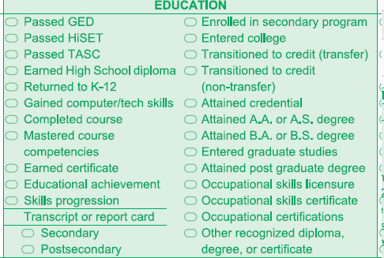
Post-Secondary
Completion of Post-Secondary certificates, degrees, or training programs.
Field 9 Work
  Entered apprenticeship
Field 9 Education
  Attained credential
  Attained AA/AS/BA/BS
  Graduate/post-graduate studies
  Occupational licensure/certificate

Slide 64
Enter Employment
Employment and Wages
  AEBG will primarily capture and report data elements related to employment and wages after participant exit, using a data match with the EDD wage file.
  WIOA II related follow up employment outcomes:
        Entrance into unsubsidized employment two quarters after exit
        Entrance into unsubsidized employment four quarters after exit
        Median earnings two quarters after exit
        AEBG follow up outcomes not related to WIOA II:
        Change in earnings from one year before to one year after exit
        Attainment of regional living wage
        Employment in field of study (starting in 2018-19)

Slide 65
Enter Employment
Employment and Wages
  Given that a large number of students will likely not have SSN, AEBG will use other methods to collect employment data:
  Self report through TE
  Self report through survey (specifics to be developed and discussed over the course of PY 2017-18.)

Slide 66
Enter Employment
Enter Employment
Field 9 work
  Got a job
  Retained job
Entered military

Slide 67
Increase Wages
Improved Wages
Field 9 work
  Increased wages
Got a better job

Slide 68
Transition
Transition
Transition to ASE: AEBG will track transitions from ABE to ASE or ESL to ASE.
Transition into Post-secondary: Applies to participants transitioning into 1) Any K12 adult education or community college CTE program or 2) Community college for-credit coursework that is not developmental.

Slide 69
Transition
Transition to Post-Secondary
Transition into Post-secondary: Specific student based scenarios that qualify for the AEBG transition outcome:
        K12 Adult Education or community college noncredit ABE, ASE or ESL participant who enrolls in a K12 adult education CTE course
        K12 Adult Education or community college noncredit ABE, ASE or ESL participant who enrolls in a noncredit community college CTE course

Slide 70
Transition
Transition to Post-Secondary
        Transition into Post-secondary: Specific student based scenarios that qualify for the AEBG transition outcome:
        A K12 adult education ABE, ASE or ESL participant who enrolls in a community college credit course that is not developmental (including both CTE and non-CTE courses)
        A community college noncredit ABE, ASE or ESL participant who enrolls in a college credit course that is not developmental (including both CTE and non-CTE courses)

Slide 71
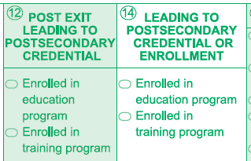
Transition
Transition to Post-Secondary
Field 9 Work
  Entered job training
  Entered training program
Field 9 Education
  Transitioned to credit
Field 12
  Enrolled in Education
  Enrolled in Training
Field 14
  Enrolled in Education
Enrolled in Training

Slide 72

Literacy Gains
Employment
Secondary
Wages
Post-Secondary
Transition

Slide 73
AEBG Outcomes
AEBG will use a combination of self-reported outcomes in TE and data match for state level reporting.
Data Match
TE only

Slide 74
AEBG Outcomes
Reported data through TE only:
Improved Literacy Skills (pre and post testing)
High School Diploma (Local Board approved)
Learning Gains
HSE/HS Diploma

Slide 75
Data Match Outcomes
A combination of self reported data through TE and data match:
High School Equivalency (HSE)
Post-Secondary
Job Placement
Improved Wages
Transition to Post-Secondary
Enter Employment
Increase Wages
HSE/HS Diploma
Post-Secondary
Transition Post-Sec

Slide 76
Data Match Outcomes
AEBG will use a combination of self-reported outcomes and data match for state level reporting.
Two separate data matches will be conducted, 1) EDD for employment, 2) CCCCO for post-secondary
Post-Secondary – CCCCO
Job Placement - EDD
Improved Wages - EDD
Transition to Post-Secondary - CCCCO

Slide 77
Data Match Outcomes
Data match with CCCCO for post-secondary related outcomes:
3. Post-Secondary
6. Transition to Post-Secondary

Slide 78
Data Match Outcomes
A combination of self reported data through TE and data match with EDD:
Job Placement
Improved Wages

Slide 79
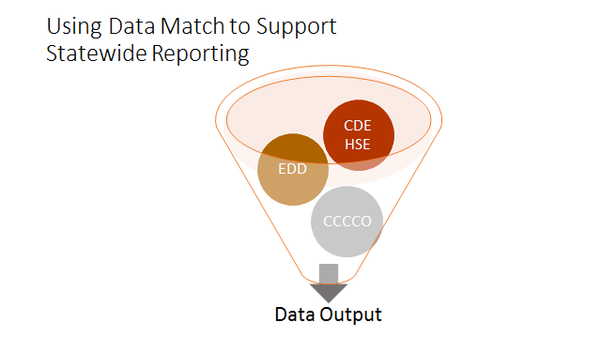

Slide 80
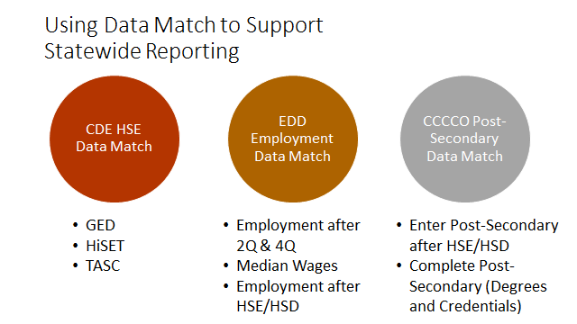

Slide 81
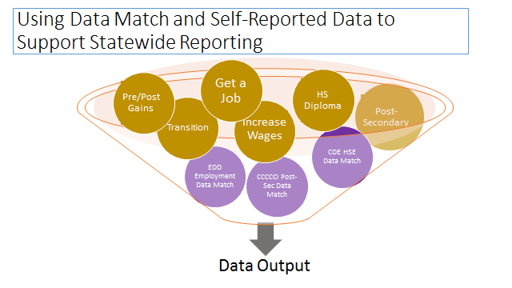

Slide 82
AEBG Outcomes
Literacy Gains
HSE/HS Diploma
Post-Secondary
Enter Employment
Increase Wages
Transition Post-Sec
Pre/Post Level Completion
Carnegie Units /HS Credits
CDCP Certificate
Occupational Skills Gain
Workforce Preparation
High School Diploma
Passed GED
Passed HiSET
Passed TASC
College Degree – AA, AS, BA, BS
Graduate Studies
Training Credential
Occupational Licensure/Certificate
Apprenticeship
Get a Job
Retain a Job
Enter Military
Increase Wages
Get a Better Job
Transition to ASE
Transition to Post-Secondary/CTE
Transition to Post-Secondary/College

Slide 83
LaunchBoard Adult Education Tab

Slide 84
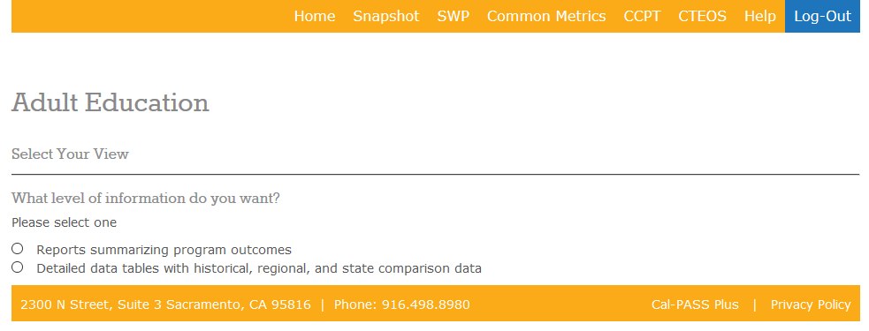
LaunchBoard Adult Education Tab
General info: http://calpassplus.org/launchboard/home.aspx

Slide 85
LaunchBoard Data Sources
Student Demographics (MIS/TOPSPro)
Coursetaking (MIS/TOPSPro)
Completion (MIS/TOPSPro/GED/TASC/HiSet)
Transfer (National Student Clearinghouse)
Employment (EDD Wage File, CTE Outcomes Survey)
Labor market information (EMSI)

Slide 86
LaunchBoard Adult Ed Tab Scope/Timeline
Comprehensive consortium & member data
Disaggregated program, demographics, barriers and other criteria
Current build includes 57 student, course taking & outcome metrics
Conducting test matching of TE, MIS and other data sources Fall 2017
Available to consortia Spring 2018
Regional training on tools and how to use the data

Slide 87
Future changes & analysis

Slide 88
Other Activities in 2017/18
Supplemental Data Report: Includes additional analysis not included in primary data collection & reporting:
Analysis of how AE students are being served in for credit college programs
Outcomes for students with low contact hours (<12)
Profiles of emergent or effective practices (immigrant integration, career advancement academies, other)
Other special analysis

Slide 89
Other Activities in 2017/18
Changes to MIS & CCC Apply:
Add MIS data elements to align MIS with adult education reporting requirements (missing population flags, preapprenticeship, diploma, etc…)
Convene process to make CCC Apply more useful for enrollment and data capture for noncredit and AE students

Slide 90
Other Activities in 2017/18
Basic Skills Crosswalk:
AEBG (WestEd) will convene faculty and leadership to build a crosswalk of the National Reporting System Educational Functioning Levels and the CB21 levels below transfer.
Issue guidance in Spring 2018 to inform content and local alignment of courses and streamline student transition between K12 and community college programs

Slide 91
Reporting in 2018/2019
Community colleges will use MIS to report students in noncredit ABE, ASE, ESL, and CTE programs
K12 adult schools will continue to report all ABE, ASE, ESL and CTE students in TOPSPro
WIOA Title II funded programs will still report quarterly data using TOPSPro
Pre and post testing using CASAS will still apply to ALL WIOA AEFLA Title II Funded Student

Slide 92
Data Flow Beginning in 2018/2019

Slide 93
Resources

Slide 94
AEBG Resources
AEBG Beginning of the Year Letter
AEBG Program Guidance
AEBG Policy Report to the Legislature
AEBG Supplemental policy guidance
Field Team White Papers
Data Dictionary
Data & Accountability Extension Letter
AEBG TAP – training, PD, & TA

Slide 95
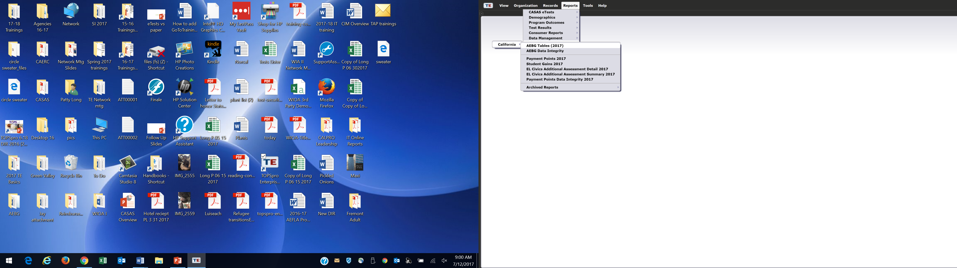
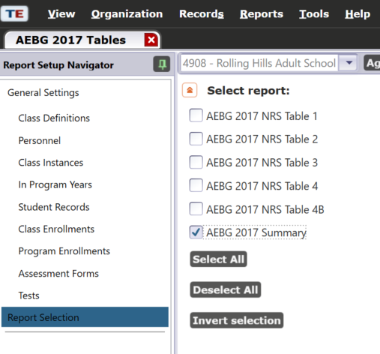
AEBG Tables

Slide 96
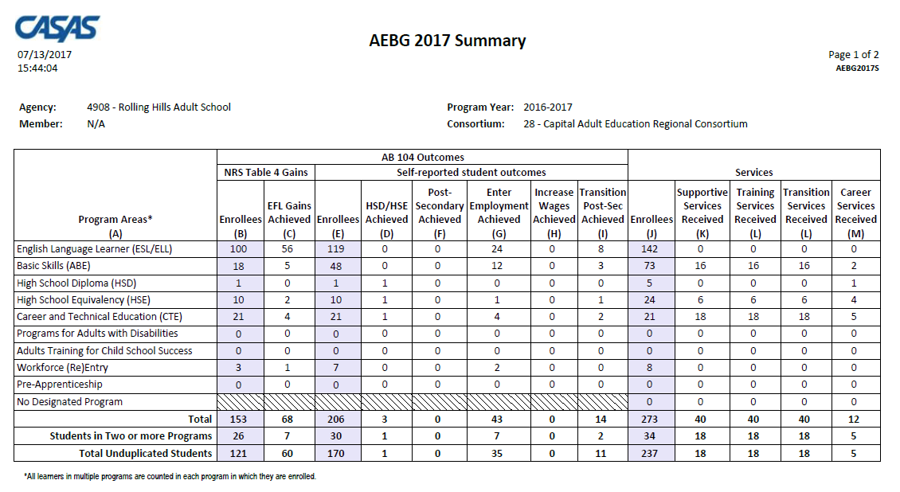
AEBG Summary
Lists the required AEBG instructional programs
Itemizes AB 104 Outcomes and Services Received by Program

Slide 97
AEBG Summary
Displays outcomes in three separate sections:
Literacy Gains and HSE/HSD using NRS Table 4 guidelines
Other AB 104 outcomes self-reported via Update Record using WIOA II reporting requirements
Services Received that do not impose WIOA II reporting requirements

Slide 98
AEBG Web Site
http://aebg.cccco.edu/Home

Slide 99
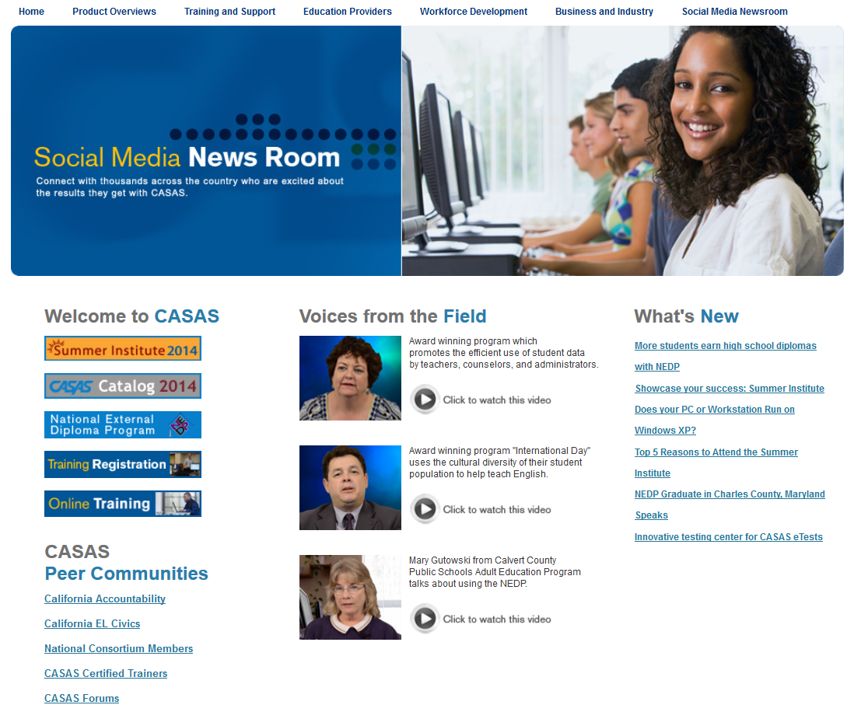
CASAS Web Site
What’s New
Online Registration
California Accountability
AEBG Web page
CASAS Forums
Download Centers
www.casas.org

Slide 100
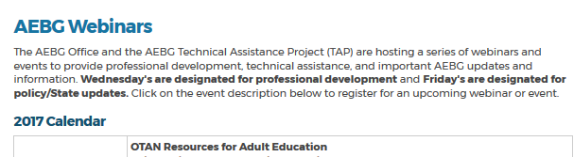
AEBG TAP
The AEBG Technical Assistance Program (TAP) provides professional development resources for all AEBG agencies statewide.
tap@aebg.org

Slide 101
CASAS Technical Support:
1-800-255-1036
CASAS Fax #:
1-858-292-2910
E-mail:
capm@casas.org
techsupport@casas.org
aebg@casas.org

