Slide 1
AEBG Webinar
Technologies that Reach Remote Learner Populations
Presented by:
Penny Pearson (ppearson@otan.us)
Notes:
Monday, January 22, 2018
Session B: 10:40–11:30 AM, Salon 6B

Slide 2
Today is an Exploration
What is RACHEL?
How is it currently used?
Ideas for education
What would you use it for?
This is a “local” technology, but I’ll show you the resources available on the device!

Slide 3
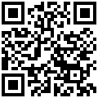
Get your own copy
To access this presentation: https://goo.gl/tNB3Mq

Slide 4
OTAN and You
Vision: To lead California adult education in the integration of technology into the educational process, ultimately empowering learners to meet their academic, employment and civic goals. [short video]
Training: f2f & online
Digests: for teachers & for administrators
News
Teaching with Technology
Technology and Distance Learning Symposium (registration is still open!)
AEBG-TAP ( tap@aebg.org )is your partner for technical assistance for non-WIOA funded Agencies! Contact them for training sessions for your consortium and partners!
Notes:
Penny Pearson - Coordinator for Distance Learning Projects at OTAN (Outreach and Technical Assistance Network)
OTAN services WIOA funded adult education agencies; which include the majority of correctional facilities within California. In the past, our services were sparse to say the least because of restrictions to technology in most facilities. Now there is a device that could change all that!
Services we provide
Training
Educational Tech integration videos
YouTube Channel with many tutorials on software and other tools teacher can use in a classroom.
And our “big event” in March 2018 of the Technology and Distance Learning Symposium!
We are here to serve you and to help you provide the best learning environment to ensure learner success.

Slide 5
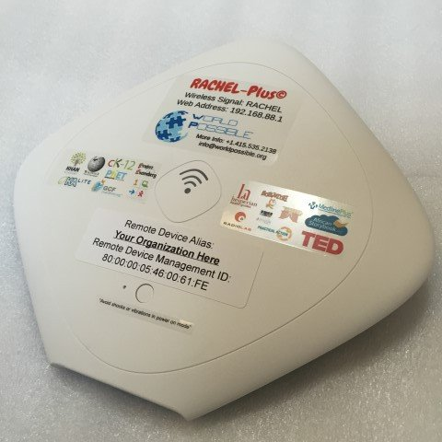
What is a “RACHEL”?
Remote
Access
Community
Hotspot for
Education and
Learning
Notes:
It’s not a who, it’s a what! RACHEL is a small device Remote Access Community Hotspot for Education and Learning
Key points:
The device was developed by World Possible, [http://worldpossible.org/] a non-profit organization with a vision to provide a quality education to everyone. Although they provide services in remote areas of Guatemala, Ethiopia, Namibia, Kenya and Sierra Leone, the possibilities were quickly realized for other applications as well. The RACHEL device provide access to learning resources for ALL learners (incarcerated, homebound, rural, remote). This will bring learning to them!
It is inexpensive, and it comes “in the box” pre-loaded with content and curriculum you can use immediately. It also has the flexibility to allow you to add your own teacher-developed materials to the device as well. You’ll learn more about what content is available and how it is used from my colleague Julie in a few moments. But one key point that needs to be made: All content is licensed under a Creative Commons license and is considered an Open Educational Resource (OER). World Possible puts it this way “We are delivering a copy of the internet. An educational slice of free, OER content...We are building a digital library of the World’s leading online educational resources for download and use offline.”
.

Slide 6
Some Examples
Notes:
Use in Corrections: (from racheloffline.org)
Thus far, RACHEL has been mainly for education programs, vocational, leisure study and free time reading.
Here are a few facility examples
Connect to a school network for safe content access. Instructors can focus on education content and students can focus on their studies. Internet like access without the headache of hacking out.
Special intake units. Access helps users to gain constructive use of time. Constructively helps to keep a positive climate within the facility intake area.
Vocation Education Programs. Vocational education content place course specific content directly in their content area - for example automotive repair course material, welding resource manuals - study guides. Also approved text books and that allow digital access for study.
Off site Access: Green House / Master Garden Application - RACHEL can be used in the field and has battery operation for around 8 hours. Instructors can use content in the field for gardening programs or other outdoor class application. Fire Fighting Program is another example - especially video content.
College Content; RACHEL has college content that can be used by instructors, volunteer tutors, Inside Out programs - resource material for students and instructors.
Local Development of College Courses. Instructors have created their own college course content on RACHEL. Students accessed, articles, videos and pictures - all compiled by the instructor.
RACHEL Packaged College Course Content - Self Paced - There are around 10 packaged courses that allow students to access course material. Students can experiment and try an area of study without any fiscal commitment. Students can team together for studies, staff can help students in course work, and also volunteers can run studies.
Testing Out for College Credit - RACHEL College content and courses helps to prepare students to test out for college credit. Some states offer College-Level Examination Program® (CLEP) that allows testing out for college credit.
RACHEL on living units. Some facilities have access for students on their place of residency. Students check out laptops to gain access to RACHEL for school Studies and leisure reading.
Access to education programs for Sex Offender facilities. Management of these facilities had praise for the RACHEL content - since it offered good content without the issue of access to the internet.

Slide 7
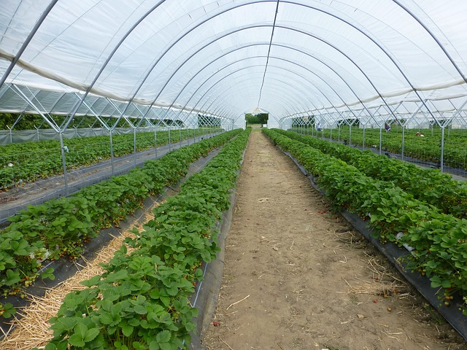
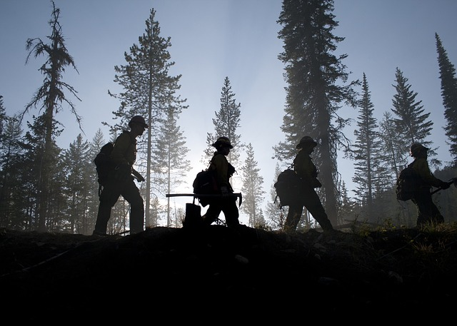
Some Examples
CC0 - Laura Hughes, Pixabay
CC0 - sasint, Pixabay
CC0-12019, Pixabay
CC0-Capri23auto, Pixabay
Notes:
Use in Corrections: (from racheloffline.org)
Thus far, RACHEL has been mainly for education programs, vocational, leisure study and free time reading.
Here are a few facility examples
Connect to a school network for safe content access. Instructors can focus on education content and students can focus on their studies. Internet like access without the headache of hacking out.
Special intake units. Access helps users to gain constructive use of time. Constructively helps to keep a positive climate within the facility intake area.
Vocation Education Programs. Vocational education content place course specific content directly in their content area - for example automotive repair course material, welding resource manuals - study guides. Also approved text books and that allow digital access for study.
Off site Access: Green House / Master Garden Application - RACHEL can be used in the field and has battery operation for around 8 hours. Instructors can use content in the field for gardening programs or other outdoor class application. Fire Fighting Program is another example - especially video content.
College Content; RACHEL has college content that can be used by instructors, volunteer tutors, Inside Out programs - resource material for students and instructors.
Local Development of College Courses. Instructors have created their own college course content on RACHEL. Students accessed, articles, videos and pictures - all compiled by the instructor.
RACHEL Packaged College Course Content - Self Paced - There are around 10 packaged courses that allow students to access course material. Students can experiment and try an area of study without any fiscal commitment. Students can team together for studies, staff can help students in course work, and also volunteers can run studies.
Testing Out for College Credit - RACHEL College content and courses helps to prepare students to test out for college credit. Some states offer College-Level Examination Program® (CLEP) that allows testing out for college credit.
RACHEL on living units. Some facilities have access for students on their place of residency. Students check out laptops to gain access to RACHEL for school Studies and leisure reading.
Access to education programs for Sex Offender facilities. Management of these facilities had praise for the RACHEL content - since it offered good content without the issue of access to the internet.

Slide 8
Oregon Youth Authority
Carla Caesar, a marketing manager at Intel, summed up the day this way: “It’s easy to sit in my cubicle and work on these projects and think, ‘This is a cool thing we’re making.’ It’s a whole other thing to go out and see its impact — to hear how these youth are using it not only for education but also for researching the law and their rights — and learn how it’s improving lives.”
Incarcerated Oregon youth work directly with Intel and WorldPossible staff on improvements and deployment options.

Slide 9
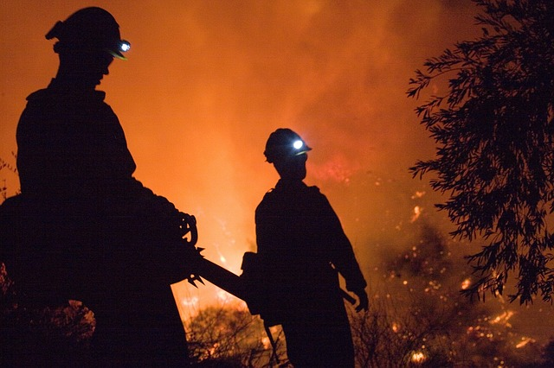
Fire Camps
Notes:
Free images from Pixabay, CC0 - no attribution required.
Right side: https://pixabay.com/en/fire-fighters-night-heat-hot-blaze-1002283/
Left side: https://pixabay.com/en/career-firefighter-relaxing-job-1501615/

Slide 10
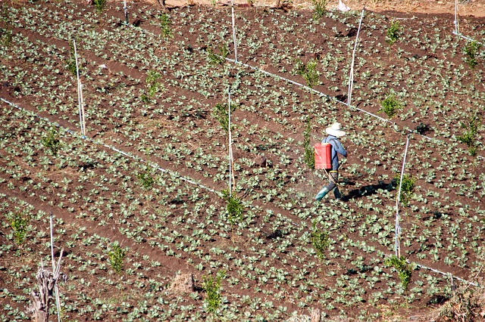
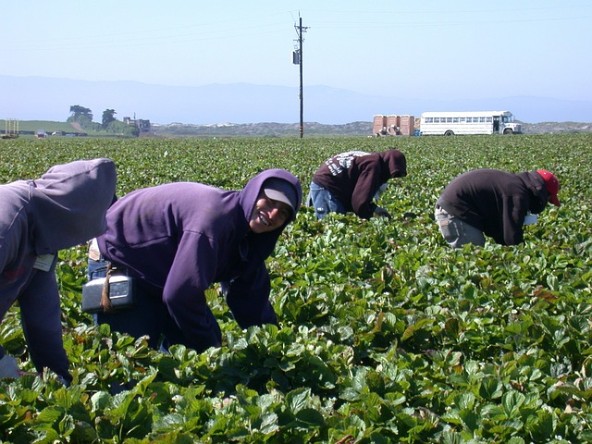
Agriculture
Notes:
https://pixabay.com/en/field-spray-water-fertilizer-2290749/
Field workers: https://pixabay.com/en/ingathering-strawberry-hardwork-607121/

Slide 11
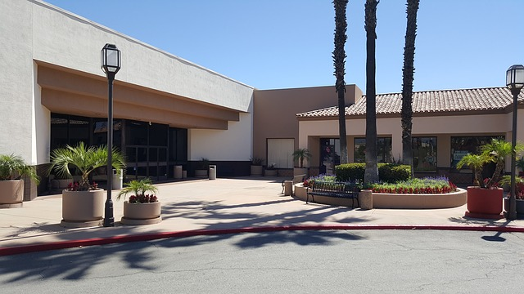
Urban Satellite Educational Facilities
Notes:
Strip mall: https://pixabay.com/en/strip-mall-stores-shops-retail-2352212/

Slide 12
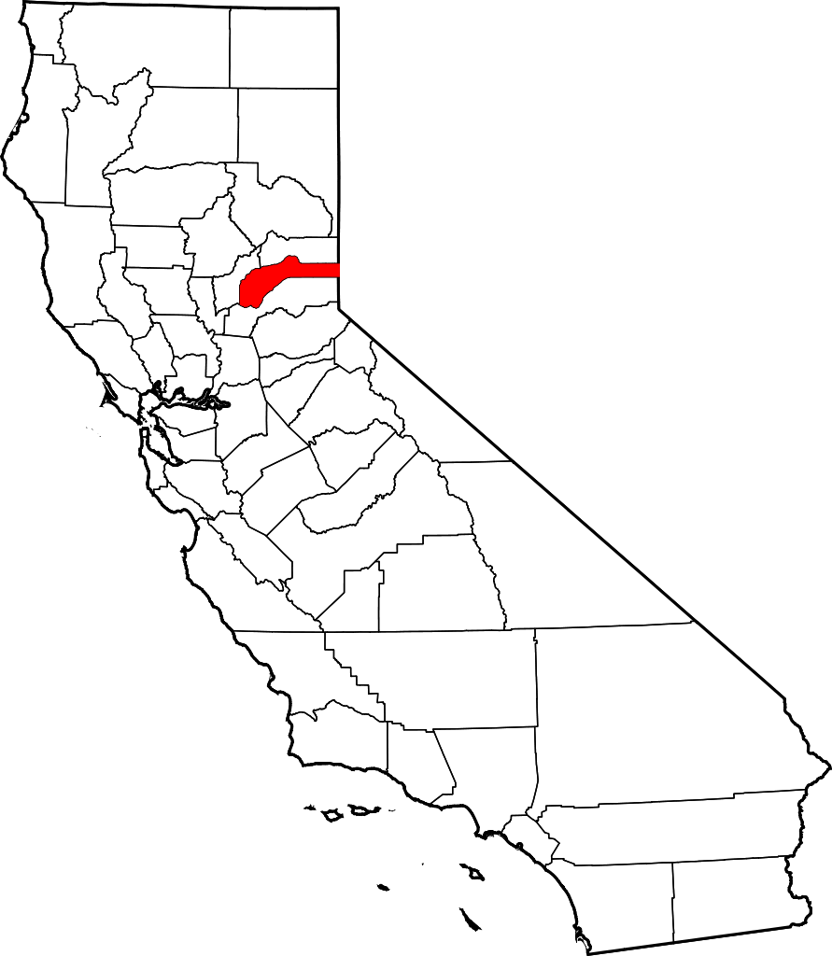
Western Nevada County is in the Sierra Foothills between Sacramento and Lake Tahoe on Highway 49
Population: 100,000 spread out over 974 square miles
Wayne Brown Correctional Facility (Nevada County Jail)
In Nevada City (population 3000)
Approximately 200-250 inmates
Notes:
Nevada County Jail (Wayne Brown Correctional Facility)
200+ inmates
Nevada County is a small county on Hwy 49, between Auburn and Truckee. This is my 12th year teaching with the school district all at the Nevada County Jail, also known as Wayne Brown Correctional Facility.
Description of Educational Program
4 classrooms, each with 6 computers networked to RACHEL
High School Equivalency, High School Diploma, and more… Career/Tech Ed

Slide 13
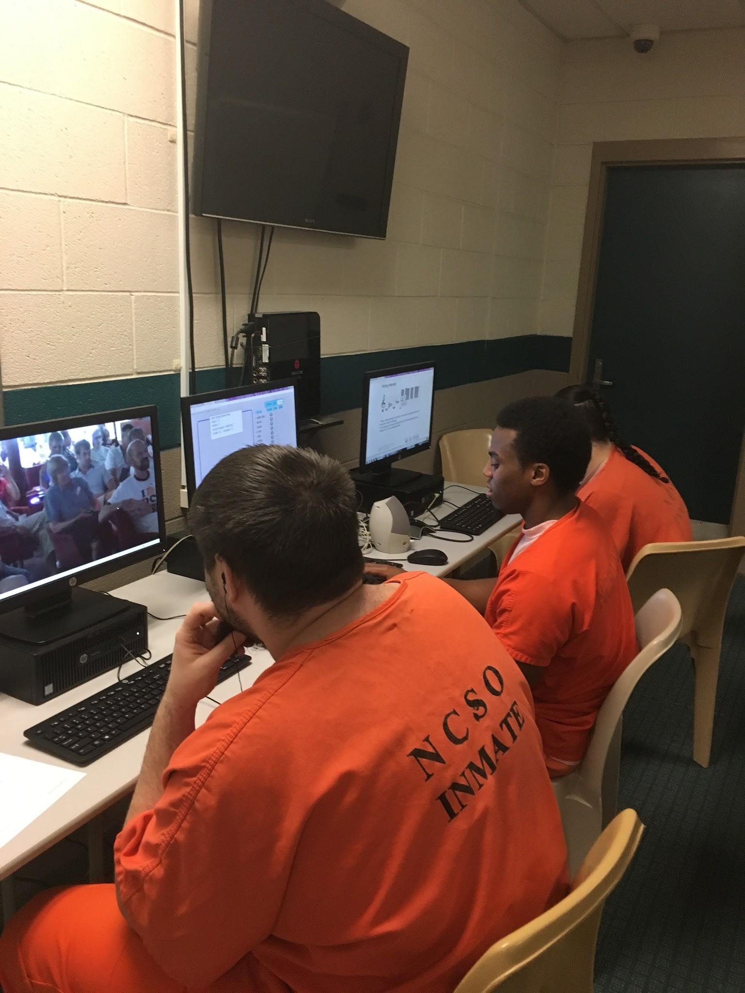
Where it’s used:
Nevada County jail
How it is being used:
Classroom enrichment, independent study, career planning…..
Image credit: Julie Collins, NCSO, CC-BY
Notes:
Using RACHEL at WBCF
Great addition for students who have completed high school
Students can design own curriculum based on personal educational or career goals

Slide 14
What does RACHEL content look like

Slide 15
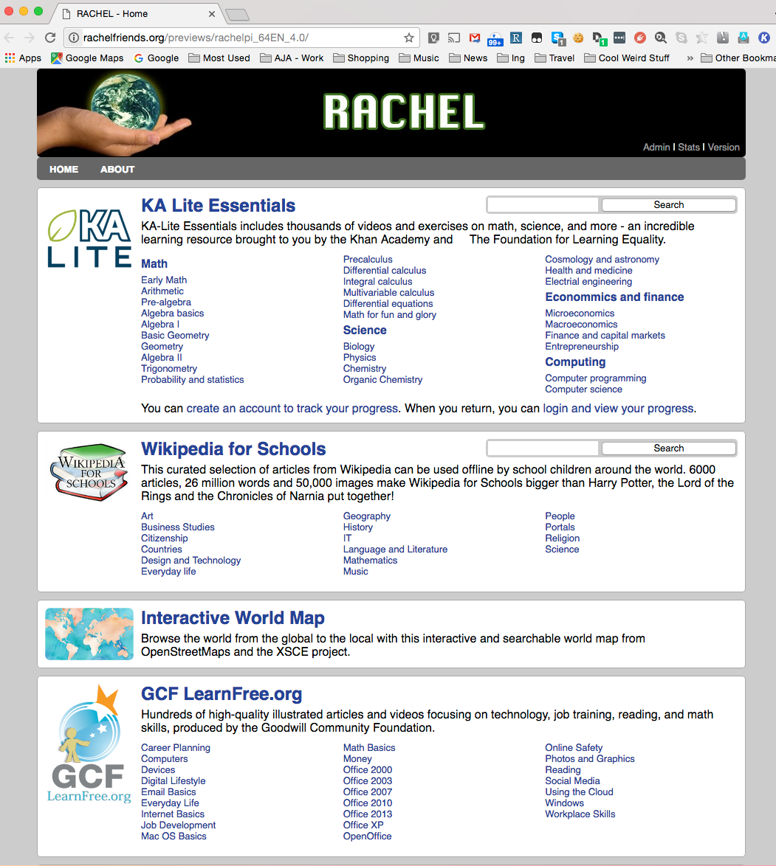
RACHEL home page
Notes:
Although this is a screenshot of the RACHEL homepage, remember that you can select which materials you want on your own device, as well as add your own.
Over 24 different modules in English, and many of the same modules also in Spanish

Slide 16
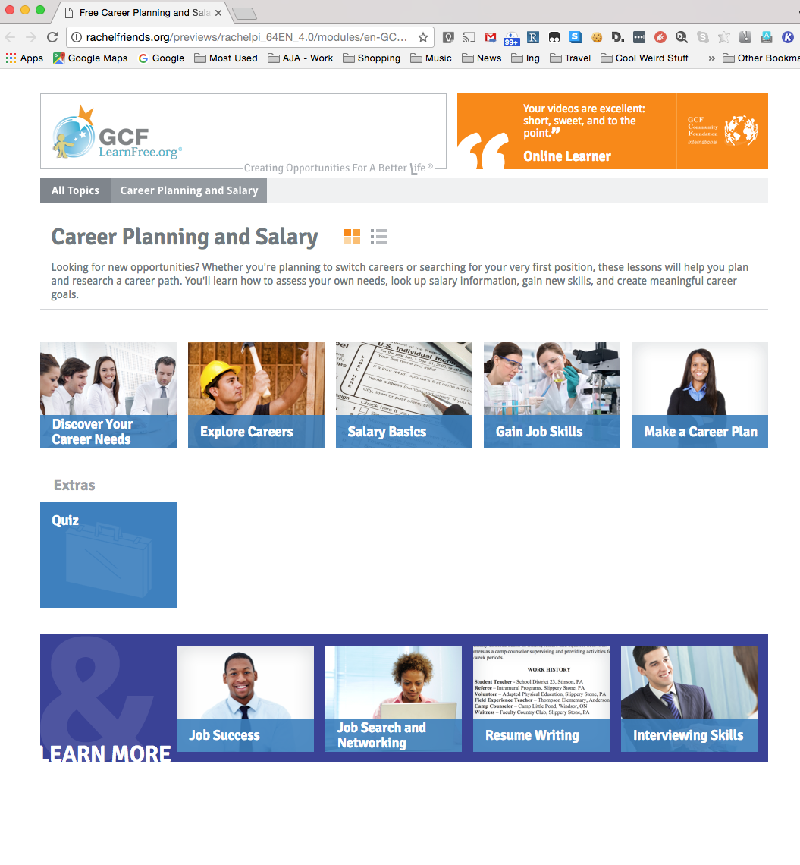
Module for Career Planning
Nevada County jail learners begin here and plan their own curriculum based on S.M.A.R.T. goals
Notes:
Once Nevada Co Jail students are familiar with RACHEL content, they all start with the same module. GCF Learn Free has a series of lessons on Career Planning. It introduces the students to the process of setting SMART goals and how to think proactively about both the short term and long term future. The final page of the last module has a lesson on SMART goals and a printable worksheet on setting such goals. I help the students set a career or educational objective This objective then dictates the curriculum for the next 6 weeks. Under the umbrella of the “objective”, the student sets SMART goals. Since they’ve already had a chance to become familiar with RACHEL content, they think about what modules are interesting to them and how that might apply to the future.
Learn more at RACHEL Friends: http://rachelfriends.org/

Slide 17
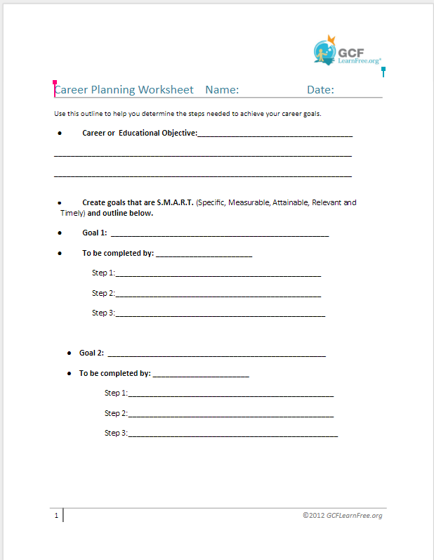
Support worksheet
(The image will link you to a copy of this worksheet.)
Notes:
Here’s a copy of the worksheet adapted for the Nevda Co jail students. It is still a work in progress. Very easy to adapt and change.
Comments from Julie Collins, Nevada County
The first class and maybe even the second depending on the student, I encourage free exploration. Next I begin a conversation with the student about goals and interests. Are they interested in more education? Do they have a career? Are they looking for a career or a particular skill? How long has it been since last in school?
GCFLearn free provides these worksheets and curriculum to teachers.
I introduce SMART goals ( straight out of the GCF learn Free module and have the student complete the GCF Learn Free module.
I have the student click through those pages no matter the level or interest. I give them the goal setting page from the site, that I have modified.

Slide 18
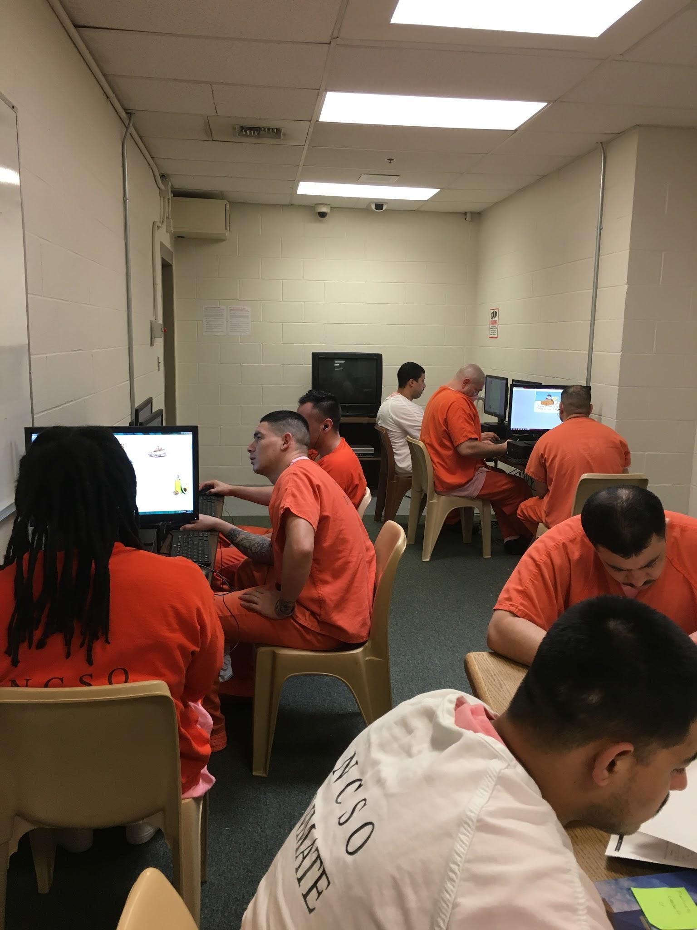
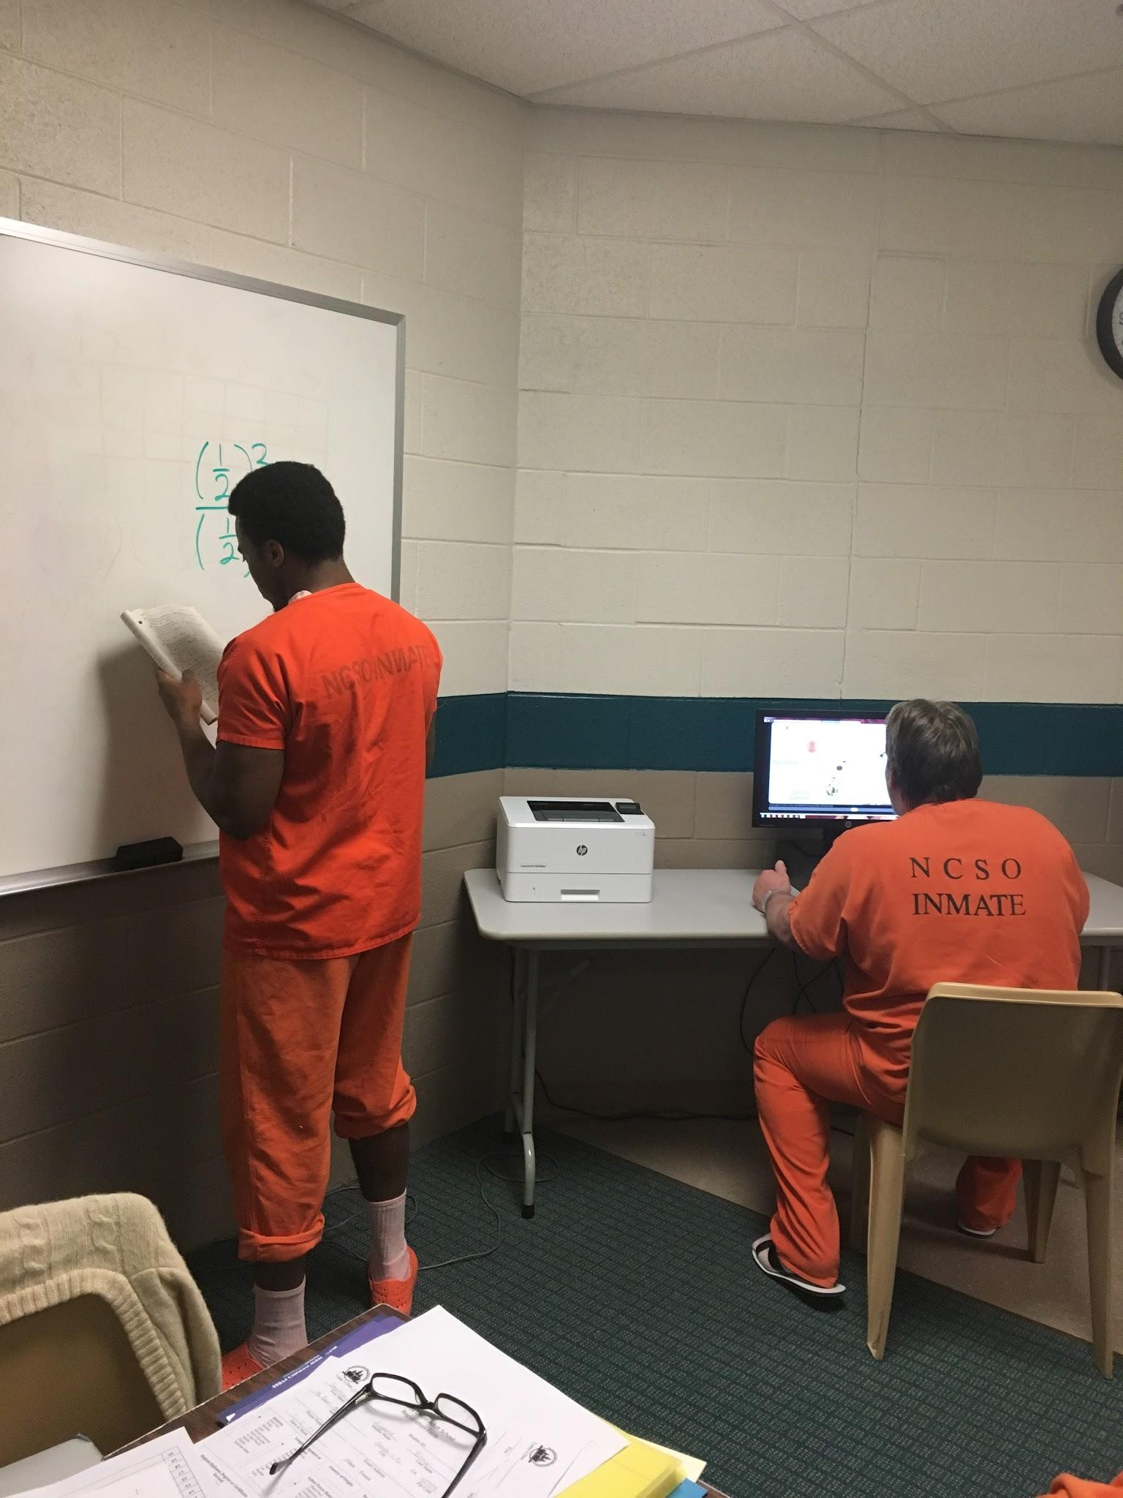
In action…..
Notes:
Photo 1: The six students sitting at computers are working independently on RACHEL, while others are working with the teacher at a separate table on High School Equivalency Prep
Photo 2: Similar set up in a different classroom.
Success stories

Slide 19
https://www.youtube.com/watch?v=vDlNpLYvFB8&feature=youtu.be
40 minute Video Overview of Rachel Plus
Notes:
Great overview of RACHEL by the Executive Director Jeremy Schwartz

Slide 20
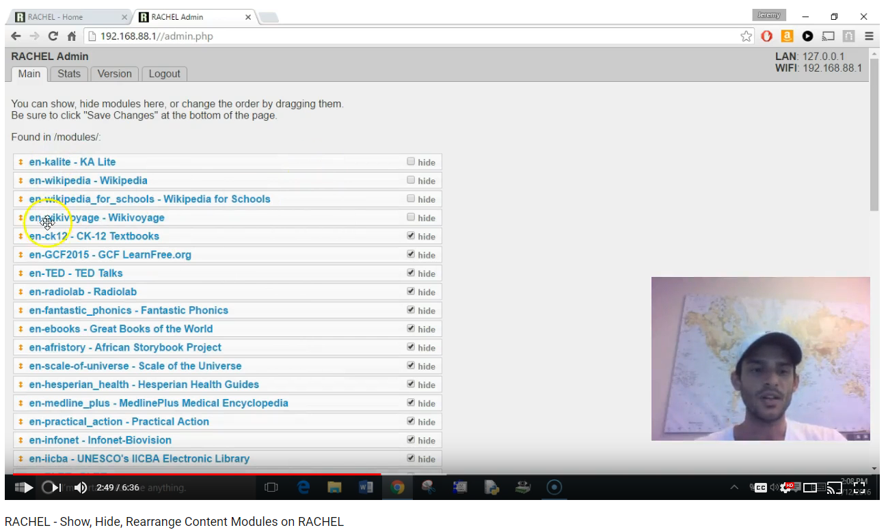
Short video on how to show, hide, rearrange content modules
https://www.youtube.com/watch?v=5qTf0nVMbsM

Slide 21
Demonstration Connecting!
Using a document camera, I’ll demonstrate how to connect to RACHEL.
Here are general directions:
Go to Settings
Find your Wireless connection
Search for RACHEL
Select it and CONNECT
Open your browser application
You should be on the RACHEL homepage
Notes:
Images from Pixabay:
CC0 Creative Commons
Free for commercial use
No attribution required

Slide 22
Explore the content on your own…
http://rachel.golearn.us/

Slide 23
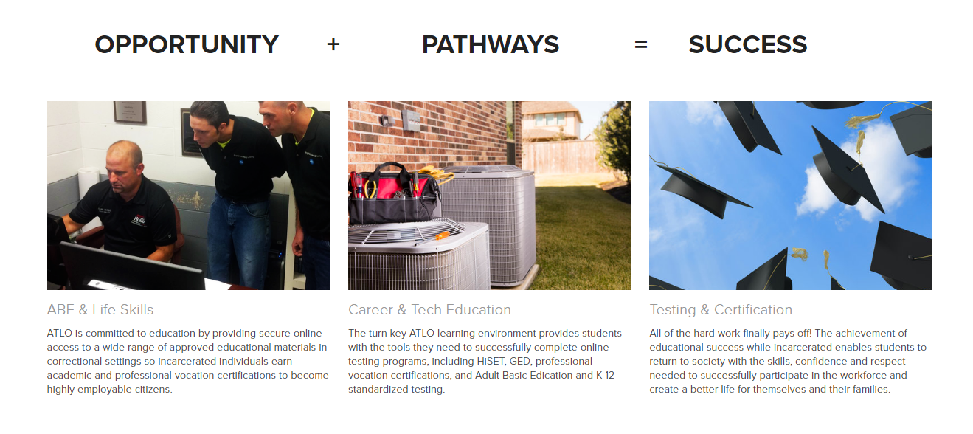
ATLO
Notes:
Contact email: info@ATLOsoftware.com
ATLO Software, LLC
42354 Deluxe Plaza, Suite 12
Hammond, Louisiana 70403
(225) 242 9891
ATLO (Assembly, Test, and Launch Operations) Software is a Louisiana-based company started by two long-time friends that decided to combine their skills and interests to build something revolutionary. Today, ATLO is proud to be a leader in the effort to better educate persons of all ages incarcerated in the United States. We firmly believe that there are people who deserve a second chance, and through education, ATLO can provide the path to a successful second chance.
Learn more about Assembly, Test, and Launch Operations (ATLO) and their success in Corrections: https://youtu.be/t1uMu_lsres?t=29m8s Start at 29 minutes to hear about the ATLO project.

Slide 24
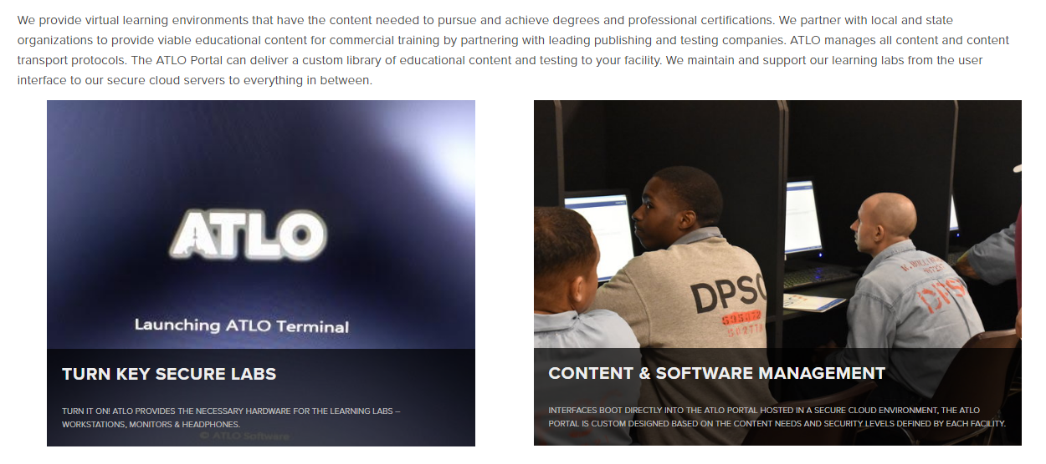
ATLO
Notes:
This Louisiana based company created a truly secure online platform that allows a virtual learning environment complete with custom or commercial educational content for incarcerated adults. ATLO manages all content and content transport protocols (meaning, they keep the information encrypted and secure). They maintain and support the learning labs from the user to their secure cloud servers -- and everything inbetween.

Slide 25
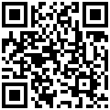
Get your own copy
To access this presentation: https://goo.gl/UYKRVJ

Slide 26
License
Technologies that Reach Remote Learner Populations by Penny Pearson is licensed under a Creative Commons Attribution 4.0 International License.
Based on a work at http://www.otan.us.
Please share with your colleagues! You are allowed to modify and redistribute this presentation, simply give credit (attribution) to Penny Pearson, OTAN
ppearson@otan.us

