Slide 1
Engaging Employers with the
Mission of Adult Education
Funded by the California Department of Education and Chancellor’s Office of the California Community Colleges (CCCCO).

Slide 2
Strategy – Technology – Professional Development

Slide 3
Business U, Inc.
Strategy – Technology – Professional Development
Facilitators:
Dr. Christine Bosworth
Co-founder/CEO
Celina Shands, M.S.
Co-founder
2017 Innovation of the Year Award for Learner Engagement

Slide 4
Webinar Topics
Bringing Together Two Cultures: Business & Education
Key findings from Business U’s National Business Engagement Study
Understanding the value of strategic, long-term & transformational partnerships with employers to expand adult learner opportunities
Apply the employer perspective for successful engagement efforts
Assess your business engagement behaviors and actions.

Slide 5
Poll #1
What are your primary motivators for engaging employers? Check all that apply:
To help my students find work-based learning opportunities.
To help my students find a job.
To get businesses to support career pathways.
To help businesses grow in our region.
I don’t currently work with employers.
I don’t currently work with employers, but will do so in the future.
Other engagement types.

Slide 6
Poll #2
What are your key sticking points getting businesses to take action with your agenda? Check all that apply:
They are not interested in our work
They don’t have time
They don’t see the value
Other

Slide 8
Business Engagement – Education Market Segment
Top Issues in 1-1 Engagement
Coordination of Outreach Efforts
Top 3 Challenges
Measuring Business Engagement
Employer Time Commitment

Slide 9
Top 4 Challenges – Education Market Segment
Challenges
Difficulty working with partners to connect employers in work-based learning activities.
No business engagement outreach plan with defined objectives and goals.
No professional development that supports building relationships with industry.
Partner coordination attempts are not focused.

Slide 11
Understanding the Psyche of Business
This is what keeps “Employers” up at night:
I am more than an employer
Sales
Debt
Profitability
Growth
Marketing
Cash Flow
Product Development
Efficiencies
Competitive Edge
Contract Negotiation
Litigation
Compliance
Economic Slowdown
Reliable Help/Trained Staff

Slide 12
Business Transformational Relationships
If you work with people, you are in the
business of building relationships.
Interaction
The art of building a trustworthy and credible transformational relationship requires you to increase your interaction and decrease your expectation.
Expectation

Slide 13
Demand-driven Alignment of Programs and Resources
Business Cycle
Downsizing
Start-up
Growth
Stable

Slide 16
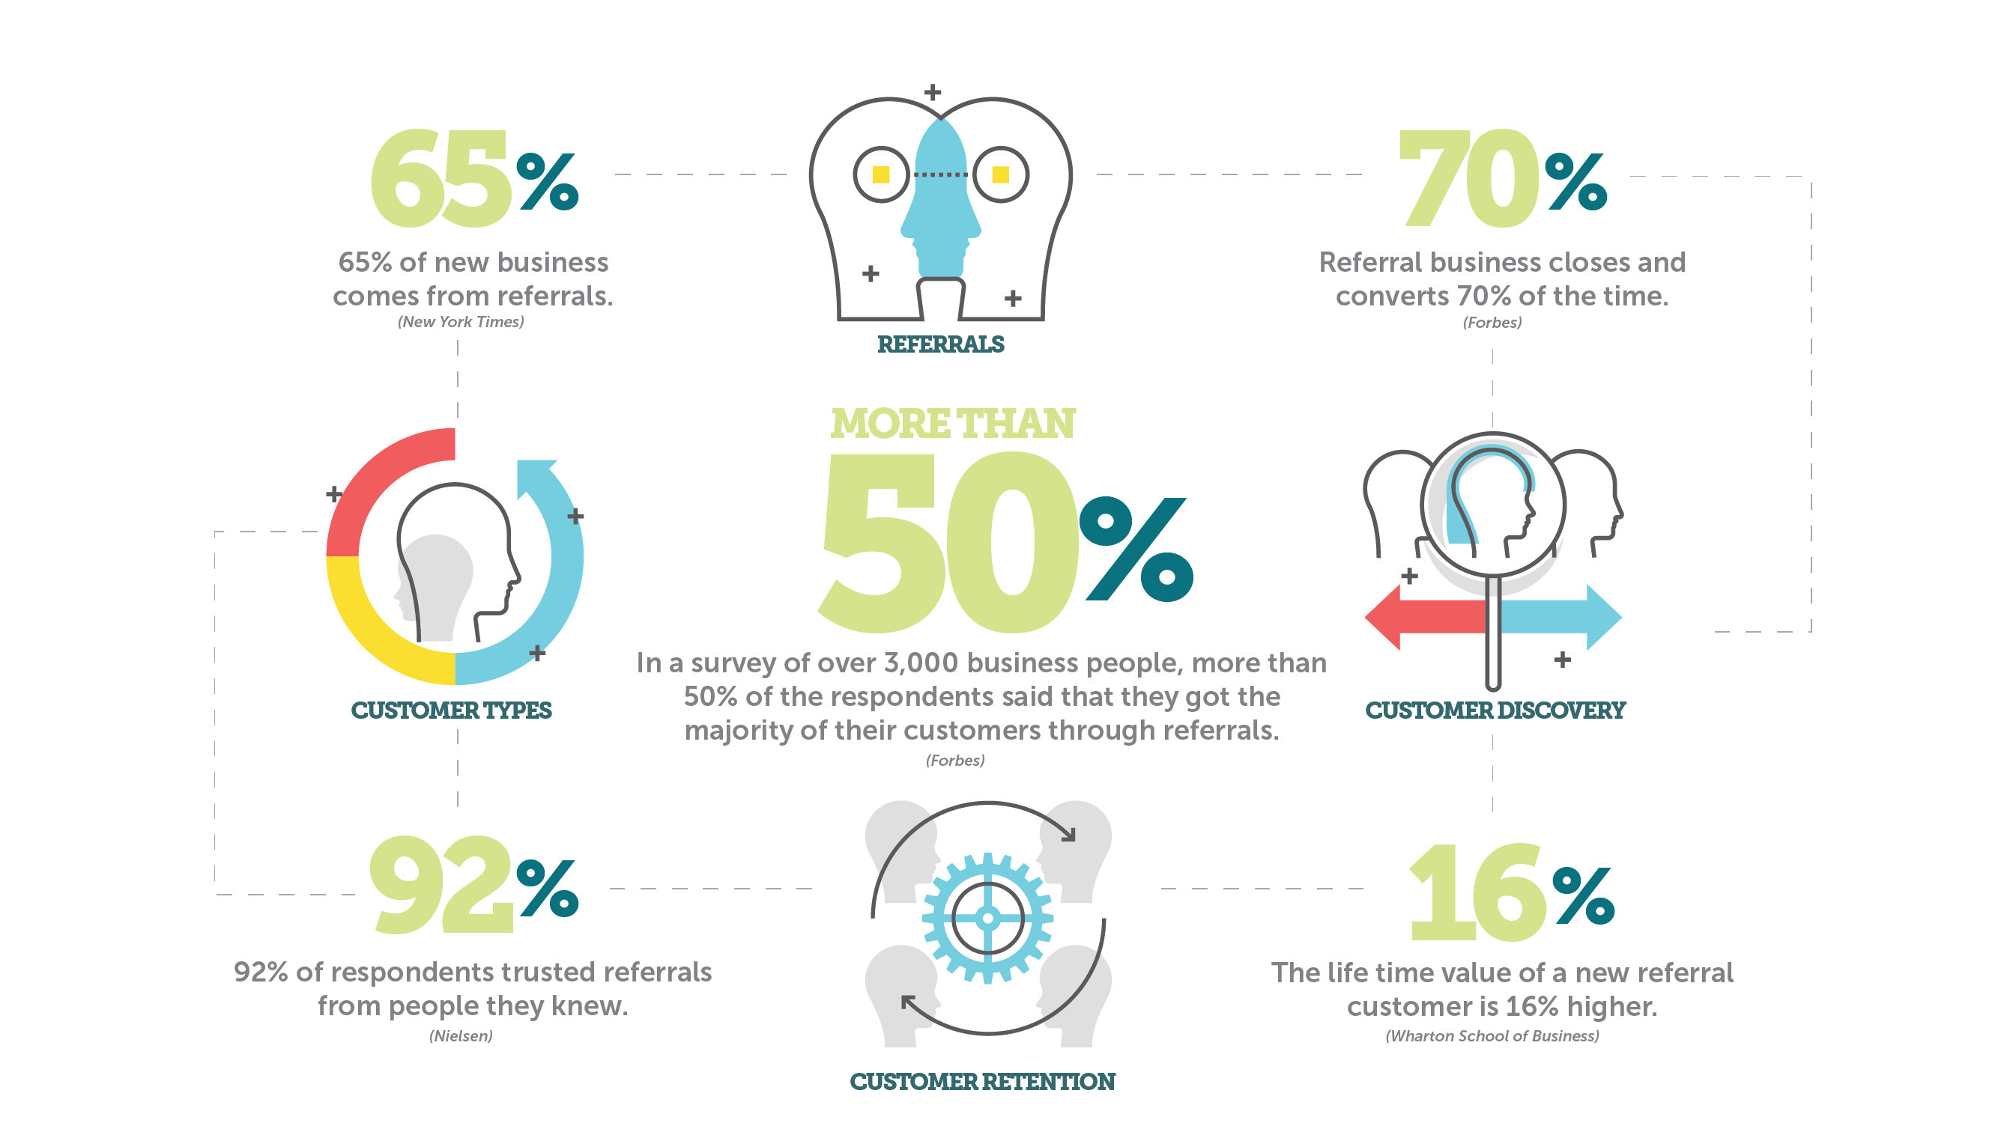

Slide 17
Features vs. Benefits
Features are factual statements about a service being discussed or promoted, but they do not engage a prospect. A benefit answers the customer’s question:
"What's in it for me?”
Stop & Check: When you’re developing value propositions for communicating one-to-one, on the web or in marketing materials, take the time to determine if you are communicating an actual benefit.

Slide 18
Example 1
Our organization prepares individuals for work-based learning opportunities in your industry.
The above statement is a features statement that contains facts about what the organization provides. This statement alone would not engage an employer prospect.
Example 2
Our no-cost services save employers time and money in finding qualified talent.
The above statement provides key benefits of engagement including no-cost and saving time and money, all of which are resources that deeply matter to a business.

Slide 19
Poll #3
Choose the statement below that an employer would find beneficial:
An internship will give students a great opportunity to experience your business.
An internship is a cost-effective way to “try out” potential employees.
An internship will help students understand more about your industry.
An internship program can build the skills of a potential worker.

Slide 20
Self-assessment
Business Engagement Behaviors and Activities

Slide 21
Summary
It’s not learning the language of business, its articulating what employers value
from their perspective.
Use the self-assessment to not only evaluate your engagement practice, but to
also help you develop your engagement strategies.
Separate your customer lists into the type of relationship you currently have (new/working/
partnership) to align you engagement strategies and objectives.
Consider how you might build transformational relationships:
- Create an asset map with your network of partners – share the map when completed.
- Develop more than one relationship with the organizations you are currently working with to increase interaction and levels of exchange
- Expand your reach through a network of partners (resulting in expanded opportunities)
- Use referrals as a means to build credibility as a resource partner with breadth and depth.

Slide 22
www.businessuonline.com/registration_ged.php
Go to:
Free GED Preparation Course
Addressing Skills Gaps for Business & Industry
In support of our education and workforce development partners, Business U has funded a web-based GED preparation course for students and job seekers who want to study for the GED test. The course is self-paced, online and available at no cost to your organization or to your clients.
About the Course:
✔ Free & available online in Business U’s state-of-the art eUniversity
✔ All four subjects of the GED Test including the Essay component
✔ Initial Assessment to focus efforts
✔ Practical quizzes
✔ Final subject tests (timed to simulate the actual exam)
✔ Self-timed final written essay component
✔ Online scientific calculator
✔ Flashcard
✔ Test-taking tips

Slide 23
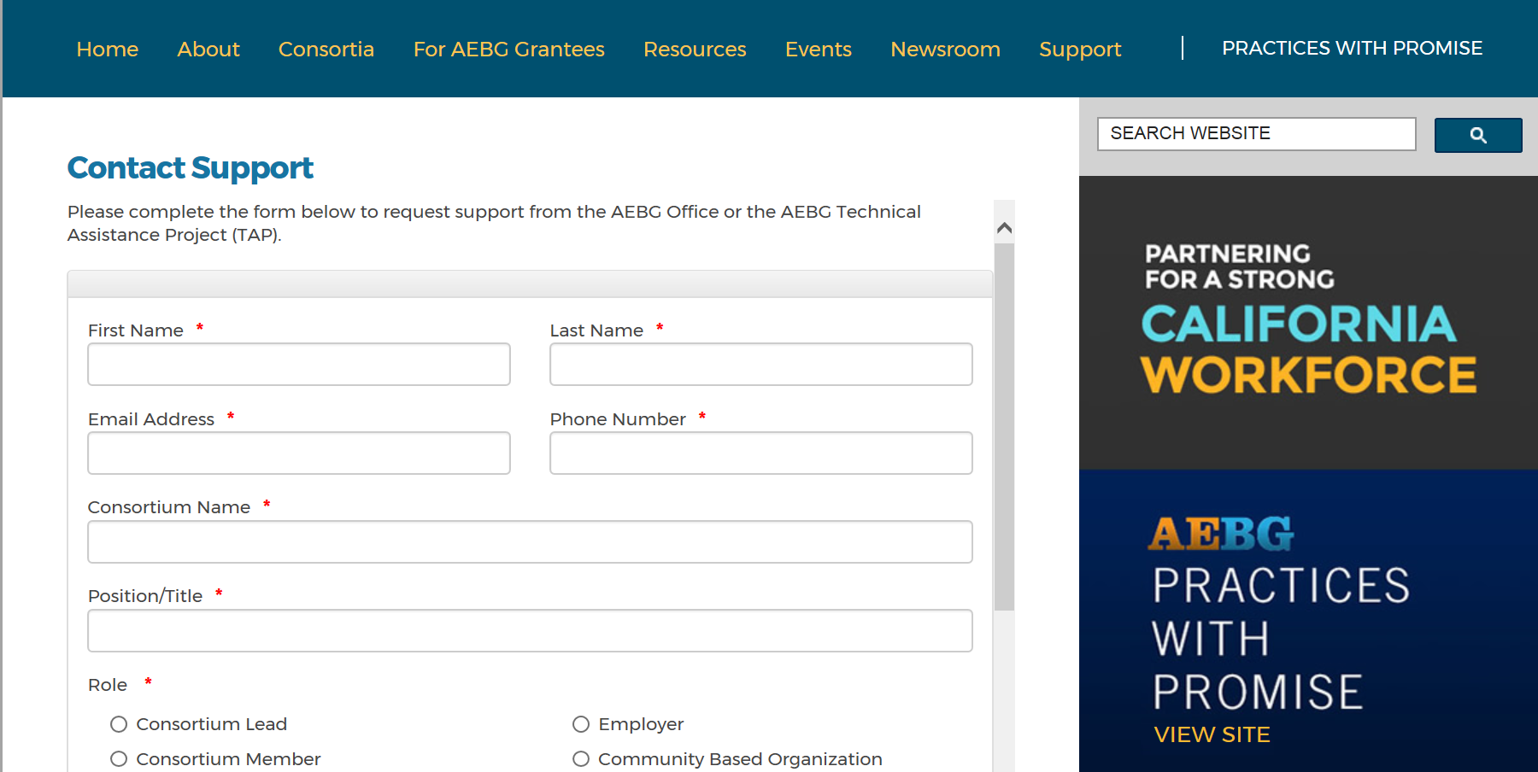
Questions?
Questions?
http://aebg.cccco.edu/ContactUs/Support
Notes:
http://aebg.cccco.edu/ContactUs

Slide 24
Thank you!
Christine Bosworth, Ed.D Celina Shands, M.S.
Business U, Co-founder/CEO Business U, Co-founder
Christine@Business-U.net Celina@Business-U.net
(310) 800.3353 (858) 793.6694

