Slide 1

Working with Key Influencers to Build Support for Adult Education
Notes:
AEBG Elevate & Educate Campaign: Working with Key Influencers to Build Support
In a highly competitive funding environment, adult educators need a coordinated strategy to inform key stakeholders about the positive impacts of adult education. This session shares how to conduct a successful briefing to key influencers utilizing the Campaign Fact Sheet, Video and Legislative Talking Points from the AEBG Educate & Elevate Campaign Toolkit, coupled with your local compelling success stories and innovations. Leaders from the AEBG Communications Committee, including Steve Curiel, MBA - President, California Council for Adult Education, and Madelyn Arballo, Ed.D. - President Elect, Association of Community & Continuing Education, share their insights and strategies, as well as their game plan for a coordinated outreach effort.

Slide 2



Facilitators
Neil Kelly – Specialist, AEBG Office
Steve Curiel, MBA – President, California Council for Adult Education (CCAE)
Madelyn Arballo, Ed.D - President Elect, Association of Community & Continuing Education (ACCE)
Celina Shands, M.S., CEO/Founder, Full Capacity Marketing, Inc.
Notes:
Neil

Slide 3

Session Topics
Overview of the Educate & Elevate Campaign Briefing Toolkit
Deploying Key Messages to Key Influencers
          Briefing Elected Officials
    Proactively Working with the News Media
    Social Media to Expand Reach
Adapting the Toolkit to Elevate your Brand
Q&A

Slide 4
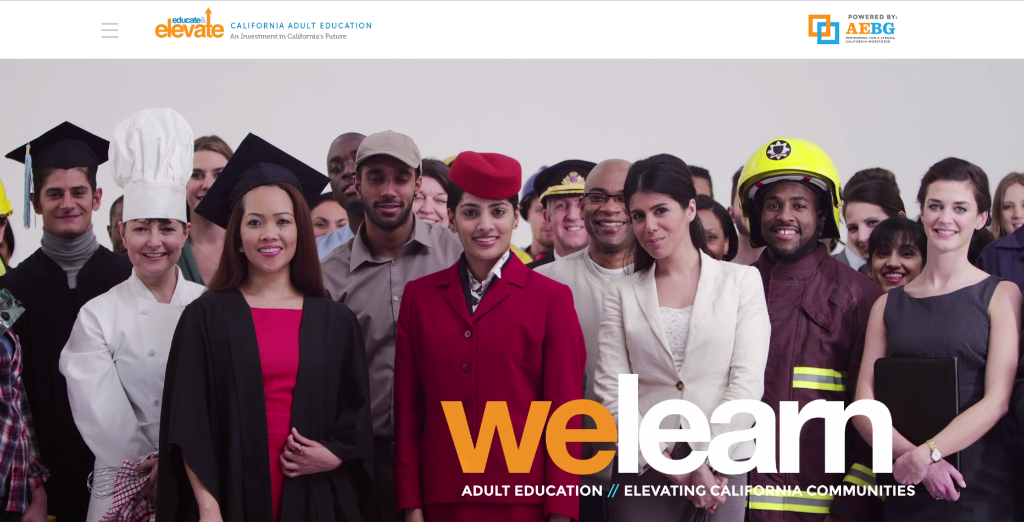
California’s Campaign Website
EducateandElevateCA.org

Slide 5

Collective Storytelling Components
Adult Education Innovations
Quantitative Data & Results
Qualitative Success Stories

Slide 6
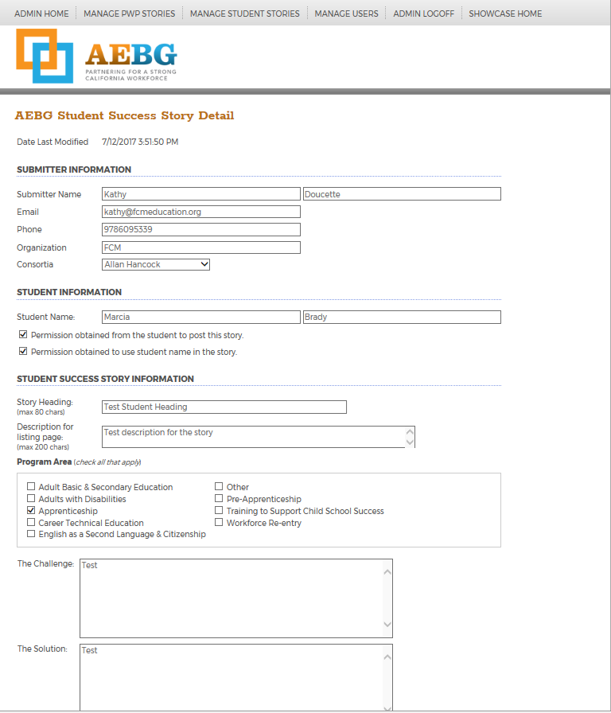
Practices with Promise: Enhancements
NEW: Student Success Stories
NEW: Employer Engagement Stories
Promising Practices
http://aebgpracticeswithpromise.com/index.asp

Slide 7

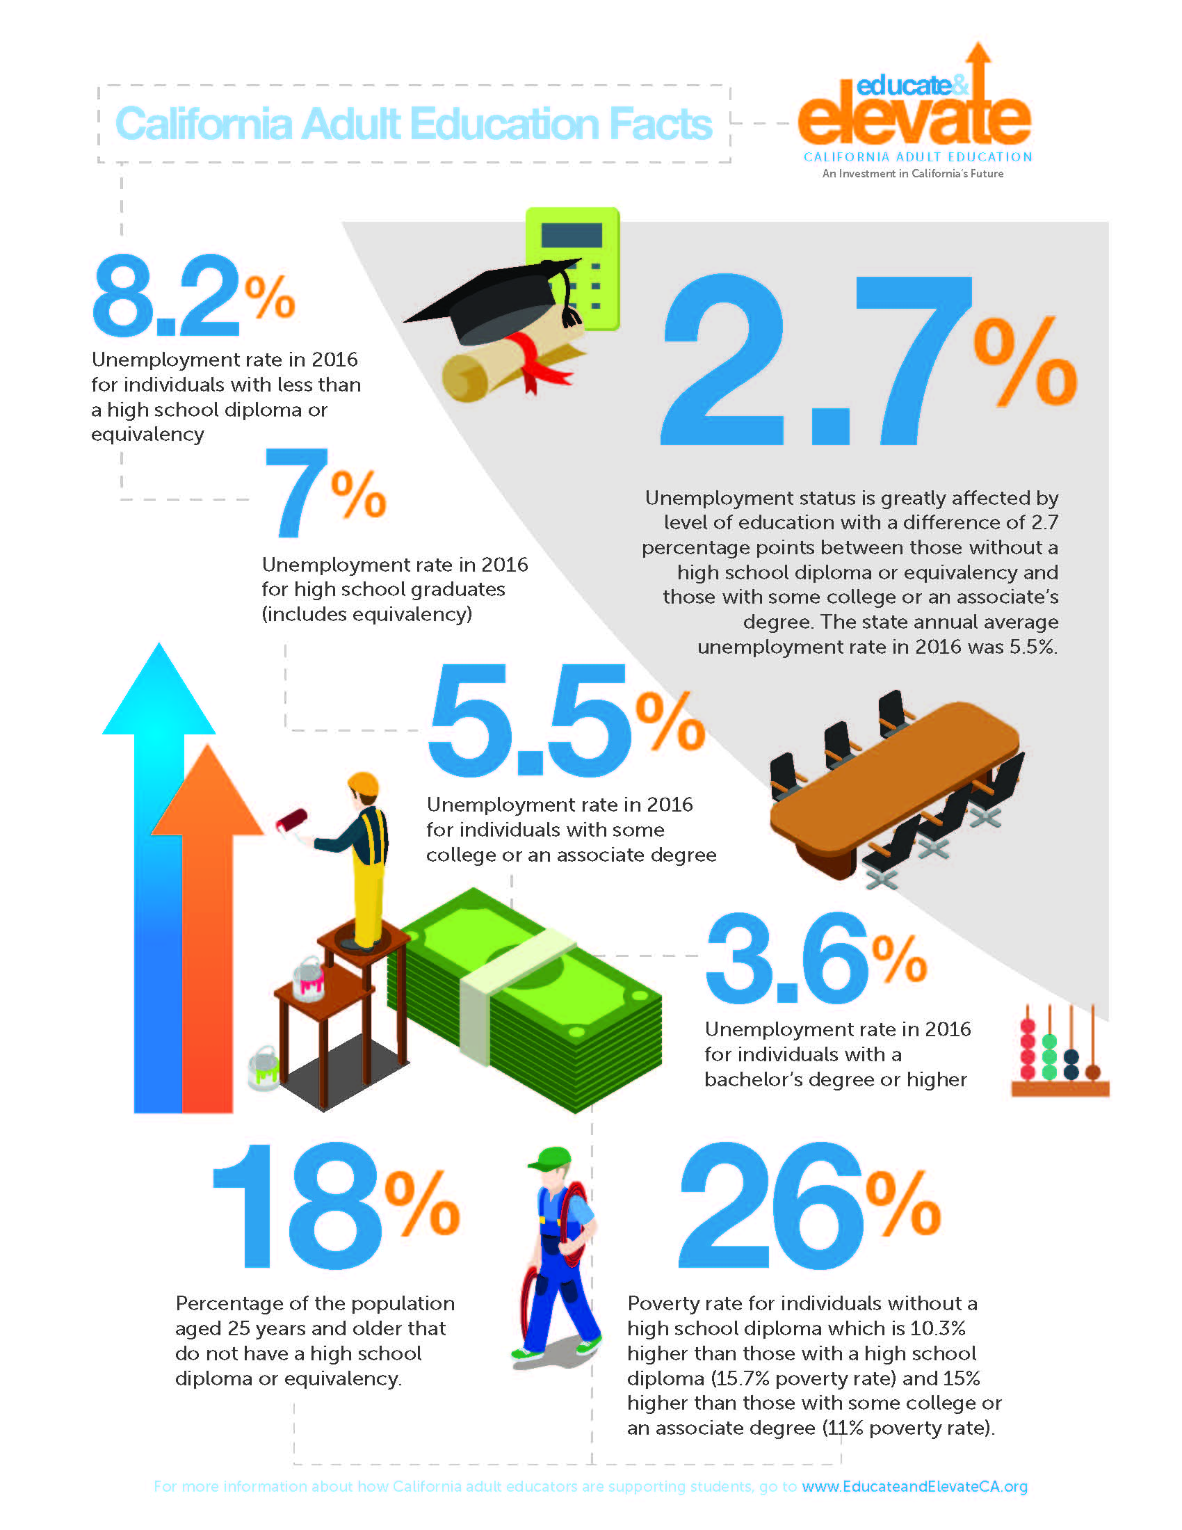
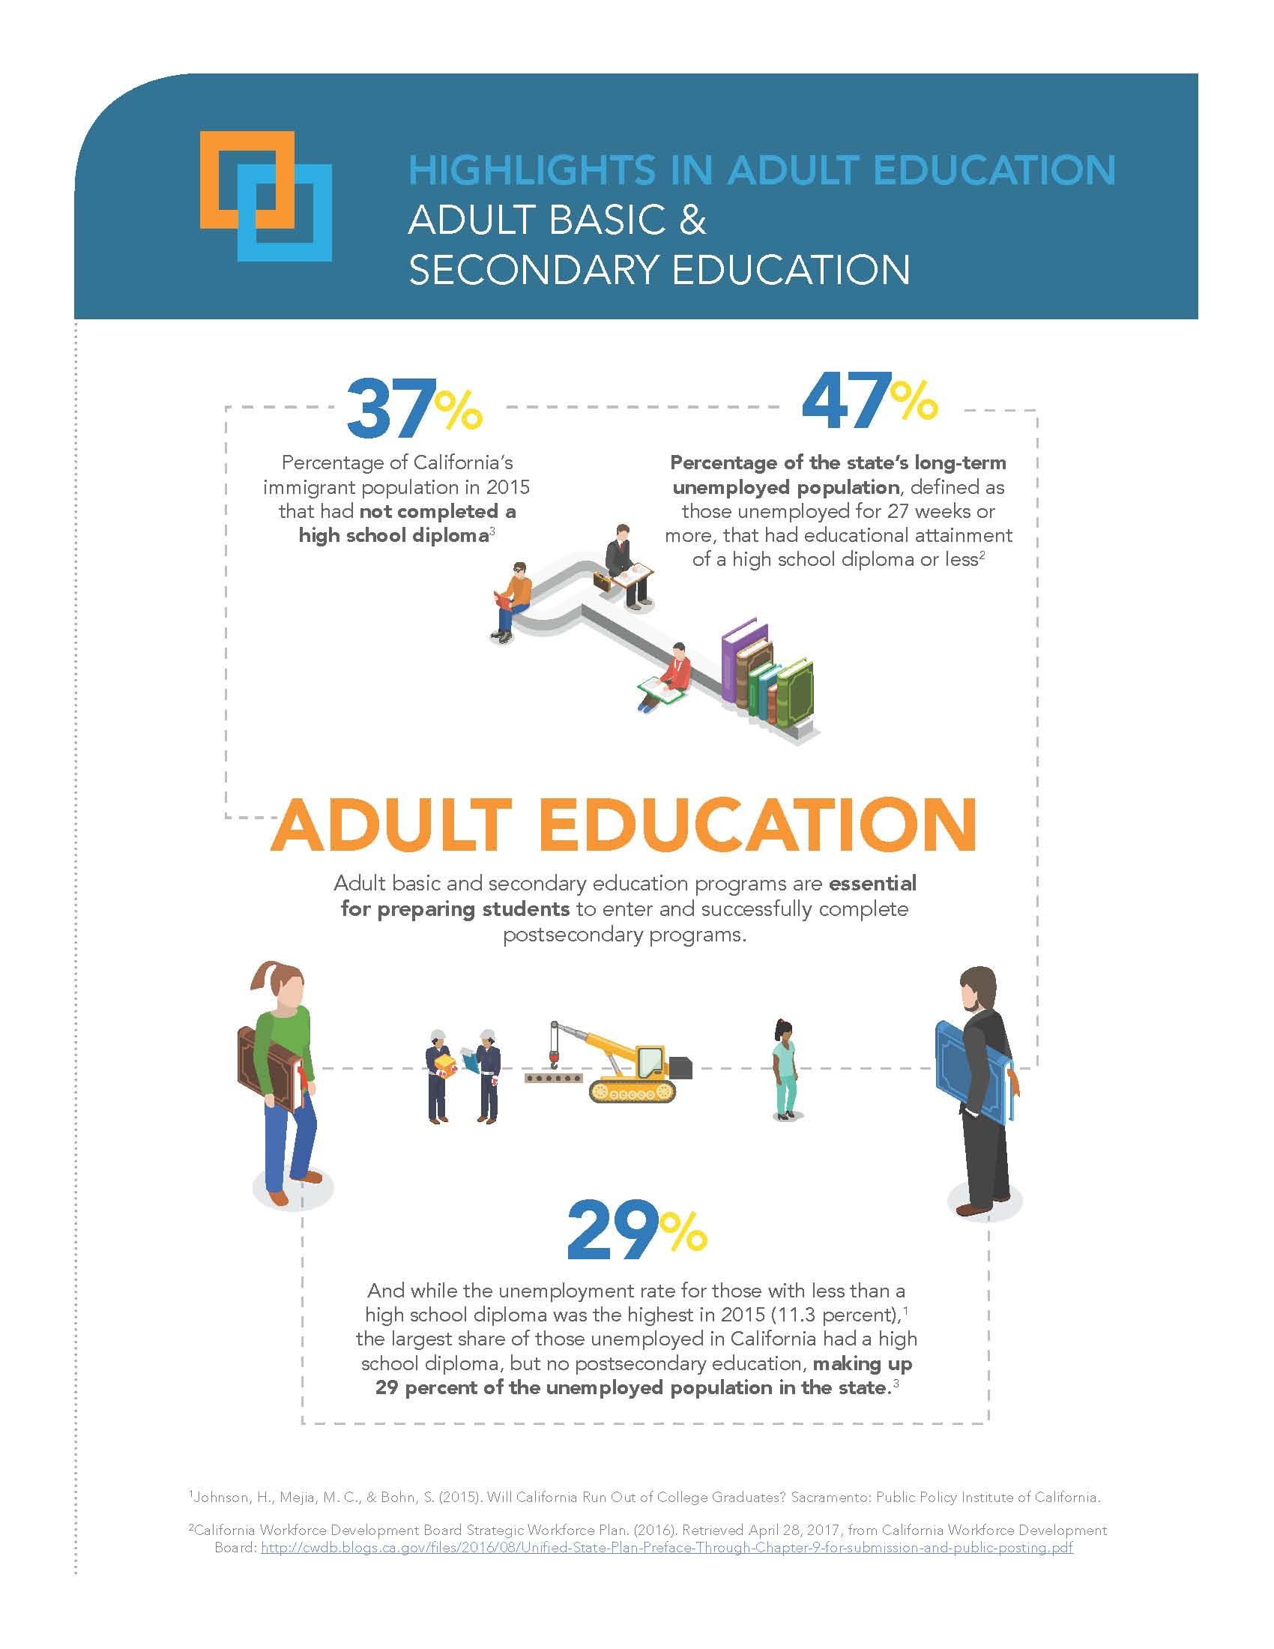
Infographics & Fact Sheets

Slide 8
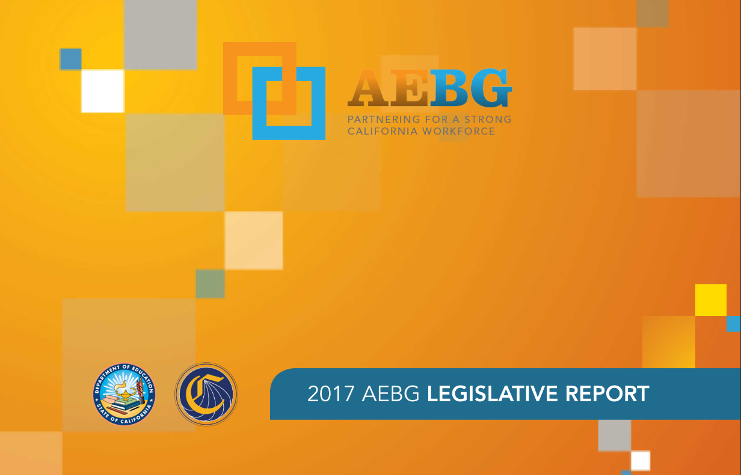
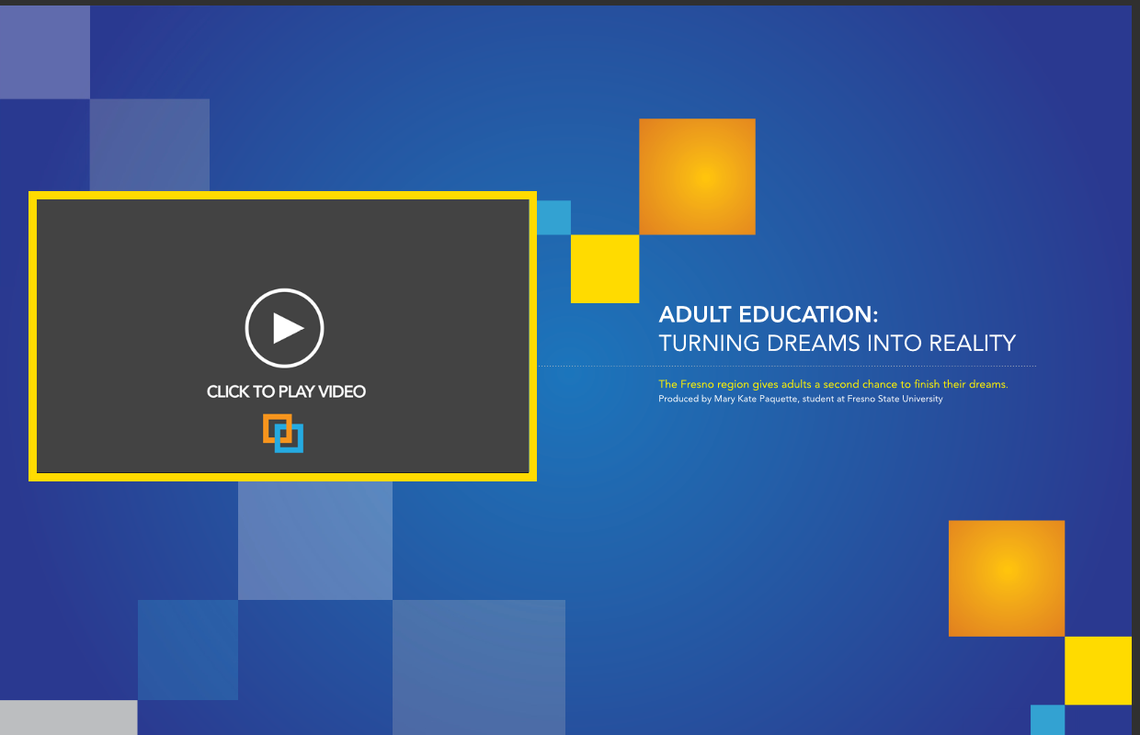
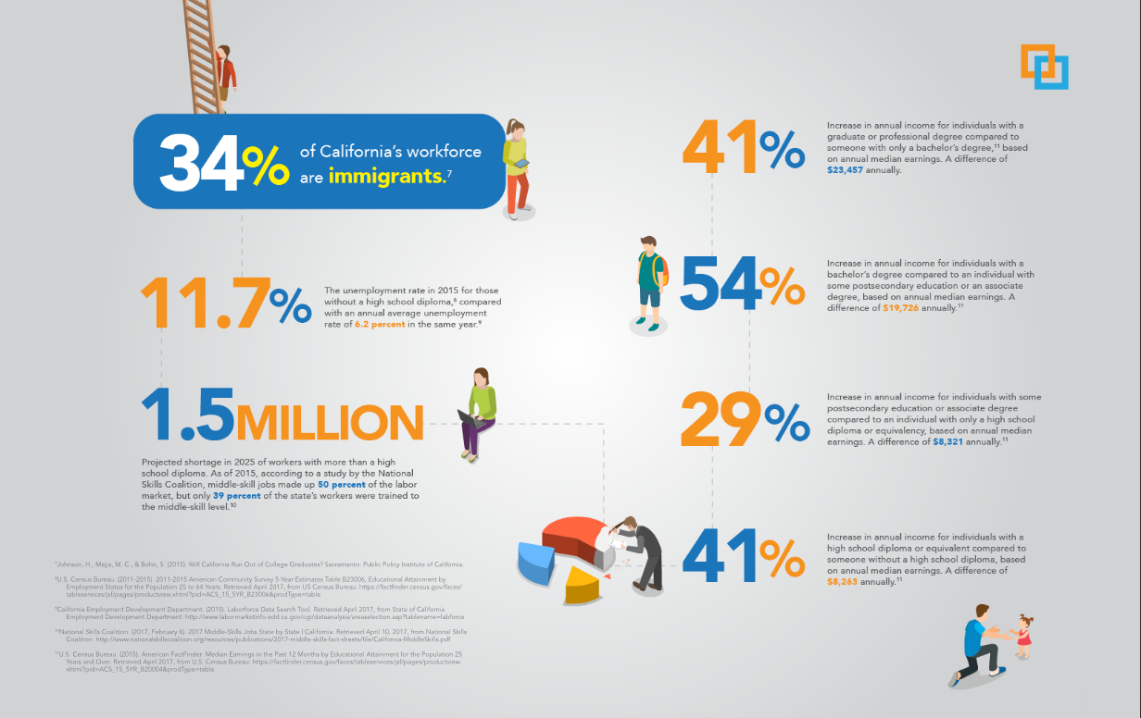
eMagazine: 2017 Progress Report

Slide 9
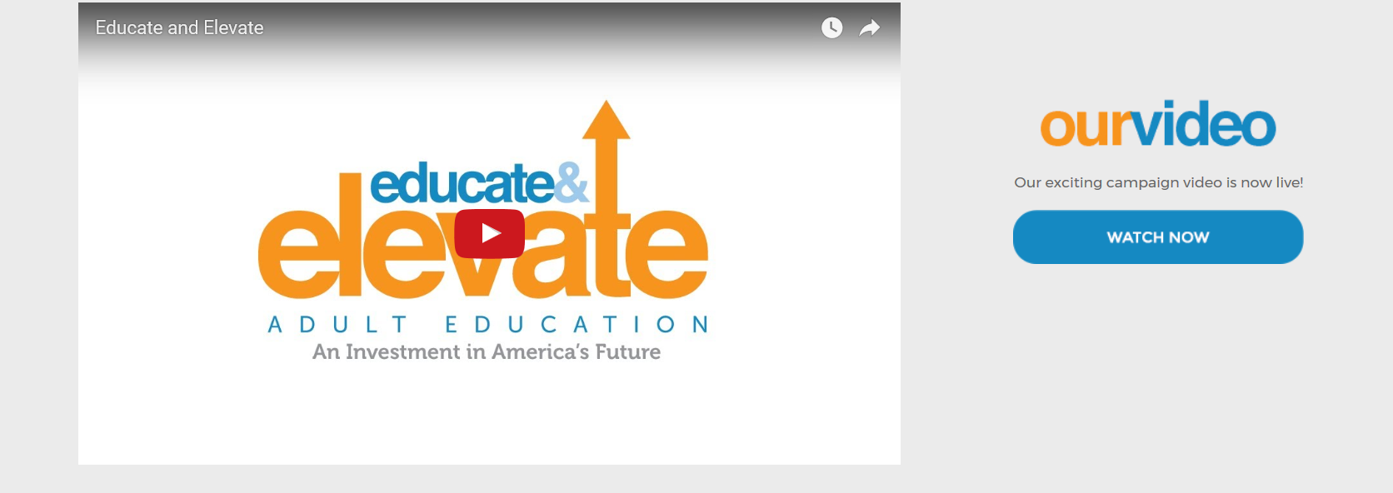
Video: AEBG Dual Delivery System
Notes:
https://www.dropbox.com/s/xuosos9k7eonbmt/EducateElevateCA.mov?dl=0

Slide 10

Insert Logo & Byline on your Website
(Insert Your Organization’s Name) is a proud partner of the Educate & Elevate California Campaign. For more information on our successes and how adult education benefits communities all across California, go to www.EducateandElevateCA.org
Download logo at:
https://fullcapacitymarketing.sharefile.com/d-sc94a28ec2344b219

Slide 11

Strategies for a Successful Briefing
Before the Visit
Plan the Briefing
    Contact other key officials
    (DOF, LAO)
At the Briefing
Overview of Students & Challenges
How Students are Served
Results of Services
How Elected Official Can Help
Emphasize the unified efforts of K12
and community colleges
After the Briefing

Slide 12

Hosting Special Events
Event Approaches
Potential Event Elements
Engaging Elected Officials
Promotion: Using Cause Marketing
Notes:
An onsite event at your school is an opportunity to showcase your adult education programs to the community, key stakeholders & elected officials.

Slide 13

Potential Event Elements
Think “Visual”
      Elected Official Presents Proclamation to the Host
      Students Share Success Stories
      Employer Endorsements & Highlight Partnerships
      “Visual” Class Demo (e.g. CTE)
      Mini Classes
      Tour of School
      Information Stations
      Student Success Data

Slide 14
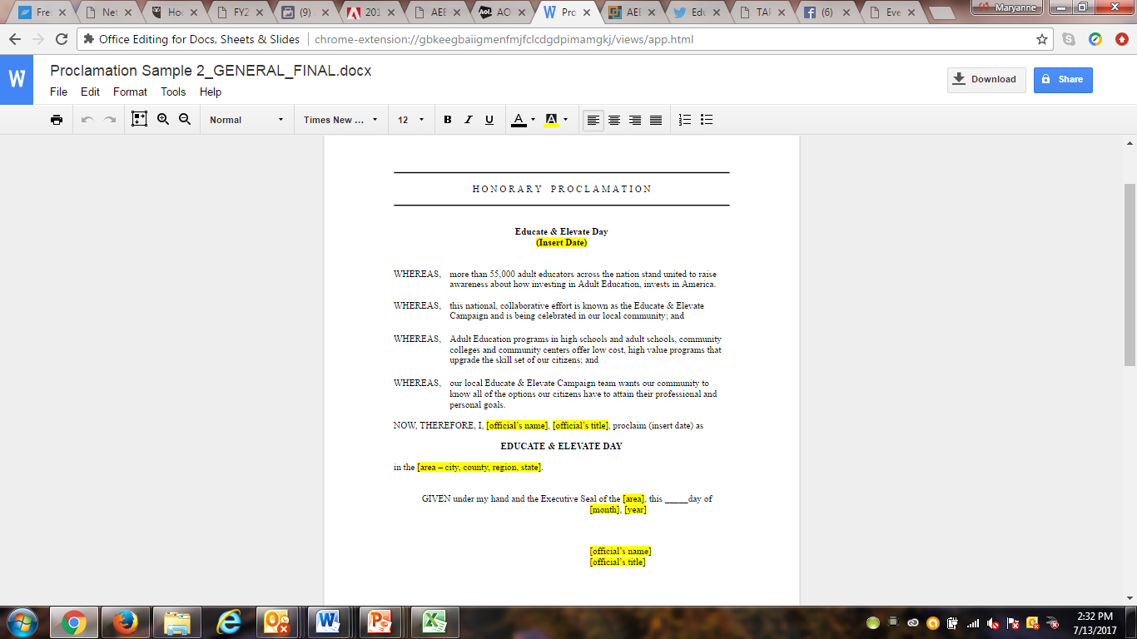
Local Proclamation Presentation
  Toolkit has verbiage to adapt for local proclamation for Educate & Elevate CA Day
  Acknowledge elected official presenting the proclamation
  Invite students to share in ceremony with legislator to enhance photo opportunities

Slide 15
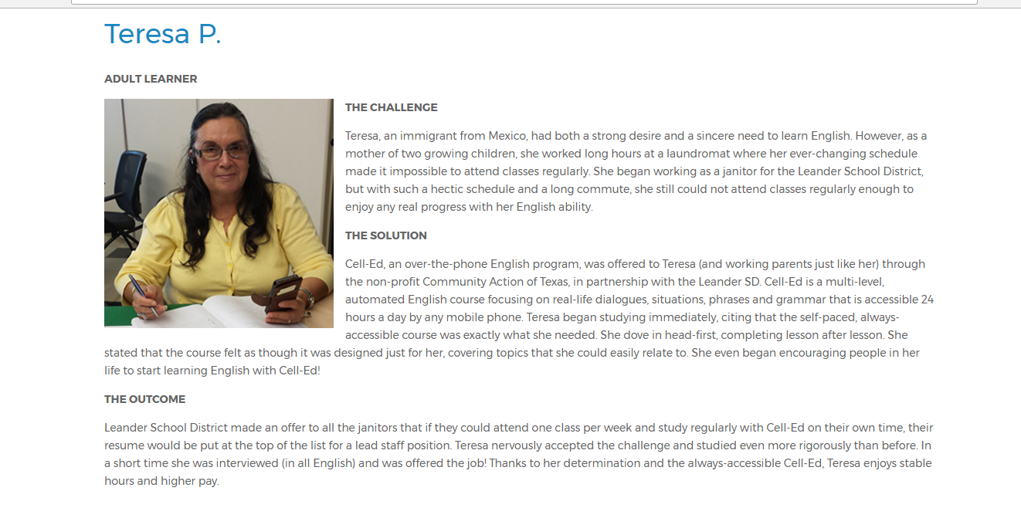
Student Speakers
Showcase Your Students
What was their challenge?
How did adult education change their situation?
Why would they recommend your school to others?
Create photo opportunities & meeting with legislators at the event
Students SHOW adult education success stories better than we can ever TELL them

Slide 16
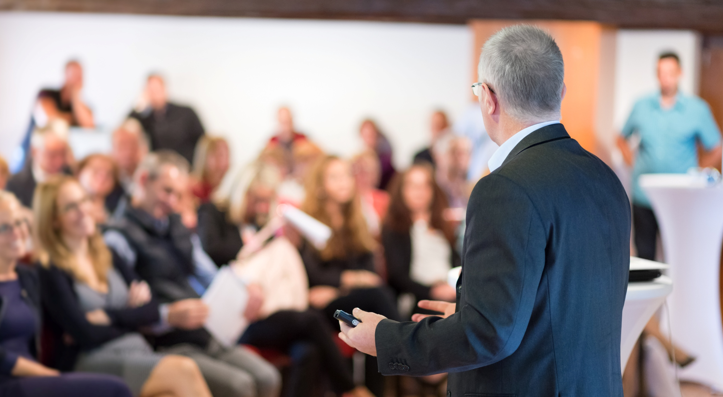
Employer Speakers
Showcase Your Partners
Are there employers who have supported your adult school by partnering in work-based learning opportunities or hiring students?
Employers build credibility in your event line up by sharing their perspective about the importance of adult education.

Slide 17

Visual Demonstrations
Are there classes that can be demonstrated such as students learning a new skill set in CTE?
Can you host “mini classes” on various topics to give adult learners an actual experience of what you do in classes?
Is there something interesting that would provide a visual opportunity to showcase classes via a tour of the school or a particular class?
Could you set up Information Stations with passionate instructors that share information about their classes?

Slide 18

Promotion via Cause Marketing Strategies

Slide 19

Cause Marketing
When a for-profit and non profit/public sector organization partner for mutual benefit.

Slide 20

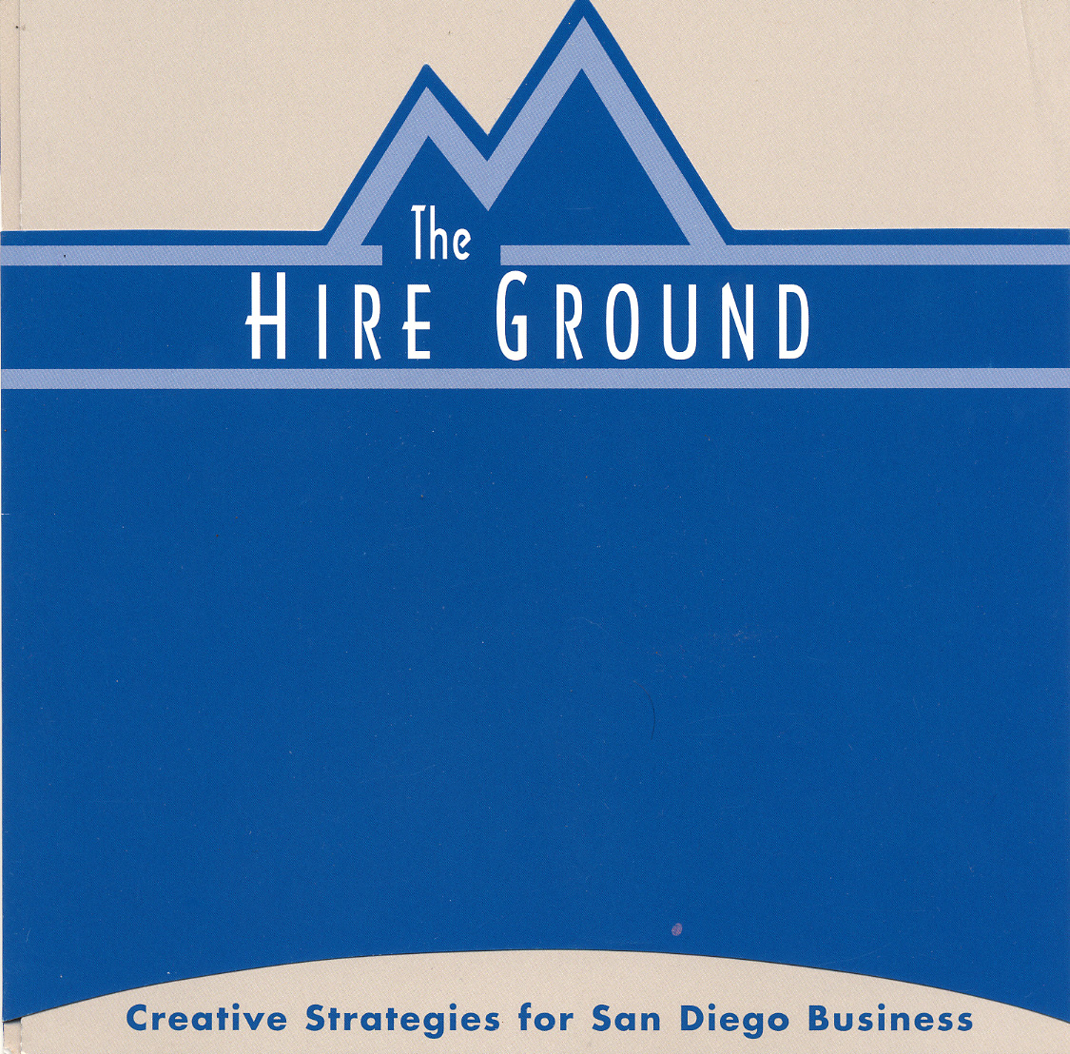
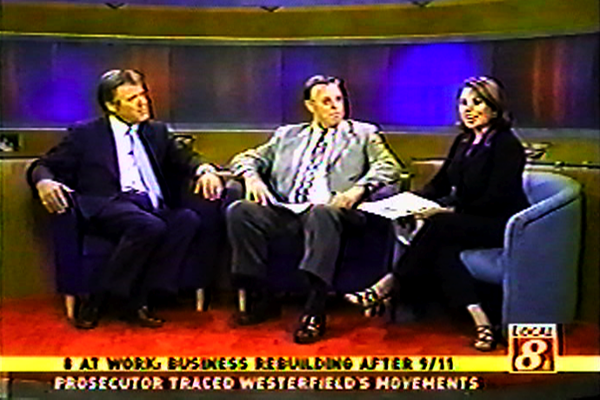
Case Study:
News Media Cause Marketing Partnership
http://fullcapacitymarketing.com/portfolio/kfmb-news-media-partnership-8-at-work-campaign/

Slide 21
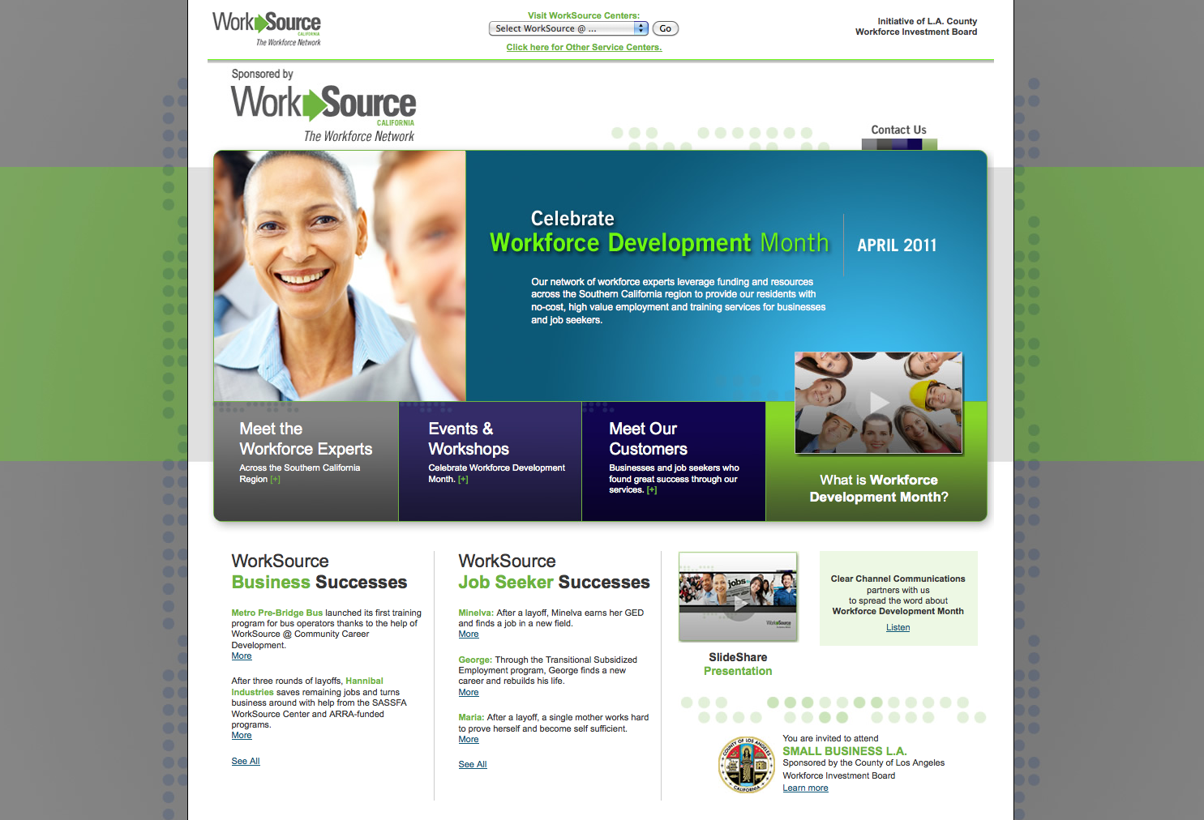
Case Study:
News Media Cause Marketing Partnership
http://fullcapacitymarketing.com/portfolio/southern-californias-workforce-development-campaign/

Slide 22
Clear Channel Partnership
Flight Mentions, Streaming and On Air Spots
Additional PSAs
Web postings and dedicated section of site
Calendar Events inclusion
Newsletter eblast to 60,000+ registered users
Inclusion on the “HOT” Helping Others Together Community Page
Guerilla street marketing –Flyer distribution
Promotional Value: $43,100
Cost: $5,000

Slide 23

Cause Marketing Summary
Build a Business Case for Support: Campaign Fact Sheets/Infographics
Identify Potential Sponsorship Partners
Identify Potential Media Outlets for Partnerships
  Connect with Media Outlet’s Sales & Marketing Divisions
  Inventory Media Outlet’s Current Causes
Identify Potential Strategies for the Media as a Partner
Develop a Win-Win: They Get Exposure/Recognition; You Get Additional Promotional Opportunities

Slide 24

News Media: Building Relationships
The news media is an important target audience & your organization needs to proactively build relationships with them to garner support.

Slide 25

Local Media Landscape
Local Media Outlets:
Create your Database
Newspaper Search – USNLP: http://www.usnpl.com/
Radio – Radio Locator: https://radio-locator.com/cgi- bin/page?page=states
TV – TV Listings: http://www.tvguide.com/listings/
Online News Websites – Patch: https://patch.com/
Option: Buy Media Services (e.g. PR Newswire)

Slide 26
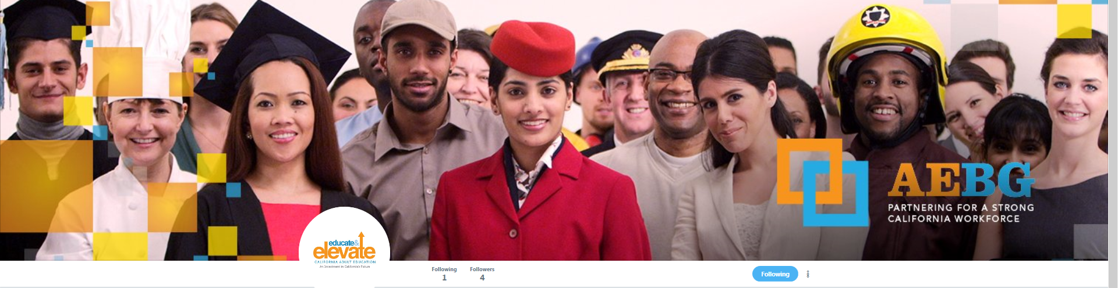

Social Media
@AEBGElevate

Slide 27

Building Your Following with Press
Create or Use an existing list of Media Contacts.
Follow BOTH outlet accounts and reporter accounts
Don’t forget Bloggers and Local Community Papers
Search Your City/County/State on Twitter and Facebook

Slide 28

Leveraging the Campaign Toolkit
Build YOUR Brand!
Crosswalk Crosswalk Action Planner
Logo & Byline for Website
Adult Education Infographics
AEBG Video
Adult Education Program Sheets
AEBG Fact Sheet
Educational Webinars
Download at: https://fullcapacitymarketing.sharefile.com/d-s5e4b307e709436d8

Slide 29
Thank you!
Steve Curiel, MBA – President
California Council for Adult Education (CCAE)
scuriel@HBAS.edu
Madelyn Arballo, Ed.D - President Elect
Association of Community & Continuing Education (ACCE)
marballo@mtsac.edu
Celina Shands, M.S. – CEO/Founder
Full Capacity Marketing, Inc.
AEBG Communications TAP
270 N. El Camino Real #285
Encinitas, CA 92024
T: (760) 274-6370
F: (760) 274-6235
Celina@FullCapacityMarketing.com
www.fullcapacitymarketing.com

