Slide 1
AEBG
Data Submission Guidelines for Quarter 1, July 1 – September 30 2017
Due October 31, 2017

Slide 2
Due Dates
Each quarter’s data is submitted from July 1 to the end of that quarter
Oct 31
  First Quarter Data, TOPSpro® Enterprise Due
  First Quarter AEBG Data Integrity Report (e-mail, fax, or mail hard copy to CASAS)

Slide 3
Preparing your TOPSpro (TE) Data
Each Agency needs to enter every student enrolled in an AEBG funded program. Each student needs:
  An Entry Record
  A Pre-Test (ESL, ABE and ASE)
  A Post-test (if enough class hours) (ESL, ABE and ASE)
  An Update Record (if student has left the program)
  Attendance hours

Slide 4
Attendance Hours
Include all attendance hours from July 1 to the end of the quarter
If using a 3rd party attendance system,
  export your files from your attendance system as csv files
  save the files onto your desktop
  in TE, use the Import Wizard under Tools to move your data.
TOPSPro Enterprise
ASAP
Schoolhouse
AIM
Banner

Slide 5
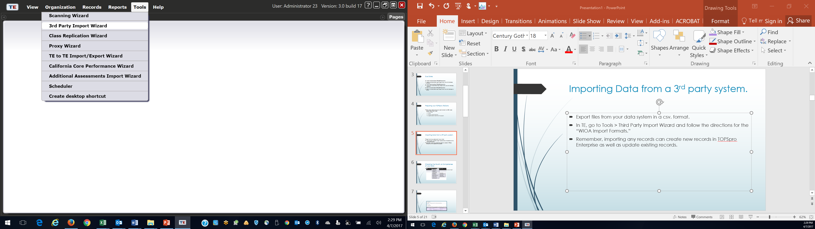
Importing Data from a 3rd party system.
Export files from your data system in a csv. format.
In TE, go to Tools > Third Party Import Wizard and follow the directions for the “WIOA Import Formats.”
Remember, importing any records can create new records in TOPSpro Enterprise as well as update existing records.

Slide 6
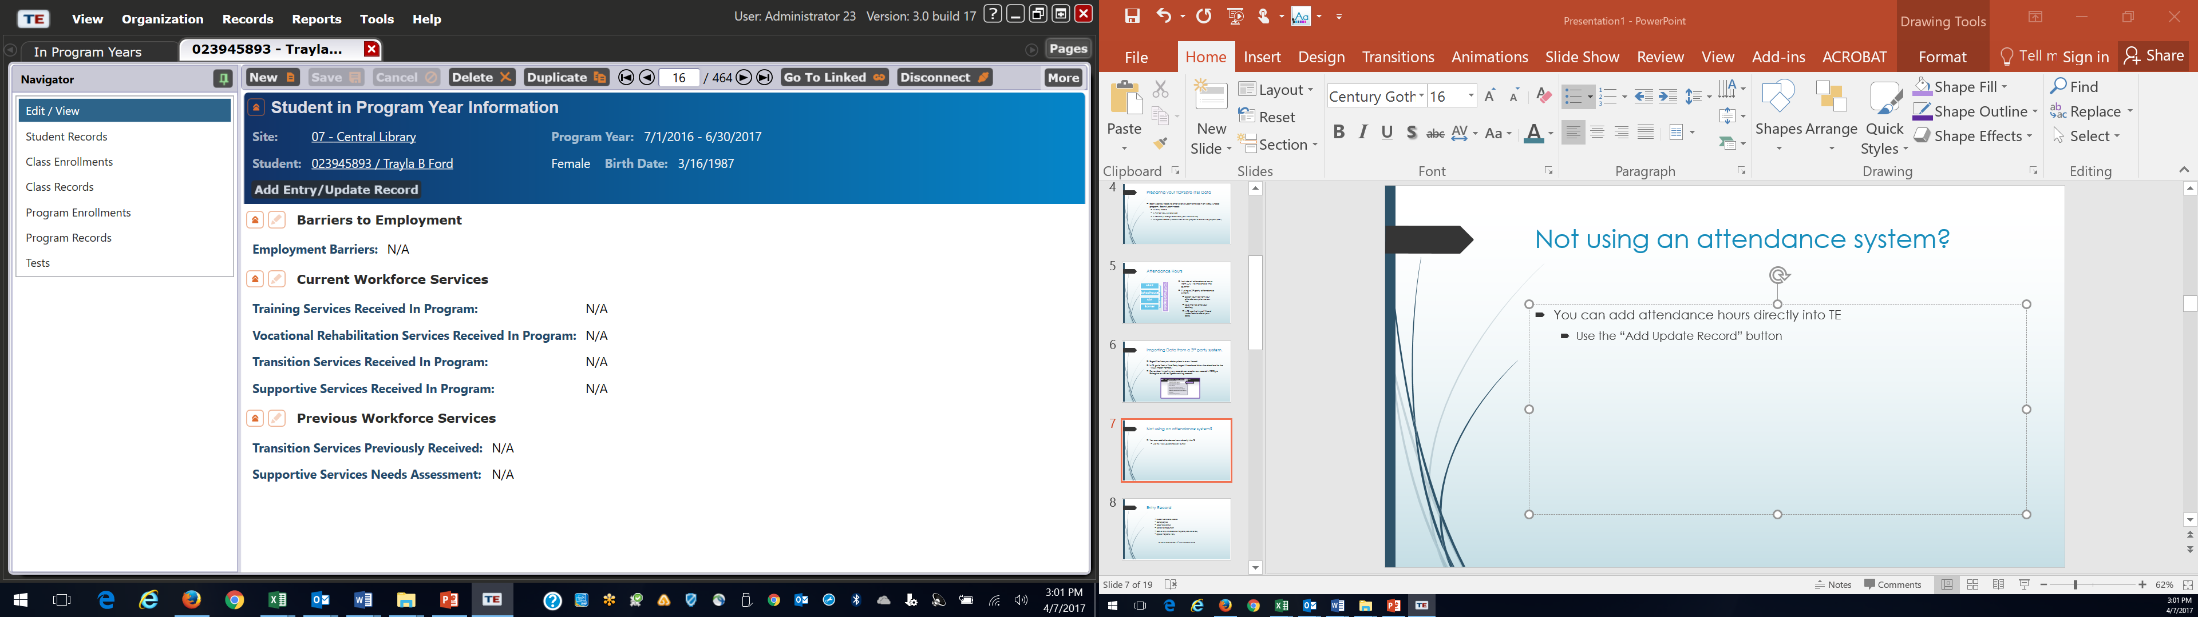
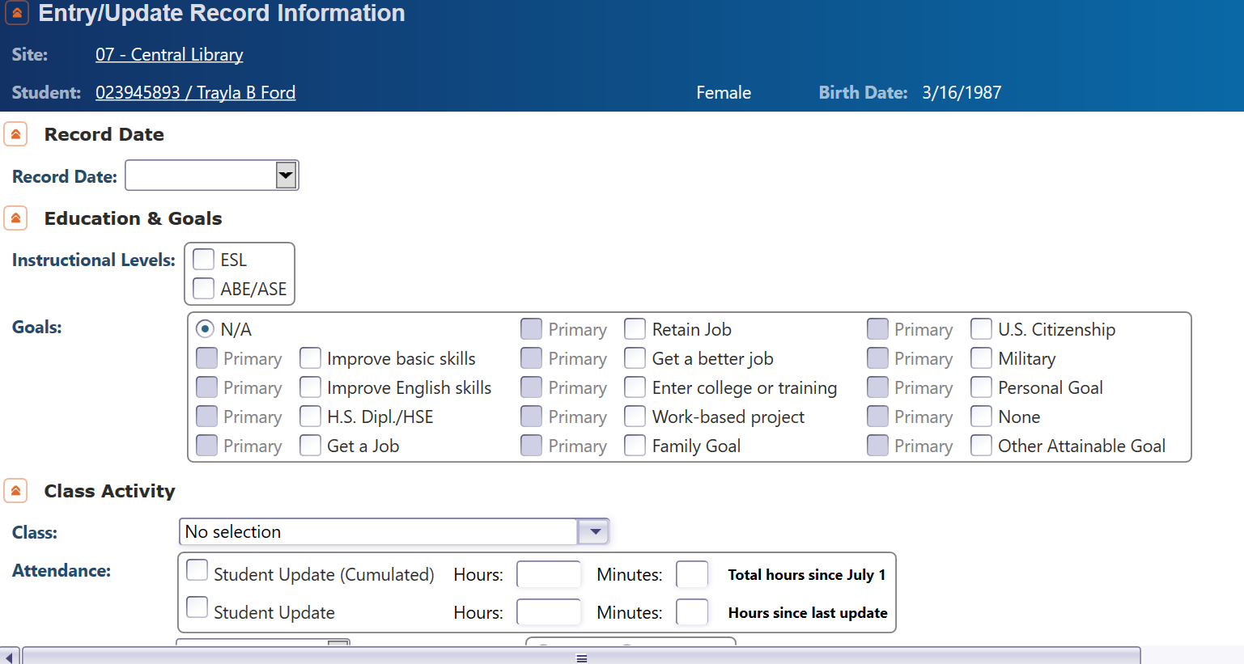
Not using an attendance system?
You can add attendance hours directly into TE
  Use the “Add Update Record” button

Slide 7
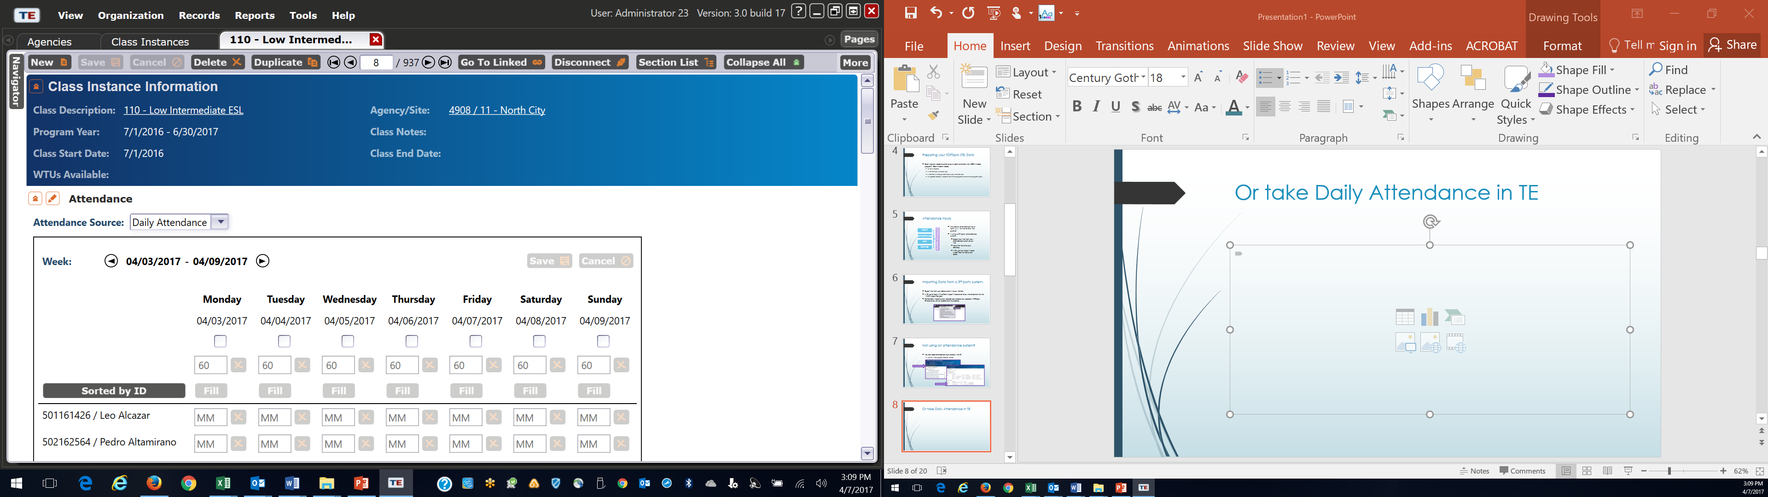
Or take Daily Attendance in TE

Slide 8
Entry Record
    Student Name and Address
    Demographics
    Labor Force Status
    Barriers to Employment
    Date of Entry into Class and Programs (ABE, ASE or ESL)
    Special Programs, if any
      Can be imported from a 3rd Party attendance system

Slide 9
Pre- and Post tests
Assessments approved by the NRS for AEBG
  CASAS
  TABE
  GAIN

Slide 10
Update Record
Date of Update (there can be more than one in a year)
Class
Instructional Program
Services received (whether enrolled in classes or not)
Learner Results

Slide 11
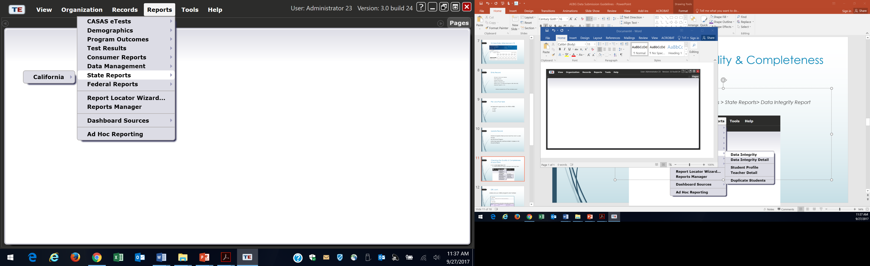
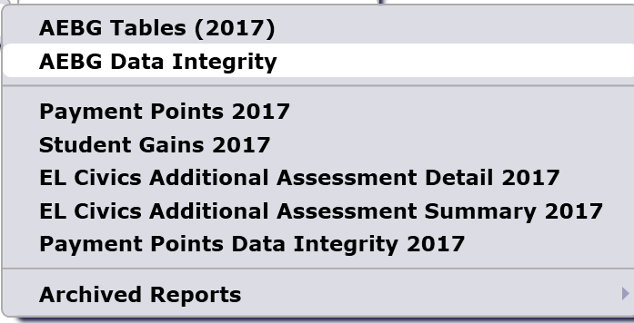
Checking the Quality & Completeness of your Data
Run the Data Integrity Report (DIR)
  In TOPSPro Enterprise, go to Reports > State Reports> California> AEBG Data Integrity

Slide 12
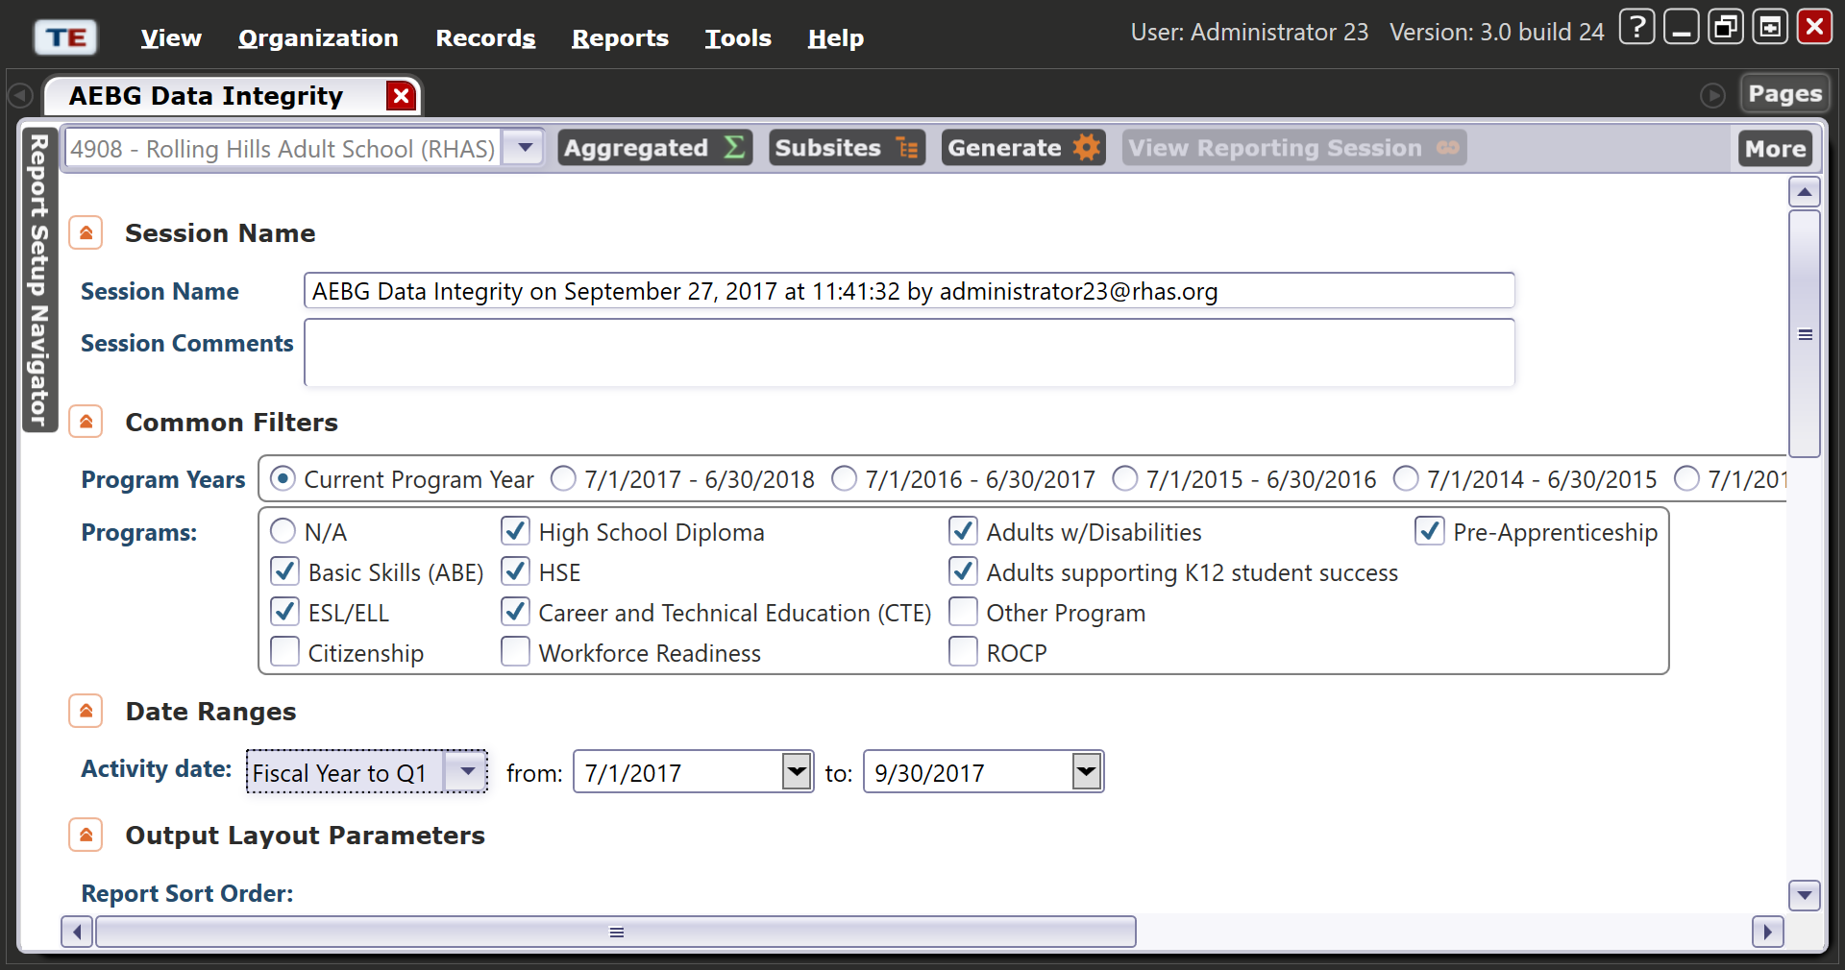
DIR, cont.
  In the report set-up window, make sure your AEBG programs are marked:

Slide 13

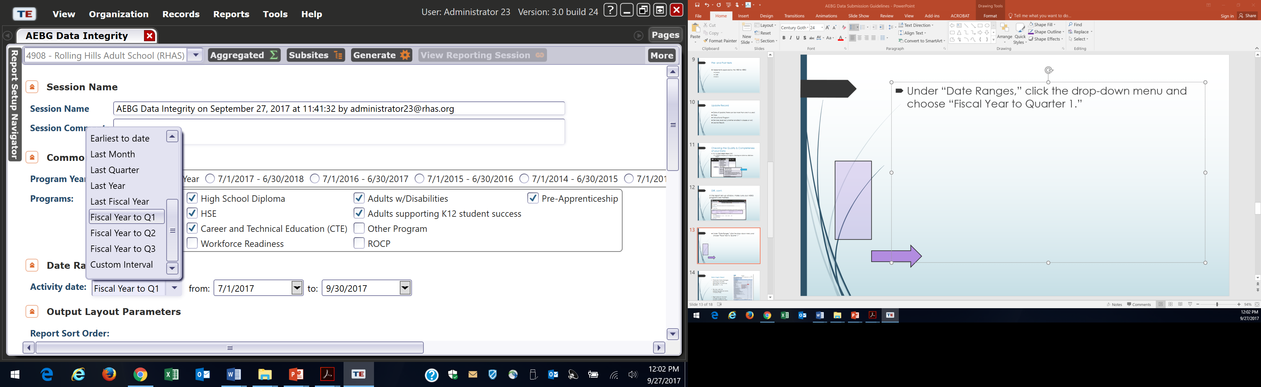
Under “Date Ranges,” click the drop-down menu and choose “Fiscal Year to Quarter 1.”

Slide 14
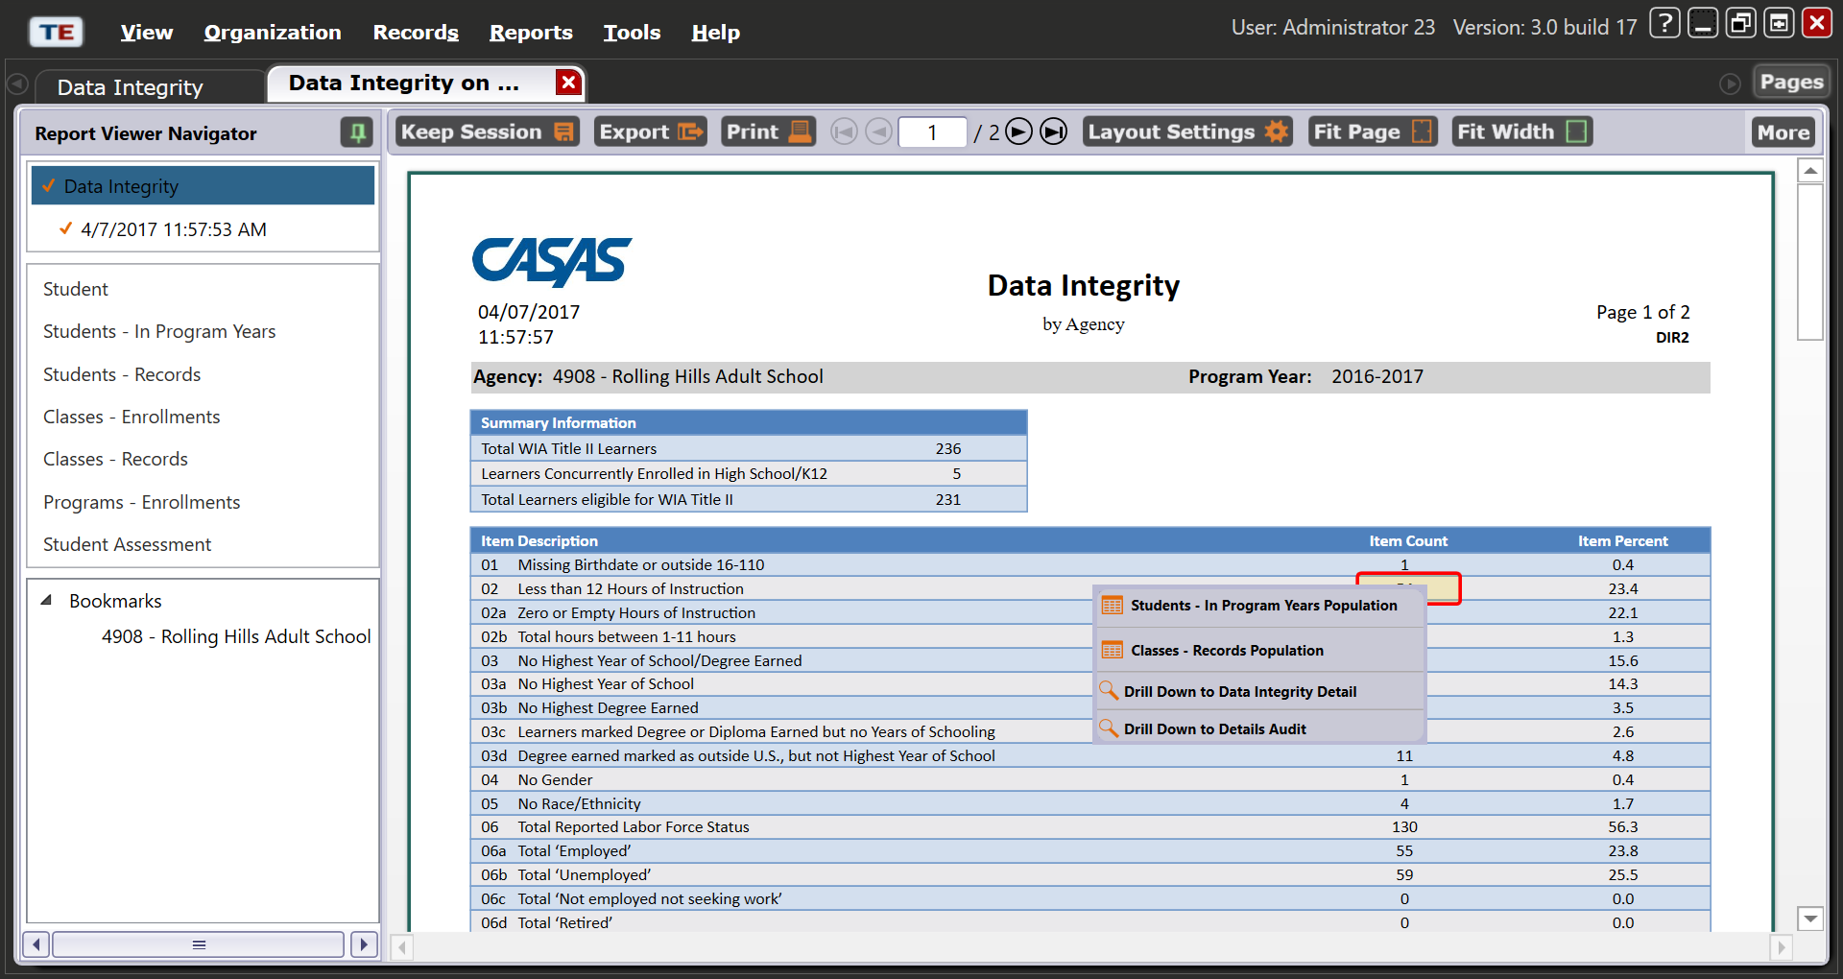
Data Integrity Report
Items 1 – 9 are required elements, that if missing, could affect your outcomes.
Items 10-25b reflect totals in your database, including items that may be missing key information.
Right-click on the item number to get to the student records to add or edit information.

Slide 15
What’s next?
Your agency’s data is in TOPSPro
You’ve added any missing data or corrected items in your data based on your DIR report.
Now, generate a new DIR.
  Export it as a pdf.
  Attach it to an email and send to aebg@casas.org and your designated consortium data manager.
  That’s it!

Slide 16

How does your data get to your Consortium? How does it get to the state?
The cloud
All your data is housed on CASAS servers. Your designated consortium data manager can access your data at any time, as can CASAS. Once you send your DIR to us, that tells us that your data is ready to be reviewed. The various consortia will send their reports to us, and we’ll combine it into the state report and submit it to CDE and the Chancellor’s office.
CASAS
Consortium
Agency
Agency
Agency
CDE/Chancellor’s Office

Slide 17
For more information
For technical assistance:
call CASAS at 1-800-255-1036
email at techsupport@casas.org
Thank you for attending!

