Slide 1
The Future Vision of the California Adult Education System in 2020
Javier Romero
Dean
Workforce and Economic Development
California Community College Chancellor’s Office
Carolyn Zachry, Ed.D.,
Education Administrator/State Director
Adult Education Office
California Department of Education
Notes:
Carolyn

Slide 2
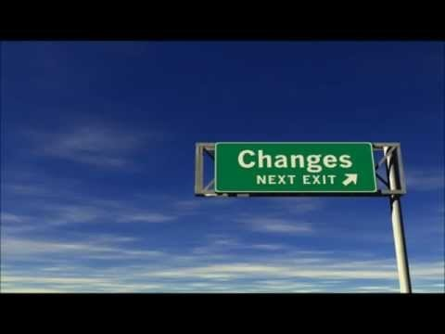
Transformational Leadership:
Building Capacity at All Levels
https://youtu.be/sBkqiqfEnzE
Notes:
Carolyn

Slide 3
Transformational Leaders
Visionaries
Knowledgeable
Goal Oriented
Motivational
Respectful
Authentic
Expert
Inspirational
Catalyst for Change
Share Leadership
Flexible
Charismatic
Encourage Growth
Notes:
Carolyn

Slide 4
Visionaries
We need a clear vision of what the adult education system will look like in 2020.
Notes:
Javier

Slide 5
Knowledge
Share knowledge across the adult education system
Notes:
Javier

Slide 6
Motivation
Based on tangible objectives
Optimism about achieving the objectives
Bernard M. Bass, Leadership and Performance
Notes:
Javier

Slide 7
Encourage Growth
How do we grow our adult education system to meet the needs of our customers?
How do we help our teachers to grow professionally?
How do we as leaders grow?
Notes:
Carolyn

Slide 8
Catalyst for Change
In change we need to balance between short and long term objectives.
What are your consortia's short and long term objectives?
www.cleverism.com/transformational-leadership-guide
Notes:
Javier

Slide 9
Shared Leadership
How is leadership distributed in your consortia?
Notes:
Carolyn

Slide 10
Flexible
How adaptable is your consortia to:
          Labor market changes
      Economic changes
      Demographic changes
      Political changes
      Leadership changes
Notes:
Carolyn

Slide 11
Celebrate success and failures
How does (or will) your consortia use data to celebrate or to reflect?
What data do we need to collect in the future?
  How will that data be used to drive programs?
Notes:
Javier

Slide 12
Success for the California Adult Education system will require leadership and collaboration in unprecedented ways.
We need to build on the our capacity at all levels.
Prosperity Through Partnership, CLASP Presentation, October 12, 2017
Notes:
Javier

Slide 13
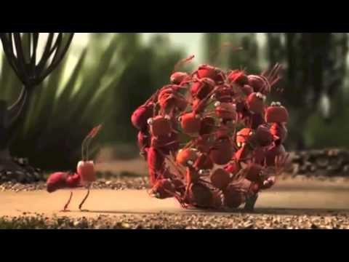
https://youtu.be/HxEntJiIEd0
Notes:
Carolyn

