Slide 1

California Adult Education Data and Accountability System
Randal K Tillery, WestEd
rtiller@wested.org

Slide 2
Background – DAC Process
Leg Report and Metrics
Reporting and Data Systems
Alignment of Assessment

Slide 3
Background

Slide 4
Legislative Requirements (AB104; 2015)
Identify common measures for determining effectiveness of members of consortia in meeting educational needs of adults
Align data used for reporting with data reported by local agencies for other purposes such as WIOA (Perkins, Strong Workforce)
Establish common assessments and policies regarding placement of adults into adult education program, measuring needs of adults, and effectiveness of providers
Report twice yearly to the legislature: Preliminary Report October 30th; Final Report March 1st after the end of the previous program year (July 1 to June 30th)

Slide 5
AB104: Data for Measuring the Effectiveness of Consortia:
How many adults are served by the consortium.
How many adults served by the consortium have demonstrated the following:
Improved literacy skills.
Completion of high school diplomas or their recognized equivalents.
Completion of post-secondary certificates, degrees, or training programs.
Placement into jobs.
Improved Wages
Transition into post-secondary education

Slide 6
Adult Education Data and Accountability System Planning Process
AEBG Field Team Process
3 Teams: Data & Accountability, CTE, Basic Skills
35 Field Participants
K12, community college, WIOA system, labor, CDE, CCCCO
40 hours in 8 meetings over 8 weeks
White papers, notes, agendas published on AEBG site

Slide 7
References and Resources
AB86/AB104
Legislation
2012 LAO
Report
Workforce
Innovation &
Opportunity Act
Office of Career,
Technical, &
Adult Education
National
Reporting
System
Title IV Federal
Student Aid
Council on
Occupational
Education
Center for Law
& Social Policy

Slide 8
Metrics and Guidance

Slide 9
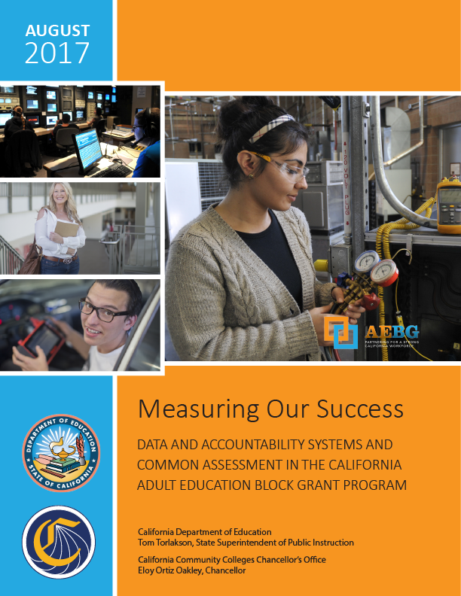
Definitions and Guidance:
AE Program Definitions
Adult Basic and Secondary Education
ESL and EL Civics Education
Adults Entering or Re-Entering the Workforce
Adults Helping Children Succeed in School
Adults with Disabilities
Short Term CTE Leading to Employment
Preapprenticeship
Data Element Definitions
AEBG Reportable Programs
AE Reportable Individual & Participant
Measurable Skills Gain and EFL Attainment for ABE, ASE, ESL
Program Transition
Progress to Diploma
Postsecondary Credential Completion
Occupational Skills Gain
Workforce Prep Milestone
Postsecondary Transition
Employment & Wages

Slide 10
Overarching Framework:
Metrics needed to be concrete and clear
Focus on all AE students regardless of funding source
Incorporate, expand on, or default to WIOA definitions
Aligned to Strong Workforce, Perkins, other definitions
Revised policies should inform guidance that can be refined and grow as needed by the field

Slide 11
Adult Education Reportable Programs:
Population: All adult education students enrolled in ABE, ASE, ESL, or CTE programs enrolled at a:
K12 adult education school
Community college non-credit program
Third party provider supported by a consortium for the purposes of providing training or supportive services
This includes all students regardless of funding source including AEBG, CDCP, Perkins, WIOA, fee based, etc

Slide 12
Adult Education Students:
Number of Adults Served by the Consortium: Reportable Individuals which includes all K12 adult education or community college noncredit students who 1 or more hours of instructional contact hours in any of the 7 program areas and or received support services
Adults Achieving Progress or Outcomes: Participant who has received 12 or more contact hours of instruction
Definitions follow WIOA definitions for reportable individuals and participants

Slide 13
Postsecondary Credential Completion:
        For K12 AE and community college CTE programs - Completion of a credential that leads to employment in a clearly-defined occupation including, but not necessarily limited to:
          Locally approved certificates eligible for inclusion on the Eligible Training Provider List (ETPL)
          CDCP CTE certificates with more than 48 instructional contact hours
          Certificates that meet the minimum threshold for inclusion under Perkins
          Certificates that meet the threshold for Title IV federal student aid
          Workforce preparation (work readiness) or occupational safety certificates (e.g. OSHA or Safeserve) ARE NOT counted for completion under this metric
          Completion of any degree or for credit certificate over 6 units

Slide 14
Data Tools and Visualization

Slide 15
Reporting Requirements:
        2017/2018: Quarterly Reporting into TOPSPro Enterprise for community college noncredit and K12 adult education institutions offering programs in the 7 AEBG program areas
        2018/2019: College data will be pulled directly from MIS for data matching and display in the Launchboard
        Reporting and assessment guidelines stay the same for WIOA Title II funded programs (TopsPro, CASAS pre and post testing)
        New MIS elements aligning MIS to the AEBG reporting metrics and guidance (elements and coding) will be released in October

Slide 16
Data System (2018/19)
Quarterly Data Collection
TOPSPro
Enterprise
CO MIS System
Data Matching
K12 AE
Students
College MIS Data
EDD Wage
File
HS Equiv
Test Data
DAS
Data Visualization
LaunchBoard Adult Educ Data Tab

Slide 17
Annual Data Process

Slide 18
LaunchBoard Adult Education Data Scope/Timeline
Comprehensive consortium & member data
Disaggregated program, demographics, barriers and other criteria
Current build includes 57 student, course taking & outcome metrics
Conducting test matching of TE, MIS and other data sources Fall 2017
Available to consortia Spring 2018
Regional training on tools and how to use the data

Slide 19
Other Activities in 2017/2018
Supplemental Data Report: Annual Report analyzing effective practices, how students are served in credit programs, deeper analysis of work within a region or other special analysis
MIS Changes: Implementation of new metrics in CC MIS System
Analysis of Potential Changes to CCC Apply: Analysis of how to make CCC Apply more relevant for noncredit students

Slide 20
Common Assessment:
CB21/National Reporting System Crosswalk

Slide 21
Legislative Requirements
SB173 (2014)
Chancellors Office and CDE “shall jointly develop and issue assessment policy recommendations regarding assessments to be used by school districts and community college districts for purposes of placement in adult education courses”
AB104 (2015)
Establish a menu of common assessments and policies regarding placement of adults seeking education and workforce services into adult education programs to be used by each consortium to measure educational needs of adults and the effectiveness of providers in addressing those needs

Slide 22
Basic Skills Assessment Field Team
Met twice as a part of the AEBG data and accountability field process
Reviewed processes for placement and measuring student progress in K12 and college ABE, ASE, and ESL programs
Define outcome and progress metrics for ABE, ASE, & ESL
Make recommendations regarding alignment of assessment between K12 adult and community college systems

Slide 23
3 Key Issues
Placement
When students enroll they are placed in the right class
Progress
Clear standards for measuring & reporting student progress
Transition
Students transition from K12 to college ready & at the correct level

Slide 24
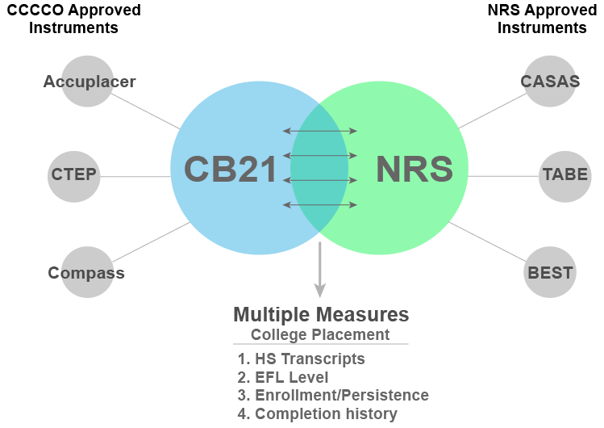
CB21/NRS Crosswalk
Underlying competencies rather than the testing instruments
Test agnostic – work with any test aligned to CB21 or NRS rubrics
Guidance for local placement & multiple measures development
Capture skills gains in college by CB21 course completion in MIS
Basis for distinguishing ABE/ASE basic skills levels for colleges

Slide 25
AEBG CB21/NRS Crosswalk
ESL, English, and math crosswalk sessions scheduled for October 2nd, 3rd, and 10th (4.5 hours each)
College faculty appointed by ASCCC; K12 by recommendation from CCAE, CDE, and AEBG office
Faculty are reviewing and editing draft crosswalks based on current NRS EFL descriptors and CB21 descriptors
After initial maps are created, will vet them with the field

