Slide 1
AEBG
Data & Accountability
Fiscal Management
October 12, 2017

Slide 2
Big Policy Changes for 17/18

Slide 3
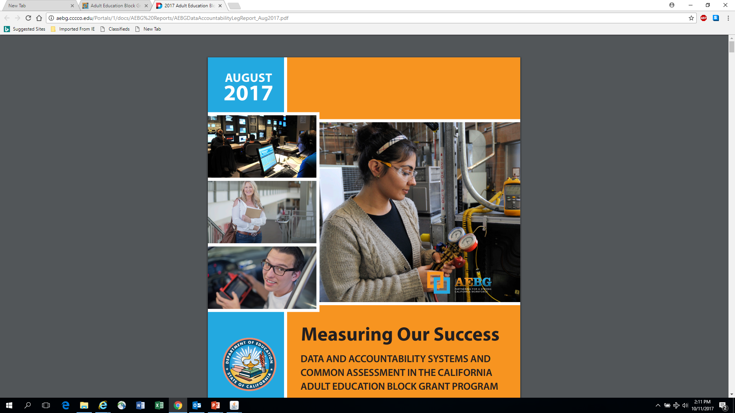
Reports That Matter

Slide 4
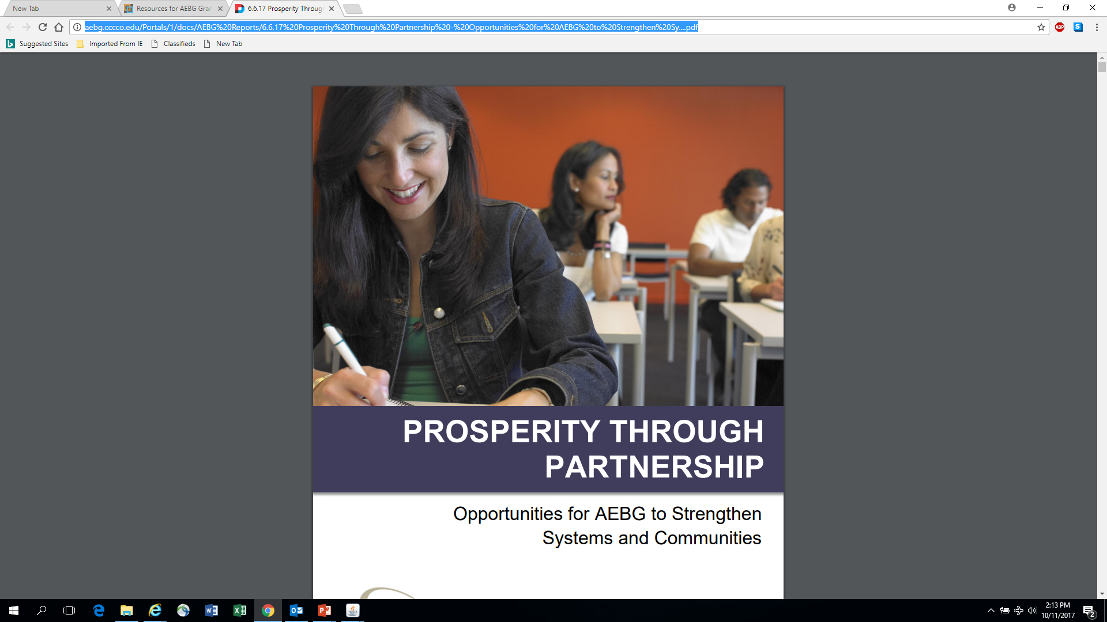
Reports That Matter

Slide 5
Why the changes????
Metrics needed to be concrete and clear
Focus on all AE students regardless of funding source
Incorporate, expand on, or default to WIOA definitions
Aligned to Strong Workforce, Perkins, other definitions
Revised policies should inform guidance that can be refined and grow as needed by the field.

Slide 6
2017/2018 Reporting Requirements
Population: All adult education students enrolled in ABE, ASE, ESL, or CTE programs enrolled at a:
K12 adult education school
Community college noncredit program
Third party provider supported by a consortium for the purposes of providing training or supportive services
This includes all students regardless of funding source including AEBG, Noncredit, Perkins, WIOA II, CalWORKS, Adults on Correctional Facilities, Strong Workforce (noncredit programs), LCFF, etc.

Slide 7
2017/2018 Reporting Systems
All AEBG consortia members and providers will use TOPSPro Enterprise
Quarterly reporting of enrollment and outcomes
K12 adult school, community college noncredit, 3rd party providers supported by consortia
AEBG Office will use LaunchBoard to match AE student data with MIS, EDD wage file, HS equivalency testing data

Slide 8
Population Definitions
Number of adults served by the consortium – Aligned to WIOA reportable individual definition. 1 or more contact hour of instruction or participation in self directed or information only activities
Adults who attain milestones or outcomes – Aligned to WIOA definition of a participant under AEFLA WIOA Title II. 12 or more contact hours of instruction in ABE, ASE, ESL or CTE.
AEBG will analyze outcomes for reportable individuals using the supplemental data report but not include that data in the primary report to the legislature for 17/18

Slide 9
Member Reduction in Funding
The amount of funds to be distributed to a member of that consortium shall be equal to or greater than the amount distributed in the prior fiscal year, unless the consortium makes at least one of the following findings related to the member for which the distribution would be reduced:
(A) The member no longer wishes to provide services consistent with the adult education plan.
(B) The member cannot provide services that address the needs identified in the adult education plan.
(C) The member has been consistently ineffective in providing services that address the needs identified in the adult education plan and reasonable interventions have not resulted in improvements.

Slide 10
Adult Education Programs part I
Adult Basic Education
Foundational academic skills, such as reading, writing, and basic mathematics, as well as learning skills and study skills. Includes courses below Low Adult Secondary Education/9th grade level
Adult Secondary Education
Foundational academic skills and learning/study skills. Includes courses at Low Adult Secondary Education/9th grade level & above, and/or leading to a diploma, GED, or high school equivalency certificate
English as 2nd Language
Instruction in the English Language to adult non-native English speakers with varied academic, vocational, citizenship, and personal goals
Short Term CTE
Education and training that prepares adult learners to enter the workforce or improve their occupation or earnings in a a year or less

Slide 11
Adult Education Programs part II
Adults with Disabilities
Mark instructional program = Adults with Disabilities if the participant is enrolled in a specialized program designed specifically for adults with intellectual/ developmental disabilities
Workforce Entry/Reentry
AEBG defines this program area as populations with systemic barriers to economic success who enroll in CTE programs
Pre-Apprenticeship
Adult education providers should only enroll students in the pre-apprenticeship instructional program if participants are enrolled in programs that meet DOL Quality Elements criteria
Adults/K12 Success
AEBG defines this program as providing education and training to adults, typically parents and-or community members, to help school-aged children succeed in school.

Slide 12
17/18 Program Changes

Slide 13
Late Breaking……..
AEBG Fees Policy Review
K12 Adult Education Code Review
AEBG age requirement is still18 years old
Use of Funds in non-AEBG Program Areas
All existing education code and regulation are still in effect. AEBG does not supersede current code & regulations.

Slide 14
17/18 Fiscal Changes

Slide 15
Fiscal Reminders
Not a Grant
Restricted Funds
Continue to use reasonable, justifiable, & allocable for purchases
Encourages leverage & braiding state & federal fund sources.
No longer “touched by AEBG”

Slide 16
Fiscal Reminders (cont.)
Out of State Travel still needs state approval
Capital Outlay – does not require state approval, but…….
Indirect rate is still the state approved rate for each K12 member or the negotiated rate for CCDs.
Passing funds through to members (45 days)

Slide 17
Recording AEBG funds in state systems
Use your local system along with state reporting requirements (SACS or BAM)
New trailer bill language – must be deposited in an Adult Education Fund.
                K12 = Fund 11
        K12 Resource Code = 6391
        Comm. Colleges – see fiscal services memo on pass through and participant /provider coding.

Slide 18
Consortium Administrative Function
Consortia oversight is required of member’s budgets & expenditure reporting.
Consortia may use the 5% administrative cap to pay for the oversight activities.
Applies to fiscal agents and direct funded consortia.
Oversight option must be agreed to and approved by consortium membership.

Slide 19
Consortium Oversight Examples
Outside audit
Agreed upon certification process
Peer-to-peer member review
Fiscal agent certification
A combination of options
Or other options
AEBG TAP will be hosting a webinar on the topic next month.

Slide 20
Reporting in TE Guidelines

Slide 21
AEBG Program Year Reporting
 | Date Range | Reporting Deadline
First Quarter | July 1 – Sept 30 | October 31, 2017
Second Quarter | July 1 – Dec 31 | January 31, 2018
Third Quarter | July 1 – Mar 31 | April 30, 2018
Fourth Quarter-EOY | July 1 – June 30 | August 1, 2018

Slide 22
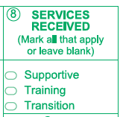
Short Term Services
Record short term services to students such as counseling or mentorship that may be received outside of the classroom.
Supportive Services
Training Services
Transition Services
Enter in TE in Records – Students –
In Program Years -OR- use Update Record field #8

Slide 23
AEBG Outcomes
Improved Literacy Skills
High School Diploma/HSE
Post-Secondary
Job Placement
Improved Wages
Transition to Post-Secondary

Slide 24
Learning Gains
Improved Literacy Skills
  For ABE/ESL/ASE programs, measured by pre/post learning gains
  ABE/ESL/ASE: Career Development and College Preparation (CDCP) certificate
  HS Diploma can report gains through achieving high school credits/Carnegie Units
  Occupational Skills gain
  Workforce Readiness Milestone

Slide 25
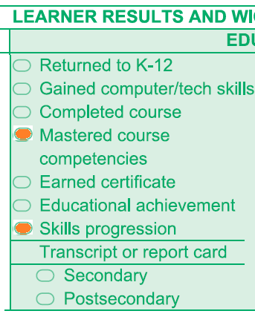
Adults With Improved Literacy & Basic Skills
Attainment of a functional level tied to completion of a course or a Career Development and College Preparation (CDCP) certificate using a crosswalk of the National Reporting System EFLs and the community college CB21 course rubric for levels below transfer
Mark “Mastered Course Competencies on Update field #9 (Education):

Slide 26
Learning Gains
Improved Literacy Skills – HS Diploma
      Progress towards Diploma (New) – Participants who improved from ASE low to ASE high on the NRS-approved assessment– or, who completed enough high school credits to advance from ASE Low (9th/10th grade) to ASE High (11th/12th grade) levels.
      Instructional Program = HS Diploma
      Instructional Level = ASE Low or ASE High – either through pretest or self-report (Entry Record field 18)
      If ASE Low – learner achieves outcome by marking self-report ASE High, or earn HS diploma
      If ASE High – learner achieves outcome by marking earn HS diploma

Slide 27
Learning Gains
Other CTE-Related Skills Gains
Occupational Skills Gain – Participants who achieve milestones in CTE programs, but who do not complete their credential or certificate because they obtain employment or realize a shorter-term goal related to occupational advancement.
Workforce Preparation Milestone – Participants who complete workforce preparation courses or certificates.

Slide 28
Post-Secondary
Post-Secondary
Postsecondary Credential Completion
        For K12 community college CTE programs - Completion of a credential that leads to employment in a clearly-defined occupation including, but not necessarily limited to:
          Locally approved certificates eligible for inclusion on the Eligible Training Provider List (ETPL)
          CDCP CTE certificates with more than 48 instructional contact hours
          Certificates that meet the minimum threshold for inclusion under Perkins
          Certificates that meet the threshold for Title IV federal student aid
          Completion of any degree or for credit certificate over 6 units

Slide 29
Post-Secondary
Post-Secondary
Postsecondary Credential Completion
        Workforce preparation (work readiness) or occupational safety certificates (e.g. OSHA or Safeserve) ARE NOT counted for completion under this metric
        These outcomes should count as short term services, not Post-Secondary outcomes

Slide 30
Transition
Transition
Transition to ASE: AEBG will track transitions from ABE to ASE or ESL to ASE.
Transition into Post-secondary: Applies to participants transitioning into 1) Any K12 adult education or community college CTE program or 2) Community college for-credit coursework that is not developmental.

Slide 31
Transition
Transition to Post-Secondary
Transition into Post-secondary: Specific student based scenarios that qualify for the AEBG transition outcome:
        K12 Adult Education or community college noncredit ABE, ASE or ESL participant who enrolls in a K12 adult education CTE course
        K12 Adult Education or community college noncredit ABE, ASE or ESL participant who enrolls in a noncredit community college CTE course

Slide 32
Transition
Transition to Post-Secondary
        Transition into Post-secondary: Specific student based scenarios that qualify for the AEBG transition outcome:
        A K12 adult education ABE, ASE or ESL participant who enrolls in a community college credit course that is not developmental (including both CTE and non-CTE courses)
        A community college noncredit ABE, ASE or ESL participant who enrolls in a college credit course that is not developmental (including both CTE and non-CTE courses)

Slide 33

Literacy Gains
Employment
Secondary
Wages
Post-Secondary
Transition

Slide 34
Data Matching Framework

Slide 35
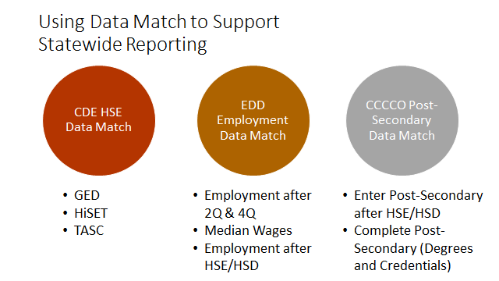

Slide 36
AEBG Outcomes
Learning Gains
HSE/HS Diploma
Post-Secondary
Enter Employment
Increase Wages
Transition Post-Sec
Pre/Post Level Completion
Carnegie Units
High School Diploma
Passed GED
Passed HiSET
Passed TASC
College Degree – AA, AS, BA, BS
Graduate Studies
Training Credential/Milestone
Occupational Licensure/Certificate
Apprenticeship
Get a Job
Retain a Job
Enter Military
Increase Wages
Get a Better Job
Enter Job Training
Enter College
Transition to Credit
Entered Training/Education Leading to Post-Secondary

Slide 37
Data System (2018/19)
Quarterly Data Collection
TOPSPro
Enterprise
CO MIS System
Data Matching
K12 AE
Students
College MIS Data
EDD Wage
File
HS Equiv
Test Data
HS Equiv
Test Data
Data Visualization
LaunchBoard Adult Educ Data Tab

Slide 38
LaunchBoard Adult Education Tab

Slide 39
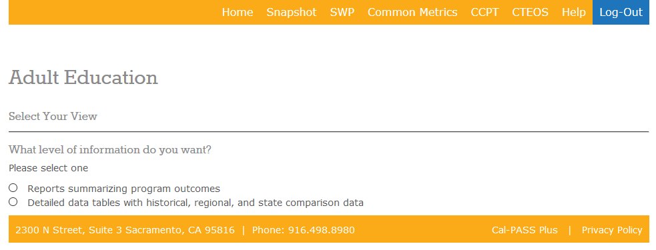
LaunchBoard Adult Education Tab
General info: http://calpassplus.org/launchboard/home.aspx

Slide 40
LaunchBoard Data Sources
Student Demographics (MIS/TOPSPro)
Coursetaking (MIS/TOPSPro)
Completion (MIS/TOPSPro/GED/TASC/HiSet)
Transfer (National Student Clearinghouse)
Employment (EDD Wage File, CTE Outcomes Survey)
Labor market information (EMSI)

Slide 41
LaunchBoard Adult Ed Tab Scope/Timeline
Comprehensive consortium & member data
Disaggregated program, demographics, barriers and other criteria
Current build includes 57 student, course taking & outcome metrics
Conducting test matching of TE, MIS and other data sources Fall 2017
Available to consortia Spring 2018
Regional training on tools and how to use the data

Slide 42
18/19 Changes & Future analysis

Slide 43
Other Activities in 2017/18
Supplemental Data Report: Includes additional analysis not included in primary data collection & reporting:
Analysis of how AE students are being served in for credit college programs
Outcomes for students with low contact hours (<12)
Profiles of emergent or effective practices (immigrant immersion, career advancement academies, other)
Other special analysis

Slide 44
Other Activities in 2017/18
Changes to MIS & CCC Apply:
Add MIS data elements to align MIS with adult education reporting requirements (missing population flags, preapprenticeship, diploma, etc…)
Convene process to make CCC Apply more useful for enrollment and data capture for noncredit and AE students

Slide 45
Other Activities in 2017/18
Basic Skills Crosswalk:
AEBG (WestEd) will convene faculty and leadership to build a crosswalk of the National Reporting System Educational Functioning Levels and the CB21 levels below transfer.
Issue guidance in Spring 2018 to inform content and local alignment of courses and streamline student transition between K12 and community college programs

Slide 46
Reporting in 2018/2019
Community colleges will use MIS to report students in noncredit ABE, ASE, ESL, and CTE programs
K12 adult schools will continue to report all ABE, ASE, ESL and CTE students in TOPSPro
WIOA Title II funded programs will still report quarterly data using TOPSPro
Pre and post testing using CASAS will still apply to ALL WIOA AEFLA Title II Funded Student

Slide 47
New Fiscal System

Slide 48
Fiscal System
Member based – budgets & expenses
Rolled up to consortium level
Consortium would have their own budget showing program and fiscal budget/expenses.
Budget & expenses by object code (1000s-7000s)
Members would check off which annual plan strategies they are focused on for the program year.
Budget & expenses would display all active funding.

Slide 49
AEBG Web Site
http://aebg.cccco.edu/Home

Slide 50
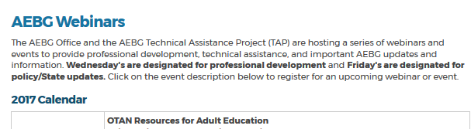
AEBG TAP
The AEBG Technical Assistance Program (TAP) provides professional development resources for all AEBG agencies statewide.
tap@aebg.org

