Slide 1
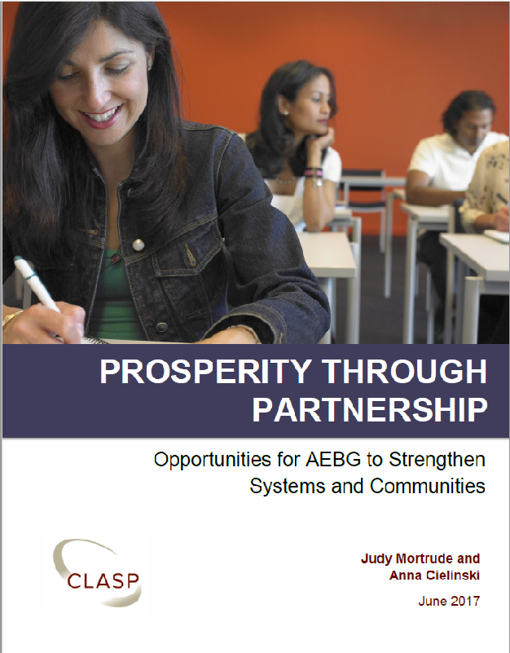
Prosperity Through Partnership
Opportunities for AEBG to Strengthen Systems and Communities
Center for Law and Social Policy (CLASP)
Notes:
Hello everyone – I’m JM and this is AC and we work for the Center for Law and Social Policy in Washington DC.
By now I think you all know that Debra Jones and Neil Kelly engaged CLASP to do a study as AB86 planning rolled into AB104 implementation. Anna and I will be the first to let you know that CLASP is not a research firm, we are an antipoverty organization and our team at CLASP is focused on promoting policies that make adult and postsecondary education and workforce development more effective for low-income adults. In June we released our report, some of you may have seen our presentation at the CASAS Summer Institute, and this week we are in town meeting with policy makers and other stakeholders – like you – to discuss moving forward with the report’s recommendations
You have a 6 page executive summary of the report which is also available at the AEBG website AND as we very briefly review the recommendations in the report, you have two ways to provide feedback…

Slide 2
AEBG Implementation Study Goal
AEBG’s purpose: “to improve coordination and better serve the needs of adult learners within each region.”
CLASP AEBG Implementation Study purpose:
Foster greater understanding of AEBG implementation – both governance and direct service
Analyze current and potential impacts of AEBG for partners and participants
Offer recommendations for potential policy and implementation changes for CDE, CCCCO, and other policy makers
Notes:
As you well know, AB86 and AB 104 do not represent a simple reinstatement of dedicated state ad ed funding but instead are funds tied to an effort to build regional delivery systems that better served adult learners in those regions through coordinated efforts. AEBG requires regional partners – not only adult schools and CCs but any entity receiving public funding for adult education (CalWorks, correctional education, COE, ROPs).
The CLASP study aimed to do 3 things – build awareness and understanding of what was happening both in AEBG administration and in direct service; analyze the impact of what was happening for practitioners and participants; and offer recommendations for potential policy and implementation changes.

Slide 3
Offering Recommendations
2 | Clarify AEBG’s mission & vision
2 | Use AEBG to drive a comprehensive career pathway system
2 | Tie AEBG accountability to impact through establishment of a cross-system accountability structure
2 | Provide comprehensive technical assistance and professional development
Notes:
We have 19 major recommendations which we present under these 4 themes…
In our brief time together, I’m going to give a high level overview of the 19 recommendations and ASK for your reaction & response

Slide 4
Clarify AEBG mission & vision
Connect AEBG impacts to ‘community of need’ & evaluate the extent of strategically aligned work and the demonstrable impact of AEBG
Improve AEBG data and accountability by leveraging existing data collection, performance measures, and goal to frame a new AEBG accountability system
Strengthen AEBG governance and empower the AEBG office to issue joint guidance that is equally binding for Adult Schools and Community Colleges
Notes:
In this Clarifying mission/vision theme, we have four recommendations, 3 of which we bring to policy makers…
One is about community of need; a second is about the AEBG accountability system (we know that field teams have been hard at work on much of this detail) and our recommendations here include the idea of a bonus funding incentive for serving more people in the community of need populations, and finally a recommendation on governance and guidance.

Slide 5
Community of need
Clarify AEBG Mission & Vision
Funding allocated by formula based on
Educational attainment (no HSD)
Employment (unemployed adults)
Adult population (18 yr +)
Poverty (household)
Adult literacy (7th grade education level)
English as a second language (ability to speak English)
Notes:
While the largest sysmeic shift of AEBG was the consortia structure, perhaps the biggest shake up to the legacy adult ed structure was the shift from contact hour funding to awarding funds based on Community of Need. These characteristics outlined in the legislation drive the funding formula. But the big question is how will AEBG show its impact via the Community of Need formula?
A solid step by California leaders was to link AEBG accountability with other partners in this work under the Workforce Innovation and Opportunity Act and the Strong Workforce program. Shared measures will help systems that share a low-wage, low-skill population start thinking about leveraging their work together to create larger community responses.
CLASP asserts that AEBG aloen won’t move the needle on these population level characteristics but can be a core partner in moving the needle. We recommend that State leaders evaluating consortia-level work should also consider the extent of strategically aligned work and the demonstrable impact of AEBG in a region’s workforce development, human services, correctional education, school district achievement, and Community College successes.

Slide 6
Accountability Targets & Reports
Clarify AEBG Mission & Vision
Identify model for setting or negotiating targets for measures, as under WIOA title II Adult Education
Compare actual outcomes to targets
Multiple levels of reporting:
  State level for legislature
  Consortia level for program improvement
  Member-level for consortia member accountability to remain in consortia
Performance Improvement plans for low performers
Notes:
Our report includes recommendations for the AEBG accountability system, and we know the field team work has set recommendations on a number of alignment issues.
CLASP recommends setting targets to compare actual results to, as under WIOA title II.
Multiple levels of reporting
Establish a protocol for Performance improvement plans for low performing members of consortia to address member effectiveness

Slide 7
Incentive for serving community of need
Clarify AEBG Mission & Vision
Recommend performance bonus for serving community of need
6% increase in state appropriation
Similar to Ohio’s postsecondary education outcomes-based funding bonus for targeted populations
Serve student with one need characteristic = small bonus; serving 2, 3 and 4 = increasing larger bonuses
Modest amounts of money can incent behaviors
Notes:
In the study, we naturally heard from many of you about resources and the need to increase funding over time. We agree, but think it should be tied explicitly with serving members of the community of need.
Incentive funding, with 30 million increase
Increasing bonuses for individuals with increasing number of community of need characteristics. Looking at alignment between AEBG community of need and WIOA individuals with barriers to employment characteristics which include basic skill deficiency, non native English speaker, cultural barriers, single parenting of minor children, disabilities, and more..
Serving people with more barriers would result in more pay off. Mechanism could be similar to the Strong Workforce 17% funding which benefits institutions through increased funding for populations with defined characteristics

Slide 8
Strengthen governance
Clarify AEBG Mission & Vision
AEBG Virtual Office – CDE and CCCCO staff on five teams:
External Communications;
Data, Accountability, and Reporting;
Field Capacity Building;
Fiscal; and
Governance and Policy
Notes:
In 2016, CDE and CCCCO leadership defined an AEBG Office Infrastructure consisting of CDE and CCCCO staff on five teams list here.
It is unclear how many staff from each agency is dedicated to these teams, but there is clearly an imbalance of staff dedicated to the federal WIOA title II funds at CDE and the much larger state investment through AEBG. AND while AEBG’s newly selected supplemental service providers will now support some operational functions in these five areas, it is not possible for contractors to lead cross-agency governance and policy decision making.
The AEBG Office needs to be empowered to issue joint guidance that is equally binding for Adult Schools and Community Colleges. Failing that, California leaders will need to consider an alignment of both the state investment and the federal adult education into one agency.

Slide 9
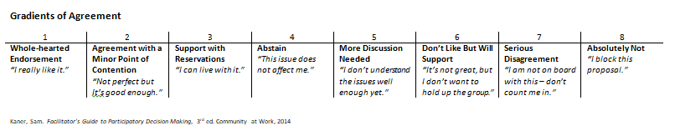
Discussion & Polling
Clarify AEBG’s mission and vision
Notes:
Obviously, CLASP has opinions – we’re not shy about expressing them – but as the primary stakeholders we need to hear YOUR opinions. So we are asking for you to weigh in via the Gradients of Agreement Scale.
Take a few minutes to discuss initial reactions and then weigh in BOTH on paper and via your phone. Also add notes – we will collect the papers (which can remain anonymous) and tally them for AEBG leadership.

Slide 10
Use AEBG to drive a comprehensive career pathway system
Create educational pathways for adults through guidance on pathways strategies for the Adult School to Community College transition
Promote CCC internal alignment efforts for equitable career pathways
Create CCCCO & CDE guidance on Ability to Benefit pathways
Design career pathways with WIOA core partners
Strengthen the ‘priority of service’ link among AEBG, WIOA, Human Services
Promote immigrant integration pathways
Notes:
OK – the second theme is using AEBG to drive a comprehensive career pathway system and we have SIX recommendations within this theme….
Guidance on pathways/transition strategies between AS and CC
Internal CC initiative alignment
Standing up ATB
Designing CP with WIOA core partners
Taking advantage of the WIOA title I adult PoS mandate, and
Promoting Immigrant Integration through pathways
So a bit more detail on each and then you’ll vote again.

Slide 11
Adult school to CC alignment strategies
Comprehensive CP System
“Dual enrollment” for adults – take down barriers
Credit for Prior Learning agreements (Adult School CTE to Community College programs of study)
List all Adult Schools on CCD online application systems
Link “guided pathways” to Adult Schools
Notes:
AEBG legislation calls for “consortia to integrate their existing programs and create seamless transitions into postsecondary education or the workforce” [California Ed Code 84830(d) (3)]. Consortia partners need state guidance to accomplish this systemically.
The Joint AEBG Office should create guidance on pathway strategies for the Adult School to Community College transition, including incentives for dual enrollment for Adult School students in Community College programs, (Constructing the adult pipeline using the same mechanisms that high schools have been developing for years)
and credit for prior learning guidance for non-credit CTE courses to articulate into Community College awards.
It should also issue clear guidance that all Adult Schools in a Community College District should be listed on the CCD institutions’ online application systems and provide guided pathway designs that include adult education students and bring the disparate departments in the CCCCO together.

Slide 12
CCC internal alignment strategies
Comprehensive CP System
Connect college focused initiatives with AEBG:
Guided pathways – “intra-institutional alignment”
CC Basic Skills and Student Outcomes Transformation Program
Credit vs Non-Credit – equity implications
Student Success and Support Program
Student Equity Plans
Developmental Education
Notes:
To build toward this comprehensive delivery model, California’s investments in the Community College Basic Skills and Student Outcomes Transformation Program, Student Success and Support Program (SSSP), and Student Equity Plans (SEP) need to be combined with AEBG and Strong Workforce investments. CCCCO leaders need to bring together staff who work on for-credit developmental education redesign with staff who work on non-credit basic skills and staff who work on credit and non-credit CTE to find common ground and overlap in their work.
Our primary argument is that people with foundational skill needs should have access to service delivery models that integrate foundational skills/occupational skills. Doing one without the other (straight up basic ed; straight up short term training) hasn’t been shown to move the needle for folks; that short-term credentials that do not “stack” toward higher levels of for-credit education are not a career ladder.
The AEBG Office should analyze patterns of course taking among AEBG participants to ensure adults with foundational skill needs are gaining those skills and occupational skills in a manner that will build, over time, toward higher levels of credentialing. California leaders need to have frank discussions about the equity implications of building pathways in non-credit for some target populations and other pathways in credit for other populations.
The AEBG Office cannot be tasked with California Community College development education redesign. However, the AEBG Office should recommend that AEBG resources and AEBG accountability, including standard assessments, be used for no-fee Adult School and Community College courses.

Slide 13
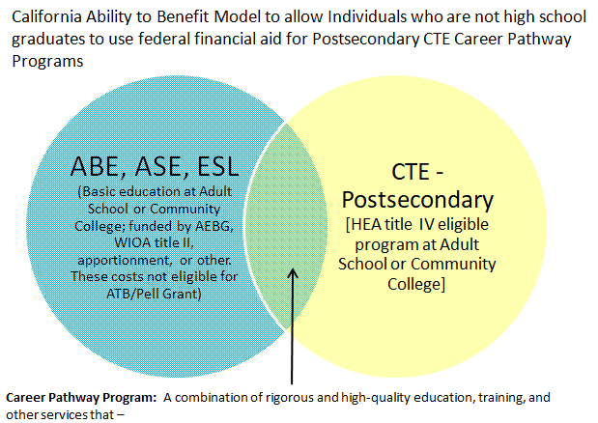
Ability to benefit guidance
Comprehensive CP System
20 U.S. Code § 1091
Notes:
While California Board of Governor waivers have reduced the financial barrier for many low-income, low-skill populations, using the Ability to Benefit (ATB) mechanism is a powerful strategy for Integrated Education and Training (IET) and seamless transition. The ATB provision allows people without high school equivalency to simultaneously work on high school equivalency and a CTE program of study within a ‘career pathway’, defined in the Higher Education Act with the exact language used in WIOA. The AEBG Office should guide CCCCO in providing clear guidance on ATB use across the CCC system in partnership with Adult Schools and with the couple dozen adult school CTE programs that are HEA title IV eligible.

Slide 14
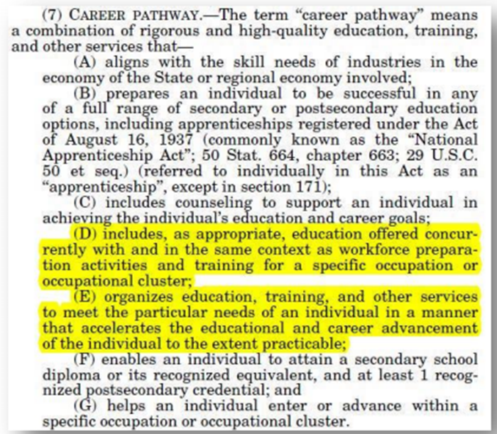
WIOA career pathways
Comprehensive CP System
WIOA Sec 3(7)
Notes:
And the definition for ATB CP is the same as the definition for WIOA CP.
The state agencies should determine whether partners have built career pathway programs that meet this definition and offer infrastructure and guidance on defining and tracking participants who are on a "state-recognized" career pathway. These considerations are especially critical:
Define a process for recognizing local/regional career pathway programs, including how to verify that a program meets all required elements of the WIOA career pathway definition.
Define target populations for career pathway programs to include out-of-school youth, individuals with disabilities, non-native English speakers, individuals with basic skill deficits, and others.
Supporting local development and implementation of career pathways will necessitate state policy and guidance in key areas:
Build pathway identifiers into administrative data systems so that individual participants can be “flagged” as participating in a particular state-recognized program. Many benefits of adult education require time. Having the ability to review longitudinal data on adult education participants should reveal the interventions that made a difference. These data flags would need to be included in TopsPro Enterprise, CCC MIS, EDD WIOA title IB, and human service data.
Ensure that state-recognized career pathway programs are on California’s Eligible Training Provider List, making them eligible for title I-B training funds.

Slide 15
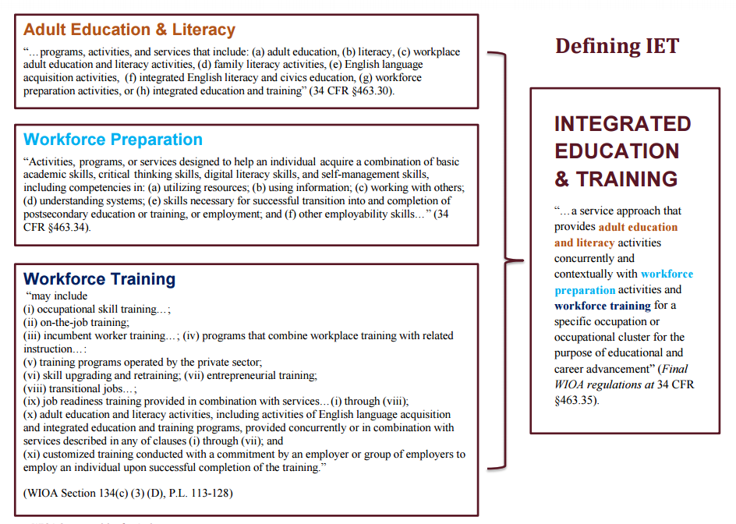
WIOA career pathways
Comprehensive CP System
Notes:
The instructional innovation in CP is IET (those two highlighted components)
AEBG legislation calls for the Employment Development Department (EDD) and the California Workforce Investment Board (CWDB) to “provide any assistance needed to align delivery of services across state and regional workforce, education, and job service programs” [CA ED Code 84917(b)(3)]. The AEBG Office – CDE WIOA title II included --, together with partners in the California Employment Development Department (EDD) and the California Workforce Development Board (CWDB), need to jointly develop IET and co-enrollment policies and guidance for local providers to support best practice models of career pathways for low-income, low-skill adults.

Slide 16
WIOA priority of service
Comprehensive CP System
WIOA Section 134(c)(3)(E) requires that priority for Adult career services and training services be given to recipients of public assistance, other low-income individuals and those who are basic skills deficient
WIOA basic skills deficient = “…unable to compute or solve problems, or read, write, or speak English, at a level necessary to function on the job, in the individual's family, or in society.”
Notes:
The WIOA priority-of-service mandate provides an additional opportunity for AEBG leaders to support aligned services. This requires programs to target services to low-income individuals, individuals with basic skill deficiency, and public benefits recipients. AEBG should create its own priority-of-service guidance to ensure AEBG services support and connect students to other public benefits.

Slide 17
Immigrant integration
Comprehensive CP System
AEBG directive: CDE and CCCO senior leadership to “seek advice from, and coordinate with, other state officials responsible for programs for adults.”
Regional WIOA plans – 15% requirement
EDD/CWDB Workforce Navigator Pilot Program
IET for incumbent workers
Notes:
AEBG could play a larger role in immigrant integration through dedicated incumbent worker Integrated Education and Training (IET) programs. Most immigrants are working, surviving and even thriving in California jobs. IET programs designed with employers could help more immigrants achieve career advancement and enhanced economic mobility.
California’s regional WIOA plans in areas with an immigrant population of 15 percent of more must detail demographic information and strategies to serve this population. Further, the Employment Development Department (EDD) and California Workforce Board’s Workforce Navigator Pilot Program will support five local workforce service areas “to promote increased access, create/enhance program structure and availability, and provide supportive services within the workforce system for California’s English Language Learner Population.”14 The strategies developed under this effort can support the AEBG directive for CDE and CCCCO senior leadership to “seek advice from, and coordinate with, other state officials responsible for programs for adults.” The AEBG Office should issue joint guidance with the Office of Immigrant Integration to further immigrant integration career pathways.

Slide 18
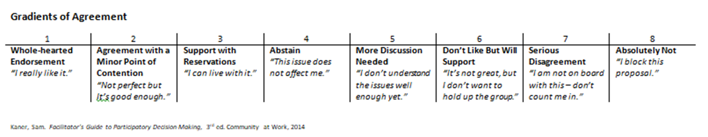
Discussion & Polling
Use AEBG to drive a comprehensive pathways system
Notes:
OK – time to weigh in.

Slide 19
Establish a cross-system accountability structure
Delineate and distinguish ‘populations’ from ‘programs’
Clarify fund reporting on AEBG’s five objectives
Align data definitions and processes among AEBG, WIOA title II, and Community College providers
Maximize the use of WIOA Measurable Skill Gain in AEBG
Clarify transition to postsecondary education across reporting for AEBG, WIOA title II, and LaunchBoard
Measure progress on mandated objectives in AEBG regional plans
Notes:
Our third bucket is about establishing a cross-system accountability structure and tying AEBG accountability to impact through six major recommendations including distinguishing the seven program areas from populations, focusing on funds and activities as they relate to AEBG objectives, aligning data definitions and processes including the WIOA MSG and the “transition” metric.

Slide 20
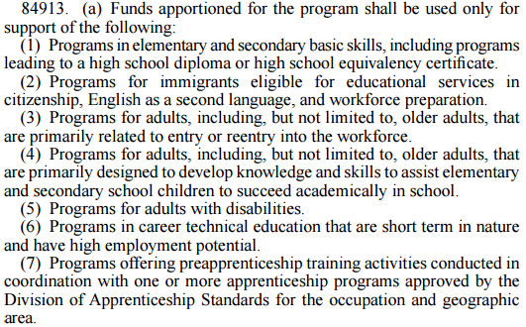
Population vs. services
Cross System Accountability
http://aebg.cccco.edu/portals/1/docs/SEC_38-40_from_20150AB104_96.pdf
Notes:
With the 2016-2017 accountability decision to align AEBG with WIOA title II reporting under TopsPro Enterprise, the AEBG Office should direct the use of data tags within TopsPro for individual participant characteristics (individual with disability, English language learner, justice involved adult, etc.) and for course characterization (pre-apprenticeship, workforce re-entry, CTE, family literacy, etc.). Creating these data tags will provide a more concise picture of who is receiving AEBG services and what those services are. AB104 should be updated to support this updated fund reporting by course categorization rather than population.

Slide 21
Fund reporting on AEBG objectives
Cross System Accountability
AEBG Office also requires consortia to describe the expenditure of funds used in the seven program areas to accomplish five objectives:
Integration of existing programs to create seamless transitions into postsecondary education or the workforce;
Activities implemented to address gaps in service delivery for community needs;
Joint strategies employed to accelerate progress toward academic or career goals;
Building staff capacity for program integration and improved student outcomes;
Leveraging existing regional structures, including workforce development boards, local public agencies responsible for social services, libraries, and other community partners.
Notes:
Currently AEBG funds are reported via program area and objective. The lion’s share of funds have been in “gaps in service,” which was the natural result of an infusion of funds, but either the AEBG Office should expect to see a dramatic drop in spending in this category or should relabel the category as sustainability of service provision. Consortia will need guidance on fund reporting for this category.
Similarly, Accelerated Learning needs refinement. As AEBG and other reform efforts seek to accelerate an individual’s progress toward credential attainment and economic self-sufficiency ,and as career pathway definitions in the Workforce Innovation and Opportunity Act (WIOA) and the Higher Education Act (HEA) clearly call for programs that are organized for acceleration, AEBG leaders should provide guidance for AEBG practitioners and their partners to differentiate compressed time from organized for acceleration strategies
And consortia need more guidance on leveraging existing regional structures as WIOA plan updates, AEBG 3 year plans, SW planning, SNAP E&T plans and more come along – need help with alignment!

Slide 22
Clarify “transitions” definition
Cross System Accountability
The current LaunchBoard pilot tracks “transition” from Adult School to Community College; Field Team recommendation defines AEBG transition as secondary to postsecondary
WIOA MSG on “transition to postsecondary” allows transition to development education as success
Are the definitions of transition equivalent? Should they be?
Notes:
The AEBG field team is doing much in the areas of aligning data definitions and types, but attention must also be paid to AEBG to WIOA title II alignment, for example “transition” in WIOA title II includes transition to developmental education, but in AEBG it does not.
WIOA title II will also need to be reporting up through the WIOA quarterly reporting and stand up a wage record match protocol that includes SSN when available and supplemental wage information when not. How will this interact with AEBG wage record match protocols?

Slide 23
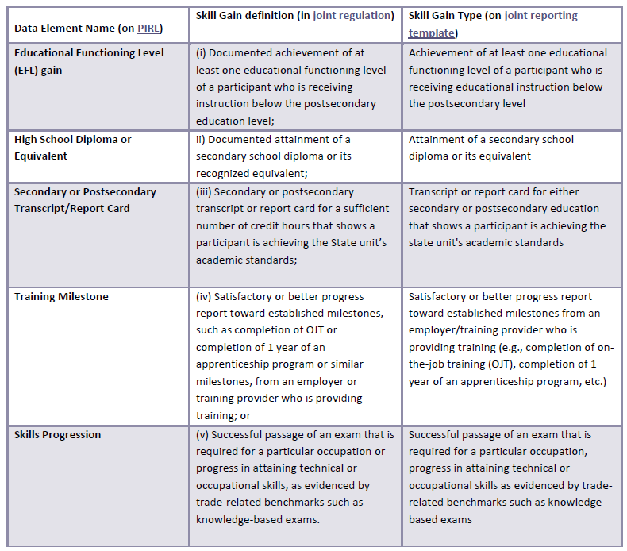
Maximize measureable skill gains
Cross System Accountability
Notes:
AEBG to use WIOA measures but there’s confusion on WIOA metric definitions and measurement calculations. The MOST powerful WIOA measure is MSG and AEBG needs a comprehensive, aligned strategy with all the WIOA core partners to use this for maximum impact.

Slide 24
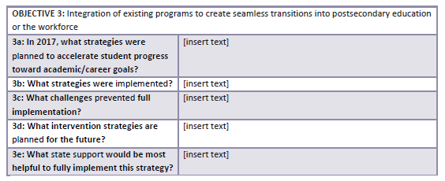
Measure Progress on Objectives
Cross System Accountability
Notes:
While evolving AEBG accountability efforts will result in better administrative data on student outcomes, it is also important to measure progress on mandated objectives in AEBG regional plans:
As the heavy lift of participant data reporting lessens for AEBG administrators, an annual narrative report or consortia self-assessment process can help partners reflect on progress made and challenges to be addressed in their AEBG plans. This accountability can be designed to lead into strategic and operational planning for the next service delivery plan.
Make these do-able by consortia members and not by consultants!

Slide 25
Discussion & Polling
Tie AEBG accountability to impact through the establishment of a cross-system accountability structure

Slide 26
Provide comprehensive technical assistance and professional development
Amplify senior leadership messaging and build capacity of leaders at all levels
Establish common standards across providers
Support and strengthen consortia structure
Incentivize faculty-led models and learning communities
Notes:
The AEBG Office has done yeoman’s work in supporting the transition from AB 86 planning to AB 104 implementation. The decision to create a “virtual office” with existing CDE and CCCCO staff has put pressure on both agencies, but it has led to growth and understanding of systemic barriers and opportunities. By selecting the Sacramento County Office of Education (SCOE) as the AEBG professional development technical assistance provider, the AEBG office has created an opportunity to significantly increase capacity. The AEBG office should provide direction on a comprehensive capacity building plan for AEBG consortia
CLASP has four recommendations in this space:

Slide 27
Leaders at all levels
Comprehensive Technical Assistance
Former Chancellor Skinner expressed his sincere belief that
AEBG and similar efforts lead to the realization that “collaboration is not just something we ask other people to do;”
success requires leaders to collaborate in unprecedented ways.
Notes:
The inclusion of AEBG in strategic planning structures on Strong Workforce and WIOA demonstrates the importance senior leadership puts on the AEBG effort and stretches local leaders to see their efforts within a larger economic mobility context. Our study revealed a need for training to build the skills of local leaders to collaborate across agencies and to articulate the opportunities and barriers in such collaboration to system leaders, so that supportive cross-agency policies are developed and collaborative practices scale and sustain.

Slide 28
Instructor standards
Comprehensive Technical Assistance
AEBG requires local programs
to improve transitions and alignment,
including attention to “qualifications of instructors, including common standards across entities that provide education and workforce services to adults” [CA ED Code 84906 (b)(8)(C)].
Notes:
Nonetheless, AEBG requires local programs to improve transitions and alignment, including attention to “qualifications of instructors, including common standards across entities that provide education and workforce services to adults” [CA ED Code 84906 (b) (8) (C)].
This delineation of regional common standards for those working with low-skill adults, in Adult Schools, Community College, AND in any of the regional adult education and workforce service providers should lead to quality indicators that can be embedded into staffing decisions regardless of other specific institutional requirements. AEBG technical assistance providers should initiate a state working group to initially frame a set of common standard qualification criteria for consideration by local AEBG consortia.

Slide 29
Consortia structure
Comprehensive Technical Assistance
AEBG requires collaboration
Adult Schools and Community Colleges AND
with other adult service providers and “entities that are impacted by, or that have a fundamental interest in, the provision of those services” [CA ED Code 84906(b)(2)(B)].
Notes:
AEBG professional development needs to build the capacity of local consortia leaders to understand the other adult-serving systems in their region and develop a vision for an adult service strategy with partners across a variety of public and private settings.
Additionally, targeted capacity building is needed for practitioners serving low-skill adults under these major systems:
• CCC credit based developmental education, CCC non-credit CTE and CCC basic skills.
• WIOA Title II Adult Education and Family Literacy Act providers.
• AEBG basic skills and non-credit CTE providers not aligned with one of the above systems.

Slide 30
Faculty-led models
Comprehensive Technical Assistance
Professional Learning Communities
  Content: mathematics, ESL
  Instructional Models: Integrated Education and Training
Notes:
Some AEBG consortia are bridging the Adult School and Community College institutional divides by putting classroom practitioners and other frontline service delivery providers in charge of designing and delivering cross-system professional development.
This event is an example of The AEBG office and professional development team providing guidance and ongoing support for interinstitutional professional learning communities to help embed collaboration in a consortia’s way of doing business and scale best practices.

Slide 31
Discussion & Polling
Provide comprehensive technical assistance and professional development

Slide 32

California…
“… is – and must always be – a refuge of justice and opportunity for people of all walks, talks, ages and aspirations – regardless of how you look, where you live, what language you speak, or who you love.”
“…has long set an example for other states to follow.”
http://sd24.senate.ca.gov/news/2016-11-09-joint-statement-california-legislative-leaders-result-presidential-election
Notes:
Finally We want to recognize the challenging and critical work AEBG professionals do every day and honor the courage of AEBG participants who make the bold choice to step into our classrooms every day.
And I want to end getting a little political – with some excerpts from a joint statement of CA legislative leaders (after the national election) but regardless of your politics, you must admit, CA has the scale and energy to move the nation and the important work being done under AEBG is yet another example.

Slide 33
Contact Information
Judy Mortrude
jmortrude@clasp.org
Anna Cielinski
acielinski@clasp.org
Notes:
ANNA
Conclude and thank

