Slide 1
The Road Ahead:
Advancing Social Mobility through Our Workforce Mission
Van Ton-Quinlivan, Vice Chancellor of Workforce & Digital Futures
vtquinlivan@cccco.edu | @WorkforceVan
Notes:
Justin does roll call

Slide 2
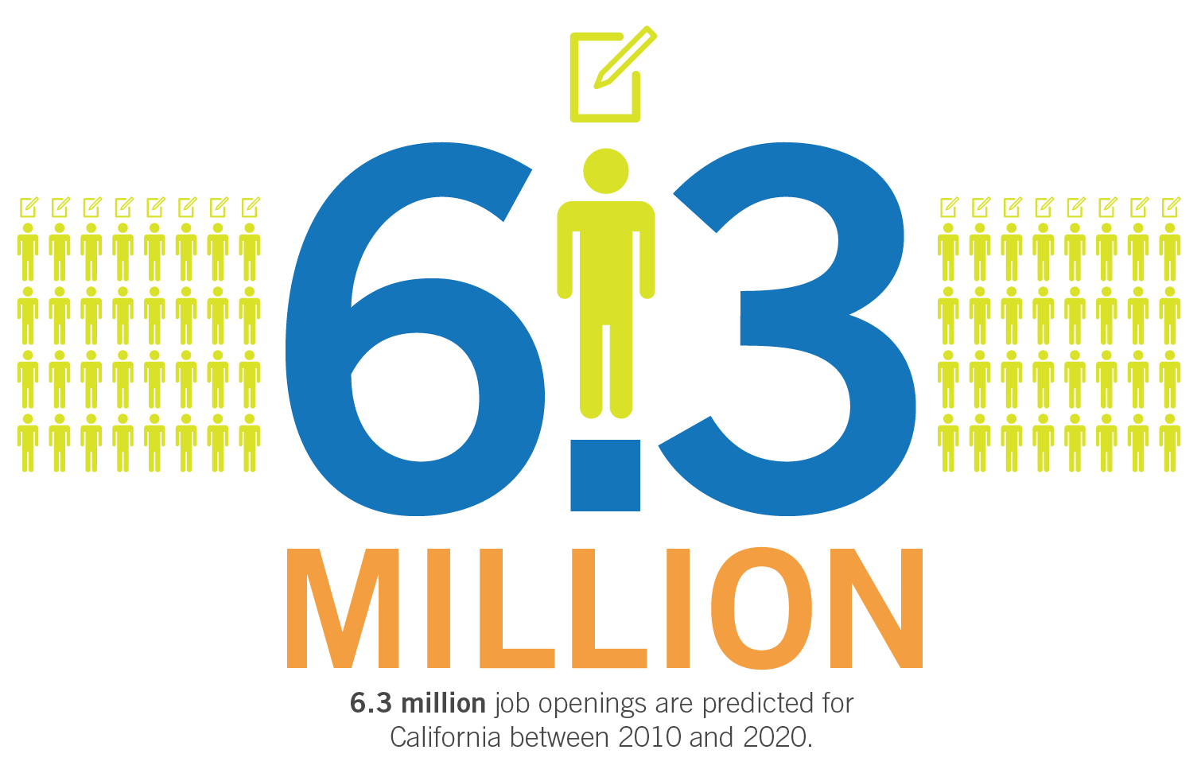
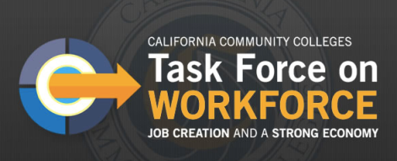
#StrongWorkforce
Notes:
CA has come out of the recession. Expected to have 6.3M job openings.

Slide 3
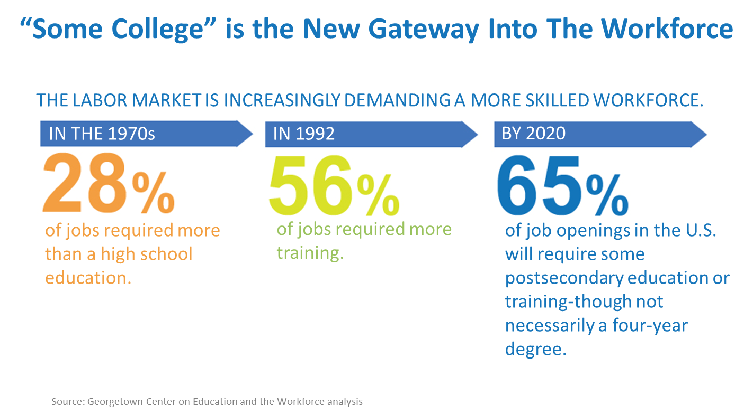
Notes:
“Some College” has become the new gateway for employment. 65% of jobs openings require an AA, certificate, industry-recognized credential or more.

Slide 4
California needs 1 million more AA, certificates, or industry-valued credentials.
Notes:
1 M more middle skill credentials – more than a high school degree but less than a BA. A.k.a., subbaccalaureate: AA, certificates and industry-valued credentials.

Slide 5
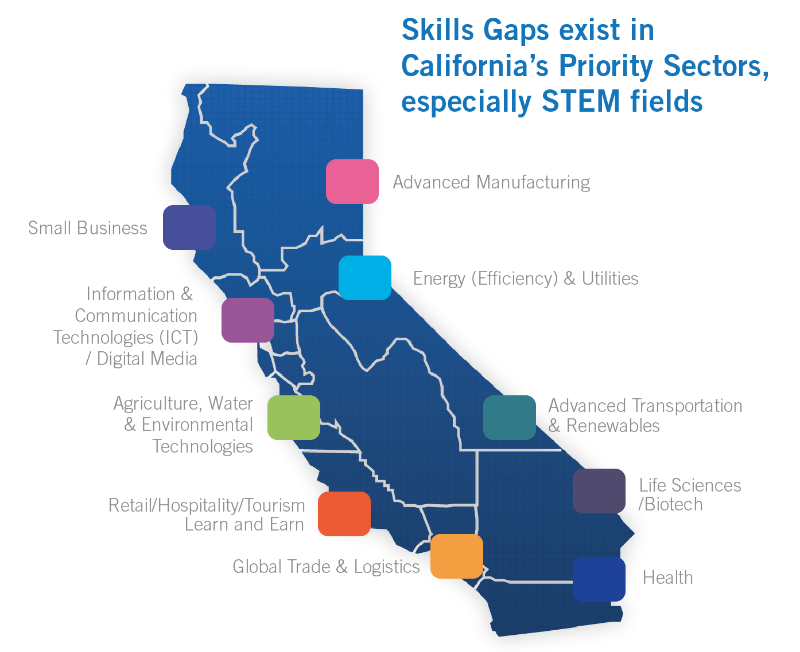
CALIFORNIA
Regional economies
- Differing labor market needs
- Industry sectors
- Guided pathways
114 community colleges
325 K12/COE adult ed providers
Student workforce outcomes
doingwhatmatters.cccco.edu

Slide 6
WORKFORCE MISSION
From $100M to $900M…
From afterthought to state policy priority…
Ecosystem of “intrapreneurs”
Tools to “free the data”
Innovations-at-scale
All supportive of Chancellor Oakley’s emphasis on
guided pathway development
and to serve a resource for AEBG collaboration.
doingwhatmatters.cccco.edu
Notes:
Van Ton-Quinlivan

Slide 7
Ecosystem of “intrapreneurs”
AEBG consortia
AEBG TAP for professional development
Field Teams
Industry Sector
Technical Assistance (TAP)
Region
doingwhatmatters.cccco.edu
Notes:
Van Ton-Quinlivan
What’s new: 360 degree feedback
Projects in common: Regional projects in common (e.g., STEM TPP, New World of Work, Get Focused Stay Focused); Sector projects in common

Slide 8
Tools to “free the data”
“The LaunchBoard makes the California Community College system the national leader in the development of data base tools for aligning student's career aspirations, curricula and labor market opportunities.
Anthony P. Carnevale Research Professor and Director, McCourt School of Public Policy Georgetown University Center on Education and the Workforce
doingwhatmatters.cccco.edu
Notes:
Van Ton-Quinlivan
What’s new: K-14 CTE transitions tab, adult education tab, guided pathway tab

Slide 9
Celebrate Strong Workforce Stars!
Outcomes must demonstrate that:
Students increased earnings by 50% or more
70% or more attained the regional living wage, or
90% or more reported being employed in their field of study
9
Notes:
Van Ton-Quinlivan
Outcomes That Count
(all in your LaunchBoard)
Completion: CTE certificate or degree
Transfer: to a four-year institution
Employment: employment in 2nd and 4th quarter after exit; rate of employment in field of study
Earnings: median earnings 2nd quarter after exit; number of CTE students who improve earnings; living wage attainment
Skills-gains: credit units and noncredit contact hours

Slide 10
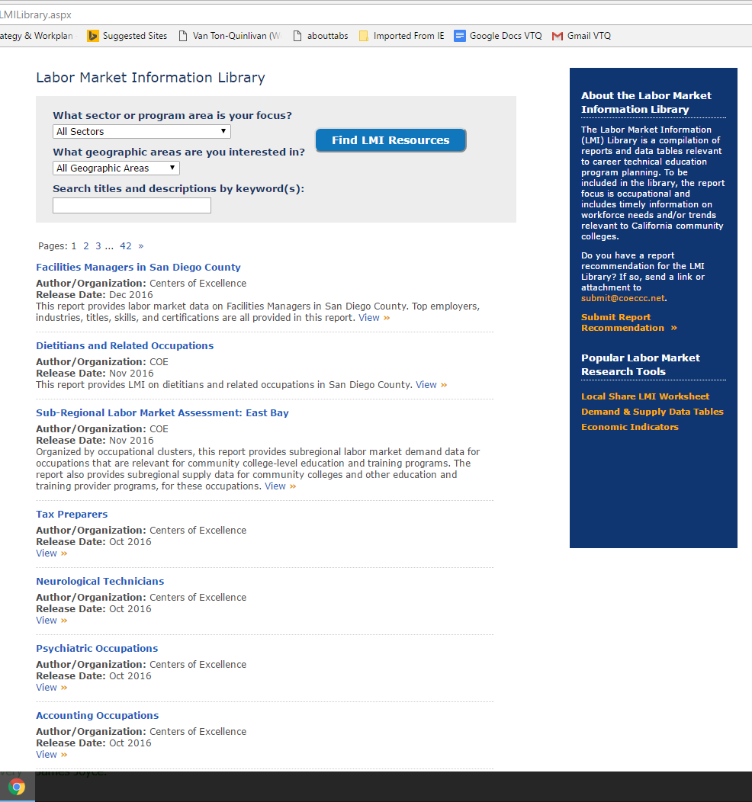
More data tools:
Labor Market Need
Notes:
Matt Roberts

Slide 11
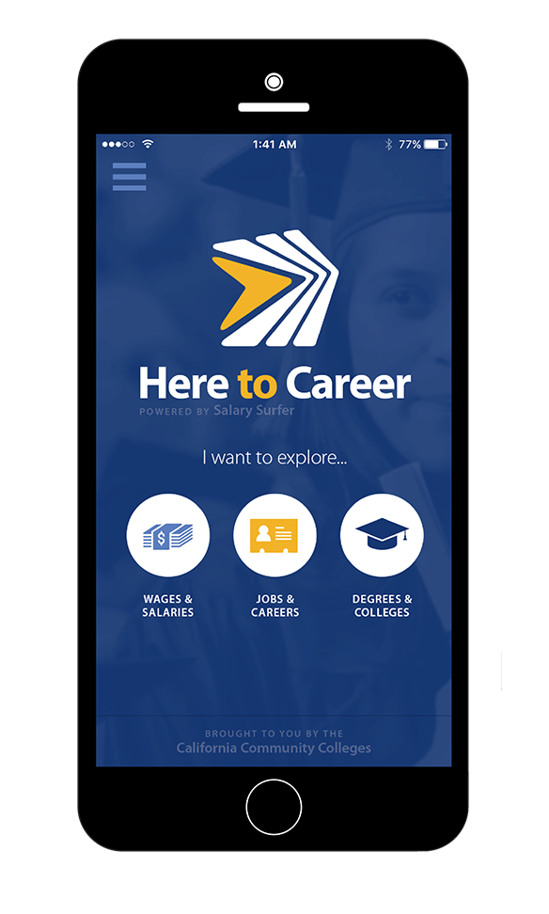
Innovations-at-scale….to benefit students
Top Ten
21st Century Skills
Adaptability
Analysis/Solution Mindset
Collaboration
Communication
Digital Fluency
Entrepreneurial Mindset
Empathy
Resilience
Self-Awareness
Social/Diversity Awareness
doingwhatmatters.cccco.edu
Notes:
Van Ton-Quinlivan
cccMaker = 28 colleges….CTE and GE faculty collaborating
GFSF Current:
Cuesta College
Bakersfield Community College
Berkeley City College
Woodland Community College
Ventura College
Santa Barbara City College
Porterville College
Pasadena City College
Imperial Valley College
Laney College
Feather River College
College of the Canyons
Canada College
American River College
Lake Tahoe Community College
Oxnard College
Norco College
Southwestern Community College
GFGF Fall 2017:
East Los Angeles College (ELAC)
Mendocino College
Allan Hancock College
Butte College
Sierra College
Lassen College
Shasta College
Mendocino College
San Joaquin Delta College
Santa Ana College
Santa Monica College
Contra Costa College
Skyline College
Cal State Monterey (CSUMB)
Cal State Long Beach (CSULB)

Slide 12
Visit
DoingWhatMATTERS.cccco.edu
AEBG.cccco.edu
doingwhatmatters.cccco.edu

