Slide 1
CAEP Carryover Compliance
NOVA Enhancements 2024
January 30, 2024

Slide 2
Agenda
Introductions
AB 1491 Overview
Member Carryover Compliance
Consortia Carryover Compliance
NOVA Enhancements
Tools and Resources

Slide 3
Presenters:
Mayra Diaz California Community Colleges Chancellor’s Office
Neil Kelly California Department of Education
Mandilee Gonzales
CAEP Technical Assistance Provider
Susan Wynn
KAI Partners

Slide 4
AB 1491 Carryover Compliance Overview
Impacts ED Code 84901 & 84914
Tracking begins FY 23-24 (July 1, 2023)
Addresses actions related to carryover of funds from a previous FY to the next
Has two parts that impacts members and consortia differently:
Member Level
Members vote to set a carryover % threshold within their consortium.
Consortium Level
Consortia exceeding 20% carryover annually will be monitored by the Chancellor’s Office and CDE.
Consortia exceeding 20% carryover annually will be required to submit a written expenditure plan and assigned technical assistance by the Chancellor’s Office and CDE.
Member funding for one year may be impacted after two years are assessed.

Slide 5
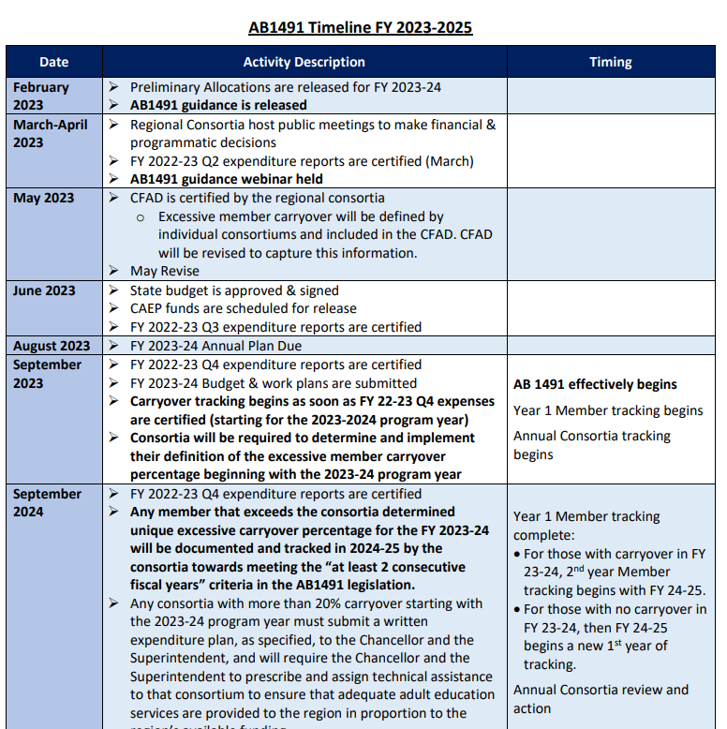
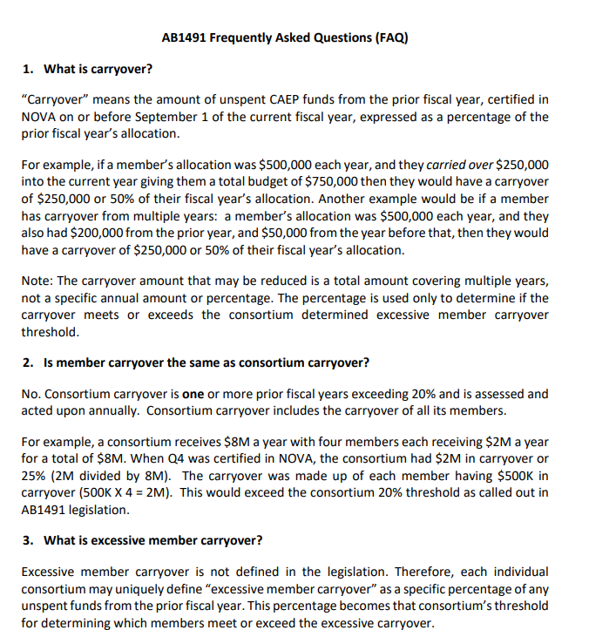
State Policy Guidance Issued: February 27, 2023
AB 1491 Guidance
AB 1491 Timeline
FAQ

Slide 6
Member Carryover Compliance

Slide 7
Carryover Compliance for Members
AB 1491 legislation authorizes a consortium to reduce a member's allocation by no more than the amount of the member's carryover
Authorizes not mandates
Reduce funds by no more than the carryover

Slide 8
Carryover Compliance for Members (continued 2 of 3)
If the consortium makes a finding by a majority vote, based on the member having excessive carryover for at least 2 consecutive fiscal years beginning with the 2023–24 fiscal year, a consortium is authorized to reduce a member's allocation by no more than the percentage of the member's carryover.

Slide 9
Carryover Compliance for Members (continued 3of 3)
Has to be a majority vote
“Excessive” member carryover is determined by each consortia
Must be two consecutive fiscal years
Funds may be reduced by no more than the carryover; the amount could be from 0% up to the total amount of carryover
Fund reduction is for that fiscal year only and does not impact the base allocation of future years
Vote could take place once Q4 is certified

Slide 10
Excessive Member Carryover
“Excessive” member carryover is not defined in the legislation.
Each individual consortium may uniquely define “excessive” member carryover as a specific percentage of any unspent funds from the prior fiscal year.
This percentage becomes the consortium’s threshold for determining which members meet or exceed the excessive carryover.
Each consortium defines this percentage annually when completing the Consortium Fiscal Administration Declaration (CFAD), starting with FY 23-24.

Slide 11
FY 23-24 Carryover Threshold –
CAEP Consortia Counts
Threshold Carryover Percentage | # of Consortia
15% | 4
19% | 1
20% | 38
30% | 1
40% | 1
Opted Out | 26

Slide 12
Majority Membership Vote
Education Code Section 84914 (d)(1) was amended to state that a finding to reduce carryover made by a consortium shall require a majority vote of its membership to vote and approve.
Membership is defined in Education Code Section 84905(a) as: any community college district, school district, or county office of education, or any joint powers of authority located within the boundaries of the adult education region.
Each member will have one vote when voting on reducing member carryover.

Slide 13
Carryover Reduction Amount
AB 1491 legislation authorizes a consortium to reduce a member’s allocation by “no more than the amount of the member’s carryover” as certified in Q4 of the previous fiscal year.
The legislation does not specify a percentage or an amount.
Consortia will decide how much of a reduction is appropriate based upon a % threshold; no more than the amount of the carryover.
The vote to reduce a member’s agreed carryover amount will affect the prior year carryover only, not future years’ allocation or base funding.

Slide 14
Member Carryover Reduction Process
Beginning in the 2023-24 fiscal year, the consortium must track member carryover to determine if the member has excessive carryover for at least two consecutive fiscal years.
Excessive carryover, as determined by the individual consortium, would be based on the certification of Q4 in NOVA on or before September 1 (with the consortium certification by September 30).
The consortium must offer members locally determined technical assistance to help prevent them from having two consecutive fiscal years of carryover funds.
If the consortium determines that a member has excessive carryover for at least two consecutive fiscal years, and a reasonable intervention has not eliminated the carryover, then the consortium can reduce the member’s carryover with the required majority vote.

Slide 15
Consortium By-Law Updates Considerations
A consortium may need to evaluate their by-laws to ensure that they can accommodate or include changes in the law/education code. Some items for consideration are:
Agreement on the percentage of member carryover that will be defined as excessive.
Agreement on the % of member carryover that will be reduced.
Decision-making / majority voting process to reduce the member carryover.
Consortium technical assistance / reasonable intervention to help avoid a member carryover finding.

Slide 16
Carryover Compliance Takeaways for Members
Be clear in your consortium governance how you plan to implement this new legislation.
Track members and assess annually: offer interventions, vote on possible one-time carry-over reduction.
Consortia needs to fill in the gaps on how much will be reduced, voting process, timetable / check-ins, and how to utilize any reallocated carryover funds.
Consortia and members can use the tools to assist with tracking that are available in NOVA.
There are some risks by doing nothing (see consortium requirement not to exceed 20% carryover)

Slide 17
Consortium Carryover Compliance

Slide 18
Consortium Carryover Compliance
AB 1491 requires a consortium with carryover from one or more prior fiscal years exceeding 20% to….
Submit a written expenditure plan, to the Chancellor and the Superintendent
Chancellor and Superintendent will:
“Prescribe and assign technical assistance to that consortium to ensure that adequate adult education services are provided to the region in proportion to the region's available funding.”

Slide 19
Consortium Carryover Tracking Timeline
Consortium carryover tracking began at the start of FY 23-24. First year of tracking will complete once Q4 expenses are certified by September 30, 2024.
This start date includes the tracking of both member carryover and consortium carryover.

Slide 20
Calculating the 20% Consortia Carryover
Consortium carryover is one or more prior fiscal years exceeding 20% and is assessed and acted upon annually.
NOTE: Consortium carryover includes the carryover of all its members.

Slide 21
Consortium Written Expenditure Plan
AB 1491 requires a consortium with carryover from one or more prior fiscal years exceeding 20% to submit a written expenditure plan, as specified, to the Chancellor and the Superintendent.
The consortium required written expenditure plan will populate in NOVA.
This will also allow the State to track the progress of the expenditure plan.

Slide 22
Technical Assistance
The State will assign technical assistance to those consortia to ensure effective use of funds as specified by policy, and to ensure that the consortium’s annual carryover does not continue to exceed the 20% threshold so that it continues to provide adequate adult education services to the region.
This will include Technical Assistance from the enhanced CAEP Technical Assistance Providers, Sacramento County of Education and North Orange Continuing Education.

Slide 23
CAEP Carryover Compliance NOVA Enhancements
*DISCLAIMER
At this time, there will be NO DATA populated in NOVA surrounding the enhancements on AB 1491 carryover compliance tracking for members nor consortium, as there isn’t data available until after FY23-24 Q4 certification (post September 30, 2024).
The following NOVA screenshots are from a test system and do not reflect real data; they are for illustrative purposes only.

Slide 24
NOVA Terms & Definitions for CAEP
FIFO:
First In First Out - When an allocation has a multi-year spending duration, expenditures are earmarked against the oldest allocation year first. Once a year’s allocation is exhausted, expenditures are earmarked against the next allocated funding year.
Allocation:
The amount of funding distributed from the state to the consortium and distributed completely among the active member institutions each funding year.
CAEP allocated funds have a 30-month spending duration.
Available Funds:
The current allocation plus any true carryover funds from the prior fiscal year. The available funds are required to be 100% utilized for the member budget and workplan.
Allocation + True Carryover = Available funds
Budget:
Budget and Available Funds are always equal dollar amounts. A member’s annual budget is the available funds. Or, the sum of the current year allocation amount + any actual carryover.
Allocation + True Carryover = Available Funds
A member’s unspent available funds calculated when Q4’s fiscal report is certified. This is the dollar amount that will be added to the next year’s allocation to equal the available funds.
Budget - Expenditures = True Carryover
True Carryover:

Slide 25
NOVA Terms & Definitions for CAEP- continued
AB 1491 Carryover:
The amount of funds that remain unspent on midnight September 30th of each fiscal year. In instances where Q4 reports have been certified, these numbers will be equal. When Q4 reports have not been certified by Sept. 30th, this definition of carryover will be different from the actual carryover. This is the number used to determine Consortia Carryover Compliance.
Allocation - Certified Expenditures as of 9/30 = AB 1491 Carryover
AB 1491 Carryover Percentage:
The percentage of the allocation remaining at the close of the fiscal year. Note, this is not based on the remaining budget.
(Allocation - Certified Expenditures as of 9/30) / Allocation = Carryover Percentage
Remaining Allocation:
The amount of a funding year allocation that remains after expenditures are earmarked against it. This is not the same as carryover.
Earmarking:
The process of appropriating expenditures against an allocation based on the FIFO principle. At Q4 certification, expenditures for the year are appropriated against the oldest remaining allocated funds. This process decrements the oldest remaining allocation to $0 before appropriating expenditures to the next allocation.

Slide 26
Consortium Fiscal Administration Declaration (CFAD) Update
Added to the CFAD process the ability for each consortium to establish their carryover compliance threshold. A consortium may also opt out. Gets revisited annually.
Should a consortium opt in by establishing a carryover compliance threshold, they will also establish a corrective action plan threshold by quarter.
Year one (FY 23-24) quarter thresholds were preset in NOVA.
FY 24-25 and onward will be managed by consortia, requires all members to agree.
Corrective action plan threshold is to monitor and encourage members to conform to an acceptable expenditure rate throughout the year.
Should a members carryover exceed the corrective action plan threshold, they will be asked to provide an explanation of the reasons during quarterly expenditure reporting.
Notes:
First development implemented in Spring 2023 before CFAD was due, May 2, gave the field an opportunity to select the desired carryover threshold.
Green dots simply identify the enhancements that were made.

Slide 27
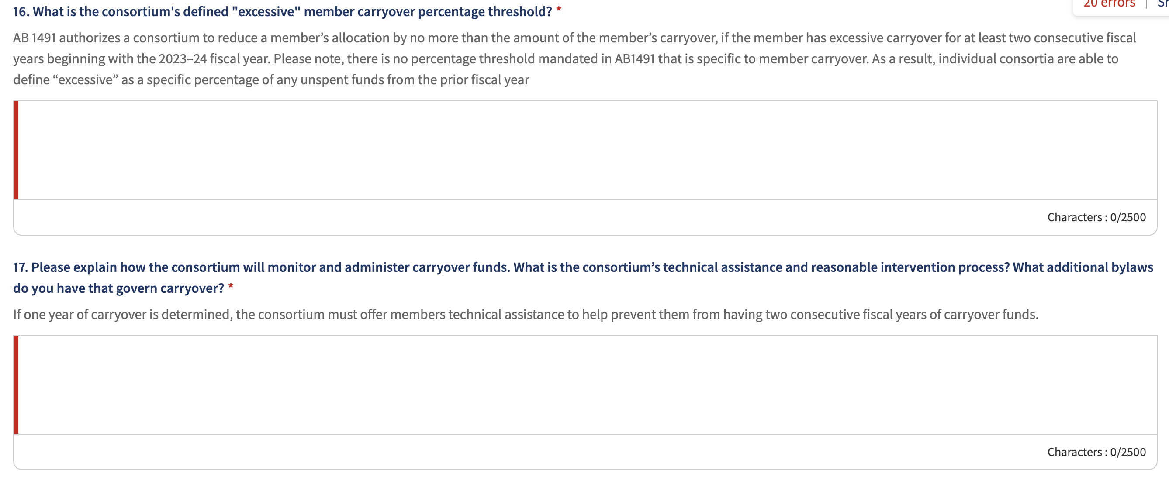
Q16 and Q17 AB 1491 carryover compliance
Q16 and Q17 were added in FY23-24 as part of AB 1491 carryover compliance. These questions ask consortia to define the member carryover percentage threshold and the process to monitor carryover.

Slide 28
Compliance Tracking & Identification
Identifying Carryover Compliance
Carryover compliance is calculated in NOVA upon Q4 certification.
Carryover compliance calculated on September 30 at 11:59 p.m.
If a consortium has carryover, in Fiscal Reporting, a tag appears next to the consortium name.
The tags that will be visible next to the member in fiscal reporting are:

Slide 29
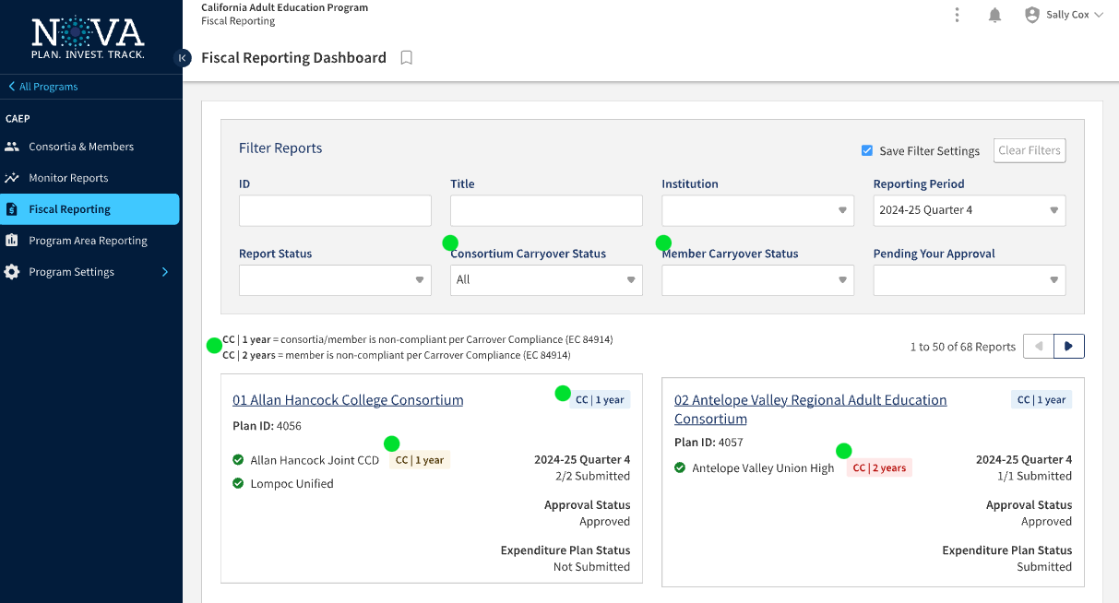
Fiscal Reporting Dashboard Mock-Up Example
Notes:
This will not be live until after Q4 is certified after September 30, 2024.

Slide 30
Fiscal Reporting Update - Consortia Carryover Tracking Ribbon

Slide 31
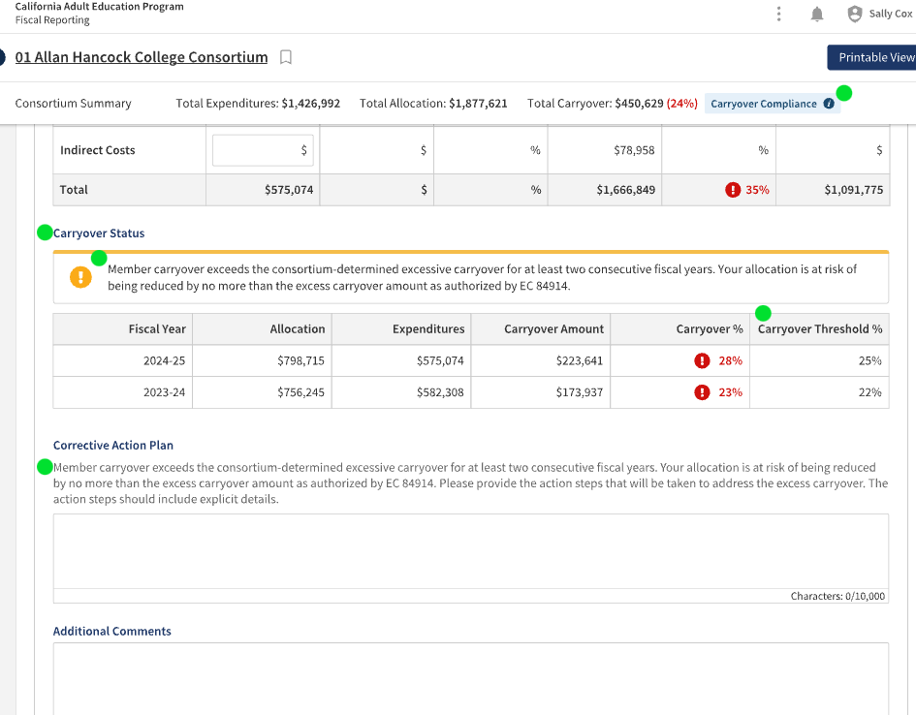
Screenshot of NOVA
Notes:
This will populate in the Fiscal Reporting Tab. Member level carryover

Slide 32
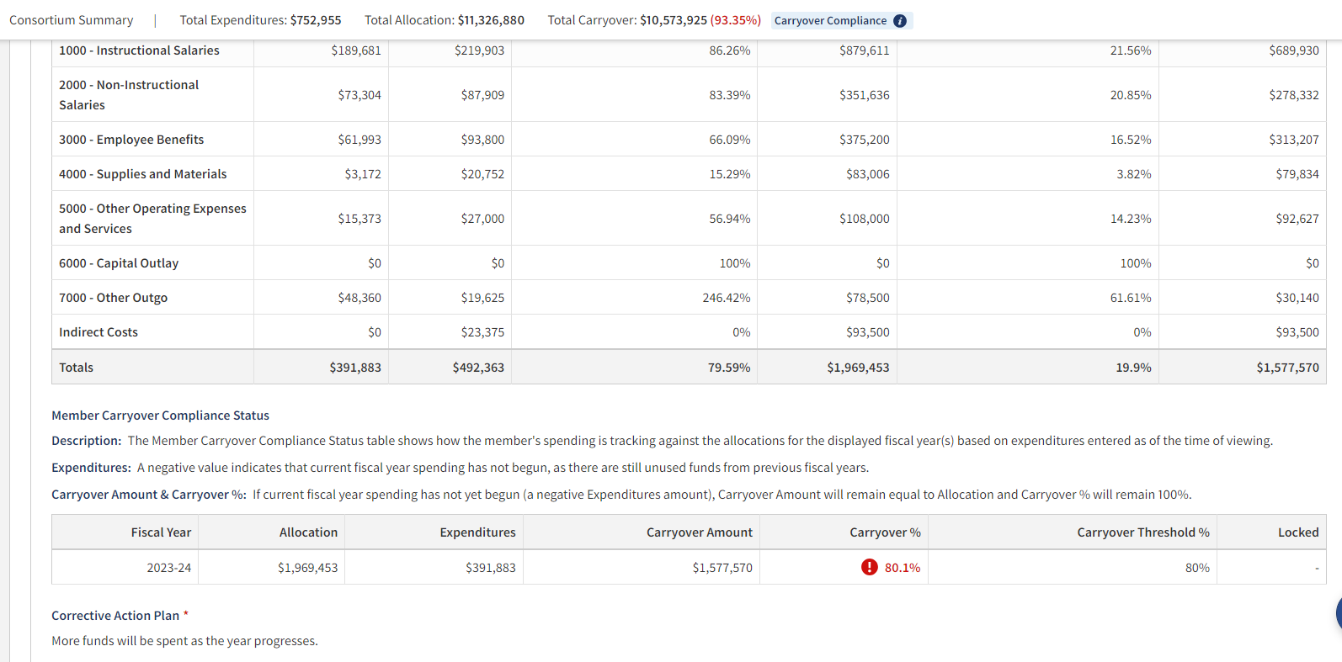
Fiscal Reporting Update – Example A
Notes:
This will populate in the Fiscal Reporting Tab. Member level carryover

Slide 33
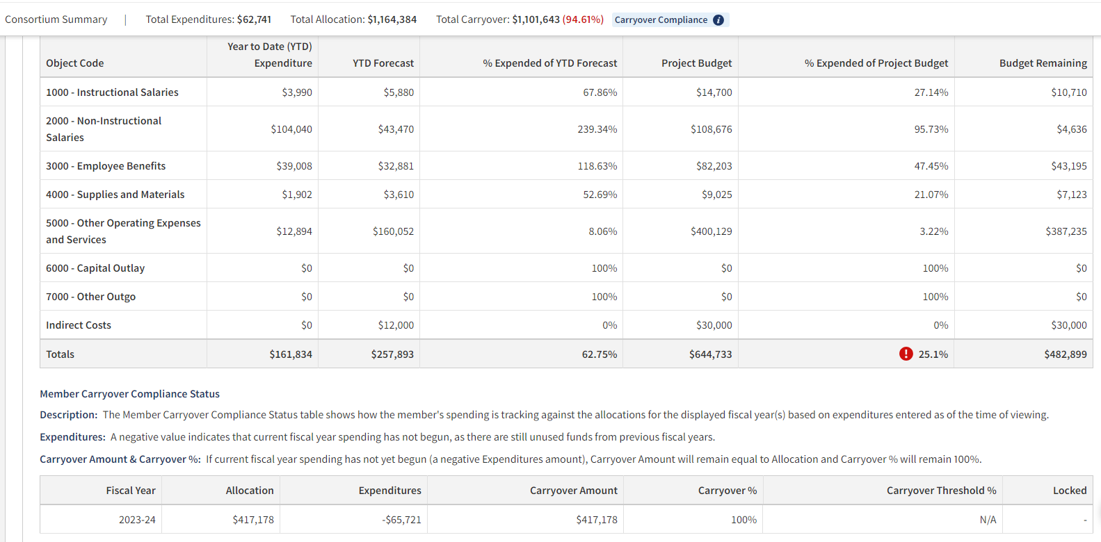
Fiscal Reporting Update - Example B
Notes:
This will populate in the Fiscal Reporting Tab. Member level carryover

Slide 34
Member Corrective Action Plan
When a member’s quarterly expenditures are entered, NOVA will calculate the carryover percentage for that quarter. Should the quarter’s carryover percentage exceed that of the Corrective Action Fiscal Reporting Quarterly Threshold, a corrective action plan will appear as required.
The corrective action plan is a single narrative asking for an explanation of the steps taken to become compliant with the Corrective Action Fiscal Reporting Quarterly Threshold the following quarter.
Notes:
Member Corrective Action Plan logic was updated during the NOVA enhancements changes to align with carryover compliance. Previously, the corrective action plan was triggered by expenditures, now, logic is on carryover.

Slide 35
NOVA Enhancements - Members
If Carryover Exceeds Threshold:
Year 1 – No action
Year 2 – Consortium members may vote to reallocate carryover amount of member(s) exceeding consortium-determined threshold.
Allocation adjustments are made in NOVA and designated as ‘Carryover Compliance’

Slide 36
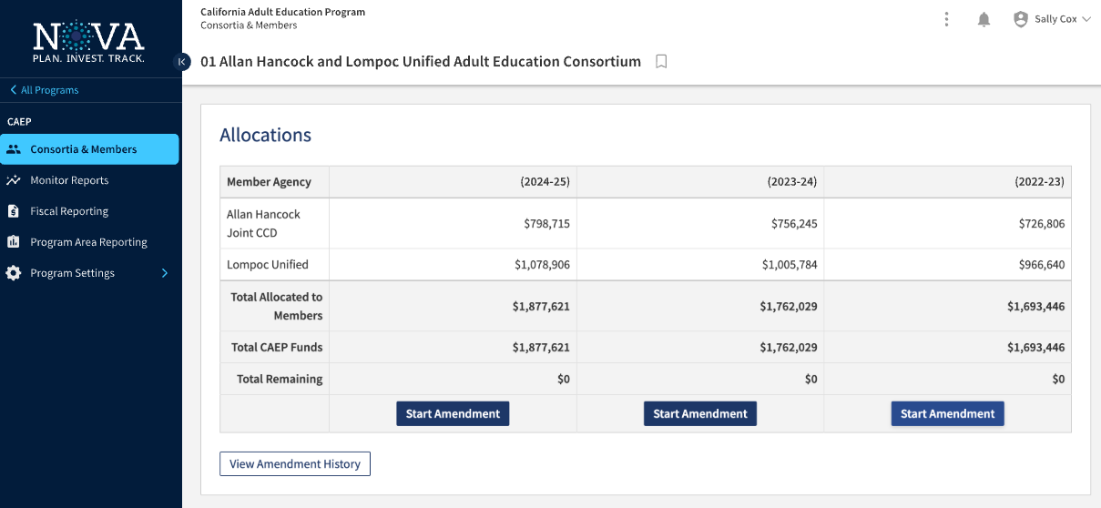
Member Allocation Amendment

Slide 37
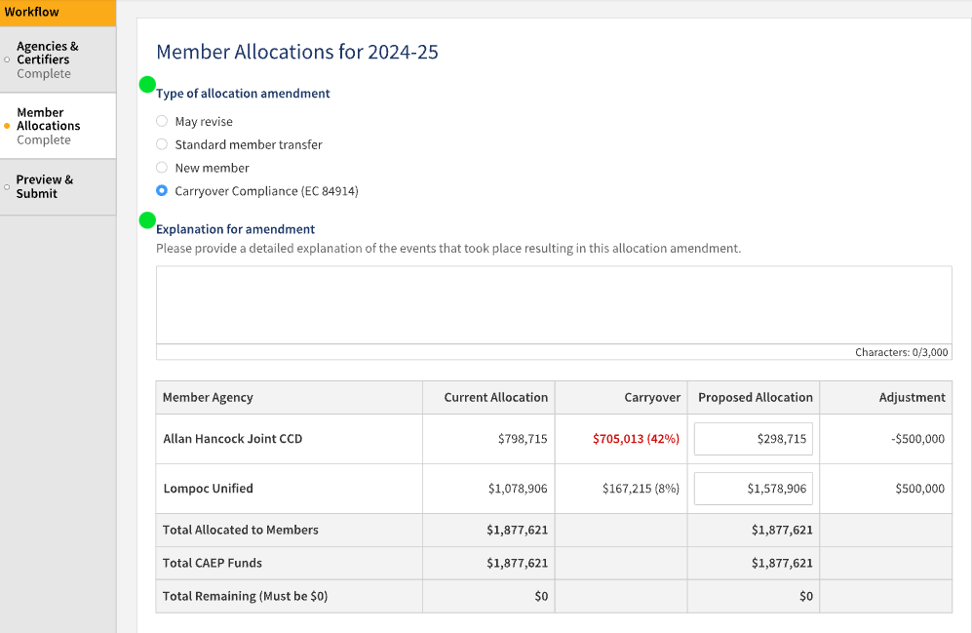
Member Allocation Amendment (cont.)
Notes:
Updates to the allocation amendment process. A reason for the allocation amendment will now be captured. Should the reason be carryover compliance, there will be validation to ensure money is only taken from non-compliant members and that it does not exceed their carryover amount.

Slide 38
Consortium Written Expenditure Plan (1 of 3)
If annual consortium carryover is greater than 20%:
Consortium must complete a Written Expenditure Plan.
Consortium lead receives a notification and alert to complete the Written Expenditure Plan in NOVA.
Notification is in the NOVA dashboard as a new requirement on the consortium’s main screen.
Approval of plan is required by majority of consortia members.
Approval is also required from the State Office.
38
Notes:
When a consortium becomes non-compliant, they are required to complete a written expenditure plan. The consortium lead contact(s) will receive a notification and alert in their user dashboard to complete the written expenditure plan. In addition, it will appear as a new requirement on the consortium’s main screen.
Upon completion of the written expenditure plan, the approval process will require a majority member approval. Should a majority approval be achieved, the approval will then require State Office approval.

Slide 39
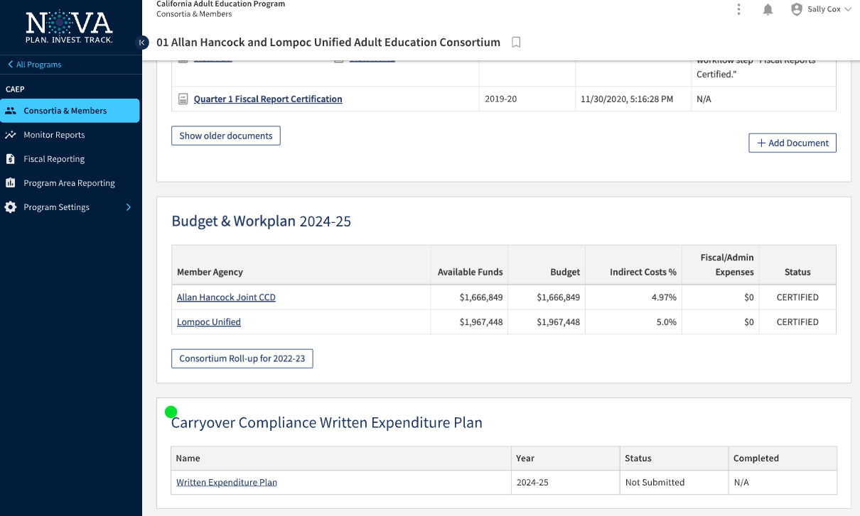
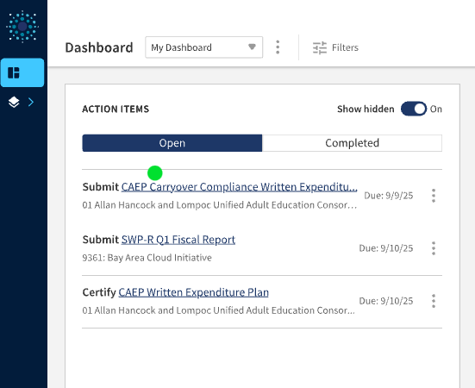
Consortium Written Expenditure Plan (cont. 2 of 3)

Slide 40
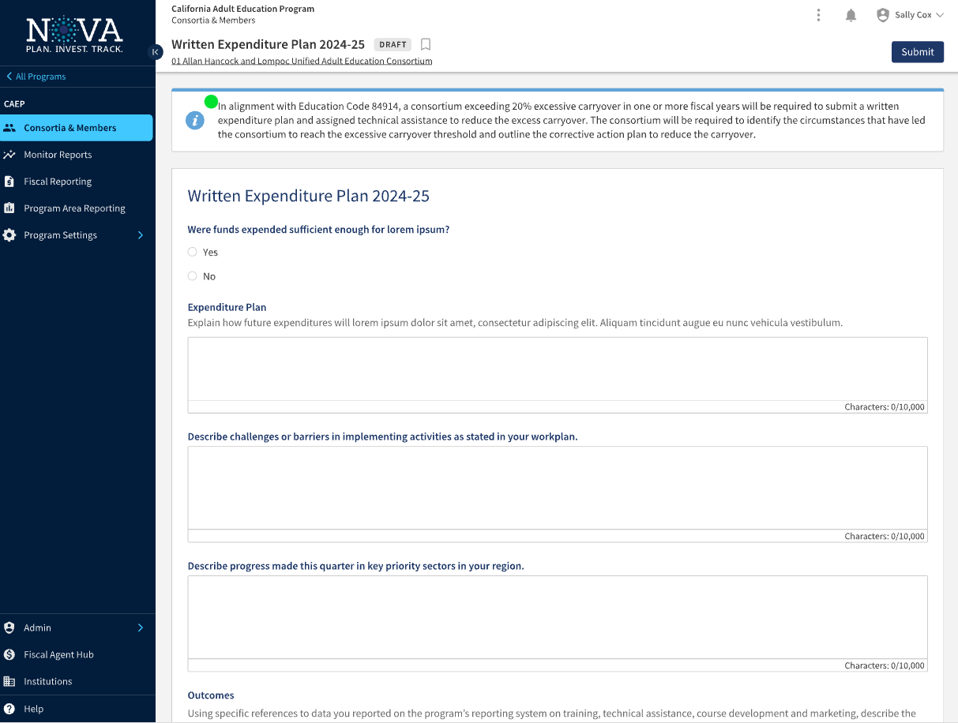
Consortium Written Expenditure Plan (cont. 3 of 3)
20

Slide 41
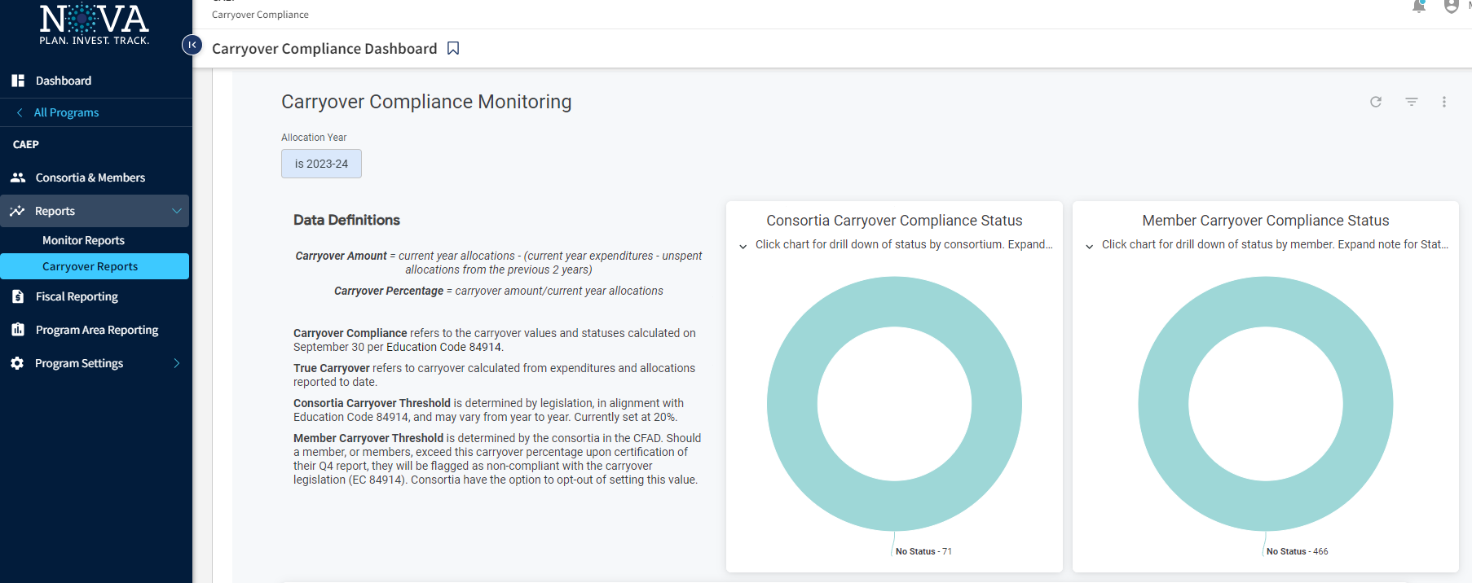
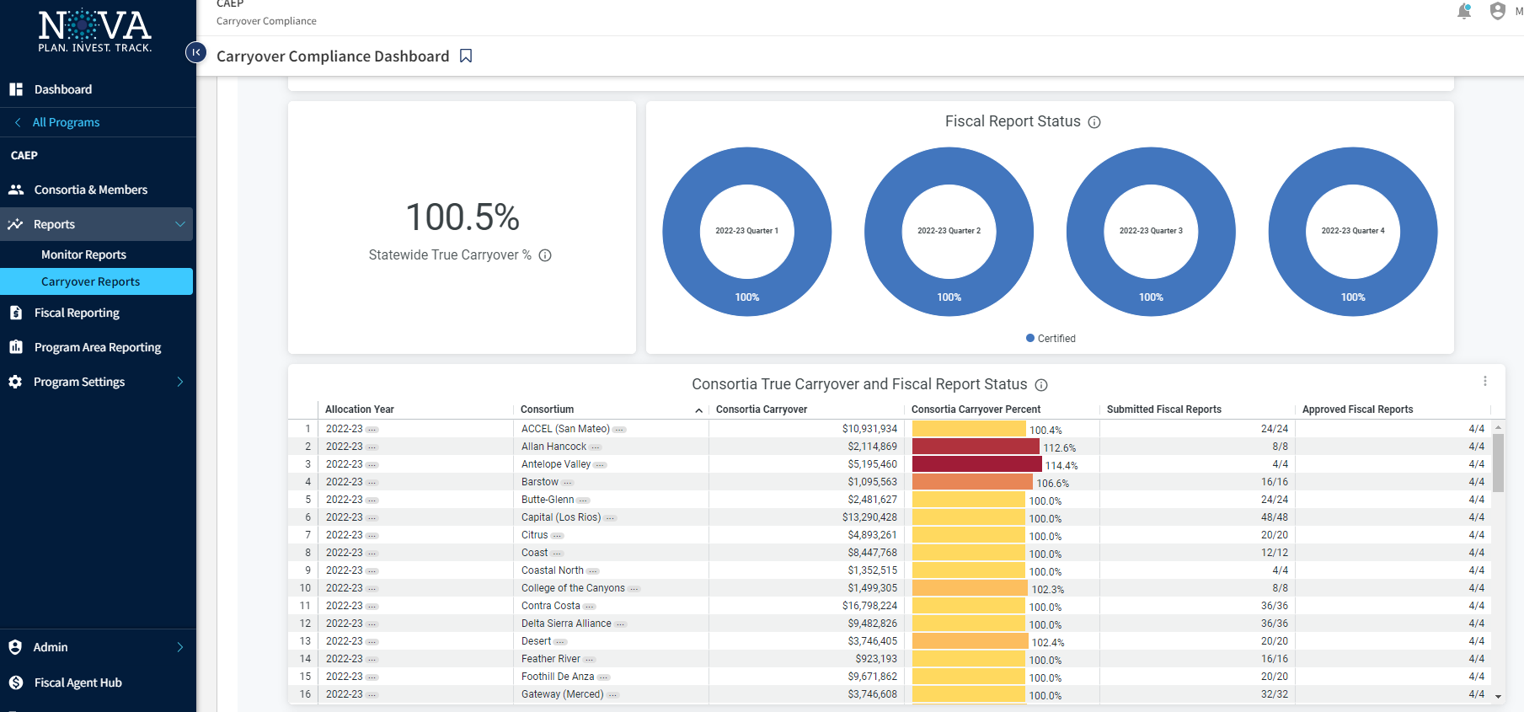
Carryover Compliance Dashboard *Note – This dashboard is only intended to capture carryover compliance data.

Slide 42
Carryover Compliance Dashboard

Slide 43
Live Demo Walk Through

Slide 44
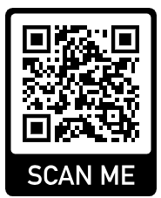
CAEP TAP Support
Resources:
AB 1491 Guidance
AB 1491 Timeline
Updated Program Guidance w/ AB1491 FAQ
Webinar Chat Q&A (March 23, 2023)
Professional Development: CAEP Technical Assistance Project Events

Slide 45
Tools & Resources
NOVA
Forecasting tool
Expenditure threshold percentage tool (state level setting)
Member Corrective Action Plan
Annual Plan question on carryover (Fiscal Management section)
Reports for carryover at the member level
CFAD governance section on carryover (Q#16 & Q#17)
CAEP Technical Assistance Providers (TAP)
Consortium on-boarding (governance, administrative functions)
Targeted technical assistance
NOVA workshops and technical assistance
Professional Learning Circles (PLC)

Slide 46
Request Support from CAEP TAP

Slide 47
Thank you!

