Slide 1
Budget and Work Plan and
Quarterly Expenditure Reports for 2023-24

Slide 2
Presenters:
Mayra Diaz
Chancellor’s Office
Neil Kelly
California Department of Education
Renee Collins
CAEP TAP – Sacramento County of Education
Mandilee Gonzales
CAEP TAP – Sacramento County of Education

Slide 3

Agenda
Presentation Outcomes
Sequence of CAEP Deliverables
Reporting Requirements
Budget and Work Plan
Technical Assistance
Resources
Live Demonstration in NOVA
Q & A

Slide 4

Outcomes
  Understand the sequence of CAEP deliverables, the importance of timely reporting, and how each component is a building block to the next step as it pertains to the Budget and Workplan and Quarterly Expenditure Reports.

Slide 5
Sequence of CAEP Deliverables
Allocation
CFAD
Annual Plan
Annual Plan - August 15th
This must be approved in NOVA before the Budget and Work plan opens.
Identify the strategies/activities and metrics from the three-year plan.
Formulate and implement strategies.
Identify plans of action to increase student outcomes
Consortium Fiscal Administrative Declaration CFAD
The CFAD must be Consortium Approved by May 2 of each year.
The CFAD consists of four main components, which include the Fiscal Declaration, Agencies & Certifiers, Member Allocations, and the Preview sections.
Allocation Amendments & Budget Changes
Preliminary Allocations released by February 28th.
Consortia certification via the CFAD by May 2nd.​
May Revise (mid-May) and/or Trailer bill (late June)adjustment.​
State submits CAEP schedules to DOF (July 15th)​
State begins CAEP fund disbursement (August 15th)​
Consortium members certify amendments (September 1st)
Notes:
Allocation: The initial release of the preliminary allocations starts the cycle for the CFAD
Reminder: CFAD CFAD is approved, it can’t be edited.
Three-Year Plan : Next one is due in 2025
Assess the impact of services provided over the previous period
Define strategies and activities to meet needs
Identify educational and workforce needs among beneficiaries and providers in the region

Slide 6
Sequence of CAEP Deliverables (cont.)
Budget and Workplan
Program Area Report
Expenditure Report
Once the member submits their work plan and budget, the consortium membership will review, approve, and certify for the upcoming year.
If the member has changes to their work plan and/or budget, they will go back through NOVA and update.
Budget & Workplan
Program Area Report
All members (K12 districts, county offices of education, joint powers authority, and community college districts) must submit in NOVA the total operational cost by fund source and instructional hours in the seven CAEP program areas (adult education/noncredit). Fund sources also include any fee revenue collected.
Consortium members are required to submit their expenses in NOVA. Expenditure reports are year to date (cumulative) and expenses cannot be less than what was reported in the previous quarter.
Expenditure Reports; quarterly reporting
Consortia Lead will use the same process of consortium membership review, approval or reject, and certification.
If rejected, a change of $1 must be made before resubmitting.

Slide 7
Expense Reporting Cycle
Q1
Report Due
Member
December 1
Consortium December 31
Q2
Report Due
Member March 1
*Close out of prior, prior year Member Funds due in NOVA
Q3
Report Due
Q4
Report Due
Member
September 1 (prior year)
Consortium September 30 (prior year)
Member June 1
(prior year)
Consortium June 30
(prior year)
Reminder:
The target spend down date for 2021-22 funds is June 30, 2023. With a corrective action plan, funds can be spent through December 31, 2023. However, the corrective action plan must include clear, concise, and actionable steps to spend down by December 31, 2023.
Reminder: The Quarter 2 certification also includes the closeout of the 2020-21 funds. After the certification process, any 2020-21 funds that have not been expended will be returned to the State.
Consortium Certified March 31
*Close out of prior, prior year Member funds in NOVA certified by Consortia in NOVA
Notes:
Once the member expense report is submitted, the consortium must review, approve, and certify.
*If the due date falls on a weekend or a holiday, the report shall be due by close of business on the last working day prior to the reporting deadline.
Members or consortia that need assistance to submit their reports on time can reach out for technical assistance through CAEP TAP.

Slide 8
Quarterly Expense Reporting
Quarter | Member Deadline | Consortia Deadline
First Quarter | December 1 | December 31
Second Quarter | March 1 | March 31
Third Quarter | June 1 | June 30
Fourth Quarter | September 1 | September 30
Once the member expense report is submitted, the consortium must review, approve, and certify.
*If the due date falls on a weekend or a holiday, the report shall be due by close of business on the last working day prior to the reporting deadline.
Members or consortia that need assistance to submit their reports on time can reach out for targeted technical assistance through CAEP TAP.

Slide 9
Q4 Expense Report Reminders
Due Dates:
Once the Q4 Expense Report is closed, it cannot be reopened.
Quarter 4 must be closed out to reflect accurate available funds in the 2023-24 Budget and Workplan.
If Quarter 4 is not closed out, members will see double allocations in their “Available Funds”.
Best practice is to complete the Quarter 4 expense report prior to completing the 2023-24 Budget and Work Plan.
September 1: | 21/22 and 22/23 Member Expense Report due in NOVA
September 30: | 21/22 and 22/23 Member Expense Report certified by Consortia in NOVA

Slide 10

AB 1491 Reminders!
Tracking begins FY 2023-24
Member carryover impacts consortia carryover
FY 2023-24 Q4 will be certified September 30th, 2024
AB 1491 authorizes the consortium to reduce a member’s “excessive” carryover funding (EC 84914). Consistent with:
  The member no longer wishes to provide services consistent with the adult education plan.
  The member cannot provide services that address the needs identified in the adult education plan.
  The member has been ineffective in providing services that address the needs identified in the adult education plan, including having excessive carryover for at least two consecutive fiscal years beginning with the 2023–24 fiscal year, and each fiscal year thereafter, and reasonable interventions have not resulted in improvements.
  NOVA Enhancements Webinar will be announced soon!

Slide 11

Consortium Responsibilities & Accountability
Consortium should verify that expenditures are aligned to the annual and Three-year plans.
Understanding of the expenditure reporting requirements, including reconciling expenditures and completing budget revisions (if needed) prior to completing the report.
Notes:
Ed Code Related to Funding (EC 84913, 84914):
CAEP funds are expended within the seven CAEP program areas, and are consistent with each consortium's adult education regional plan.
Consortium expenditures must align with the objectives of the consortium’s annual plan as approved by the regional consortium board.
Regardless of whether you choose a fiscal agent or a direct funded structure, a consortium must use their administrative funding to ensure that member fiscal information (budget, expenses, etc.) is valid, and tied to the effectiveness of the consortium plans (3 year & annual). (CAEP FG pg 23)

Slide 12

Related Fiscal or
Administrative Activities
• Develop consortium and member budgets based on CAEP planning.
• Documenting member and consortium activities as it relates to CAEP funding.
• Reviewing each member’s budget & expenditures for State reporting.
• Administering a review process of financial budget & expenses to CAEP planning
(Three-year plans & Annual plans).
• Preparing and setting up fiscal / administrative oversight related meetings.
• Working with members to submit budget & expenditures reports.
• Coordination and tracking of consortium & member spending.
• Coordinating budgets in collaboration with consortium members, district administrators, and accounting staff.

Slide 13

Budget Modifications
Budget modifications must be submitted in NOVA prior to the submission of the quarterly expenditure report.
  In order to submit a budget revision, the consortium primary contact must un-certify the budget and the member representative un- submits, in order to allow changes to be made.
  The member representative enters their changes and re-submits the budget, upon which the consortium primary contact will need to re-certify.

Slide 14

Budget and Workplan Overview
Based on the annual plan strategies (submitted by August 15th) and the CFAD (submitted by May 2nd), each member creates a budget and work plan for the new fiscal year (July 1 to June 30).
The member budget is by object code, which aligns with the member work plan to spend all active funding during that 12-month fiscal year period.
Active funding includes all carryover and new funding combined into one budget.
Due Dates:
September 30: | 23/24 Member Program Year Budget and Work Plan due in NOVA
October 30: | 23/24 Member Program Year Budget and Work Plan certified by Consortia in NOVA

Slide 15

Budget and Workplan Overview (cont.)
The member work plan aligns with the strategies of the annual plan. Members will check off which strategies from the annual plan they are covering with their 12- month budget.
Once the member submits their work plan and budget, the consortium membership will review, approve, and certify for the upcoming year.
If the member has changes to their work plan and/or budget, it will go back through NOVA using the same process of consortium membership review, approval, and certification.
Member Budget and Work Plan from prior year can be modified until submission of Q4 Expenditure Report

Slide 16
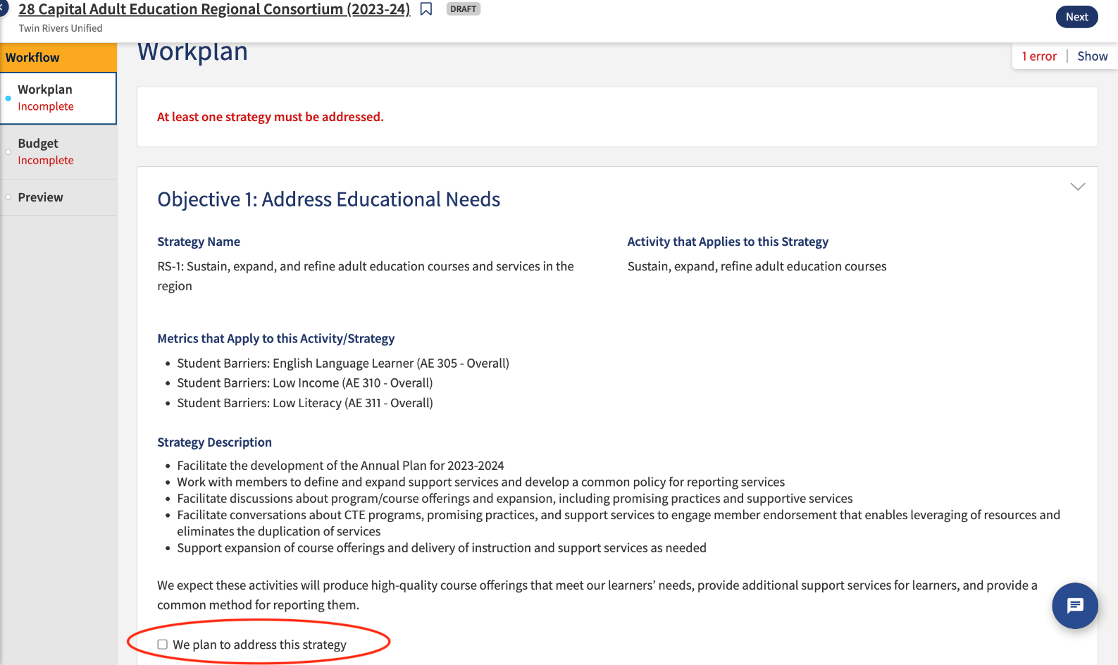
Member Work Plan
Identify strategies that will be addressed within the 3 objectives (must address at least 1 strategy)
Address Educational Needs
Improved Integration of Services and Transitions
Improve Effectiveness of Services
Remember: Objectives, metrics, and strategies are pre-populated in the Workplan.
Objective and strategy language is an automatic import from the Annual Plan. Members select Objectives and Strategies that they will address.

Slide 17
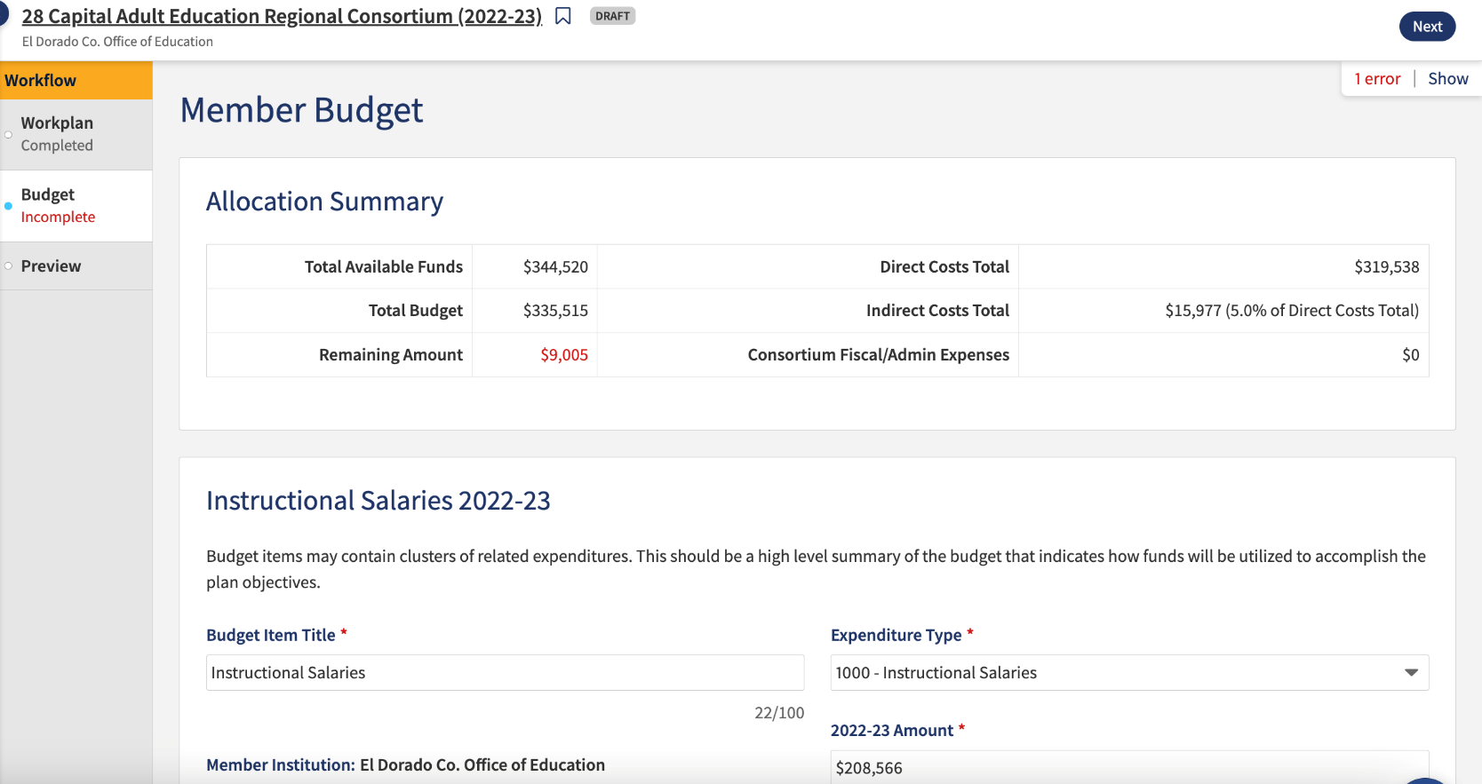
Allocation Summary
The amount showing in red as available on the 23-24 Budget work plan includes 21/22 funds as well as 22/23 available funds.
Once Q4 is certified, the amount will decrease to reflect current available funds.
Reminder: Q4 will need to be completed prior to the Budget and Work Plan opening in NOVA.

Slide 18
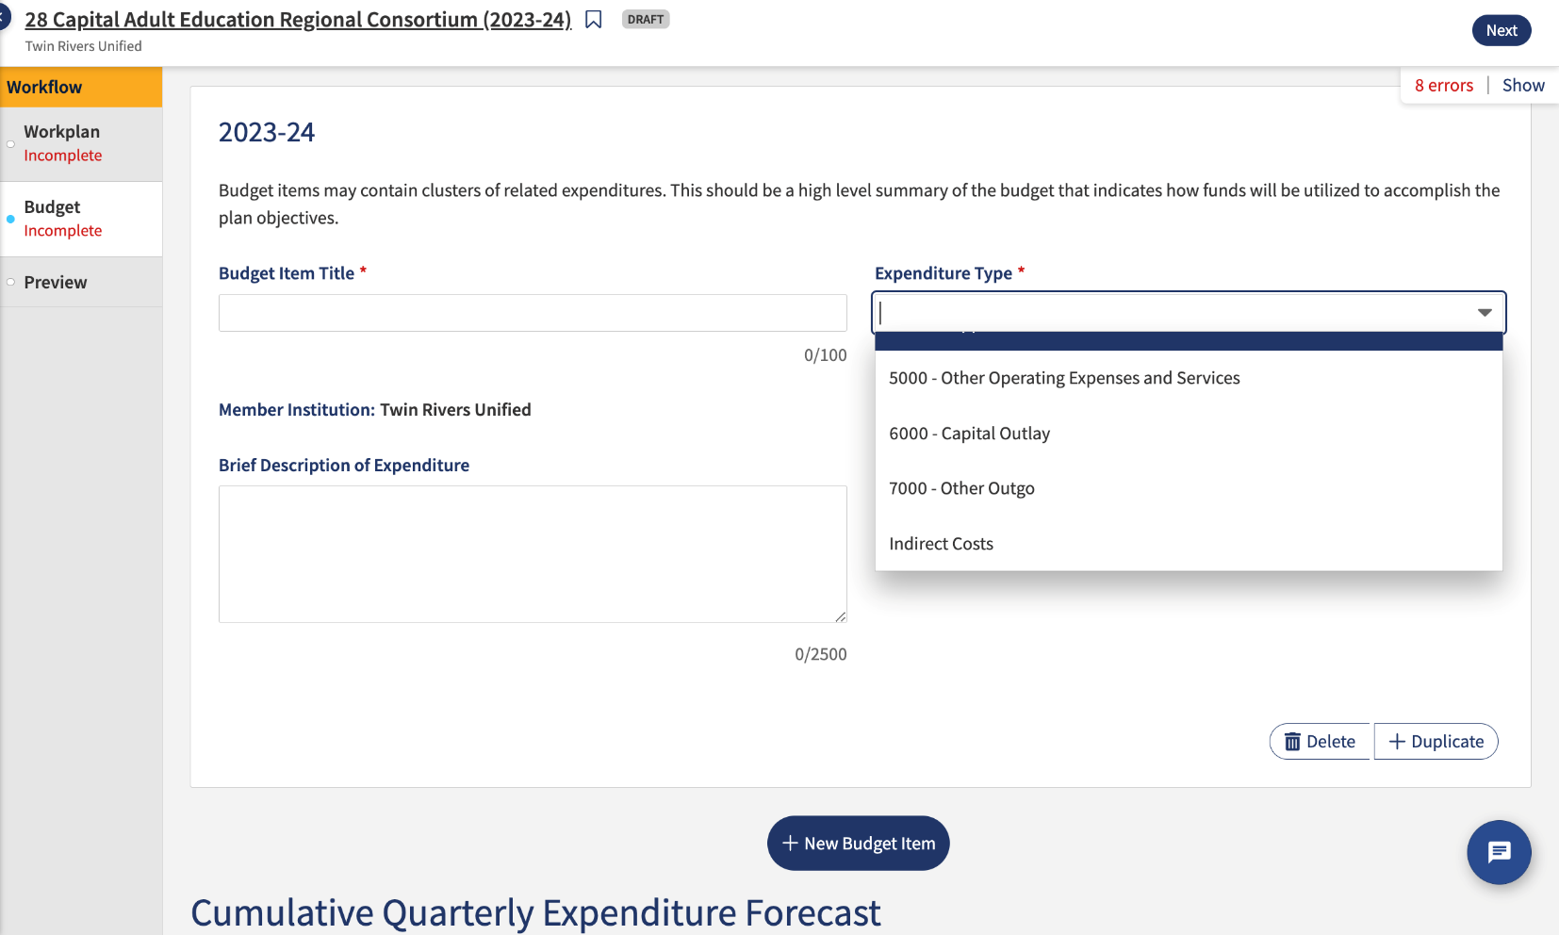
Budget Development
Budget items are entered by Object Code
Total must match the total in the Allocation Amendment.
Include a brief description for each object code.
Indirect cost cannot be greater than 5%.
Notes:
Can cluster related expenditures
This is also the area that agencies can identify consortium fiscal/admin expenses separate from member-specific expenses

Slide 19
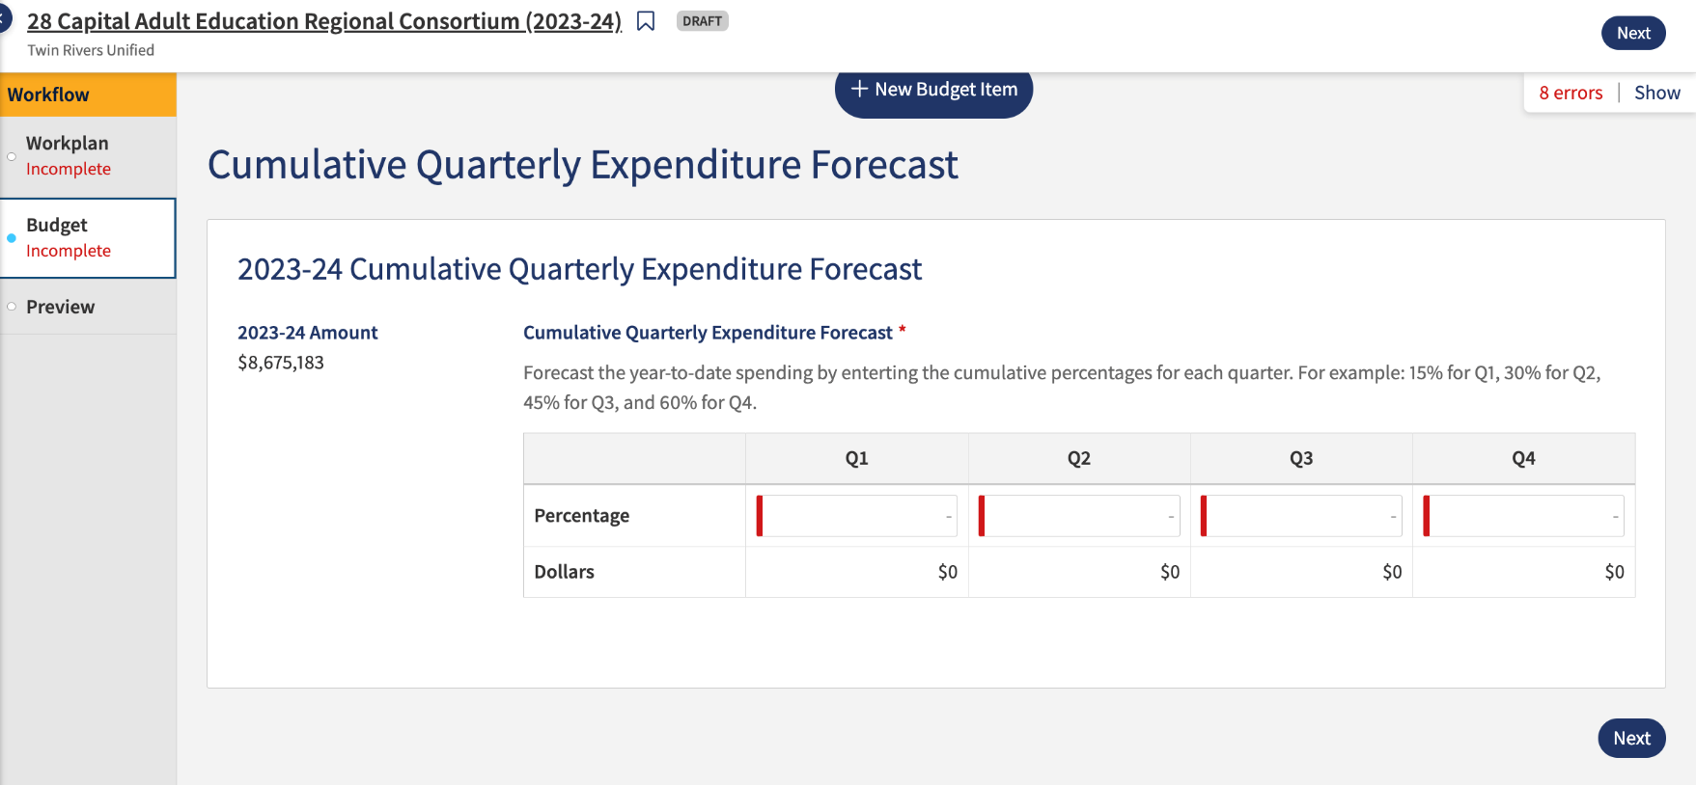
Cumulative Quarterly
Expenditure Forecast
Enter cumulative targets for Q1-Q4
You can enter a member forecast of any percentage so long as by Q4 the minimum remaining expenses are 20% or below

Slide 20

Live NOVA Demonstration

Slide 21
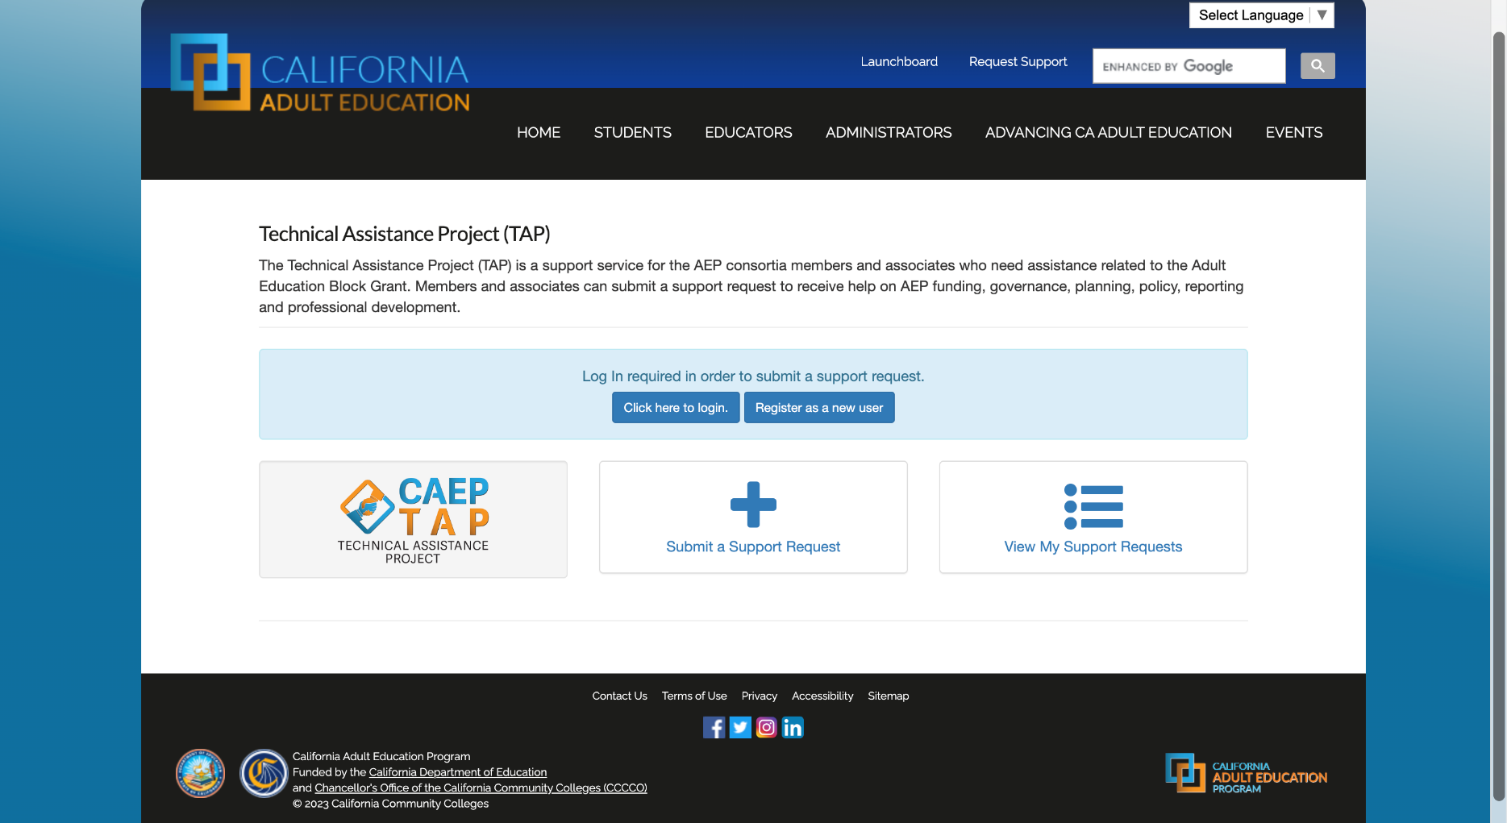
Support Request
If you need assistance with this process, please contact CAEP TAP at tap@caladulted.org or (888) 827-2324.

Slide 22

Questions

Slide 23

Resources
  Adult Education Program Fiscal Management Guide Allowable Uses of Adult Education Program Funds:
  https://caladulted.org/DownloadFile/1300
  Due Dates:
  https://caladulted.org/DueDates
  Support Request:
  https://caladulted.org/TAP?id=TAPLink
  AB 1491 Guidance Memo:
  https://caladulted.org/DownloadFile/1295
  AB 1491 Frequently Asked Questions (FAQ):
  https://caladulted.org/DownloadFile/1298
  AB 1491 Timeline:
  https://caladulted.org/DownloadFile/1297

