Slide 1
Advancing
Digital Equity
&
Social Justice in Adult Education
Veronica N. Parker, Ed.D. & Mandilee Gonzales

Slide 2
What are your interests

Slide 3
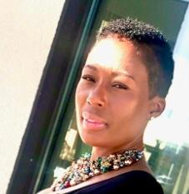
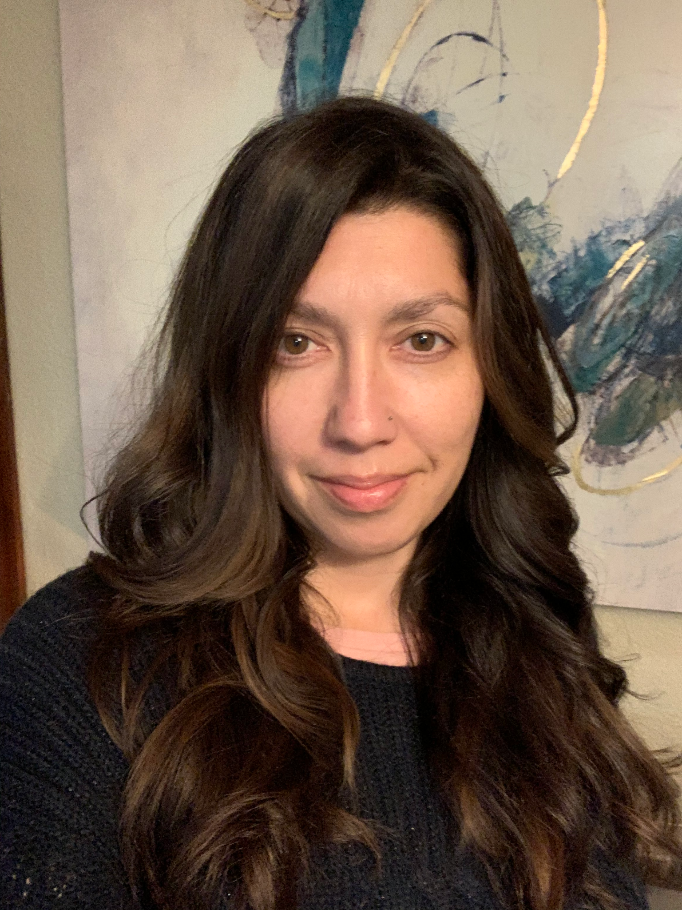
Your Facilitators for Today
Veronica Parker Ed.D.
Coordinator,
Adult Education vnparker@scoe.net
Mandilee Gonzales
Project Specialist,
Adult Education mgonzales@scoe.net

Slide 4
Outcomes
Outcome #1
Outcome #2
To leave with a deeper understanding of what social justice and digital equity are and how they impact the digital divide.
To critically reflect on our positionalities and current research, and identify strategies to close the digital equity gap.

Slide 5
Today’s Agenda
Welcome
Objectives
Essential Agreements
Creating a Brave Space
Historical Context of Education
Critically Reflecting to Assess Positionality
WHAT is Social Justice and WHAT is Digital Equity
Activity: Reflection
Developing Teachers as Agents of Inclusion and Social Justice

Slide 6
Essential Agreements
Stay Engaged
Speak Your Truth
Actively Listen
Assume Best Intent
Expect and Accept Non-closure
Be open to experience discomfort
(Singleton, 2015)
Thank you for trusting us and
participating in this space!

Slide 7
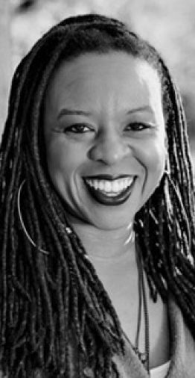
An Invitation to Brave Space by Micky Scott Bey Jones
An Invitation to Brave Space
By
Micky ScottBey Jones
Notes:
https://www.youtube.com/watch?v=D5XSTnYKgS8
https://www.lrng.org/interfaith-youth-core/playlist/interfaith-cooperation-civil-rights-reflect/activity/an-invitation-to-brave-space

Slide 8
Historical Context

Slide 9
Historical Timeline of Public Education in the U.S.
Oppression and Education
The Lens of Systemic Oppression
Notes:
1779 Thomas Jefferson proposes a two-track educational system, with different tracks in his words for “the laboring and the learned.” Scholarship would allow a very few of the laboring class to advance, Jefferson says, by “raking a few geniuses from the rubbish.”
1830s By this time, most southern states have laws forbidding teaching people in slavery to read. Even so, around 5 percent become literate at great personal risk.
1820-1860 The percentage of people working in agriculture plummets as family farms are gobbled up by larger agricultural businesses and people are forced to look for work in towns and cities. At the same time, cities grow tremendously, fueled by new manufacturing industries, the influx of people from rural areas and many immigrants from Europe. During the 10 years from 1846 to 1856, 3.1 million immigrants arrive, a number equal to one eighth of the entire U.S. population. Owners of industry needed a docile, obedient workforce and look to public schools to provide it.
1852 Two years after California became a state; the legislature passed a bill barring African American children from schools. The First State Convention of Colored Citizens of the State of California met in 1854 and in a public pronouncement chafed against this discriminatory measure.
1864 Congress makes it illegal for Native Americans to be taught in their native languages. Native children as young as four years old are taken from their parents and sent to Bureau of Indian Affairs off-reservation boarding schools, whose goal, as one BIA official put it, is to “kill the Indian to save the man.”
By 1870 California had devised a formula of ten. When African Americans, Asian Americans, or American Indians numbered ten students, a school district was empowered to create separate schools for whites and non-white children.
Understanding individual and systemic oppression and its effects on leading and relationships will help to
Historical Timeline of Public Education in the U.S.
https://drive.google.com/file/d/1VIJvbkSoCDUFj4ZhFk4gZ13QASp2qkmv/view
Oppression and Education
https://drive.google.com/file/d/1mWCcdoxETZHSJdvQOg1zpK_FEBahxbNH/view
The Lens of Systemic Oppression
https://drive.google.com/file/d/1WLqCpL1eV2NVE4_0qrGWl7e1iU2RGVyA/view

Slide 10
Social Justice and Equity
Notes:
5 mins

Slide 11
What is
Social Justice?
Social justice is about distributing resources fairly and treating all students equitably so that they feel safe and secure—physically and psychologically.
(National Education Association, 2019)

Slide 12
Social Justice Principles
Work continuously to understand historic patterns of injustice and hold ourselves accountable for our actions in perpetuating, disrupting, and ameliorating those patterns in our education system.
Celebrate/Acknowledge diversity.
Understand mechanisms that perpetuate social oppression.
Address oppression and discrimination head-on.
Take positive actions to eliminate discrimination and social oppression.
(National Education Association, 2019)

Slide 13
What is Equity?
Equity means that every learner receives what they need to develop their full and societal potential.
(National Equity Project, 2021)

Slide 14
What is
Digital
Equity?
Digital Equity is a condition in which all individuals and communities have the information technology capacity needed for FULL participation in our society, democracy and economy. Digital Equity is necessary for civic and cultural participation, employment, lifelong learning, and access to essential services.
(North Carolina Department of Information Technology, 2017)

Slide 15
Teacher Agency and Positionality

Slide 16
Positionality
Positionality is how one fits in based on gender, race, class, sexuality, ethnicity, culture, language and other social factors.
Douglas & Nganga, 2013

Slide 17
Critical Self-Reflection to Increase Self-Awareness
Identify the ways that you perceive and process differences​
Understand how you have been shaped by the world around you, and, in turn, how others have been shaped by the world around them​
Make sense of the things you do, say, and believe​
Become more aware of your perceptions of and interactions with others​
Better understand yourself, your motivations and values, and how they impact how you engage with those whose backgrounds differ from your own​

Slide 18
Pausing with Intention to Critically Reflect
What identities and roles (occupation included) do you hold?
What privileges do you hold and when did you become aware of them?
When did you first recognize your ethnicity or race?
How have you been marginalized?
Thinking of your life’s choices, why do you make the decisions that you make in your organization?

Slide 19
Activity: Think, Pair, Share
What did you discover about yourself?
What surprised you?

Slide 20
Teacher Agency
Theory
Inclusive Education
Development
Undertheorized
Starts with purpose…
“How to” beyond tradition…
(Min et al., 2021)

Slide 21
Teacher Agency Ecological Model
Human Agency
Iterational
Professional histories
One’s intentionality
Projective
Practical-
evaluative
Short- and long-term orientations of action
Cultural, structural, and material aspects
(Priestley et al. 2015)

Slide 22
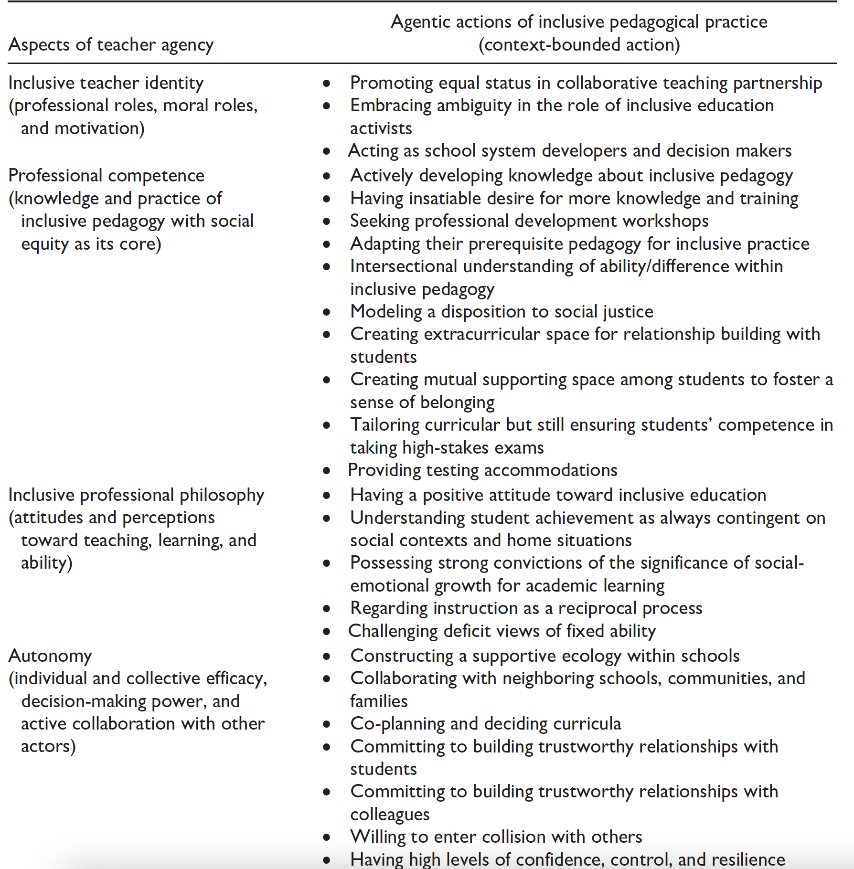
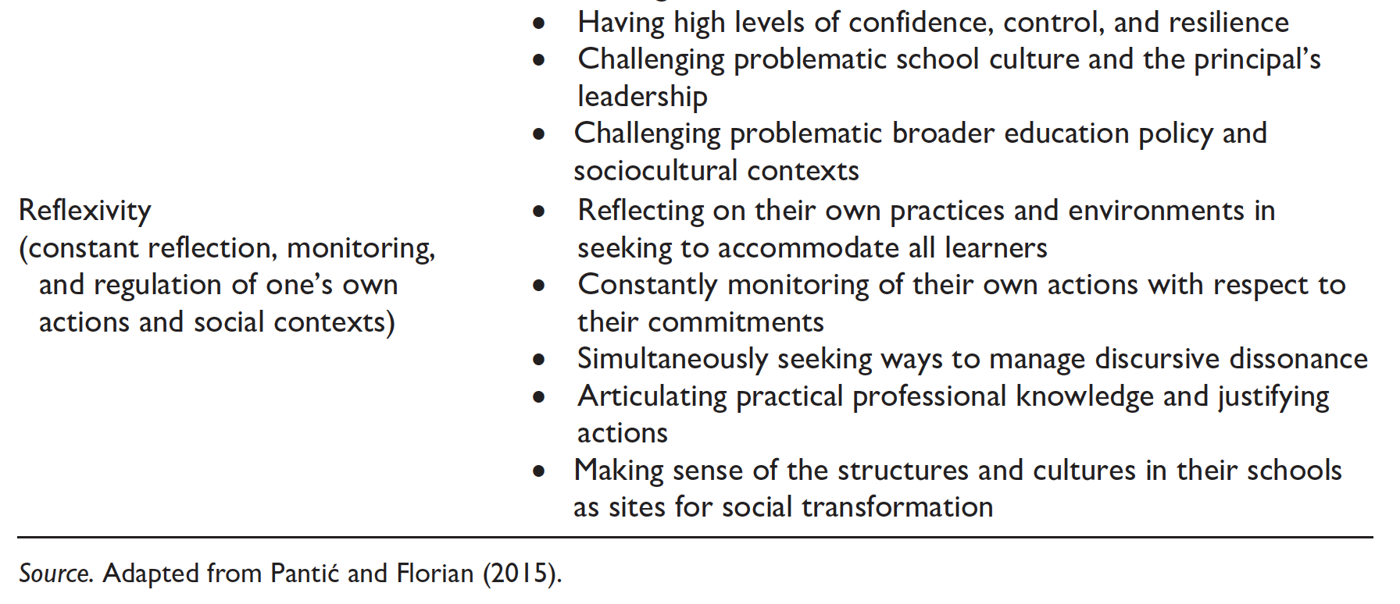
Inclusive Education Practices
Notes:
Kozelski et al., (2014) says by definition, inclusive education aims to enhance access, participation, and outcomes for all diverse student populations who have been traditionally excluded from formal education.

Slide 23
LINCS Assessment- Why?
The purpose of this assessment is to help you identify your inclusive classroom practices and areas of growth.​
​
The results are indicators for future learning and not as a failure if you score "neutral" or "unaware."
Notes:
https://lincs.ed.gov/publications/te/self-assessment.html

Slide 24
Teacher Development
Possibilities include:
1) nurturing commitment to social justice as part of teachers’ sense of purpose;
2) developing competencies in inclusive pedagogical approaches, including working with others;
3) developing relational agency for transforming the conditions of teachers’ workplaces; and
4) a capacity to reflect on their own practices and environments when seeking to support the learning of all students.

Slide 25
Social Justice Purpose Statement
Notes:
Link to Padlet: https://padlet.com/parkernveronica/social-justice-purpose-statement-71d72lbm6g9d5r2o

Slide 26
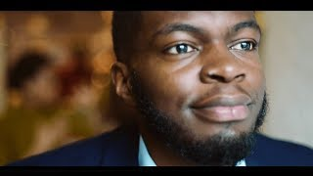
We will leave you with this…
Notes:
https://ceoactionracialequity.com/issues/closing-the-digital-divide/
Video

Slide 27
Reflection

Slide 28
Thank You
Mandilee Gonzales
Veronica N. Parker, Ed.D.
vnparker@scoe.net
mgonzales@scoe.net
Notes:
Part III will engage attendees in a lightly-facilitated discussion addressing current digital equity questions. Link to Google Form to submit questions: https://docs.google.com/forms/d/e/1FAIpQLScvXuWab_rx6C_H0NDHPRYrOzVHMyYUzIaONdvLOoOjZd1m7Q/viewform

Slide 29
Resources (1 of 2)
The Digital Equity Act: New Federal Funding & What it Means for WIOA Partners – November 30, 2022
https://www.youtube.com/watch?v=xf23mdWD7os
Advancing Digital Equity for All
https://www.youtube.com/watch?v=SLbkpUjyQt0
New York State Library Digital Inclusion Toolkit
https://www.nysl.nysed.gov/libdev/Digital-Inclusion-Toolkit.pdf
Digital Equity Act
https://www.digitalequityact.org/
Digital Equity Plans - Releases Sept. 22’ https://tech.ed.gov/files/2022/09/DEER-Resource-Guide_FINAL.pdf

Slide 30
Resources (2 of 2)
World Education
Hanover
Social Justice, Inclusive Education, and Teacher Agency
What COVID-19 Taught Us About Pedagogy and Social Justice—Pandemic or Not
Open Source curriculum / Digital literacy
https://www.goodfirms.co/blog/best-free-open-source-library-management-software-solutions
https://www.ppic.org/blog/commentary-narrowing-the-digital-divide-with-pandemic-benefits/
Affordable Digitale Connectivity Program - FCC / EBB
This fact sheet focuses on the latest available data, from 2019 and 2020.
Advancing our commitment to equity, social justice and economic justice: https://docs.google.com/presentation/d/1LgtHdbH3Xyx9SHE7ph7PI8363zmrVu84gvA7nZTdf14/edit#slide=id.gf9f96dbc7d_0_19

