Slide 1
Managing CAEP Data in ASAP
CAEP Summit
October 2022

Slide 2
Agenda
The Data Files
Review ASAP Data Before Exporting
Export Settings & Options
Best Practices
ASAP Reports
CASAS Test Scores in ASAP
Resources

Slide 3
The Data Files

Slide 4
The 8 Data Files
PERS Personnel
CLS Classes
DEM Demographics
ENTR Entries
ATT Attendance
UPDT Updates
SPS Student Program Status
SCS Student Class Status

Slide 5
Personnel & Classes
PERS Personnel
CLS Classes
DEM Demographics
ENTR Entries
ATT Attendance
UPDT Updates
SPS Student Program Status
SCS Student Class Status
Teacher Name & Email
Course Descriptions, Class Instances, Time, Location, Instructional Program, Focus Area, Special Program

Slide 6
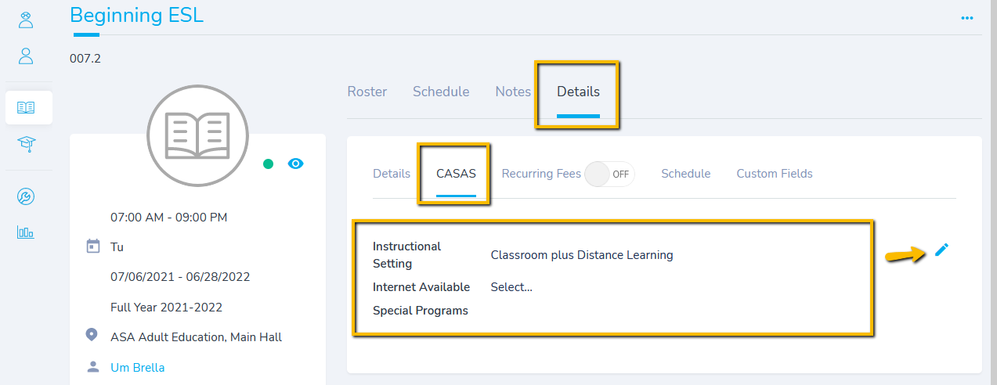
Class Instructional Setting
Classroom, Classroom plus Distance Learning, Distance Learning only

Slide 7
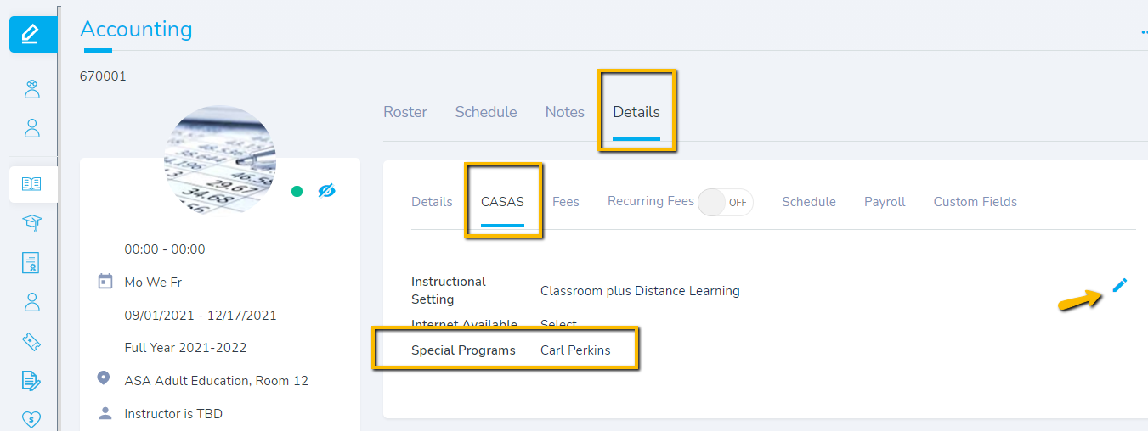
Class Special Programs
Perkins funded CTE classes must be identified as Carl Perkins

Slide 8
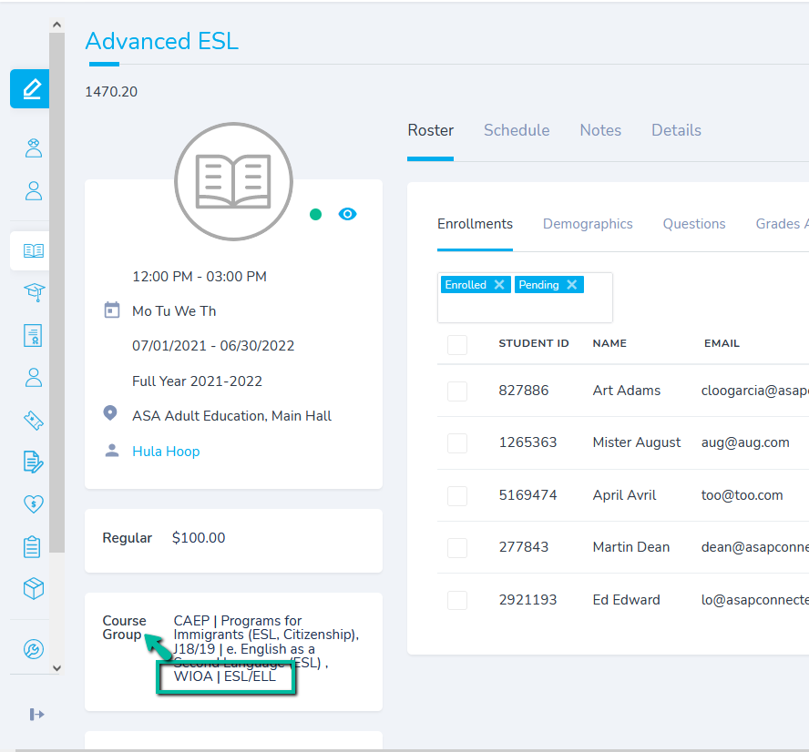
Class/Course + WIOA Course Group
Class must be assigned to
one WIOA course group.
This designates the instructional program
to the class enrollment.

Slide 9
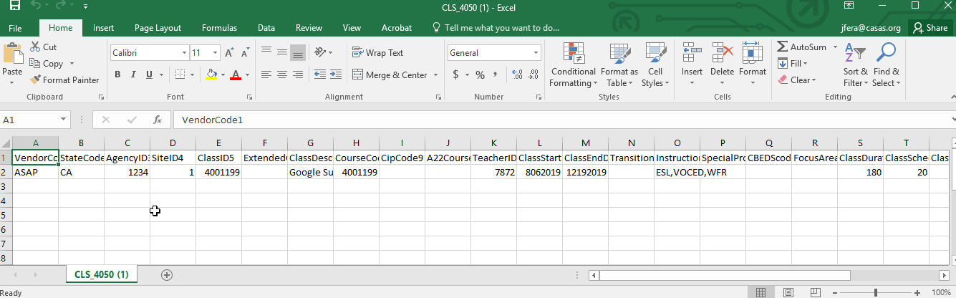
Class Export from ASAP

Slide 10
Demographics & Entries
PERS Personnel
CLS Classes
DEM Demographics
ENTR Entries
ATT Attendance
UPDT Updates
SPS Student Program Status
SCS Student Class Status
Education History
Class Enrollment, Goals, Barriers, Employment Status

Slide 11
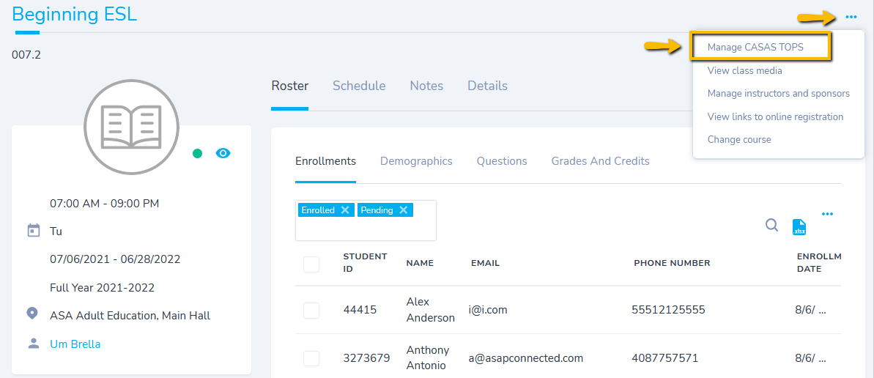
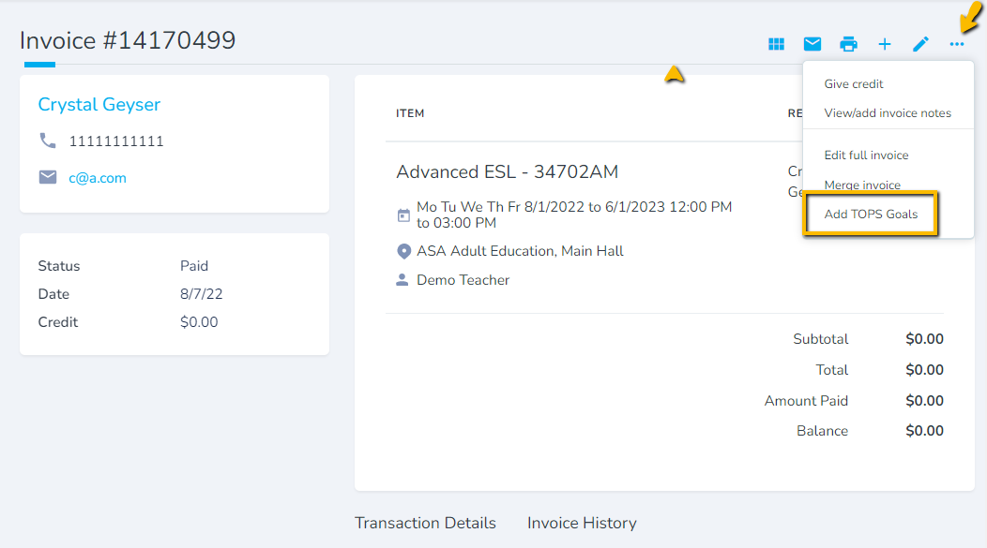
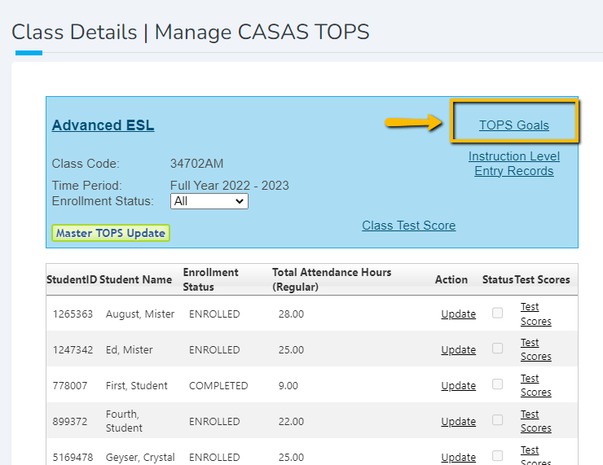
Goals
Class Details/Manage CASAS TOPS
Invoice/Add TOPS Goals
Notes:
Demo in ASAP

Slide 12
Attendance
PERS Personnel
CLS Classes
DEM Demographics
ENTR Entries
ATT Attendance
UPDT Updates
SPS Student Program Status
SCS Student Class Status
Daily Attendance Hours
Export MONTHLY (minimally)
Export TWICE A MONTH (better)
Export WEEKLY (best!)

Slide 13
Attendance
ONLY USE ONE OPTION FOR THE FULL PROGRAM YEAR
DAILY * Attendance Hours = Record for each individual day
Enter a date range. Check the option Export Daily Attendance
CUMULATED Attendance Hours = This new record will enter the latest total.
Do not enter a date range. Check the option Export all hours for class up to today
UPDATE Attendance Hours = This new record will add to the previous one
Enter a date range. Do not check "Export all hours for class up to today“
* CASAS recommends Daily
HOW OFTEN TO EXPORT/IMPORT HOURS
To remain compliant with Federal POP WIOA rules, you must export/import hours on a MONTHLY basis. If you use Cumulated and wait more than one month, you risk restarting POP for students.

Slide 14
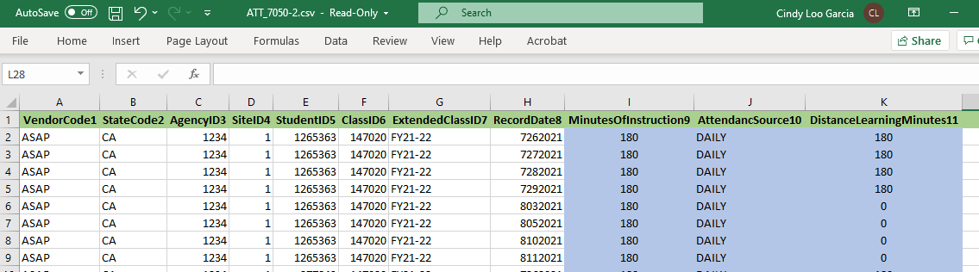
Daily Attendance Export from ASAP

Slide 15
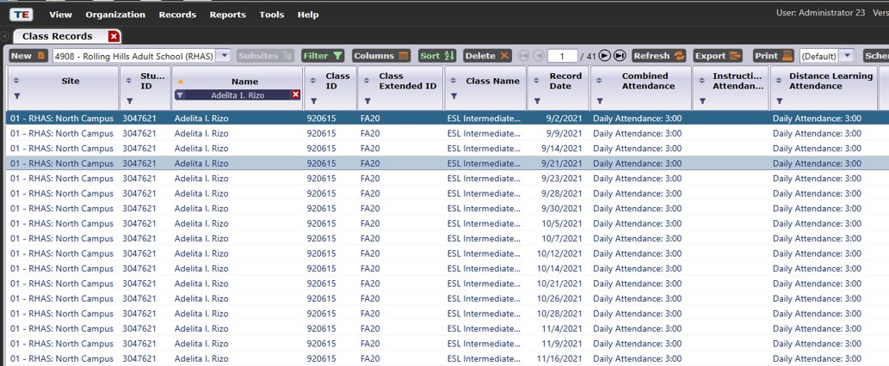
Daily Attendance Hours in TE

Slide 16
Updates
PERS Personnel
CLS Classes
DEM Demographics
ENTR Entries
ATT Attendance
UPDT Updates
SPS Student Program Status
SCS Student Class Status
Outcomes
Workforce Services (Training, Transition, Supportive)
Learner Results (Earned HSD/HSE, Got a Job, etc.)

Slide 17
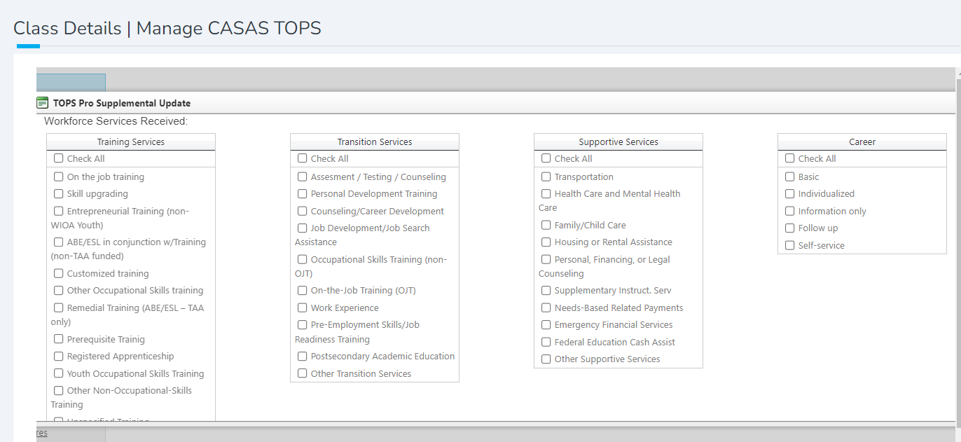
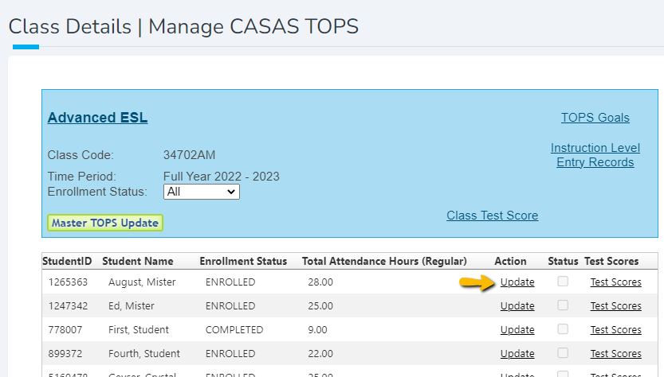
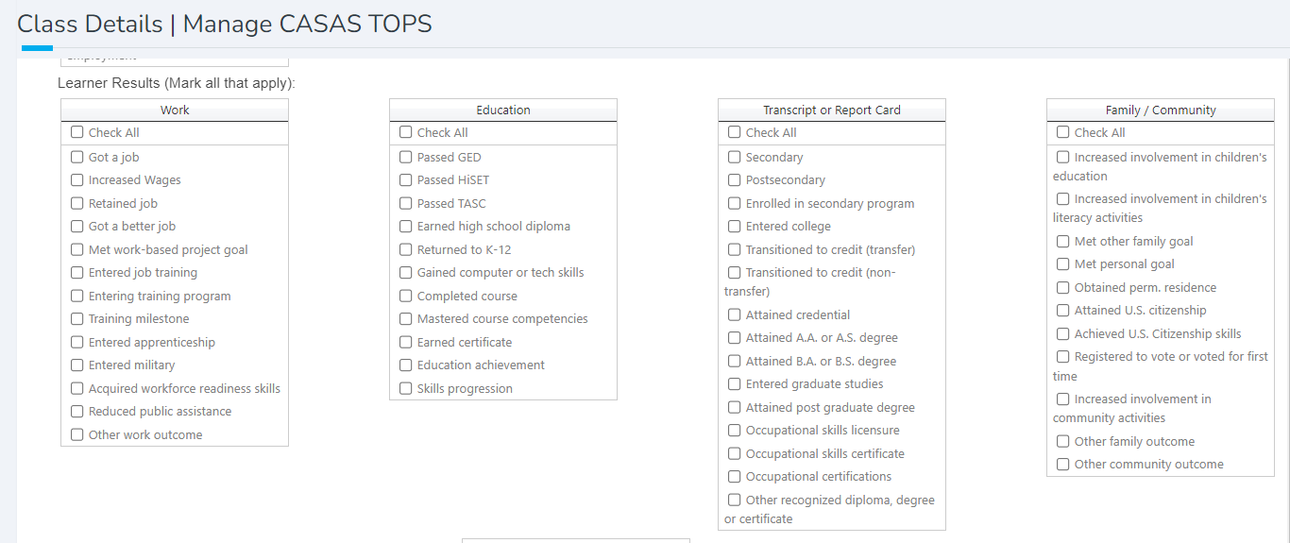
Updates/Outcomes
Workforce Services Received
Class Update by Student
Learner Results

Slide 18
Student Program Status
PERS Personnel
CLS Classes
DEM Demographics
ENTR Entries
ATT Attendance
UPDT Updates
SPS Student Program Status
SCS Student Class Status
Instructional Program
Start Date

Slide 19
Student Class Status (optional)
PERS Personnel
CLS Classes
DEM Demographics
ENTR Entries
ATT Attendance
UPDT Updates
SPS Student Program Status
SCS Student Class Status
Student is Finishing Class
Student is Leaving Program
End of Semester

Slide 20
Review Data Before Exporting

Slide 21
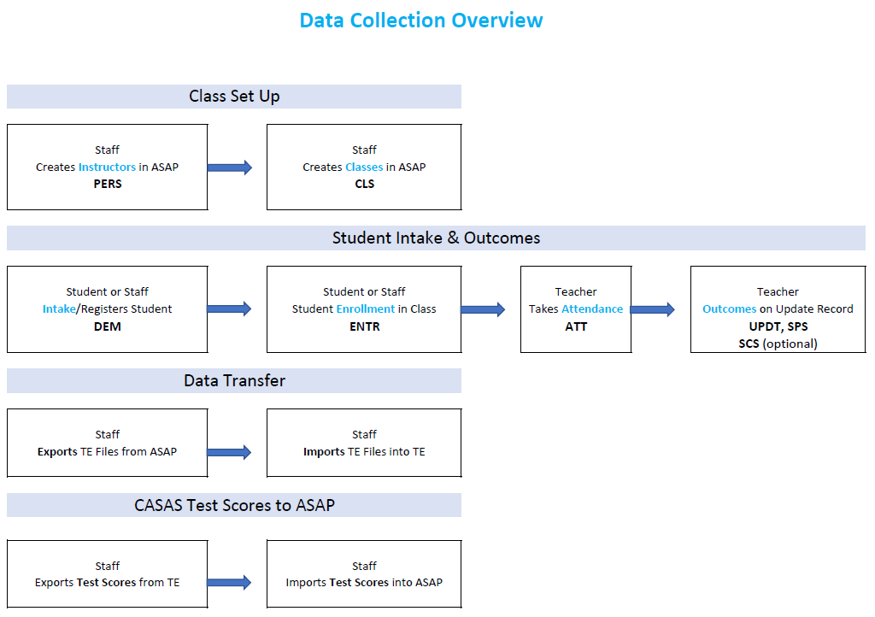
Data Collection Overview

Slide 22
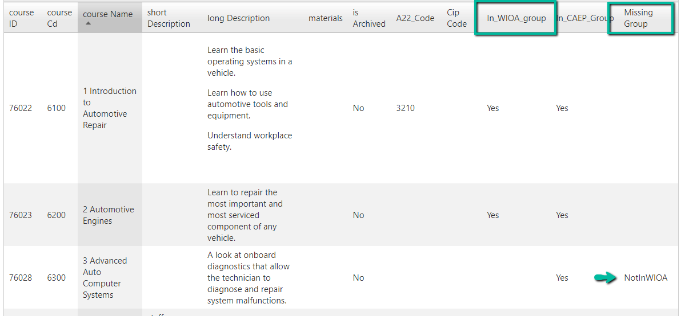
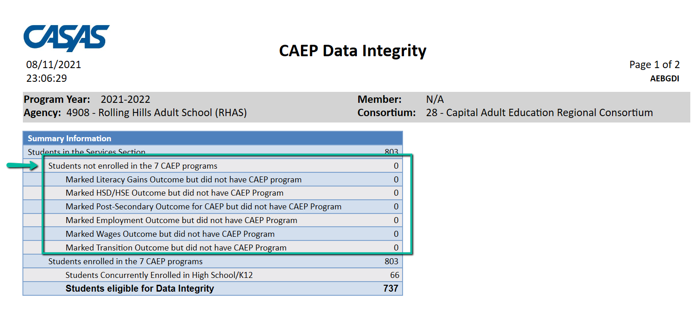
Managing CAEP Programs
Assign courses to include in TE to a WIOA Course Group even if the course is not WIOA funded.
Use All Courses by Organization report to check course set up. (Reporting/Custom Queries/All Courses by Org)

Slide 23
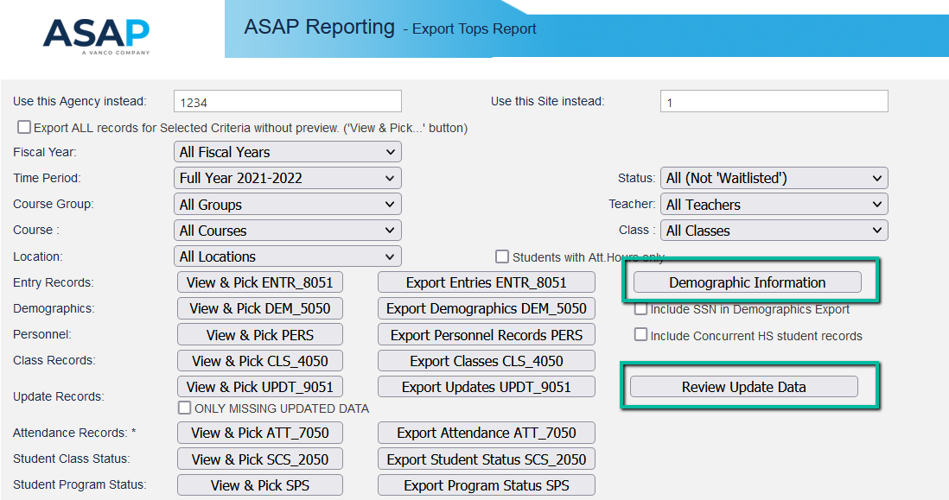
Are Demographics and Updates ready for export?
Run these 2 reports from the Export TOPS window
                Demographic Information
                Review Update Data

Slide 24
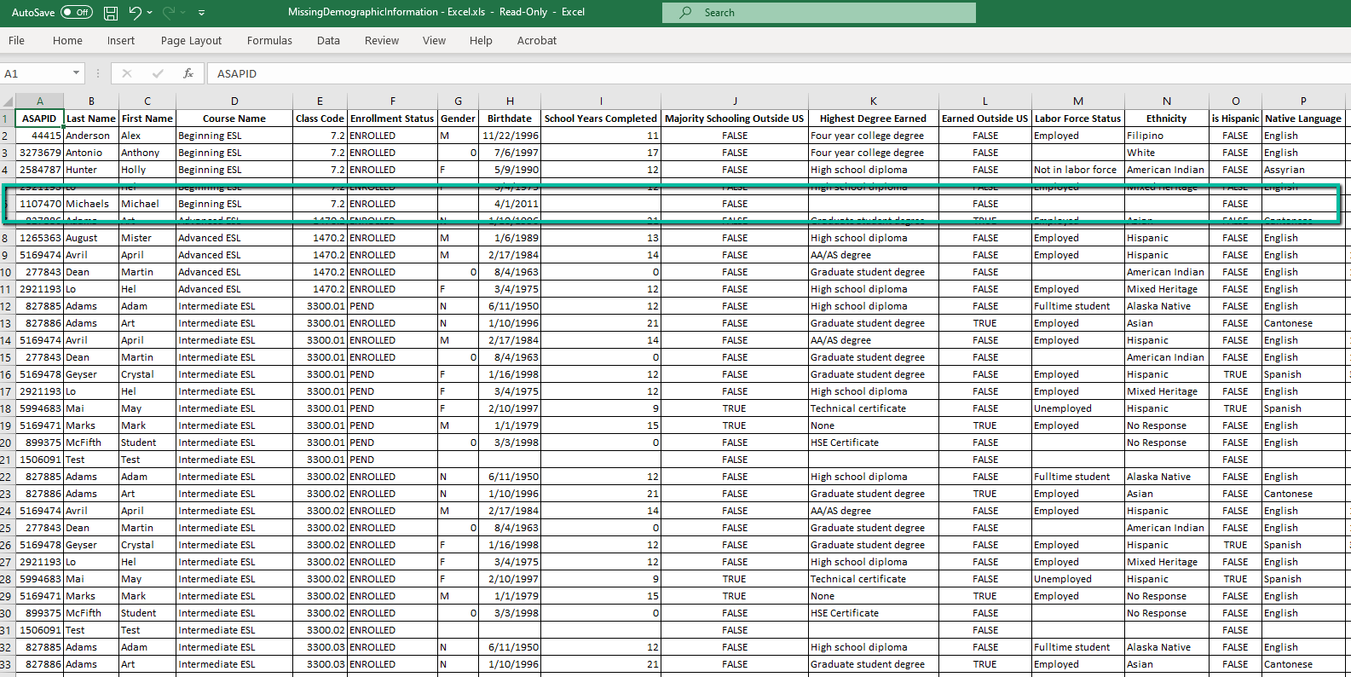
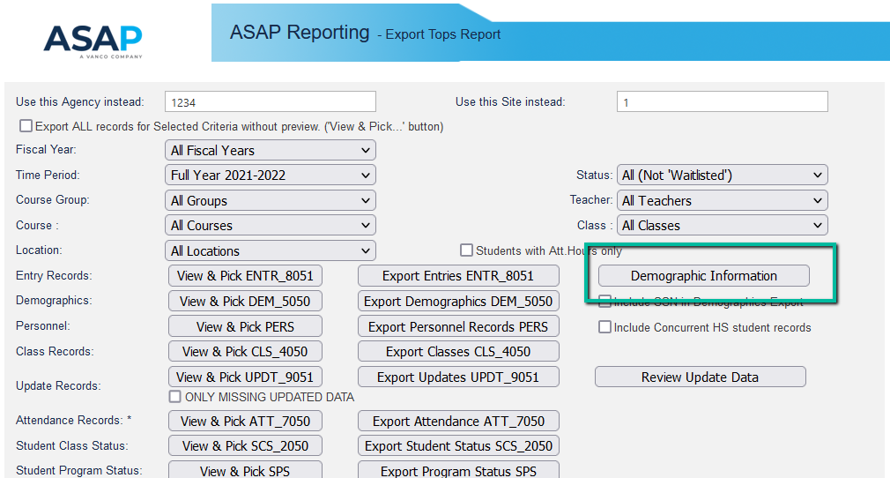
Review Demographic Data

Slide 25
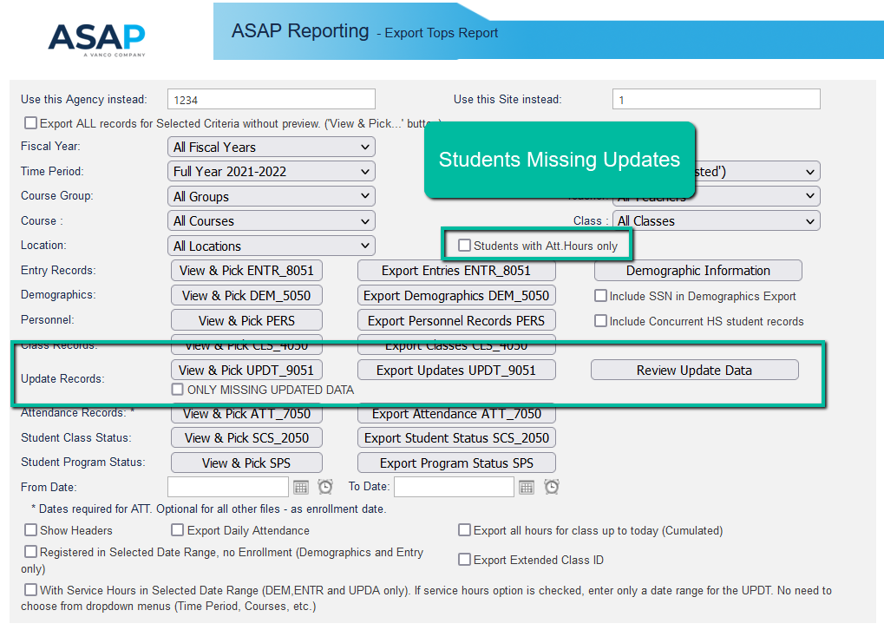
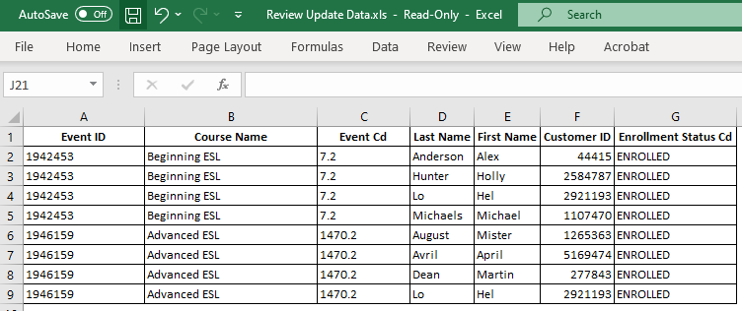
Review Update Data

Slide 26
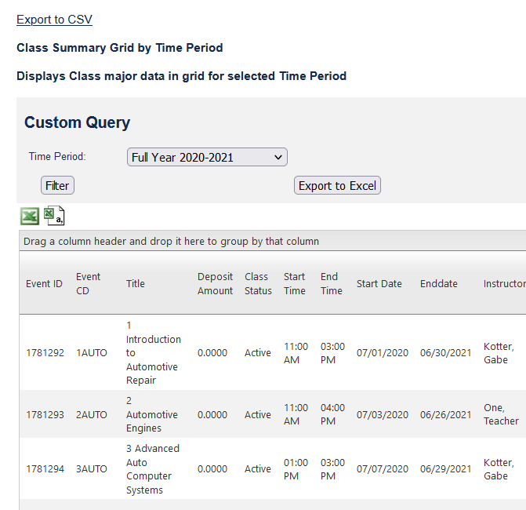
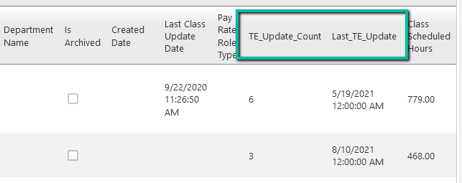
Have Teachers Done Class Updates?
Class Summary Grid by Time Period
(go to Reporting/Custom Queries in ASAP 4)
TE Update Count: # of students with Updates
Last TE Update: date of the latest update

Slide 27
Export Settings & Options

Slide 28
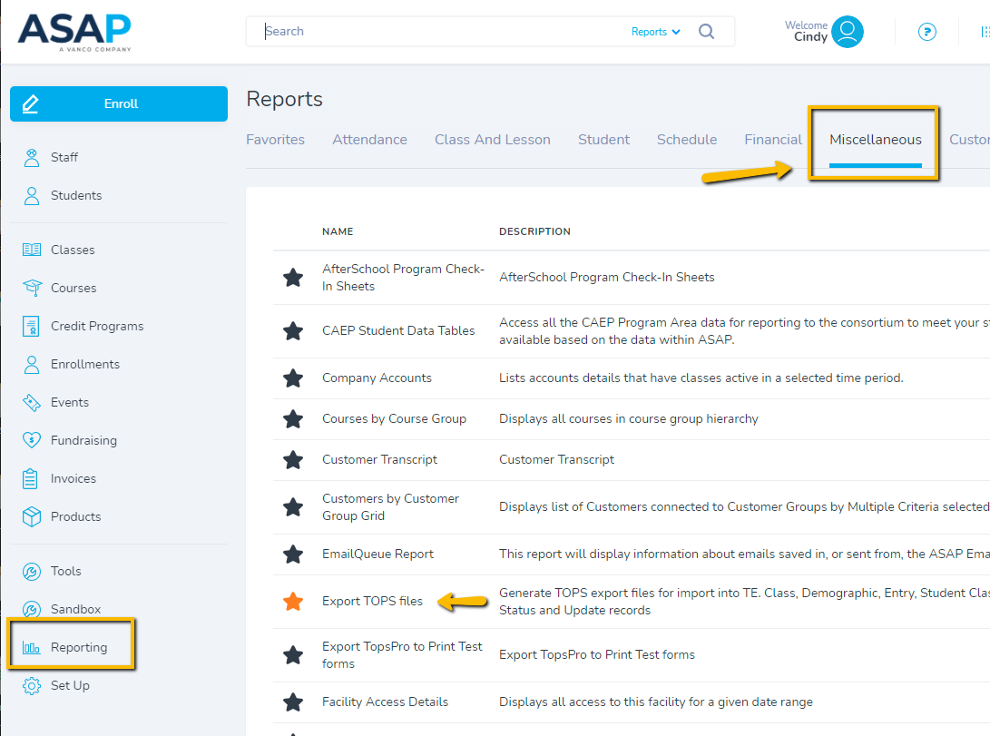
Export TOPS files
Go to Reporting/Miscellaneous

Slide 29
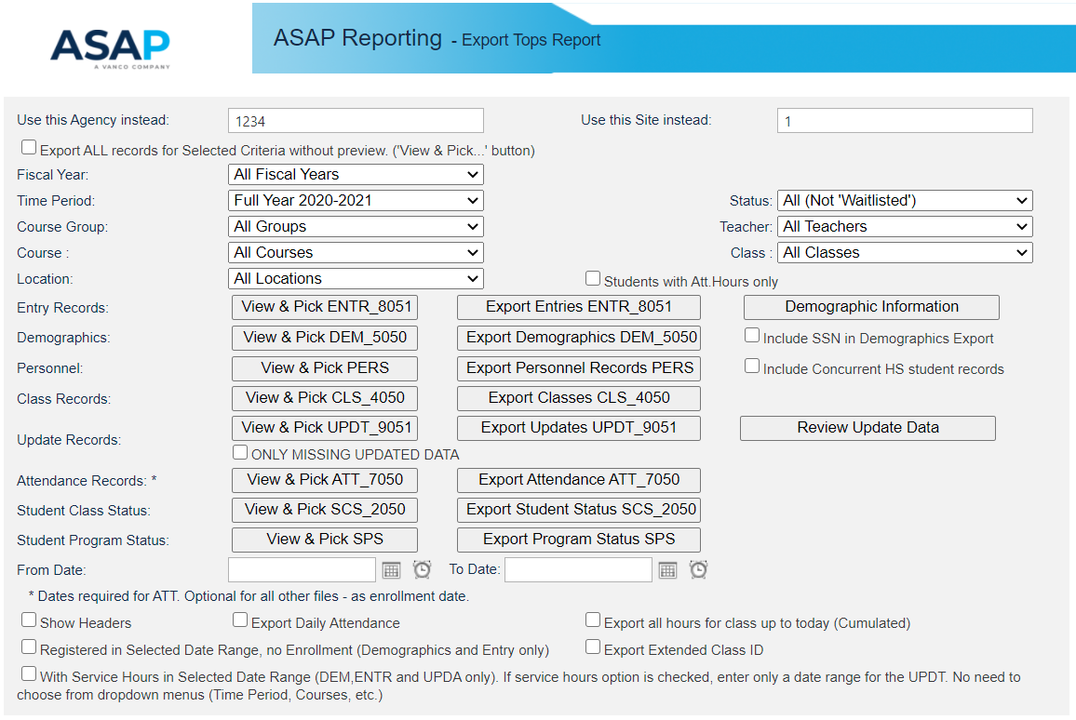
Export TOPS

Slide 30
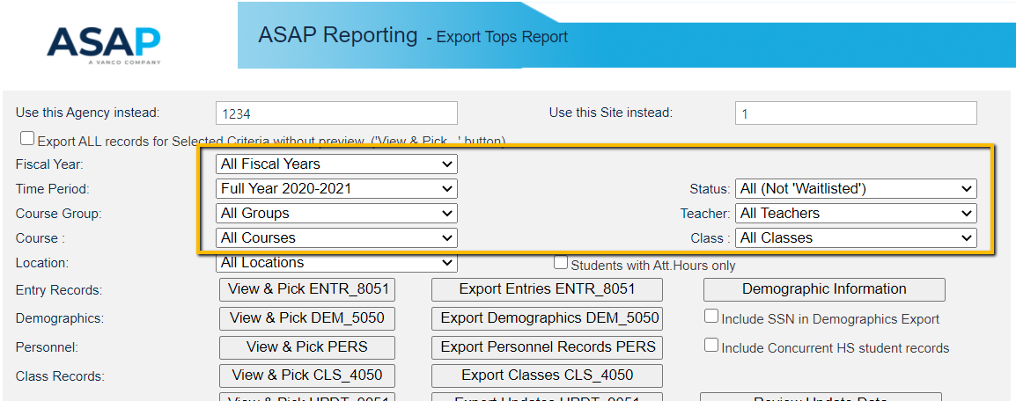
Export Filters

Slide 31
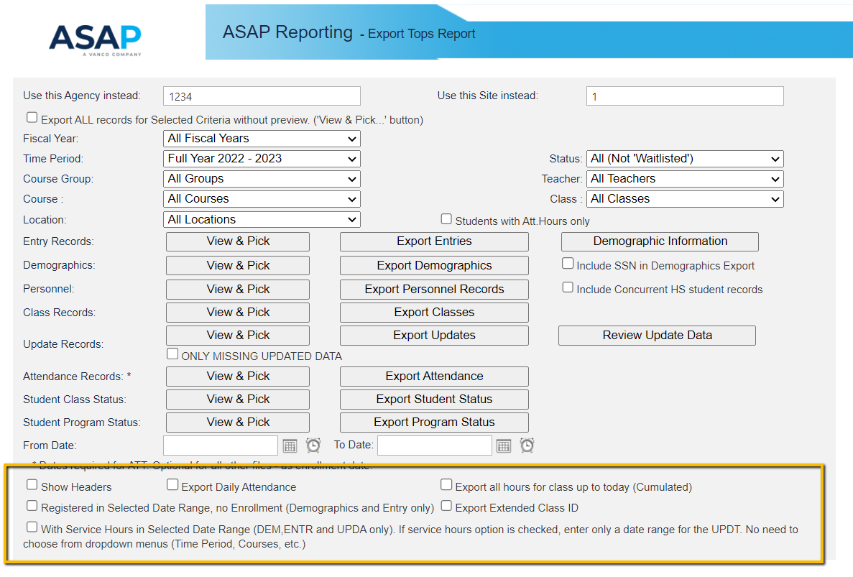
Export Options

Slide 32
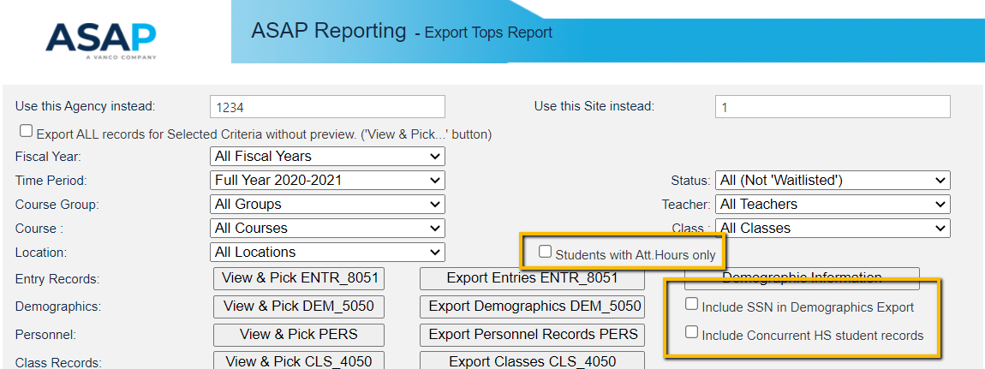
More Export Options

Slide 33
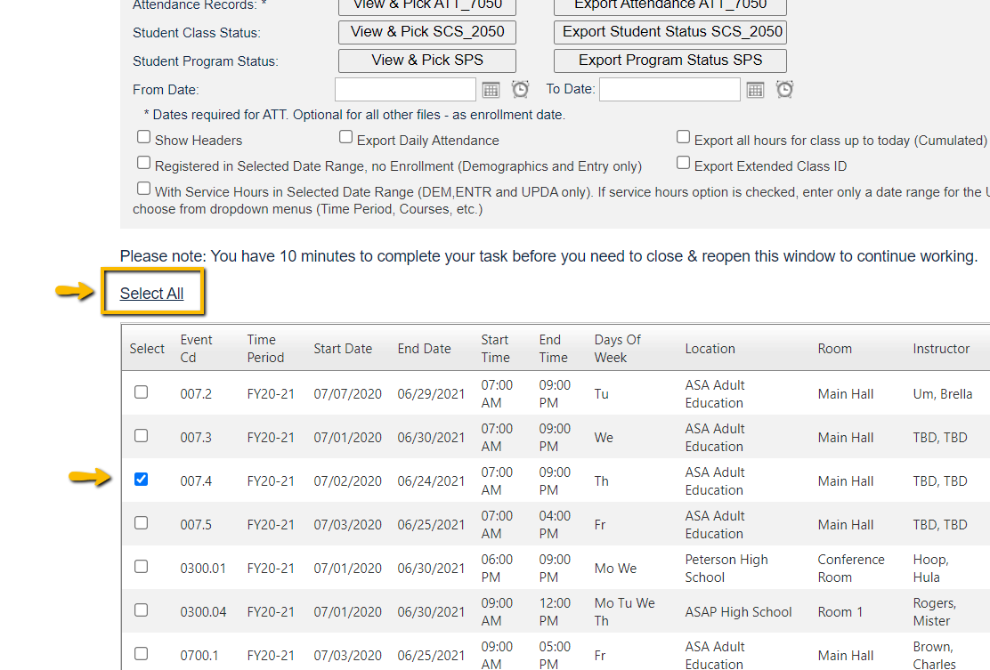
Option to Select All or
Check Individually

Slide 34
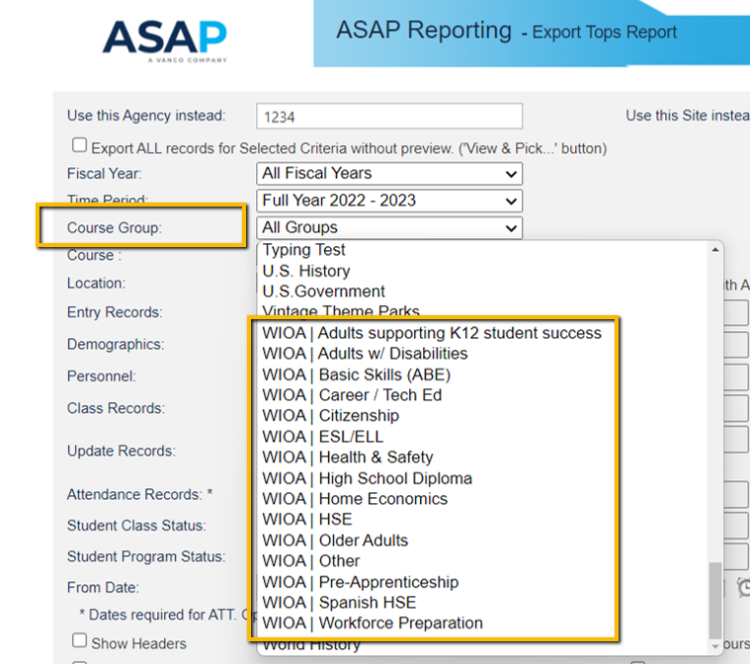
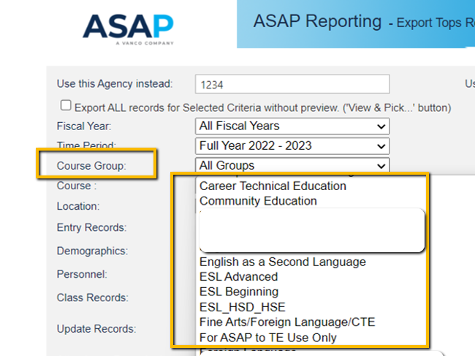
ASAP Course Groups
WIOA default course groups
Custom course groups
Create your own course groups to filter specific data for export.

Slide 35
Best Practices

Slide 36
Recommended Export/Import
Frequency
  Personnel Once at the start of the school year or when new teachers are added
  Classes Each new term/time period, duplicates are not accepted
  Demographics Beginning of a class and as new students are added
  Student Program Status Beginning of a class and as new students are added
  Entries Beginning of a class and as new students are added
  Student Class Status Optional
  Attendance Minimally monthly
  Updates End of time period or end of class

Slide 37
Create your own Log Sheet
Record what and when data file was exported from ASAP and imported into TE
              Record file type (such as DEM)
              Record date of export/import
              Record data date range or time period
              Record course group, courses or classes
              Check as completed
              Include notes, comments

Slide 38
Create your own Log Sheet to track data management
Create your own Log Sheet to track data management
Process Date | Class ID Description | Data Date Range | Done | Notes | File | When to Export/Import
7/19/2021 | All ESL |  | X |  | PERS | Beginning of the year and whenever a teacher is added.
7/19/2021 | 10101, 10102, 10103 |  | X | 3 records | CLS | Beginning of a term (year, quarter, semester, etc.). Duplicates not accepted.
7/19/2021 | 10101, 10102, 10103 |  | X | 51 records | DEM | Beginning of a class and as new students are added.
7/19/2021 | 10101, 10102, 10103 |  | X |  | SPS | Beginning of a class and as new students are added.
7/19/2021 | 10101, 10102, 10103 |  | X |  | ENTR | Beginning of a class and as new students are added.
7/19/2021 | 10101, 10102, 10103 |  |  |  | SCS | Optional. Load if you want to capture class status of Active, Inactive, or Completed.
7/19/2021 | 10101, 10102, 10103 | 7/12 - 7/17/2021 | X |  | ATT | Minimally monthly. Remember to be consistent with Daily, Cumulated, or Student Update.
7/26/2021 | 10101, 10102, 10103 |  | X | 51 dupes, 3 new | DEM | If new students were added since the last upload.
7/26/2021 | 10101, 10102, 10103 |  |  |  | SPS | If new students were added since the last upload.
7/26/2021 | 10101, 10102, 10103 |  |  |  | ENTR | If new students were added since the last upload.
7/26/2021 | 10101, 10102, 10103 |  |  |  | SCS | Optional. Load if you want to capture class status of Active, Inactive, or Completed.
7/26/2021 | 10101, 10102, 10103 | 7/18 - 7/24/2021 |  |  | ATT | Minimally monthly. Remember to be consistent with Daily, Cumulated, or Student Update.
11/29/2021 | 10101, 10102, 10103 | 7/12 - 11/27/2021 |  |  | UPDT | End of a term or end of a class.

Slide 39
ASAP Reports

Slide 40
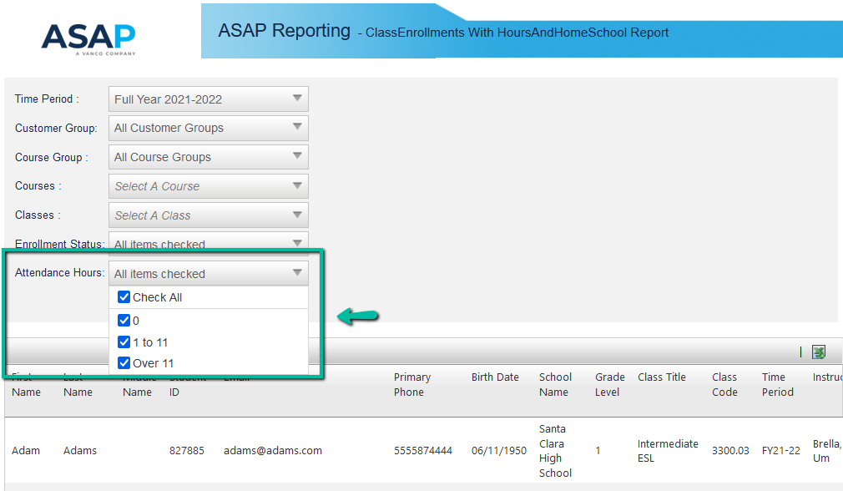
Students with zero hours or < 12 hours
Class Enrollments with Total Hours & Home School
(go to Reporting/Attendance/Class Enrollments with Total Hours and Home School)

Slide 41
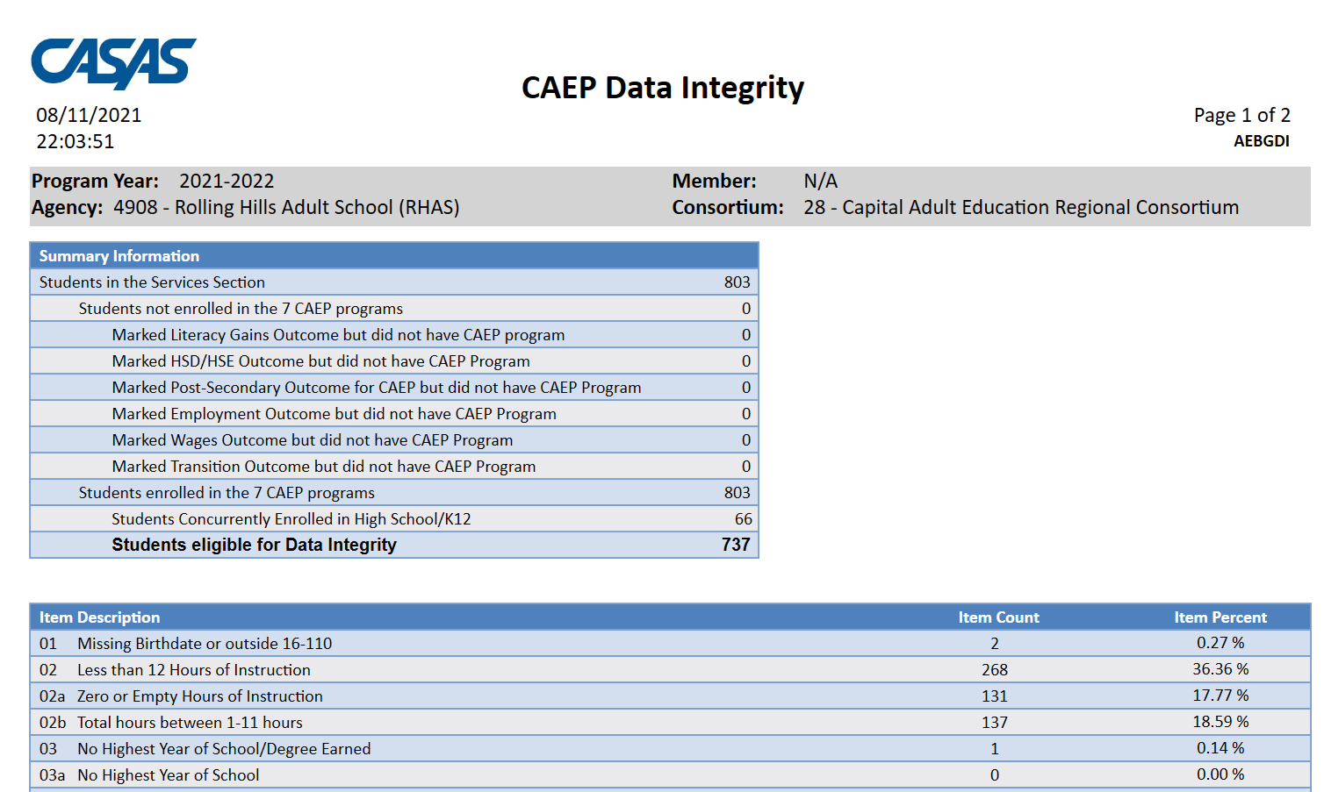
CAEP Data Integrity

Slide 42
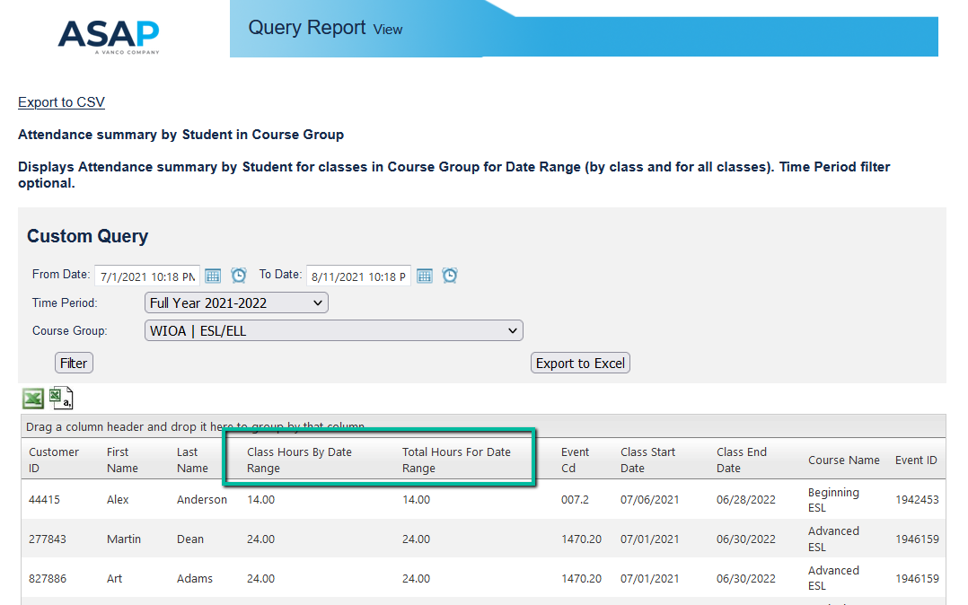
Determine when to Post-Test
Attendance Summary By Student in Course Group
(Go to Reporting/Custom Queries/Attendance Summary By Student in Course Group)

Slide 43
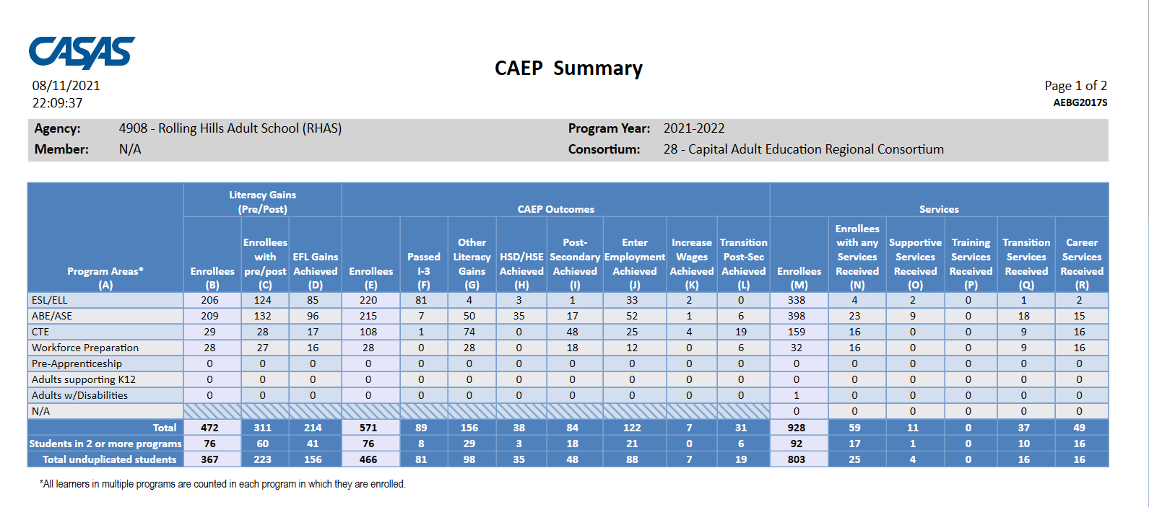
CAEP Tables (CAEP Summary)

Slide 44
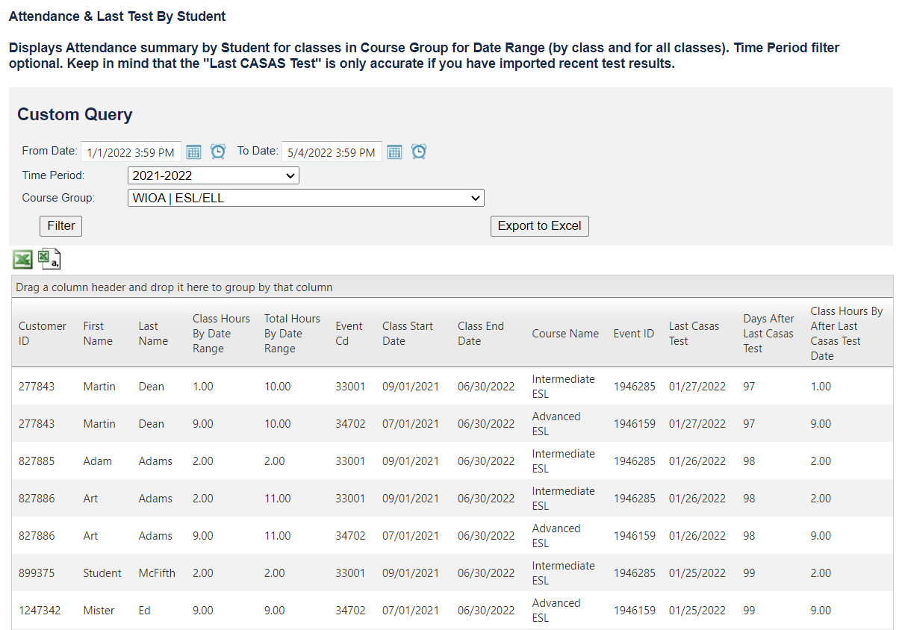

Attendance & Last Test by Student
Attendance report to determine post-test eligibility
Includes the number of hours since the last CASAS test date
​
Allows you to proactively schedule post-testing.
Be sure to have the most recent TE test results imported into ASAP to ensure report accuracy.
https://app.asapconnected.com//reports/CustomQuery.aspx?ReportID=11758&returnToA4=1
Notes:
Dependent on importing TE test results

Slide 45
Data Exports & Imports

Slide 46
Managing CASAS Test Scores in ASAP

Slide 47
Managing CASAS Test Scores
IMPORT PAGE
Login into ASAP and go to https://app.asapconnected.com/importdata.aspx. Select the import type “Import TOPS Tests" (new WIOA.csv or xlsx – depending on which option you exported) Browse/select the test score file. Click Upload to start the process.
CLASS DETAILS
Once the test scores are imported into ASAP, teachers can view these scores from Class Details by clicking the ellipsis (upper right corner of page) then selecting "Manage CASAS TOPS”.
STUDENT DETAILS
Test scores can also be viewed individually by student. From the Students Detail page, go to the Education Records tab and then Test Scores.
REPORT
All imported scores can also be viewed in the Imported CASAS TOPS Test Scores report found under View Reports/Master Reports/Custom Queries
Notes:
A4 Class Detail
A4 Student Page
A4 Test Score Report

Slide 48
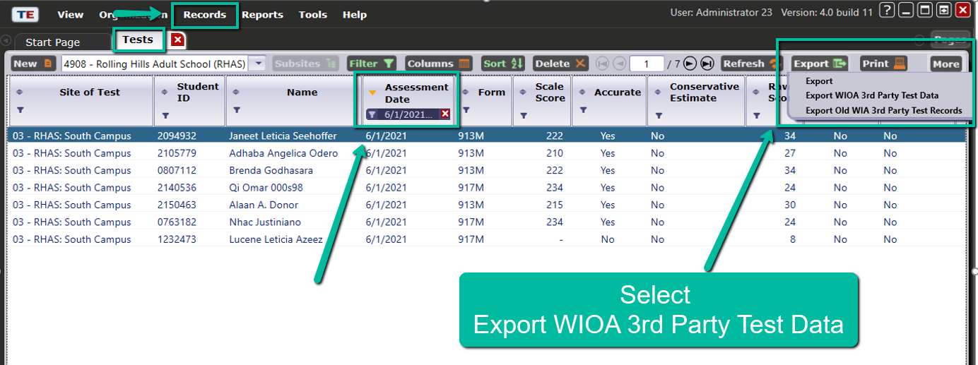
Export CASAS Test Scores
1. Go to Records/Tests
2. Filter by Assessment Date
3. Export WIOA 3rd Party Test Data

Slide 49
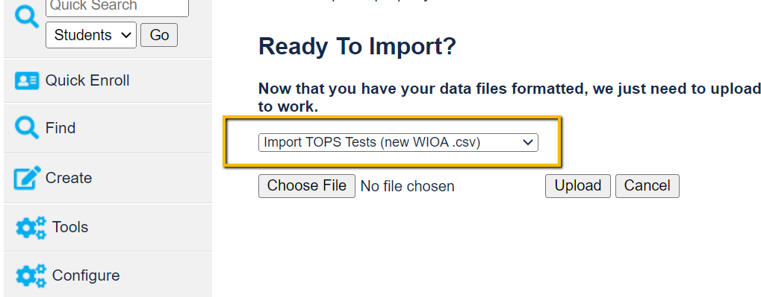
Import Page https://app.asapconnected.com/importdata.aspx

Slide 50
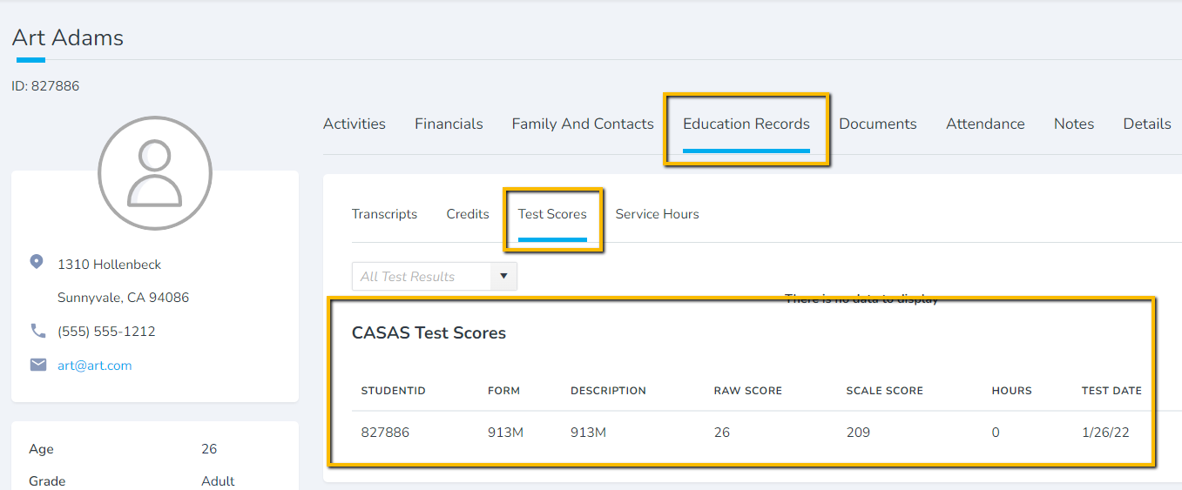
Student Details/Education Records/Test Scores

Slide 51
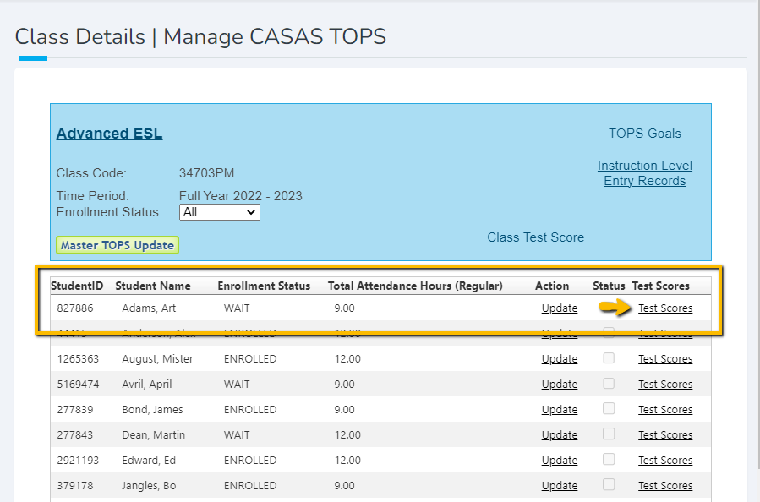
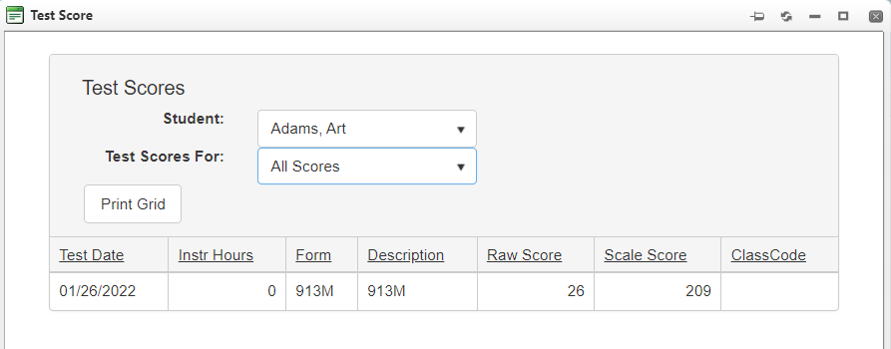
Test Scores in Class Details

Slide 52
Resources

Slide 53
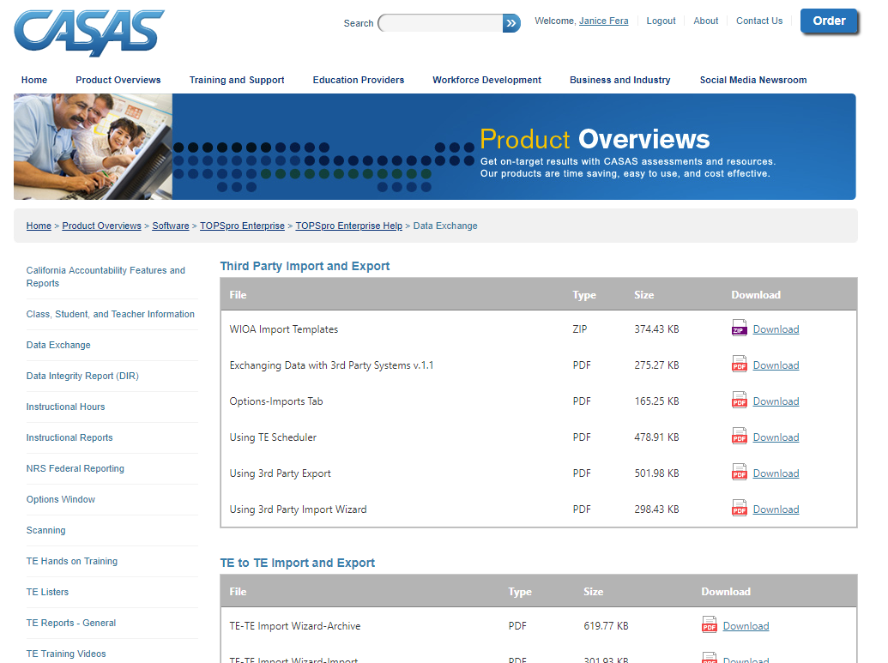
CASAS.org: Data Exchange Details and Instructions
Home – Product Overview – Software – TOPSpro Enterprise – TOPSpro Enterprise Help – Data Exchange

Slide 54
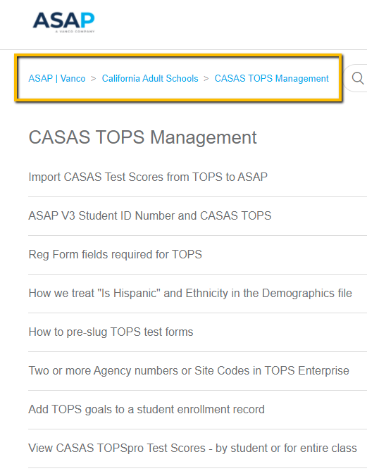
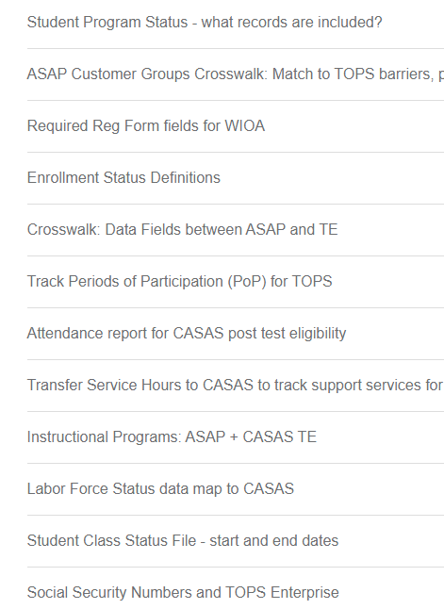
ASAP Resources https://asapconnected.zendesk.com/hc/en-us/sections/360008637334-CASAS-TOPS-Management

Slide 55
ASAP Support
Email
support@asapconnected.com
Phone
855 245-6946

