Slide 1
SB554 Implications
for Dual Enrollment:
Moving the Conversation Forward
October 27, 2022

Slide 2
Who We Are
Peter Simon
Co-Founder
High Road Alliance
Jennie Mollica
Co-Founder
High Road Alliance
Ute Maschke
Manager
East Region Adult Education
We convene partnerships to open doors to
equitable, inclusive employment opportunities
and career advancement.
Education that works

Slide 3
State-level Respondents
Gary Adams
Dean, Innovation & Systems Capacity
Workforce and Economic Development Division, CCCCO
Mayra Diaz
Specialist, General Vocational Education
Workforce and Economic Development Division
Neil Kelly
Consultant
California Department of Education

Slide 4
Objectives
Share findings and recommendations from a new report on dual enrollment in California adult education and community colleges
Take stock of the state of things: SB 554 in 2022
Move the conversation forward
The Power Is Yours! CAEP Summit 2022

Slide 5
Why adult dual enrollment?
Makes education more equitable
Provides opportunities for adult ed students to accelerate, advance, explore, and plan wisely
Accelerates pathways toward education and career goals
Part of a larger toolkit of (college) transition strategies
The Power Is Yours! CAEP Summit 2022

Slide 6
Senate Bill (SB) 554 (2019)
Authorizes an adult student pursuing a high school diploma (HSD) or a high school equivalency (HSE) certificate in California to enroll as a special part-time student at a community college.
Student access to credit-bearing college courses
No tuition costs (delay start of the “financial aid clock”)
Enhanced community college apportionment for special admit students (under Student Centered Funding Formula implementation)
Increased community college enrollment
The Power Is Yours! CAEP Summit 2022

Slide 7
Dual Enrollment in California Adult Education and Community Colleges: Lessons and Opportunities
The Power Is Yours! CAEP Summit 2022

Slide 8
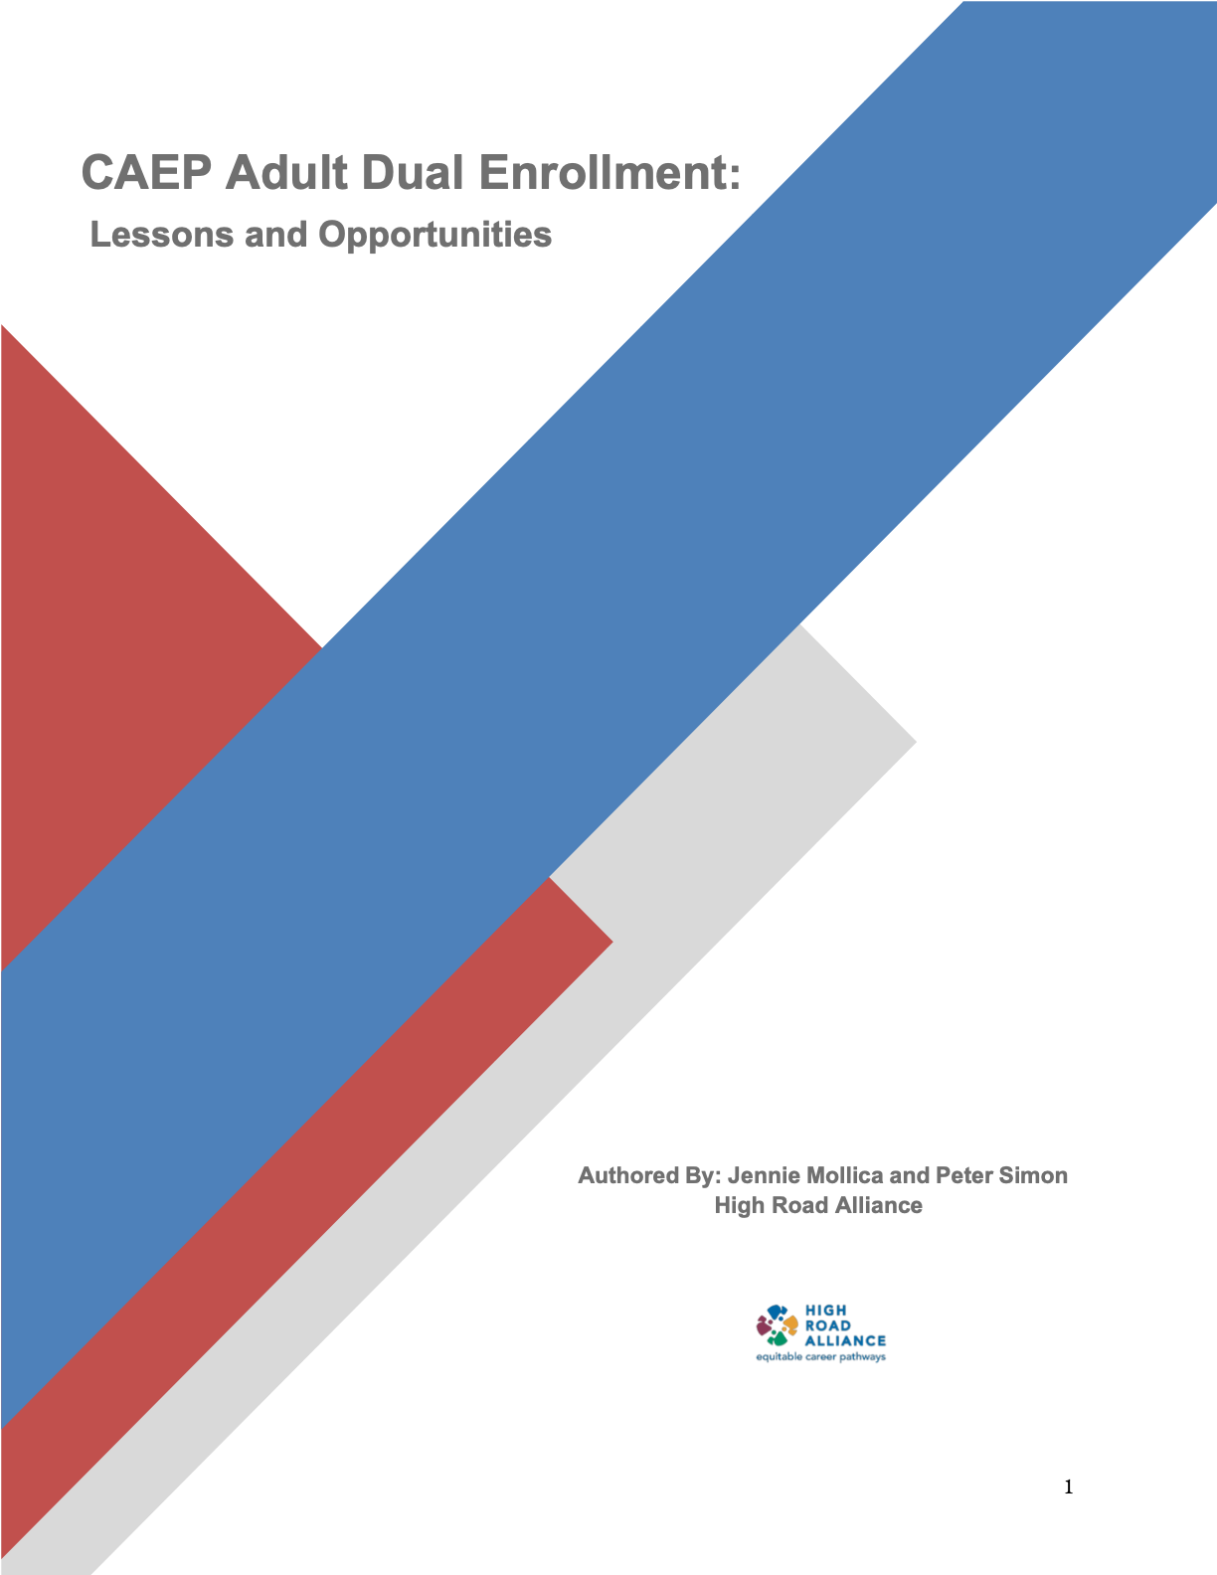
Dual Enrollment in California Adult Education and Community Colleges: Lessons and
Opportunities
Notes:
https://caladulted.org/DownloadFile/1264

Slide 9
Themes (from interviews)
Securing Partnerships and Commitments
Student Eligibility and Application Process
Marketing and Student Engagement
Course Enrollments
Supporting Persistence and Completion of College Courses
Guidance and support
The Power Is Yours! CAEP Summit 2022

Slide 10
We need to talk.
The Power Is Yours! CAEP Summit 2022

Slide 11
What is an ADE strategy that has worked really well?
The Power Is Yours! CAEP Summit 2022

Slide 12
What have you learned about partnering through working on ADE and SB 554?
The Power Is Yours! CAEP Summit 2022

Slide 13
How do you ensure the implemented ADE/SB 554 process is running smoothly?
The Power Is Yours! CAEP Summit 2022

Slide 14
What is getting in the way of expanding or starting to implement ADE and SB 554?
The Power Is Yours! CAEP Summit 2022

Slide 15
Interlocutors:
What stands out to you after listening in?
What strikes you as an innovation that could lead to more transformation?
The Power Is Yours! CAEP Summit 2022

Slide 16
Now what?
The Power Is Yours! CAEP Summit 2022

Slide 17
Thank you for joining us!
The Power Is Yours! CAEP Summit 2022

Slide 18
Contact Information
Jennie Mollica jennie@highroadalliance.org (510) 436-4968
Peter Simon peter@highroadalliance.org (510) 219-1868
Ute Maschke ute.maschke@gcccd.edu
The Power Is Yours! CAEP Summit 2022

