Slide 1
CAEP as a Catalyst for Developing a Regional Pathway System

Slide 2
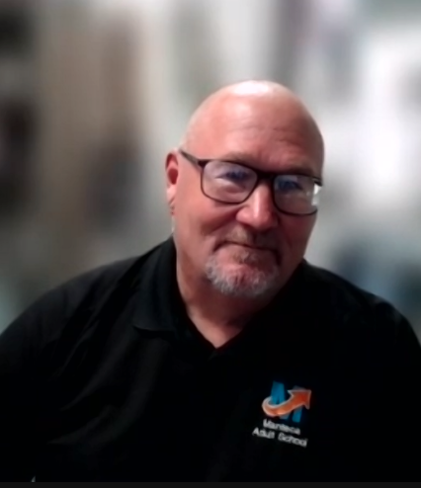
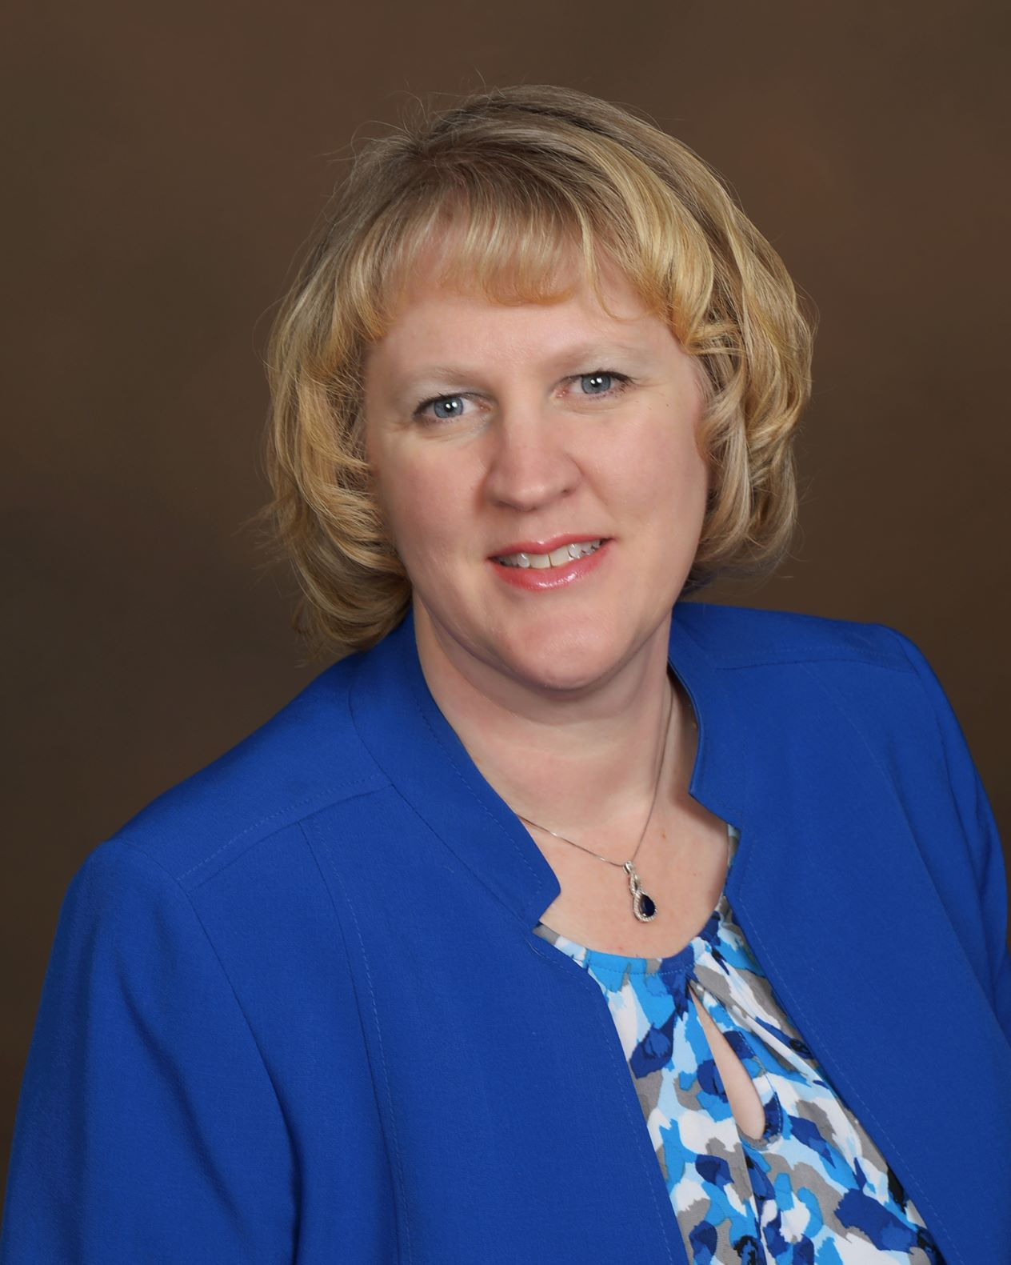
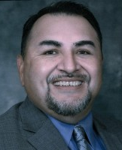
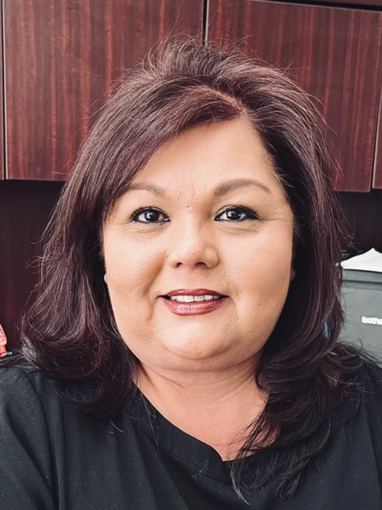
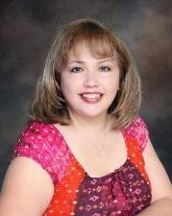
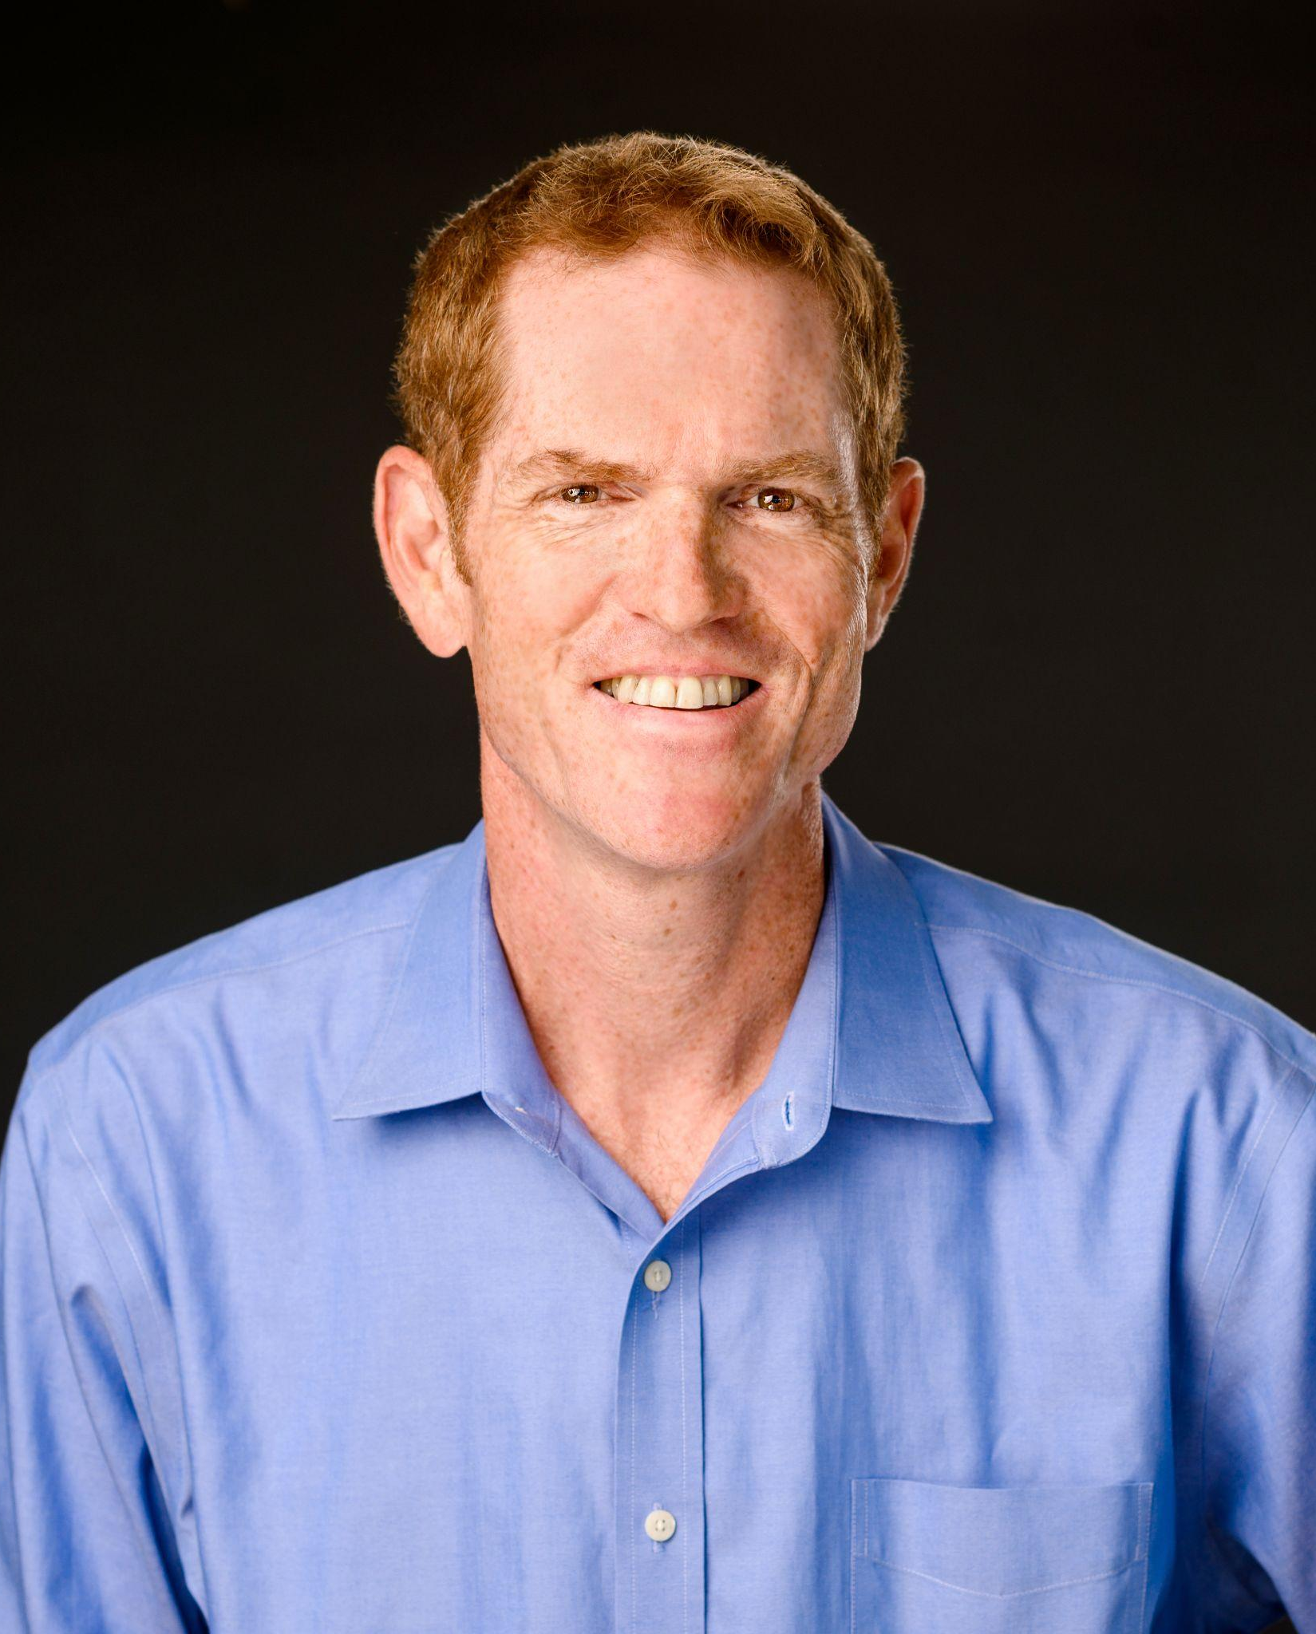
Presenters
Brad Harrison
Principal
Manteca Education and Training Center
Danell Hepworth
Dean of CTE and Workforce Development
San Joaquin Delta College
Jose Dominguez
Executive Director
Ready to Work
Lourie Subega
Calworks Manteca Site Supervisor
El Concilio
Patty Virgen
Executive Director
San Joaquin County WorkNet
Paul Rosenbloom
Consortium Manager
Delta Sierra Adult Education Alliance

Slide 3
DSAEA - Strength Through Collaboration
Workforce Development Board
Adults in the Delta Sierra Adult Education Alliance (DSAEA) region, no matter which school or partner organization they access, have the opportunity to increase skills and transition to a program providing a post-secondary credential leading to a job with living wages.
Workforce Development Board
Probation
Probation
Employers
Employers
Delta College
Stockton School for Adults
Human Services Agency
Human Services Agency
Foundations
Foundations
County Offices of Education
Lincoln USD
Adult Client Success
Jail Education Services
Faith-Based Orgs
Lodi Adult School
Jail Education Services
Faith-Based Orgs
Manteca Adult School
Tracy Adult School
Wind River Adult School
Economic Development
Community Based Orgs
Economic Development
Community Based Orgs

Slide 4
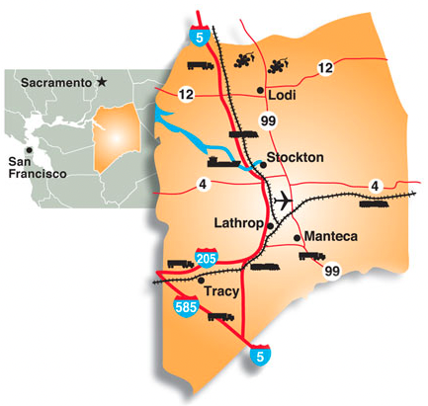
Why Logistics, Industrial Maintenance and Manufacturing (LIMM)?
San Joaquin County is a central distribution hub for California
Highly connected by land, sea and air to the whole state
Major highways, railways and a deep water port
Reach 50% of the state within three hours of driving
The County has the second highest concentration of transportation and warehousing employment in the United States
Transportation and Warehousing employment exceeds retail employment in the County

Slide 5
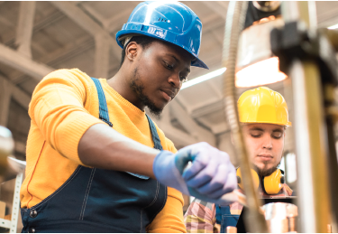
What is Logistics, Industrial Maintenance and Manufacturing (LIMM)?
Logistics Jobs
Industrial Maintenance Jobs
Advanced Manufacturing Jobs
Order Selector
Receiving Clerk
Forklift Operator
Warehouse Supervisor/Manager
Truck Driver
Industrial Machinery Mechanic
Installer
Maintenance Technician/Planner/Supervisor with skills in pneumatics or electrical
Inspectors
Machinists
Welder
CNC Tool Operator
Production Supervisor/Manager

Slide 6
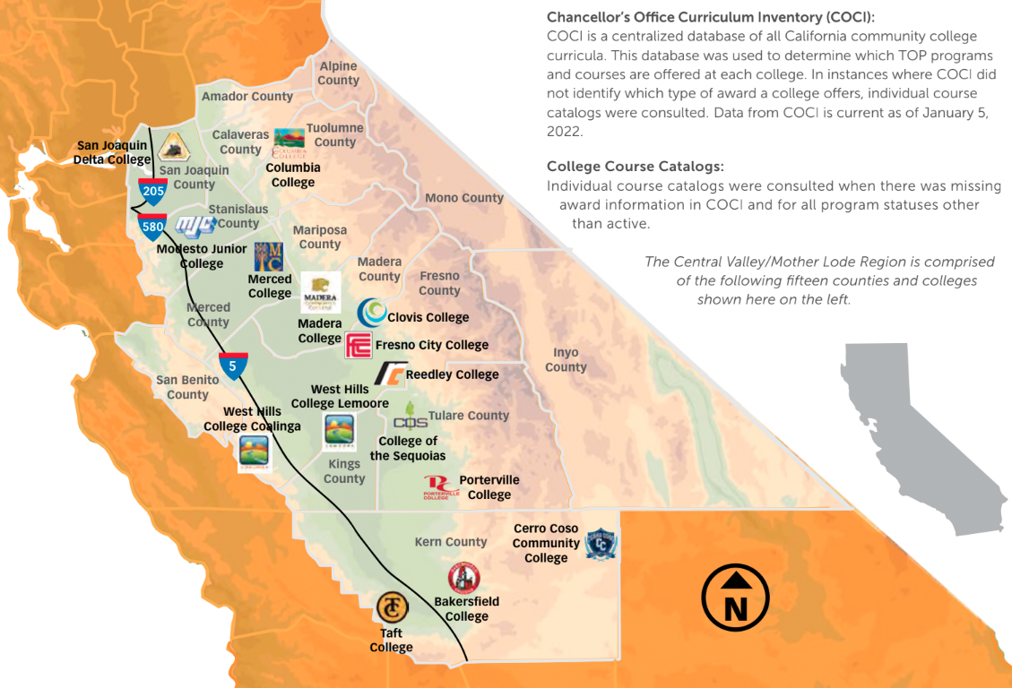
Central Valley/ Motherlode

Slide 7
Logistics, Industrial Maintenance and Manufacturing Pathway Bridge
Project Organization
Strategy Coordination Team (SCT)
Planning Committee
Delta College
Manteca Adult
WorkNet
Other stakeholders
Delta Pathway Mapping / Design
SCT members
Industry/labor representatives
2 members of Teams
CBO / Agency representatives
Participant
Engagement and Navigation
Bridge Curriculum Team
Employer Engagement Group
Engagement/Outreach
Career Dev Curriculum & Instruction
Counseling/Transitions
Enrollment Support
Review/incorporate critical industry skills
CTE curriculum
CTE Dual Enrollment or articulation strategies
Work with CTL comm to support contextualization
Overall employer relationship management
Data base
Management of points of contacts
Partnership steps

Slide 8
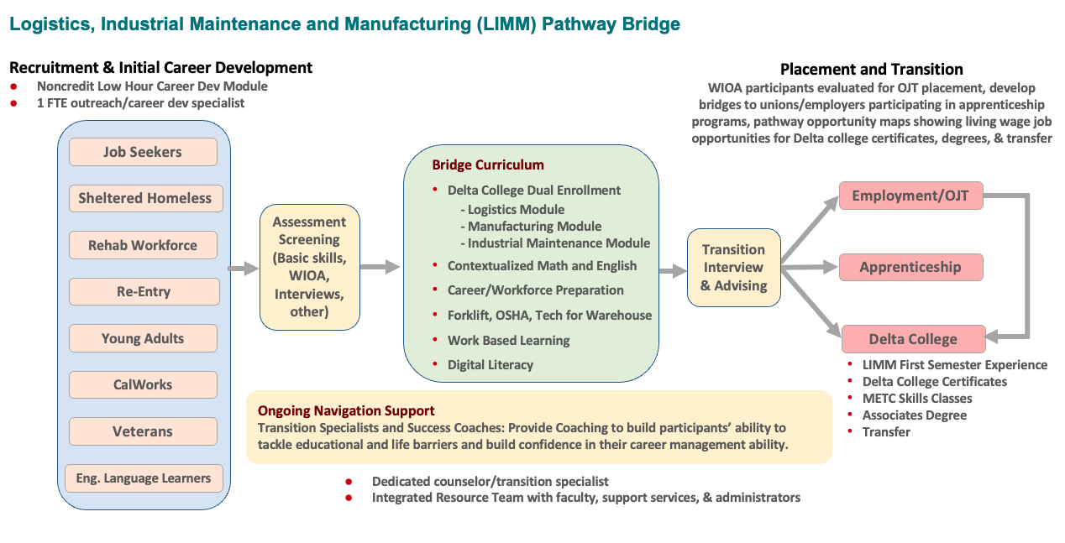
LIMM Pathway Bridge

Slide 9
Jamboard example 1

Slide 10
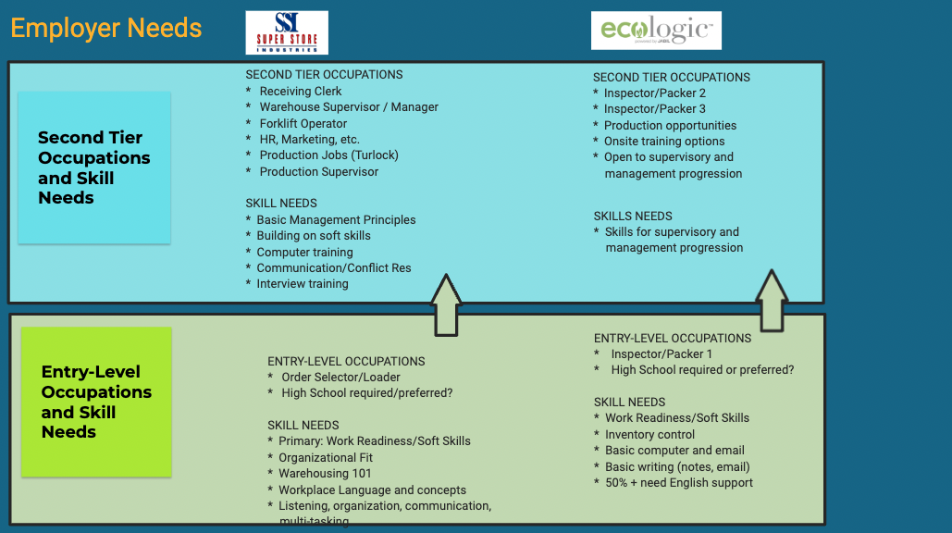
Employer Needs

Slide 11
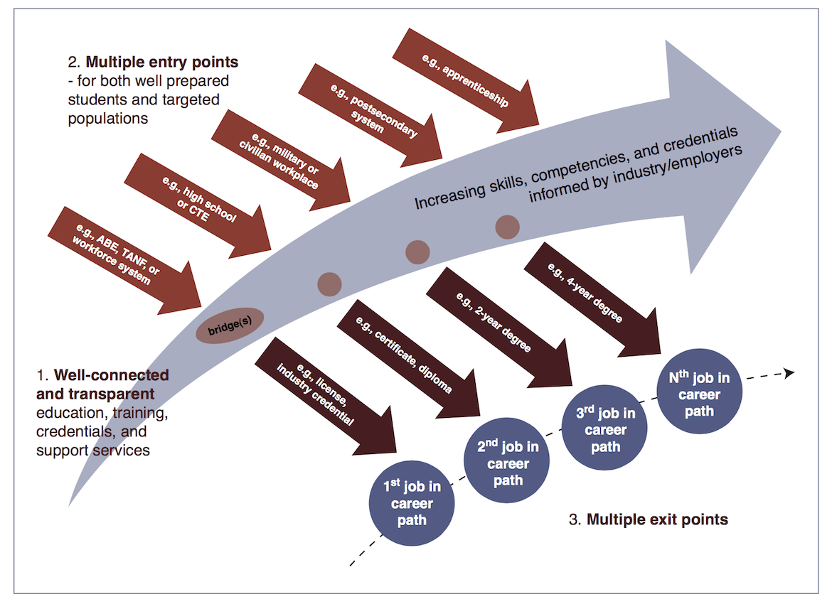
Bridge Curriculum Team
Bridge Curriculum Team
Purpose:
Create a Bridge for adult school students to prepare for entry into a Delta College or immediate employment
Primary Implementation Responsibility:
Adult Education
BRIDGE DESIGN

Slide 12
LIMM Pathway Bridge

Slide 13
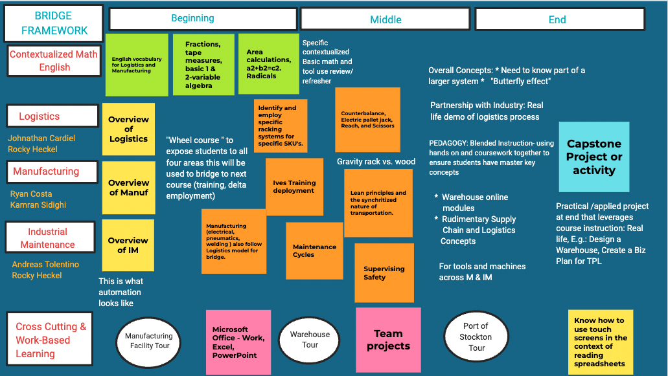
Jamboard example 2

Slide 14
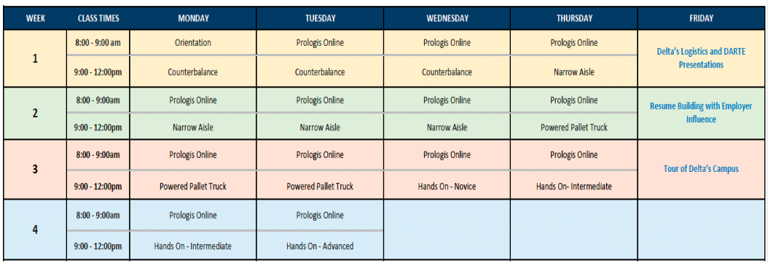
Course Outline

Slide 15
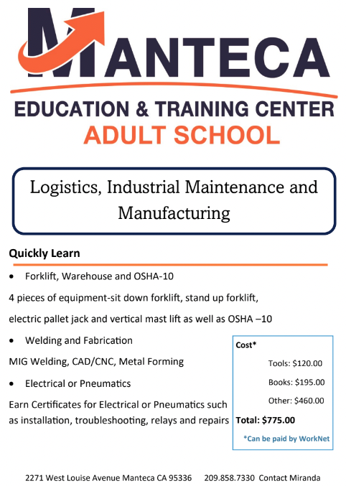
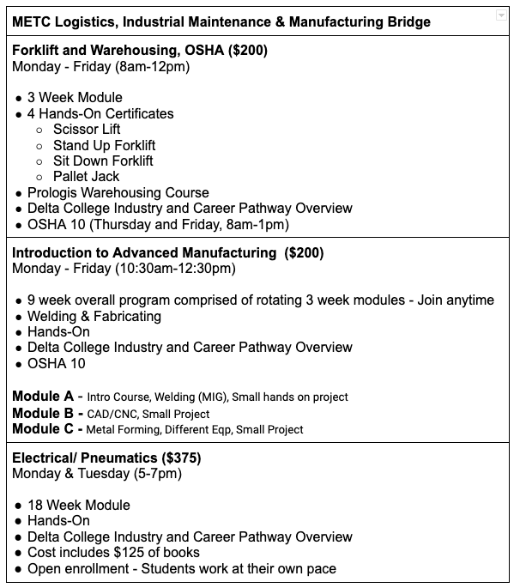
Manteca Bridge Pilot

Slide 16
Pathway Design
Bridge Curriculum Team
Purpose:
Create a Bridge for adult school students to prepare for entry into a Delta College or immediate employment
Primary Implementation Responsibility:
Adult Education
P A T H W A Y D E S I G N
LIMM Pathway Design Team
BRIDGE DESIGN
Purpose:
Create the full sequence of courses, certificates and work experience from initial Delta College certificate, through associate’s degree and onto 4-Year programs
Primary Implementation Responsibility
Delta College credit programs

Slide 17
LIMM Career Pathway Design
Project Purpose
Create a strategic plan for an integrated LIMM career pathway from the adult education bridge, through Delta certificates and degrees, to transfer to 4-year programs
Objectives
Engage industry leaders to co-design the pathway based on accurate labor market information
Build on existing Delta College programs and/or create new programs
Focus on anticipated future industry and skills needs
Deliverables
A strategic plan: vision, goals and overall implementation phasing
A visual career pathway map
An ongoing industry engagement structure

Slide 18
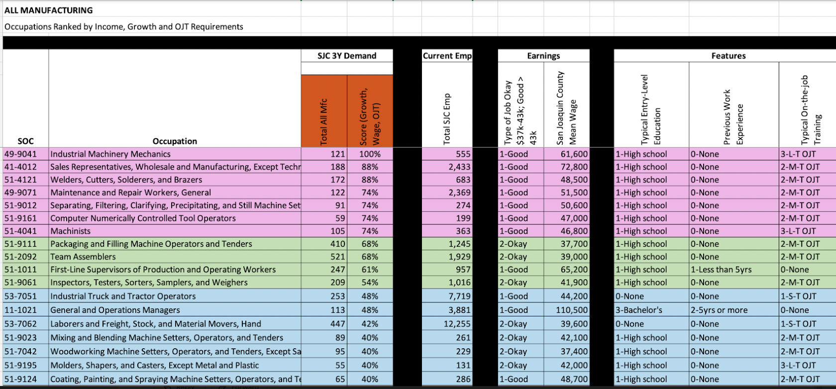
Jobs analysis

Slide 19
For more information
For More Information Contact Paul Rosenbloom
prosenbloom@gmail.com

