Slide 1
Increasing Collaboration within the Ecosystem:
San Diego/Imperial Counties Adult Education CTE Course Mapping & Repository Project
CAEP Summit
October 2022

Slide 2
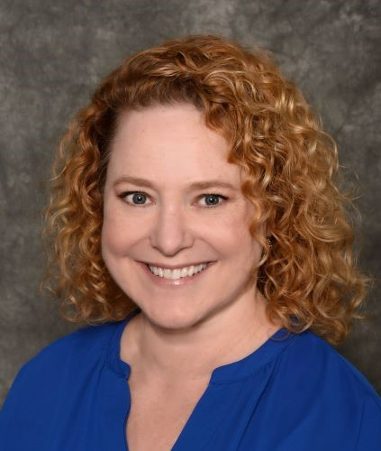
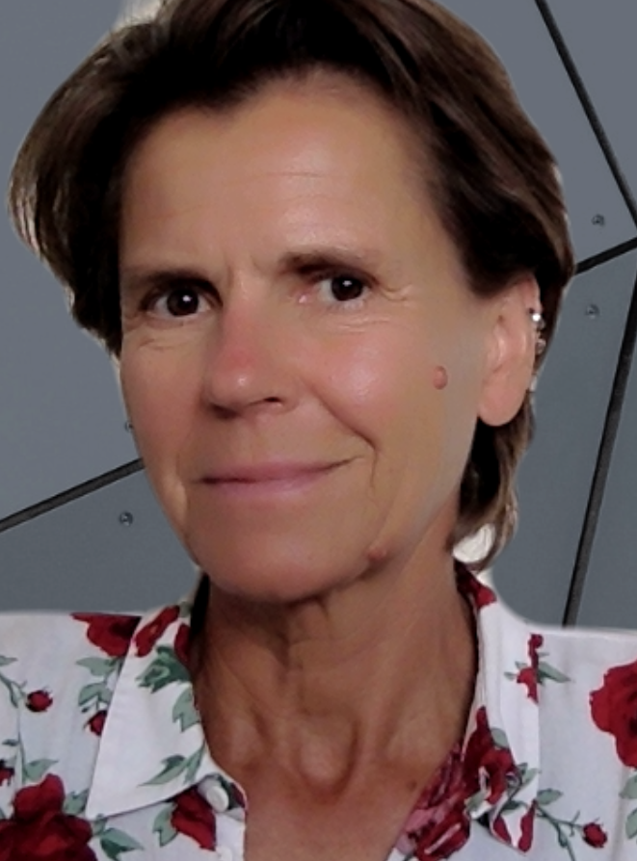
About Us
Suzanne Sebring
SDIC Manager, Career Pathways
SDIC SWP Consortium
Ute Maschke
CAEP Manager
ERAE Consortium
Greg Hill Jr.
Senior Program Manager
WestEd

Slide 3
Our Goals for Today’s Session
Highlight efforts within the San Diego / Imperial Region to develop / streamline pathways
Share process / framework for facilitating horizontal and vertical alignment within and across segments
Share lessons learned and next steps along our journey

Slide 4
Welcome & Introductions
Let’s get to know one another
Notes:
🡪

Slide 5
5
San Diego / Imperial County Adult Education Super Region
Who?
Six regional consortia with seven K-12 Adult Schools in a super region
Serving Whom?
~ 75,000 students in three main areas: ESL (~25,000*), ABE/ASE (~12,500*) and CTE (~17,500*)
Where?
In areas of extreme poverty and extreme wealth, rural and urban, with and without access

Slide 6
Why collaborate at the regional level?

Slide 7
We cannot talk seriously about equity without including adult education in the conversation.

Slide 8
Adult Education Has Unique Challenges
Comparability, lack of shared nomenclature around AE CTE offerings within and across AE
Limited standardization around program-level data collection and reporting
Lack of clarity around the goals of AE, program areas, and populations
Misconceptions among K12 and Postsecondary around AE offerings and where to “put” AE

Slide 9
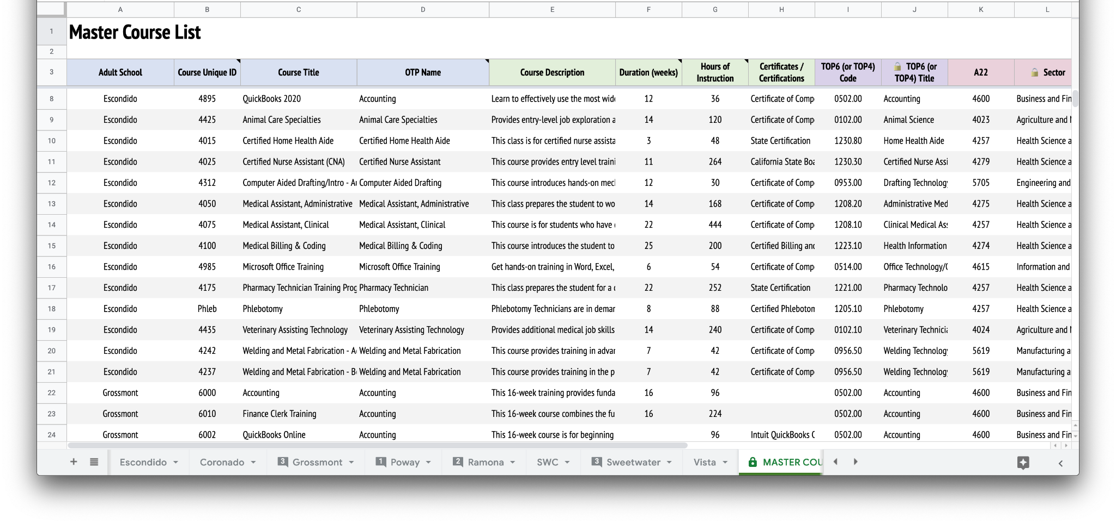
Data Repository

Slide 10
Classify + Cluster + Code
Classification System
WELDING
Guiding Questions
TIER 3
Occupational Training Program
Courses or sequences of courses of sufficient duration and intensity that develop skills for an individual to enter or advance in a specific occupation or industry
Does the offering prepare students to enter directly into the job(s) that it is designed to train them for?
Is it coherent, complete, aligned to industry standards or expectations for performance in a specific occupation?
TIER 2
Occupational Skills Builder
Core occupational skills and competencies that augment or expand previous education or training
GMAW
Does the offering build upon or augment prior learning?
Does the offering teach skills essential for a specific occupation?
TIER 1
Workforce Preparation
Employability and general skills necessary for success in the workforce
NUMERACY
Does the offering develop general employability skills?
Is it perhaps occupational in nature, but not necessarily tied to a specific industry or job?

Slide 11
Classify + Cluster + Code
GMAW
GTAW
SMAW
GTAW
+
+
SMAW
+
NUMERACY
GMAW
NUMERACY

Slide 12
Classify + Cluster + Code
GTAW
TOP
SMAW
GMAW
NUMERACY
A22

Slide 13
Lessons Learned
Course coding was one essential step toward pathway mapping--both horizontal and vertical
Mapping to SOC helped participants coalesce around the end goal of employment, but it can only partially account for the student journey through training into careers
The lack of a shared nomenclature and classification system for educational training programs within / across segments remains a challenge
Digging deeper into the surface-level alignments to assess comparability, standardize, and integrate into a coherent, region-wide pathways system even more difficult in the absence of a common source for programmatic information

Slide 14
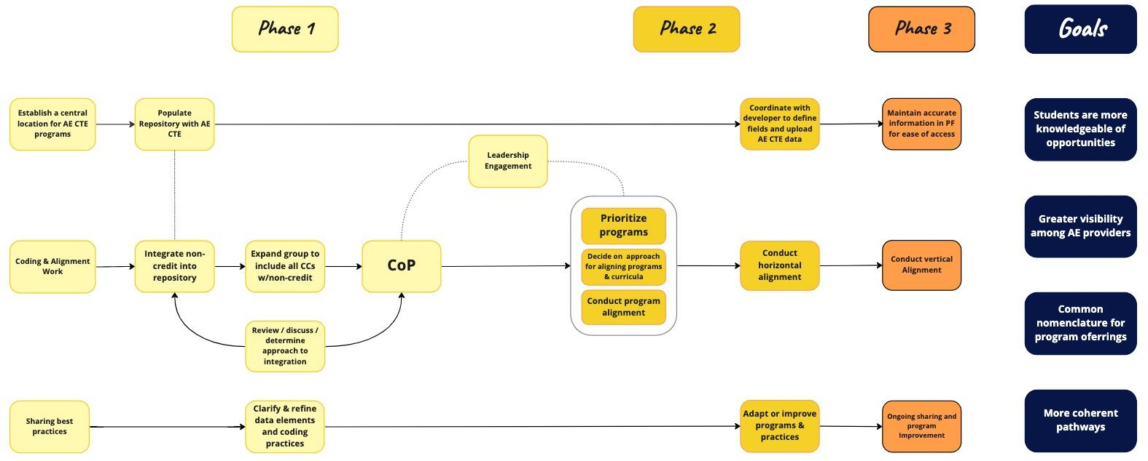
From Repository to Community of Practice

Slide 15
Emerging Discussions
If the region was to be successful at alignment, it would need to:
Expand the idea of the traditional educational pathway to include adult education
Clarify where and how adult education fits into the complex educational system
Find ways to ensure pathways address unique needs of adult learners (e.g., entry and exit at all points) and provide inclusive educational and training opportunities and supportive services

Slide 16
Horizontal Alignment - Health
Legend
◯ AE
◯ CC
Key
CN = Coronado
ES = Escondido
GS = Grossmont
IV = Imperial Valley
MC = MiraCosta
PR = Palomar
PY = Poway
SD = SCCCD
ST = Sweetwater
VS = Vista
Certified Nurse Assistant
Escondido | Grossmont | Poway | SDCCE | Sweetwater
Certified Nurse Assistant (CNA) | CEUs for CNAs ⎯ Nurse Assistant (CNA) | Nurse Assistant | Nursing Assistant Training ⎯ Acute Care Nurse Assistant ⎯ Restorative Nurse Assistant ⎯ Behavioral Health Aide | Certified Nurse Assistant
Medical Assistant, Administrative
Escondido | Grossmont | SDCCE | Sweetwater | Vista
Medical Assistant, Administrative | Electronic Medical Records | Medical Terminology ⎯ Health Unit Coordinator Basics | Medical Assistant Administrative ⎯ Medical Terminology | Medical Billing & Coding ⎯ Medical Insurance Billing for the Physician Office ⎯ Patient Service Representative

Slide 17
What’s Next?
Continue to refine process and workflows around coding and data storage
Explore ways to use data to inform planning and engage stakeholders
Leverage shared knowledge and repository to further horizontal and vertical alignment

Slide 18
Questions?

Slide 19
Contact
Suzanne Sebring
SDIC Manager, Career Pathways
SDIC SWP Consortium
suzanne.sebring@gcccd.edu
Ute Maschke
CAEP Manager
ERAE Consortium
umaschke@guhsd.net
Greg Hill Jr.
Senior Program Manager
WestEd
ghill@wested.org

Slide 20
20

