Slide 1
CAEP Annual Plan
Presenters: Mayra Diaz, Neil Kelly & Veronica Parker

Slide 2
Agenda
CAEP Annual Plan in Statue
CAEP Planning Components
Moving from AB86 to AB104
Breaking Down the Annual Plan
Timeline/Deadlines
Annual Plan Tips
Live NOVA Demonstration

Slide 3
CAEP Annual Plan in Statue
EC 84906 (a) (1) Commencing with the 2019–20 fiscal year, as a condition of receipt of an apportionment of funds from this program for a fiscal year, the members of a consortium shall have a consortium-approved three-year adult education plan that addresses a three-year fiscal planning cycle. The plan shall be updated at least once each year based on available data pertaining to the requirements of subdivision (b)

Slide 4
CAEP Annual Plan in Statue (cont.)
EC 84906 subdivision (b)…. An adult education plan shall include all of the following:
Three action areas, three evaluation areas, three descriptive areas, and a list of entities that provide education and workforce services to adults in the region.
See list of ten required items for the three-year plan and annual plan update in 84906 (b) 1-10.

Slide 5
CAEP Annual Plan in Statue (cont.2)
EC 84906 subdivision (b)…. An adult education plan shall include all of the following:
Actions that the members of the consortium will take to address the educational needs identified pursuant to paragraph (1) (adult ed needs).
Actions that the members of the consortium will take to improve the effectiveness of their services.

Slide 6
CAEP Annual Plan in statue (cont.3)
Actions that the members of the consortium, the entities listed pursuant to paragraph (2), and other interested parties will take to improve integration of services and to improve transitions into postsecondary education.

Slide 7
CAEP Annual Plan in statue (cont.4)
EC 84914 (a) As a condition of receipt of an apportionment from the program, a consortium shall approve a distribution schedule that includes both of the following:
(1) The amount of funds to be distributed to each member of the consortium for that fiscal year.
(2) A narrative justifying how the planned allocations are consistent with the adult education plan.

Slide 8
CAEP Planning Components
Consortium Three-Year Plan
Certified CFAD (annually)
Consortium Annual Plan
Member Work Plan
Member Budget

Slide 9
Moving from AB86 to AB104
AB86 funded the regional planning grants to establish the regional consortium structure (2013).
AB 86 also required regional consortia to develop plans to include:
Plans to address gaps in services.
Plans to integrate their existing programs and create seamless transitions into postsecondary education or the workforce.
Plans to employ approaches proven to accelerate a student’s progress.
Plans to collaborate in the provision of ongoing professional development.
Plans to leverage existing regional structures.

Slide 10
Moving From AB86 to AB104 (cont.)
In January of 2019, the California State Legislature added Education Code §84906 to specifically address CAEP Three-Year Planning including the following action items:

Slide 11
Moving From AB86 to AB104 (cont. 1)
Actions that the members of the consortium will take to address the educational needs.
Actions that the members of the consortium will take to improve the effectiveness of their services.
Actions that the members of the consortium will take to improve integration of services and to improve transitions into postsecondary education and the workforce.

Slide 12
Moving From AB86 to AB104 (cont. 2)
AB 86 Planning | Transition | Education Code
Plans to address gaps in services. | → | Actions to address the educational needs.
Plans to integrate & create seamless transitions into postsecondary education or the workforce. | → | Actions that the members of the consortium will take to improve integration of services and to improve transitions into postsecondary education and the workforce.
Plans to accelerate a student’s progress. | → | Actions that the members of the consortium will take to improve integration of services and to improve transitions into postsecondary education and the workforce.
Plans to collaborate in the provision of ongoing professional development. | → | Actions to improve the effectiveness of their services.
Plans to leverage existing regional structures. | → | Actions to address the educational needs.

Slide 13
Breaking Down the Annual Plan
Section | Instructions
Section 1: Plans and Goals | Identify an executive summary, a regional planning overview, and how the annual plan will meet the identified regional needs.
Section 2: Address Educational Needs | Define the strategies to address the activities, barriers and metrics.
Section 3: Improve Integration of Services & Transitions | Define the strategies to address the activities, barriers and metrics.

Slide 14
Breaking Down the Annual Plan (cont.)
Section | Instructions
Section 4: Improve Effectiveness of Services | Define the strategies to address the activities, barriers and metrics.
Section 5: Fiscal Management | Describe how the consortium’s available funds, including carry-over funds, will be leveraged to impact the strategies identified in the plan..
Section 6: Preview & Submit | Review the content of each prior section.

Slide 15
Timeline/Deadlines
Your annual plan must be submitted and approved by all members in NOVA by September 14, 2022 for the 2022-23 program year.
After submission and approval of the annual plan, consortium member agencies will have until October 30, 2022 to submit their member work plan and budget.
The consortium has until November 30, 2022 to certify all member work plans and budgets.
Member Q1 expenditure reporting is due December 1, 2022.

Slide 16
Annual Plan Tips (cont. 1)
Consortia can copy and paste from last year’s annual plan or modify existing strategies that are ongoing. The annual plan can have a mixture of new and/or existing strategies.
If a consortium’s annual plan is similar to the prior year, please do your best to describe what is different from last year to this year (i.e. maybe you have completed some of the strategy action steps, but not all) and how it is responsive to current events described above.

Slide 17
Annual Plan Tips (cont. 2)
The annual plan can consist of implementing existing strategies as the CAEP Office knows some strategies are long term in nature.
CAEP planning is hierarchical – the three-year plan aligns with the State’s CAEP vision and goals. The annual plan contains those strategies that help consortia achieve those goals. The member’s budget and expenses support those specific strategies.
Annual plans can be amended throughout the program year.

Slide 18
Annual Plan Tips (cont. 3)
Use the ‘Send Reminder’ feature in NOVA to notify Member Representatives to approve.
Consortia work plans and budgets will open after the annual plan has been approved by all Member Representatives.
The strategies are selected by checking a box (no need to rewrite the strategies or provide additional information).

Slide 19
Annual Plan Tips (cont. 4)
The consortium annual plan strategies will be used by consortium members to drive their member work plans and they will be consortium certified by October 30th.
Members will select a specific number of strategies from the annual plan to focus on from July 1st to June 30th.

Slide 20
Annual Plan Live Demonstration in NOVA

Slide 21
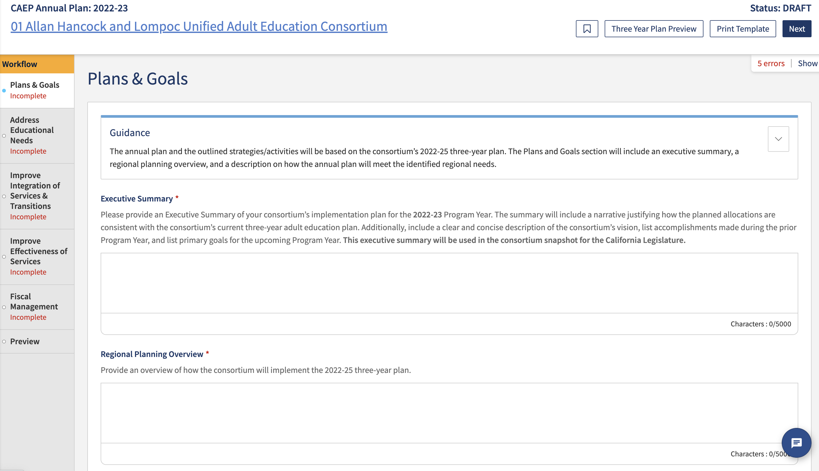
Screenshot 1
A link to the consortium’s three-year plan is provided here as well as the ability to print the annual plan template.
Guidance is provided at the top of each section.
After you have entered information for each section, click on the ‘Next’ button.
Examine the helper text provided underneath each header for instructions on what to include. Also, pay attention to the character limit for each section.

Slide 22
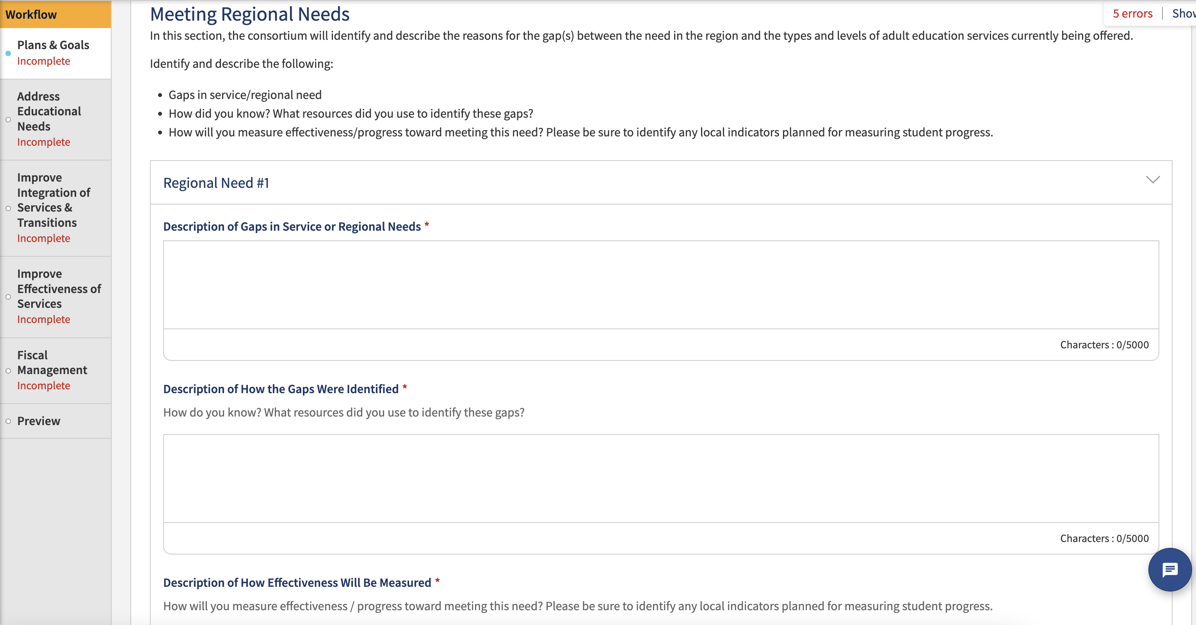
Screenshot 2
Add additional regional needs by clicking on the button below.

Slide 23
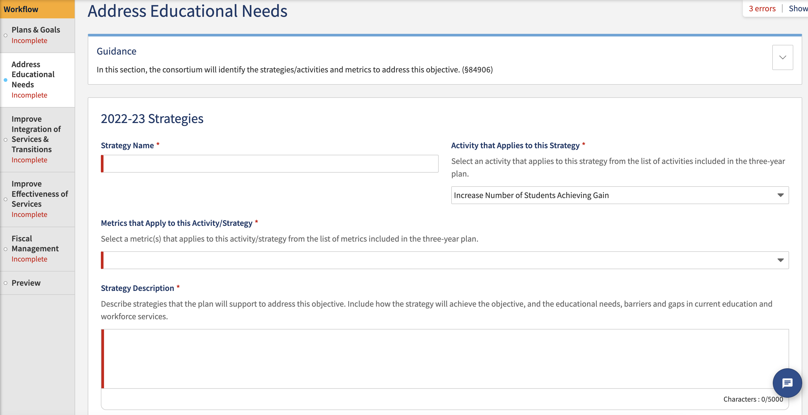
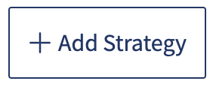
Screenshot 3
Guidance is provided at the top of each section.
Select an activity from the drop-down menu. These activities were imported from the CAEP 2022-25 three-year plan.
Add strategy name.
Select a metric(s) from the drop-down menu. These metrics were imported from the CAEP 2022-25 three-year plan.
Add additional strategy by clicking on the button below.
Add the strategy description. There is a character limit of 5000.

Slide 24
Screenshot 4
Guidance is provided at the top of each section.
Select an activity from the drop-down menu. These activities were imported from the CAEP 2022-25 three-year plan.
Add strategy name.
Select a metric(s) from the drop-down menu. These metrics were imported from the CAEP 2022-25 three-year plan.
Add additional strategy by clicking on the button below.
Add the strategy description. There is a character limit of 5000.

Slide 25
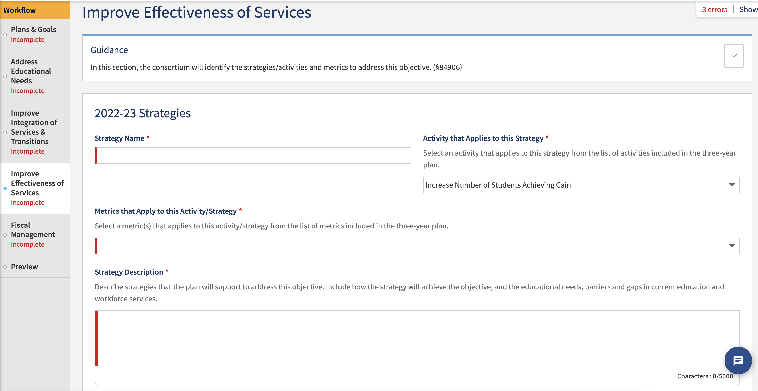
Screenshot 5
Guidance is provided at the top of each section.
Select an activity from the drop-down menu. These activities were imported from the CAEP 2022-25 three-year plan.
Add strategy name.
Select a metric(s) from the drop-down menu. These metrics were imported from the CAEP 2022-25 three-year plan.
Add additional strategy by clicking on the button below.
Add the strategy description. There is a character limit of 5000.

Slide 26
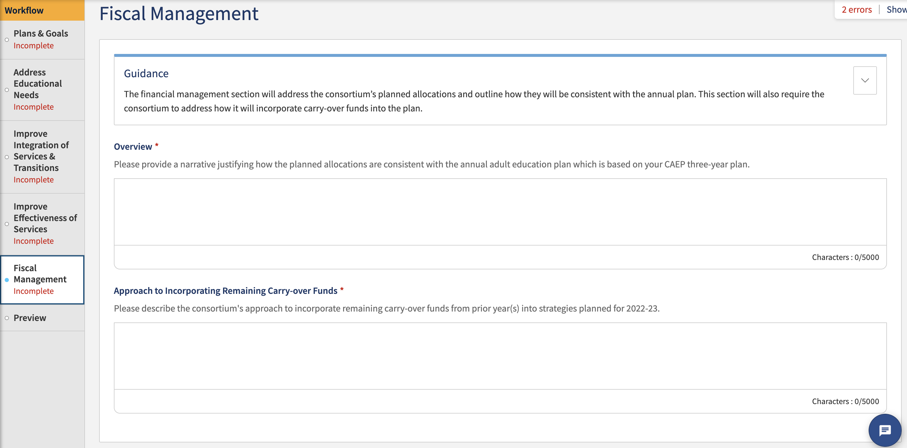
Screenshot 6
Guidance is provided at the top of each section.
Add an overview of justifying planned allocation. There is a character limit of 5000.
Add a description for the approach to incorporate carry-over funds. There is a character limit of 5000.

Slide 27
Wrap Up and Questions

Slide 28
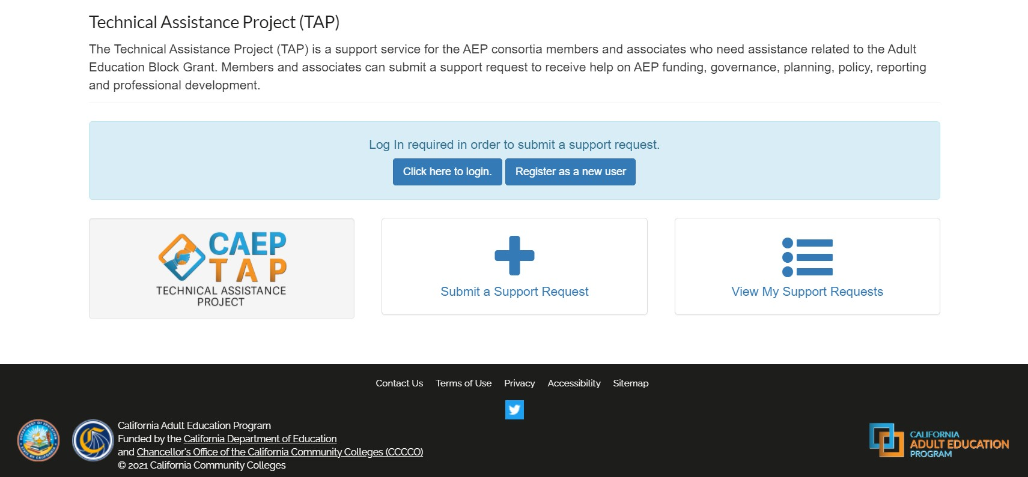
Request Support from CAEP TAP

