Slide 1
Building Career Pathways Using the CA Adult Ed Career Education Dashboard Tool
Session I
June 15, 2022

Slide 2
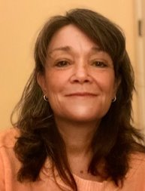
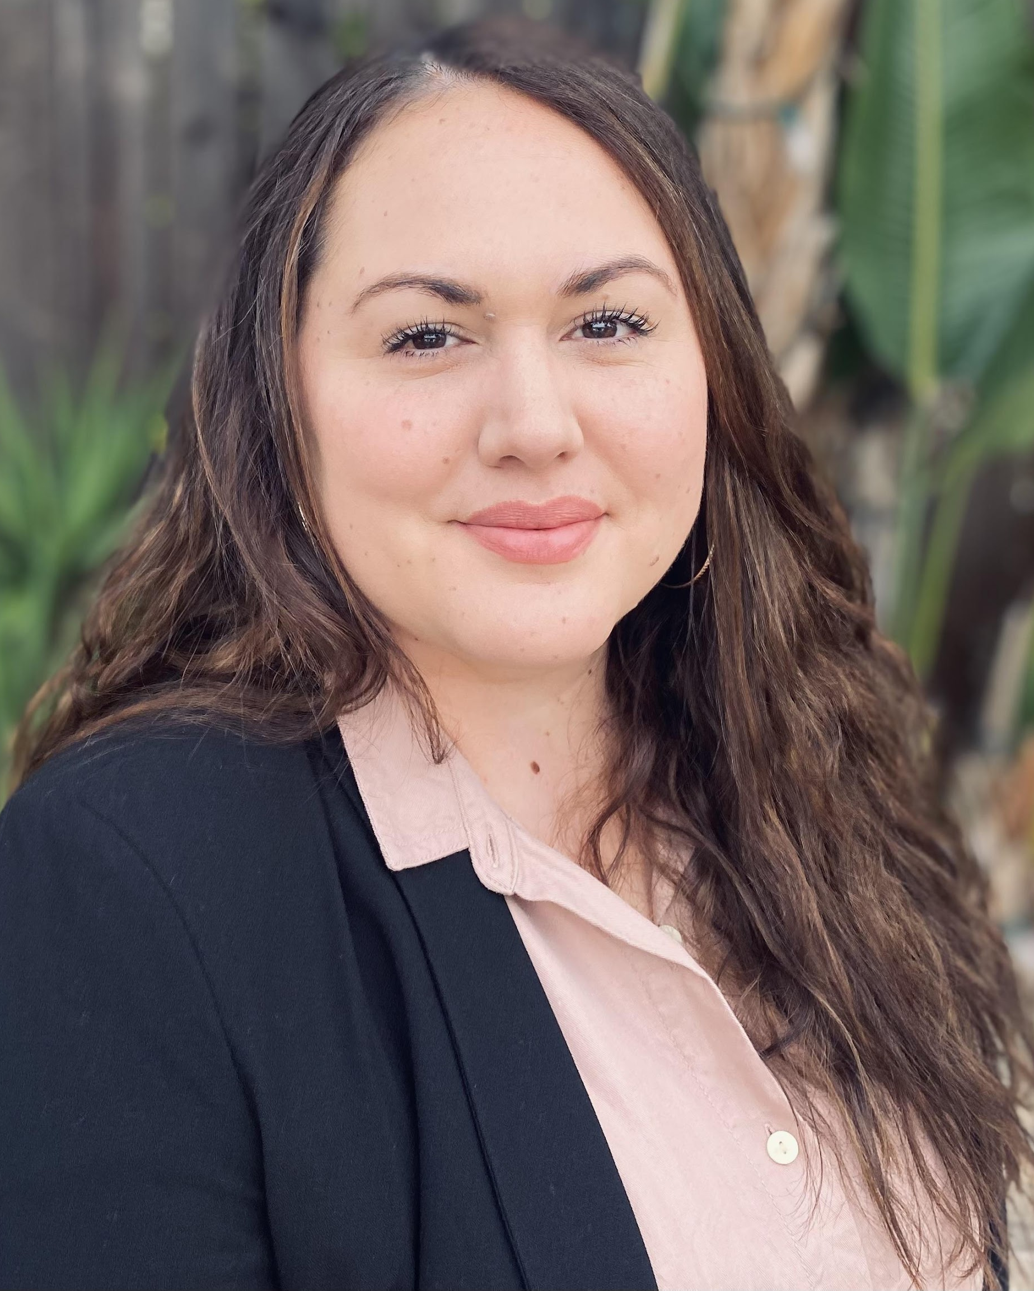
CAEP AEP Team
Blaire Willson Toso
Senior Program Manager
btoso@wested.org
Jessica Keach
Senior Research Associate
jkeach@wested.org
Ayanna Smith
Program Coordinator II
asmith5@wested.org

Slide 3
Chancellor’s Office Welcome
Mayra Diaz
CAEP Program Lead
Chancellor’s Office
Lindsay Williams
Program Manager
Chancellor’s Office

Slide 4
Today’s Presenters
Allie Bollela
Program Coordinator II
abollel@wested.org
Alexandria M. Wright Ph.D.
Senior Research Associate
awright@wested.org

Slide 5
Agenda
Review of CA Adult Ed Career Education Dashboard
Exploring Steps to Building Career Pathways & Career Systems with Equity
Exercise: Using the CA Adult Ed Career Education Dashboard to build Arts & Humanities Pathways in the Bay Macroregion

Slide 6
Objectives
Understand the data curation process for the CA Adult Ed Career Education Dashboard and how to submit updated CE programming with associated information for inclusion in the dashboard
Understand and apply the steps to building career pathways and career systems with equity
Understand and apply the CA Adult Ed Career Education Dashboard for pathway development

Slide 7
Review: Adult Education to Workforce Data Project

Slide 8
CTE & Workforce Course Types
Workforce Preparation
Occupational Skills Builder
Occupational Credential Programs
Workforce Readiness, OSHA, ServeSafe – general skills necessary for success in the workforce
Offerings that advance skills related to an industry but that by themselves do not qualify a student for a specific occupation within an industry
Programs/courses of sufficient duration and intensity that provide skills for an individual to enter into or advance in a specific occupation and industry

Slide 9
San Diego/Imperial CTE Course Alignment & Career System
Goal: Organize and classify regional CTE courses to build a career pathway system and career navigation platform across the SDIC Region/Super-region
Implement an adult learner career exploration portal that captures the regional AE career pathways and system
Establish processes and a data structure for aggregating and updating course and program data
Establish common definitions, organize courses and programs, and code courses and programs

Slide 10
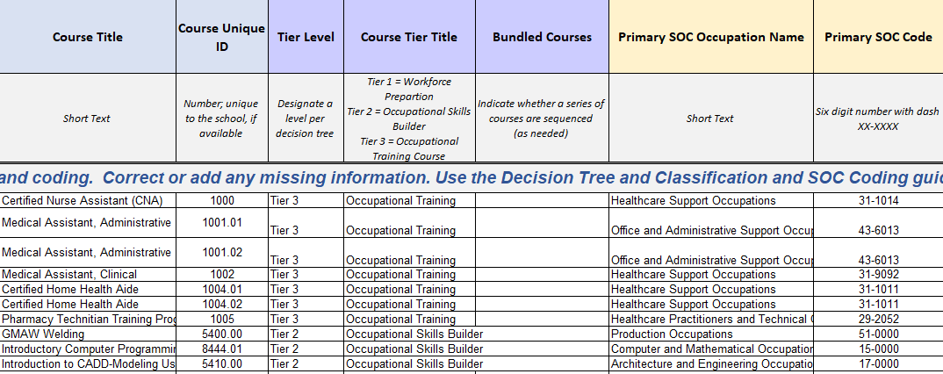
Data Collection Process

Slide 11
Data Collection Process and Annual Updates
Using modified template from San Diego project.
Dashboard still has data from original only for schools that did not send data.
Updated programs can be sent to abollel@wested.org or Btoso@wested.org
Be sure to include:
School
Program Title
Affiliated industry credential
IET or IEL/CE designation
Pre-apprenticeship designation
SOC associated with the program or Industry Sector
Which type of Career Education program: workforce preparation, occupational skills builder, occupational credential program

Slide 12
Pathway Planning

Slide 13
What data do we need to build or enhance career pathways with equity?
Local Economic and Labor Market Information
Provides information on the high demand jobs in your region that lead to a living wage, the industry sectors that are hiring, and the career pathways that will result in economic mobility in the local economy.
Real-time Labor Market Information
Provides information on skills demand, competencies, and frequency of job postings per occupation.
Adult Education, community college and university latticed programs for pathways
Credentials:
Should be of short duration
Have labor market value by themselves, thus adding to student’s earning power
Should be part of a structured pathway that is not repetitive

Slide 14
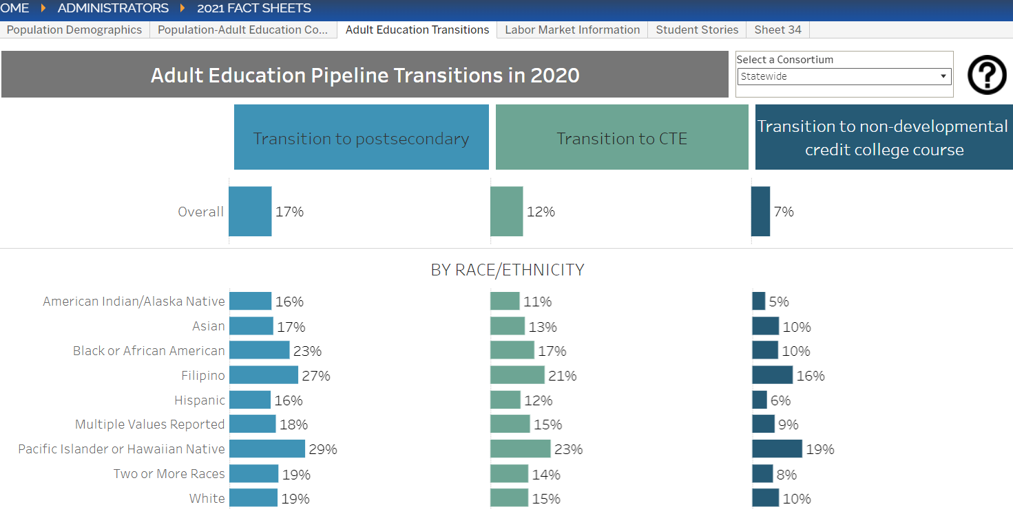
Steps to Pathway Planning
Identify target population(s)
Tool: CAEP 2021 Fact Sheet https://caladulted.org/2021FactSheets
Identify Pathway Program:
target sector, skills occupational cluster, industry credentials
Tool: CA Adult Ed Career Education Dashboard bit.ly/CAEP_CTE_Courses
Identify strategies for accelerated learning
Stacked and latticed credentials that lead to high-quality jobs that align with a career pathway into community college and university.
Competency-based education and assessment such as pre-apprenticeships or skills-builder courses
IET or IEL/CE Programming
Improved comprehensive and personalized student support services and career guidance
Online and distance learning and advanced training technologies for rapid feedback and adaptive learning

Slide 15
Steps to Pathway Planning
4. Identify Pathway System Partners
Workforce Development Board
One-stop/AJCC
Labor Unions
Industry Associations
Economic Development Collaboratives
Community-based Organizations connected with target populations and sectors
Entrepreneurial Assistance – SBDCs, SCORE, WBCs
5. Identify tangible pathway system changes to address equity gaps
program designs (to include pre-apprenticeships to apprenticeships, or WBL)
policy changes
new workforce system or employer partnerships (such as membership in industry associations)
new approaches to employer engagement (beyond the traditional AB format i.e. CTE Fact Sheet)
new ways of supporting students
new methods of instructional design and delivery
“Sustainable systems change alters a sufficient number of key drivers (incentives, rules, etc.) such that the system that once perpetuated a ‘problem’ now instead perpetuates a ‘solution.’ This has implications on the way projects are designed and implemented.”
-Woltering, L. et al. 2019

Slide 16
CA Adult Ed Career Education Dashboard (bit.ly/CAEP_CTE_Courses)
Arts & Humanities Pathways
Query by sector then region.
Query by Entry Level Education to best analyze high-quality career pathways with projected growth.
Begin with the three entry level education categories that align with Adult Ed awards
Hint: Try looking at Opportunity Maps for your macroregion to verify the occupations you should be targeting
https://www.wested.org/project/designing-metamajors/

Slide 17
Arts & Humanities Pathways
J
K
Look at Adult Ed regional program offerings to identify opportunities to build new pathways, opportunities to leverage existing pathway programs, and to reduce duplication of efforts
Look at community college programs by occupational cluster to identify stackable career pathways
CA Adult Ed Career Education Dashboard

Slide 18
Arts & Humanities Pathways
Opportunity Maps
Sequence the learning from ABE/HSE/GED into stackable career education courses that offer generalizable work-readiness, occupational skills-building or industry credentials.

Slide 19
Arts & Humanities Pathways
Opportunity Maps
How are we ensuring equity in career pathway programs and systems?

Slide 20
Questions & Thoughts

Slide 21
Thank You
Alexandria M. Wright Ph.D.
Senior Research Associate
awright@wested.org
Blaire Willson Toso Ph.D.
Senior Program Manager
btoso@wested.org
Allie Bollela
Program Coordinator II
abollel@wested.org
Ayanna Smith
Program Coordinator II
asmith5@wested.org
Jessica Keach
Senior Research Associate
jkeach@wested.org

