Slide 1
Adult Education Pathways Through Education to Workforce
June 9, 2022

Slide 2
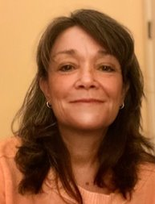
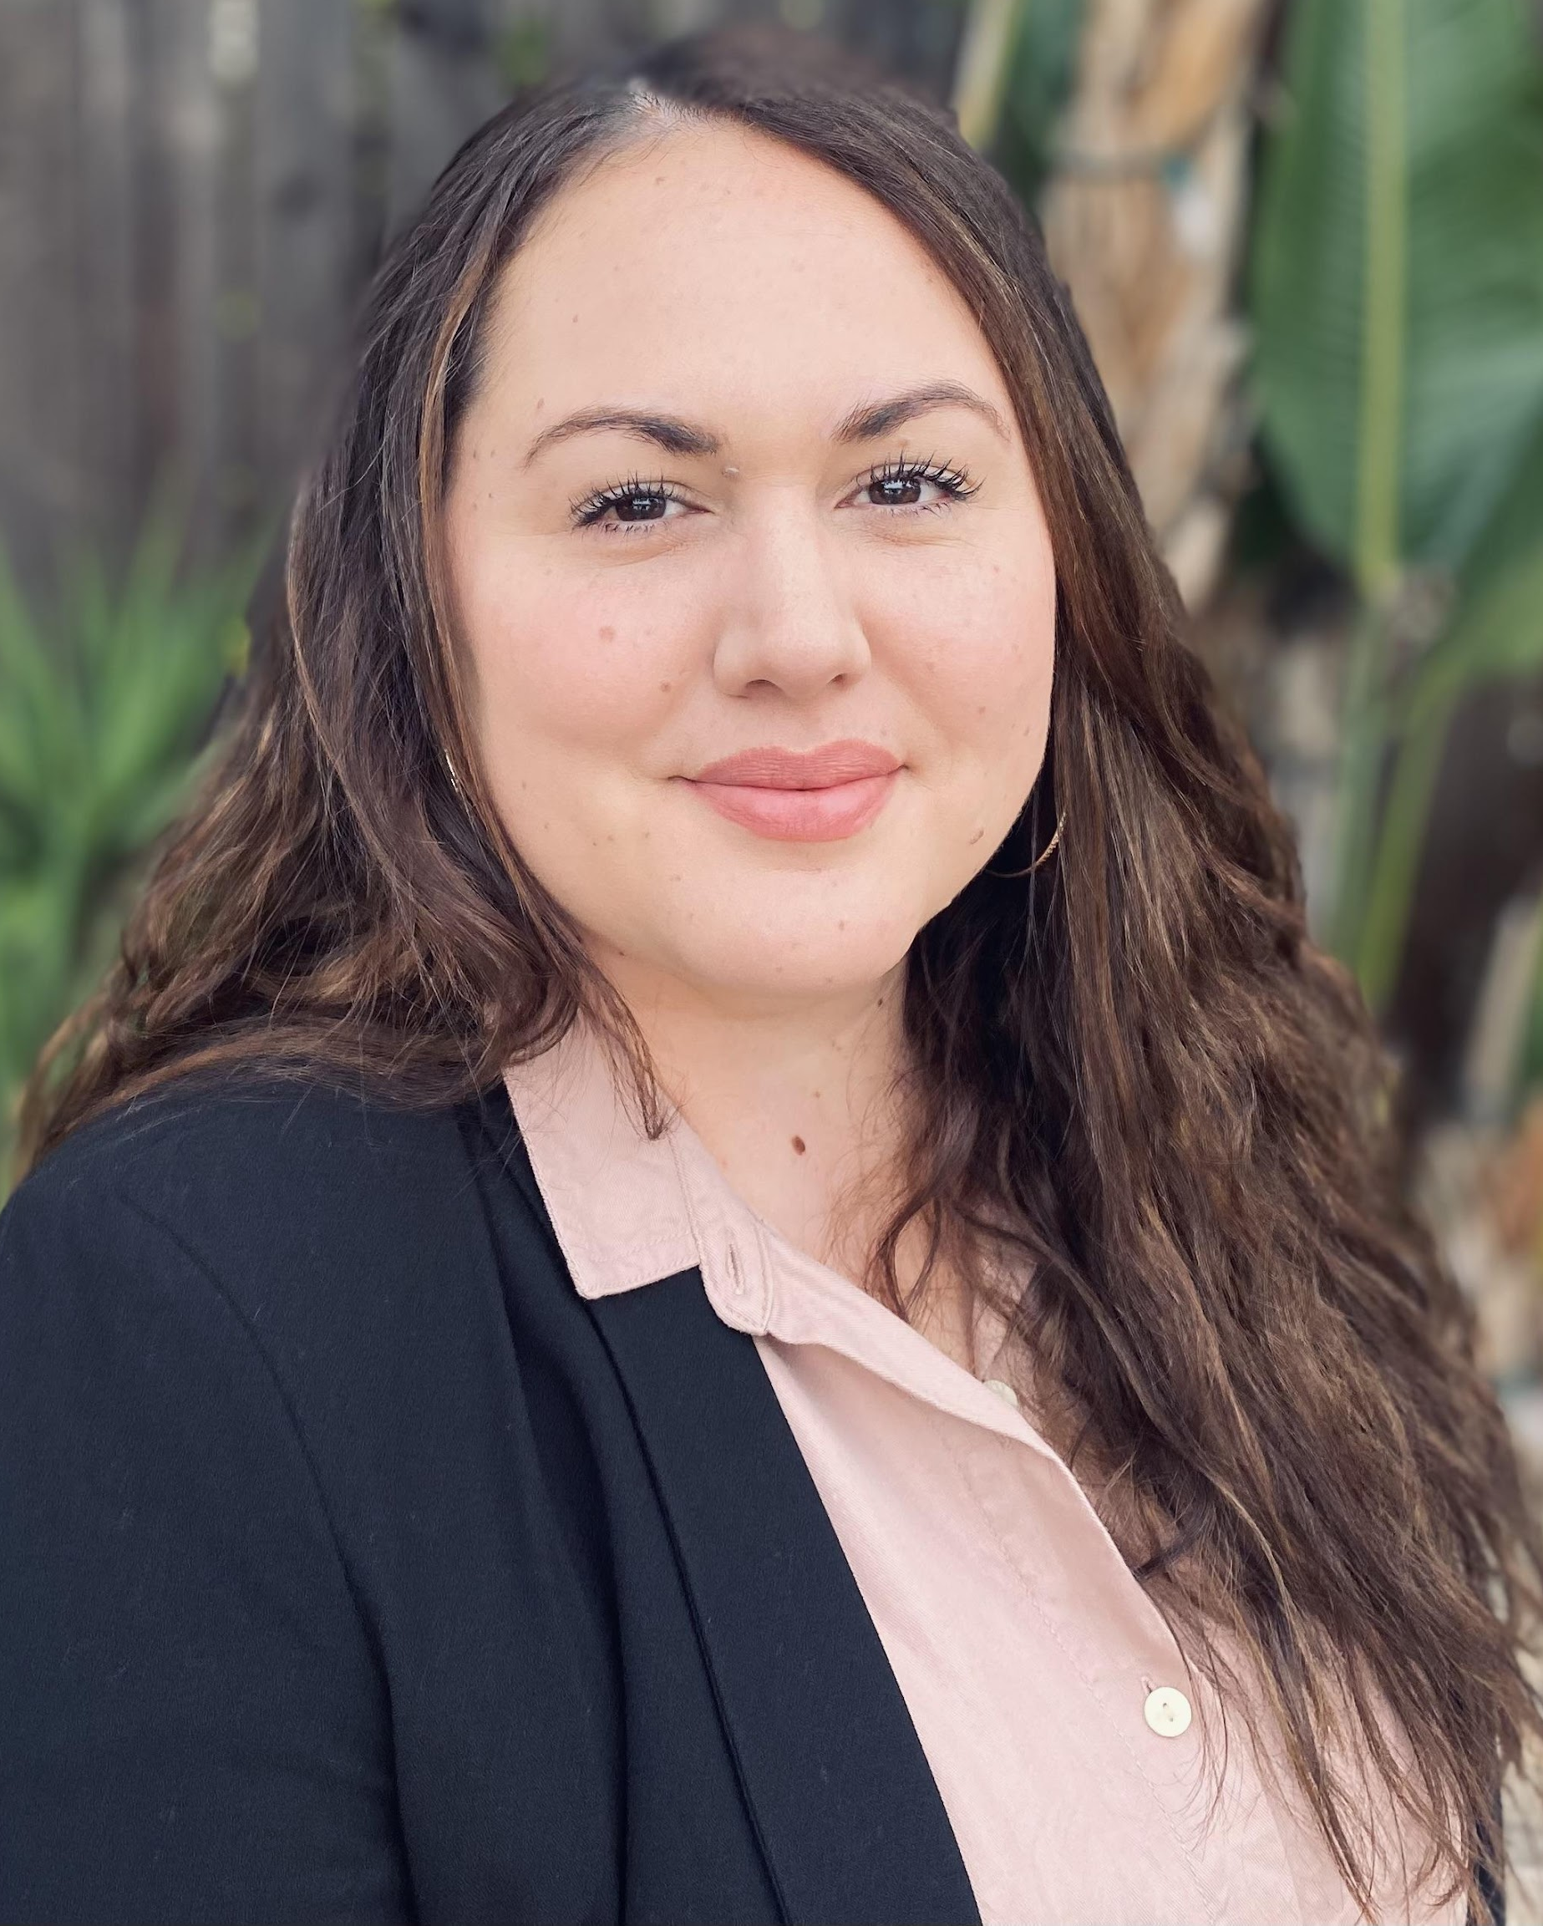


Today’s Presenters
Blaire Willson Toso
Senior Program Manager
btoso@wested.org
Jessica Keach
Senior Research Associate
jkeach@wested.org
Ayanna Smith
Program Coordinator II
asmith5@wested.org
Allie Bollella
Program Coordinator II
abollel@wested.org

Slide 3


The Chancellor's Office
Mayra Diaz
CAEP Program Lead
Chancellor’s Office
Lindsay Williams
Program Manager
Chancellor’s Office

Slide 4
Agenda
Introduction to Adult Education Course Scan
Example of Data Collection and Management from San Diego
Review of Updated Adult Ed Career Education Dashboard
Using the Adult Ed Career Educational Dashboard

Slide 5
Goals
Provide an overview of the adult education career education course dashboard
Demonstrate the value of aligning educational offerings to labor market data
Provide examples of regional career education course alignment that create transparent career pathways
Demonstrate how to identify trends for planning purposes
Present labor market resources and career exploration tools for regional planning and alignment

Slide 6
How the Work Started:
Adult Education to Workforce Data Project

Slide 7
Purpose
Understand the continuum of CTE & career courses offered by NC & adult ed practitioners
Map the relationship between adult ed CTE & career offerings, credit programs, and regional labor markets
Support consortia pathway development and conversations about using labor market and other resources to support CAEP students

Slide 8
Scope & Scale
Scanned 521 institutions
225 agencies providing CTE & Workforce Preparation Courses
Includes Over 7000 course offerings

Slide 9
CTE & Workforce Course Types
Workforce Preparation
Workforce Readiness, OSHA, ServeSafe – general skills necessary for success in the workforce
Occupational Skills Builder
Offerings that advance skills related to an industry but that by themselves do not qualify a student for a specific occupation within an industry
Occupational Credential Programs
Programs/courses of sufficient duration and intensity that provide skills for an individual to enter into or advance in a specific occupation and industry

Slide 10
Higher Level Findings
Regions across California had a diverse mix of occupational training courses and skills builder courses, as well as occupational sectors, however statewide approximately 60% of courses were skills builder courses
At least a third of the adult education schools did not have any CTE or Workforce Preparation courses in their catalogues, websites, or associated brochures
From the public information it was hard to identify which schools were offering integrated or IET programs
Emphasis on skills builder courses is strongly aligned with mission of adult education to help adults get skills quickly relevant to their needs

Slide 11
Implementing Data Collection Processes:
San Diego/Imperial CTE Course
Alignment & Career System

Slide 12
San Diego/Imperial CTE Course
Alignment & Career System
Establish common definitions, organize courses and programs, and code courses and programs
Establish processes and a data structure for aggregating and updating course and program data
Implement an adult learner career exploration portal that captures the regional AE career pathways and system
Goal: Organize and classify regional CTE courses to build a career pathway system and career navigation platform across the SDIC Region/Super-region

Slide 13
Structure & Focus
Target Region: Greater San Diego Region
Participants: Super-region adult schools & college noncredit programs
3 Train the Trainer sessions for consortia reps to learn about occupational coding and framework
Consortia course categorizing and SOC coding planning sessions (w support from WestEd)
Developing & populating dataset
Next Steps
  Horizontal alignment of course features across the region to ensure equitable understanding
  Align with Community College credit pathways
  Explore development of online career platform

Slide 14
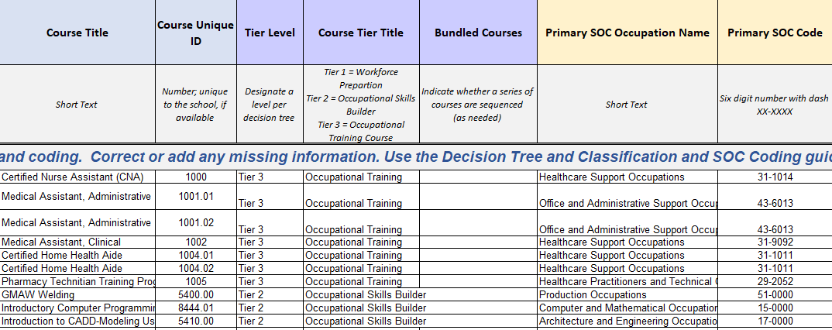
Data Collection Process

Slide 15
Gave Rise Questions & Opportunities
QUESTIONS
OPPORTUNITIES
How and to what extent do we need to align classes?
How do we leverage similar but different educational opportunities?
How do we measure the value and quality of our courses (e.g., hours, certificates)?
What is the value of Skills Builder Courses versus Occupational Training Courses?
Refined understanding of different student populations among members
Promoted discussion across members
Opened programming conversations among instructors
Refined marketing messages: students, employers
Provided focus on program planning

Slide 16
Revising the Dashboard:
California Adult Ed Career Education Dashboard

Slide 17
Data Collection Process
Collected data from across the state in Spring 2022
Data collection used a modified version of the template used in San Diego.
The Dashboard includes data from:
          The most recent round of data collection (Spring 2022) and;
                the original round of data collection (Winter 2019-2020)

Slide 18
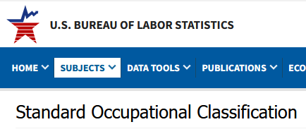


Design Process of the Dashboard
Occupational Data:
                Organized by Standard Occupational Codes (SOC) – Occupations are standardized by BLS and given 6-digit codes places in placed within one of the 23 major groups.
                Annual Openings Definition – A combination of both new jobs and replacement jobs divided by the number of years in the timeframe.
                Median Wage Definition – Indicates the halfway point of all worker wages in the given occupation. This value is collected from employers.
                2020-2025 % Change Definition – Percent change in the annual openings of an occupation between the base year and the end year.
                Additional Data:
                MIT Living Wage – MIT determines the living wage in each county for the US.
                ONET Skills – Onet standardizes skills and assigns skills to occupational codes.

Slide 19
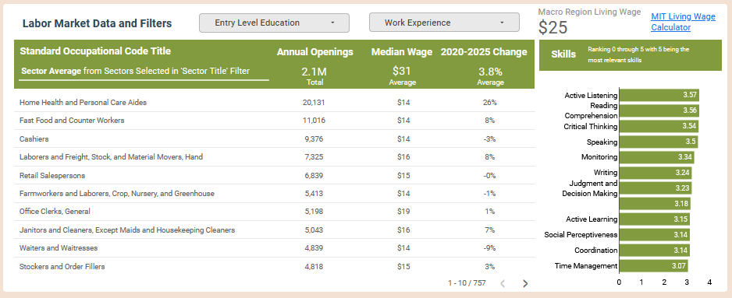
Labor Market Data and Filters

Slide 20
Macro Regions & Counties
Bay Area
          Alameda County
          Contra Costa County
          Marin County
          Monterey County
          Napa County
          San Francisco County
          San Mateo County
          Santa Clara County
          Santa Cruz County
          Solano County
          Sonoma County
Central Valley Mother Lode
          Alpine County
          Amador County
          Calaveras County
          Fresno County
          Inyo County
          Kern County
          Kings County
          Madera County
          Mariposa County
          Merced County
          Mono County
          San Joaquin County
          Stanislaus County
          Tulare County
          Tuolumne County
Inland Empire
Riverside County
San Bernardino County
LA Orange
Los Angeles County
Orange County
San Diego Imperial
Imperial County
San Diego County
South Central Coast
San Luis Obispo County
Santa Barbara County
Ventura County
North far North
Butte County
Colusa County
Del Norte County
El Dorado County
Glenn County
Humboldt County
Lake County
Lassen County
Mendocino County
Modoc County
Nevada County
Placer County
Plumas County
Sacramento County
Shasta County
North far North (cont.)
Sierra County
Siskiyou County
Sutter County
Tehama County
Trinity County
Yolo County
Yuba County

Slide 21
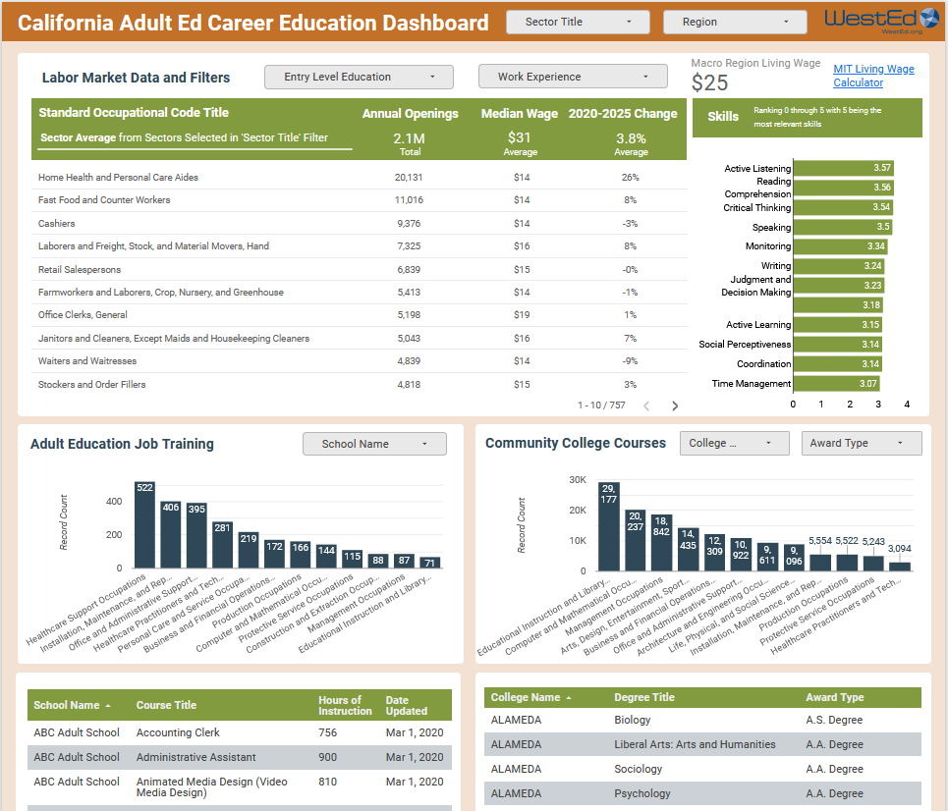
Dashboard Design & Demo
Link to New Dashboard:
https://bit.ly/CAEP_CTE_Courses

Slide 22
Q & A

Slide 23
Upcoming Webinars
Two Session Professional Development Opportunities
6/14/2022 & 6/28/2022 | Part I & 2: Creating Career Pathways Using the Updated Adult Education to Workforce Dashboard Tool

Slide 24
Thank You!

