Slide 1
AEP Data for Continuous
Improvement & 3-Year Planning
May 10, 2022

Slide 2
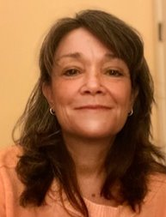
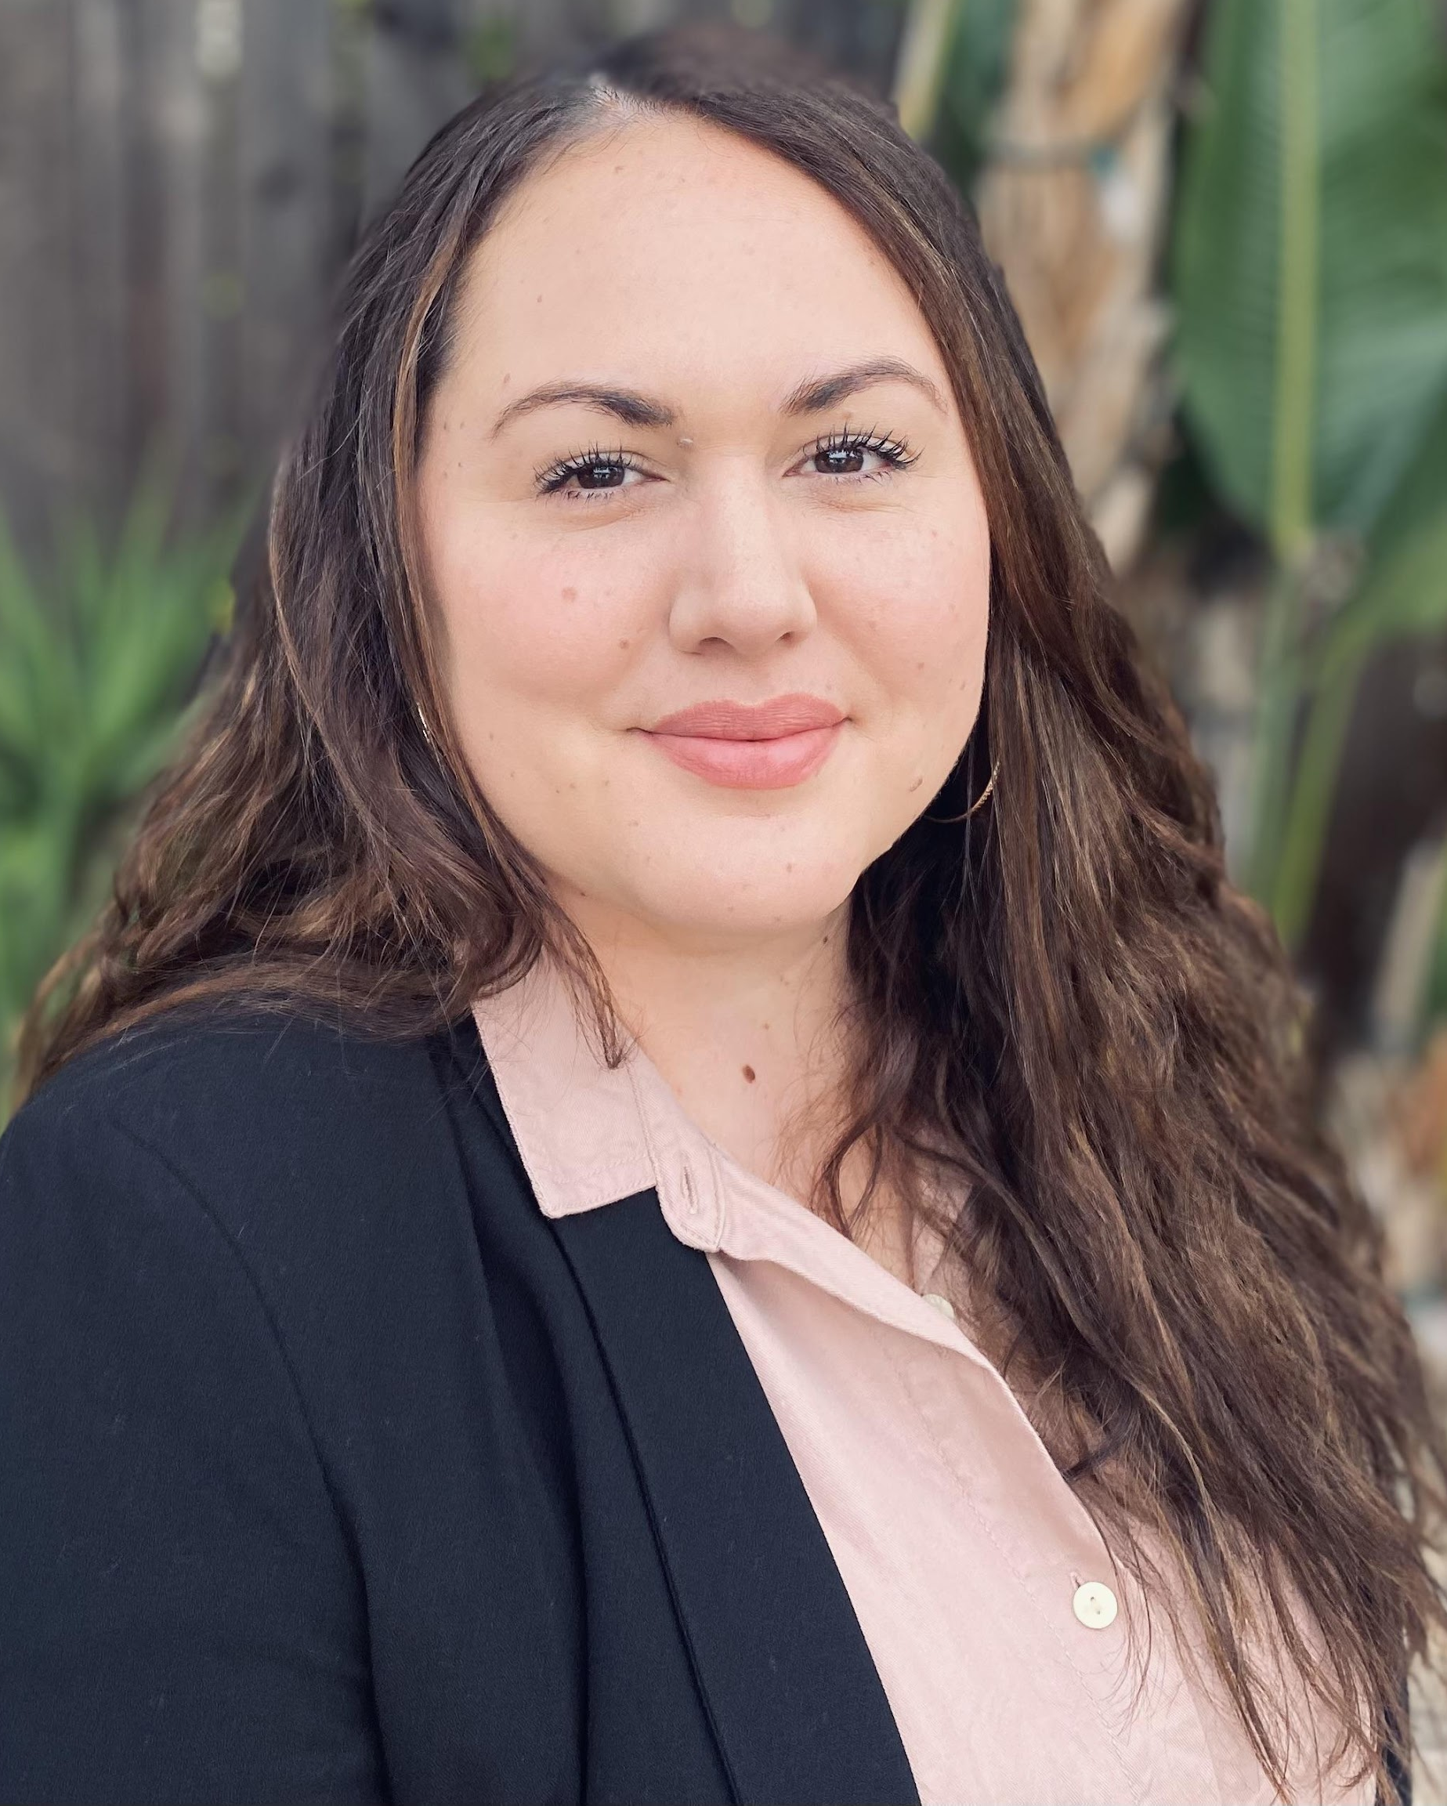
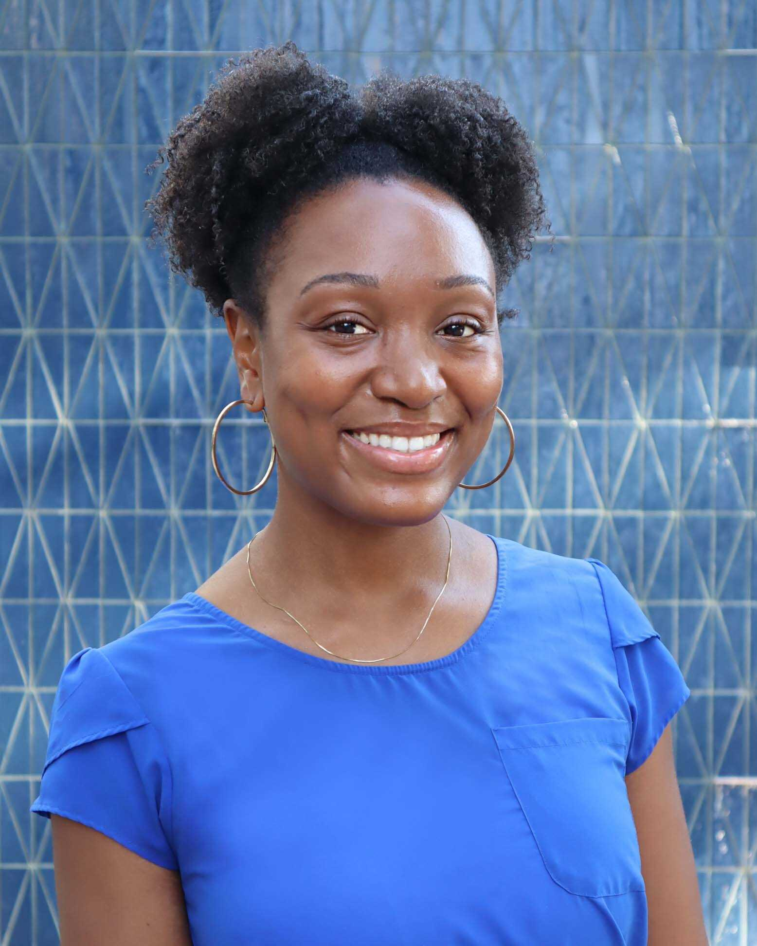
Today’s Presenters
Blaire Willson Toso
Senior Program Manager
btoso@wested.org
Jessica Keach (she / her)
Senior Research Associate
jkeach@wested.org
Ayanna Smith
Program Coordinator II
asmith5@wested.org

Slide 3
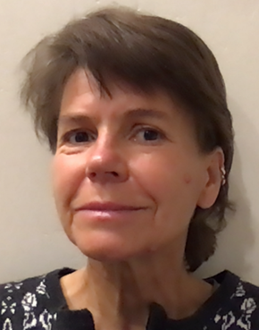
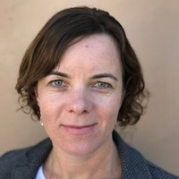
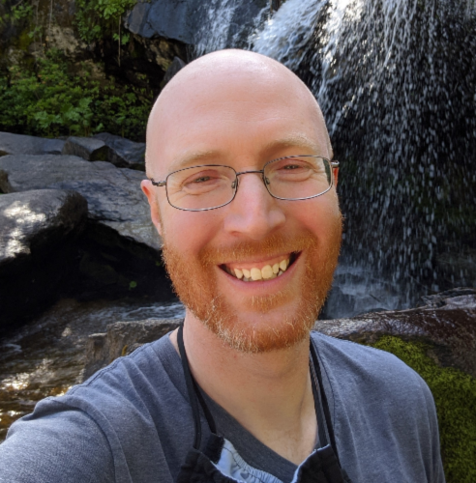
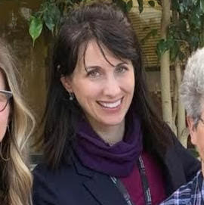
Guest Presenters
Ute Maschke, Ph.D.
CAEP Manager
East Region Adult
Education Consortium
Ilse Pollet
Director
South Bay Consortium for
Adult Education
Rick Abare
Research and Data Analyst
South Bay Consortium for Adult Education
Jenna Cestone
Academic Project Coordinator
Silicon Valley Adult Education

Slide 4
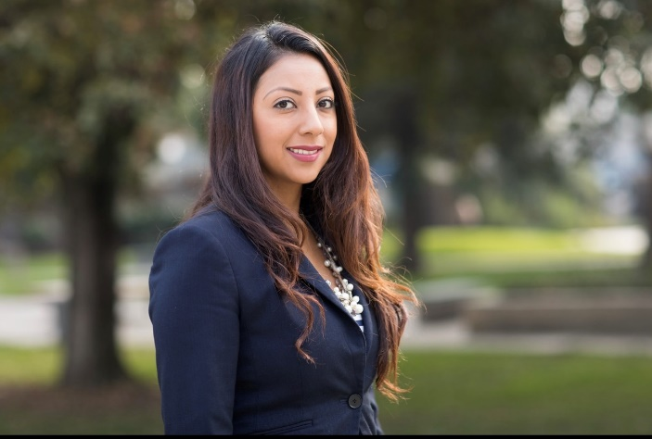
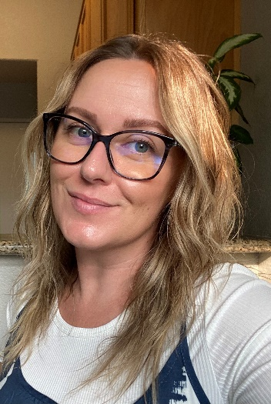
Welcome
Mayra Diaz
CAEP Program Lead
Chancellor’s Office
Lindsay Williams
Program Manager
Chancellor’s Office

Slide 5
Agenda
Welcome
The Continuous Improvement Process
Learnings From the Field
  Rick Abare & Ilse Pollet, South Bay Consortium for Adult Education
  Ute Maschke, East Region Adult Education Consortium
  Jenna Cestone-Greene, Silicon Valley Adult Education
Discussion

Slide 6
Objectives
Identify the four continuous improvement phases
Use the Five Whys to identify and refine the issue
Use data to explore and identify solutions

Slide 7
Step-by-step improvement process
Continuous Improvement Process
Review
Identify
Execute
Plan

Slide 8
Step-by-step improvement process
Continuous Improvement Process
What’s the issue or problem?
What is really going on?
How might we change it?
How might we address the issue?
Review
Identify
Execute
Plan

Slide 9
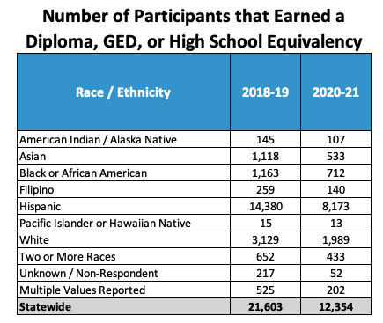
Diploma / GED / HSE Completion by Race / Ethnicity
Note: The number of Participants in ASE declined by 17% during the time period.
Source: LaunchBoard, Adult Education Pipeline Dashboard, Accessed 5/2/22

Slide 10
Jamboard: Define the Problem https://bit.ly/3vQ4Kyg

Slide 11
Discussion: Define the Problem
What problems did you identify?

Slide 12

Determine what’s going on:
Five Whys
Helps dig into the problem
Helps to refine your understanding of the issue and begin to identify strategies
Helps to guide what data you might want to collect.
First Why: Why is this happening? why, why, why, why?

Slide 13

Breakout Group: 5 Whys https://bit.ly/3vQ4Kyg
Move into your breakout group.
Choose a problem identified in the jamboard
Use the jamboard to work through the 5 Whys
8 minutes

Slide 14
Discussion: 5 Whys
What kinds of Why questions did you come up with?
What answers did you come up with?
What new ideas or clarifications did you experience?
How did it refine your thinking about the problem?

Slide 15
Step-by-step improvement process
Continuous Improvement Process
What data do you need to collect to understand the issue?
What activities do you need to collect the data and explore solutions?
What is your timeline?
Who needs to be involved?
Review
Identify
Execute
Plan

Slide 16
Diploma / GED / HSE Completion by Race / Ethnicity
Reminder: The number of Participants in ASE declined by 17% during the time period.
Chat
What data do you need to collect to understand the issue?

Slide 17
Step-by-step improvement process
Continuous Improvement Process
Implement your plan
Are you collecting the correct data? Do you need to collect additional data?
Have you engaged stakeholders?
Are you beginning to see any patterns or trends?
Review
Identify
Execute
Plan

Slide 18
Step-by-step improvement process
Continuous Improvement Process
What did you learn?
What action might you want to take and why?
What are next steps?
And, don’t forget… Continuous Improvement doesn’t stop here!
  How will you know your intervention or strategy worked?
Review
Identify
Execute
Plan

Slide 19
Learnings From the Field
Rick Abare & Ilse Pollet
South Bay Consortium for Adult Education
Ute Maschke
East Region Adult Education Consortium
Jenna Cestone-Greene
Silicon Valley Adult Education

Slide 20

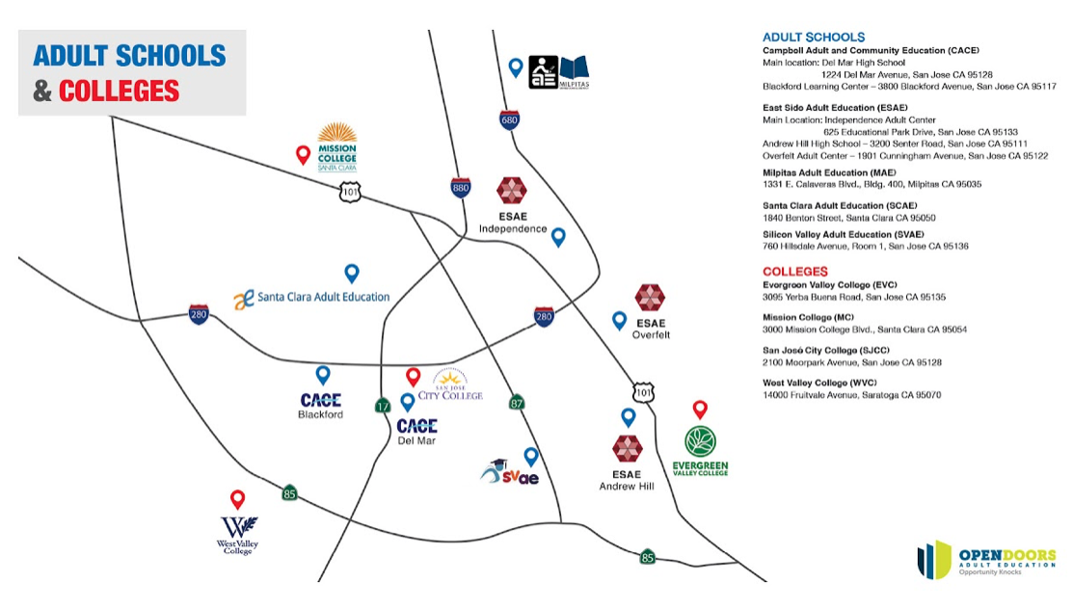
South Bay Consortium for Adult Education
www.sbcae.org
www.opendoorssouthbay.org
https://www.facebook.com/OpenDoorsAdEd

Slide 21


ASE/CTE Orientation
IET Classes
Integrated Educational Training

Slide 22
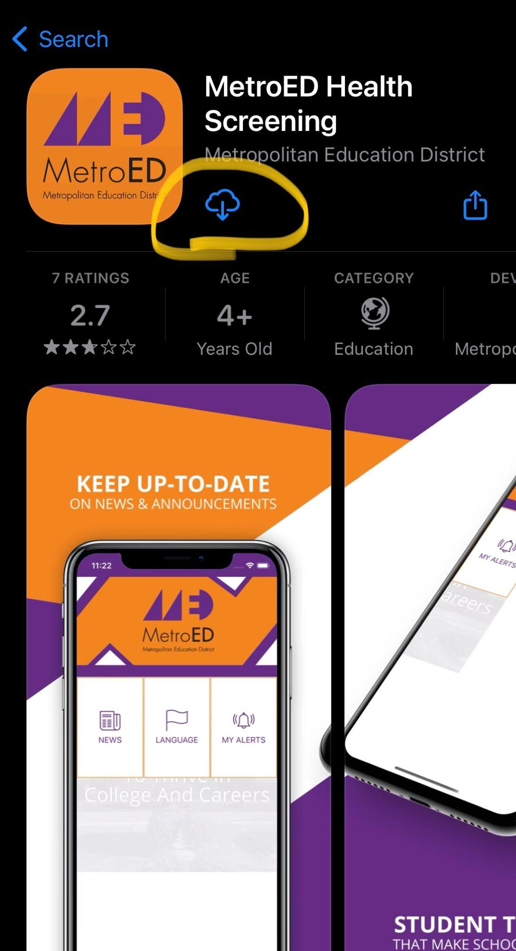
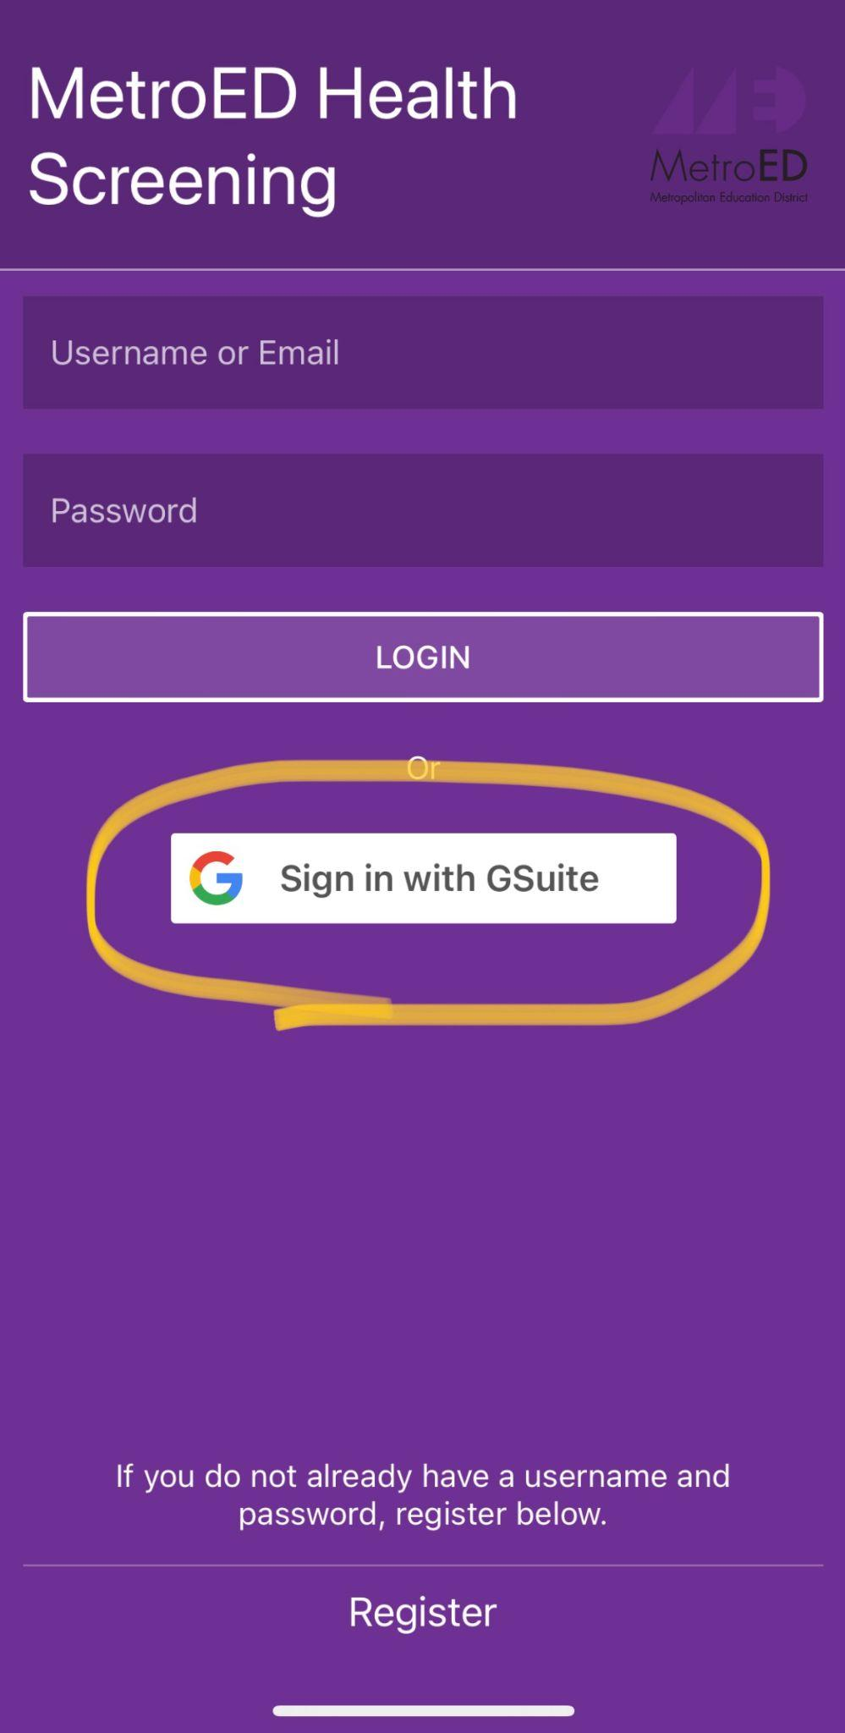
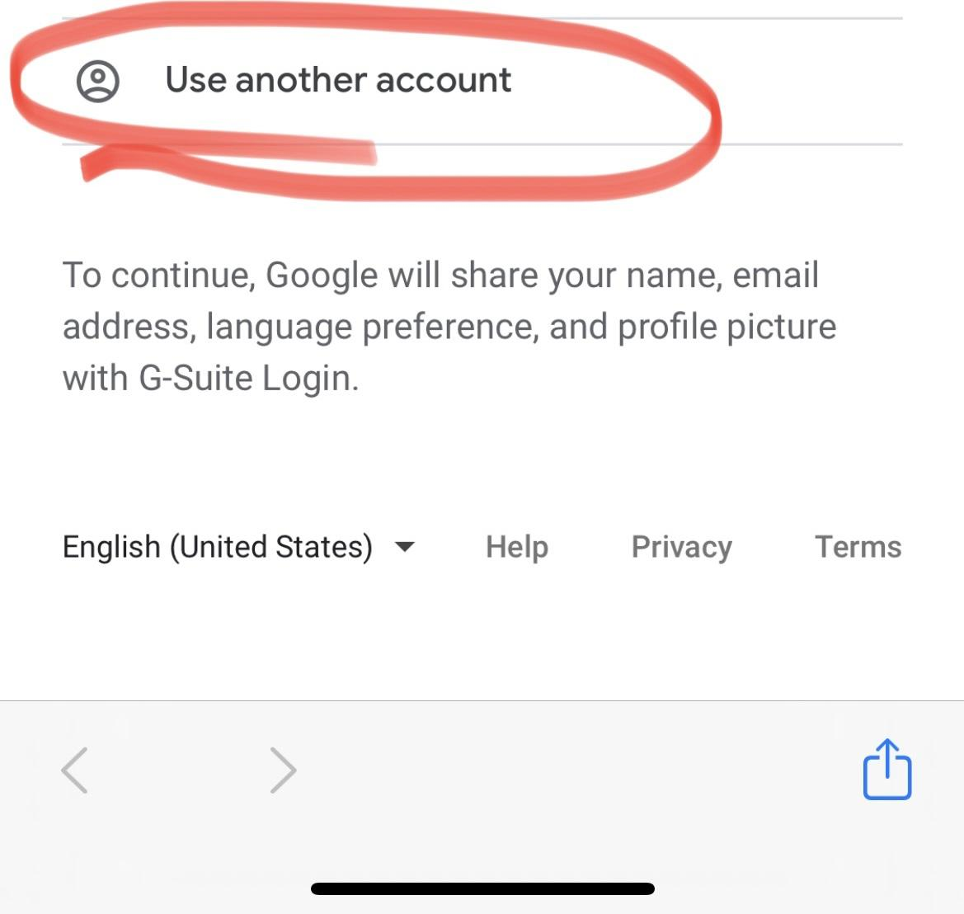
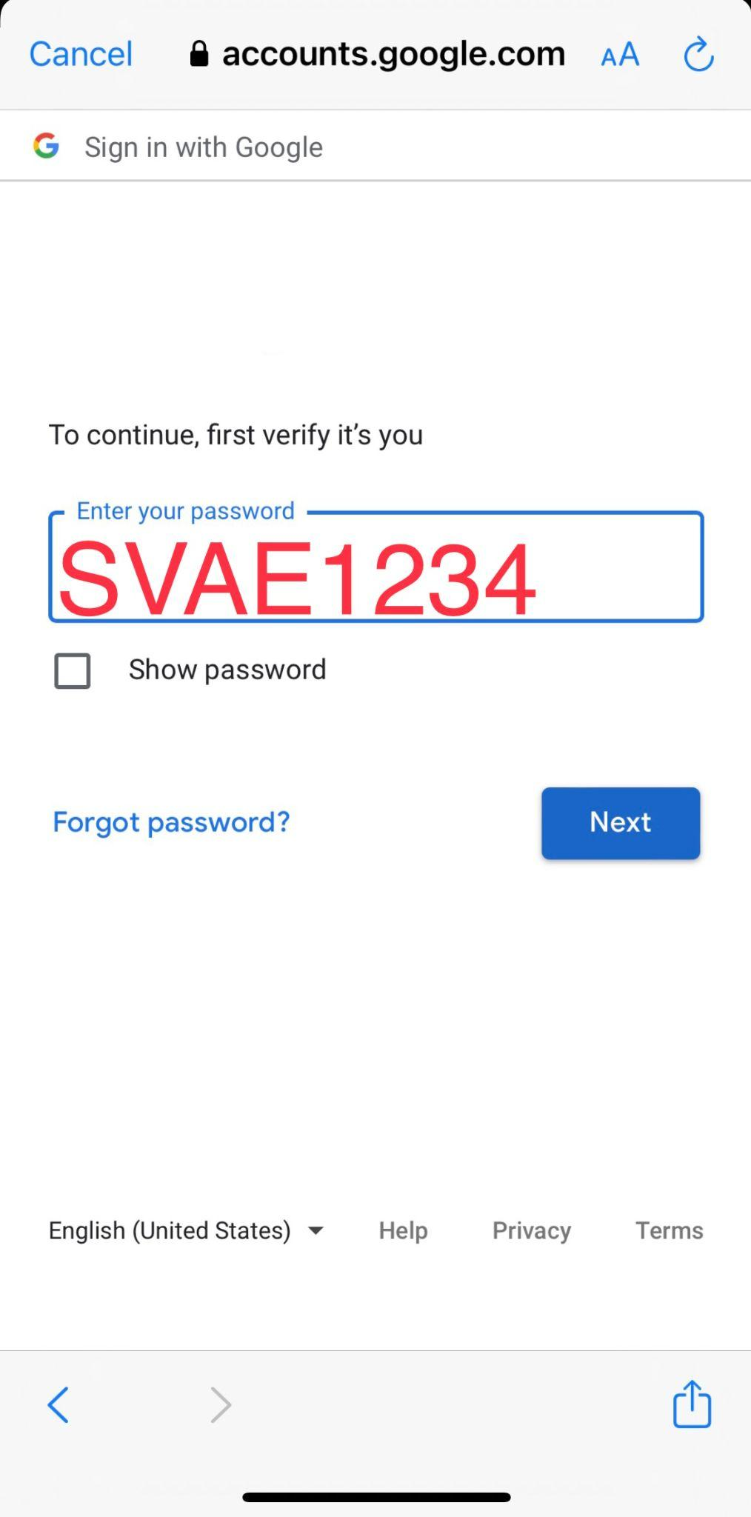
MetroED Health Screening

Slide 23

How can I get a diploma in California?
THERE are 3 options:
Option #1: HSD - High School Diploma Class - 30 units or less to complete.
High School California requirements are 150 credits .
We need your transcripts to evaluate what credits you still need.
Average time to complete one credit is one week. (1 cr. = 1 week, 5 cr. = 5 weeks)
Option #2: HSE - High School Equivalency (GED or HiSET) Class - Test OUT course each of the 5 subjects (Reading, Writing, Social Studies, Math, Science) to pass each of the GED or HiSET tests.
if you have a lot of credits to complete or you want to finish your high school education quickly.
www.GED.com

Slide 24

National External Diploma Program
Option #3
Finish in about 6 months (click here for details)
- all virtual, you don’t come to school every day
Meant for students who have 30+ credits to complete 150 credits
Portfolio Based assessment and review
Pre/Post test in CASAS
IET ready- Students can dual enroll in ESL or CTE classes
Weekly check-ins with teachers or program Supervisor
Learn Technology skills you need for the workplace

Slide 25
How do I finish My High School Diploma in California?
Orientation- 1 hour
HSD
NEDP
HSE
Finish Your Traditional High School- 150 Units
Need Transcripts
Take 4 or 5 tests in our GED/HiSet Class- in person class
All virtual classes- In office checks, finish in 5-6 months
This is a stand alone class- great workforce training option for students who have more than 30+ credits to finish
This is a Test prep class. You prepare and take the test- lost of practice tests
Best choice if you have 30 (or under) units to finish

Slide 26

CLASSES we have for achieving your DIPLOMA
HSD Classes | HSE Classes GED/HiSET | NEDP National External Diploma Program | HSD class + CTE Trades CLASS
AM: 8:45-11:45 M-F PM: 6:00-9:00 M-TH | AM: 8:45-11:45 M-F PM: 6:00-9:00 M-TH | Virtual -online, work from home Check ins by appts | Tues/Thursday Nights 5-9pm Some day classes but space is limited
Need Transcripts R 236 M 230 Usually need under 30 units to finish | Need Transcripts R 236 M 230 (Test Prep Class) Fees* | NO transcripts needed R 236 M 230 Like to work at your own pace | Dual Enrollment= taking 2 classes At the same time

Slide 27

Silicon Valley CTE Courses
Full list is online
You must be concurrently enrolled in the Adult School to get the discounted fee of $1050.00 per course.
(Usual cost is ~ $3780.00!)
ESL + CTE Class= IET
HSE + CTE Class=IET
HSD + CTE Class=IET
Night Class are Tues/Thurs 6-9pm
https://www.metroed.net/svcte/cte-courses

Slide 28

CASAS Test Scores
CASAS Reading | 236 +
ABE Literacy | 193-203
Basic | 204-216
Low Intermediate | 217-227
High Intermediate | 228-238
Low Secondary | 239-248
High Secondary | 249-254 +
CASAS Math | 230+
ABE Literacy | 184-193
Basic | 194-203
Low Intermediate | 204-214
High Intermediate | 215-225
Low Secondary | 226-235
High Secondary | 236-249 +
ABE: Adult Basic Education CLASS
You need 236 in Reading & 230
in Math to move to HSE/HSD
Need to work on your questions you missed, after 2 weeks take the test again.
CASAS test Prep Class
Teachers will go into this more the first week of classes

Slide 29

Information
SVAE Attendance Policy - If you are going to be absent, please call or email your instructor or the office. The phone number for the office is (408) 723-6450.
If you are absent for more than 3 days and we don’t hear from you, you can be dropped. If you are dropped from your class, you will have to re-enroll and go through the CASAs testing and Orientation again.
Technology Agreement - Please read & sign the technology agreement handout.
Other important Information:
-ID Badges - Must be worn at all times
-No food or drink in the classrooms
-Wear your mask at all times
-Do not come to class if you are feeling ill; call the school or your teacher
-No Smoking or Vaping on Campus Grounds (including parking lot)
-No children at school, no pets in cars

Slide 30

CalWORKs is a program providing recipients with:
Cash aid
Free Childcare
Help paying for school (and more)
Eligibility
Low income families
Apply
Online: mybenefitscalwin.org
In-Person:1867 Senter Rd. San Jose, CA 95112
Phone: 408 - 758 - 3800
CalWORKs Services at SVAE

Slide 31
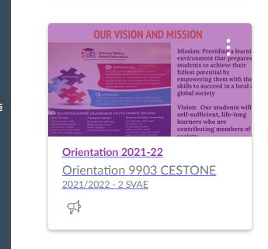
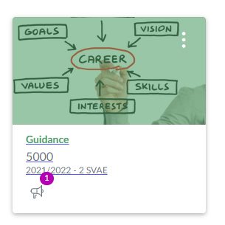
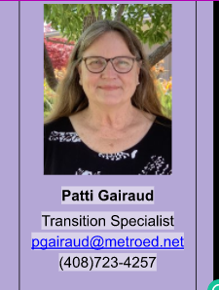
Jenna Cestone- Academic Project Coordinator, Room 3
Leyna Le- Vice Principal at SVAE, Building 1

Slide 32

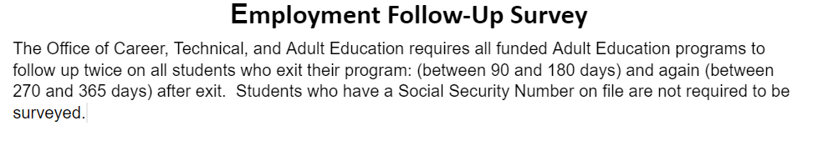

Employment Survey
Look for text or Email from SVAE
Fill out the Survey
It helps us with funding for our school

Slide 33

Thank you for attending Orientation today!
ANY QUESTIONS?

Slide 34
Discussion

Slide 35
Reflecting on Learnings
What is something we discussed that squared with your experience?
What are three points you want to remember?
What is a lingering question still going around in your mind?

Slide 36
Upcoming Webinars
Individual Webinar Opportunities
6/9/2022 | Adult Education Pathways Through Education to Workforce
Two Session Professional Development Opportunities
5/5/2022 & 5/17/2022 | Part I & 2: Exploring Equity in CAEP Programming using AEP Dashboard Data and other Data Tools
6/14/2022 & 6/28/2022 | Part I & 2: Creating Career Pathways Using the Updated Adult Education to Workforce Dashboard Tool

Slide 37
Thank You!
Blaire Willson Toso
Senior Program Manager
btoso@wested.org
Jessica Keach
Senior Research Associate
jkeach@wested.org
Ayanna Smith
Program Coordinator II
asmith5@wested.org

