Slide 1
Exploring Equity in CAEP Programming using AEP Dashboard Data
Session 1
May 5, 2022

Slide 2
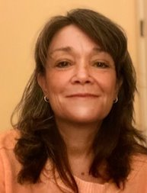
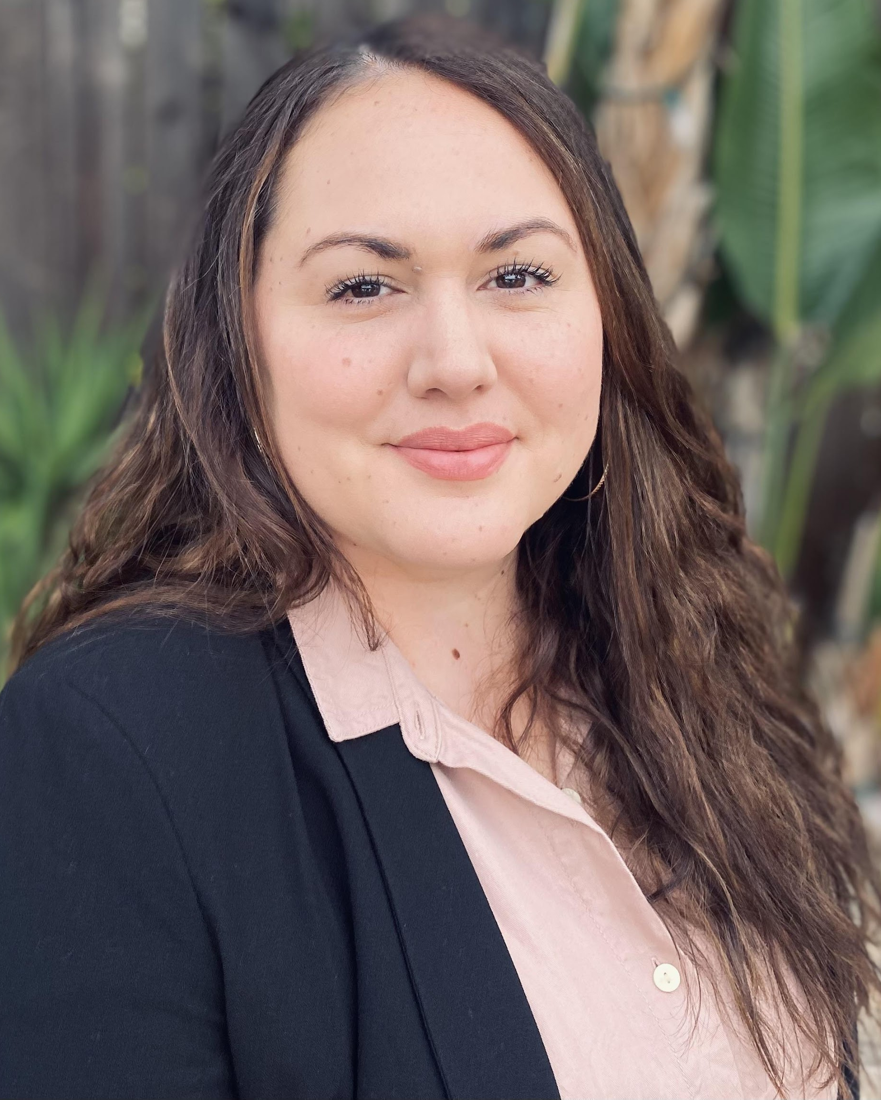
Today’s Presenters
Blaire Willson Toso
Senior Program Manager
btoso@wested.org
Jessica Keach (she / her)
Senior Research Associate
jkeach@wested.org
Ayanna Smith
Program Coordinator II
asmith5@wested.org

Slide 3
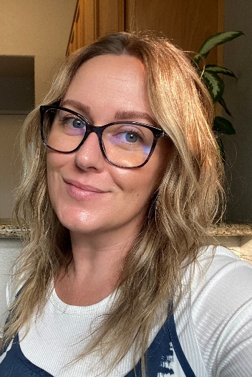
Welcome
Mayra Diaz
CAEP Program Lead
Chancellor’s Office
Lindsay Williams
Program Manager
Chancellor’s Office

Slide 4
Agenda
Walkthrough of Adult Education Pipeline and Related Tools
Let’s Talk about Equity: Discussion
Data Equity Walk
After the Data Equity Walk: What’s next?

Slide 5
Objectives
Define and operationalize equity in adult education
Become familiar with tools and resources to identify equity gaps in your data
Practice using data to inform and ask questions
Identify strategies to further explore and address equity gaps

Slide 6
Adult Education Pipeline and Related Tools

Slide 7
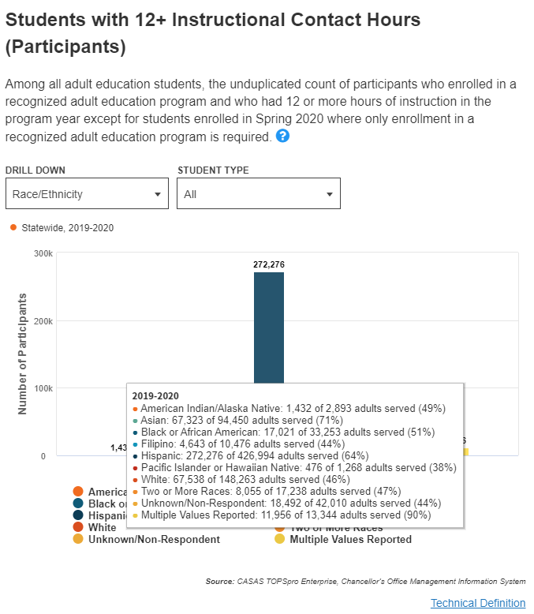
Adult Education Pipeline Dashboard
Who are our current customers?
What characteristics define the populations engaged in the programs we currently offer?
How many and what type of students are in which programs?
What outcomes do our current students achieve?
How do student outcomes compare across different student populations and programs?
Are particular demographic groups achieving outcomes at higher rates than others
How do our outcomes compare to state averages?
Are graduates earning a living wage for the region?

Slide 8
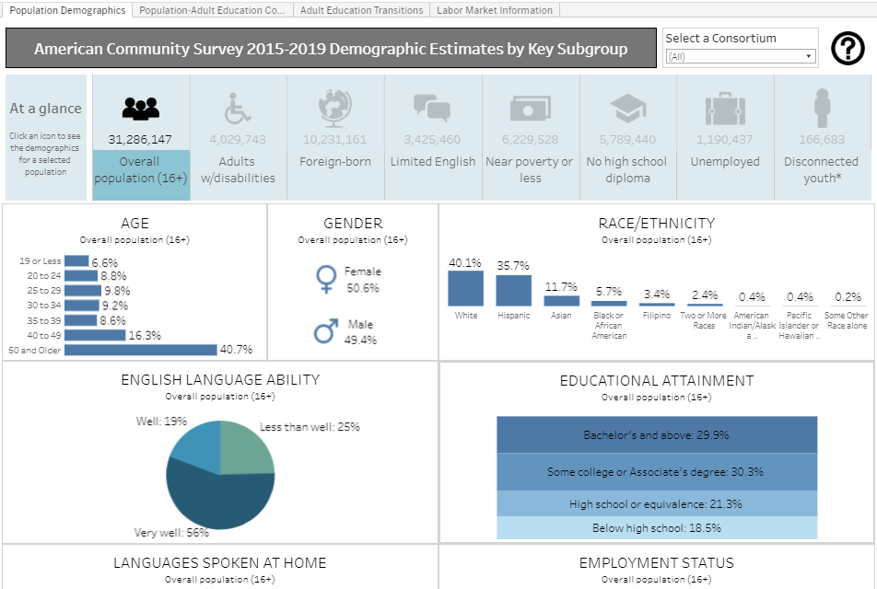
CAEP Fact Sheet: American Community Survey
What characteristics define the regional community?
How do those align with profiles of students currently served by adult education programs?
Who is not being served by adult education and should be served?
What characteristics might be barriers to students coming to programs? (i.e. lack of public transportation; times and days of classes, etc.)

Slide 9
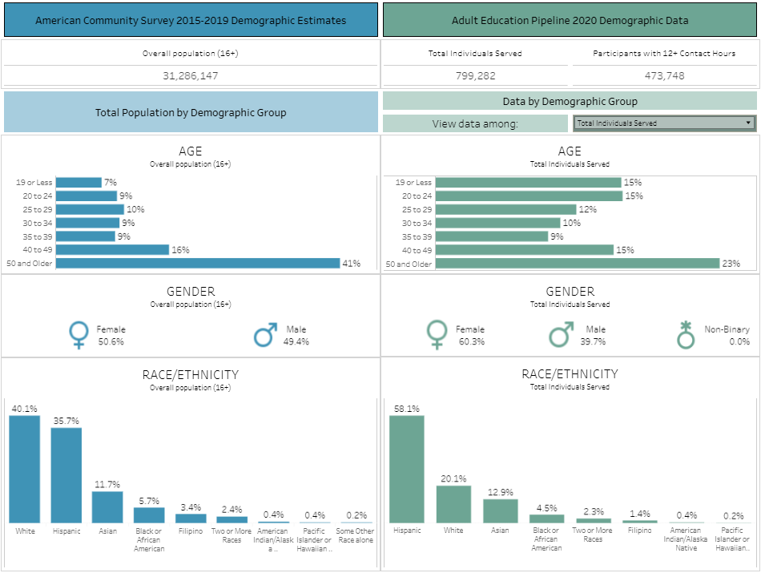
Demographic & CAEP Learner Comparison
How do community characteristics align with profiles of students currently served by adult education programs?

Slide 10
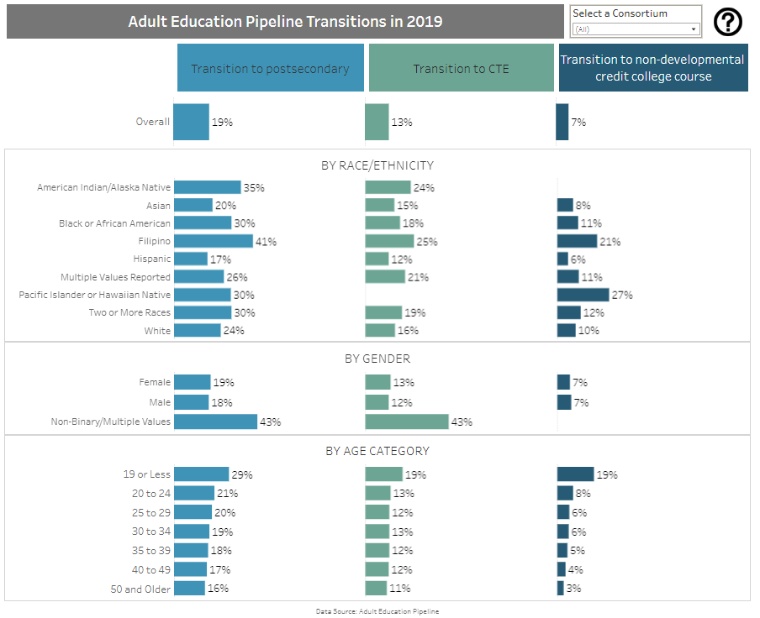
Transitions
What outcomes do our current students achieve?
How do student outcomes compare across different student populations and programs?
Are particular demographic groups achieving outcomes at higher rates than others?

Slide 11
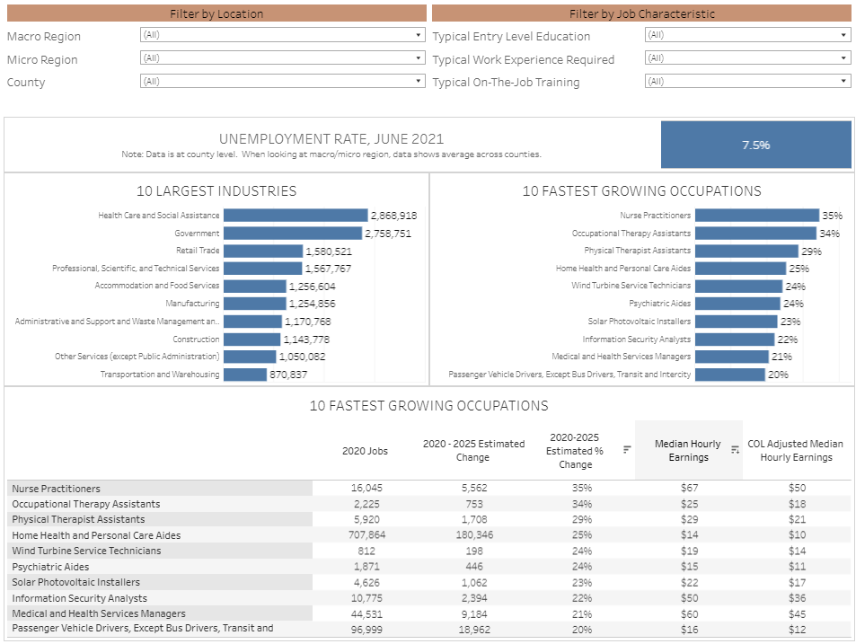
Labor Market Information Data
What industries is the region home to?
What kind of skills are they looking for in their employees?
What kinds of credentials do they value?
Are there new industries expected to be moving into the region?
What needs and goals of students and area employers should be addressed by adult education?
What needs and goals of students and area employers are currently unmet?

Slide 12
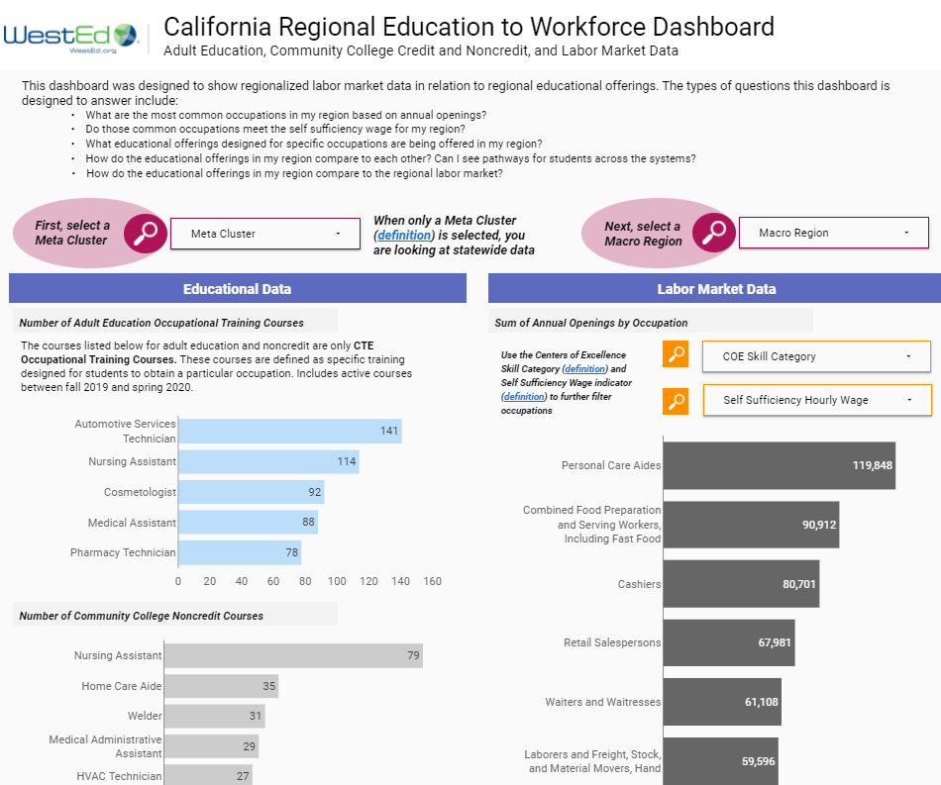
Educational Offerings & Local Labor Market Information
California Regional Education to Workforce Dashboard - User Guide

Slide 13
Let’s Talk about Equity

Slide 14
Our Mindset
As we reflect, let’s remind ourselves to frame our thoughts and inquiry around the systems and programs that exist to serve adult learners. It is important to remind ourselves not to attribute data to the intrinsic qualities of people or groups.
Icon attributed to Flaticon.com

Slide 15
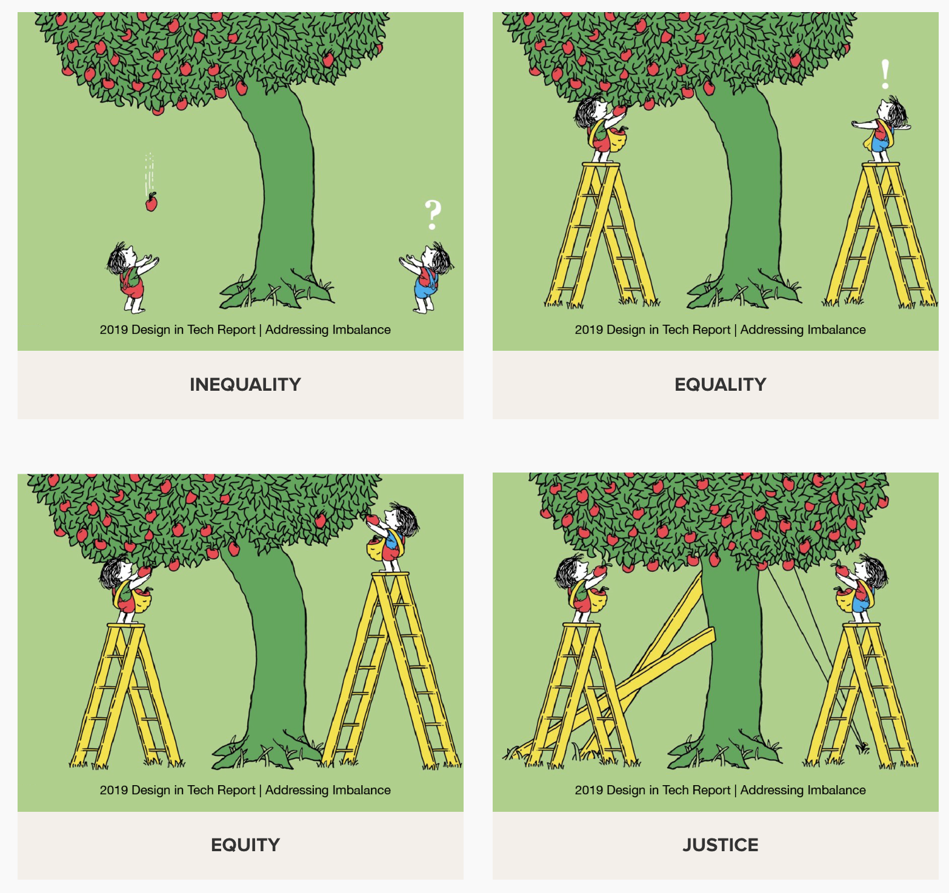
Have you seen this graphic or something similar?
Source: George Washington University, https://onlinepublichealth.gwu.edu/resources/equity-vs-equality/; Original Source: “Addressing Imbalance,” by Tony Ruth for the 2019 Design in Tech Report.

Slide 16
Group Discussion
Jamboard: https://bit.ly/3LBg8Ul

Slide 17
Why do you work in adult education?

Slide 18
What does equity in adult education mean to you?

Slide 19
What are equitable outcomes that you want to see in adult education?

Slide 20
Data Equity Walk

Slide 21
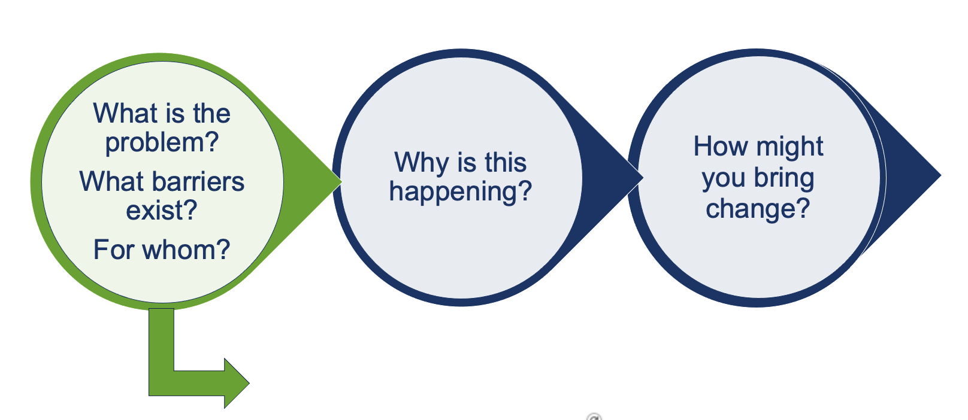
Data Informed Practice: Guiding Questions to Support Planning
Facilitation Technique: Data Equity Walk
Adopted from Ed Trust West's Data Equity Toolkit
https://west.edtrust.org/data-equity-walk-toolkit/

Slide 22
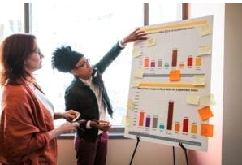
About the Data Equity Walk
“A Data Equity Walk is a 45-90 minute activity for any size audience – high school and college students, teachers, district leaders, community members, or others – to engage with education data and discuss equity issues. Participants dive into data that shows education outcomes and exposes gaps between groups of students. The data usually show district or school performance across different measures like student achievement and school climate.
Participants explore the data individually before collectively discussing implications and identifying solutions to address disparities and improve outcomes. Data Equity Walk participation does not require prior experience with data and is geared toward all audiences.” – Education Trust West
Photo attributed to The Education Trust West
Source: The Education Trust West, Data Equity Walk Toolkit, https://west.edtrust.org/data-equity-walk-toolkit/

Slide 23
AEP Data Equity Walk
We are going to walk through four slides on data from the Adult Education Pipeline.
As we look at data to determine inequities, reflect and record.
Jamboard: https://bit.ly/3sayUKr
As you reflect, remember to frame your thoughts and inquiry around the systems and programs that exist to serve learners. Remind yourself not to attribute data to the intrinsic qualities of people or groups.
Icon attributed to Flaticon.com

Slide 24
What do you notice?
Reflection 1:
Reflection 2:
Reflection 3:
Reflection 4:

Slide 25
What else do you want to know? What additional information do you need as you move forward in the planning process?

Slide 26
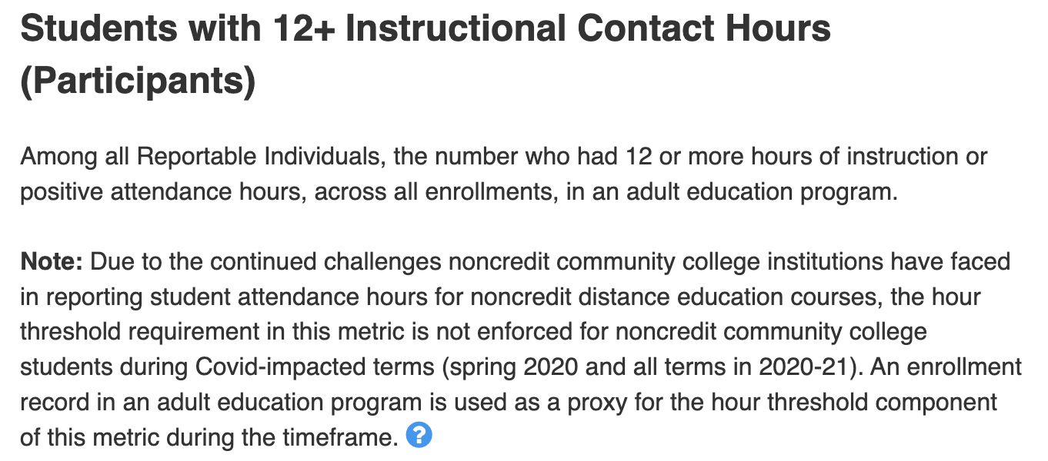
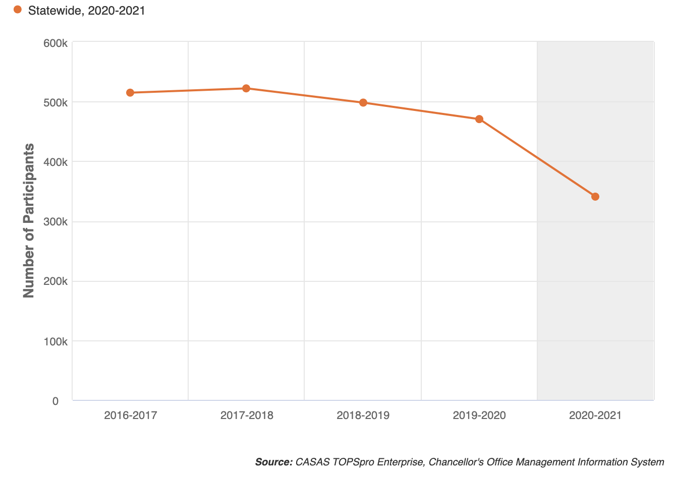
Reflection 1: Decline in CAEP Students During the Pandemic
-32%
Source: LaunchBoard, Adult Education Pipeline Dashboard, Accessed 5/2/22

Slide 27
Reflection 2: Decline in CAEP Students During the Pandemic by Program Area
Source: LaunchBoard, Adult Education Pipeline Dashboard, Accessed 5/2/22

Slide 28
Reflection 3: Decline in CAEP Students During the Pandemic by Program Area and Race / Ethnicity (Change in Participants between 2018-19 and 2020-21)
Source: LaunchBoard, Adult Education Pipeline Dashboard, Accessed 5/2/22

Slide 29
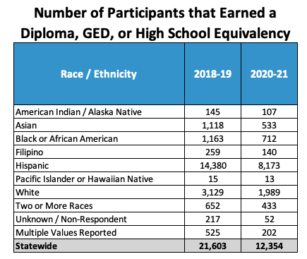
Reflection 4: Diploma / GED / HSE Completion by Race / Ethnicity
Reminder: The number of Participants in ASE declined by 17% during the time period.
Source: LaunchBoard, Adult Education Pipeline Dashboard, Accessed 5/2/22

Slide 30
Discussion
What else do you want to know?
What did you notice?
https://bit.ly/3sayUKr

Slide 31
Resources for Facilitating Conversations at Your Institution
Data Equity Walk Toolkit: https://west.edtrust.org/data-equity-walk-toolkit/
Ground rules and tools for facilitating discussions around diversity and equity: https://www.ucar.edu/who-we-are/diversity-inclusion/community-resources/ground-rules-tools

Slide 32
After the Data Equity Walk: What’s next?

Slide 33
Data Informed Practice: Guiding Questions to Support Planning
Pull additional data: dig deeper!
Collect qualitative data to understand root causes:
Student interviews
Focus groups
Surveys

Slide 34
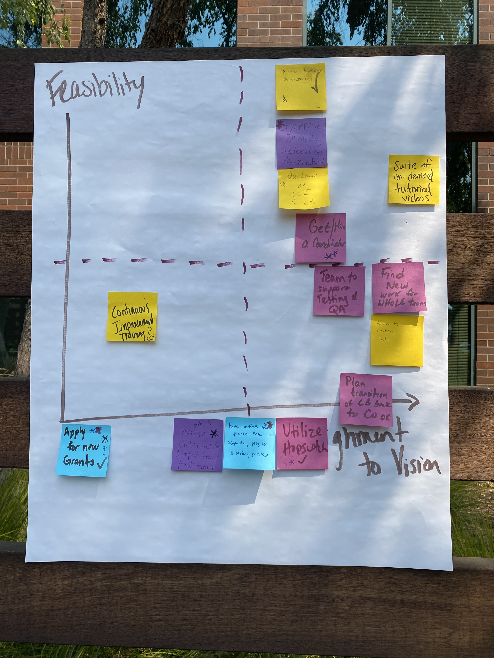
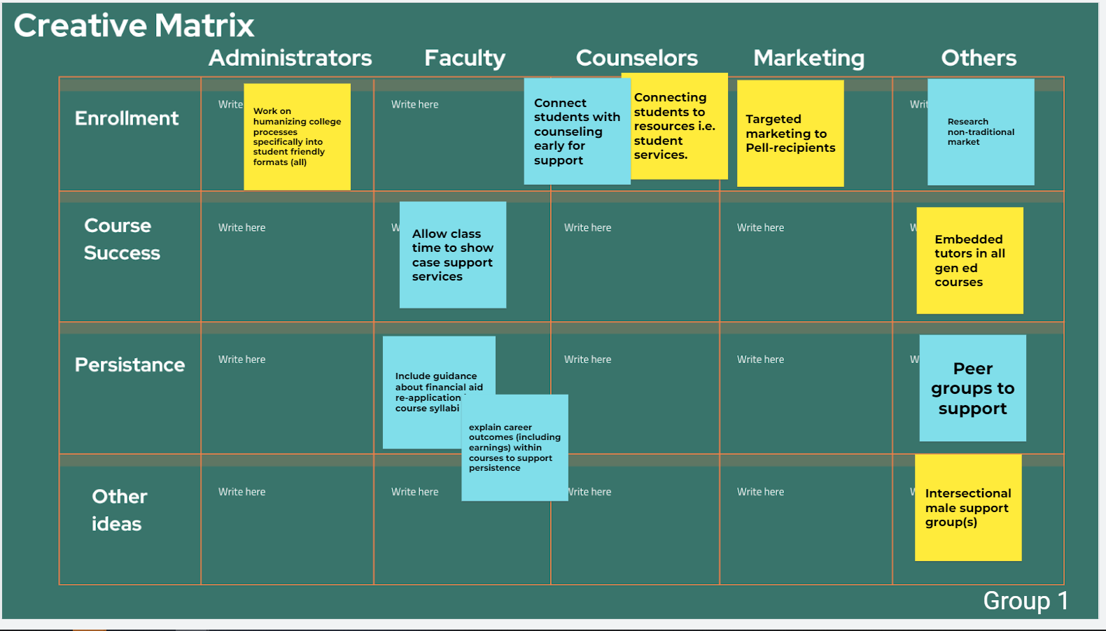
Data Informed Practice: Guiding Questions to Support Planning
Collaborative Planning:
Partner engagement
Collective brainstorming
Resource mapping
Impact feasibility matrix

Slide 35
Final Questions & Thoughts

Slide 36
Upcoming Webinars
Individual Webinar Opportunities
5/10/2022 | Adult Education Pipeline Data for Continuous Improvement and 3 Year Planning
6/9/2022 | Adult Education Pathways Through Education to Workforce
Two Session Professional Development Opportunities
5/5/2022 & 5/17/2022 | Part I & 2: Exploring Equity in CAEP Programming using AEP Dashboard Data and other Data Tools
6/14/2022 & 6/28/2022 | Part I & 2: Creating Career Pathways Using the Updated Adult Education to Workforce Dashboard Tool

Slide 37
Today’s Presenters
Blaire Willson Toso
Senior Program Manager
btoso@wested.org
Jessica Keach (she / her)
Senior Research Associate
jkeach@wested.org
Ayanna Smith
Program Coordinator II
asmith5@wested.org

