Slide 1
AEP 2022 is LIVE: New
Features and Updates to the Adult
Education Pipeline Dashboard
CAEP WEBINAR
APRIL 29, 2022

Slide 2
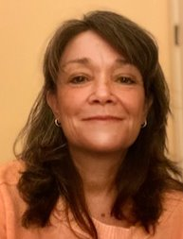
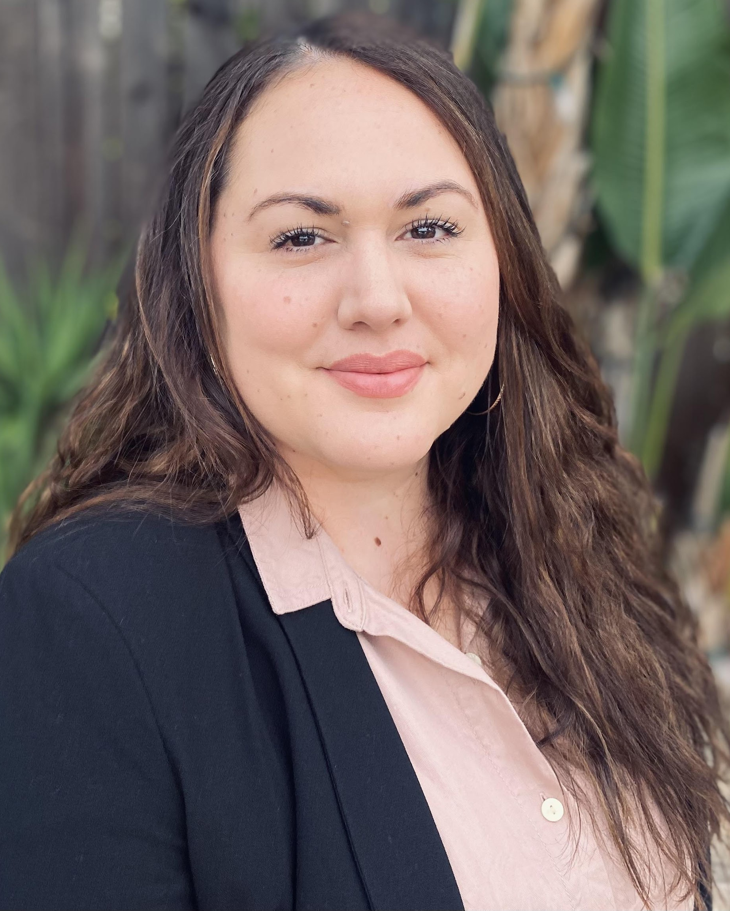
Today’s Presenters
Blaire Willson Toso
Senior Program Manager
btoso@wested.org
Jessica Keach
Senior Research Associate
jkeach@wested.org
Ayanna Smith
Program Coordinator II
asmith5@wested.org

Slide 3
Welcome
Mayra Diaz
CAEP Program Lead Chancellor’s Office
Lindsay Williams
Program Manager
Chancellor’s Office

Slide 4
Today’s Objectives
Review changes implemented on the Adult Education Pipeline
New metrics and features
Key metric changes
Improved user experience

Slide 5
Adult Education Pipeline: Purpose
To improve educational practice and economic mobility for adult learners
To view learner and program data across multiple years and along the learner journey
To serve multiple audiences: administrators, instructors, legislators
To be used by consortia for program planning and track progress on their three-year plans and annual updates submitted to the state
To prompt and answer key questions
To identify consortia who are struggling and may need technical assistance from the CAEP Technical Assistance Provider(s)

Slide 6
Adult Education Pipeline: Highlights
Metrics aligned to the student journey including entry, progress, transition, completion of credentials, and employment
Multiple data sets that include college MIS and K12 Adult Ed (TOPSpro) enrollment data and matching to EDD wage data
Only complete source of college noncredit and K12 AE student data and outcomes
Data source for consortia and institutions used for the development of three year plans (NOVA)

Slide 7
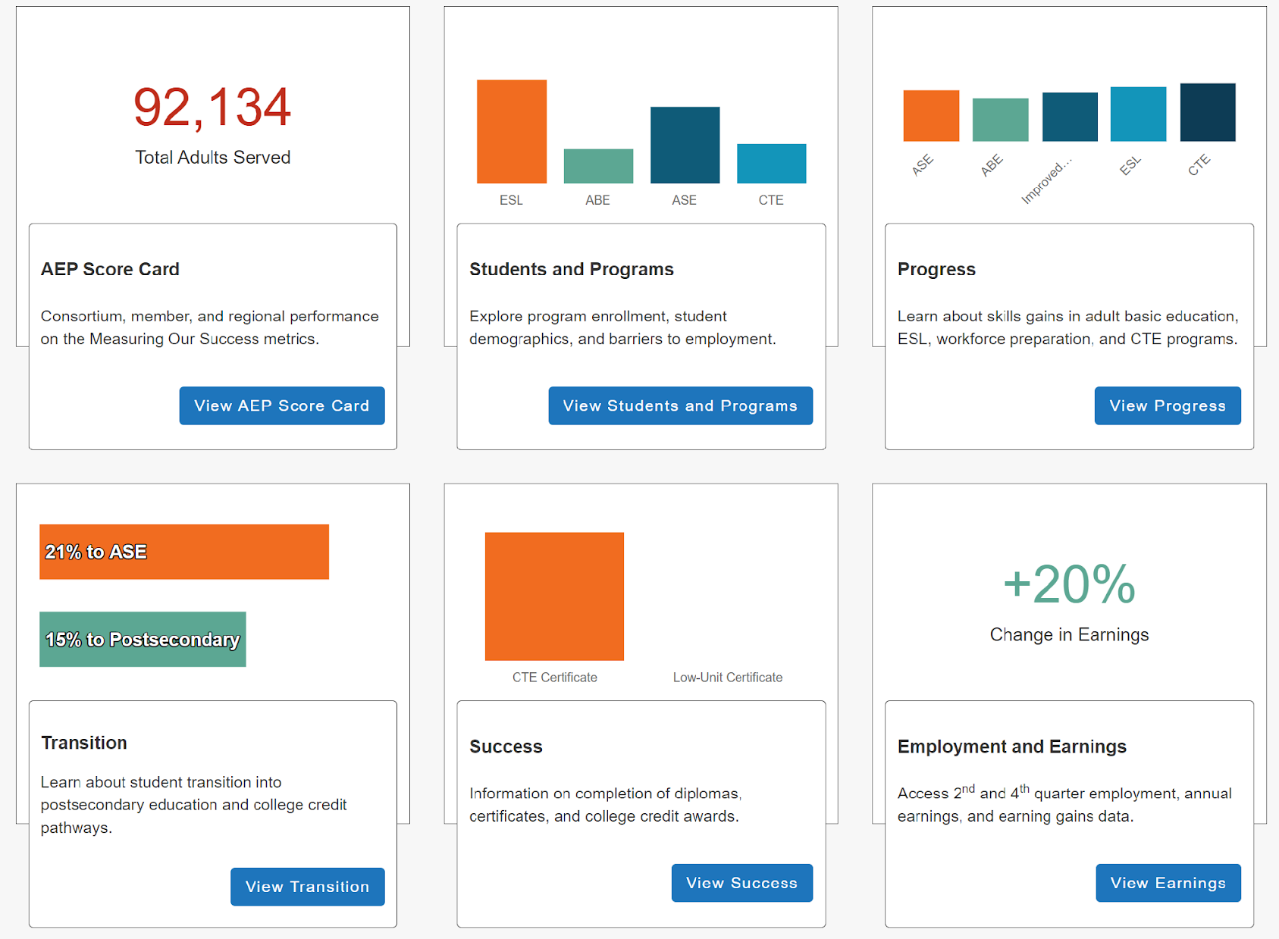
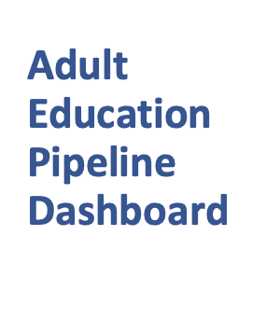
Adult Education Pipeline Dashboard

Slide 8
Why make changes?
ALIGN TO OTHER DASHBOARDS
FEEDBACK FROM THE FIELD
IDENTIFY A CODING ERROR
PRECISION OF DEFINITIONS

Slide 9
New Views and Features
2020-2021

Slide 10
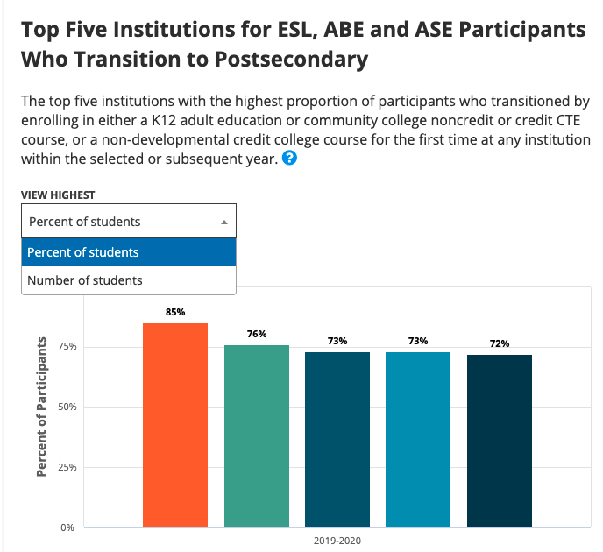
Top Five Institutions Charts
The top five charts that display the top five performing institutions in the Transition, Completion, and Employment sections have been updated to include the ability to display the top performing institutions based on percent of students or number of students.
ESL, ABE and ASE Participants Who Transition to Postsecondary(AE 520)
Participants Earning a Diploma, GED, or High School Equivalency(AE 517)
Participants Who Completed a Postsecondary Credential(AE 518)
Participants Earning a Postsecondary Noncredit CTE Certificate(AE 519)
Employment Two Quarters After Exit(AE 521)
Employment Four Quarters After Exit(AE 514)
Annual Earnings Compared to the Living Wage(AE 705)

Slide 11
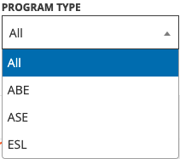
Program Type Drilldown Added to More Metrics
The program type drilldown feature has been added to the following metrics:
Students with 12+ Instructional Contact Hours (Participants)(AE 202)
Participants who Completed an Immigration Integration Milestone (AE 411)
Employment Two Quarters After Exit (AE 505)
Employment Four Quarters After Exit (AE 506)
Participants who Earned a Diploma, GED, or High School Equivalency (AE 633)

Slide 12
Key Metric Changes
2020-2021

Slide 13
Reportable Individuals
In order to align Reportable Individuals (or “Adults Served”) (AE 200) with the California Adult Education Program, the 1-hour threshold used in the calculation has been restricted to 1-hour in a CAEP program area course.
Reportable Individuals (AE 200) The number of learners who had 1 or more hours of instruction or positive attendance hours, across all enrollments, in an adult education program, and / or who received services at a K12 adult school or noncredit services* at a community college.
Previously any noncredit enrollment
Previously allowed for credit-only students who received noncredit services

Slide 14
Reportable Individuals: Impact
More accurate reflection of noncredit community college CAEP students
Reduction of reportable individuals for noncredit community colleges across years
Counts all learners who receive some kind of service provided through an adult education program EXCEPT students that only had credit enrollments
Reduction of reportable individuals for specific noncredit community colleges that previously observed inflated counts across years
Reduction in number of students with barriers to employment across metrics for all years because reportable individuals is the denominator for those metrics

Slide 15
COVID Impact
The Chancellor’s Office recognizes the continued limitation that the noncredit community has faced in reporting student attendance hours in SX05 for noncredit distance education classes.
In last year’s build of the Adult Education Pipeline (version 4.1), the Chancellor’s Office consulted with the noncredit field and determined that the benefit of maintaining the hour-threshold requirement for noncredit students during COVID-impacted terms did not outweigh the cost of excluding students due to their institution’s inability to report student attendance hours. Therefore, during Spring 2020 only an enrollment record (versus hours reported) was required for noncredit community college students to be counted in metrics that require an hour threshold.
Version 5.0 will carry over this decision for the 2020-21 year of data.
Impacted Metrics
Reportable Individuals
Students with 12 or More Instructional Contact Hours (Participants)
Students with 1 to 11 Instructional Contact Hours
Students with an Enrollment in Adult Education Program who Received Services

Slide 16
COVID Impact
Specific impact to noncredit community college student data
Consistent approach, as it was used in AEP 4.1 and treats all colleges the same
Aligns metric definitions between dashboards across the LaunchBoard (ex. SSM)
Participants metric may include students that did not complete 12+ hours for noncredit community colleges
Allows a broad universe of students available to obtain outcome metrics during the time period. Therefore, outcome counts will be available for all institutions. However, because the universe of students available to obtain outcome metrics during the time period is broad, lower rates of outcome attainment may be observed.

Slide 17
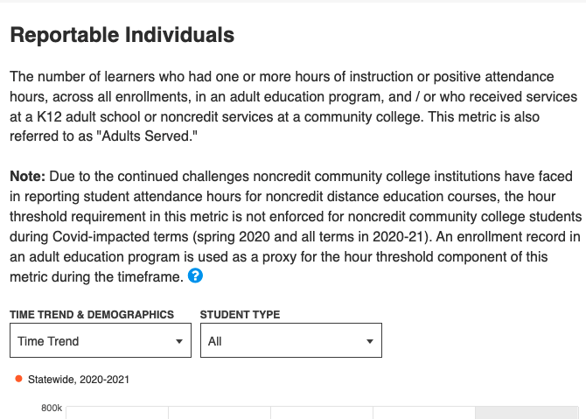
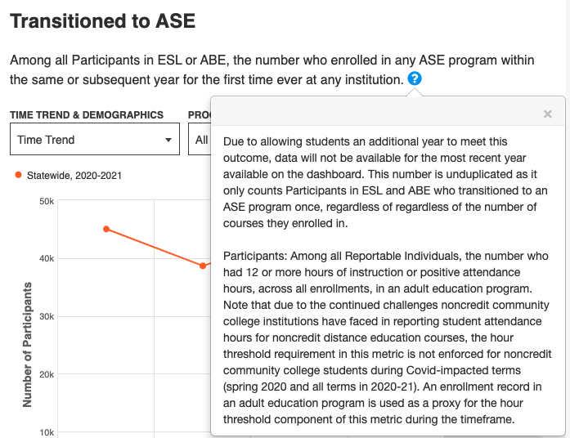
COVID Impact
"Notes" appear on metrics that are not applying the hour threshold in Spring 2020 and 2020-21.

Slide 18
Additional Changes
Age Groups: Age groupings have been adjusted to align with National Reporting System (NRS) categories. Note that these age bands differ from other dashboards in the LaunchBoard.
English Language Learners (AE 305): The COMIS calculation has been updated to align with “ever enrolled in ESL” using the ESL program area definition in Participants in ESL (AE 100).
Long-term Unemployed Reportable Individuals (AE 309): In AEP 4.1, a match against the Employment Development Department (EDD) Unemployment Insurance (UI) file was conducted to determine employment status and count students as long-term unemployed. This process has been removed from the metric calculation.
Low Literacy Reportable Individuals (AE 311): In AEP 4.1, students ever enrolled in ABE or ASE were included as Low Literacy Reportable Individuals (AE 311). After feedback during our pre-release meeting, consultation with the field, and in alignment with the way CASAS TOPSpro Enterprise reports students for WIOA Title II reporting, ESL has also been added to the calculation in AEP 5.0.
Icon attributed to Flaticon.com

Slide 19
Calculation Fixes
Transitioned to Postsecondary (AE 602): Previously TOP code 1260.00 Health Professions, Transfer Core Curriculum was being coded as CTE. Additionally, the calculation was previously counting a student’s first-time enrollment in CTE based on the first time they were enrolled as a Participant in CTE, versus any enrollment in CTE. This has been corrected in AEP 5.0.
Completed a Postsecondary Credential (AE 625): A coding error has been corrected to align with the definition listed in the MDD. In the prior build, the code did not capture all intended certificates and awards. Additionally, the COMIS calculation has also been updated to correct the outcome attainment timeframe to awards earned in the current or any subsequent year. Previously, awards earned prior to adult education enrollment were also included.
Earned a Postsecondary Noncredit CTE Certificate (AE 604): A coding error has been corrected to align with the definition listed in the MDD. In 4.1, the code did not restrict this metric to noncredit certificates in CTE.

Slide 20
Improved User Experience
2020-2021

Slide 21
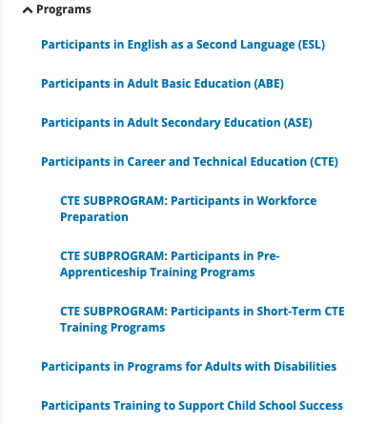
Improved User Experience
Comprehensive review and alignment of metric descriptions
Revised Metric Definition Dictionary (MDD)
Improved tool tip descriptions
Visual improvements – ex. indented submetrics on the left navigation
Icon attributed to Flaticon.com

Slide 22
Resources
2020-2021

Slide 23
Resources to Support Understanding These Changes
Changes in definitions document is posted to the Adult Education Pipeline Dashboard
Metric Definition Dictionary is updated with any new definitions

Slide 24
What do changes look like on the AEP Dashboard
Change is implemented for all years shown
Updated numbers
New displays
New metrics
Additional information

Slide 25
Using Data for Planning
Ask Questions
Identify Trends
Identify Gaps
Set Goals
Identify Thought Partners (e.g., other institutions who can be engaged to discuss solutions, programming, etc.)

Slide 26
Questions & Discussion

Slide 27
Upcoming Webinars
Individual Webinar Opportunities | Individual Webinar Opportunities
5/10/2022 | Adult Education Pipeline Data for Continuous Improvement and 3 Year Planning
6/9/2022 | Adult Education Pathways Through Education to Workforce
Two Session Professional Development Opportunities | Two Session Professional Development Opportunities
5/5/2022 & 5/17/2022 | Part I & 2: Exploring Equity in CAEP Programming using AEP Dashboard Data and other Data Tools
6/14/2022 & 6/28/2022 | Part I & 2: Creating Career Pathways Using the Updated Adult Education to Workforce Dashboard Tool

Slide 28
Thank You
Blaire Willson Toso
Senior Program Manager
btoso@wested.org
Jessica Keach
Senior Research Associate
jkeach@wested.org
Ayanna Smith
Program Coordinator II
asmith5@wested.org

