Slide 1
Managing CAEP Performance and Persistence
April 7, 2022

Slide 2
Managing CAEP Performance and Persistence
3/31 -- CAEP Reports Updates in TE
3/31 -- TE Solutions for Agency and Consortium Level Metrics
Recap: Establishing Local Performance Goals
Using Data to Identify Strengths and Areas for Improvement
Suggestions for Improving Learner Persistence
Suggestions for Improving Pre/Post-Test Performance
Using CAEP Reports to Focus on CAEP Specific Programs and Areas of Performance

Slide 3
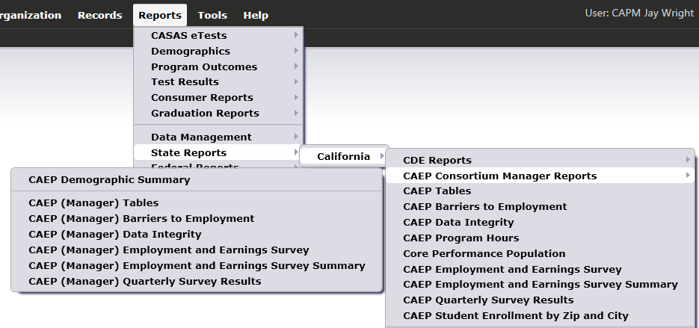
CAEP Reports Updates in TE
Consortium Manager Tables:
I-3 Summary
Student Enrollment by Zip and City
Student Enrollment by Zip and Demographics
Butterfly Hours

Slide 4
CAEP Goal Setting & Targets
Consortium Level Metrics (mandatory)
- Student Barriers & Enrolled Adults
Member Level Metrics (mandatory)
- % of funds spent & number of participants
Optional Member Level Metrics
- list of ten from which to choose

Slide 5
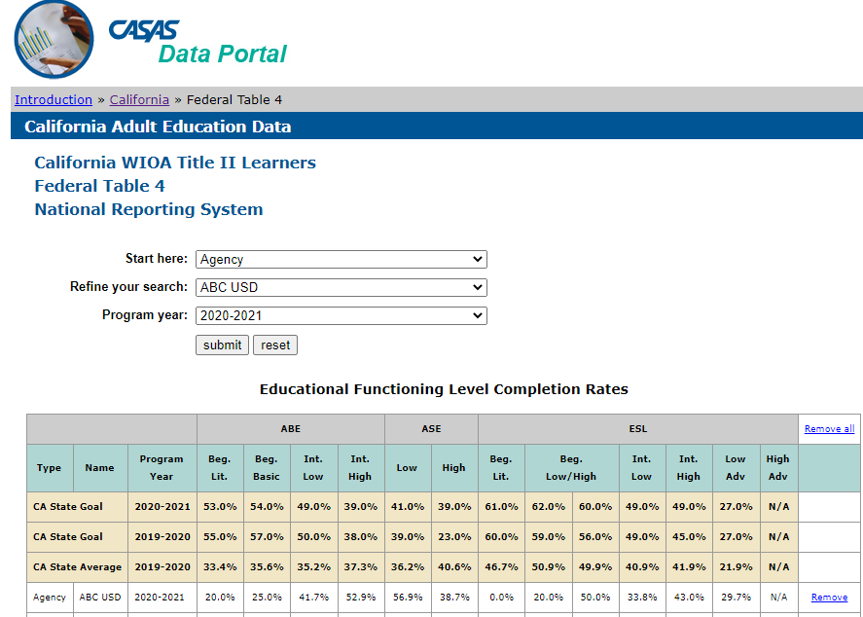
CASAS Data Portal
http: www2.casas.org/dataportal/
Employment & Earnings Survey data from PY 2020-21 now also available!

Slide 6
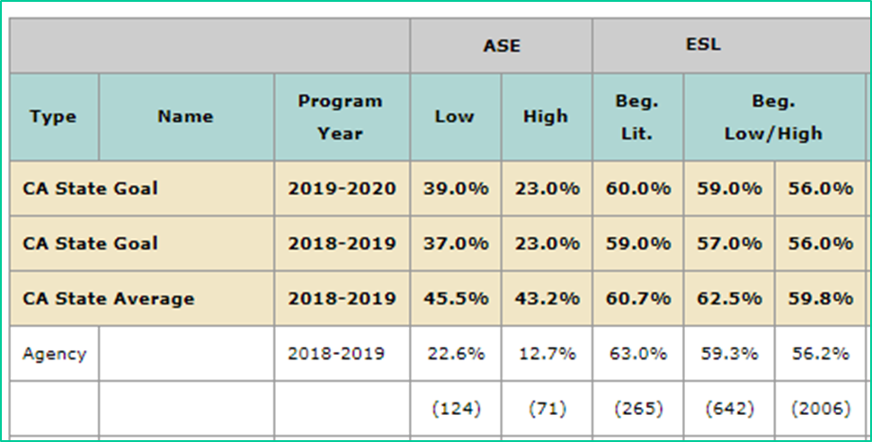
NRS Local Performance Goals: ASE Low/ESL Beginning
Identify EFL’s that represent areas of strength versus others that may need improvement.
ASE Low is an area where this agency may need improvement
ESL Beginning Lit is an area where this agency is performing well.
Notes:
Concludes this section.
Transition to Statewide partner discussion.

Slide 7

Local Performance Goals (a)
How do we begin our work focusing on the areas of improvement?
Target your data to the areas of need
Develop agency and student level strategies that match each area

Slide 8
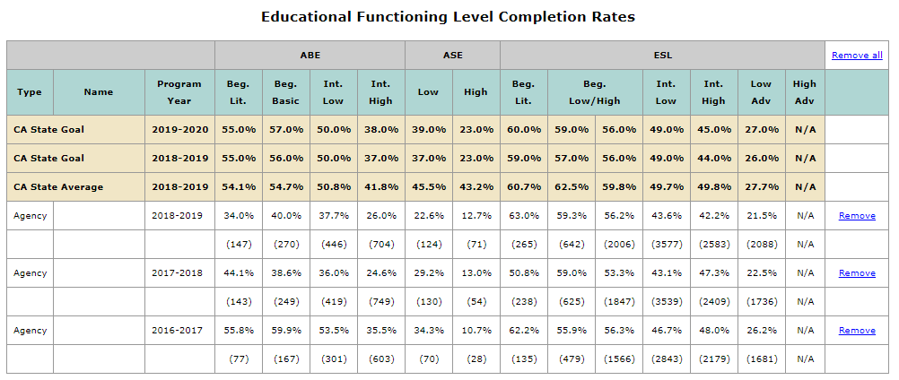
NRS Local Performance Goals
Can you identify any EFL’s besides ASE low that may serve well as targets for NRS Local Performance goals?
ABE Intermediate High may be a good target given that it performs well below the state goals and average.
ASE Low is an area where this agency may also need improvement
Notes:
Concludes this section.
Transition to Statewide partner discussion.

Slide 9
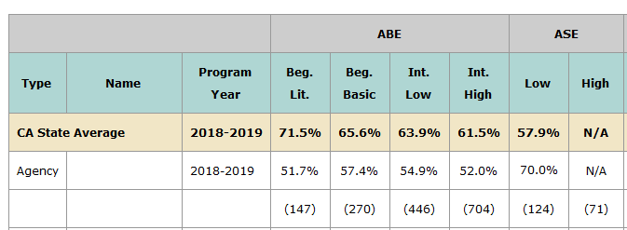
Evaluating Persistence (a)
Focus on the EFL’s with low performance that you targeted in the previous exercise.
ABE Intermediate High is an example where low persistence may be a primary factor in low performance.
ASE Low shows persistence well above average – so most likely there are other reasons for low performance.
Notes:
Concludes this section.
Transition to Statewide partner discussion.

Slide 10
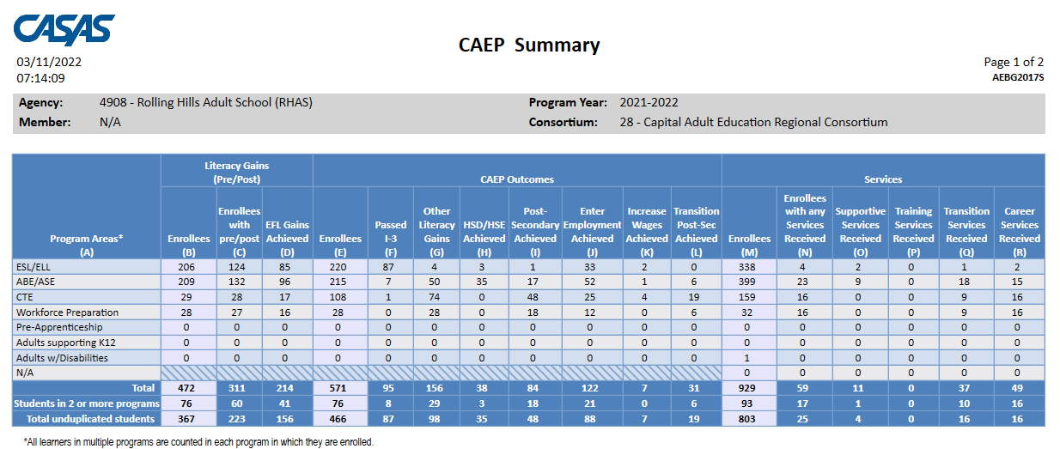
CAEP Summary

Slide 11
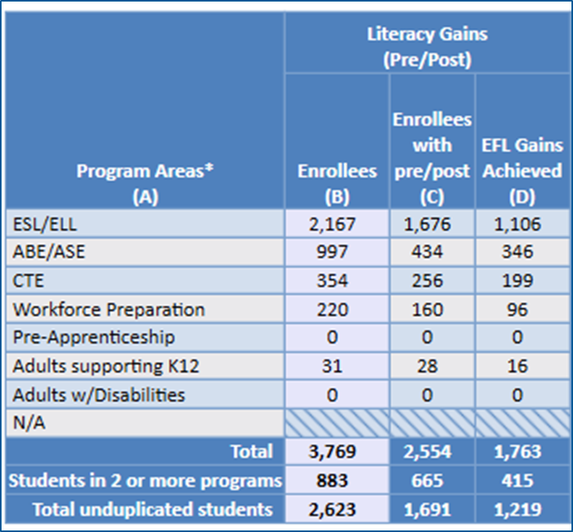
CAEP pre- and post-testing – Use the CAEP Summary
Use the TE CAEP Summary to measure pre/post-test progress.
Refer to the Literacy Gains (Pre/Post) section of the TE CAEP Summary.
Compare pre/post-test pair (C) with total number of enrollees to compute persistence rate.
Compare EFL Gains (D) with total enrollees to compute overall performance.

Slide 12
CAEP Persistence
Refer to the Literacy Gains (Pre/Post) section of the TE CAEP Summary.
Column C ÷ Column B = Persistence Rate
“Good persistence” = 70% or better

Slide 13
CAEP Performance
Refer to the Literacy Gains (Pre/Post) section of the TE CAEP Summary.
Column D ÷ Column B = Performance Rate
This shows the percentage of students in each program that achieved an EFL gain.

Slide 14
Local Performance Goals:
Pre/Post-Test Performance
Has our agency/consortium done well with meeting Performance Goals for NRS/WIA/WIOA II reporting?
Are there any classes, teachers, or groups of students that do noticeably better or worse than others?
Are there specific EFL’s in ABE or ESL that perform better or worse than others?
If we were able to add just 1-2 points to each student’s post-test score… would that make any difference?

Slide 15
Local Performance Goals:
Pre/Post-Test Persistence
Are there any classes, teachers, or levels that do noticeably better or worse than others?
Has our agency/consortium done well with pre/post-test persistence?
How have we responded since COVID?
Do the low performing areas we already identified also need to improve pre/post-test persistence?
Can we improve performance if we solely focus in improving persistence?

Slide 16
Evaluating Persistence (b)
Focus on the EFL’s with low performance that you targeted in the previous exercise.
ABE Intermediate High is an example where low persistence may be a primary factor in low performance.
ASE Low shows persistence well above average – so most likely there are other reasons for low performance.
Notes:
Concludes this section.
Transition to Statewide partner discussion.

Slide 17
Persistence
Lo Performance
Hi Persistence
Hi Performance
Hi Persistence
Lo Performance
Lo Persistence
Hi Performance
Lo Persistence
Performance

Slide 18
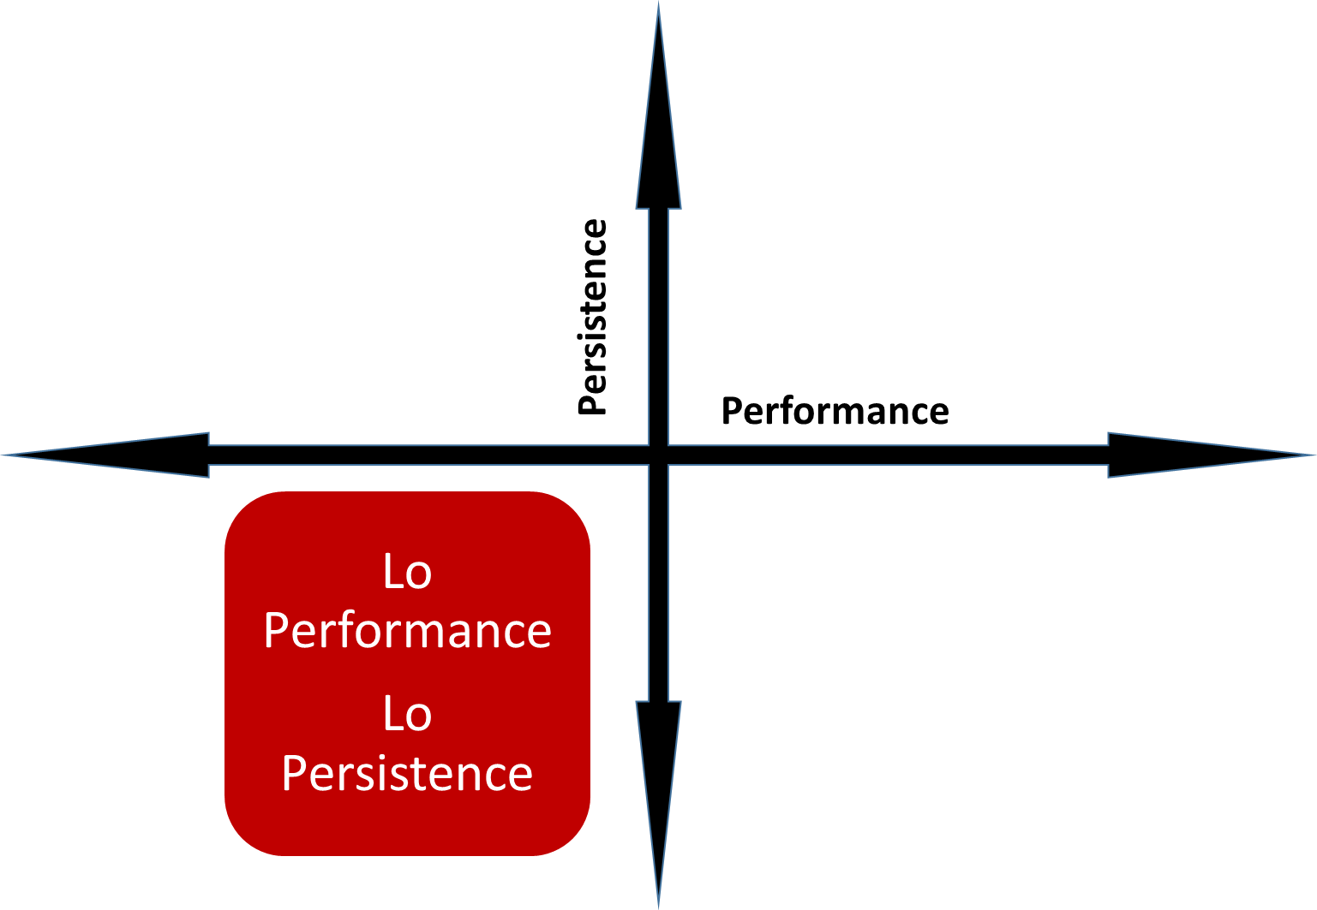
When Performance and Persistence are Both Low (a)
The agency should address basic data clean up first – that is, missing student demographics or attendance hours.
Once basic clean up is complete, then start with the persistence side – specifically, student pre/post-testing rates.

Slide 19
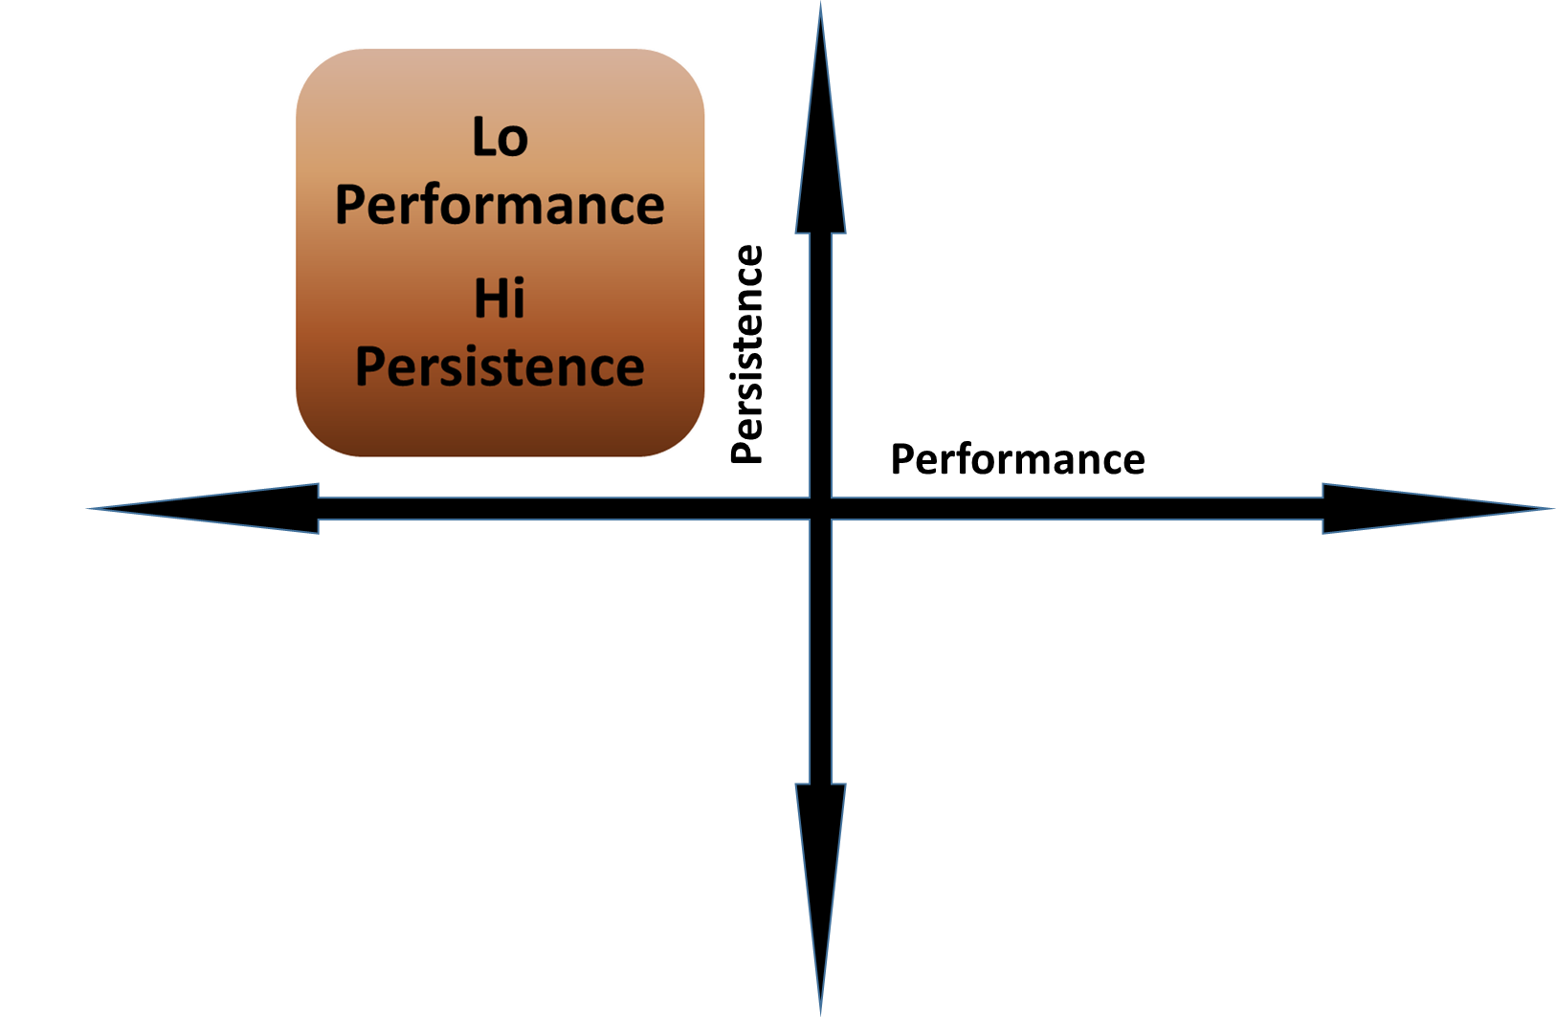
When Performance is Low and Persistence is High
The agency is doing well with completing data collection and testing requirements, but needs to address instruction in the classroom.

Slide 20
Local Performance Goals (b)
How do we begin our work improving the levels we targeted?
Find the “gaps, hotspots, and diamonds in the rough”
Define and follow up with staff, teachers, and students included in the areas you identified

Slide 21
Evaluate & Troubleshoot Selected Levels
Compare longitudinal data for the level(s) you targeted, and identify year to year trends for specific data points that change
“Infiltrate your hotspots” – Identify areas within the selected level that perform the lowest and the highest
Find “diamonds in the rough” that represent strong areas of performance within weak EFL’s
Uncover “what ifs” – highlight specific students who may be retested, “almost” made a gain, or accrue more hours
Compare NRS performance with similar students/classes/ teachers reported under “neighboring” EFL’s

Slide 22
Define Who Represents Your Selected Levels
Select specific teachers, classes, students, affected by selected NRS level or CAEP Program
Interview key staff and students
Identify at least one strong pocket of performance and at least one that needs improvement
Solicit ideas for improving persistence
Solicit ideas for improving performance in the classroom

Slide 23
When Performance and Persistence are Both Low (b)
The agency should address basic data clean up first – that is, missing student demographics or attendance hours.
Once basic clean up is complete, then start with the persistence side – specifically, student pre/post-testing rates.

Slide 24
When Performance and Persistence are Both Low (c)
TE Reports to Improve Persistence:
“Roster” Reports –
  Student Test Summary
  Student Gains
  Next Assigned Test
Instructional Hours Reports
Enrollees by Hours
Services Enrollees by Hours
NEW: Enrollees by City and Zip
NEW: Butterfly Hours

Slide 25
When Performance and Persistence are Both Low (d)
TE Reports to Improve Persistence:
DIR
  Items 8-9-10 (Item 10a especially)
  Items 22 a-b-c
CAEP Reports
  NRS Monitor
  CAEP Outcomes
  CAEP Enrollees by Hours
  New: Butterfly Hours
Consider “CAEP logic” vs “DIR logic”

Slide 26
Local Performance Goals:
Troubleshooting Persistence
Which classes, teachers, or groups of students do noticeably better or worse than others?
What is the difference in feedback from teachers and students in higher performing classes? From lower performing classes?
Do teachers receive regular communication from your agency about who is responsible for testing and collecting student attendance?
Do students in turn receive regular feedback about this from teachers?

Slide 27
When Performance is Low and Persistence is High (a)
TE Reports for Performance Improvement:
DIR Items 10 a-b (10b especially)
NRS Monitor
CAEP Outcomes
I-3 Summary

Slide 28
When Performance is Low and Persistence is High (b)
TE Reports for Performance Improvement:
Test Results Reports
  Content Standards/CCRS
  Competencies
  Individual Skills Profile
  Refer to “Curriculum Management & Instruction” section of CASAS Web

Slide 29

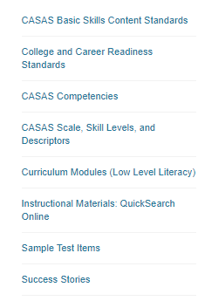
Curriculum Management & Instruction (a)

Slide 30
Curriculum Management & Instruction (b)
Related TE Reports & TE Report Issues
2009 CASAS Content Standards. Still applicable to Life and Work Reports – Test Results – Content Standard
2016 CCRS. Used in GOALS, and will be used in the new CASAS tests. Reports – Test Results – Content Standard
Reports – Test Results - Competency
Included in Individual Skills Profile
Could be used for placement of low level ABE/ESL Referral for “Does not have skills…”
Filter for competency or content standard Filter for special program or modality

Slide 31
Local Performance Goals:
Troubleshooting Performance
Which classes, teachers, or groups of students do noticeably better or worse than others?
What is the difference in feedback from teachers and students in higher/lower performing classes? Is there any difference between teachers and students?
Are teachers empowered to identify and employ best practices for student learning?
Are students able to relate class activities to personal goals and assessment results to instruction?

Slide 32
Troubleshooting Suggestions for ABE/ASE:
“What if” ABE/ASE students made more pre/post gains, accrued hours, etc.
Organize data into three buckets – 1) ABE; 2) HSE; 3) HS Diploma
Modify, if necessary, into two buckets – 1) ABE; 2) ASE
For ASE only – compare HSE students vs HS diploma program students
Compare math scores vs reading scores
Identify students at higher levels who may have scored “too high” on the pretest to achieve an EFL gain
Compare pre/post outcomes to HS diploma credits progress for students in high school diploma
Relate pre/post results to HSE attainment/HSE sub-section progress
Compare GED vs HiSET, if applicable
Evaluate by HSE/HS subject area
Notes:
Drill down to get more info

Slide 33
Troubleshooting Suggestions for ESL
“What if” ESL students made more pre/post gains, accrued hours, etc.
Organize data into buckets that separate students in EL Civics from “regular” ESL students
Modify to further separate students by ELC focus area
Modify to compare students in IET/workforce training
Compare listening scores vs reading scores
Identify students at higher levels who may have scored “too high” on the pretest to place into an ESL level
Compare NRS pre/post outcomes to success on ELC COAAP’s
Compare by key demographics factors important to your local region
Notes:
Drill down to get more info

Slide 34
Troubleshooting Suggestions for CTE
“What if” CTE students made more outcomes, accrued hours, etc.
Organize data into buckets that separate students in CTE from programs such as Pre-Apprenticeship or Workforce Preparation
Use alternative persistence measures using instructional hours if applicable
Modify to separate students by CTE occupation, CIP, or course code
Modify to compare students in IET/or with co-enrollment in both ABE/ESL
Compare “other literacy gains” (such as occupational skills gain)
Compare and contrast specific outcomes for Transitions and Post-Secondary
Strengthen ties with regional partners such as the AJCC
Ensure agency outcomes relate to regional priorities
Compare by key demographics factors important to your local region
Notes:
Drill down to get more info

Slide 35
Troubleshooting Suggestions– Special Programs
“What if” students in specific Special Programs – or students with specific Barriers to Employment - made more pre/post gains, accrued more hours
Identify key special programs (or barriers) at your agency, and the specific EFL’s relevant to this population (for example, issues with Adults with Disabilities could be reflected by ABE 1/Beginning Literacy).
Isolate students with special needs or specific barriers to employment
Compare data from students enrolled in the Special Program vs everyone else
Evaluate students in distance learning vs hybrid/hyflex vs f2f instruction
Evaluate students with “workforce” connections such as IET, VABE/VESL, workforce preparation, or WIOA Co-Enrollment
Relate data to students receiving short term services
Notes:
Drill down to get more info

Slide 36
Systems in Place to Support
Local Performance Goals (a)
Review feedback to identify improvements for student orientation, managed enrollment and attendance policy
Identify areas to improve student class and level placement and scheduling pre/post-testing
Review feedback to identify any needs for new curriculum and lesson planning materials
Administer short term services to address student needs that might affect classroom learning

Slide 37
Systems in Place to Support
Local Performance Goals (b)
Share feedback and solutions with teachers, data managers and other staff to ensure universal understanding
Ensure students are included in every step of the process
Use information from interviews to bolster collaboration with regional partners
Encourage “360 degree” feedback from students, regional partners, and other stakeholders
Develop a “culture of data” at your agency

Slide 38
Systems in Place to Support Performance Goals
Local Assessment Policy
Targeted instruction
Supported and Training Services
Regular data reviews
Clear channels of communication
Regional Collaboration
360 Degree Feedback

