Slide 1


CB 21, Educational Functioning Levels, and Curriculum Alignment:
Seeking Possibility and Opportunities
July 22, 12:00pm – 1:00pm

Slide 2

Presenters
WestEd
  Randy Tillery, Area Director, Workforce Development and Postsecondary Education rtiller@wested.org
  Blaire Toso, Senior Program Manager, Workforce Development and Postsecondary Education btoso@wested.org
  Jessica Chittaphong, Program Coordinator & AEP Dashboard Manager, Workforce Development and Postsecondary Education jchitta@wested.org
Cypress College
  Alison Robertson, Professor of ESL arobertson@cypresscollege.edu
Glendale Community College
  Jan Young, Division Chair Noncredit Business and Life Skills, Continuing Education,, jyoung@glendale.edu

Slide 3
Agenda
Intros
AB705
    Why Should CB21 Matter to Adult Educators?
    Rubrics
AEP Dashboard
Voices From the Field

Slide 4
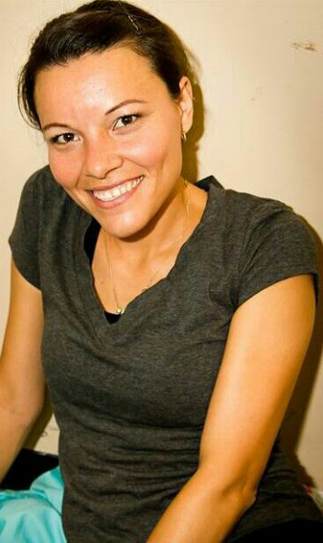
Meet the Student
Student at a California community college who started in the ESL program
Completed the noncredit ESL program, earned a Cosmetology Certificate, and is now pursuing both an AS and an ADT in Accounting
Would like to be able to work legally in the US and to earn a bachelor’s degree

Slide 5
Where she started
Grew up in Guadalajara, where she finished high school was studying accounting at a university
Moved to the US at age 21, with no English skills
Started taking ESL classes at the neighborhood adult school and a teacher recommended enrolling in a community college ESL program
For two years, took high school equivalency classes at the adult school in the morning, took higher-level ESL courses at the college in the afternoon, and took Cosmetology courses at night

Slide 6
She is succeeding despite the odds
Benefitted from a counselor who helped her get aid and explained what her options are as an undocumented student
Is deeply thankful to teachers who urged her to pursue her dreams, despite significant set-backs
Noted the biggest challenge in the credit-to-noncredit transition is the relative lack of connection to faculty on the credit side of the college
Urged fellow students to convince teachers that they are serious about their work, even if life circumstances make it difficult to get work done

Slide 7
Definitions and Acronyms
CB21: A Course Code in MIS that identifies the course level below the college level course for math, English, and ESL. Based on a rubric developed by faculty and the academic senate. Student progress is measured by course progression to higher level courses.
Educational Functioning Level: Federally determined rubric for assessing an adult learner’s level of skills in math, English, or ESL. Student progress measured by pre and post testing with Federally approved instruments such as CASAS, TABE, and others. Developed and informed by faculty and psychometricians. Used for reporting student progress under WIOA Title II funded programs.
Understanding both these frameworks is critically important to the work of increasing access to postsecondary and college programs for adult learners in K12 adult education and college noncredit programs

Slide 8
Why Should CB21 Matter to Adult Educators?

Slide 9
AB104 (2015) – AEBG/CAEP
CAEP sets the goal, AB705 sets the rules
AB705 (2017)
Required alignment of assessment processes for placement into courses
Increased emphasis on transition into post-secondary and completion of post-secondary credentials
Created need for greater alignment between adult education and college frameworks for measuring student skills and progress
Eliminated use of Placement tests
Time frames for students to complete transfer math/English (1, 3 yrs)
Requires multiple measures including HS transcripts where available for placement into college level math/English
Changes the purpose for CB21 and how the course levels function in relationship to credit and noncredit coursework

Slide 10
AB705: The Why & The What
Community college district or college maximize the probability that a student will enter and complete transfer-level coursework in English and math within a one year timeframe (ESL three year timeframe)
The one- and three-year time frames apply equally to achieving the level of math or English proficiency required for CTE pathways if that level is not a transfer-level course.
Requires a multiple measures process eliminating placement tests for placing students into transfer level math or English instead using high school coursework, grades and grade point average as documented by HS transcripts
For students w/o HS transcripts colleges are directed to use guided self placement or other multiple measures processes.
Eliminated developmental course sequences leading to transfer level math and English in credit programs. DE level courses could be used in other circumstances (CTE programs and college noncredit adult education programs.
Shifted use of CB21 more heavily to noncredit programs (except for ESL)

Slide 11
Two Systems, Two Frameworks, One Solution?

Slide 12
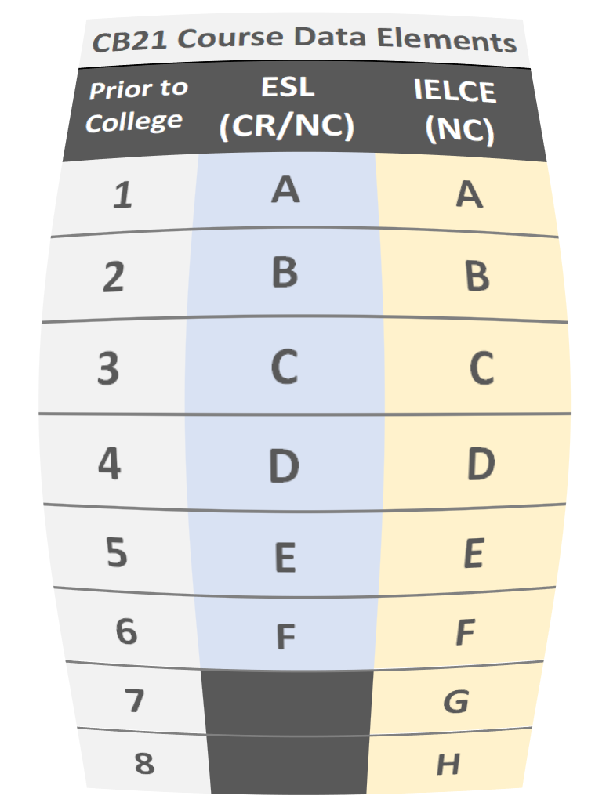
Crosswalk or Align CB21
AB705
(2017/18 – Student Success Act)
AB104
(2015 – Adult Education)
Elimination of Placement Test
1 yr/3 yr Time Clock
Multiple Measures
Guided Self Placement
Adult Ed Consortia (K12/CCs)
Align Assessment
Transition to Postsecondary

Slide 13
Two Processes
2017/2018
2018/2019
CB21/EFL Crosswalk
Math, English, ESL
CB21, EFL, CAI descriptors
CC credit, NC and K12 AE
Met 3 times (15 hrs)
CB21 Revision
Math, English, ESL
CB21, EFL, CAI descriptors
CC credit, NC & K12 AE
Meet twice

Slide 14
Revised CB21 Rubrics: Purpose
Integrate
Integrate objectives related to quantitative reasoning, English/reading courses, and ESL from the federal Educational Functioning Levels (EFL) already in use by noncredit programs and K12 adult schools.
Integrate
Integrate outcomes from C-ID approved courses.
Enable
Enable faculty to document the types of skills that students will have mastered by the end of a broader range of pre-collegiate courses, such as pre-stats.
Facilitate
One consolidated rubric will facilitate alignment between credit, noncredit, and adult schools and allow for mirrored courses.
Continue
The element will continue to be used to determine skills gains in contexts like AB705, the Student Success Metrics, and the Adult Education Program.

Slide 15
EFL/CB21 Alignment Processes
Goal was to revise CB21 to match the federal EFL levels
Three workgroups - Math, ESL, and English
Used the revised (new) EFLs and the Common Assessment Initiative (CAI) rubrics to develop revised rubrics
Each group included credit, noncredit, and K12 adult ed faculty
Math and English groups met twice and finished by January 2019
ESL continued to meet for a year to develop final CB21 Rubric
Parallel groups met to establish goals for the process and recommend MIS changes for reporting

Slide 16
How does Alignment Help?
Establishes equivalency between student skills gains measured by pre and post testing with CASAS or TABE and developmental education courses taken by students in noncredit programs.
Supports multiple methodologies for tracking skills gains in the LaunchBoard: Pre and post testing using CASAS or other federally approved instrument or student course progression in CB21 coded math, English or ESL courses.
Creates common targets for K12 adult ed, noncredit, and credit practitioners to develop transition and bridge programs from adult education into postsecondary education and college.

Slide 17
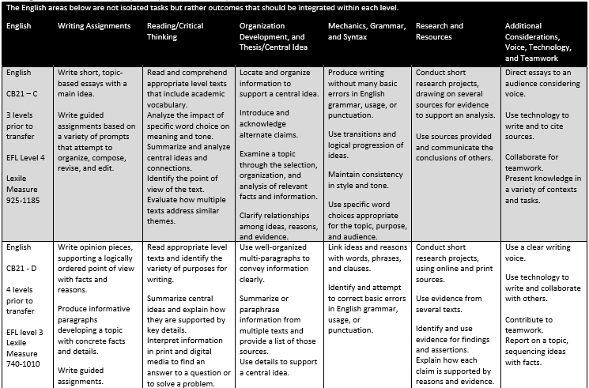
English Rubric
https://www.asccc.org/resolutions/course-basic-cb-21-rubrics-coding-course-outcomes
Notes:
https://www.asccc.org/resolutions/course-basic-cb-21-rubrics-coding-course-outcomes and this one for ESL: https://www.asccc.org/resolutions/adopt-updated-course-basic-cb-21-rubrics-coding-english-second-language-esl-course

Slide 18
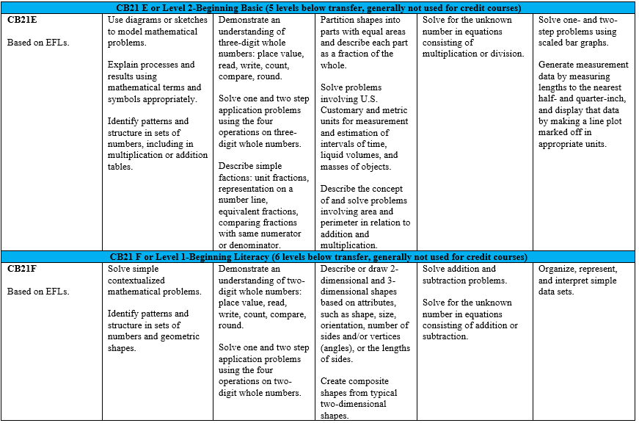
Quantitative Reasoning Rubric
https://www.asccc.org/resolutions/course-basic-cb-21-rubrics-coding-course-outcomes

Slide 19
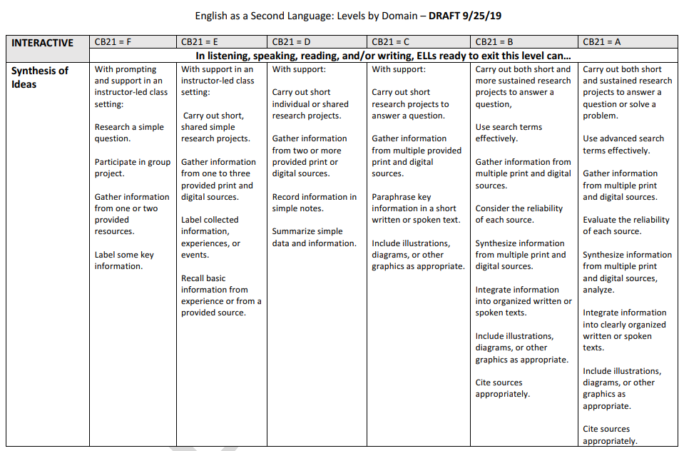
English as A Second Language Rubric: Levels by Domain
DOMAINS
Listening
Speaking
Reading and/or
Writing
SKILLS
Interpretive
Productive
Interactive
https://www.asccc.org/sites/default/files/ESL_CB21%20Competencies%20Crosswalked%20to%20Educational%20Functioning%20Levels.asd__0.pdf
Notes:
INTERPRETIVE
Complexity and Type of Passages
Main Idea or Topic
Purpose and Audience
Claim and Support
Vocabulary
Cohesive Devices to Interpret Meaning (Relationship of Ideas)
PRODUCTIVE
Complexity and Type of Text/ Organization
Claim and Support
Texts Across Rhetorical Modes
Language Choice and Style
Vocabulary
Grammar and Sentence Structure
Editing
INTERACTIVE
Type and Complexity of Interaction
Synthesis of Ideas

Slide 20
AEP: What & Why Code CB21 in MIS
CB21 Course-Prior-to-College-Level
  Used in the following metrics:
    Participants in ABE, Participants in ASE
    Students with an Enrollment in an Adult Education Program Who Received Services
    English Language Learner, Low Literacy, Reportable Individuals
    Complete One or More EFL’s
    ESL or ABE Participants Who Transitioned to ASE
    ESL, ABE and ASE Participants who Transition to Postsecondary
    Participants Who Completed 6+ College Credit Units for the First Time

Slide 21
CB21 on the Adult Education Pipeline
Where view results
  Progress → Summary and Detailed data pages
Calculation
  Advanced one or more CB21 levels in the selected year compared to prior CB21 level in the prior or selected year at the selected college:
    WHERE EITHER [MIN CB21 per term (GI03) must decrease in the selected year compared to prior CB21 in any term in the prior or selected year
    WHERE CB21 not equal to Y at the selected college
  AND CB21 advancement must be in the SAME discipline area:
    WHERE CB03 IN (493084, 493085, 493086, 493087, 493090, 493100, 493060, 493062) for ESL advancement
    OR CB03 IN (1701.00) for Math advancement
    OR CB03 IN (1501.00, 1520.00) for English or Reading advancement
NOTE: CB21 course progression v. EFL Gains through assessments
  May disaggregate in future

Slide 22
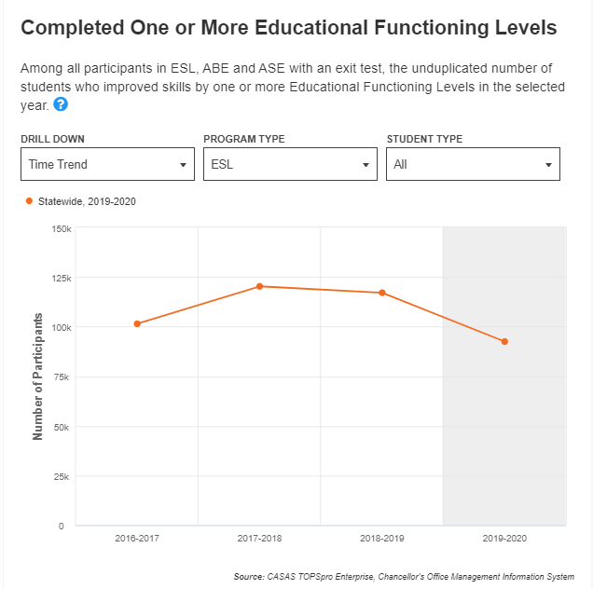
View By Program Type
* ABE, ASE, CTE, ESL

Slide 23

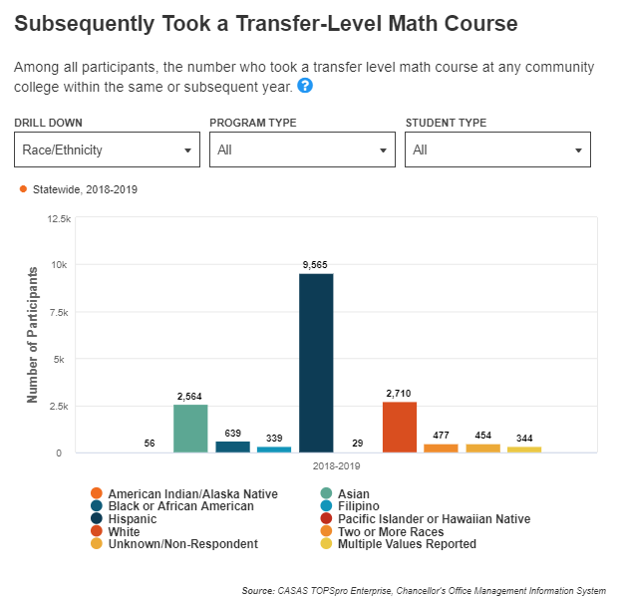



View By Student Demographics
*Gender, Race/Ethnicity, Age

Slide 24
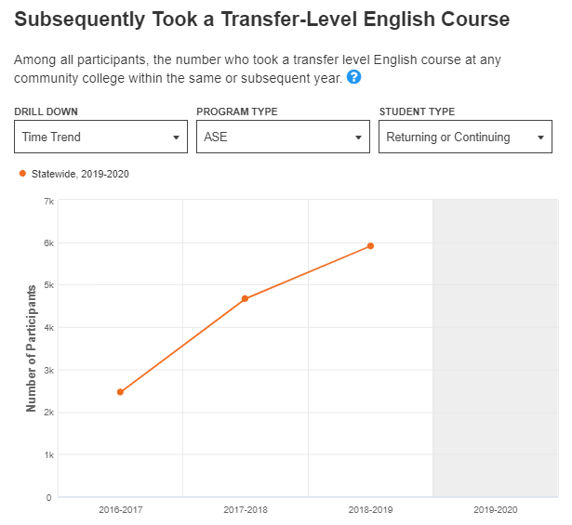
View By Student Type
*First Time, Returning or Continuing

Slide 25
CB21
Making a Difference
Community colleges have made tremendous progress under Assembly Bill (AB) 705, which passed in 2017 and overhauled the placement policies that made it harder for students to take and complete gateway courses.
Mapping Equitable Access to Math at California’s Community Colleges (May 11, 2021): https://www.ppic.org/blog/mapping-equitable-access-to-math-at-californias-community-colleges/

Slide 26
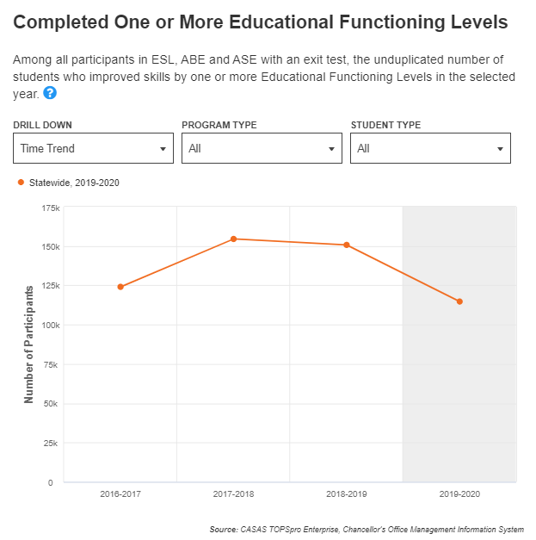
Adult Education
EFL Gains
37%
39%

Slide 27
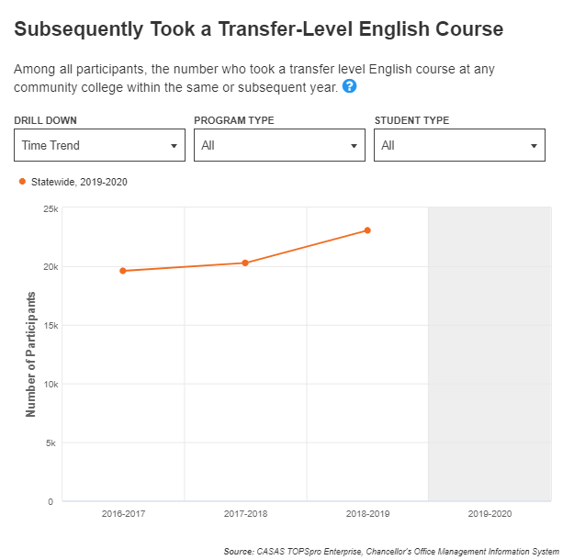
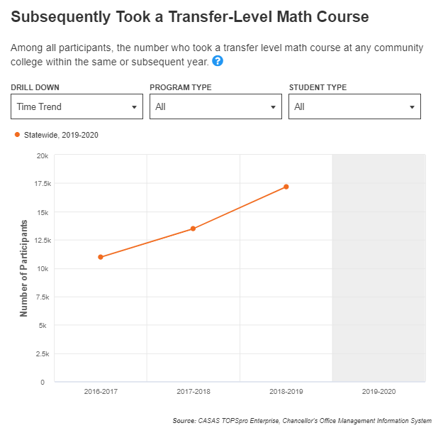
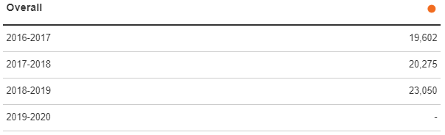
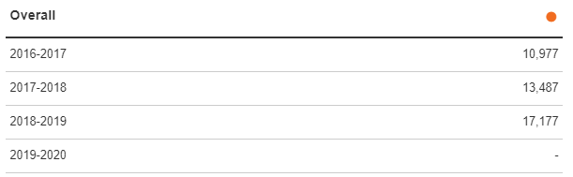
Subsequently Took a Transfer Level Course
Transfer Level English
Transfer Level Math
5%
4%
3%
3%

Slide 28
Voices from the Field
Alison Robertson
Cyprus College (ESL)
Jan Young
  Glendale Community College (English)

Slide 29
Cypress College ESL Program Overview

Slide 30
CB21 Rubric & Core Sequence Revision
Using the CB21 Rubric, we confirmed that 186 (original end point–one below TLC) showed significant academic creep.
To begin reworking of our core sequence,
  we referenced the C-ID for TLC/English 100
  we turned ESL 186 into ESL 110, TLC
For 109 and below, we referenced the CB21 rubrics to continue to revise our sequence.

Slide 31
ESL Progression
Low Intermediate Academic Reading and Writing (CSU elective)
High-Intermediate Academic Reading and Writing (CSU elective)
Advanced Academic Reading and Writing II (Humanities CSU C2 & AA GE C2, UC elective)
ESL 105
ESL 106
ESL 107
ESL 108
ESL 109
ESL 110
Intermediate Academic Reading and Writing (CSU elective)
Advanced Academic Reading and Writing I (Humanities CSU C2 & AA GE C2 UC elective)
College Composition for Non-Native Speakers (Written Communication IGETC 1A/CSU A2/AA GE A1)

Slide 32
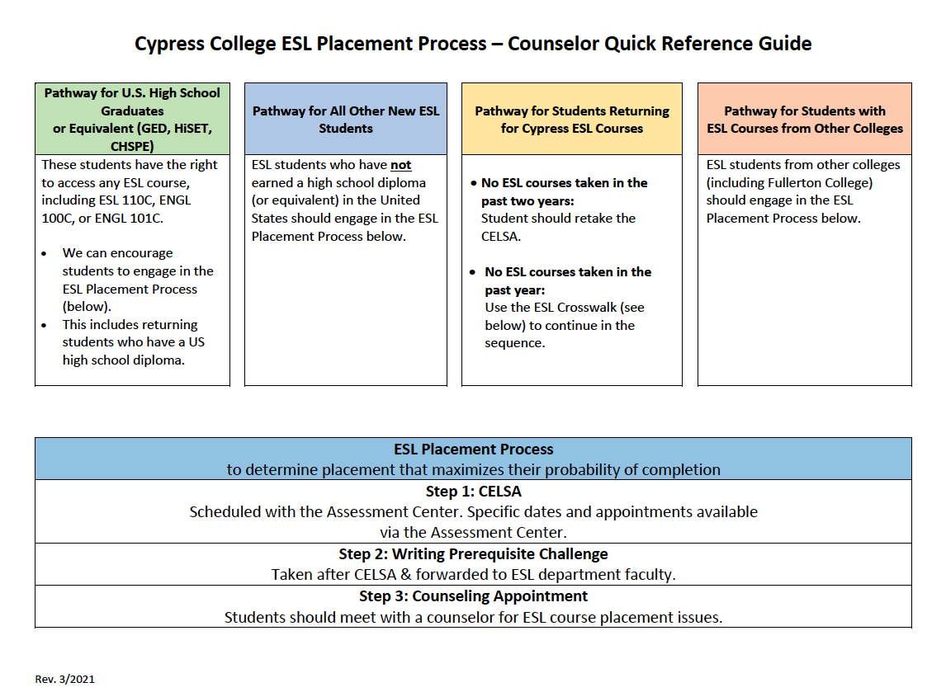
Cypress College ESL Placement Process

Slide 33
Placement into & Movement through Credit
Our processes allow multiple opportunities for students to maximize movement through the ESL sequence by ensuring the validity and reliability of the following opportunities:
CELSA
Prerequisite writing challenge for new students
End-of-semester challenge to jump the next level

Slide 34
Guided Pathways ESL Milestone Certificates
Pathway to SEM
Pathway to Kinesiology
Pathway to CTE/ATC
Pathway to Business & CIS
Pathway to Transfer: Language Arts/Oral Communication
Pathway to Transfer: Language Arts/Written Communication
Pathway to Dental Hygiene/Nursing/Psychiatric Technology
Pathway to DMS, HIT, or RADT
Pathway to Transfer: Social Sciences

Slide 35
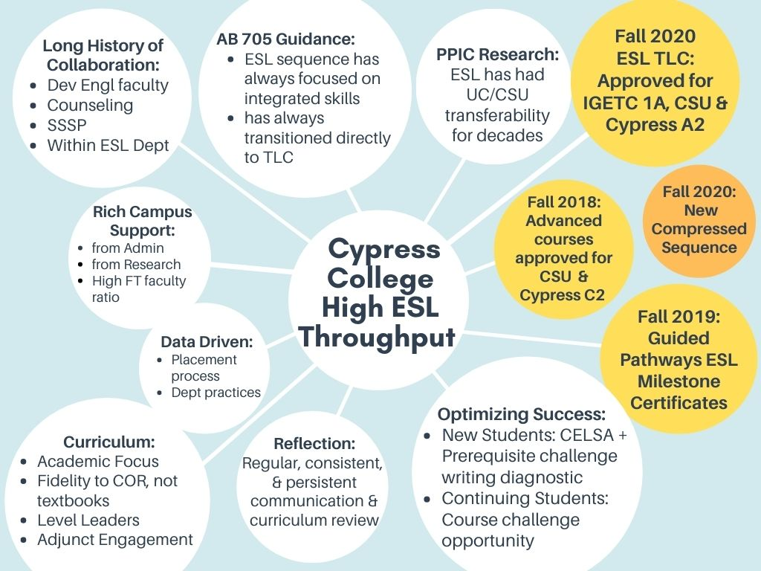
Cypress College High ESL Throughput

Slide 36
Glendale Community College
English Language Arts

Slide 37
Outcomes vs. Entry Standards
In order to pass the GED Language Arts Through Reasoning test, students must be able to:
Read excerpts from a variety of informational and literary sources, show ability to draw conclusions, and write clearly.
Demonstrate ability to analyze two passages, decide which argument has more convincing evidence and explain why the evidence supports this position.
Timed test. Write a well written essay in 45 minutes.
Entry Standards for English 101:
Read and critically analyze various academic readings
Organize fully developed essays in both expository and argumentative modes.
Employ basic library research techniques
Revise writing to eliminate errors in syntax and grammatical constructions.

Slide 38

The Gap
Credit and noncredit faculty identified gaps in preparing students for English 101.
Created a workshop that targeted: incoming students, GED graduates, and 2nd and 3rd repeaters
For summer and winter term, one week 15 hrs. Plans on piloting workshops for 2nd part of fall semester to prepare repeaters for next term.

Slide 39
The Bridge: English Workshop
Building self-efficacy is more than half the battle. Infused growth mindset and habits of mind exercises throughout.
Shared expectations of instructors for 101 and where to get further help on campus. Resource guide provided includes GCC OER handbook.
Reviewed sentence structure, paragraph development, summarizing vs. analyzing, and editing/fine tuning.
Unpacking the prompt!!

Slide 40
Unpacking the Prompt
Why Do The Skaters Seek Thrills?
Prompt for Paper #1
Re-read Parts One and Two Carefully. Then, using Dr. Siegel's theories on adolescent development, write a multi-paragraph essay and explain why the skaters "hill bomb." Identify and examine how the characteristics of the young men's behavior align with the characteristics of adolescent behavior defined in Brainstorm. Develop a deeper understanding of the seemingly careless behavior of the skaters by showing how the skaters exemplify the traits of adolescents. Your paper will demonstrate and critique the actions of the skaters. You are persuading your reader to understand that there are developmental reasons for the skater's behavior and that there are implications of such behavior.
This is a paper that finds scientifically proven reasons for particular adolescent actions and reflects on the significance of such findings. You are using academic analysis from the discipline of psychology and biology to deeply explain what is happening and the significance of what is happening. You are discovering the deeper origins of the decision to hill-bomb. Your thesis makes an argument about what motivates the skaters and demonstrates the significance of this argument. Each topic sentence clarifies your thesis claim.

Slide 41
And More…..
-Offering an 8 hr. writing workshop for high school students entering dual enrollment program. Students needed an introduction to academic writing, particularly in social sciences.
-Offering a pre-Stat course for entering SLAM students
-Offering an Algebra review course for entering STEM students

Slide 42
Q & A

Slide 43
Contact Information
  Randy Tillery, Area Director, Workforce Development and Postsecondary Education rtiller@wested.org
  Blaire Toso, Senior Program Manager, Workforce Development and Postsecondary Education btoso@wested.org
  Jessica Chittaphong, Program Coordinator & AEP Dashboard Manager, Workforce Development and Postsecondary Education jchitta@wested.org
  Alison Robertson, Professor of ESL arobertson@cypresscollege.edu
  Jan Young, Division Chair Noncredit Business and Life Skills, Continuing Education jyoung@glendale.edu

