Slide 1
Member Effectiveness 2021-22
Presenters: Carolyn Zachry, Neil Kelly, Veronica Parker & Jay Wright

Slide 2
Presentation
CAEP Legislative Requirements (Member Effectiveness)
NOVA Certification of Assurances
Consortium Responsibilities
CAEP Member Effectiveness Process
Release of CAEP Member Effectiveness Memo (and TOPSPro Reporting process)
Consortium Governance Certification
Questions

Slide 3
CAEP Legislative Requirements
CAEP member effectiveness is defined per the CAEP assurances listed and further defined/mandated by education code (84900 – 84920).
The CAEP assurances are part of the CFAD certification process in NOVA (in order to receive state CAEP funding).

Slide 4
CAEP Assurances
Membership and Decision-Making
Public Meetings
Reporting Requirements

Slide 5
Membership & Decision-Making
I certify that any community college district, school district, or county office of education, or any joint powers authority consisting of community college districts, school districts, county offices of education, or a combination of these, located within the boundaries of the adult education region shall be permitted to join the consortium as a member (EC 84905 (a)(b).
I certify that only members as described above (and in EC 84905) are allowed to join my consortium as members and participate in decision making and approvals whether in a public meeting, or via the NOVA planning, budgeting & expense reporting system.
I certify that as a condition of joining a consortium, as a member, I shall commit to reporting any funds (as described in EC 84916) available to that member for the purposes of education and workforce services for adults and the uses of those funds through the annual Program Area exercise in NOVA for reporting leveraged funds, and instructional hours.
I certify that as a member of the consortium my district shall be represented only by an official designated by the governing board of the member (EC 84905 (c)).
I certify that as a member of the consortium, I shall participate in any decision made by the consortium (EC 84905 (d)(1)(A)).
I certify that all decision made by the consortium and its members is final (EC 84905 (d)(1)(F)).
I certify that I will adhere to the consortium rules and procedures and, as agreed upon by the consortium members, to any additional by-laws, charters, etc.

Slide 6
Public Meetings
I certify that a proposed decision is considered at an open, properly noticed public meeting of the consortium at which members of the public may comment (EC 84905 (d)(1)(B)).
I certify that the consortium has provided the public with adequate notice of a proposed decision and considered any comments submitted by members of the public, and any comments submitted by members of the public have been distributed publicly (EC 84905 (d)(1)(C)).
I certify that the consortium has requested comments regarding a proposed decision from other entities located in the adult education region that provide education and workforce services for adults (EC 84905 (d)(1)(D)(i)).
I certify that the consortium has requested comments regarding a proposed decision from other entities located in the adult education region that provide education and workforce services for adults (EC 84905 (d)(1)(D)(i)).
I certify that the consortium has considered input provided by pupils, teachers employed by local educational agencies, community college faculty, principals, administrators, classified staff, and the local bargaining units of the school districts and community college districts before it makes a decision (EC 84905 (d)(1)(E)).
I certify that in addition to the meeting requirements listed in EC 84905, and as agreed upon by the consortium members, that I will follow the public meeting requirements listed in the Ralph M. Brown Act as the Brown Act applies to the governing body of any “local body created by state or federal statute.” (Ed. Code, section 54952.)

Slide 7
Reporting Requirements
I certify that I will participate in completing and updating any consortium long range and/or short range planning efforts and/or budget work plans (EC 84906, 84914(a)).
I certify that all CAEP expenses have been expended in the CAEP seven program areas, and services provided are consistent with the 3-year plan, the annual plan, and my district’s work plan & budget as submitted in NOVA (EC 84913 (1-7), 84906, 8914(a)).
I certify that my expenditures of CAEP funds match the objectives/activities included in the annual plan and the member work plan (EC 84906, 84914(a)).
I certify that my expenditures of CAEP funds adhere to the allowable uses of funds as identified in the CAEP Fiscal Management Guide.
I certify that I will report student level enrollment data and outcomes as prescribed by the State CAEP Office (EC 84920).
I certify that I will share financial expenditure and progress reports with the members of my regional consortium.
I certify that I understand that as a member if I do not meet any of these items I have certified, I will be deemed an ineffective member which may result in a loss or reduction of CAEP funding (EC 84914(b)).
I certify that all CAEP expenses have been expended only for the education of persons 18 years of age or older (EC 84901(a)).

Slide 8
NOVA Certification
Each CAEP consortium member agrees to follow the list of CAEP assurances when they certify their annual allocation via the Consortium Fiscal Administration Declaration (CFAD).
By clicking "Approve" in the NOVA system, the member is confirming that they agree to all the CAEP assurances listed under sections labeled: Membership & Decision-Making, Public Meetings, and Reporting Requirements.
This also includes members certifying to any additional consortium rules and procedures and, as agreed upon by the consortium members (such as any additional by-laws, charters, etc.).

Slide 9
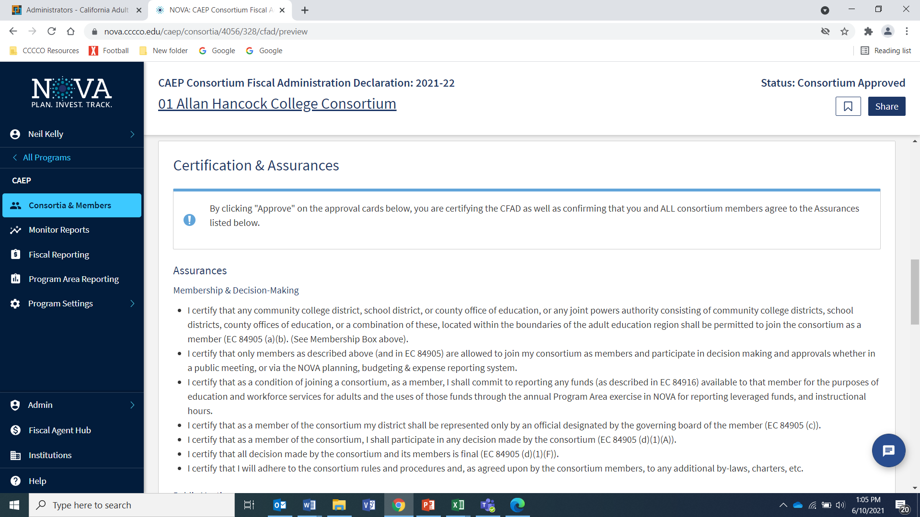
NOVA Certification & Assurances

Slide 10
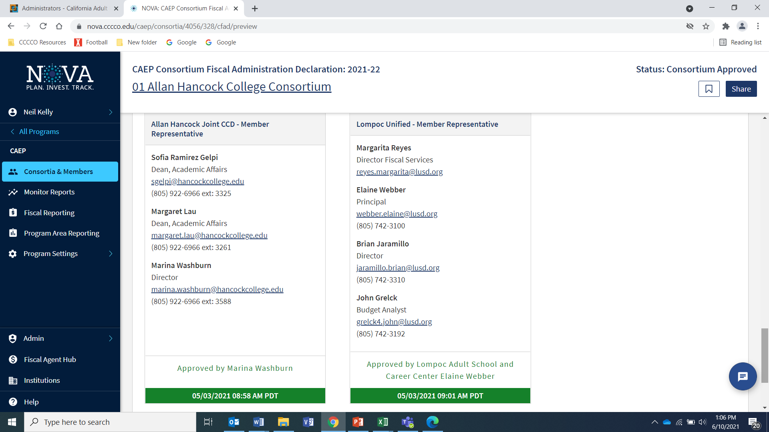
NOVA Certification & Assurances cont.

Slide 11
Consortium Responsibilities
Consortium lead/director must monitor member performance related to the CAEP assurances and identify members for non-compliance.
Consortium lead/director must provide members technical assistance and/or reach out to the CAEP Technical Assistance Project (TAP) as part of the reasonable intervention to help their members.
Once a reasonable intervention has been attempted without success, the consortium may deem that member as ineffective and their funding may be reduced.
If a consortium chooses to decrease the member’s funding, the consortium must document the reason, the technical assistance/reasonable intervention provided, and the public meeting minutes of how/when the decision was made. This documentation must be posted to the consortium’s Supporting Documentation section in NOVA.

Slide 12
Consortium Responsibilities cont.
CAEP TAP is here to assist!
Include more visible notices of upcoming CAEP deliverables in the newsletter, direct communication to the field, on the website, and via social media.
By way of an infographic, include best practices on how to complete a deliverable and what a consortium lead should be looking out for when they are getting ready to certify a deliverable/report.
The creation of a process map to show the flow of deliverables prior to their due date.
Notices will be disseminated at least 6 weeks prior to a deliverable and will include at least 3 notices through all channels.
After a deadline, The State CAEP Office will notify CAEP TAP of who has/has not submitted their deliverables and CAEP TAP will begin the notification process.

Slide 13
State Member Effectiveness Process
In addition to the consortium monitoring, the State CAEP Office will also be monitoring specific CAEP requirements.
Beginning July 1, 2021, CAEP regional consortia will be notified by the State CAEP Office through CAEP TAP or CASAS of members that have not met some or all of the assurances they certified in order to receive CAEP funds.
If the member continues to not meet the assurance(s), then the member will be deemed an ineffective member, and the State CAEP Office will inform the consortium and the member of their ineffective status.
The consortium may proceed with reducing the member’s CAEP funding. The consortium may reduce the current year’s funding or decide to reallocate the member’s base allocation (which would affect future year’s funding for the member).

Slide 14
State Member Effectiveness Monitoring
The State CAEP Office will be tracking the following requirements and will notify CAEP TAP or CASAS to reach out to the consortium/member and provide technical assistance:
Program Area Reporting of leveraged funds and instructional hours (consortium certification due 12/1)
Quarterly expenditure reporting (Q1, Q2 (includes close out), Q3, & Q4)
Plan Certification – 3-year plan, annual plan, and member work plan
CFAD and Governance Certification (due May 2nd)
For K-12/COE only – quarterly student data reporting into TOPSPro Enterprise (Q1, Q2, Q3, & Q4)

Slide 15
TOPSPro Enterprise Data Submission
Sequence of CAEP Data Submission tasks after the submission due date (K-12/COE):
On the second day after the submission due date, CASAS will send a late reminder email to all agencies who are missing any deliverables.
CASAS will send another late submission reminder email one week after the data submission due date.
If not submitted by the 2nd week after the due date, CASAS will offer technical assistance.
If the agency fails to follow up one month after due date and technical assistance has not resulted in any progress – the agency is referred to the State CAEP Office for a determination on effectiveness.

Slide 16
Consortium Governance Certification
Starting in 2022, each member (and consortium) will be required to annually certify the CAEP Governance documentation.
The Governance certification aligns with the CAEP assurances and the member effectiveness process.
Governance certification will be part of the CFAD process and certification due May 2nd each year.
The Governance questions are the same as before (from 2015) with two additional questions on carry-over funds and member effectiveness.
The Governance process will be available in NOVA later this year.

Slide 17
Governance Questions 1 of 3
Have all community college districts, school districts, or county offices of education, or any joint powers authority consisting of community college districts, school districts, county offices of education, or a combination of these, located within the boundaries of the adult education region been allowed to join the consortium as a member?
Have all members committed to reporting any funds available to that member for the purposes of education and workforce services for adults and the uses of those funds? How will the available funds be reported and evaluated?
How will you assure that each member of the consortium is represented only by an official designated by the governing board of the member?
How will you assure of the consortium shall participate in any decision made by the consortium?

Slide 18
Governance Questions 2 of 3
What will be the relative voting power of each member?
How will decision be approved?
How did you arrive at that decision-making model?
How will proposed decisions be considered in open, properly noticed public meetings of the consortium at which members of the public may comment?
Describe how will you provide the public with adequate notice of a proposed decision and consider any comments submitted by members of the public?

Slide 19
Governance Questions 3 of 3
Describe how comments submitted by members of the public will be distributed publicly.
Describe the process by which the consortium will solicit and consider comments and input regarding a proposed decision from other entities located in the adult education region that provide education and workforce services for adults. Such entities will include but not necessarily be limited to, local public agencies, departments, and offices, particularly those with responsibility for local public safety and social services; workforce investment boards; libraries; and community-based organizations.
How will you determine approval of a distribution schedule pursuant to Section 84913 (CFAD process)?
Has the consortium A) designated a member to serve as the fund administrator to receive and distribute funds from the program or B) chosen to have a funds flow directly to the member districts based upon the approved distribution schedule?
How will members join, leave, or be dismissed from the consortium?

Slide 20
Governance Questions
How does the consortium monitor and administer carryover funds? Do you have a bylaw that governs carryover?
How does your consortium define member effectiveness? What bylaws does your consortium have addressing member effectiveness?
Does the consortium have a formal document detailing its working beyond the questionnaire? (Please provide a link)

Slide 21
Wrap Up and Questions

Slide 22
Request Support from CAEP TAP

