Slide 1
CAEP CFAD Revision Process
Neil Kelly – State CAEP Office
Veronica Parker – CAEP TAP

Slide 2
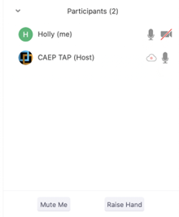




Zoom Room Controls
Everyone has the ability to speak…please raise your hand first
Everyone is muted upon entry
Feel free to communicate via the chat – even share files
You can use your camera…or not

Slide 3

Agenda
May Revise Cut
CFAD or Allocation Amendment?
CAEP planning
Education Code 84914
CAEP Calendar 20-21
Submission Process in NOVA
Wrap Up & Additional Questions

Slide 4

May Revise
CAEP received a 12.1055% or $66.7M CUT in the Governor’s May Revise to the 20-21 proposed budget (or 12.1055314889466%).
Remember, for those with larger allocations, you may have to do some rounding or hedging a few dollars to get back to your actual allocation number.
The new CAEP base for 20-21 will be $484,208,000.
All members are subject to the 12.1055% cut unless they fall under Education Code 84914 and could receive more than the 12.1055% reduction.
NOVA has been updated with the May Revise reduction numbers. This is reflected in your consortium allocation for 20-21 in NOVA.

Slide 5
CFAD or Allocation Amendment
Policy-wise, this is an allocation reduction that will result in each consortium revising your 20-21 CFAD that was originally submitted on 5/2/20.
Technically, in NOVA you will be certifying the allocation amendment and using this feature to build your revised consortium allocation.
You may upload your meeting minutes or discussion notes that resulted in the revised allocation decision in the consortium supporting documents section in NOVA.
There will not be an actual revised CFAD document. The documentation will be the certified allocation amendment in NOVA.

Slide 6
CAEP Planning Memo
Education Code 84914 (next slide) guides the allocation process for all members. This education code governs the appropriate percentage allowed for members in good standing, and also allows for a reduced amount if members cannot or no longer wishes to follow the consortium approved CAEP annual plan (or if the member is ineffective in providing services identified in the CAEP annual plan). For more information, please see the recently released CAEP Planning Memo.

Slide 7
EC 84914 – Increase/Decrease Allocations
EC84914 (2) For any year for which the chancellor and the Superintendent allocate an amount of funds to the consortium less than the amount allocated in the prior year, the amount of funds to be distributed to a member of that consortium shall not be reduced by a percentage greater than the percentage by which the total amount of funds allocated to the consortium decreased, unless the consortium makes at least one of the following findings related to the member for which the distribution would be reduced further:
(A) The member no longer wishes to provide services consistent with the adult education plan.
(B) The member cannot provide services that address the needs identified in the adult education plan.
(C) The member has been consistently ineffective in providing services that address the needs identified in the adult education plan and reasonable interventions have not resulted in improvements.

Slide 8

Revised 20-21 CAEP Calendar
20-21 Revised CFADs must be certified in NOVA by June 30, 2020.
CDE and the Chancellor’s Office hope to approve an interagency agreement for release of funds (June-July).
Governor’s Budget approved by July 1, 2020.
CAEP funds are released by August/Sept. 2020 (in 11 installments) thru May (with timely approval of the I/A).

Slide 9
FAQs
Question: Can I wait until June 30th to certify my revised CFAD?
Answer: We understand that it may be tough to schedule a meeting, but any late filing will delay the processing of CAEP funding for the 20-21.
Question: What if my consortium has a fiscal agent, do I have to submit my CFAD by 6/30?
Answer: Yes, we still need the allocation amounts (and justification if changed).
Question: Does the revised CFAD require a public meeting?
Answer: The CAEP Office suggests you check with your local district or refer to your consortium by-laws.

Slide 10
Allocation Amendment Process
Allocation Amendments are a reallocation process in NOVA after the CFAD has been certified.
Allocation amendment as a result of the May Revise or change in allocations from the State – will rebench future allocations.
Consortium based allocation amendments that are within the year and are a one-time amendment that do not affect future allocations.
To impact future allocations, members must fall under the three criteria under EC 84914.
Must be approved/certified by all members in NOVA.

Slide 11
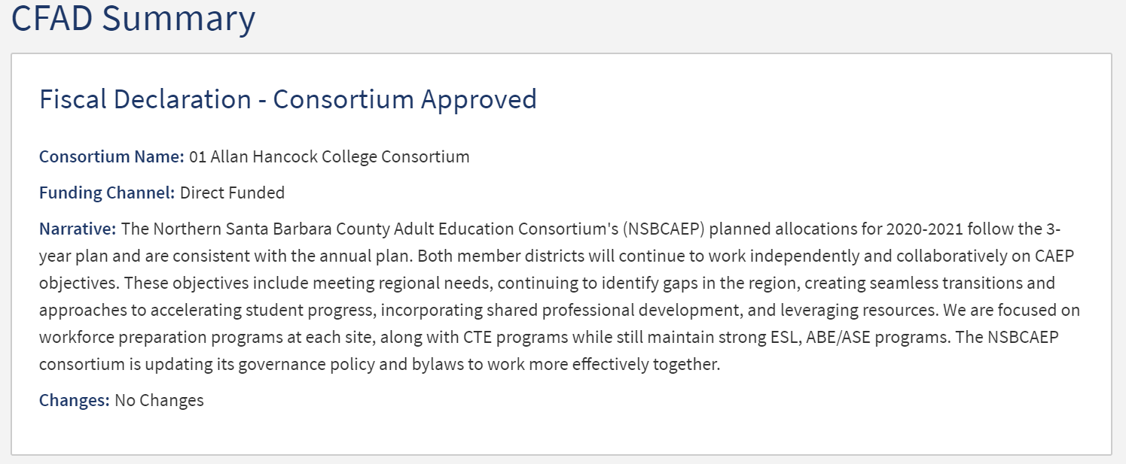
Revised CFAD Process (Allocation Amendment)

Slide 12
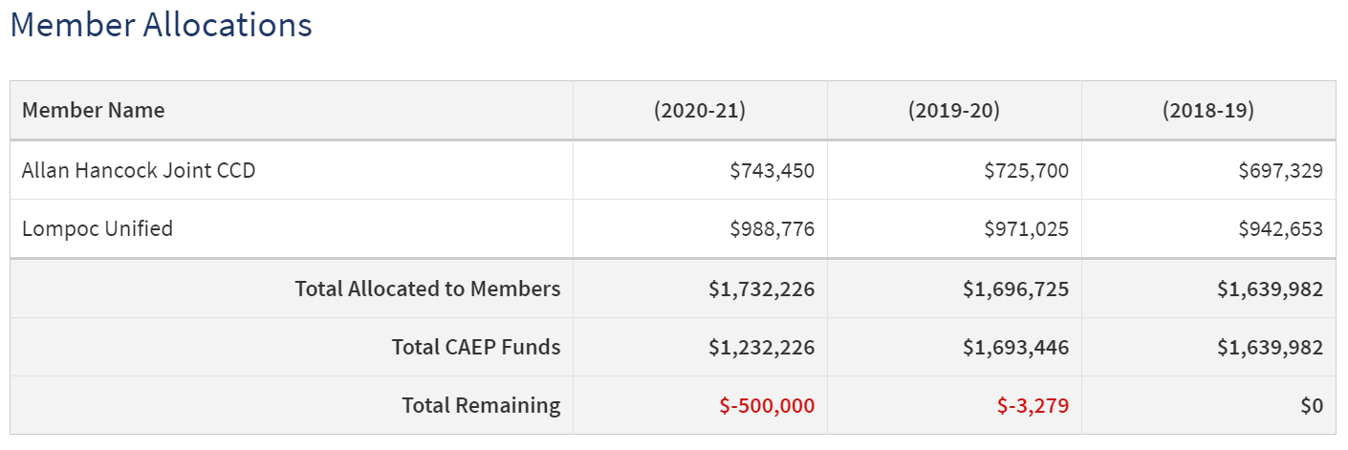
Revised CFAD Process (Allocation Amendment)

Slide 13
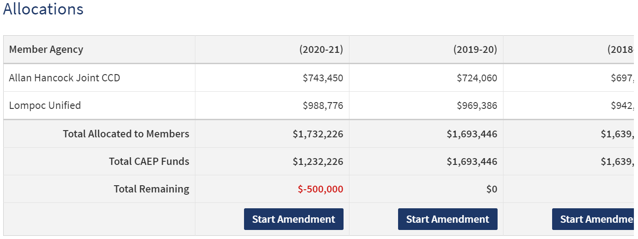
Revised CFAD Process (Allocation Amendment)

Slide 14
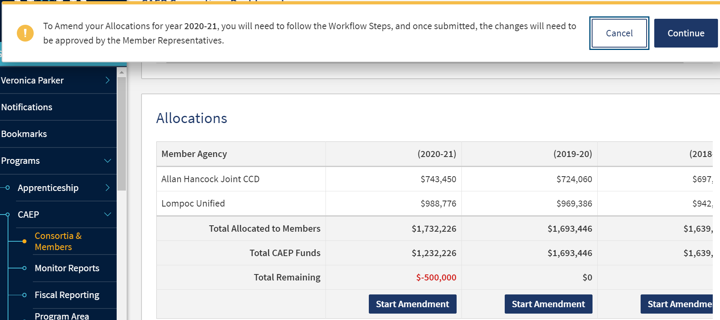
Revised CFAD Process (Allocation Amendment)

Slide 15
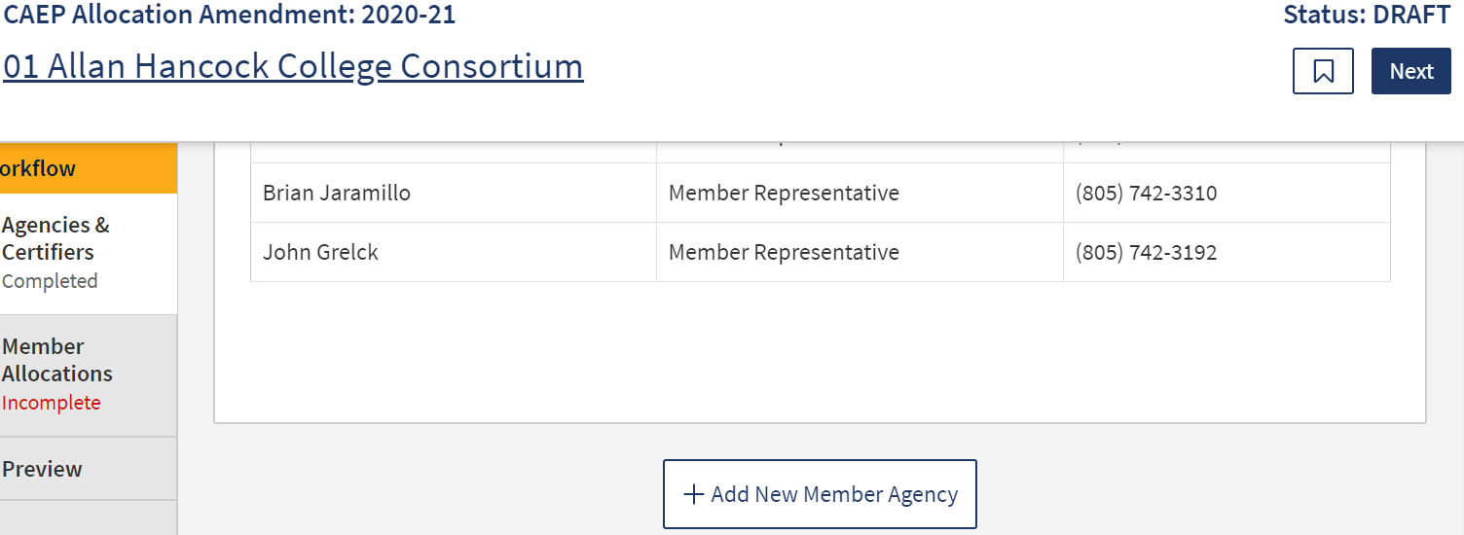
Revised CFAD Process (Allocation Amendment)

Slide 16
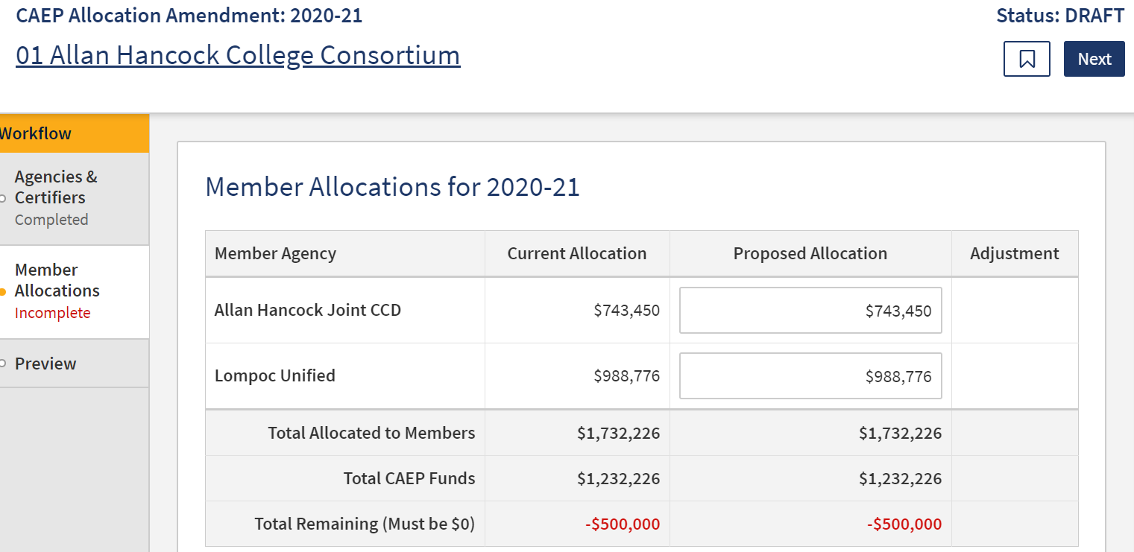
Revised CFAD Process (Allocation Amendment)

Slide 17
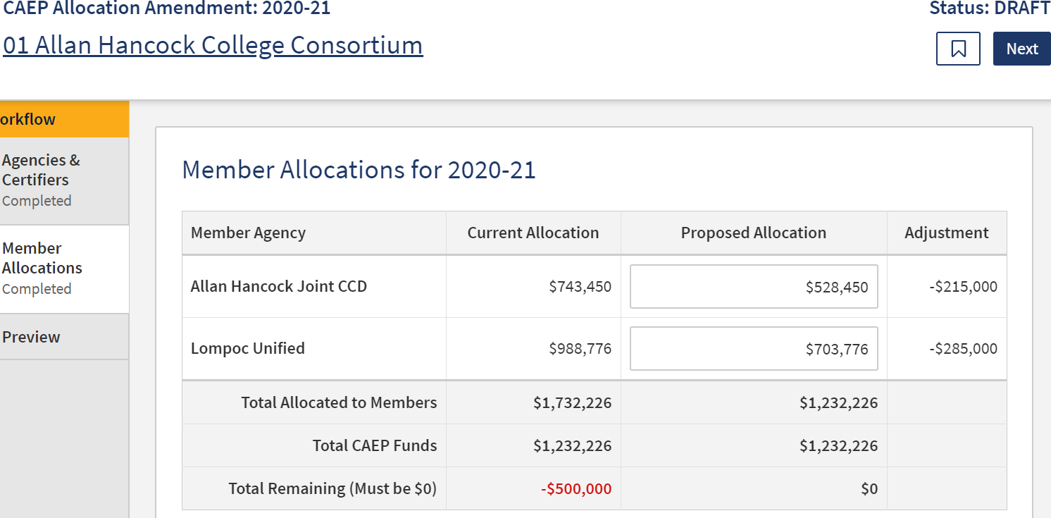
Revised CFAD Process (Allocation Amendment)

Slide 18
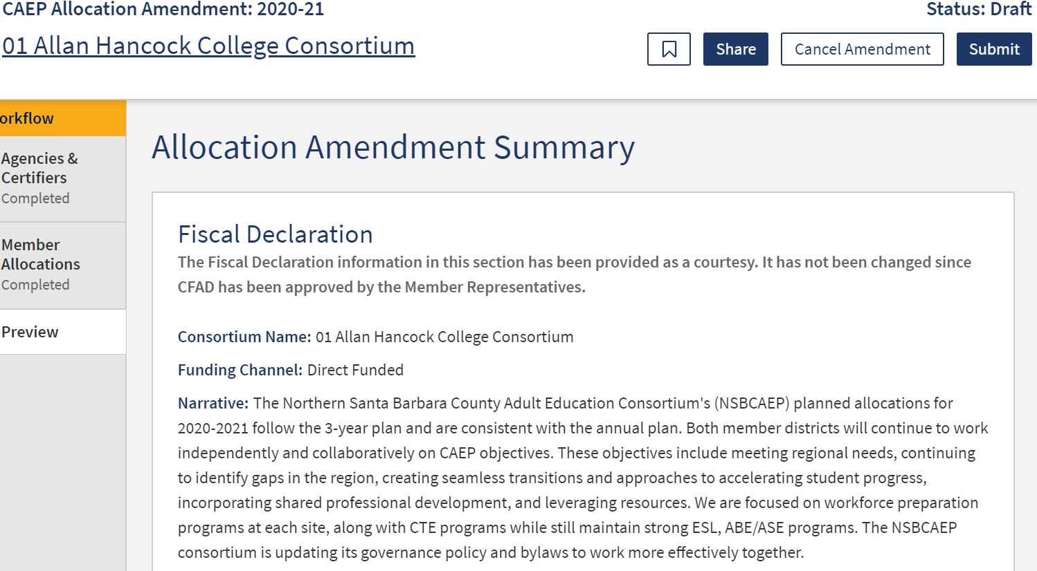
Revised CFAD Process (Allocation Amendment)

Slide 19
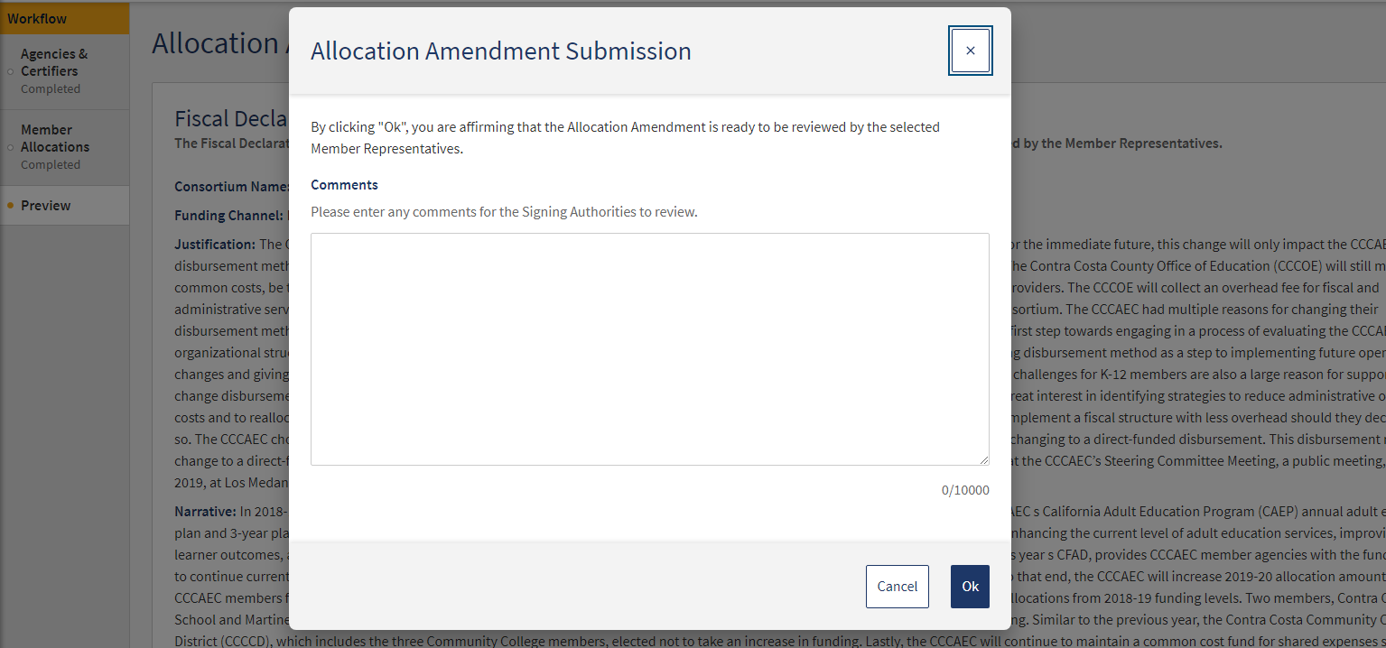
Revised CFAD Process (Allocation Amendment)

Slide 20
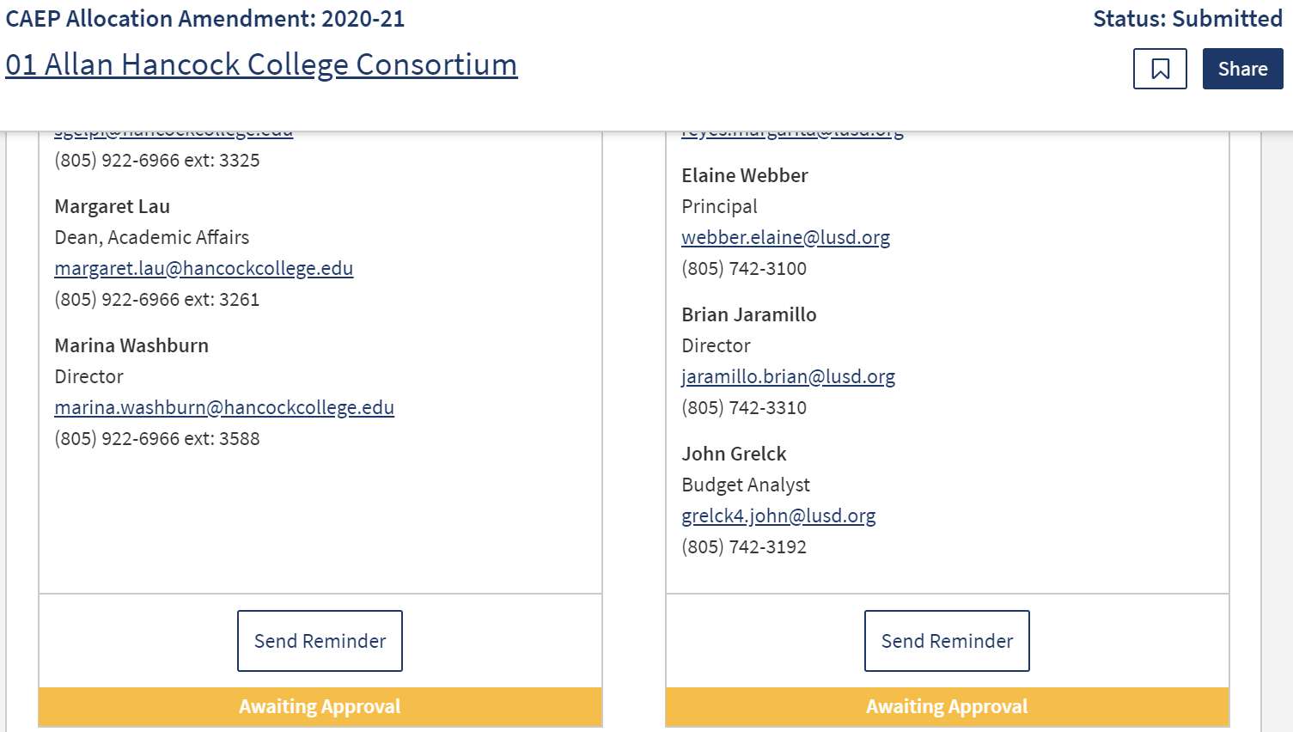
Revised CFAD Process (Allocation Amendment)

Slide 21
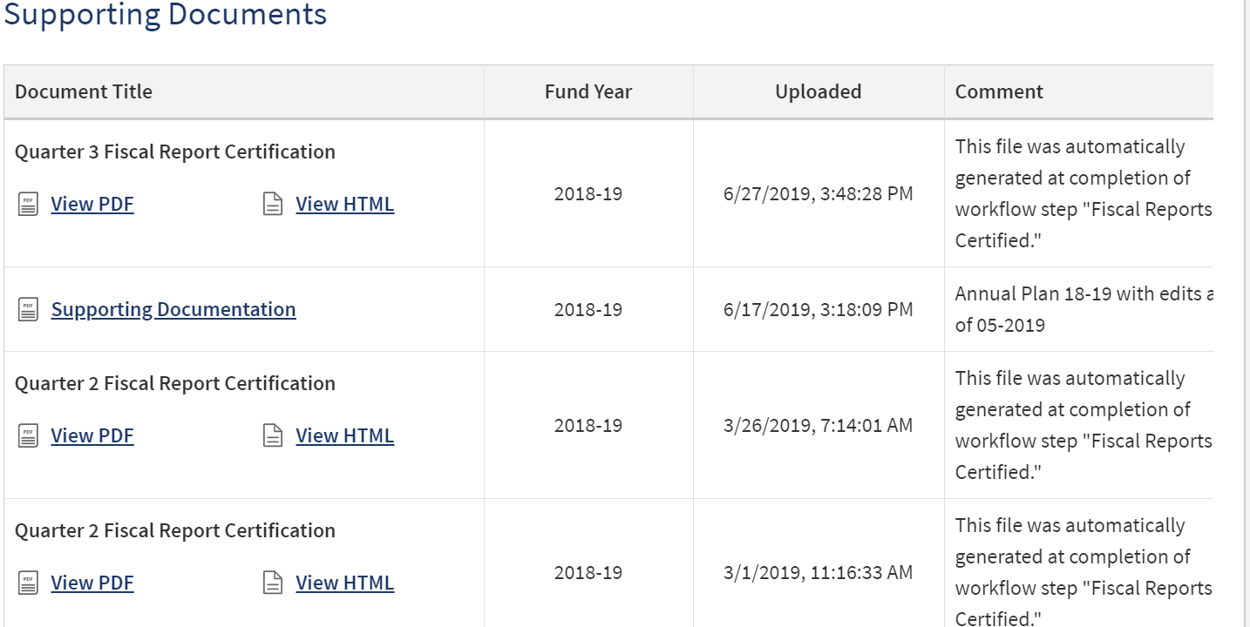

Revised CFAD Notes

Slide 22
NOVA Reminders
How to add a new member
How to update a consortium lead change
Training Resources for NOVA
How to request NOVA technical assistance
Others??????

Slide 23

Wrap Up and Questions

Slide 24
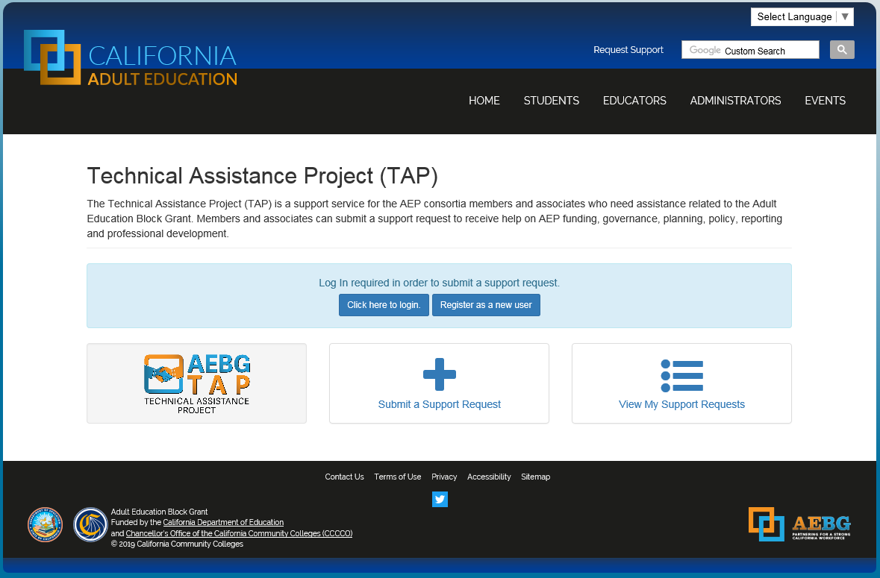
Request Support from CAEP TAP

