Slide 1
California Adult Education Program
Report on 2018-2019 Expenditures and Hours of Instruction
California Community College Chancellor’s Office
August 20, 2020
Tim Harmon
Workforce Enterprise Services, Inc.

Slide 2
Background
For the 2017-2018 program year, the State CAEP Office (Calif. Adult Education Program Office) implemented a new data collection process through NOVA to collect the required information, and to allow each CAEP consortium to review and approve program expenditure and hours of instruction reports prior to submission to the State CAEP Office.
As a result of the analysis of the first round of data collection, several changes were made to the reporting requirements for the 2018-2019 program year:
  The reporting requirements for hourly instruction were clarified to avoid any duplication of hour reporting between CTE and Workforce Reentry (now called Workforce Prep).
  ‘Instructional hour’ and ‘contact hour’ were defined to conform with federal requirements.
  The request for reporting of services hours was eliminated.
  For K12 and COE, guidance was provided regarding tracking hours of instruction for integrated courses (ESL/CTE, ASE/CTE, ABE, CTE, etc .).
  The fund source expenditure allocation reporting requirement was separated into required fund sources and optional fund sources. The required fund sources are CAEP, WIOA II, Noncredit Apportionment, CalWORKs, Perkins, LCFF, & Jail Ed Funds, Fees, and In-Kind. The optional fund sources are Contracted Services, Comm. College Supportive Services, Donations, WIOA I / ITAs, Other Federal Grants, Other State Grants, and Strong Workforce.
  The definitions of ‘in-kind’ expenditures and ‘fees’ or program income were aligned with the applicable WIOA Title II definitions and reporting requirements.

Slide 3
Background (continued)
These changes were communicated with consortia members in writing in August 2019, via webinars and presentations at the CAEP Summit in October 2019.
The reports for Program Year 2018-2019 were gathered in two phases:
  Estimated hour and expenditure data was requested by September 1, 2019.
  Final (certified) hour and expenditure data was requested by December 1, 2019.
On December 10, 2019 the final 2018-2019 data collection closed with 66 of 71 consortia submitting certified reports, representing 392 CAEP member organizations.

Slide 4
For the 2018-2019 data submission, Workforce Enterprise Services, Inc. was asked to analyzing the data to:
Characterize hours of instruction by program area;
Characterize expenditures by program area and fund type;
Compare (1) and (2) across provider types (K-12, Community College, and Other);
Compare (1), (2) and (3) across PY 2017-2018 and PY 2018-2019; and
Examine data quality issues.
Notes:
The report provides a little background on the reporting requirement, and the reporting changes that were implemented between 2018 and 2019 reports. It then lists the five things that are covered in the analysis (shown on this slide), and a little about how the data were processed.

Slide 5
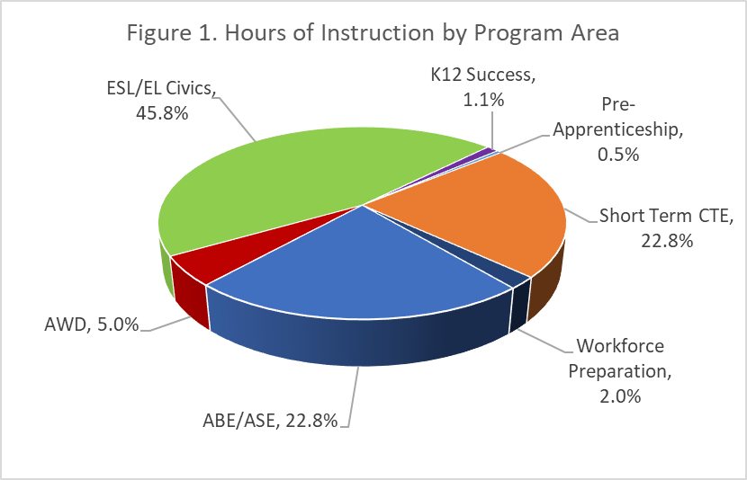
Results
Hours of instruction by program area
Notes:
Hours of instruction. The analysis of hours of instruction addresses: 1) what programs have the greatest number of hours, 2) how is this different across different types of providers (K-12 Schools vs Community Colleges and Others), and 3) how do the PY 2019 results compare to the PY 2018 results?
Figure 1 shows the percentage distributions of hours of instruction by program area. Taken together, ESL/EL Civics, Short-Term CTE, and ABE/ASE account for 91.4 percent of all instructional hours during PY 2019

Slide 6
Results
Hours of instruction by program area
Notes:
Table 1 shows the totals and percentages of hours of instruction by program area and provider type. For the 2018-2019 Program Year, nearly 65 million hours of instruction were provided by CAEP members. About two-thirds (67.5 percent) of the hours of instruction were provided by K-12 school districts, which include elementary school districts, high school districts, unified school districts, County Offices of Education, charter schools, Joint Powers Associations, and Regional Occupational Programs. About a third (32.4 percent) of the hours of instruction were provided by community colleges and community college districts. Other providers, which includes workforce development boards, libraries, community-based organizations and others, provided 0.04 percent of total hours.

Slide 7
Results
Hours of instruction by program area
Notes:
Table 2 compares the hours of instruction by program area across the two program years, PY 2018 and PY 2019. There was a substantial increase in the number of instructional hours for ABE/ASE, and substantial decreases in hours for K-12 Success and Workforce Preparation. However, overall hours were about the same across the two years.

Slide 8
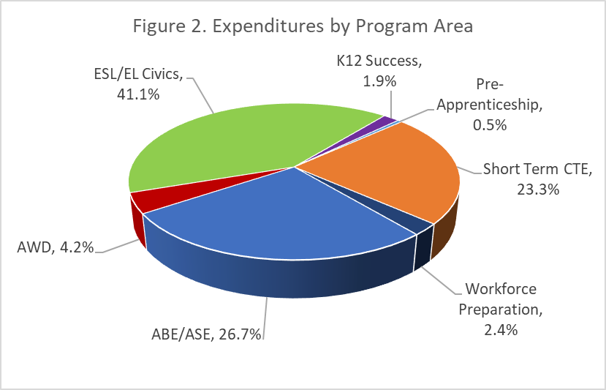
Results
Expenditures by program area
Notes:
Expenditures. The analysis of expenditures addresses: 1) what programs have the highest expenditures, 2) what fund sources have the highest expenditures, 3) how do expenditures vary across the different types of providers (K-12 Schools vs Community Colleges and Others), and 4) how do the PY 2019 results compare to the PY 2018 results?
Figure 2 shows the percentage distribution of expenditures by program area. As was the case for hours of instruction, almost all the expenditures also fall into one of three categories: ESL/EL Civics, Short-Term CTE, and ABE/ASE. The distribution of expenditures across program categories is very similar to the distribution for hours of instruction.

Slide 9
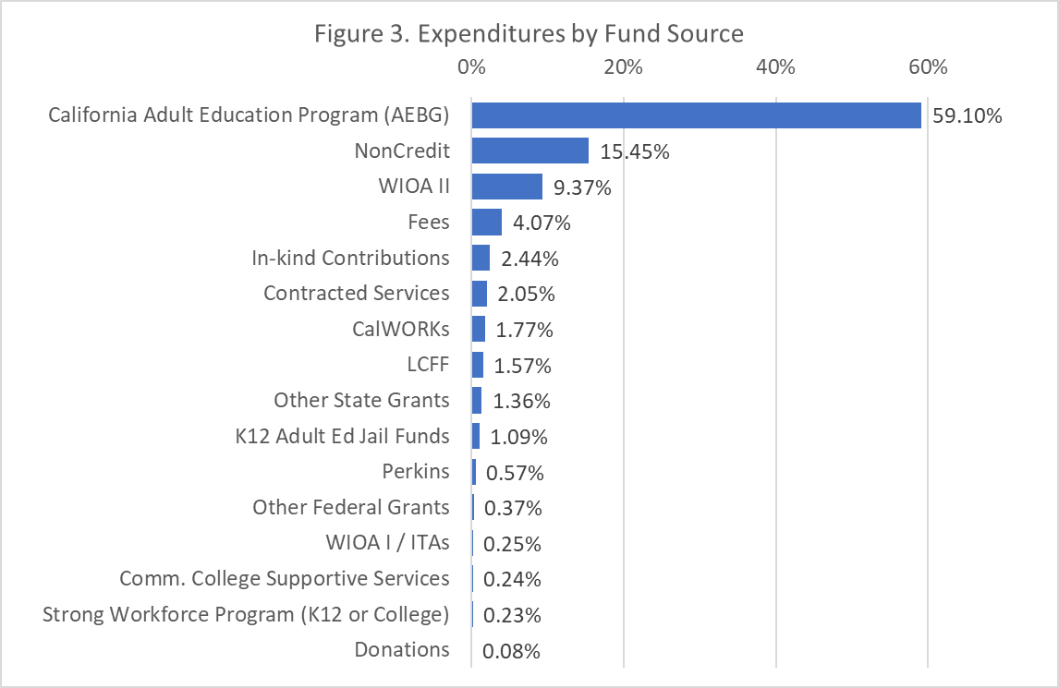
Results
Expenditures by fund source
Notes:
In addition, to reporting expenditures by program area, the State CAEP Office reporting policy requires consortia to allocate expenditures for each program area across the various funds that contributed to these program expenditures, so that CAEP can have a more complete picture of how locally-available fund sources are being leveraged to support the operation of CAEP programs. Figure 3 shows the percentage distribution of expenditures by fund source type. Nearly 84 percent of all expenditures fall into one of three fund types: California Adult Education Program (formerly AEBG), Noncredit apportionment, and WIOA Title II AEFL funds. Reporting of expenditures associated with each of these fund types is required, as is reporting for Fees, In-Kind Contributions, CalWORKs, LCFF, K-12 Adult Ed Jail Funds, and Perkins funds. Reporting of expenses for the other fund type categories is optional under the revised reporting policy for PY 2019.

Slide 10
Results
Expenditures by program area
Notes:
Table 3 shows the totals and percentages of expenditures by program area and provider type. For the 2018-2019 Program Year, over 812 million dollars were expended by CAEP providers. Nearly three-fourths (74.2 percent) of total spending was done by K-12 school districts, and about one-fourth (25.7 percent) was spent by community colleges and community college districts.

Slide 11
Results
Expenditures by program area
Notes:
Table 4 compares the expenditures by program across the two program years, PY 2018 and PY 2019. There were substantial increases in expenditures for K-12 Success (19 percent), ABE/ASE (10.4 percent) and AWD (6.3 percent). There were substantial decreases in expenditures for Workforce Preparation
(-37.2 percent), Pre-Apprenticeship (-13.8 percent) and Short-Term CTE (-7.5 percent). Overall expenditures were down just 0.5 percent
The State CAEP Office should review these shifts in spending and hours of instruction among the program categories between 2018 and 2019 to assess if these changes seem reasonable given the changes in reporting definitions and guidance summarized on page one of this report.

Slide 12
Results
Data quality
Notes:
Compliance with reporting requirement: To what extent did members and consortia comply with the reporting requirement? Table 5 shows the number and percent of CAEP members who either did not submit a report or submitted a report with zero total expenditures or zero total hours of instruction. This is shown for each of the two years, and for those not reporting in both years. Over eleven percent of members failed to report hours of instruction in one of the two years, and six percent did not report hours in either year. About eight percent (in 2018) and nine percent (in 2019) failed to report expenditures, and 3.6 percent did not report expenditures in either year.

Slide 13
Results
Data quality
Notes:
Beyond overall compliance with the reporting requirement, to what extent did members provide information for each of the major report data elements? Table 6 shows the percent of members providing a non-zero response to each of the major report elements, including each of the hour of instruction program categories, each of the program expenditure totals, and each of the fund type totals.

Slide 14
Results
Data quality
Notes:
Consistency within reports for members: Are the underlying values that would be used to create a cost per value (hours of instruction and expenditures) related to each other in a predictable manner? In other words, do members with high reported hours of instruction also have high reported expenditures, and do those with low reported hours have low expenditures? Figure 4 plots total hours of instruction and total expenditures for each member on a log scale. This plot suggests that the relationship between expenditures and hours of instruction is closer for K-12, than it is for Community Colleges. This is a pattern in the expenditure and hours data that was also observed with the initial PY 2018 data. All scatterplots in this report exclude cases with zero values on either axis.

Slide 15
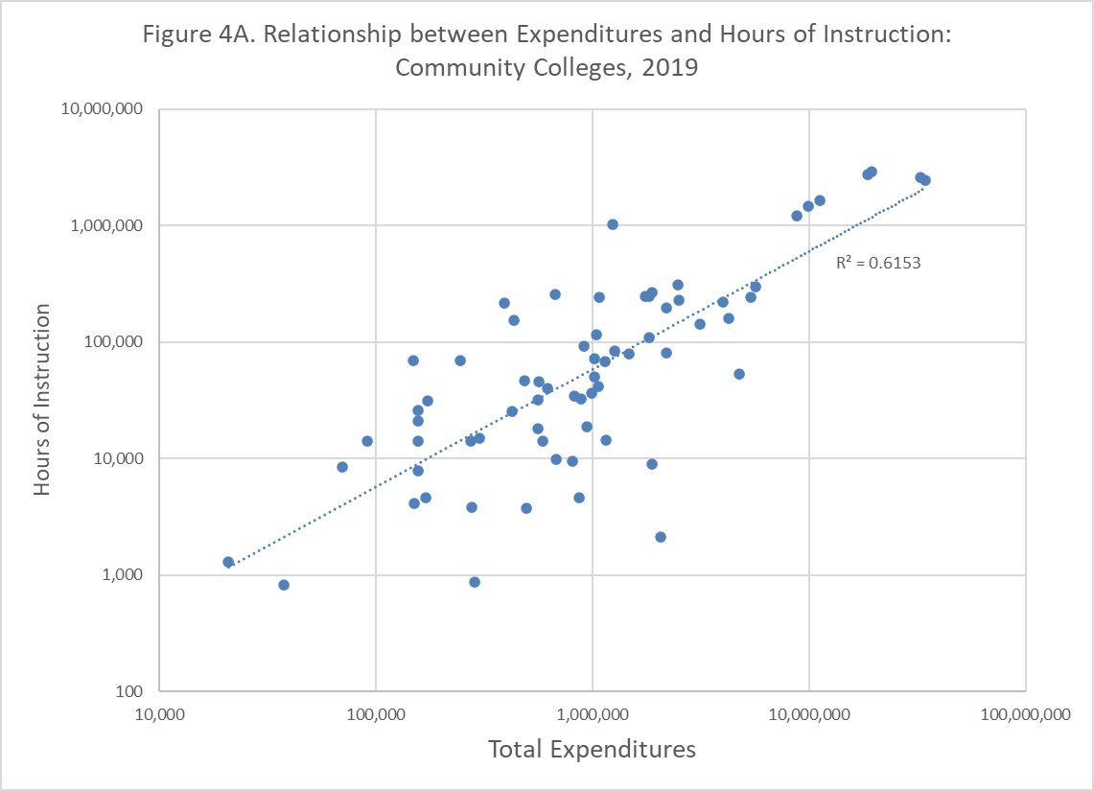
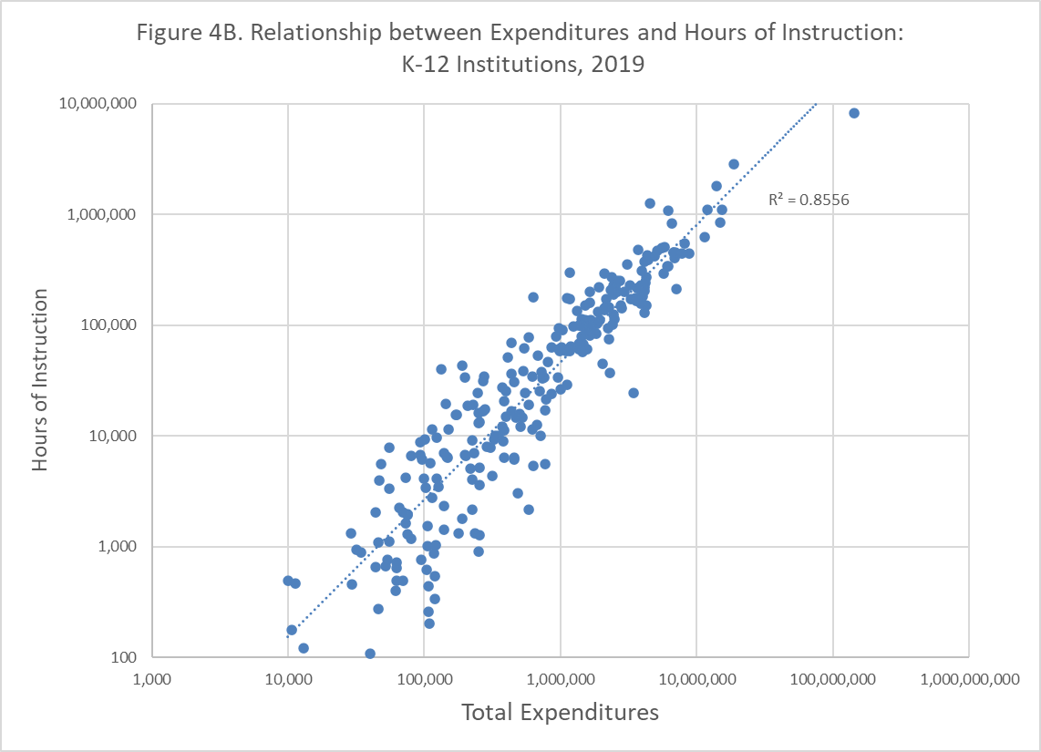
Results
Data quality
Notes:
These figures present the same data as Figure 4, but separately for community colleges and K-12 providers.

Slide 16
Results
Data quality
Notes:
Figure 5 shows this relationship between total expenditures and the total cost per hour for PY 2019. Overall, there is low correlation between unit costs and total expenditures. There may be many reasons why such a correlation is not seen.

Slide 17
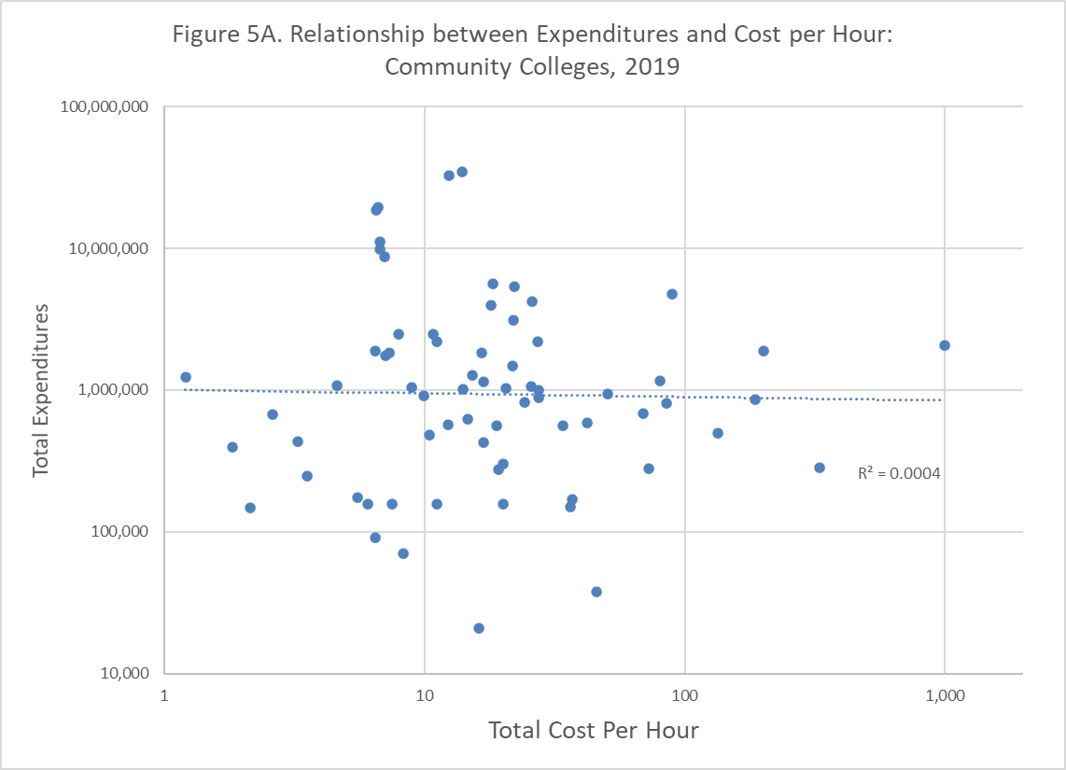
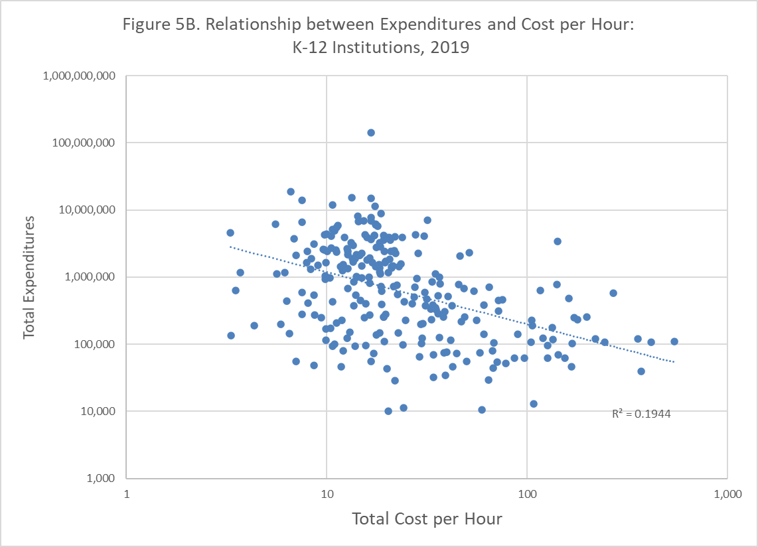
Results
Data quality
Notes:
These figures present the same data as Figure 5, but separately for community colleges and K-12 providers.

Slide 18
Results
Data quality
Notes:
Extreme values: It is possible that members responded to the report request (i.e., they reported a non-zero value for one or more reporting categories) but their reports reflect inordinately low values. This under-reporting would affect the data quality and could depress (in the case of expenditures) or inflate (in the case of hours) any unit cost data calculated from the reports. We reviewed the entries for very low values. The results are displayed in Table 7.
Year to year member consistency: If members are accurately reporting their hours and expenditures, then we would not expect to see many large differences in total expenditures or hours of instruction from 2018 to 2019, since there have not been large changes in available funding. We might still see expect to see large differences in particular programs or fund source categories, given changes to reporting policy and definitions, however. In order to examine this, variation percentages were computed for each member who had reported expenditures or hours of instruction in both years. The results of this are shown in Table 8. A substantial portion of the members had variation in reported expenditures or hours of instruction from one year to the next that was greater than 25 percent.

Slide 19
Recommendations:
The State CAEP Office should continue to investigate and where feasible, implement technical improvements to the NOVA reporting system in order to improve data quality. Suggested changes include:
  Standardize member names across reports. Matching the data from PY 2018 to PY 2019 at the member level required manually matching member names, since these names were spelled differently in the two report submissions.
  Prohibit report certification with zero entries. Twenty-one members submitted certified reports with zero entries for hours of instruction, and 14 members submitted certified reports with zero expenditures.
  Require consistency between hour and expenditure entries at the program level. It should not be possible to certify a report with hours of instruction in a program category but no expenditures, or expenditures but no hours of instruction.
  Link report requirements to records of fund availability at the member level and require reports to provide hours and expenditure data for funded programs in order to be certified.

Slide 20
Recommendations:
The State CAEP Office should continue to support consortia and members with training and technical assistance on the reporting policy and procedure, including best practices for allocating costs to leveraged fund sources.
The State CAEP Office should continue to work with consortia and members to gather input to make further improvements in policy and procedure in relation to the reporting process and use of the data.
The State CAEP Office should provide feedback to members on their reporting results, including unit cost estimates, prior to member submission of revised reports for PY 2019.
The State CAEP Office should consider options in addition to technical assistance to improve compliance with the reporting requirement, once the other recommendations have been implemented. This should include the addition of a review of the hour and expenditures report submission as part of periodic monitoring of members.

Slide 21
Questions and Discussion

