Slide 1
CAEP Fiscal Update
Neil Kelly – State CAEP Office
Veronica Parker – CAEP TAP

Slide 2
Agenda
Review Quarterly Expenditure Process
Review Closing Out 17-18 funds
Allocations for 20-21
COLA
CFAD Submission
Allocation Amendment Process
NOVA Basics/Reminders
Wrap Up & Additional Questions

Slide 3
Review Quarterly Expenditure Process
Submitted quarterly by members in NOVA.
District accounting office has reviewed expenses and approves submission.
Consortium reviews member submission to see if it aligns with 3 year plan, annual plan, and approved member budget.
Member annual plan and budget have to be certified before submitting any quarterly expense report in NOVA.

Slide 4
FAQs for CAEP Quarterly Expense Reporting
Q: I have input my member expenses in NOVA, but it won’t let me submit?
A: Check to see if all members have submitted their expense reports in the prior quarter, and if the consortium has certified. You can’t move into the next quarter unless the prior quarter is certified.
Q: NOVA won’t let me submit because my expenditure fell below target. How do I fix that?
A: The member can submit a corrective action plan in NOVA stating how they will meet expenditures targets.

Slide 5
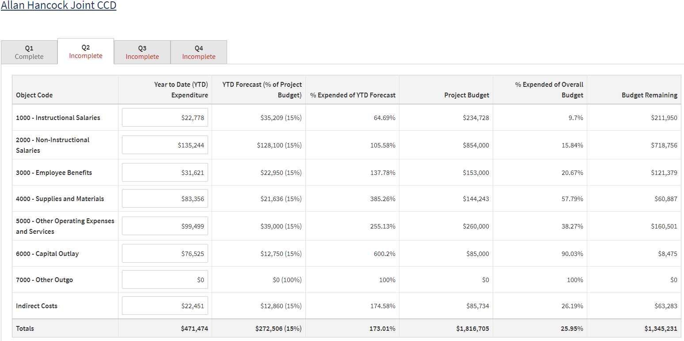
Quarterly Expenditure Process

Slide 6
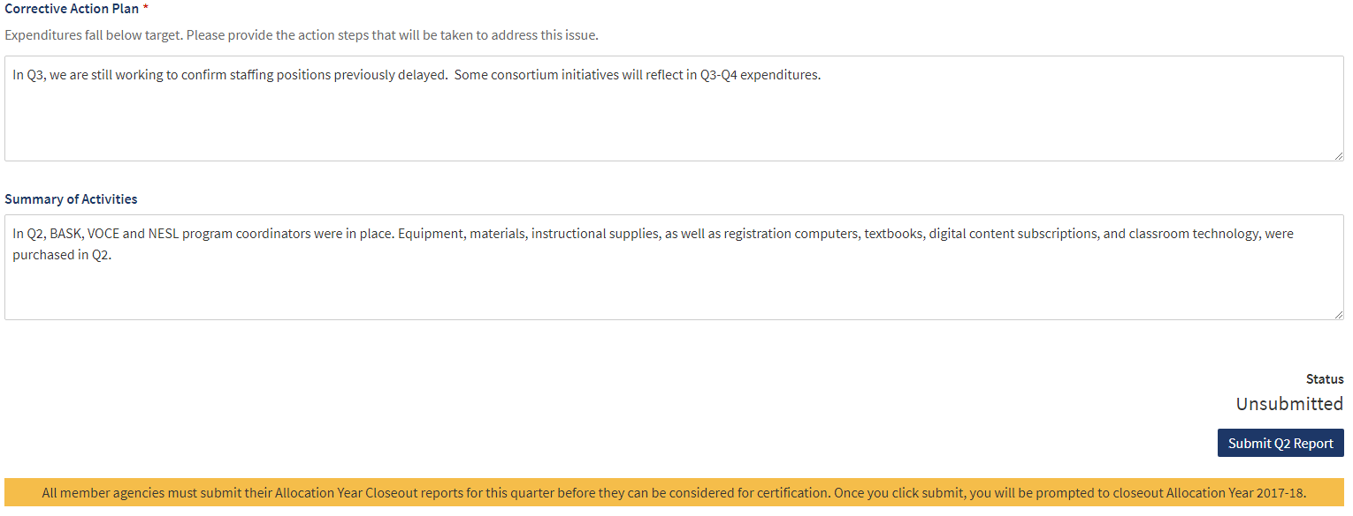
Quarterly Expenditure Process

Slide 7
Quarterly Expenditure Process

Slide 8
Review Closing Out 17-18 funds
The Life of a CAEP Dollar…..
CAEP funds have a 30 month life – beginning on July 1 of Year 1, and ending on December 31, of Year 3.
July 1 to June 30 = Year 1 (State must allocate all funds in Year 1)
July 1 to June 30 = Year 2
July 1 to December 31 = Year 3
January 1 to June 30 (close out process) = Year 3
January/February – member begins close out process
March 1 – member certifies all 17-18 funds have been spent (and submits Q2)
March 30 – consortium certifies Q2
April/May – State closes books (or if remaining balances request funds back)
June – End of fiscal year

Slide 9
Review Closing Out 17-18 funds (cont.)
Members must follow their 3 year & annual plan, and their approved budget by the consortium when spending down funds.
NOVA tracks CAEP funds over a 30 month life span – in a FIRST IN / FIRST OUT methodology.
Meaning you must spend down all “old money” first before expenses will “hit” any “new money”.
Carrying over money into the next fiscal year could have consequences – check your local by-laws.
Any remitted 17-18 funding will be returned to the State General Fund.

Slide 10
FAQs for CAEP Close Outs
Q: My member needs more time to finalize their close out report in NOVA? What do I do?
A: The consortium has until March 31 to certify Q2 and close outs. Work with your members to provide them additional time, and allow for consortium review & certification within the March 31 deadline.

Slide 11
FAQs for CAEP Close Outs
Q: My member’s accounting office asked if expenditure close outs include encumbrances rather than expenditures?
A: All CAEP activities related to 17-18 funds ended on 12/31/19. The close out report must include all confirmed expenditures. We cannot allow for open purchase orders or encumbrances for close out certification. Please have them contact TAP if they have questions.

Slide 12
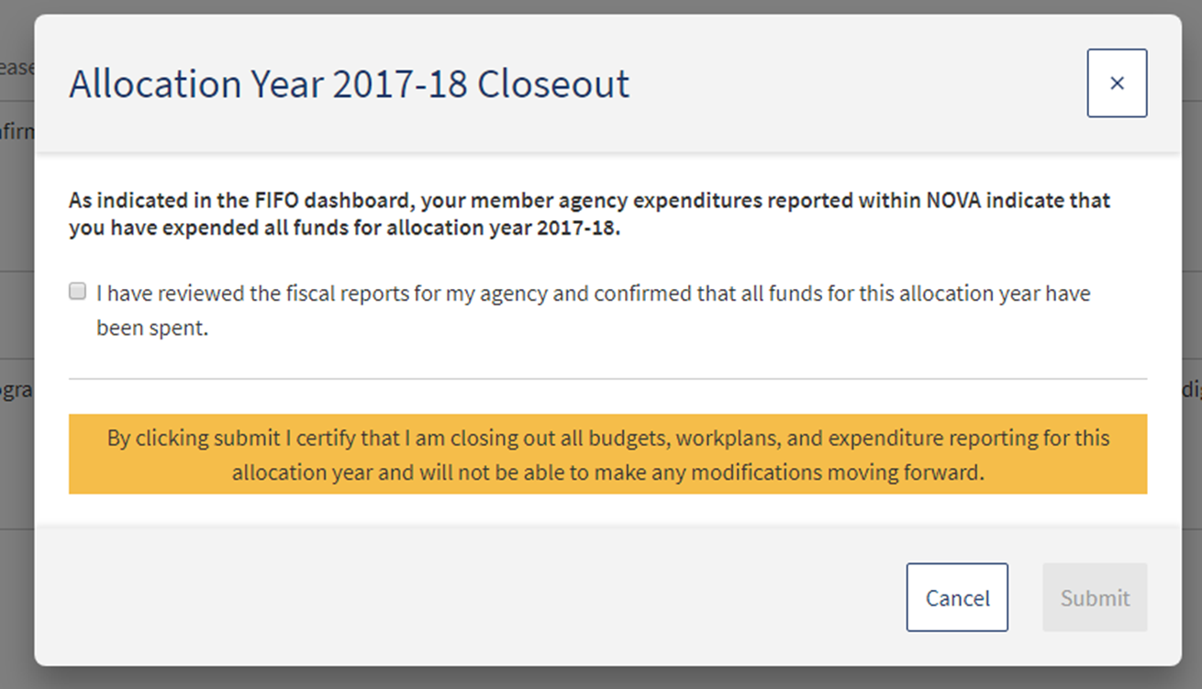
2017-18 Close Out

Slide 13
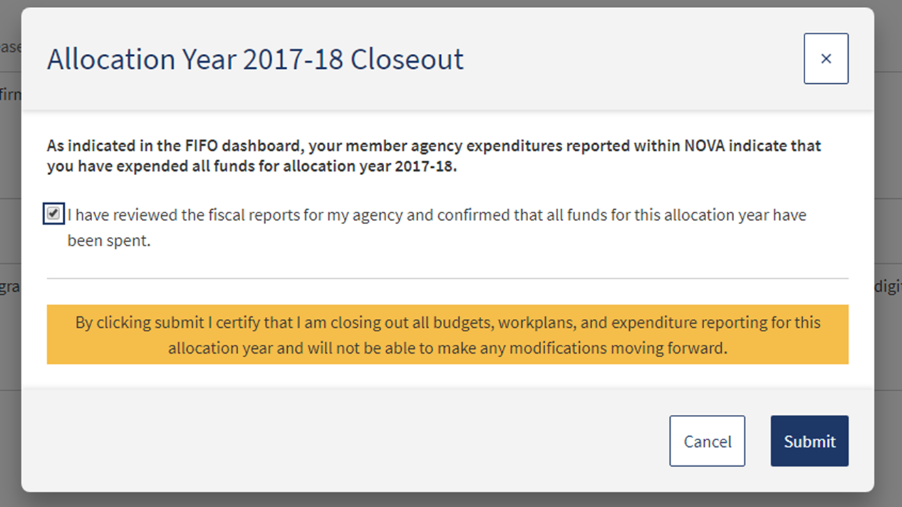
2017-18 Close Out

Slide 14
2017-18 Close Out

Slide 15
CAEP 2020-21 Allocations
Governor’s Proposed Budget for 20-21 was released in January 2020.
CAEP Preliminary Allocations for 20-21 were released late Feb. 2020.
Preliminary Allocations for 20-21 will be posted in NOVA March 2020.
20-21 CFADs will be due in NOVA by May 2, 2020.
Governor’s Budget approved by July 1, 2020 *.
CAEP funds are released by August 2020 (in 11 installments) thru May **
*May Revise reductions/additions could affect schedule
**CDE/Chancellor’s Interagency agreement needs to be approved.

Slide 16
CAEP 2020-21 Allocations (cont.)
CAEP received a 2.29% or $12.3M COLA in the Governor’s proposed
budget for 20-21.
The new CAEP base for 20-21 will be $550,897,000.
All members are eligible for the COLA.
The COLA will be based on the member’s allocation percentage from the prior year's CFAD.
Consortia cannot vote to exclude or prevent a member from receiving a COLA (provided that the member received funding in the prior year).

Slide 17
EC 84914 – Increase/Decrease Allocations
(b) (1) For any fiscal year for which the chancellor and the Superintendent allocate an amount of funds to the consortium greater than the amount allocated in the prior fiscal year, the amount of funds to be distributed to a member of that consortium shall be equal to or greater than the amount distributed in the prior fiscal year, unless the consortium makes at least one of the following findings related to the member for which the distribution would be reduced:
(A) The member no longer wishes to provide services consistent with the adult education plan.
(B) The member cannot provide services that address the needs identified in the adult education plan.
(C) The member has been consistently ineffective in providing services that address the needs identified in the adult education plan and reasonable interventions have not resulted in improvements.

Slide 18
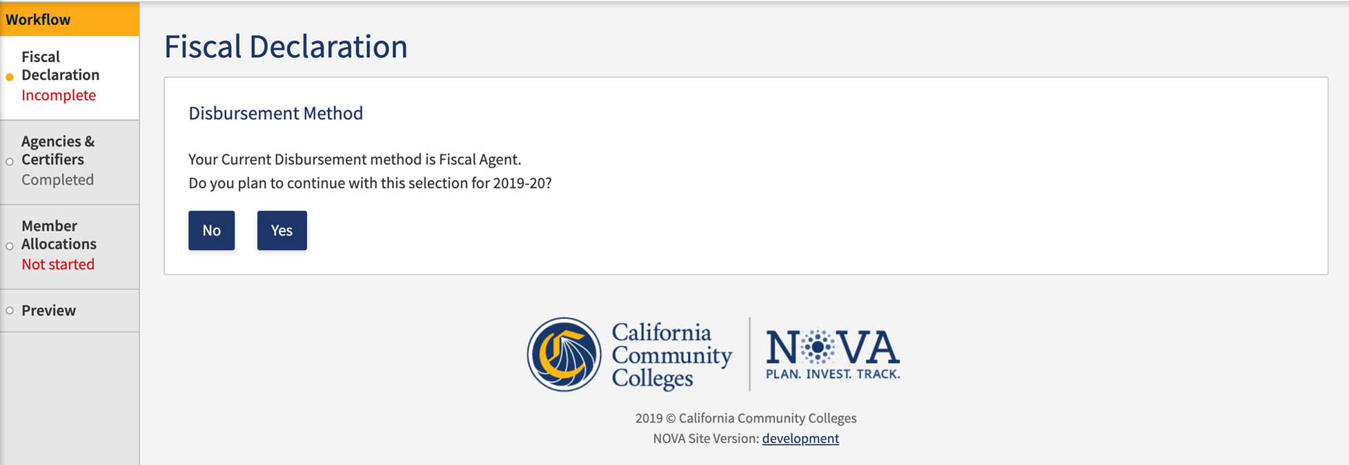
CFAD Process

Slide 19
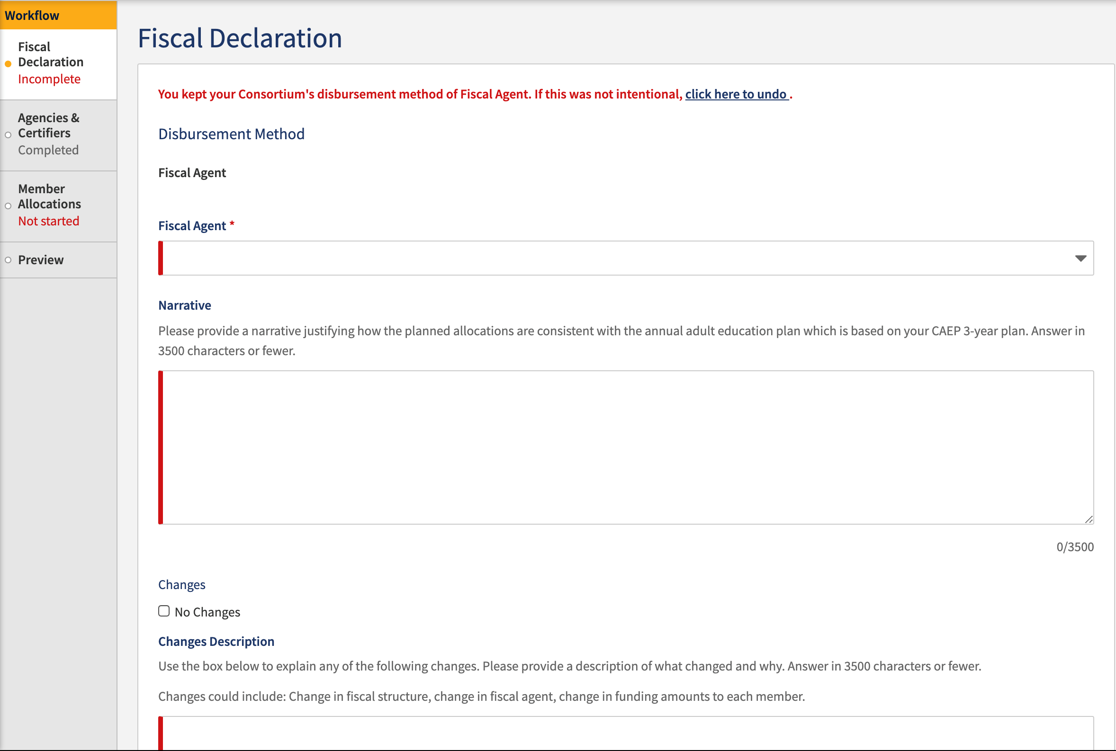
CFAD Process

Slide 20
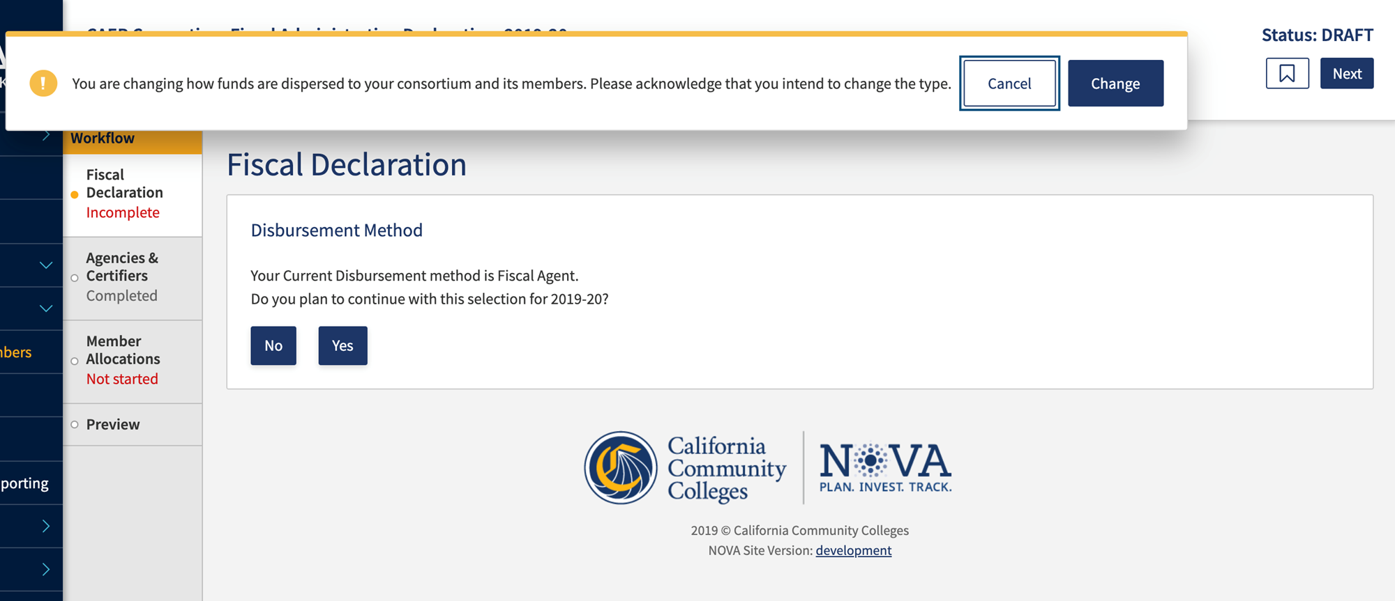
CFAD Process

Slide 21
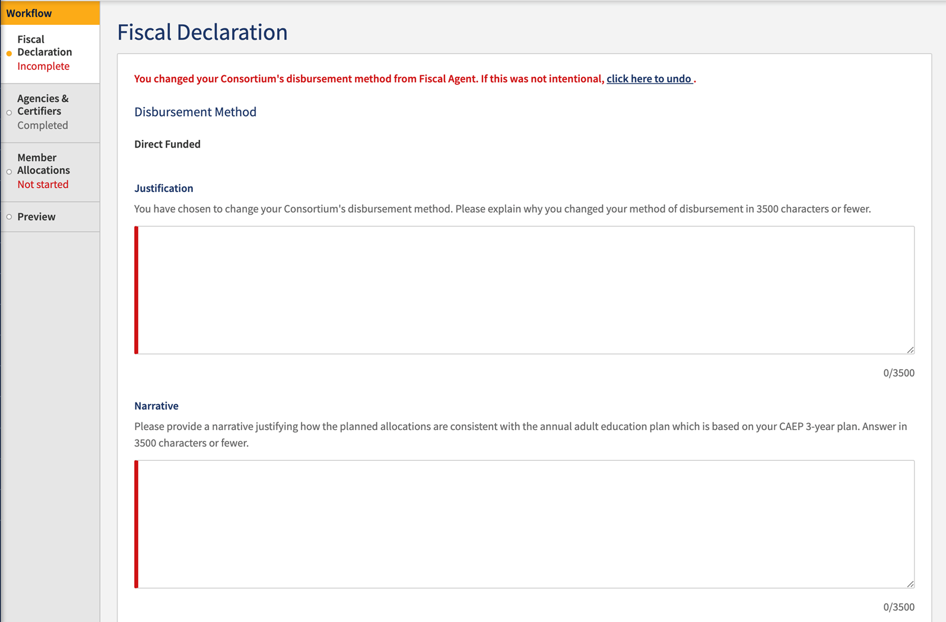
CFAD Process

Slide 22
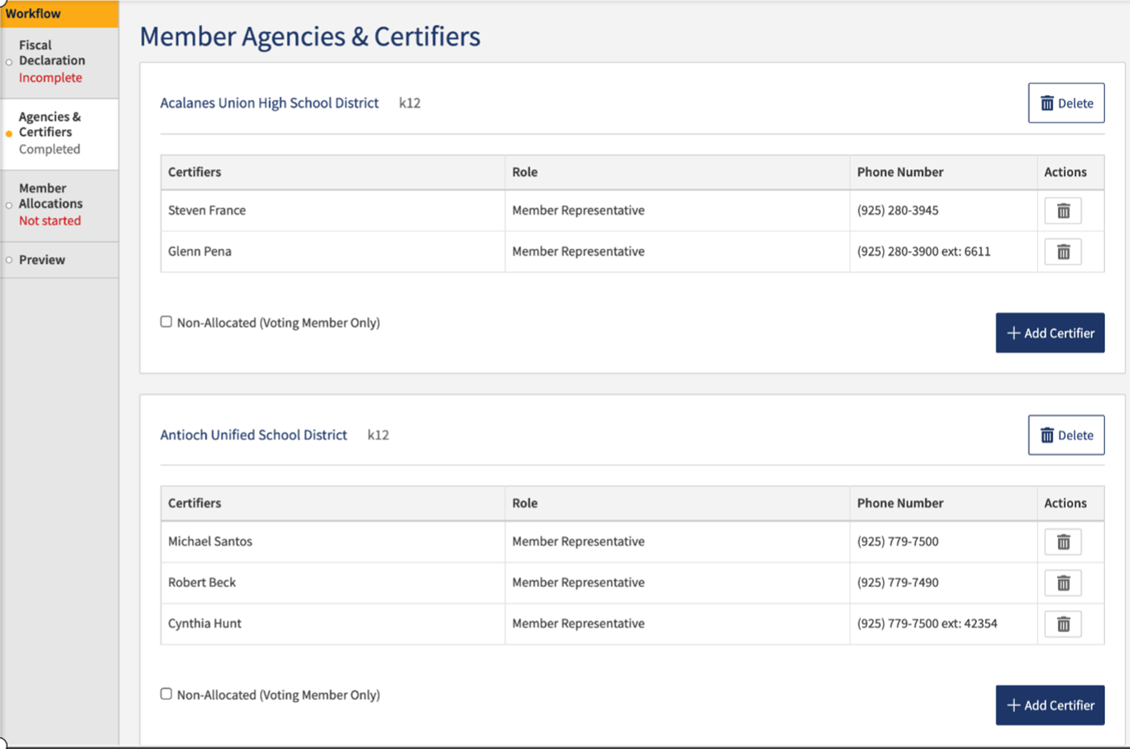
CFAD Process

Slide 23
CFAD Process

Slide 24
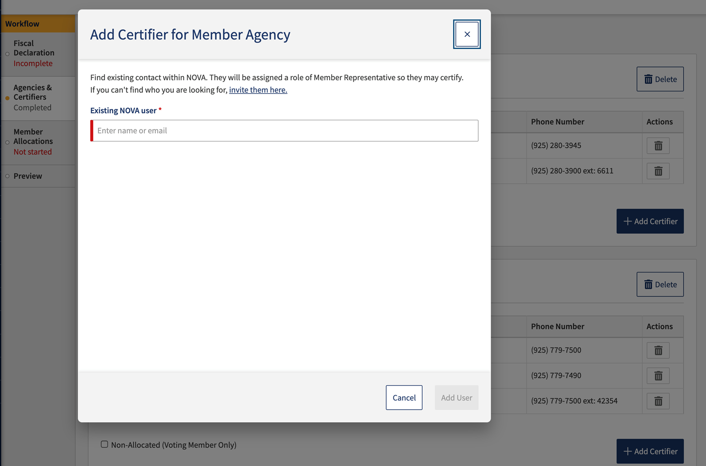
CFAD Process

Slide 25
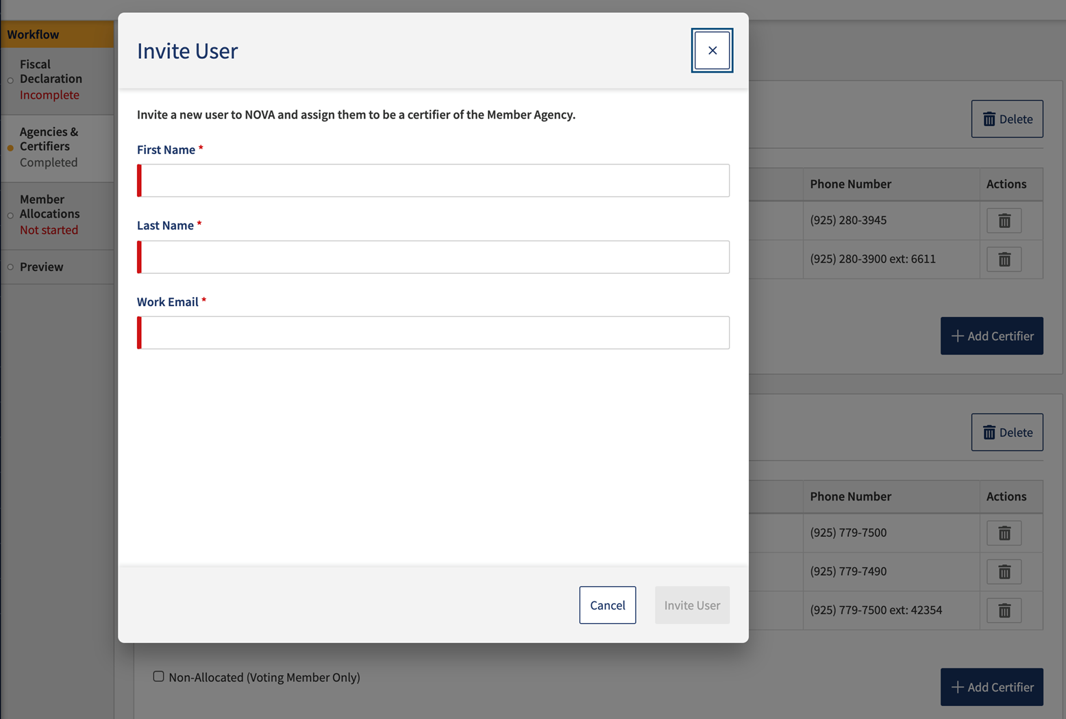
CFAD Process

Slide 26
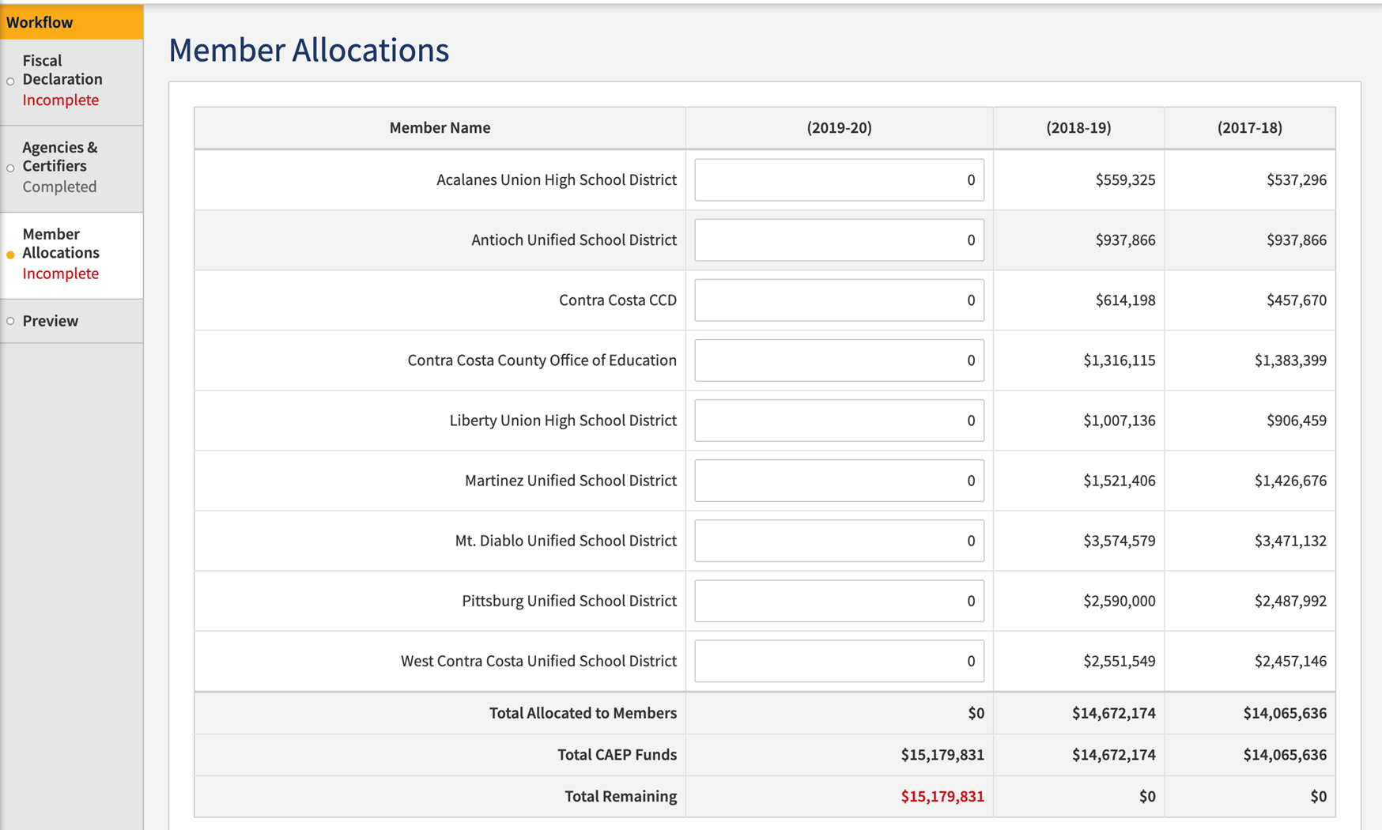
CFAD Process

Slide 27
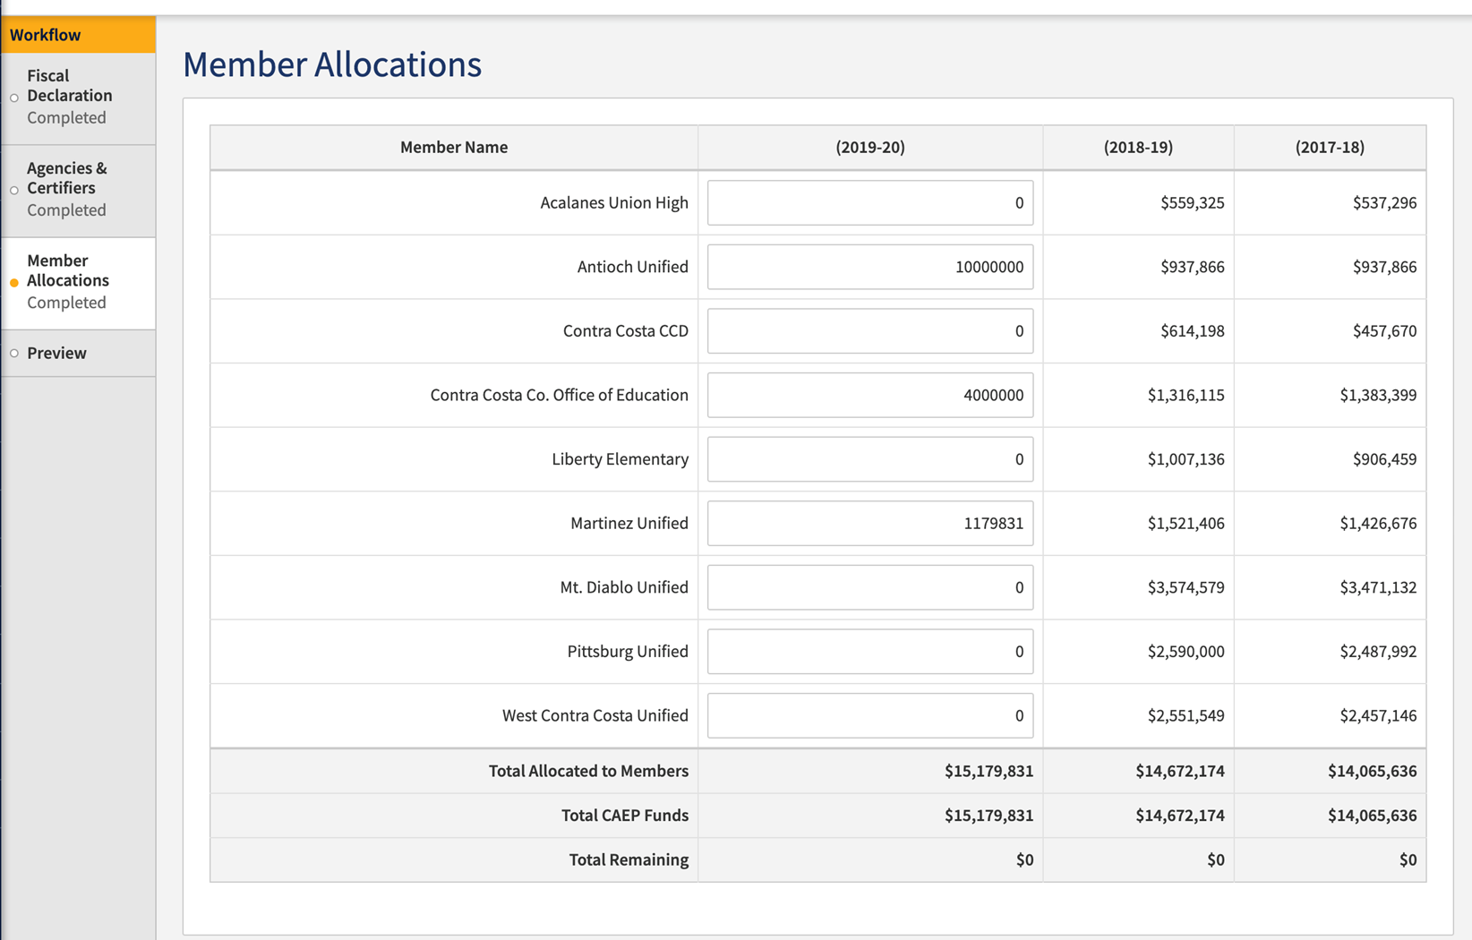
CFAD Process

Slide 28
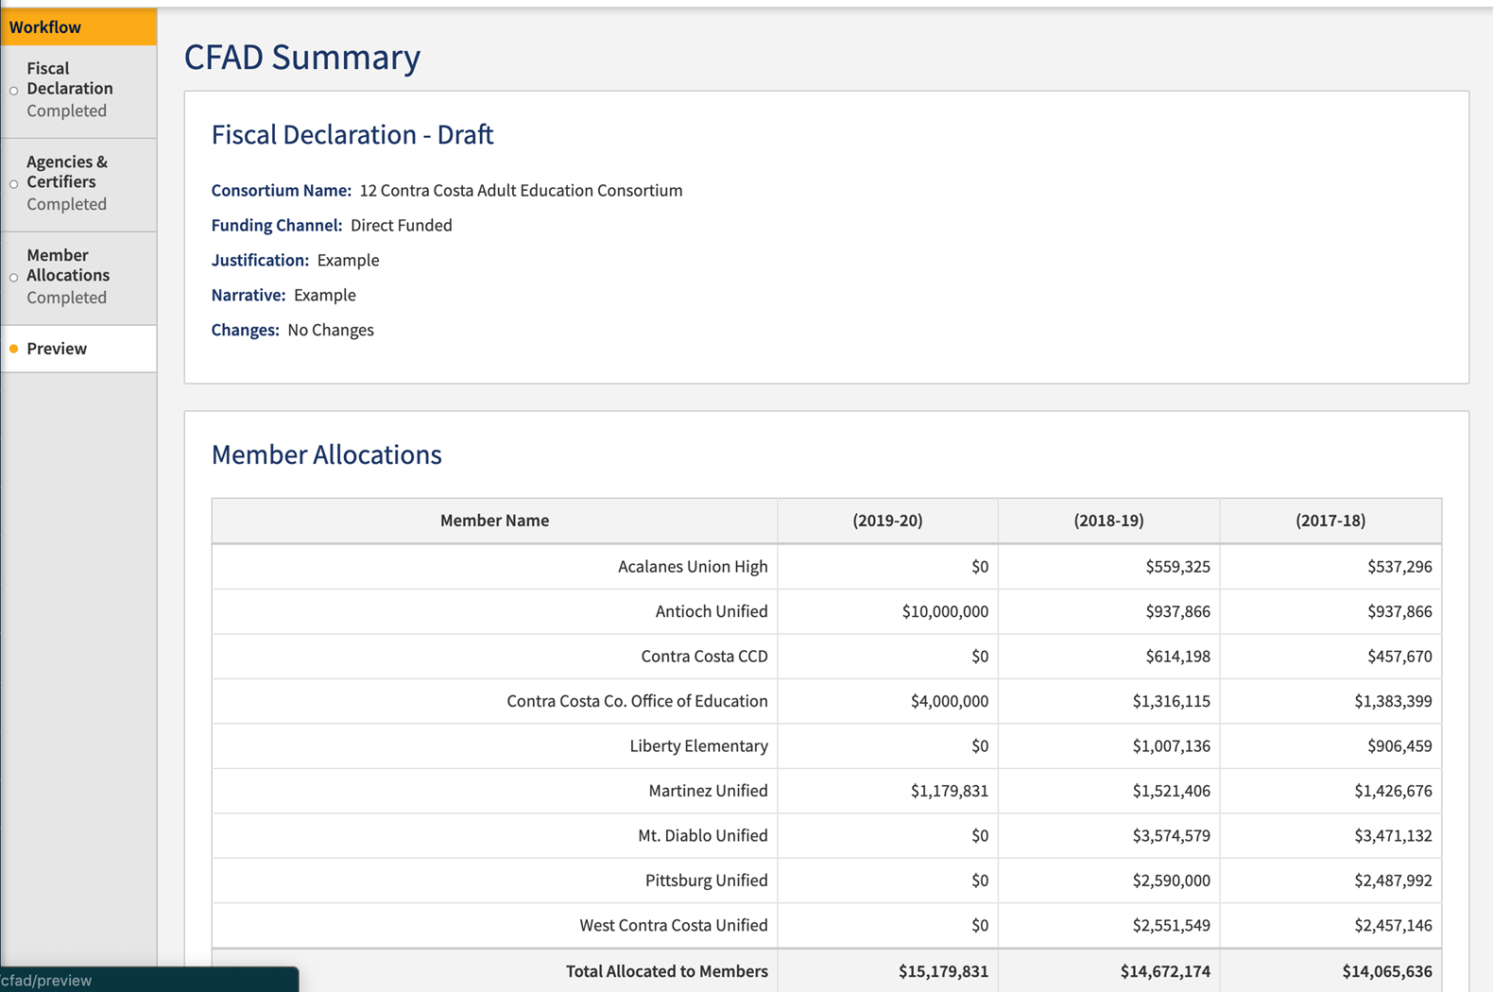
CFAD Process

Slide 29
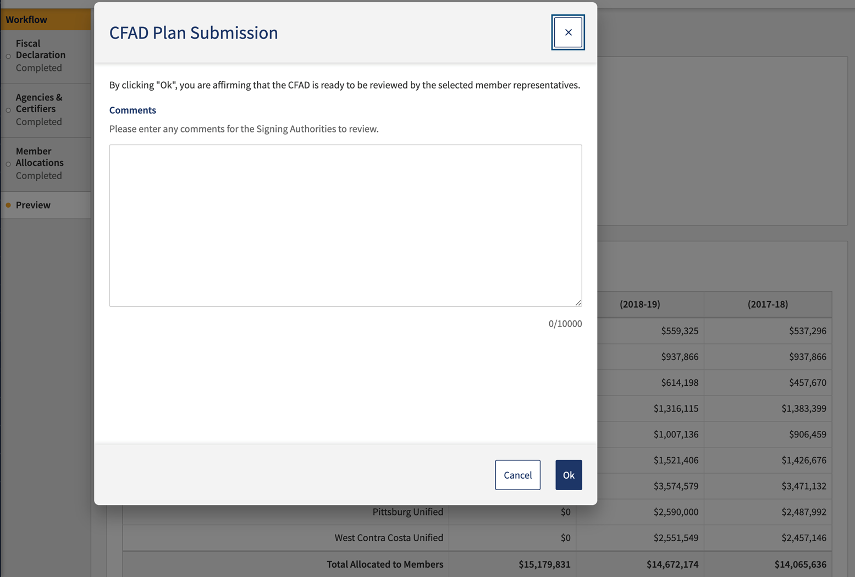
CFAD Process

Slide 30
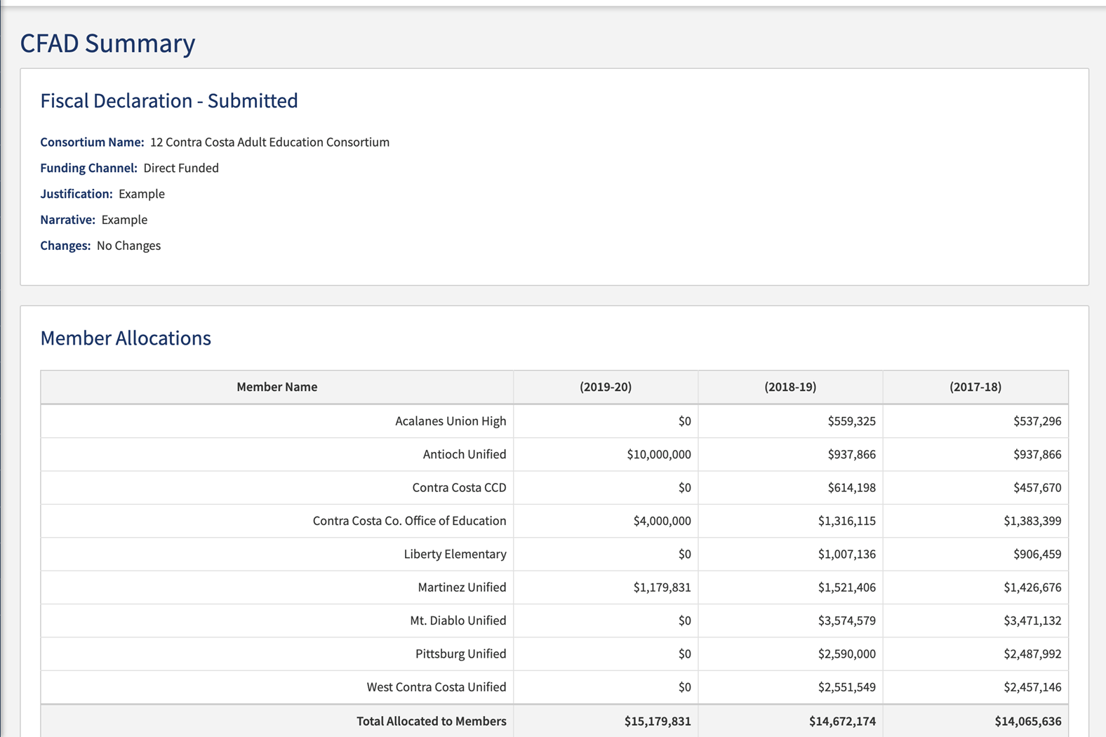
CFAD Process

Slide 31
CFAD Process

Slide 32
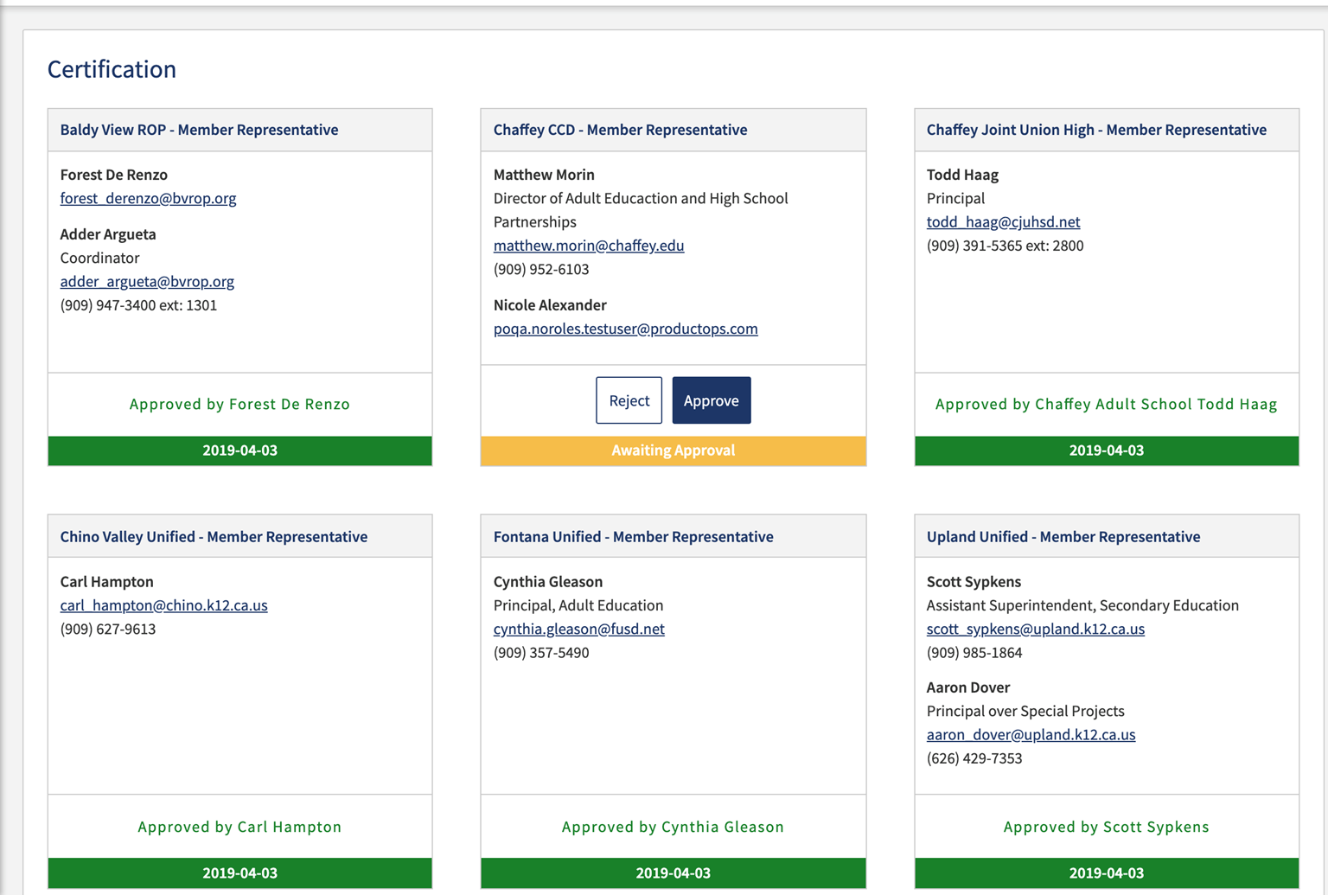
CFAD Process

Slide 33
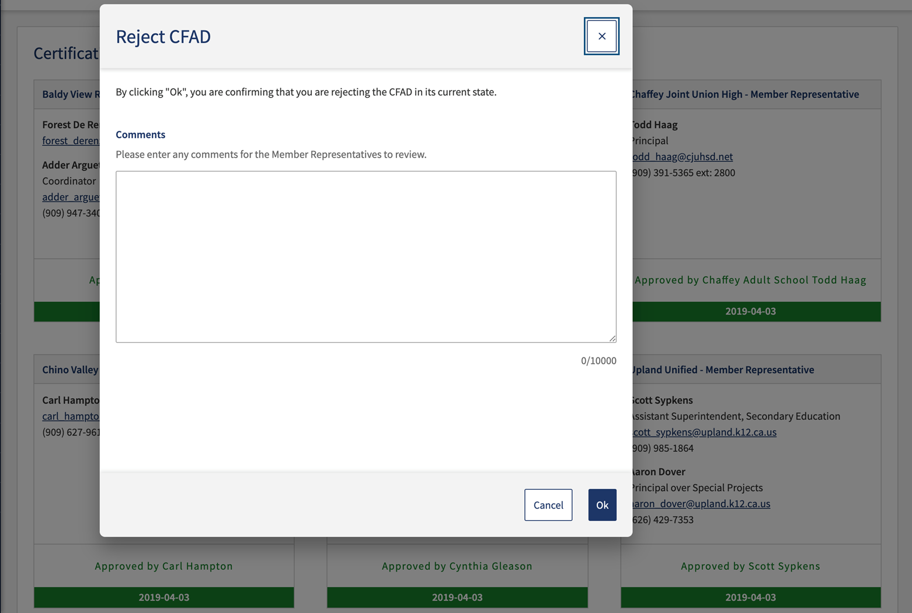
CFAD Process

Slide 34
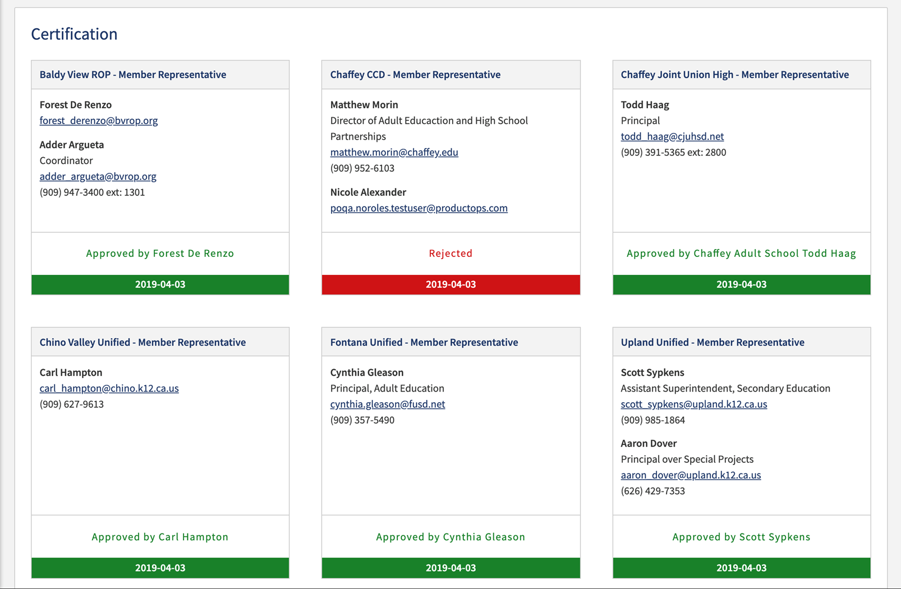
CFAD Process

Slide 35
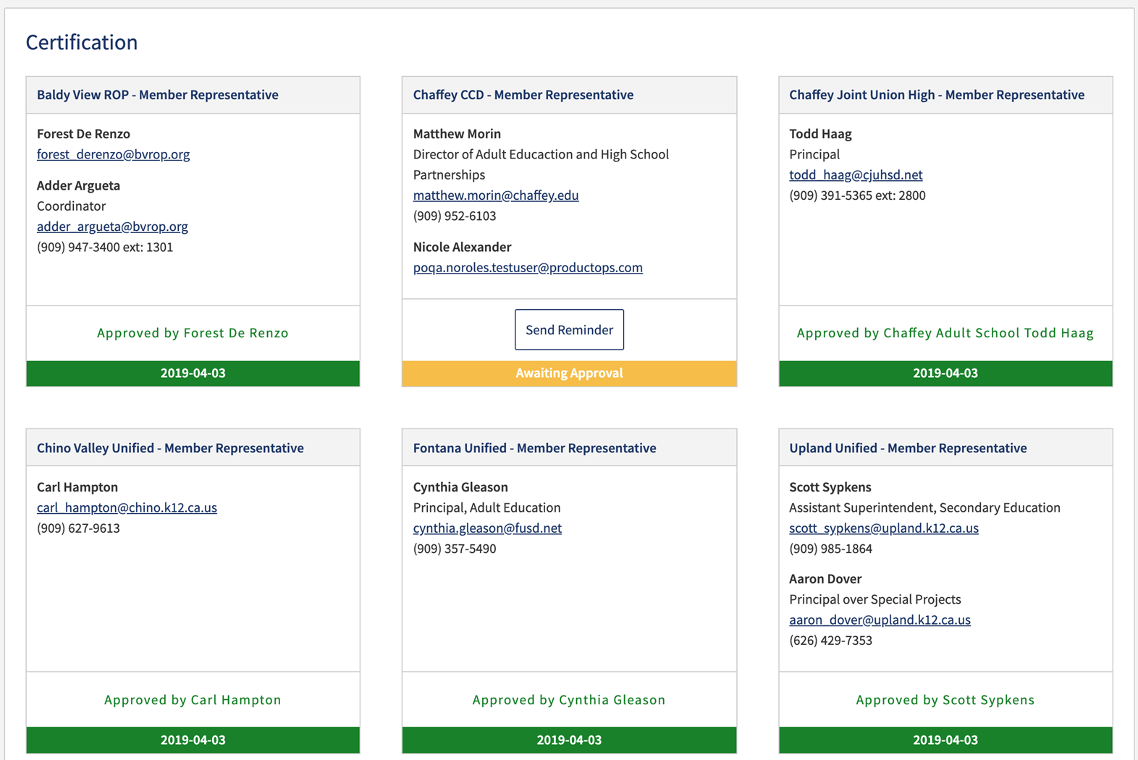
CFAD Process

Slide 36
Allocation Amendment Process
Allocation Amendments are a reallocation process in NOVA after the CFAD has been certified.
Must be approved/certified by all members in NOVA.
Allocation amendments do not affect your prior year allocation, and doesn’t impact future allocations.
Just a in-year reallocation of funds.
Some consortia have by-laws to support this process.
To impact future allocations, members must fall under the three criteria under EC 84914.

Slide 37
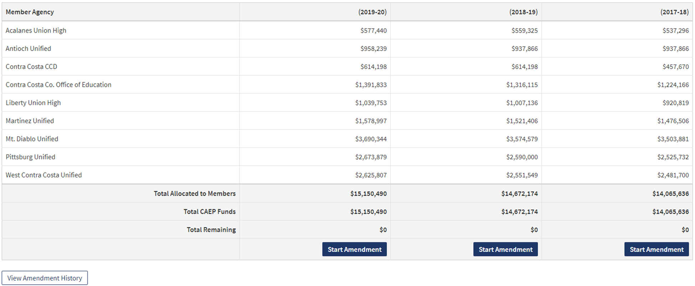
Allocation Amendment Process

Slide 38
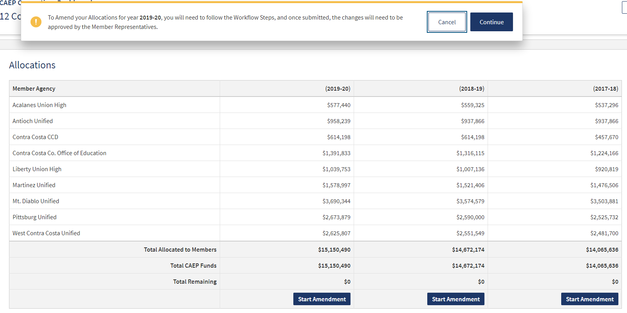
Allocation Amendment Process

Slide 39
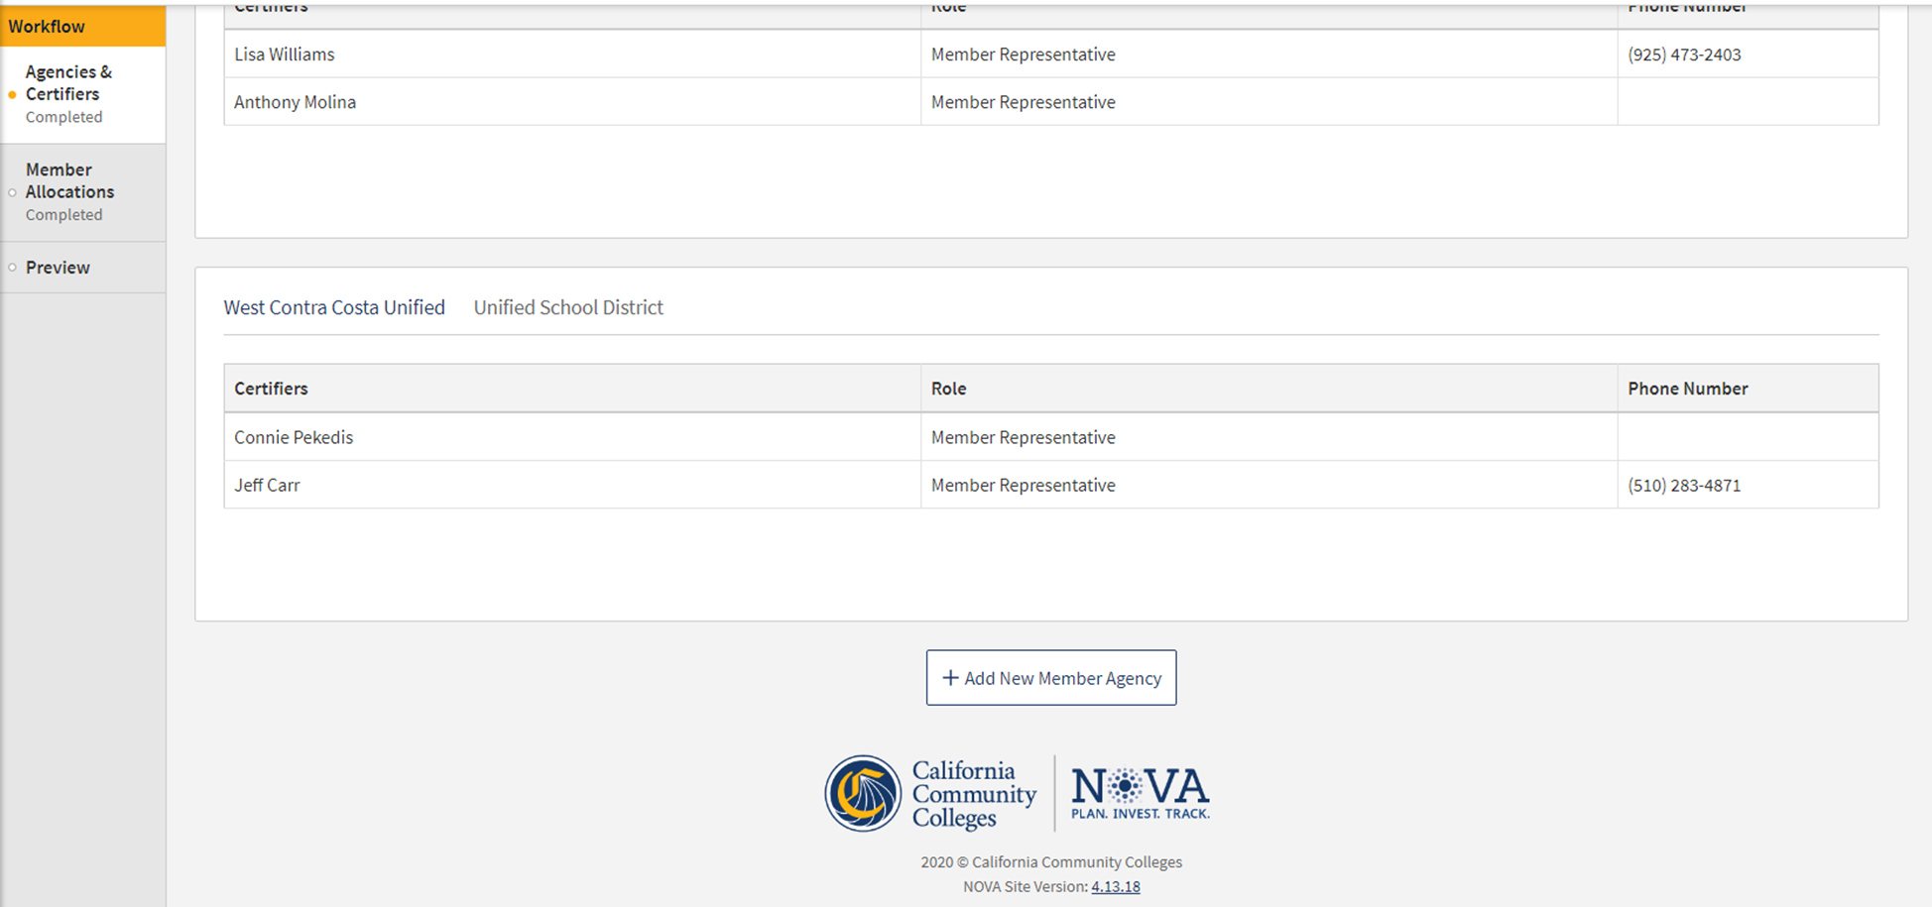
Allocation Amendment Process

Slide 40
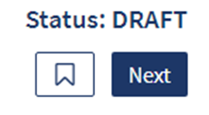
Allocation Amendment Process

Slide 41
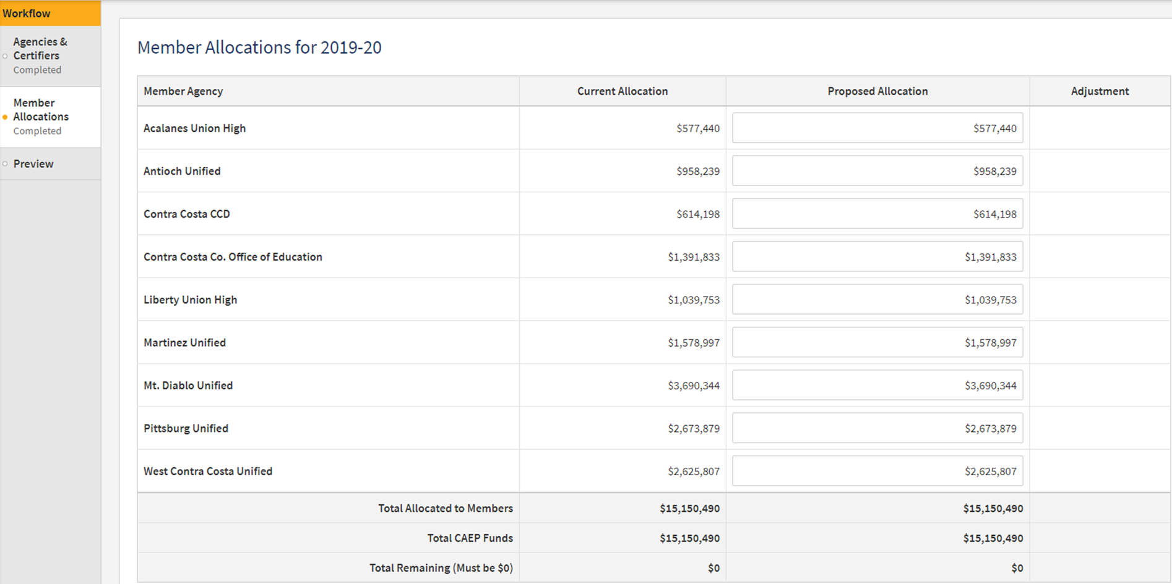
Allocation Amendment Process

Slide 42
Allocation Amendment Process

Slide 43
Allocation Amendment Process

Slide 44
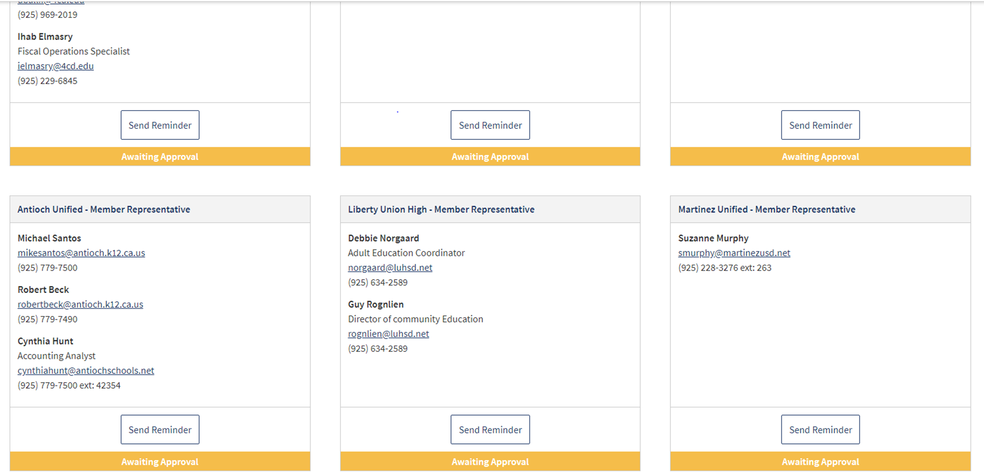
Allocation Amendment Process

Slide 45
NOVA Reminders
How to add a new member
How to update a consortium lead change
Training Resources for NOVA
How to request NOVA technical assistance
Others??????

Slide 46
Wrap Up and Questions

Slide 47
Request Support from CAEP TAP

