Slide 1
Recording CAEP Attendance Hours
November 10, 2020

Slide 2
CAEP Attendance Hours
COVID – 19’s effect on Adult Education and End of Year Data Reporting
Review of Distance Learning Considerations
Creating Classes
Recording Instructional Hours
CAEP Outcomes
Resources
Attendance Hours Examples

Slide 3
COVID-19’s Effect on CAEP Agencies
With most agencies closed for COVID-19, many agencies are quickly adapting to implementing distance learning options.
OTAN has a resource page that provides help to agencies responding to COVID-19.
https://otan.us/resources/covid-19-field-support/
For EOY reporting, CAEP agencies should continue to follow the CAEP beginning of year letter for PY 2019-20.

Slide 4
Distance Learning - OCTAE
On March 27, OCTAE disseminated Memorandum 20-3
Posted on CASAS Website: https://www.casas.org/social-media-newsroom/2020/03/27/casas-testing-during-the-covid-19-pandemic
Updated memos 20-4 (April 17, 2020) and 20-5 (May 29, 2020)
https://www2.ed.gov/policy/adulted/guid/memoranda.html

Slide 5
Distance Learning – OCTAE
Summary of OCTAE Memos:
Statewide performance reporting to the NRS is still required
For PY 2019-20 all states must report “Force Majeure”
States can now decide whether or not to allow remote testing
Each state that opts to allow remote testing submits its own remote testing plan to OCTAE
Memo 20-5 (5.29): participants can self-report into a federal EFL (Educational Functioning Level) without a pretest.
Memo 20-5 (5.29): a pretest is still required to achieve a pre/post-test MSG.

Slide 6
Distance Education
Distance Learning - NRS
Distance Education—Formal learning activity where students and instructors are separated by geography, time, or both, for the majority of the instructional period.
Distance learning materials are delivered through a variety of media, including but not limited to, print, audio recording, videotape, broadcasts, computer software, Web-based programs, and other online technology.
Teachers support distance learners through communication by mail, telephone, e-mail, or online technologies and software.
(Pg. 59 NRS Technical Assistance Guide, https://nrsweb.org/sites/default/files/NRS-TA-Guide82019.pdf )
Notes:
Instructional period – this is the length of the COURSE (I.e. full year, 18 week semester, 9 week, 6 week summer course.
Resources: from the CASAS California Adult Education Accountability and Assessment:
https://www.casas.org/training-and-support/casas-peer-communities/california-adult-education-accountability-and-assessment

Slide 7
Distance Learning - NRS
Individuals in Distance Learning programs have the same data collection requirements as other WIOA, Title II learners.
NRS policy prescribes the “50 percent rule.”
For learners with more than 50%, agencies should mark Special Programs = Distance Learning
A new feature is now in TE that tracks students with PY 2019-20 activities affected by COVID-19 (“Force Majeure”)

Slide 8
Distance Learning – Class Strategies
Calculating this at the class level for each agency depends on how your agency has structured classes in response to COVID-19.
  “Pick up where you left off.”
  Start new classes specific to DL.

Slide 9
Distance Learning – Class Strategies
“Pick up where you left off.”
If your agency is continuing classes as scheduled, but just changing the delivery method to a distance learning context because of COVID-19 – then calculate whether or not 50%+ of the instruction overall is in a distance learning format.

Slide 10
Distance Learning – Class Strategies
“Start new classes specific to DL.”
If you are now offering distance learning, and starting this activity as new classes, with a new group of students – then create the new class(es) in TE with the new Start Date.
You may want to optionally label these with a specific title to distinguish them from other classes.
For these newly created classes, mark Special Programs = Distance Learning.
For the classes that existed prior to COVID-19, leave them as “regular” (not Distance Learning) classes.

Slide 11
Distance Learning – NRS
Three models of measuring distance learning instruction (NRS):
Clock Time. Assigns contact hours based on the elapsed time that a participant is connected to, or engaged in, an online or stand-alone software program that tracks time.
Teacher Verification. Assigns a fixed number of hours for each assignment based on teacher determination of the extent to which a participant engaged in the assignment.
Learner Mastery. Assigns a fixed number of hours of credit based on the participant completing content of each lesson.

Slide 12
Distance Learning – NRS
California has historically used the “Proxy – Learner Mastery” model to document hours in distance learning programs.
The student is credited hours of instruction for completing an assignment (such as an instructional video or educational software lesson) rather than a set block of clock time.
Agencies can vary their approach to hours based on specific delivery model.

Slide 13
Distance Learning – Hours of Instruction
Facilitated online instruction can be recorded the same as “regular” instruction. (Clock time)
For educational software applications, the recommendation is to pre-assign a number of hours to each lesson or module. (Learner mastery)
There are three general approaches useful for determining “proxy” hours from educational software.

Slide 14
Distance Learning – Hours of Instruction
What if the facilitated instruction received online is recorded – and a student watches the recording instead of the “live” presentation?
Agencies can decide this as a team whether or not to allow this as hours of instruction.
If allowed – then assign the time that equates with the time assigned to the “live” presentation. Mark “Distance Learning” in TE for those over 50% DL.
Whatever the agency decision - record this policy in detail in the Local Assessment Policy.

Slide 15
Distance Learning – Hours of Instruction
How do we record hours of instruction accurately when students complete lessons using educational software (a few examples are Odysseyware, Aztec, and Burlington English).
The most common technique to document instructional hours is to tabulate “proxy” hours assigned for learner completion of each module. (Using Learner Mastery)
Contact your software publisher for recommendations and best practices.

Slide 16
Distance Learning – Three Approaches to “Proxy” Hours
With software applications that include a time pre-programmed for each lesson or module, use the hours recorded from the software.
For applications not linked to a specific time frame, but provide a recommended time for student completion – follow the educational software publisher’s recommendation.
If the software publisher does not provide recommended times for completion – meet as an instructional management team, determine the amount of time students spend on each module, and document that in your agency’s Local Assessment Policy.

Slide 17
General Guidelines for DL Hours
Contact your instructional software publisher for guidance on hours. If the application does not embed hours-related information into the software, the vendor may have information that may guide you in determining these totals.
The recommended hours you record for each student should reflect an “average” number of hours that the instructional team agrees on – and should NOT be determined by only one person.

Slide 18
General Guidelines for DL Hours
If your agency prefers to assign hours on an individual student basis, and not use the “proxy” hours method, that is permissible. Explicitly state that your agency is using this method in your Local Assessment Policy.
To assign hours by student, more vigilant observation from instructional staff is needed to ensure an accurate amount of instruction is assigned to each student, and reflects the level of effort each student gives during each instructional session.
More detailed description of this process is needed in the agency’s Local Assessment Policy.

Slide 19
Distance Learning – Recording in TE
TE now has the capability to record exactly which hours are received via distance learning versus which hours are received in a “regular classroom.”
This enables agencies to track and specify distance learning hours vs. hours from the “regular classroom.”
Instructions for recording distance learning hours in TE are posted on the same Webpage as the recent FAQ document.

Slide 20
Distance Learning – Recording in TE
TOPSpro Enterprise (TE) has the capability to record exactly #hours received via distance learning vs #hours received face-to-face in a “regular classroom.”
And… if you pre-define the default number of minutes/day for DL instruction… TE will pre-load the attendance input screen.
Pick a Class instance → Edit > Intensity
  1. “DL Interface Setting” (Yes/No=default)
  2. “Distance Learning Duration (Minutes)” (fill in the value)
Notes:
Trick: Build 70 (Dec. 2019)

Slide 21

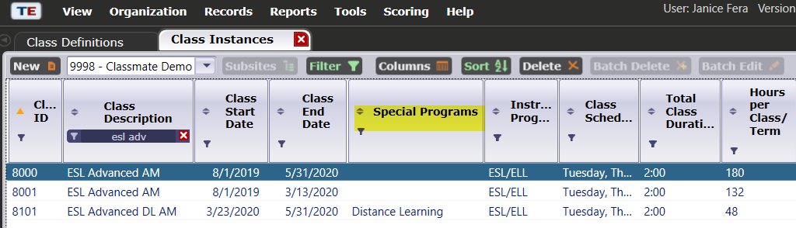
Distance Learning - Recording in TE
Let’s setup Class #8101 for easier data entry of DL attendance…

Slide 22
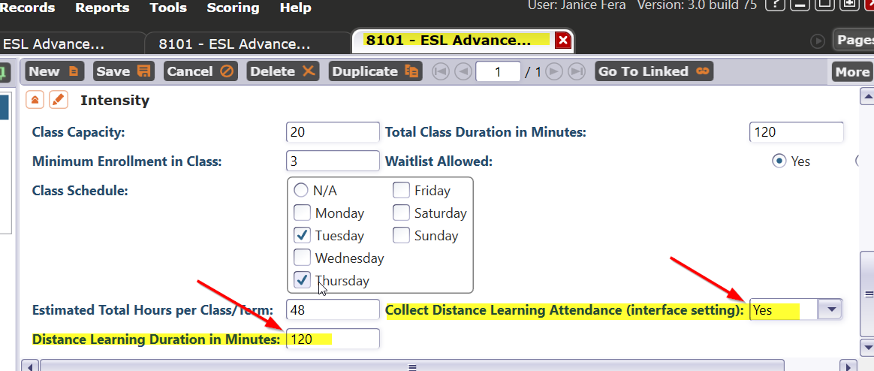
Distance Learning - Recording in TE
Specify the default #minutes of DL instruction and set the DL Attendance flag = YES
Click <SAVE>
Notes:
(1) It’s ALL DL, so DL Duration is the same as Total Class Duration
Remember this “120 minutes”
(2) Use interface for ANY of your classes (“pick up where you left off”)

Slide 23
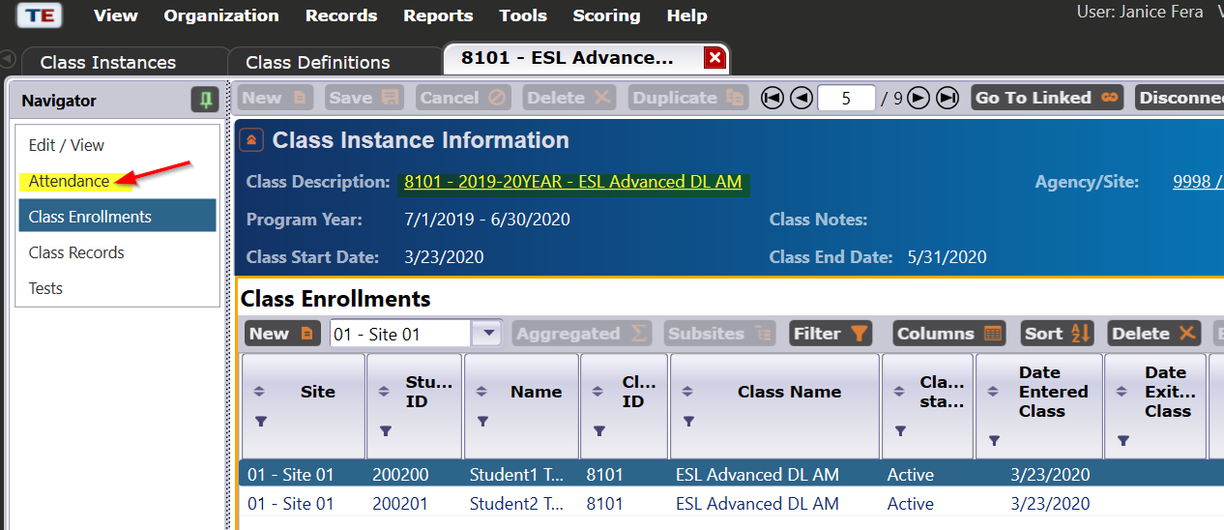
Distance Learning - Recording in TE
Done! Now let’s input attendance…
Notes:
… now let’s input attendance

Slide 24
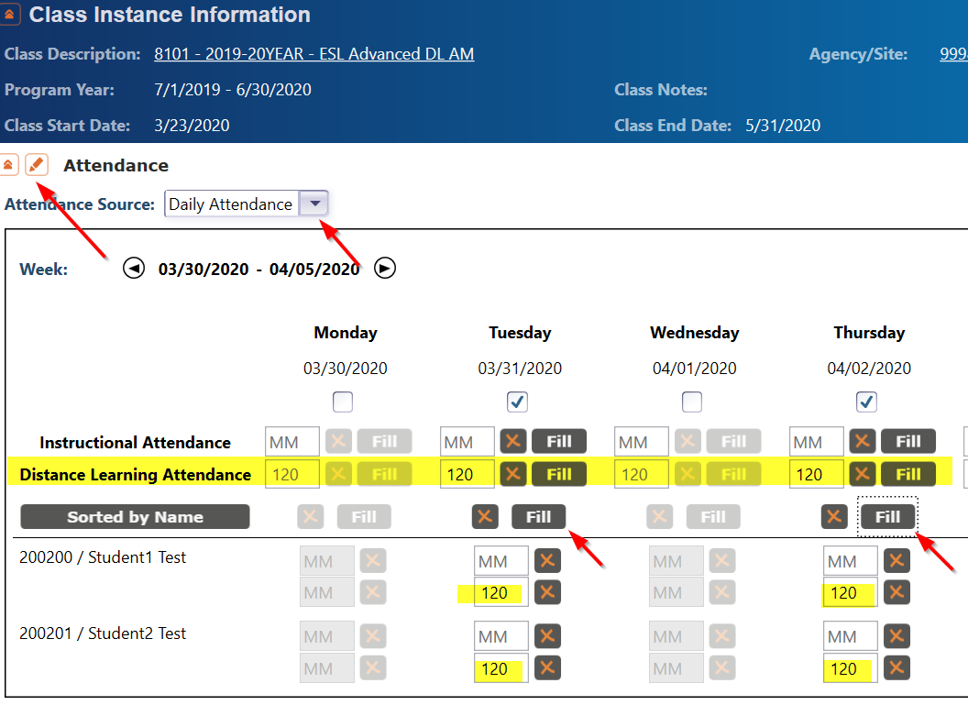

Distance Learning - Recording in TE
Notes:
Two different types of attendance in TE
..what about attendance entered in a 3rd party (Peoplesoft, ASAP, CANVAS, etc)

Slide 25
Outcomes & Resources

Slide 26
CAEP Outcomes
Literacy Gains
HSE/HS Diploma
Post-Secondary
Enter Employment
Increase Wages
Transition
Pre/Post Level Completion
Carnegie Units /HS Credits
CDCP Certificate
Occupational Skills Gain
Workforce Preparation
High School Diploma
Passed GED
Passed HiSET
Passed TASC
College Degree – AA, AS, BA, BS
Graduate Studies
Training Credential
Occupational Licensure/Certificate
Apprenticeship
Get a Job
Retain a Job
Enter Military
Increase Wages
Get a Better Job
Transition to ASE
Transition to Post-Secondary/CTE
Transition to Post-Secondary/College

Slide 27
Literacy Gains – CTE Related Outcomes
Occupational Skills Gain:
Usually suggests accomplishment of a portion of a longer term program
  For example: a student enrolls in a long term welding program in CTE, which is five semesters/five modules long. The student passes a skills check/written test that indicates the student is ready to finish Module I and enroll in Module II.
Workforce Prep Outcome:
Usually suggests completion of a shorter term program
  For example: a student enrolls and completes a 15 hour instructional module on job search strategies. The student earns documentation such as an informal certificate at the end of the instructional module.

Slide 28
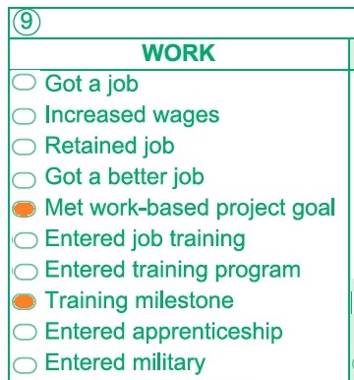
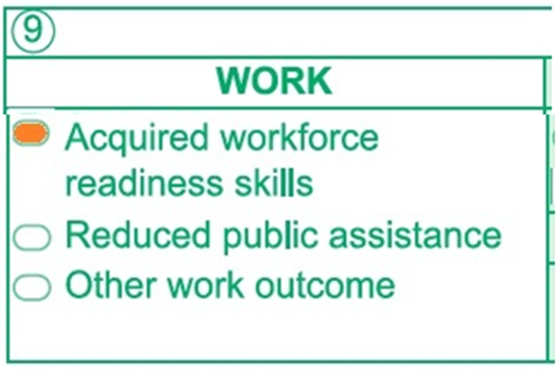
MSG’s for CTE
The Passage of Exam Measurable Skills Gain for WIOA I aligns with the CAEP Occupational Skills Gain.
  When a student achieves an Occupational Skills Gain, that now entails that the student passes an exam such as work skills demonstration
  Workforce Preparation Outcome should include some documentation of work skills progression or attainment.

Slide 29
Literacy Gains Outcomes
Mark when CAEP learners achieve outcomes in Distance Learning classes.
Record achievements already attained before closures
Use “passage of exam” process for CTE MSG’s as a guide for recording student achievement.
  Student passes informal exam such as a (virtual) class assessment, written assignment, or oral interview
  Completes skills demonstration in workforce preparation activities

Slide 30
Literacy Gains Outcomes
Passes (virtual) class assessment, written assignment, or oral interview
Learner Mastery
Educational Software
Local Program Milestones

Slide 31
Literacy Gains Outcomes
Completes skills demonstration in workforce preparation activities
EL Civics/IET
Transitions
EL Co-Enrollment

Slide 32
TE I3 Reports
TE has new I³ reports that relate results from EL Civics COAAPs to AB 2098 Immigrant Integration Indicators (I³).
There will also be a new column on the TE CAEP Summary that displays these new outcomes

Slide 33
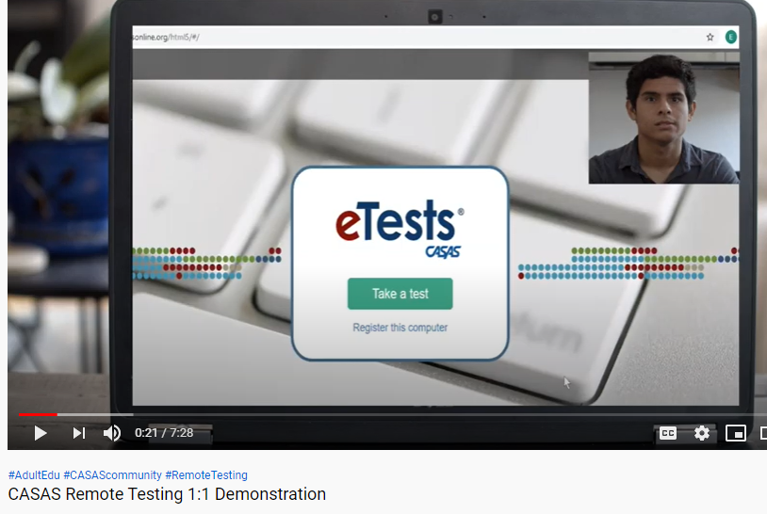
Remote Testing Information
Remote testing 1:1 Demo on video
https://youtu.be/uLoaw-BHo-s
Registering test stations for remote
testing on video
https://youtu.be/1ipRe4-8Tiw
Remote Testing Overview Documents
https://www.casas.org/product-overviews/remote-testing
Agency Remote Testing Agreement for California
Must be completed annually and copy sent to CDE consultant and CASAS Program Specialist

Slide 34
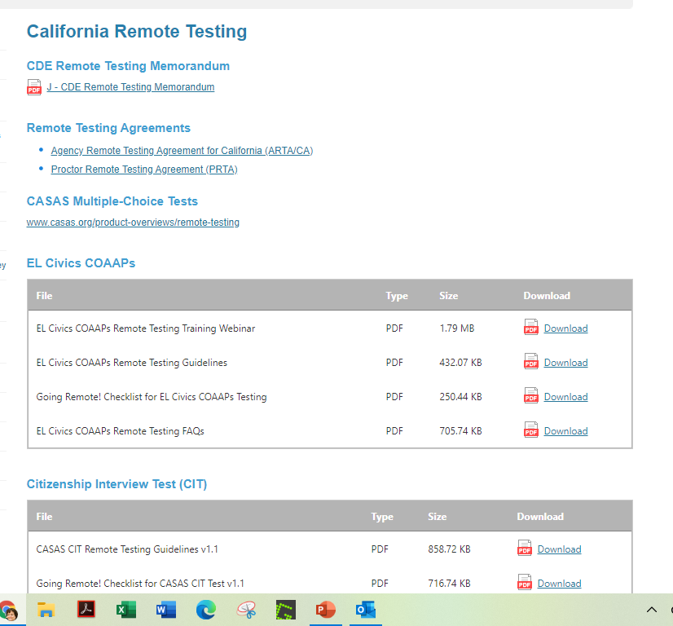
Remote Testing for EL Civics
Go to the CASAS website and go to the California Remote Testing page
Guidelines for remote assessment for CA EL Civics Additional Assessments (COAAPs) and the CASAS Citizenship Interview Test (CIT)
Webinar recordings and Frequently asked questions

Slide 35
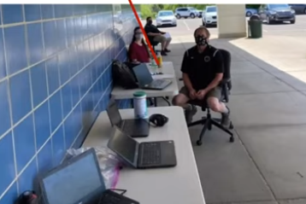
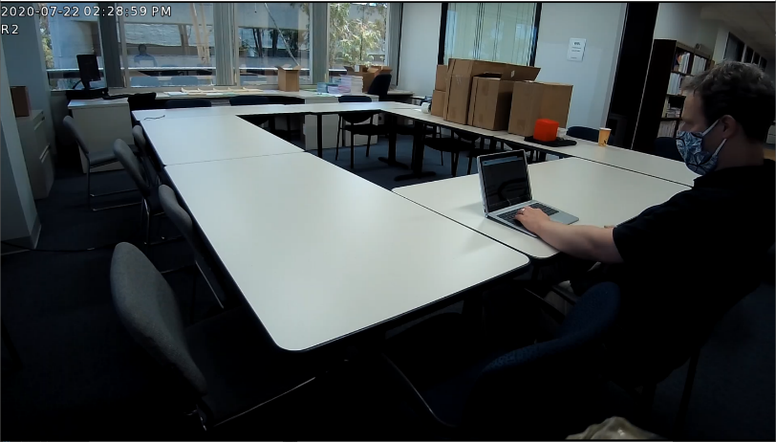
Remote Testing Considerations
Parking Lot testing
  Novi Adult Education-Testing in cars
  YouTube video of the webinar
Remote Operations with On site Proctor
On site testing with social distancing
Updates to current remote testing
options

Slide 36
Remote Testing: Preparation
Take time up front to make sure students are aware of what will happen and what to expect BEFORE the remote testing session.
Offer a “digital boot camp” for students (and staff) to bring them up to speed for distance learning and remote testing.
Designate “technology navigators” to work with students before testing

Slide 37
Remote Testing: Preparation
Involve a variety of staff– not only certified eTests proctors.
Use native language before testing begins to support lower level ESL learners.
Use the CASAS eTests Sampler to take practice items before taking the test.

Slide 38
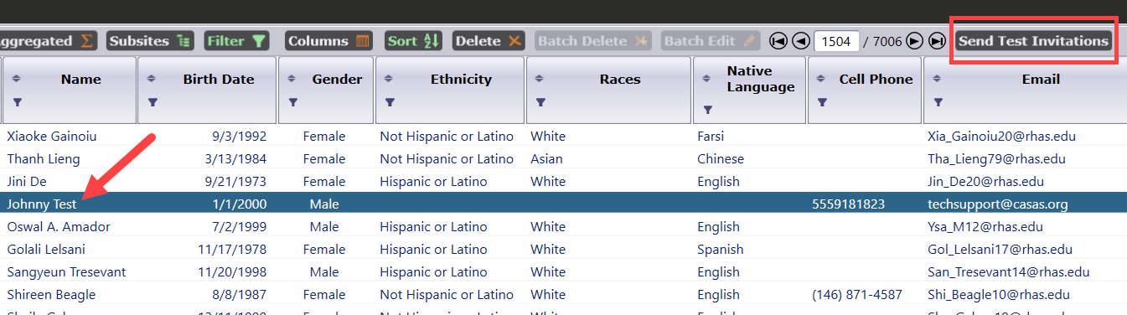
Remote Testing: RLI
Provides informal class, program, and level placement for students.
Accessible to student via cell phone
Does not require a Proctor
The Reading Level Indicator is Form 601R.
View results in the TE Test Lister.

Slide 39
Distance Learning Examples

Slide 40
Learner Mastery Process Example
Example – A 12 Module self-paced software course
Observe students who complete the modules, and identify an “average” amount of time for a student to finish each module.
If the “average” student takes two hours to complete Module 1, for example -- assign two hours to that module, and record that equally for all students who complete it.
Document your agency’s specific policy and approach in your agency’s Local Assessment Policy.

Slide 41
Clock Time Model– Example #1
20 students are enrolled in an online ESL class and all attend for one hour, Tuesday/Thursday via Zoom.
Local Assessment Policy Example:
The classes listed below meet two hours a week online via Zoom. Agency uses Clock Time model record hours- all instructional hours are accrued via Zoom. Students are required to enter name in chat upon arrival to document participation. All Zoom sessions are recorded for teacher to verify hours and participation for each student.

Slide 42
Clock Time Model– Example #2
20 students are using educational software that automatically records the correct number of hours for each student.
Local Assessment Policy Example:
Students in classes listed below complete lessons in [Software App X] for up to six hours a week. Agency uses Clock Time model - hours are automatically recorded in the software. Recorded time for each module is listed below. Students are required to login using unique username and password to document participation. Student completes all exercises as required by the software to demonstrate mastery.

Slide 43
Teacher Verification– Example #1
20 students are using educational software that does not record hours and does not include additional exercises at the end of each lesson.
Local Assessment Policy Example:
The classes listed below complete lessons in [Software App X] for up to six hours a week. Students are required to login using unique username and password to document participation. Agency uses Teacher Verification model. Student completes all activities as required by the software for each lesson. Teacher notes the progress for each student and assigns 0, 1, or 2 hours of instruction for each lesson.

Slide 44
Learner Mastery – Example #1
20 students are using educational software that does not record hours but does include required exercises at the end of each lesson.
Local Assessment Policy Example:
The classes listed below complete lessons in [Software App X] for up to six hours a week. Students are required to login using unique username and password to document participation. Agency uses Learner Mastery model. Agency has determined hours for each module in [App X]. Once the student completes all exercises as required by the software for each lesson, the student is credited with contact hours according the list below.

Slide 45
Learner Mastery – Example #2
20 students are enrolled in an online ESL class for one hour, Tuesday/Thursday via Zoom. Most attend as scheduled, but some students who cannot attend access the recorded session.
Local Assessment Policy Example:
The classes listed below meet two hours a week online via Zoom… sessions are recorded for teacher to verify hours and participation for each student. Students that miss the “live” session can access the recording anytime before the next scheduled class. Learners login to the recording just as they do the live session, and must complete a short quiz at the end of the session to get credited with instructional hours.

Slide 46
Learner Mastery – Example #3
10 students are enrolled in independent study classes and watching assigned YouTube videos as part of the required instruction.
Local Assessment Policy Example:
The classes listed below meet two hours a week online via Zoom… and also complete three lessons in [Video Series Y], one hour per video. Agency uses Learner Mastery model for the online videos. Once the student completes all three videos, the student must achieve a score of at least 80% on a quiz that incorporates all video content to achieve mastery and receive the three hours of instruction.

Slide 47
Example #1 Using Mixed Delivery Methods
20 students are using educational software that does not record hours or include additional exercises at the end of each lesson. Most participate in a “live” session with the teacher, but some who miss the live session complete activities on their own.
Students meet two hours a week online via Zoom… sessions are recorded for teacher to verify hours and participation for each student. Students that miss the “live” session can access the recording anytime before the next scheduled class. Learners login to the recording just as they do the live session, and must complete a short quiz at the end of the session to get credited with instructional hours.

Slide 48
Example #2 Using Mixed Delivery Methods
Local Assessment Policy Example:
Students complete lessons in [Software App X] for up to six hours a week. Students to login using unique username and password to document participation.
  For students who participate during schedule sessions, use Teacher Verification model by facilitating online activities and prompting participants with questions.
  For students who complete activities on their own use Learner Mastery, and must pass a quiz with at least 80% to be credited with the instructional hours.

Slide 49
Example Describing Learner Mastery Process
Example: 12-module educational software program X.
(12 modules – 24 hours total)
Module 1 – Intro to Work (1 hour)
Module 2 – Career Exploration (2.5 hours)
Module 3 – Making Career Choices (1.5 hours)
Module 4 - …
Follow the same process listing all 12 modules
List the number of hours assigned to each module.
Record hours in TE according to these specifications.

