Slide 1
CAEP Accountability Advanced 2020-21
Review: COVID-19’s Effect on Adult Education
CAEP Programs Update for 2020-21
CAEP Outcomes and Services
  Review of Key Training Issues
  New Outcome: Immigrant Integration Indicator (I3)
CAEP Reports in TE
Qualitative and Quantitative Troubleshooting
  “Qualitative” review of identifying outcomes
  “Quantitative” review of managing TE reports
Notes:
Carolyn

Slide 2
Agenda via Chat
Chat discussion:
What are some CAEP outcomes that are common with students at your agency/consortium, and how do you record them?
What are some scenarios at your agency/consortium that create uncertainty or confusion about how to record them?

Slide 3
COVID-19’s Effect on CA WIOA II Agencies
With most agencies closed for COVID-19, many agencies are quickly adapting to implementing distance learning options.
Below is a resource page that provides help to agencies responding to COVID-19
https://otan.us/resources/covid-19-field-support/
Here is a link to a set of FAQ’s
https://otan.us/media/h2saiwpj/faqs-031820.pdf

Slide 4

OCTAE Memorandums
OCTAE has disseminated Memorandum 20-3 (March 27, 2020) 20-4 (April 17, 2020) and 20-5 (May 29, 2020)
https://www2.ed.gov/policy/adulted/guid/memoranda.html
Posted on CASAS Website: https://www.casas.org/social-media-newsroom/2020/03/27/casas-testing-during-the-covid-19-pandemic
Notes:
Carolyn

Slide 5
OCTAE Memorandums
Summary of OCTAE Memos:
Statewide performance reporting to the NRS is still required
For PY 2019-20 all states reported “Force Majeure”
States can now decide whether or not to allow remote testing
Each state that opts to allow remote testing submits its own remote testing plan to OCTAE
Memo 20-5 (5.29): participants can self-report into a federal EFL (Educational Functioning Level) without a pretest.
Memo 20-5 (5.29): a pretest is still required to achieve a pre/post-test MSG.
Notes:
Carolyn

Slide 6

PY 2020-21 CAEP Program Structure: 5 Programs
Adult Basic & Secondary Education
English as 2nd Language
Career and Technical Education (CTE)
Adults with Disabilities
Parents/K12 Success
Notes:
Carolyn

Slide 7
PY 2020-21 CAEP Program Structure:
Primary Programs
Adult Basic & Secondary Education:
Basic Skills (ABE)
HSE (HiSET, GED)
HS Diploma
English as Second Language (ESL/ELL)
Career and Technical Education (CTE)
CTE
Short Term CTE
Pre-Apprenticeship
Workforce Preparation
Notes:
Javier

Slide 8
CAEP Program Structure: Summary of Changes in PY 2019-20
Workforce Reentry is now Workforce Preparation.
“Adults served” now includes three categories of learners
Tracking hours by program for learners in multiple programs
CAEP will not track service hours.
Agencies will record student barriers at intake.
The Passage of Exam Measurable Skills Gain for WIOA I will align with the CAEP Occupational Skills Gain and Workforce Preparation Outcome.

Slide 9
CAEP Reporting : CAEP Programs Under CTE
Career and Technical Education (CTE)
CTE – Long term/occupation specific
Short Term CTE – short term/occupation specific
Pre-Apprenticeship – Long term/occupation specific
Workforce Preparation – Short term/not occupation specific

Slide 10
CAEP Reporting: Adults Served
CAEP reports the number of “Adults Served” which includes three categories:
  Service only students
  Students receiving 1-11 instructional contact hours
  Participants who received 12 or more instructional contact hours over a single program year.
Notes:
Javier

Slide 11
CAEP Reporting: Hours by Program
Enrollment / Instructional Hours
  For K12/COE:
  If a class is identified as integrated, the hours will be divided equally between the programs designated for that record.
  If not integrated, or if the hours are split unevenly – the agency can create two classes, one for each instructional program represented.
Notes:
Javier

Slide 12
CAEP Program Reporting: Instructional Hours
Enrollment / Instructional Hours
An instructional hour must meet OCTAE guidelines and be associated with an instructional program. Thereby, service hours must not be commingled with instructional hours.
CAEP will not track service hours.
CAEP will only report instructional hours for NOVA program area reporting.
Notes:
Javier

Slide 13
CAEP Program Reporting: Instructional Hours
Contact Hours Definition. Hours of instruction or instructional activity that the participant receives from the program. Instructional activity includes any program-sponsored activity designed to promote learning in the program curriculum, such as classroom instruction, assessment, tutoring, or participation in a learning lab. Time spent on assessment can be counted only if the assessment is designed to inform placement decisions, assess progress, or inform instruction. Time used simply to administer tests, such as the GED tests, cannot be counted as instructional activity.
https://www.nrsweb.org/sites/default/files/NRS_TA_Guide.pdf
Notes:
Javier

Slide 14
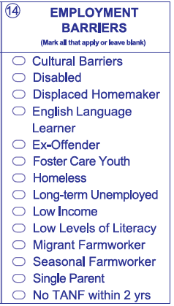
CAEP Program Reporting: Student Barriers to Employment
Agencies will record barriers to employment for all CAEP students at intake.
CAEP student barriers and their definitions will align with federal WIOA II barriers to employment.
As part of the federal alignment, ABE/ASE and ESL learners will automatically tie into specific barriers
For Workforce Preparation/Workforce Re-Entry – learners are no longer tied to any specific barriers, and no longer tied to 55 + years of age.
Notes:
CASAS

Slide 15
CAEP Reporting: CTE measurable skills gains
WIOA I / CAEP Alignment – Aligning Occupational Skills Gain and Workforce Preparation Outcome to WIOA I Passage of an Exam
WIOA I has replaced the Skills Progression Measurable Skills Gain with Passage of an Exam. CAEP will align the Occupational Skills Gain and Workforce Preparation Outcomes.
  When a student achieves an Occupational Skills Gain, that now entails that the student passes an exam such as work skills demonstration, written test, standardized pre/post-test.
  Workforce Preparation Outcome should include some documentation of work skills progression or attainment.

Slide 16
WIOA Alignment to AB 104
The WIOA Performance Indicators, along with the 5 types of MSG, comprise the framework for the six AB 104 outcomes:
Indicators:
Employment
Wages
MSGs:
Literacy gain
Secondary
Post-Secondary
Training Milestone
Skills Progression
AB 104 Outcomes:
Improved literacy skills
Completion of high school diplomas or their recognized equivalents
Completion of postsecondary
Placement into jobs
Improved wages
Post Secondary Transition
Notes:
CASAS

Slide 17
CAEP Outcomes
Literacy Gains
HSE/HS Diploma
Post-Secondary
Enter Employment
Increase Wages
Transition
Pre/Post Level Completion
Carnegie Units /HS Credits
CDCP Certificate
Occupational Skills Gain
Workforce Preparation
High School Diploma
Passed GED
Passed HiSET
Passed TASC
College Degree – AA, AS, BA, BS
Graduate Studies
Training Credential
Occupational Licensure/Certificate
Apprenticeship
Get a Job
Retain a Job
Enter Military
Increase Wages
Get a Better Job
Transition to ASE
Transition to Post-Secondary/CTE
Transition to Post-Secondary/College
Notes:
CASAS

Slide 18
Literacy Gains
Literacy Gains
AEBG Outcome | Recording Method
Pre/Post-Test Gains | Enter pre/post-test results
Carnegie Units | No “bubble” but via self reported level
CDCP Certificate | Mastered course competencies Skills Progression
Occupational Skills Gain | Met Work based Project Training Milestone
Workforce Preparation | Acquired Workforce Readiness
Notes:
CASAS

Slide 19
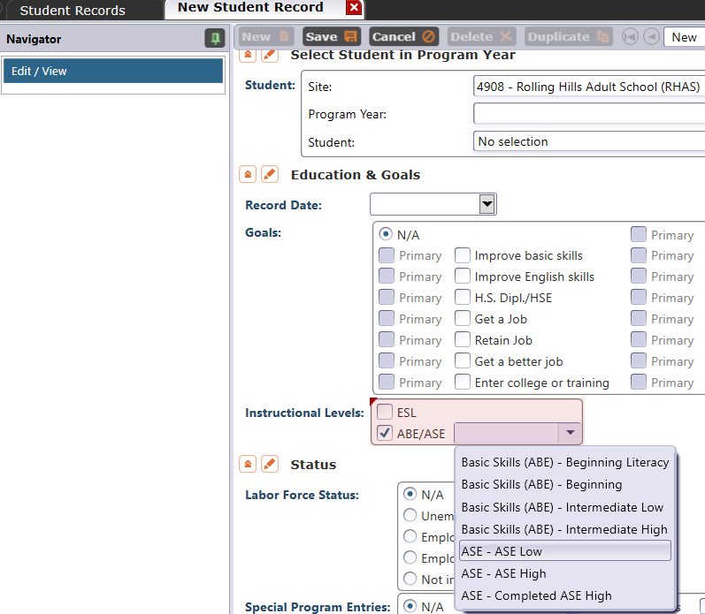
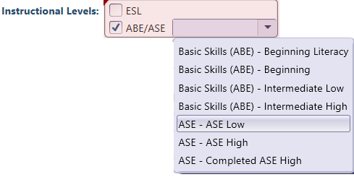
Literacy Gains – HS Credits
In TE, go to Records – Students – Records and refer to Instructional Levels:
Select ASE Low upon enrollment
Select ASE High later in the year once student progresses to the 11th or 12th grade level
Notes:
CASAS

Slide 20
Literacy Gains – CTE Related Outcomes
Occupational Skills Gain:
Usually suggests accomplishment of a portion of a longer term program
  For example: a student enrolls in a long term welding program in CTE, which is five semesters/five modules long. The student passes a skills check/written test that indicates the student is ready to finish Module I and enroll in Module II.
Workforce Prep Outcome:
Usually suggests completion of a shorter term program
  For example: a student enrolls and completes a 15 hour instructional module on job search strategies. The student earns documentation such as an informal certificate at the end of the instructional module.
Notes:
CASAS

Slide 21
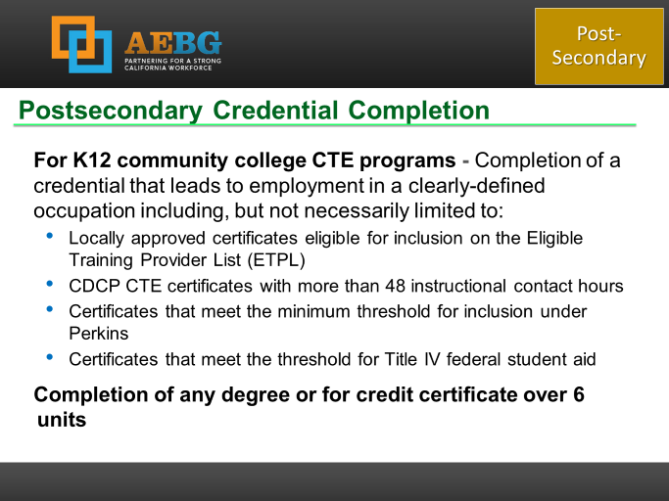
Occupational Outcomes: Post-Secondary vs. Literacy Gains
Post-Secondary:
Attained Credential
Occupational licensure
Occupational certificate
Literacy Gains:
Occupational Skills Gain
Workforce Prep Milestone
Post-Secondary =
Completion of a longer term program
“Literacy Gains” =
Partial completion of a longer term program
Completion of a shorter term program
Notes:
CASAS

Slide 22
CAEP Program Outcomes:
Passing Knowledge-Based Exam
The Skills Progression MSG has now been replaced by Passage of an Exam.
Learner passes an exam during the year that is required for a job, or that demonstrates progress in attaining technical or occupational skills.
Exam can be a hands on occupational skills demonstration, written test, standardized pre/post-test, or other method of assessment that clearly demonstrates skill progression or attainment.
Notes:
CASAS

Slide 23
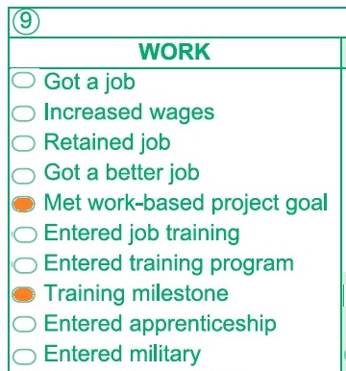
MSG’s for CTE
The Passage of Exam Measurable Skills Gain for WIOA I aligns with the CAEP Occupational Skills Gain.
  When a student achieves an Occupational Skills Gain, that now entails that the student passes an exam such as work skills demonstration
Notes:
CASAS

Slide 24
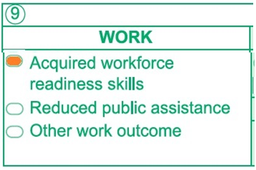
MSG’s for CTE
The Passage of Exam Measurable Skills Gain for WIOA I aligns with the CAEP Workforce Preparation Outcome
  Workforce Preparation Outcome should include some documentation of work skills progression or attainment.
Notes:
CASAS

Slide 25
Transition
Transition
AEBG Title | Update Record
Transition to ASE | No “bubble” but via instructional program
Transition to Post-Secondary/CTE | Entered job training Entered training pgm Entered apprenticeship
Transition to Post-Secondary/College | Enrolled in secondary Transition to credit
Notes:
CASAS

Slide 26
Transition
From:
To:
K12 Adult Education
(ABE, ASE, ESL)
K12 Adult Ed CTE
CC CTE
Non Credit CC
(ABE, ASE, ESL)
For Credit CC
Transition to CTE
Transition to for credit
Notes:
CASAS

Slide 27

Immigrant Integration AB2098
Notes:
CASAS

Slide 28
AB 2098 – Immigrant Integration
Consortia may report additional measures for assessing the effectiveness of programs in meeting the needs of immigrant learners seeking integration in civic and community life.
The TE CAEP Summary now has a new column that reports Immigrant Integration Indicators (I³) outcomes.
TE now includes reports that relates EL Civics COAAPs with Immigrant Integration goal areas.
Notes:
CASAS

Slide 29
AB 2098 – Immigrant Integration
Key Points About AB 2098:
We already serve this population
WIOA II grantees report EL Civics outcomes
EL Civics effectiveness is shown through these metrics
Most of the data is already there
This is not a mandate
Notes:
CASAS

Slide 30

I3 Reports in TE
TE now includes Immigrant Immigration Indicator (I3) reports that track EL Civics COAAPs outcomes and relate them to Immigrant Integration goals.
Notes:
CASAS

Slide 31
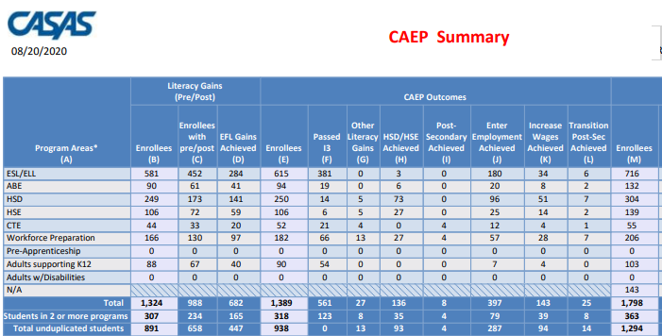
Passed I3 Outcome

Slide 32

Learner Results and WIOA Milestones
Literacy Gains
Employment
Secondary
Wages
Post-Secondary
Transition
Notes:
CASAS

Slide 33
Records – Students – Records
In TE go to Records--Students--Records
Notes:
CASAS

Slide 34
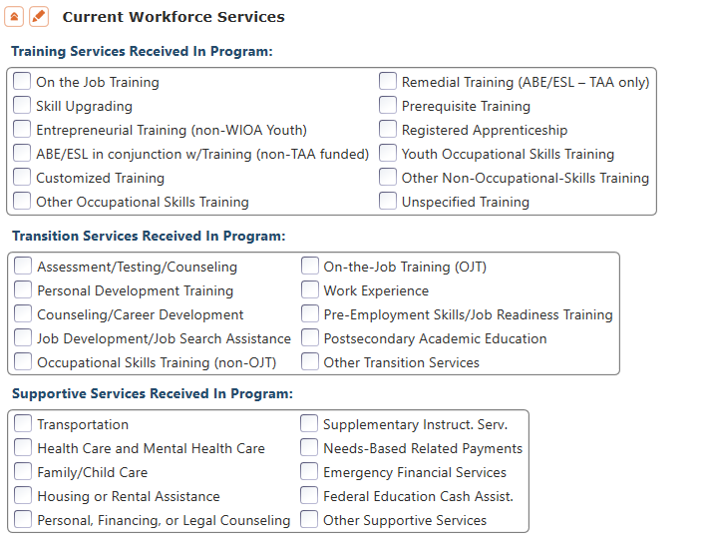
CAEP Short Term Services
Record short term services such as counseling or mentorship that may be received outside of the classroom.
Supportive Services
Training Services
Transition Services
Notes:
CASAS

Slide 35
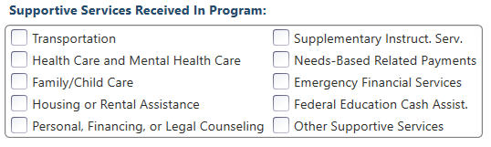
Supportive Services
Services that better enable an individual to participate in adult education activities, or related activities such as WIOA Title I -- such as transportation, child care, dependent care, housing, and personal needs
Notes:
CASAS

Slide 36
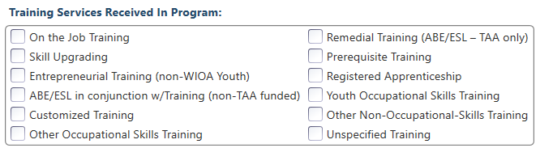
Training Services
Services that help individuals:
Select programs that relate to economic priorities in local planning region
Enroll/meet minimum qualifications for longer term employment and/or employment training programs
Services administered to individuals who have been determined to:
Be unlikely to obtain/retain employment
Be in need of additional services in order to attain economic self-sufficiency/permanent employment
Have skills sufficient to enroll in appropriate training program that provides skills necessary for self-sufficiency
Notes:
CASAS

Slide 37
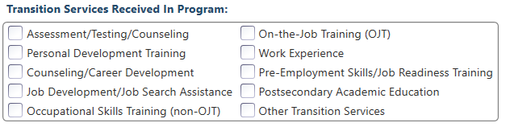
Transition Services
Services that help individuals:
Facilitate successful transition from school to postsecondary life, such as attaining employment, enrolling in college, or accessing designated pre-employment transition services.
Provide opportunities to receive training and other services necessary to achieve competitive employment or postsecondary enrollment
Notes:
CASAS

Slide 38
CAEP Short Term Services – COVID-19 Update
Record short term services received outside of the classroom.
Current Examples:
Additional Health Care needs & requirements
Financial services
Services to assist with new software applications
Skill upgrades to work remotely
Job seeking skills
Notes:
CASAS

Slide 39
CAEP Short Term Services– COVID-19 Update
Record short term services received outside of the classroom.
Current Examples:
Prerequisite training
Assessment/Testing
Job Readiness Training
Emergency Financial Services
Health Care Services
Notes:
CASAS

Slide 40
CAEP Short Term Services
Supportive Services
Transition Services
Training Services
Transportation
Child Care
Personal Counseling
Financial Assistance
Assessment (other than required pre/post)
Academic/Career Counseling
Job Development
Student Orientation
Community Support Training (OSHA, CPR, etc.)
Prerequisite Training
Notes:
CASAS

Slide 41
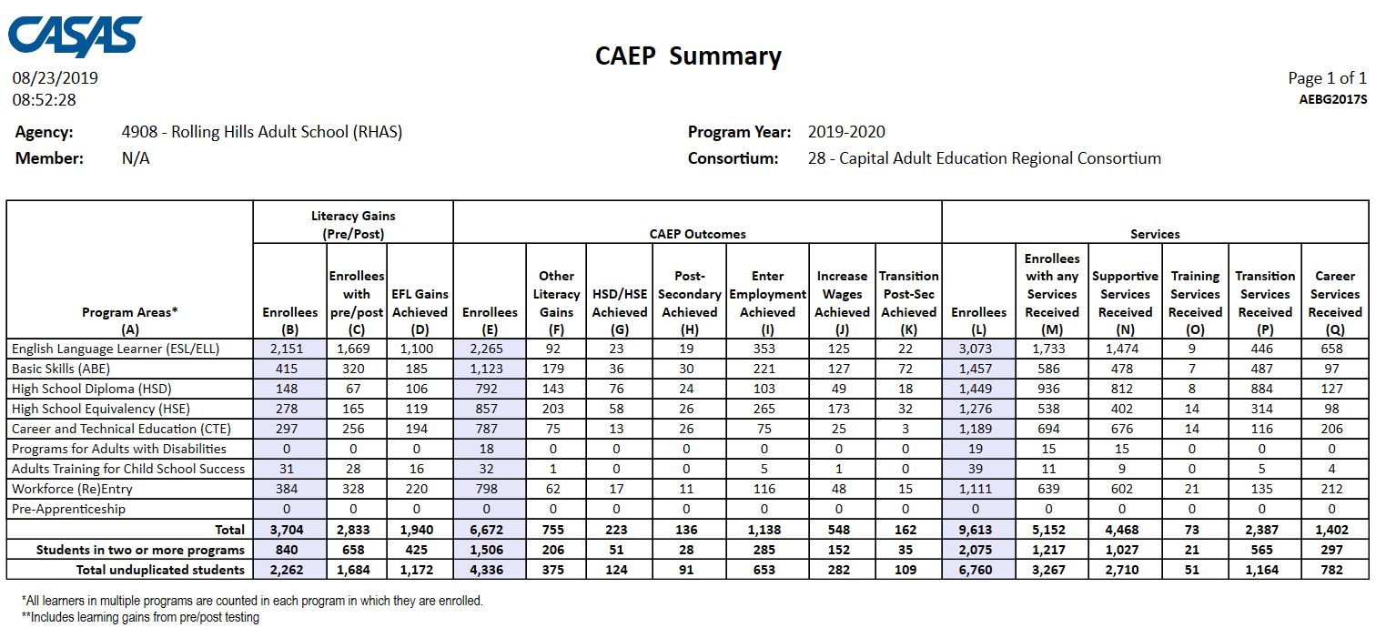
CAEP Summary
Displays outcomes in three separate sections:
Literacy Gains (Pre/Post) using NRS Table 4 guidelines
Other AB 104 outcomes using WIOA II reporting requirements but not pre/post
Services Received that do not impose WIOA II reporting requirements
Notes:
CASAS

Slide 42
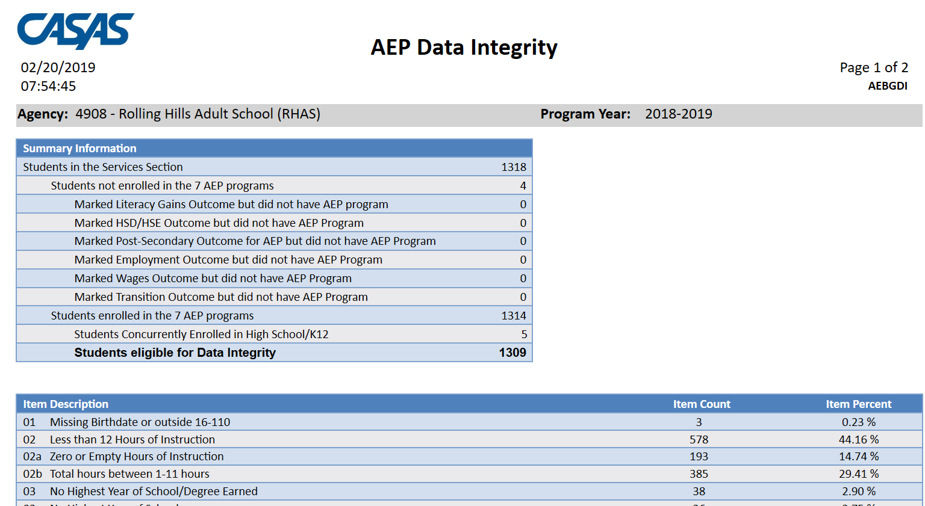
AEP Data Integrity
AEP Data Integrity displays 27 different data elements related to the AEP instructional programs and outcomes.
Item Description lists 27 data elements that may prevent or contribute to official AEP outcomes.
The DIR displays the item count and percentage for each listed item.
Item Percent = Item Count ÷ # of Students Enrolled in 7 AEP Programs
Notes:
CASAS

Slide 43
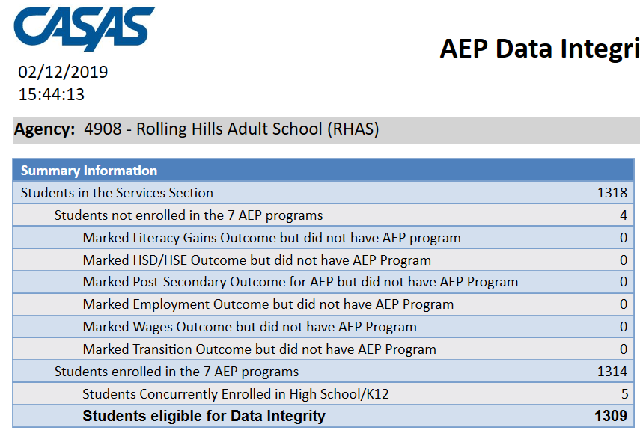
Summary Information
Summary Information reconciles all of the students included in AEP reporting.
Students in the Services Section includes everyone reported for AEP -- whether for official enrollment or for services only.
Students not enrolled in the 7 AEP programs subtracts those who received services but are not enrolled in one of the 7 AEP program areas.
The next 6 rows are subsets of those not enrolled in the 7 AEP programs – showing students not enrolled in program but who earned outcomes and may need enrollment.
Students in the Services Section
− Students not enrolled in the 7 AEP programs Students enrolled in the 7 AEP programs
Students enrolled in the 7 AEP programs is the total limited to students with official enrollment, and this number serves as the denominator for the 27 DIR items.

Slide 44
CAEP Data Integrity Report: PY 20-21
Some items that may potentially change due to COVID-19 issues:
< 12 Hours of Instruction - Item 02
No Post-Test/Pre-Post-Test pair - Items 09, 10
Earned HSE/HS Diploma - Items 12, 13
Earned outcome but did not qualify for CAEP - Items 23a-27
Achieved CAEP outcome - Items 23b-27b

Slide 45
CAEP Data Integrity Report: PY 20-21
Some items that should NOT change due to COVID-19 issues:
Demographics - Items 01, 03, 04, 05, 06
Primary/Secondary Goal - Items 17, 18
Missing Barriers of Employment - Item 19
Earned outcome but did not qualify for CAEP - Items 23a-27a

Slide 46
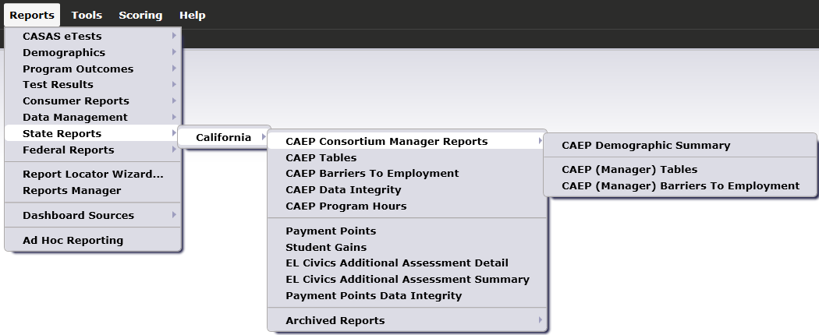
CAEP Consortium Manager Reports
CAEP Consortium Manager Reports allow a consortium level login to compare and contrast outcomes across agencies within one consortium.
Menu currently includes three reports options with this feature

Slide 47

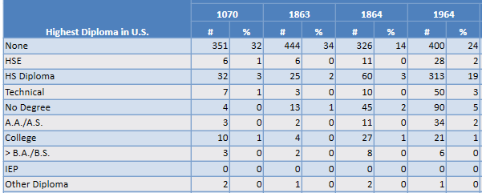
Highest Diploma in U.S.
Lists item count and percentage by Agency ID
Aggregates results for the entire consortium on the right hand column

Slide 48
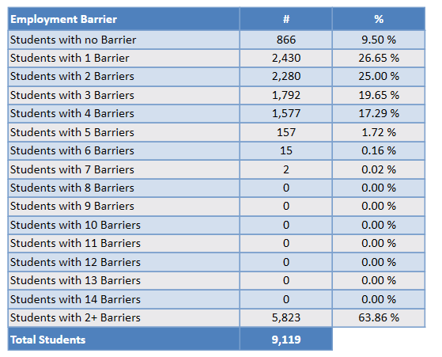

CAEP Summary and Barriers
The CAEP Summary and Barriers to Employment also lists information by agency and by consortium.
Click Aggregate Multiple Agencies to run a combined summary of all agencies in the consortium.

Slide 49
Literacy Gains Outcomes – COVID-19 Update
Mark when CAEP learners achieve outcomes in Distance Learning classes.
Use “passage of exam” process for CTE MSG’s as a guide for recording student achievement.
  Student passes informal exam such as a (virtual) class assessment, written assignment, or oral interview
  Completes skills demonstration in workforce preparation activities
Literacy Gains
Notes:
CASAS

Slide 50

Literacy Gains Outcomes– COVID-19 Update
Passes (virtual) class assessment, written assignment, or oral interview
Learner Mastery
Educational Software
Local Program Milestones
Notes:
CASAS

Slide 51
Literacy Gains Outcomes– COVID-19 Update
Completes skills demonstration in workforce preparation activities
EL Civics COAAPs now show as I3 outcomes
IET pre-requisite
Transitions to higher level placement
EL Co-Enrollment
Notes:
CASAS

Slide 52
Troubleshooting Examples
Workforce Preparation classes that are Occupation Specific
Classes required for CTE that are Occupation Generic
Workforce Prep Milestone versus short term service
OSHA/CPR/etc. when required for CTE or Workforce Prep.
EL Civics/COAAPs
IET/EL Co-Enrollment

Slide 53
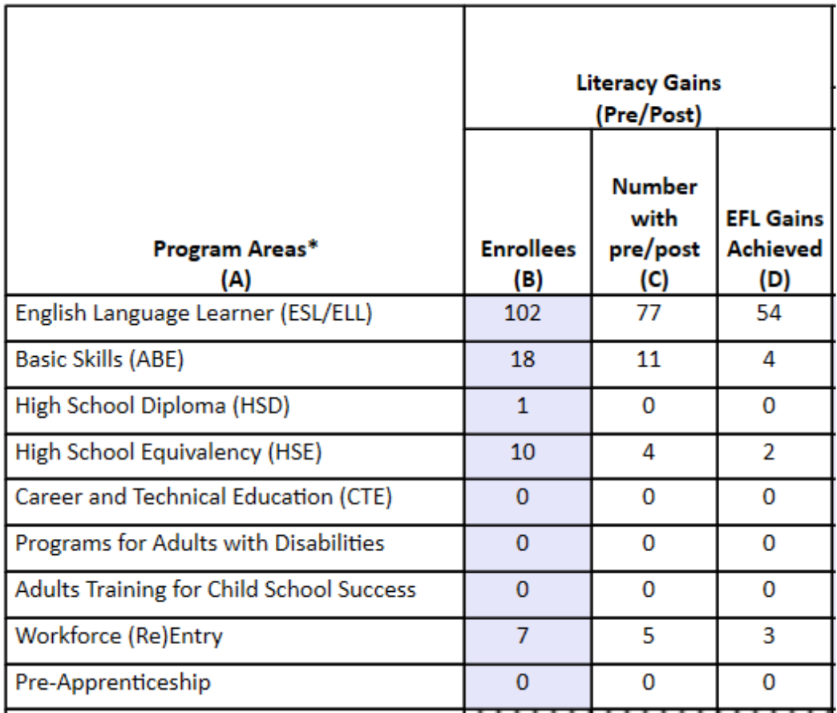
Interaction with Tables
Click any cell to generate a list of students included in that cell.

Slide 54
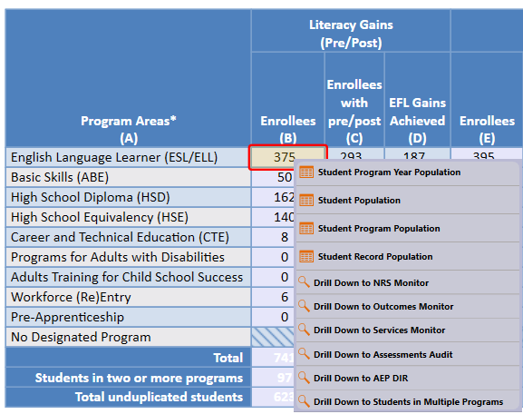
Interaction with Tables (cont)
Right click any cell and select from 6 listers and 6 reports:

Slide 55
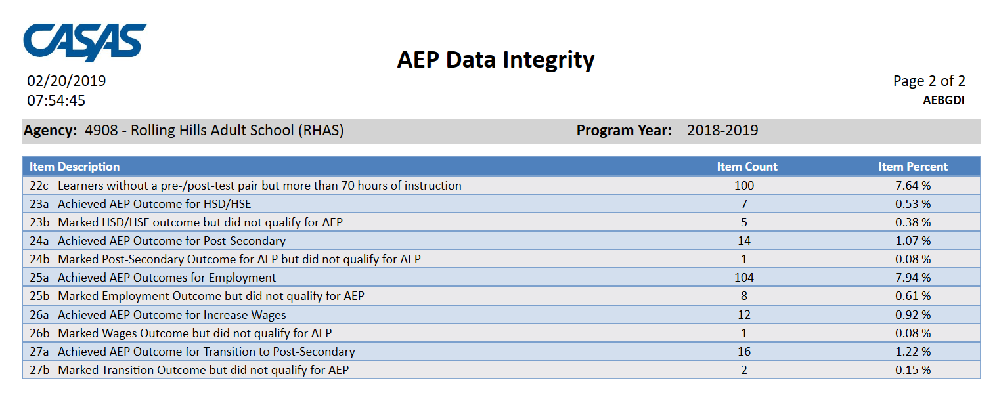
Interaction with Tables (cont)
Example 1: the number of CAEP outcomes is lower than expected, and low when compared to the number of enrollees.
Use the CAEP DIR items 23-27 to evaluate the likely source of the problem.

Slide 56
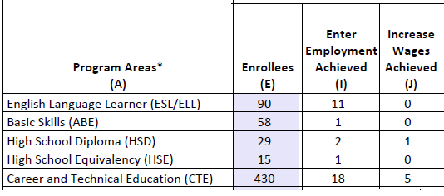
Interaction with Tables (cont)
Example 1: the number of AEP outcomes is lower than expected, and low when compared to the number of enrollees.
Specific examples include HSE and Employment outcomes.

Slide 57
Interaction with Tables (cont)
Suggestion: Right click the figures displayed in Columns E, I, and J, and generate the AEP DIR for the three different groups of students.
Compare the three reports to identify students with missing demographics and less than 12 hours of instruction.
Review DIR items specific to the outcome in question – in this example look at items 23a/23b for HSE, 25a/25b for Employment and items 26a/26b for Wages.
High totals in 25b and 26b suggest “data clean up” is necessary to improve these outcomes.
Low totals in 25b/26b in relation to totals in 25a/26a suggest that the data is “clean” – but you may just need to input more positive outcomes.

Slide 58
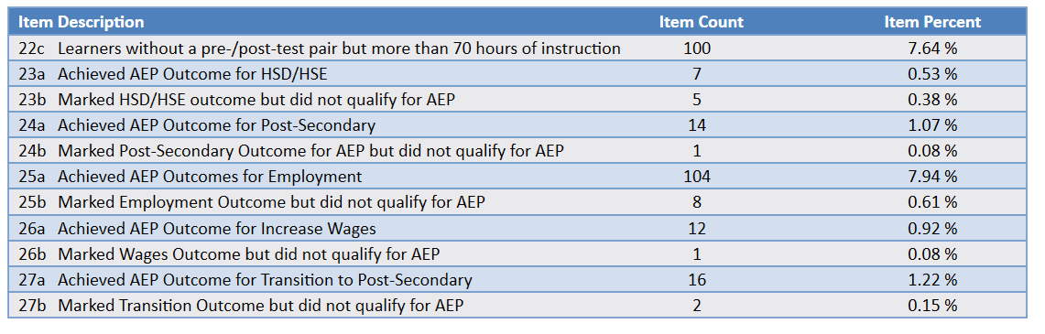
Interaction with Tables (cont)
In 23a-23b for HSD/HSE, there are almost as many who marked the outcome & did not qualify as there are those who achieved the outcome.
Solution may be to investigate drop reasons

Slide 59
Interaction with Tables (cont)
In 25a-25b for Employment, almost all who marked an employment outcome qualified for the AEP outcome.
Solution may be to mark more outcomes.

Slide 60
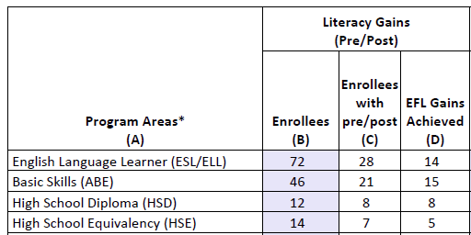
Interaction with Tables (cont)
Example 2: the number of pre/post-test learning gains is low as compared to the number of enrollees.

Slide 61
Interaction with Tables (cont)
Suggestion:
Compare the number of enrollees (Column B) with the number of enrollees with pre/post (Column C).
If these numbers in Columns B and C are far apart (like in the example above) then you need to ensure all students complete a pre/post-test pair.
If Columns B and C numbers are similar (rule of thumb: Column C should be equal to or greater than 70% of Column B) then you have done well completing testing for your students, but you should review students test scores and learning gains, and evaluate performance in the classroom to improve individual test results.

Slide 62
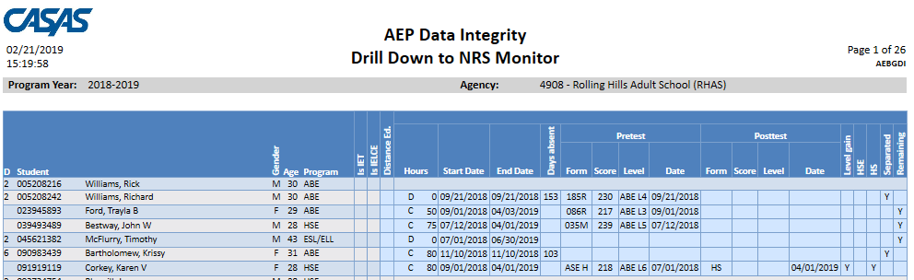
Interaction with Tables (cont)
Suggestion: Generate NRS Monitor
If these numbers in Columns B and C are far apart (like in the example above) then you need to ensure all students complete a pre/post-test pair.
  Right click to generate NRS Monitor to identify students who have qualified enrollment but no pre/post-test pair.
If Columns B and C are similar (rule of thumb: Column C should be equal to or greater than 70% of Column B) then review students test scores and evaluate performance in the classroom to improve test results.
  Right click to generate NRS Monitor to identify students test performance and highlight students with zero or minimal gains.

Slide 63
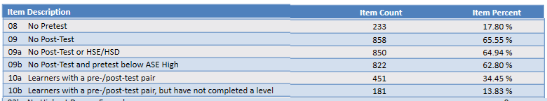
Interaction with Tables (cont)
Suggestion: Drill down to AEP DIR and review DIR items 8, 9, and 10
If these numbers in Columns B and C are far apart (like in the example above) then you need to ensure all students complete a pre/post-test pair.
  Right click to generate AEP DIR and investigate items 8 and 9 to identify students who have qualified enrollment but no pre/post-test pair.
If Columns B and C are similar (rule of thumb: Column C should be equal to or greater than 70% of Column B) then review students test scores and evaluate performance in the classroom to improve test results.
  Right click to generate AEP DIR and investigate items 10a-10b to identify students with pairs/and who have not achieved a level gain.

Slide 64
Interaction with Tables (cont)
Overall: With performance and persistence data fluctuating, increasing the number of learner outcomes may not always be possible – but the process fixing data issues should remain the same.

Slide 65
Measure Agency and Consortium Level Performance and Persistence:
Measure persistence by determining percentage of students with any AEP activity that achieve official AEP program enrollment by enrollment in a class and with at least one hour of instruction
Measure persistence by determining percentage of students with AEP program enrollment that receive at least 12 hours of instruction?
Measure performance by calculating percentage of learners with 12 hours of instruction that achieved at least one official AEP outcome
Measure persistence by calculating percentage of learners with 12 hours of instruction with a pre- and post-test pair
Measure performance by computing percentage of learners with 12 hours of instruction that achieve a pre/post-test level gain

Slide 66
Updates to Resources and Materials
Notes:
CASAS

Slide 67
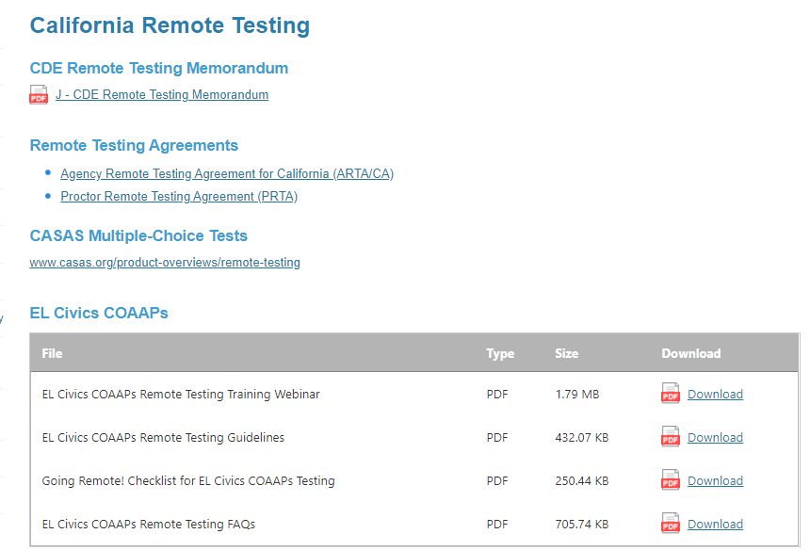
Remote Testing
The CDE has decided to permit California agencies to implement remote testing.
For more information, go to the California Remote Testing page on the CASAS Website:
https://www.casas.org/training-and-support/casas-peer-communities/california-adult-education-accountability-and-assessment/california-remote-testing
Notes:
CASAS

Slide 68
CASAS Reading Level Indicator (RLI)
Available at no cost only to eTests/TE users.
Results are shown as “Estimated NRS EFL” for ABE or ESL. No scale scores are given.
It is NOT an NRS-approved test and may NOT be used for pre- or post-testing to achieve MSGs.
The Reading Level Indicator (RLI) is Form 601R.
Notes:
CASAS

Slide 69
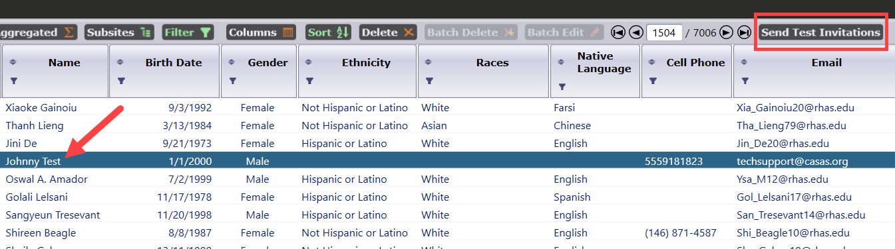
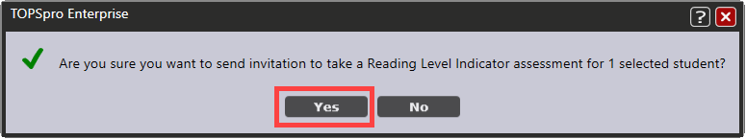
About the CASAS RLI
Initiate the RLI by selecting students in TE’s Student Demographics lister.
Click the Send Test Invitations button.
Notes:
CASAS

Slide 70
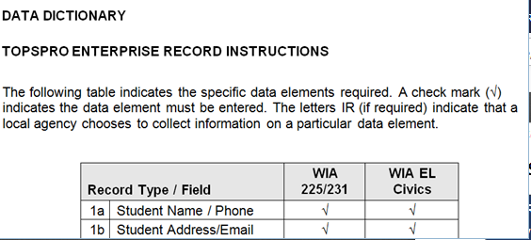
2020-21 CAEP Data Dictionary
Home > Training and Support > CASAS Peer Communities > California Accountability >
A new 2020-21 CAEP Data Dictionary is available on the CASAS Website to help CAEP meet requirements.
20-21 version includes several enhancements and updates.

Slide 71
Data Submission Calendar
CAEP Program Year Reporting
 | Date Range | Reporting Deadline
First Quarter | July 1 – Sept 30 | October 31, 2020
Second Quarter | July 1 – Dec 31 | January 31, 2021
Third Quarter | July 1 – Mar 31 | April 30, 2021
Fourth Quarter-EOY | July 1 – June 30 | August 1, 2021
Notes:
CASAS

Slide 72
TE Quarterly Data Submission Wizard
Beginning first quarter of PY 2020-21, agencies will use the TE Quarterly Data Submission Wizard to submit quarterly data, including the Data Integrity Report (DIR).
Agencies will no longer send separate pdf copies of the DIR when completing quarterly data requirements.
Notes:
CASAS

